Slide 1
FCC Arc Half-Cell Integration
May 24, 2022

Slide 2
Arc Half-Cell Goals
The FCC-ee arc are constructed from ~1,500 similar FODO cells. Because the arc cell is repeated many times and optimization of the repetitive mechanical unit, is important to simplify fabrication, installation, and operation.
→Develop an integrated model of the Arc Cell including (1) accelerator performance, (2) installation, operation, maintenance, and repair, and (3) technical infrastructure routing and interfaces with accelerator components.

Slide 3
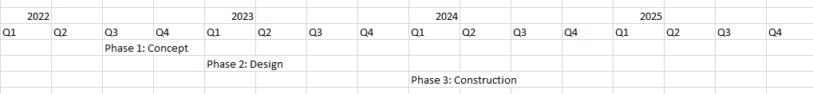
FCC Feasibility Study Schedule
Phase 1: Concept development → develop 3D model for ‘representative’ arc half-cell
Phase 2: Engineering design → complete engineering design of Mock-up
Phase 3: Construction of Half-Cell Mock-up with tunnel boundary with representative components
Want sufficiently developed components to study relevant integration aspects such as (connections, interfaces, transport, manipulation and alignment etc.) with technical infrastructures but do not necessarily need functionality for accelerator elements (field quality, powering, etc…)
Phase 1
Phase 2
Phase 3

Slide 4
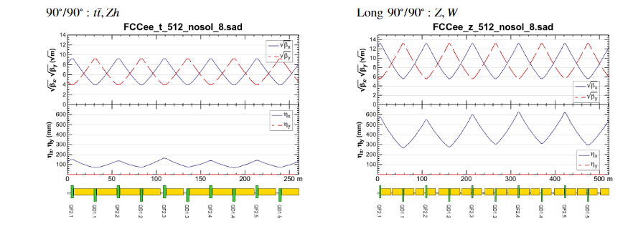
FCC Arc Cell (1/2)
The FCC arcs are constructed from roughly 1,500 (750) very similar FODO cells
There are ‘long cells’ at low energy which are roughly 100 m in length and short cells at the Zh and t-tbar. Present concept for the long cells is to leave space for addition of quadrupoles and sextupoles.

Slide 5
FCC Arc Cell (2/2)
The arc cells include a dipole magnet that will likely be divided into a number of segments, a ~3m quadrupole, a BPM, and 0, 1, or 2 sextupole magnets → Cells differ in the bend magnet length and the number of sextupoles next to the quadrupole.
Have not yet decided how to best evolve from long cell (low energy) to short cell → input from this integration effort
Integration should include the booster, presently located above the main ring. Elevation of the booster (and main rings) should remain constant around the tunnel → understand the booster elevation in RF and Detector straights

Slide 6
Phase 1 Deliverables and Challenges (1/2)
An integrated 3D model with select 2D cross-sections that illustrate the key features and challenges supported by a short-written description documenting the main choices by the end of December 2022. Describe the 3D model in a talk at the FCCIS meeting in early December 2022.
Identify the components of a representative Arc Half-Cell that will verify the key challenges.
Develop an optimal integrated solution for the mechanical layout of an Arc Half-Cell considering machine performance, installation, operation, and maintenance, as well as necessary technical infrastructure in the tunnel.
Work with the FCC Integration team to develop the detailed model and ensure that the model is consistent with other 3D models being developed including those for the RF regions as well as the Detector Halls
Work with the FCC Technology R&D Coordinator to determine the best mechanical designs to use for the beamline components
Work with the FCC Infrastructure Pillar lead to ensure that the 3D model has the appropriate infrastructure and services and
Work with the FCC Accelerator Pillar Collider Ring Optics lead and the Booster Ring lead to ensure an appropriate location of the beamline components
Verify horizontal separation of the e+ and e- rings in the arcs and the vertical separation of the booster relative to the main rings, and vertical placement of the collider rings

Slide 7
Phase 1 Deliverables and Challenges (2/2)
Define the needed level of design for the magnet and vacuum systems to clarify the interfaces between the vacuum elements (cooling, shielding, etc.) and the magnets.
Help define the preferred dipole length (e.g. 5, 8, 12 m, other?) that optimizes installation and minimizes conflicts with the vacuum system as well as power and cooling connections
Optimize the power and cooling connections for the magnets, vacuum, and beam diagnostics; the needed level of design for the magnets and instrumentation should also be defined.
Develop supports and stages while considering access to the components for installation and alignment procedures
The horizontal placement of the booster is still under development, but the goal is to center it over the main rings +/- 30 cm. Feedback on mechanical considerations on the location will be used to finalize the horizontal position.
Verify horizontal separation of the e+ and e- rings in the arcs and the vertical separation of the booster relative to the main rings, and vertical placement of the collider rings. Vertical placement of the rings should be consistent with the placement in straight-sections including the IP's, RF, and Injection/Extraction to minimize any vertical bending.

