Slide 1
Arc cell mock-up Meeting structure
24th May 2022 / Arc cell mock-up kick-off meeting
F. Carra, L. Baudin
Space for additional logos

Slide 2
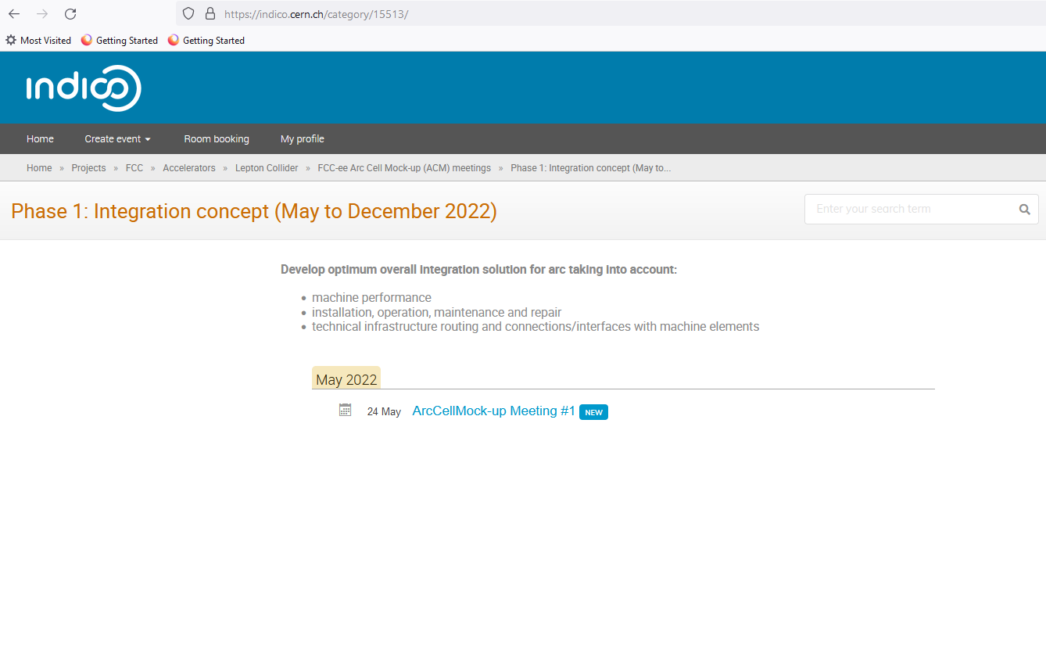
Meeting organization
24th May 2022 / Arc Cell kickoff meeting
F. Carra, L. Baudin
Indico page created for the series of events: https://indico.cern.ch/category/15512/ (please check access rights!)
Scientific secretary Lucie Baudin (thanks!)
Every 2 Tuesdays starting on May 24th
Which time? Synchronize with Accelerator Pillar meetings (3pm)?
Target duration ≤ 60 min
Agenda and invitation prepared and sent the week before the meeting
Reporting to the Accelerator Pillar meeting (once per month)
Platform for common documents / action list?

Slide 3
Meeting organization
24th May 2022 / Arc Cell kickoff meeting
F. Carra, L. Baudin
E-group fcc-ee-arc-cell-mockup-project
Members: Jean-Pierre Corso, Fani Valchkova-Georgieva, Julie Coupard, Serge Grillot, Samy Chemli, John Robert Etheridge, Kurt Artoos, Ofelia Capatina, Helene Mainaud Durand, Tor Raubenheimer, Frank Zimmermann, Roberto Losito, Olivier Brunner, Jeremie Bauche, Cedric Garion, Roberto Kersevan, Klaus Hanke, John Andrew Osborne, Marc Timmins, Alessandro Bertarelli, Katsunobu Oide, Antoine Chancé.
Let us know in case you think someone should be added / removed from the list!
Tentative agenda for next meeting (post-FCC week)
F. Valchkova-Georgieva: Current status of FCC-ee arc half-cell integration

Slide 4
Thank you for your attention.
Date / Name of the event
Name of the speaker/author
Space for additional logos
4

