Slide 1
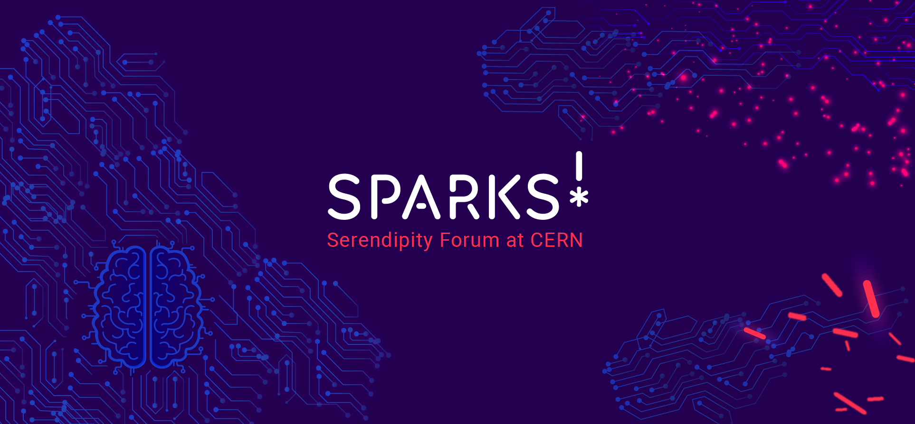
Notes:
What is Sparks?

Slide 2
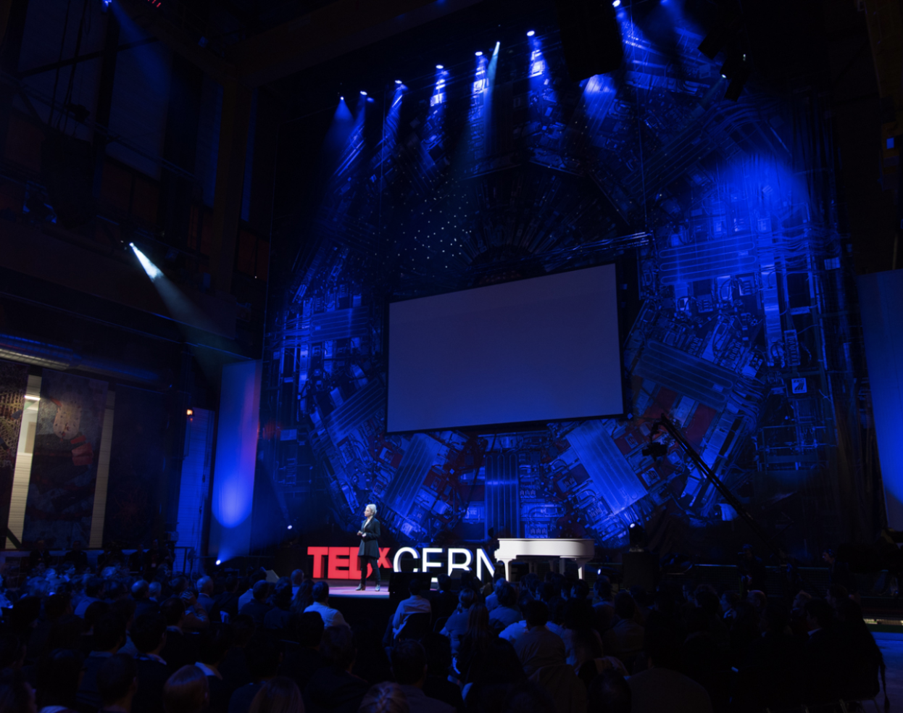
Sparks is a public event that builds on the success of the TEDxCERN events, while adding an academic component to it in a forum format.
The main goal of the forum is spark innovation in issues related to STEM that are relevant to society and to CERN.

Slide 3
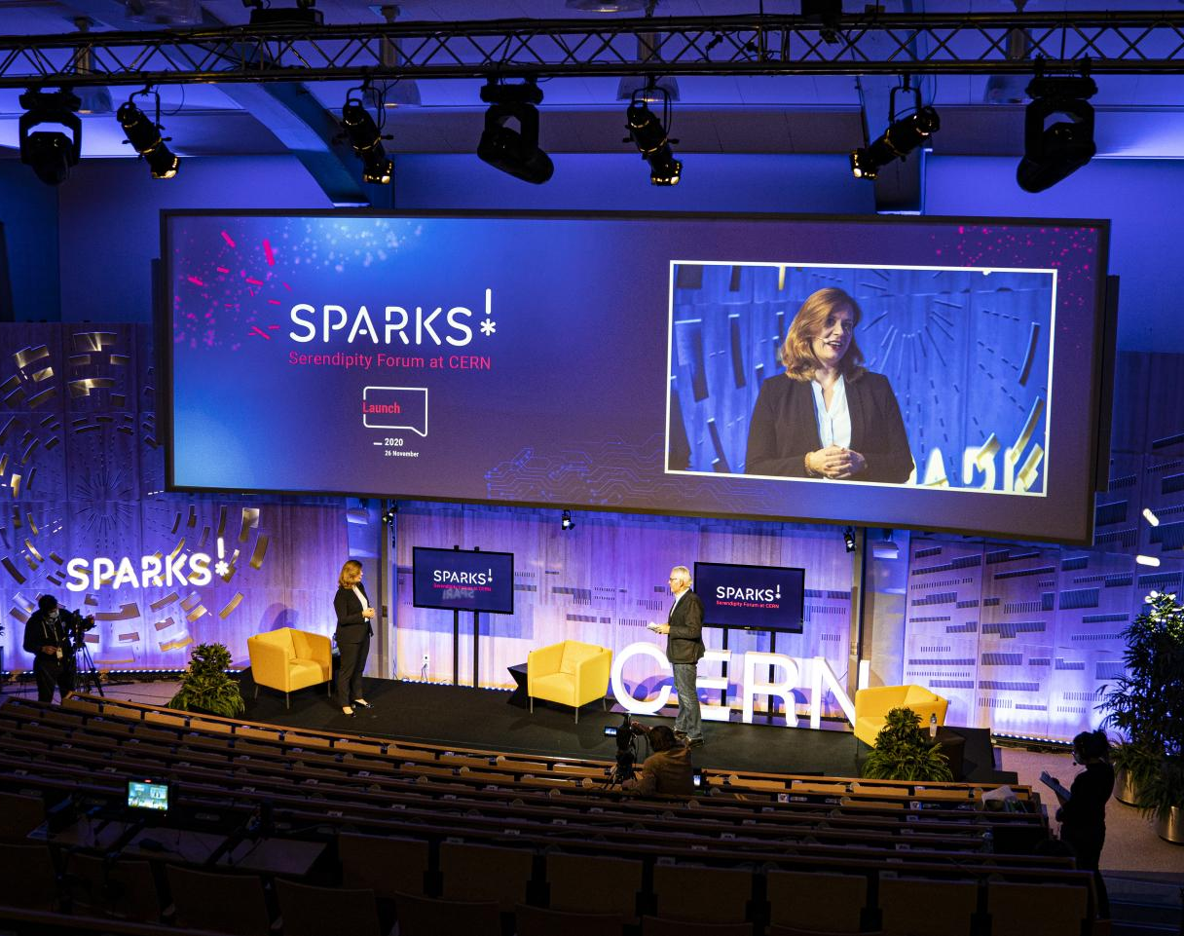
Two pilot events leading to Science Gateway:
The theme of the first event was Future Intelligence
This year we will explore Technology for Future Health

Slide 4
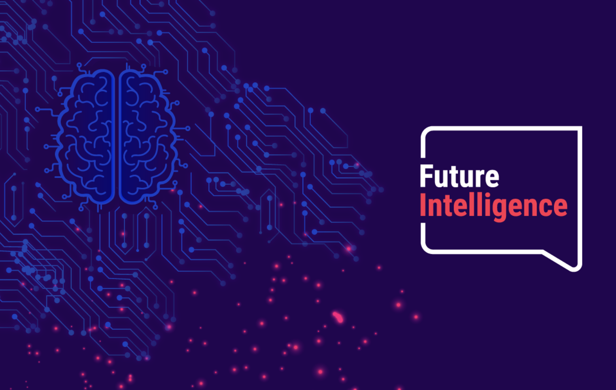
Launch 2020
Podcast Series
Forum
17 September
Public Event
18 September
Notes:
This first edition of Sparks had 4 deliverables!

Slide 5
Launch
November 2020
Notes:
The first pilot event suppose to have taken place in November 2020.
However due to the covid we held soft-launch instead.

Slide 6
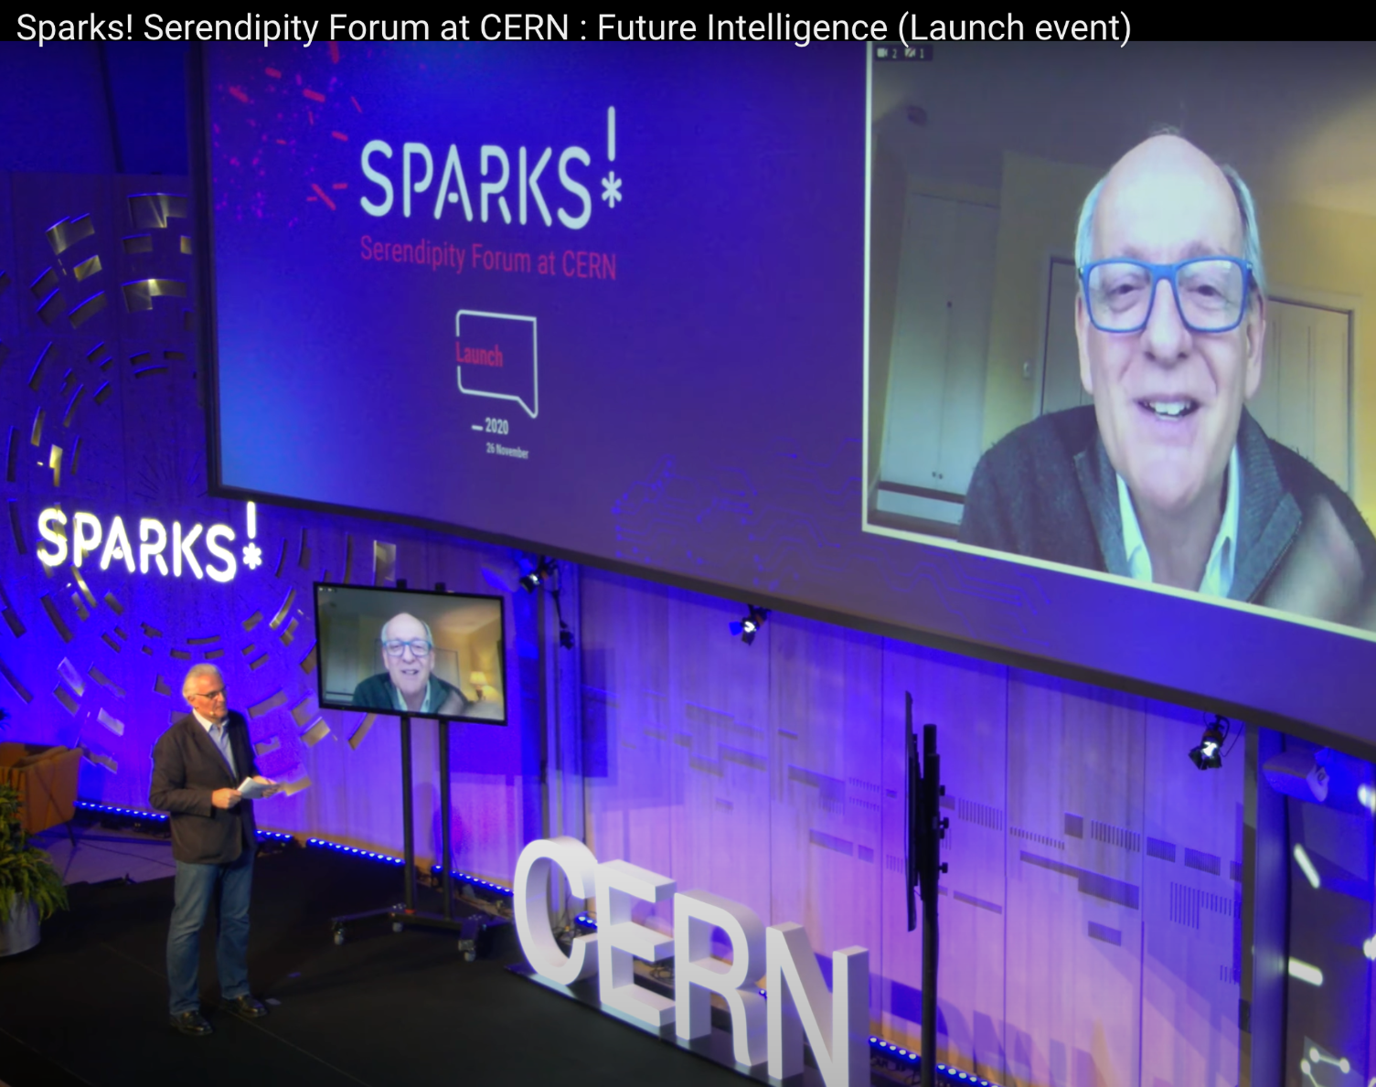
The recordings of the launch has already being seeing by more than 50K people
It mixed our own scientists with few of the confirmed participants of the forum such as Stuart Russell, Professor of AI at Berkeley talking to Bruno Giussani - TED’s Global Curator

Slide 7
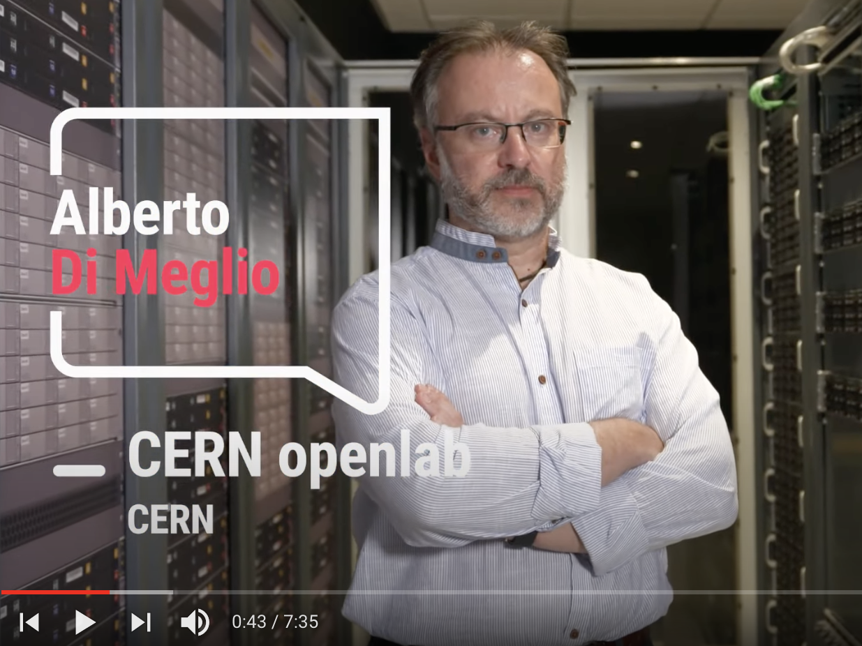
We created a video giving a glimpse on how AI is used through CERN, featuring our co-curators, Alberto Di Meglio from the CERN open Lab and Maurizio Pierini from CMS

Slide 8
Podcasts
Notes:
Between the launch and the main event, we also published a series of podcasts!

Slide 9
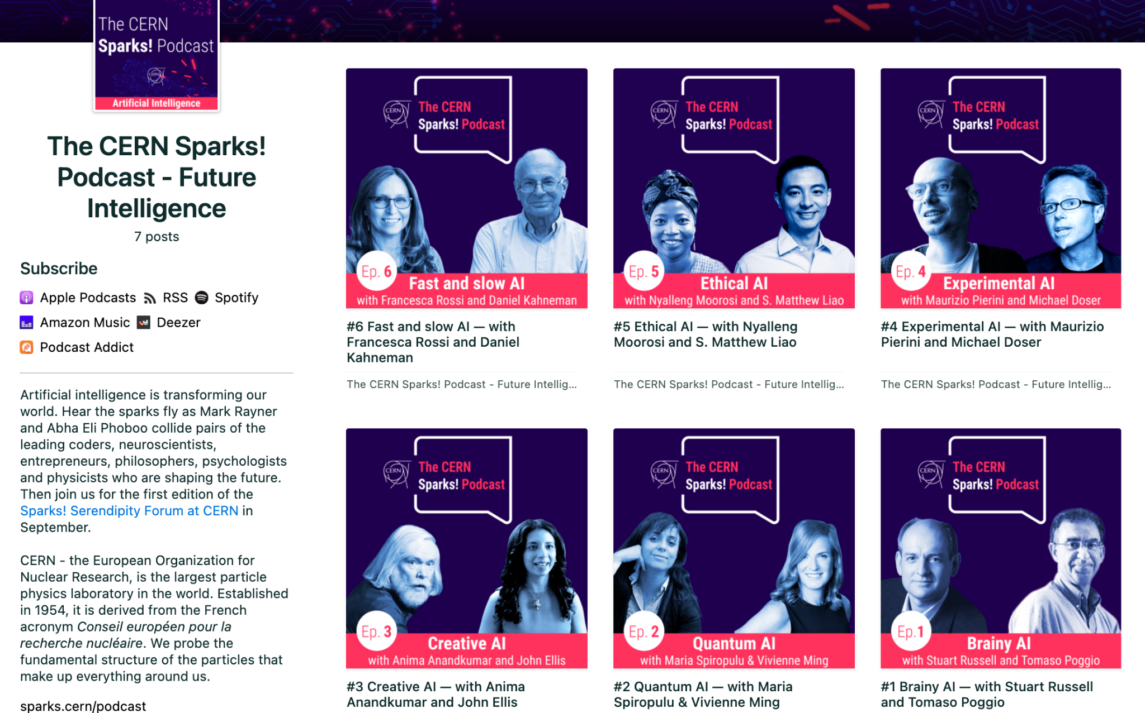
6 episodes that has so far more than 10k listeners
Once again we collided our own scientists with confirmed participants of Sparks such as John Ellis and Caltech professor Anima Anandkumar
Notes:
I

Slide 10
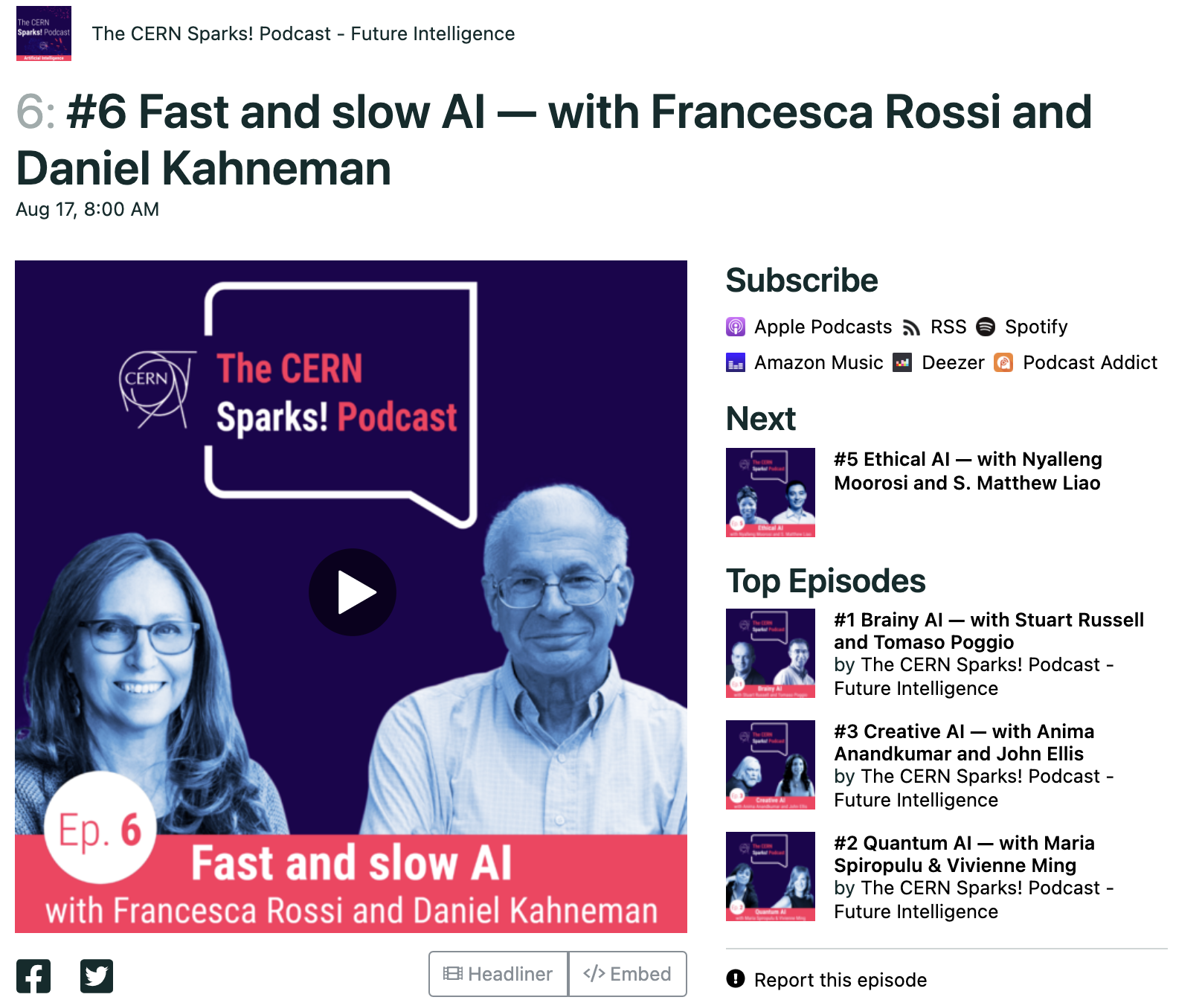
We even had a nobel prize winner, Daniel Kahneman, the author of Thinking fast, thinking slow, joining us for an episode with Francesca Rossi, who presides AAAI.

Slide 11
Forum
17 September 2021
Notes:
Finally on 17 of September we host the forum

Slide 12
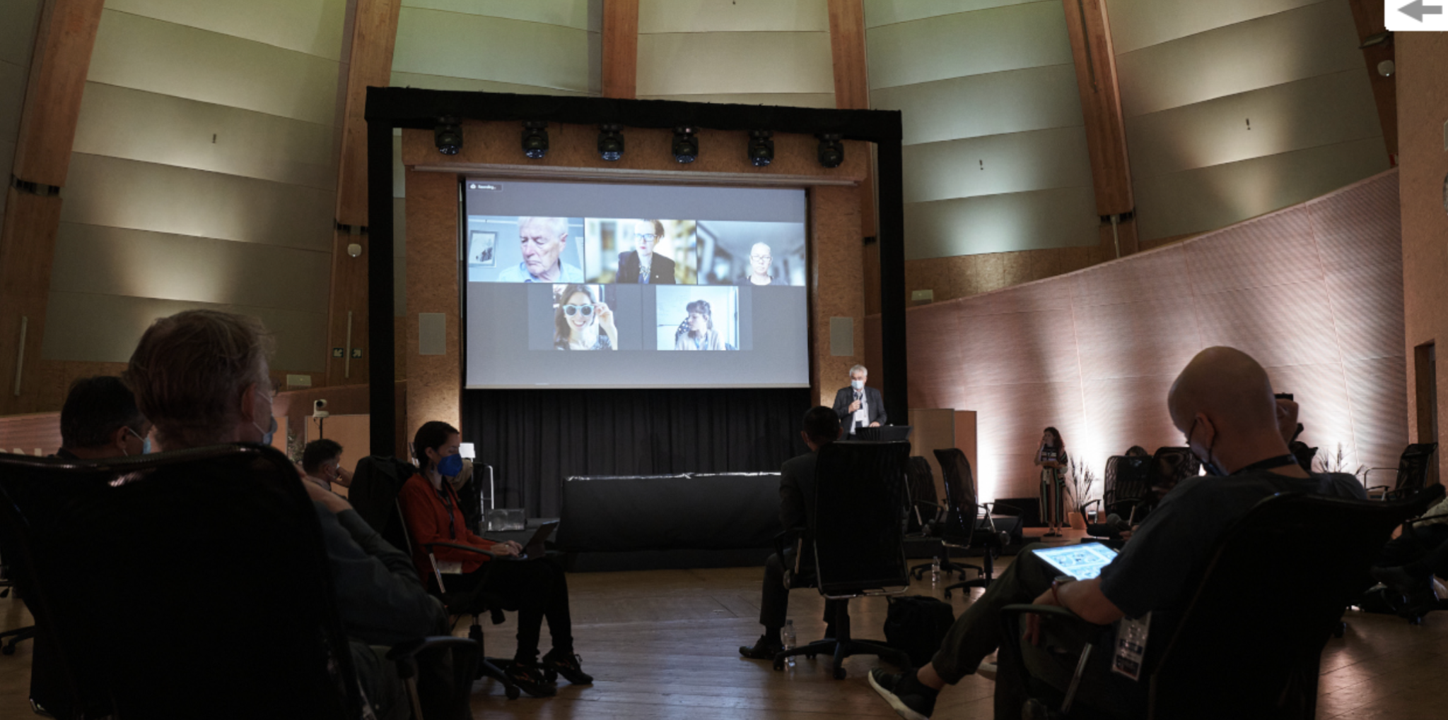
We invited 50 researchers, developers, neuroscientists, philosophers and ethics professionals to share their vision about the future of AI with scientists working with AI at CERN
in a hybrid format!

Slide 13
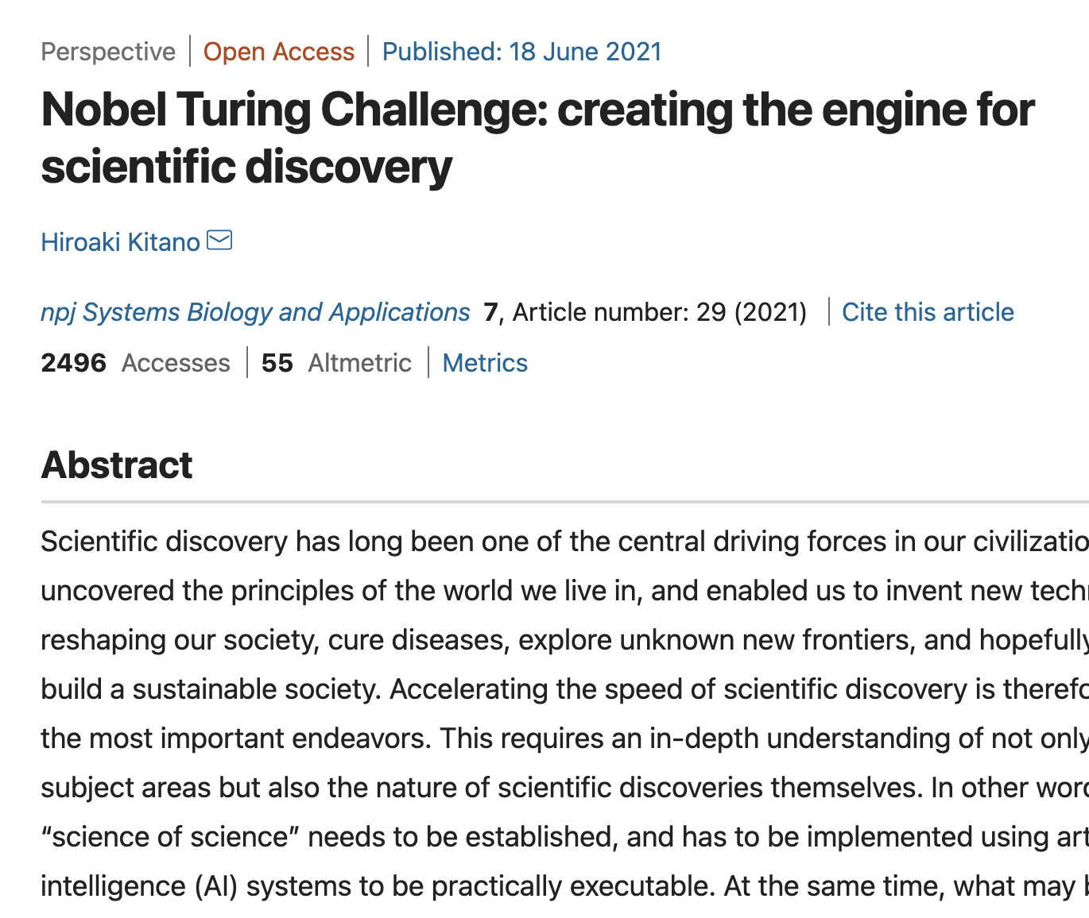
Among the in-person attendees there were 3 top scientists of Deepmind, one of the major players in the world of AI today
Virtually, we had participants from USA, Africa, Asia, including the CEO of Sony AI in Japan
Notes:
Who has recently published a paper entitled...
...Nobel Turing Challenge: Creating the engine for scientific discovery! Which generated a lot of discussions

Slide 14
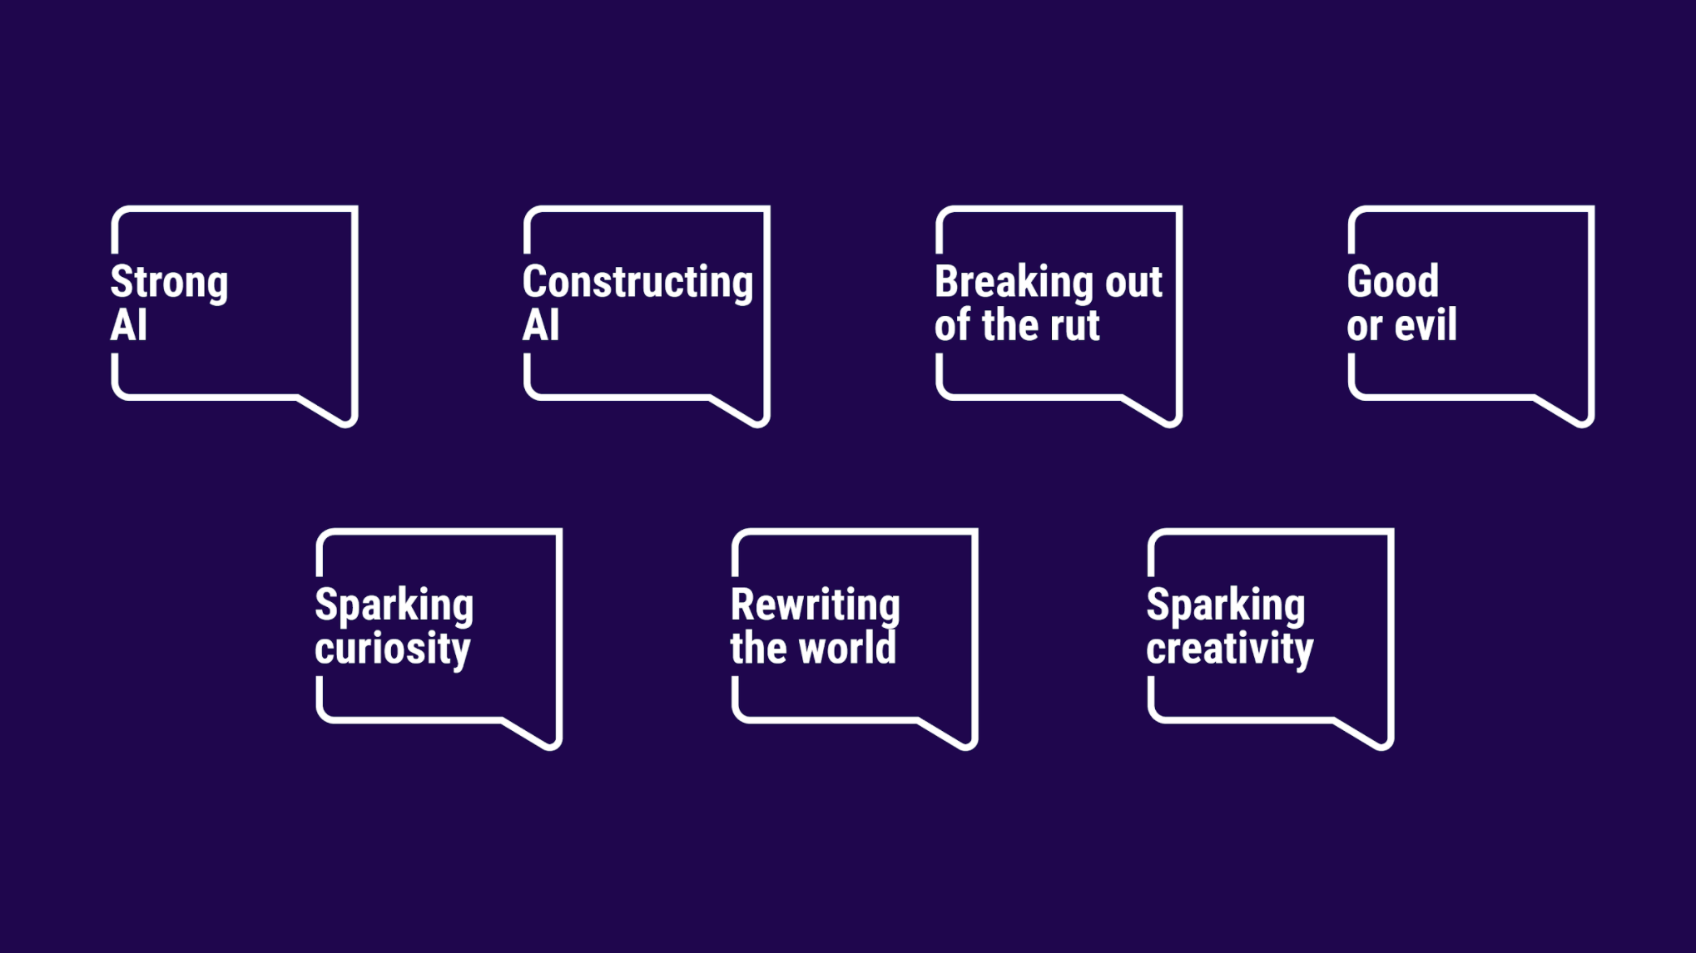
Notes:
7 topics led the discussions of the forum

Slide 15
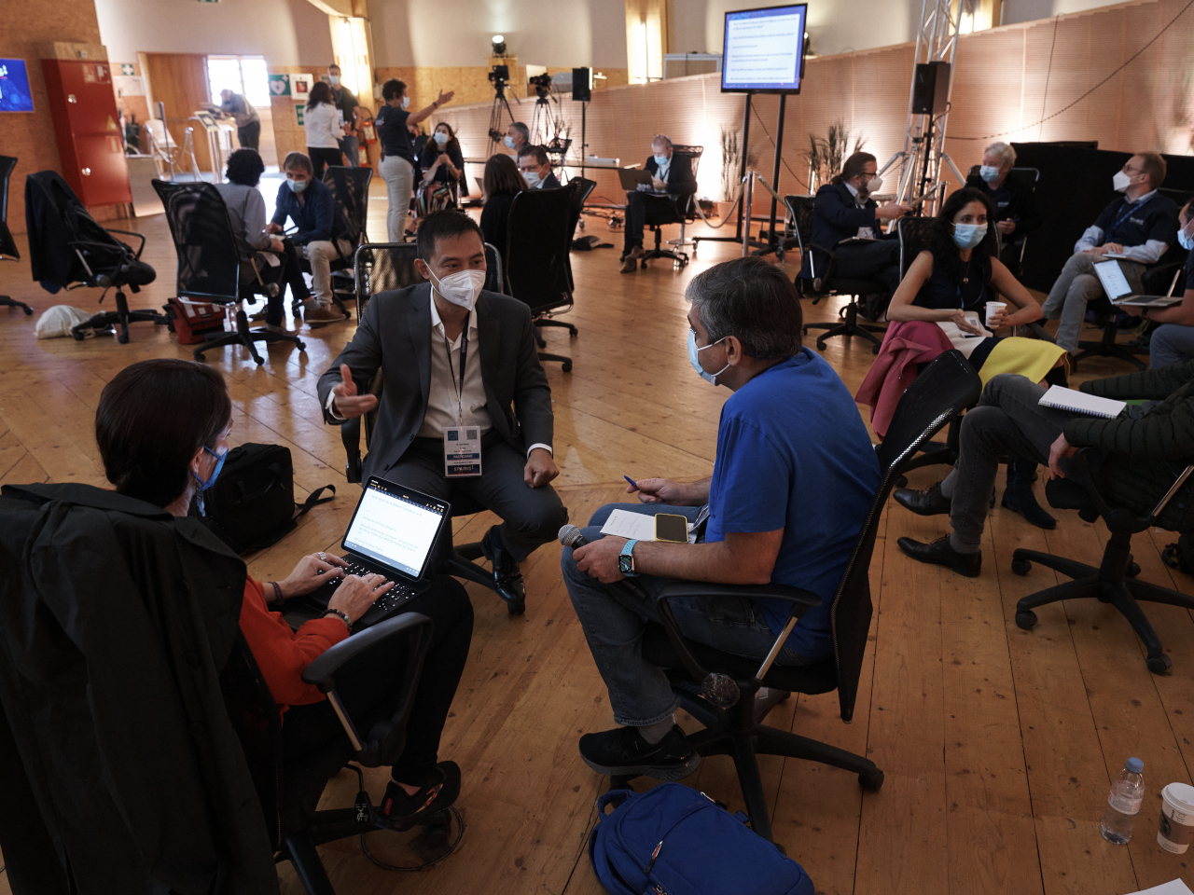
Participants of the forum had a chance to hear everyone else's ideas in the morning through a group facilitation methodology
before going to breakout rooms for in-depth discussions in the afternoon In each break-out room with a facilitator and a scribe

Slide 16
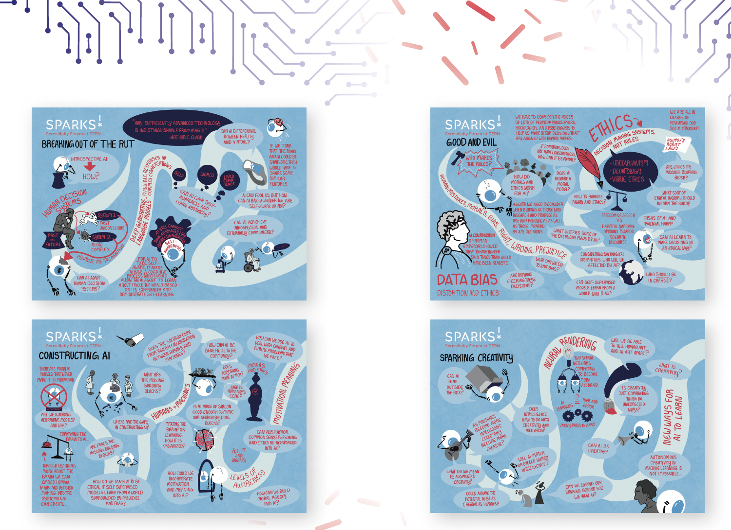
Prior to the event, we asked the participants to contribute with one page input about the 7 topics
to guide the afternoon discussions, we turned their one pagers inputs into a series of posters

Slide 17
Public Event
18 September
Notes:
Next day, on Saturday, 18 September, we host the public event
at the Globe

Slide 18
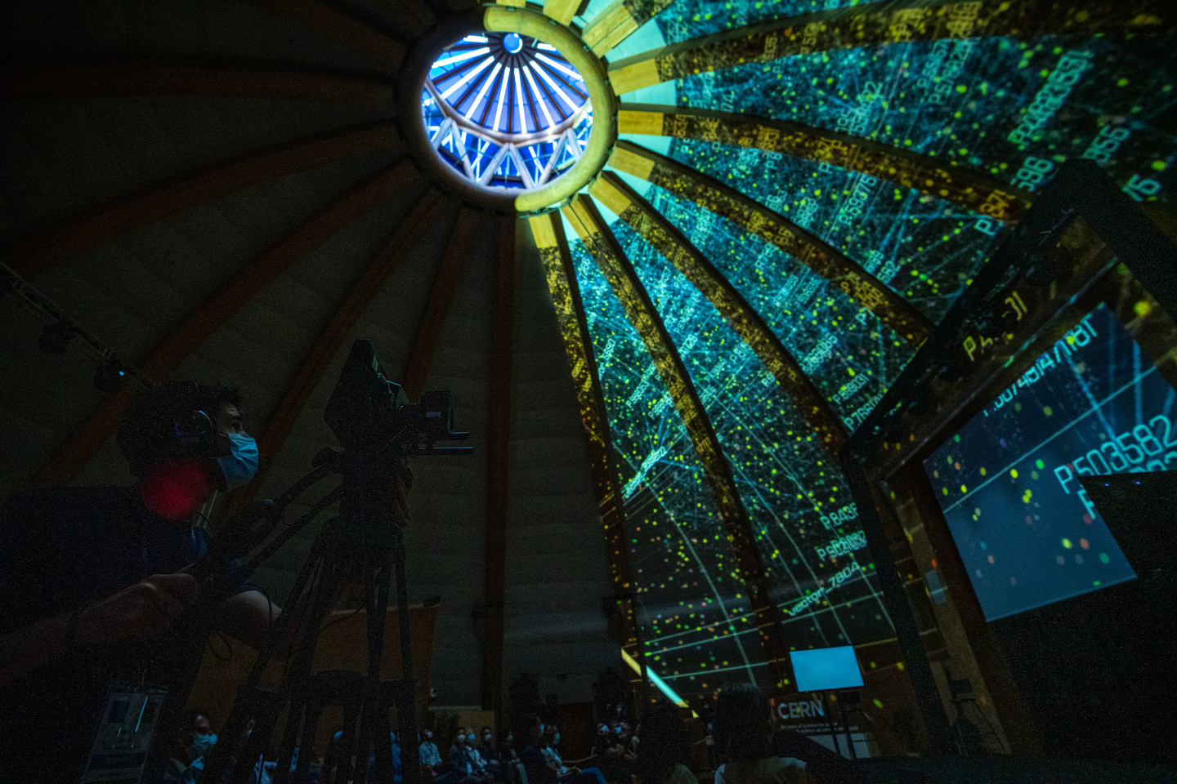
Notes:
Mapping

Slide 19
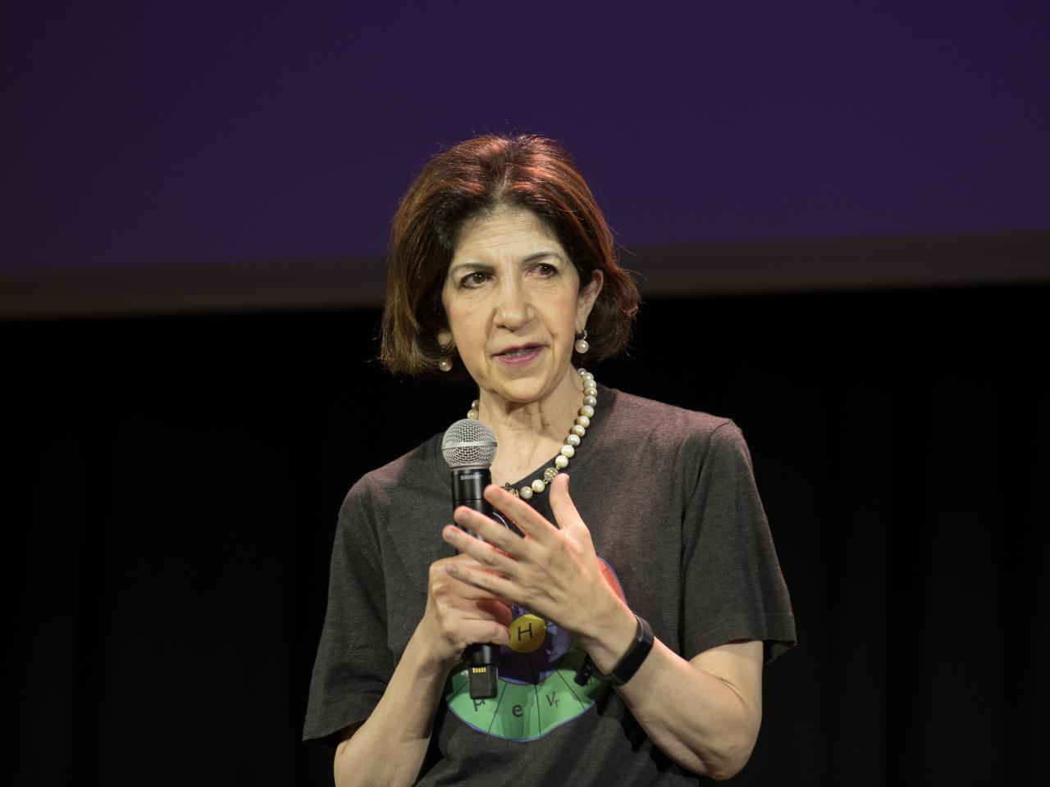
Fabiola Gianotti opened the public event
In total there were 12 talks followed by discussions
Notes:
Fabiola

Slide 20
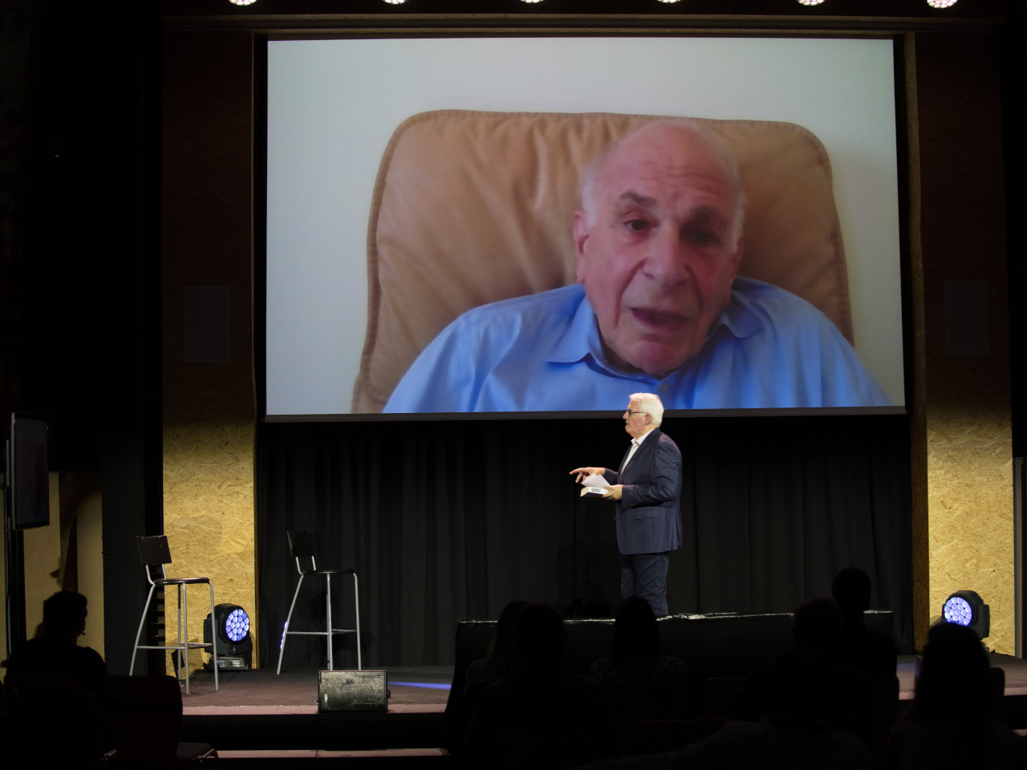
Daniel K. again talked about his new book - NOISE - and how AI can help us diminish bias in decision making
Notes:
Following that, there were 12 talks and discussions…
Daniel again talking about his new book - NOISE - and how AI can help us diminish bias in decision making

Slide 21
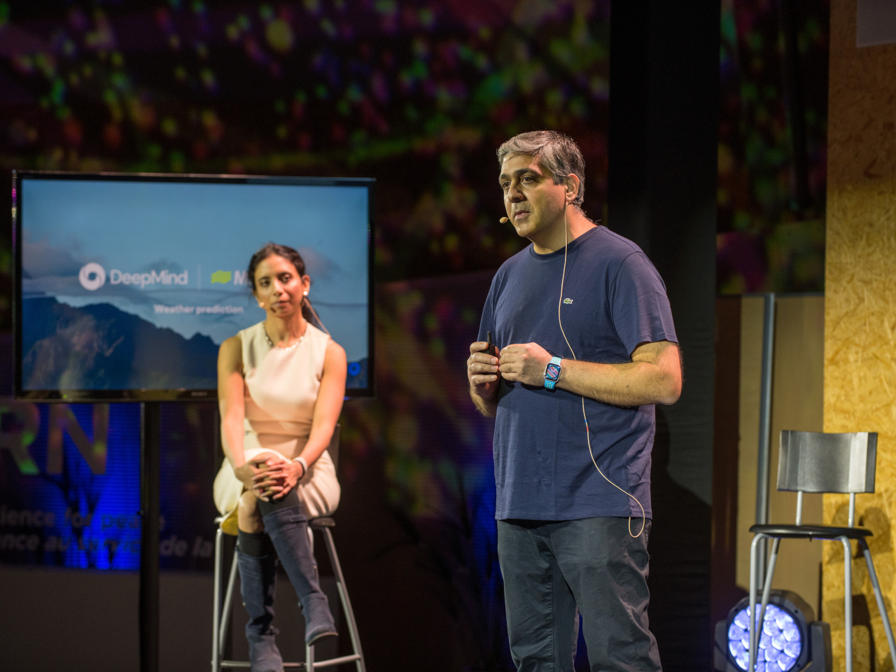
The VP research of DeepMind, Koray kavukcuoglu, presented the new developments of the field
Notes:
Caltech professor and VP research of Deep Mind - presenting the current status of the field and its challenges

Slide 22
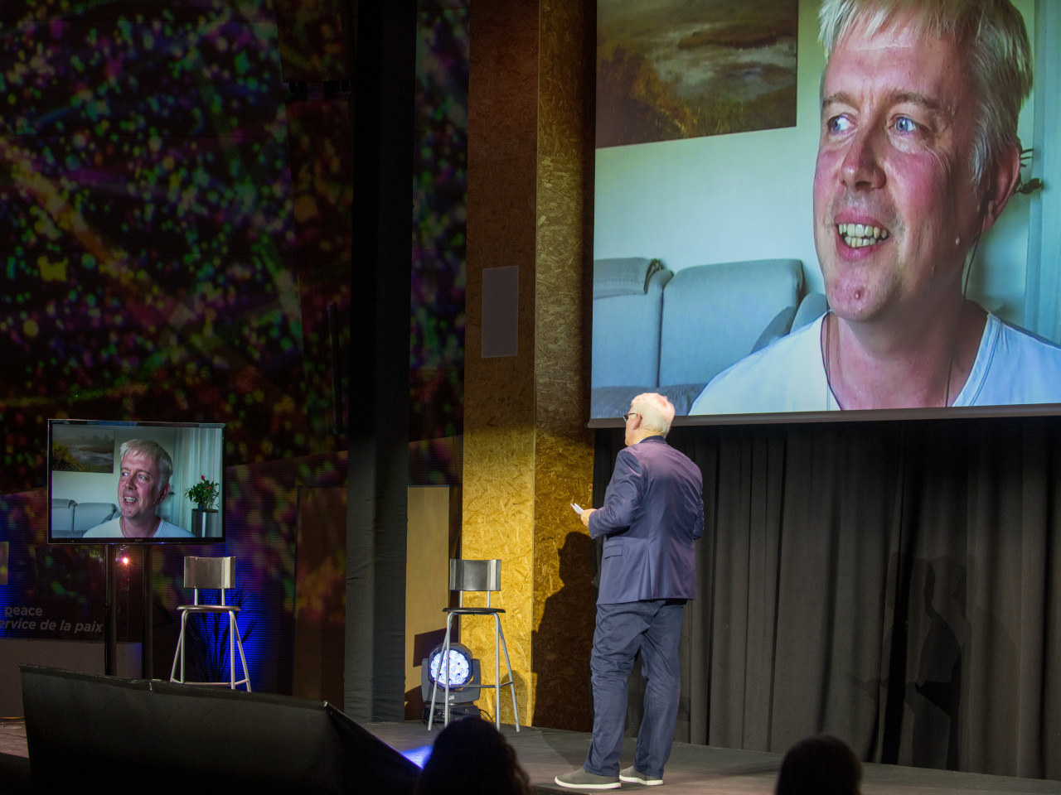
The Co-founder of Skype, Jaan Tallinn, talked AI being an existential risk

Slide 23
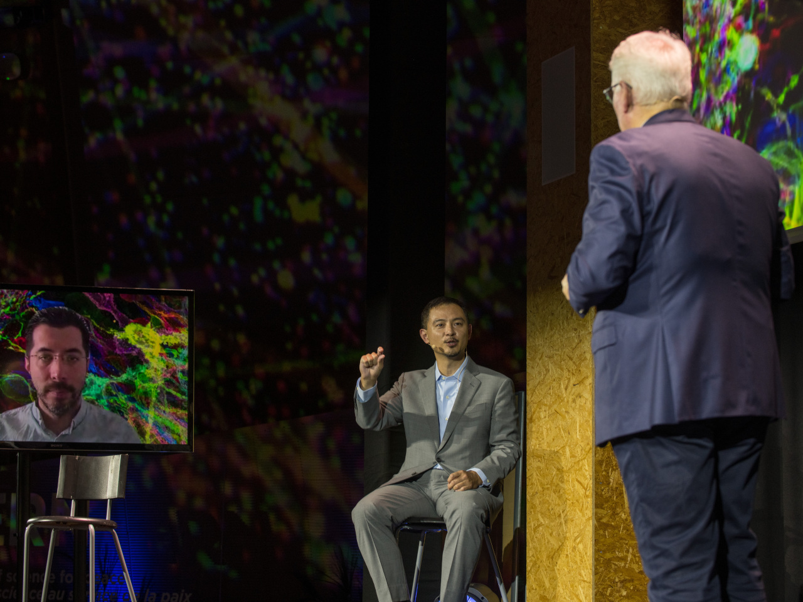
There was also a futurist discussion on the potential of human enhancement through AI among an ethics professional and a neuroscientist.

Slide 24
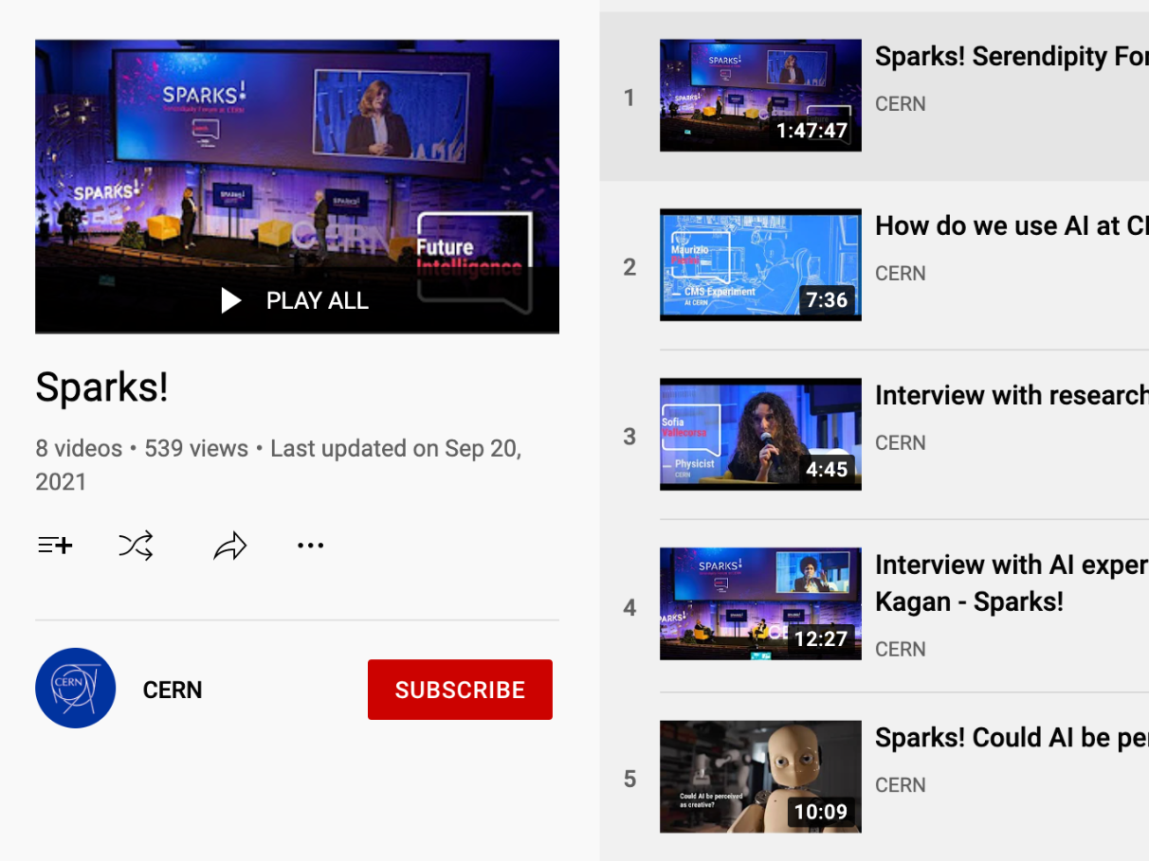
The full recording of the launch and public event is available on the CERN YouTube page
The videos combined have reached more than 15K viewers so far

Slide 25
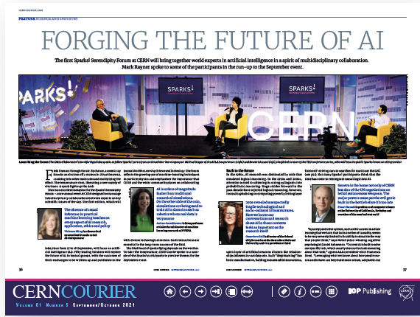
Additionally the CERN Courier published a Special edition about AI featuring Sparks!
Notes:
In terms of publications, the CERN courier published a Special edition about AI featuring Sparks!

Slide 26
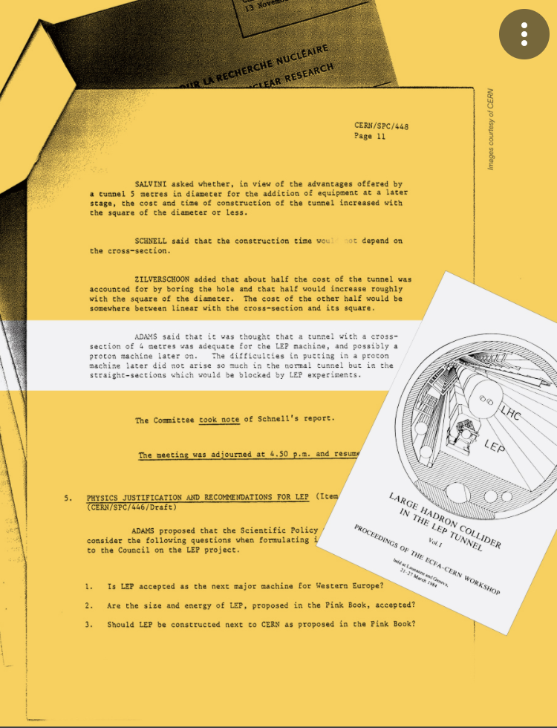
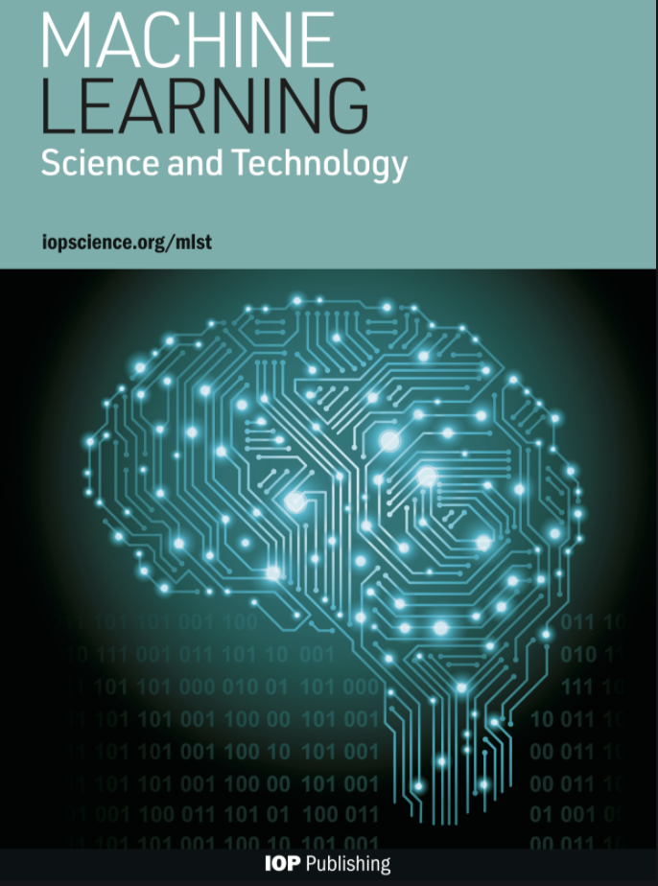
We are currently written up an yellow paper to be published by CERN
as well as in a special edition at the machine learning science and technology open journal
We also hope for many more spontaneous papers and collaborations among participants to emerge… that was the whole point of the forum!

Slide 27



Notes:
An important point I want to make, is that this whole edition was fully and “enthusiastically” externally funded

Slide 28


