Slide 1
Introduction rMPP 24 May 2022
Jan Uythoven, Christoph Wiesner

Slide 2
Classification of MDs
Dates back to 14th July 2015, initially categories A, B and C
Classification (updated):
  A: Standard operational and protection conditions, fits the present operational envelope
  B: Non-standard operation, but nominal protection settings, expected to be safe
  C: Non-standard protection settings and/or non-standard operation, leading to increased machine protection risks: to be discussed in rMPP
  D: Non-acceptable machine protection risks

Slide 3
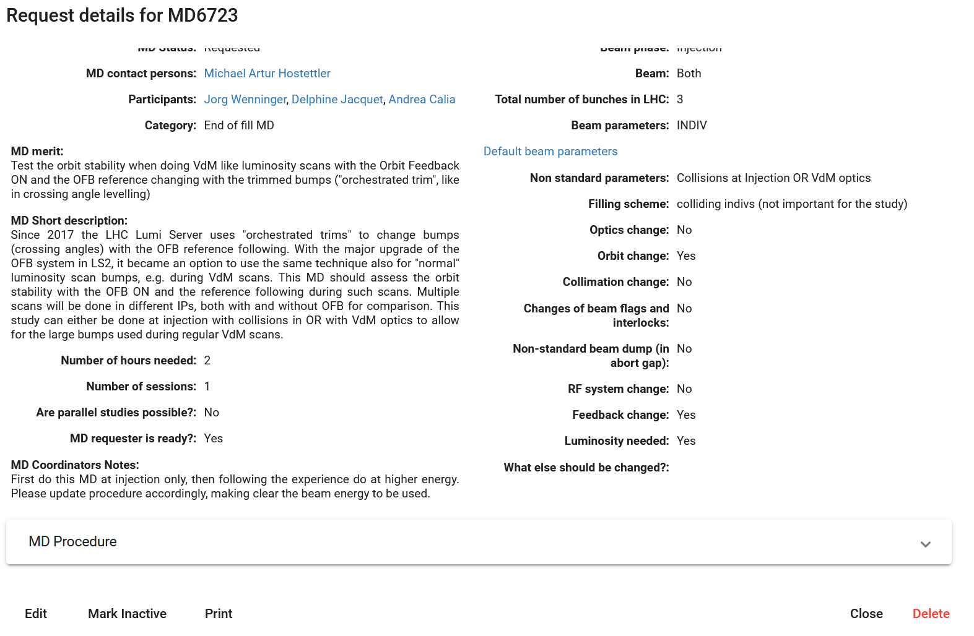
MD Coordinators’ Notes
rMPP comments can be found in the «MD Coordinators’ Notes» in ASM

Slide 4
Crystal MDs
rMPP classified C
Procedures have been reviewed in detail in the past
MD7006 Notes from MD Coordinators:
  Not OK for Sunday 22/05/2022, as machine not yet ready. 3e11 at top energy is not safe beam. Does not need to be presented at rMPP as procedures have been discussed in rMPP before. OK once the machine is ready for it (similar intensities have already been at top energy, few nominals).
MD7007 Notes from MD Coordinators:
  OK, once the machine is ready for it = has had a couple of nominals at top energy.

Slide 5
Answer to Comments:
#6723 (VdM scans with Orbit Feedback): First do this MD at injection only, then follow the experience do at higher energy. Please update procedure accordingly, making clear the beam energy to be used.
MD6803 BTF for Chromaticity Measurement: Approved with one (1) nominal bunch. More bunches would need to be quantified and beam parameters to be updated.
#6807 (Slow vs fast octupole scans in nominal conditions): If MD can be done with 3 nominal bunches, rather stick to 3 bunches instead of 10 nominal bunches. More than 3 nominal bunches need to be justified. Will be approved when number of bunches confirmed and explicitly mentioned.
#6863 (Amplitude Detuning Corrections from Feed-Down): Collimator settings to be agreed upon with the collimation team - very likely done - and to be detailed in the MD procedures, at the moment the settings are not fully clear. Once this is updated and clear, the MD will move to rMPP approved.
#6904 (Methods for nonlinear optics measurement at small action): Not clear why TDI to be moved to 10 mm. Please clarify this point and justify this value. After this is clarified, the MD will be rMPP approved.
#MD 6924 (Preparation for MD6923: Slow beam degradation from incoherent electron cloud effects): High brightness bunch to be defined and to be updated in LHC beam parameters. rMPP approved after update.

Slide 6
Dedicated presentations:
MD6948: RF cogging and orbit bumps in IR5 for HL-LHC BPM electronics development: general presentation, no specific question
MD6949: Validation of bunch-by-bunch diamond detectors functionalities: To have 25 ns spacing with pilots not evident. Need SBF to be able to move in collimators, so total < 5e11 - need get train of 6 or so. To be checked, confirmed and updated in procedure.
MD7008: Validation of method to measure aperture margin between IR6 and TCTs with non-nominal phase advance: The change of phase advance should be quantified (C3b and D2b).
Beam-Beam Tests: awaiting procedures

