Slide 1



Power Efficiency in HEP
(comparing ARM with x86)
Dr. Emanuele Simili HEPiX Benchmarking Working Group 15 November 2022
Notes:
PoW @ HEPiX working group meeting (post ACAT 2022)

Slide 2



Outline
*
Motivations and previous work
Methodology
- Available hardware
- Exporter tools & IPMI validation
Performance tests with various HEP workloads
- ATLAS full G4 simulations
- HEP-Score containers
Final focus:
- Open issues
- Conclusions and future plans
*
Previous talk @ GidPP47: https://indico.cern.ch/event/1128343/contributions/4787174/
Previous talk @ HEP WorkShop: https://indico.cern.ch/event/1170924/contributions/4995836/
Previous talk @ ACAT2022: https://indico.cern.ch/event/1106990/contributions/4991256/
D.B. talk @ WLCG WorkShop: https://indico.cern.ch/event/1162261/contributions/5134740/
2
Notes:
Outline (rev. after ACAT2022)
1) Motivation
- can we do LHC computing with less power using ARM?
2) Methodology:
- use IPMI x-checked with metered plug.
- test systems - similarities and, in particular, differences (and how you compare).
3) Tests with various HEP workloads
- idle measurement
- discussion of work load characteristics
- results.
4) Final focus:
- Use HEPSCORE to work out kW/Hepscore for LHC workloads
- Conclusions and future plans.

Slide 3
Introduction
The power consumption of computing is coming under intense scrutiny worldwide, driven both by concerns about the carbon footprint, and by rapidly rising energy costs.
ARM chips, while widely used in mobile devices due to their power efficiency, are not currently in widespread use as capacity hardware on the Worldwide LHC Computing Grid (WLCG).
LHC experiments are increasingly able to compile their workloads on the ARM architecture (and … GPUs) to take advantage of various HPC facilities (e.g., ATLAS, CMS).
To test whether WLCG sites have scenarios where power efficiency can be improved by deploying ARM-based hardware, the energy consumption and execution speed of identical CPU- and RAM-intensive workloads on two almost identical machines were tested: one with an Ampere arm64 CPU, and the other with a standard AMD x86_64 CPU.
The HEP workloads includes full ATLAS simulations and the most recent HEP-Score containerized jobs developed for Run3.
ScotGrid Glasgow: Emanuele Simili, Gordon Stewart, Samuel Skipsey, Dwayne Spiteri, David Britton
Special Thanks: Domenico Giordano (CERN), Gonzalo Menendez Borge (CERN), Johannes Elmsheuser (CERN)
3
Notes:
abstract & motivations

Slide 4
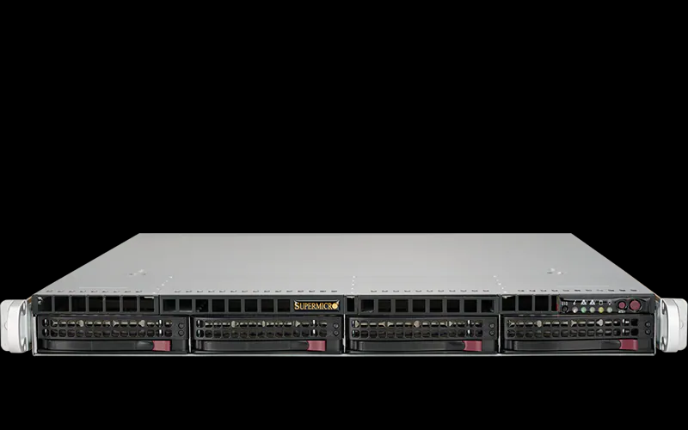
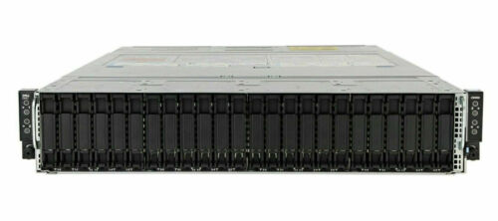
Available Hardware
We have recently purchased two almost identical machines of comparable price, one with an AMD x86_64 CPU (with HT enabled), the other with an Ampere arm64 CPU:
x86_64: Single AMD EPYC 7003 series (SuperMicro)
CPU: AMD EPYC 7643 48C/96T @ 2.3GHz (TDP 300W)
RAM: 256GB (16 x 16GB) DDR4 3200MHz
HDD: 3.84TB Samsung PM9A3 M.2 (2280)
arm64: Single socket Ampere Altra Processor (SuperMicro)
CPU: ARM Q80-30 80 core 210W TDP processor
RAM: 256GB (16 x 16GB) DDR4 3200MHz
HDD: 3.84TB Samsung PM9A3 M.2 (2280)
And we included in the comparison a standard workernode of our Grid cluster, with 2 AMD x86_64 CPUs (with HT enabled), which is also comparable in price* to the machines above:
2*x86_64: Dual AMD EPYC 7513 series Processors (DELL)
CPU: 2 * AMD EPYC 7513, 32C/64T @2.6GHz (TDP 200W)
RAM: 512GB (16 x 32GB) DDR4 3200MHz
HDD: 3.84TB SSD SATA Read Intensive
* this machine is part of a 2 unit / 4 node chassis.
4
Notes:
ARM server: Single socket Ampere Altra Processor
Architecture: aarch64
Byte Order: Little Endian
CPU(s): 80
Vendor ID:
Model name:
Manufacturer:
Ampere(R) Family: ARMv8
External clock: 1.650 GHz
Max speed: 3.000 GHz
Speed: 3.000 GHz
Core count: 80
Thread count: 80
TDP (*): 210W
---
AMD server: Single AMD EPYC 7003 series processor family
Architecture: x86_64
Byte Order: Little Endian
CPU(s): 96
Vendor ID: AuthenticAMD
Model name: AMD EPYC 7643 48-Core Processor
Manufacturer: Advanced Micro Devices, Inc.
Family: Zen
External clock: 100.000 MHz
Max speed: 3.625 GHz
Speed: 2.300 GHz
Core count: 48
Thread count: 96
TDP (*): 300W
---
DELL Epyc workernode (compute node)
DELL PowerEdge C6525
2 * AMD EPYC 7513 2.6GHz, 32C/64T, 128M Cache (200W) DDR4-3200
16 32GB RDIMM, 3200MT/s, Dual Rank 8Gb BASE
1 3.84TB SSD SATA Read Intensive 6Gbps 512 2.5in Hot-plug AG Drive, 1 DWPD,
---
GPU server (A.I. sandbox)
DELL PowerEdge + 2 * Nvidia A100 80GB
2 * AMD EPYC 7443 24Core/48T Processors @ 4.00 GHz & 512GB RAM
---

Slide 5

Power Readings
CPU, RAM usage metrics and IPMI power readings are extracted and logged by two custom scripts:
The 1st script is a cron job (by root) that every 10 seconds exports IPMI power readings with a timestamp to /tmp/ipmidump.txt (… because IPMItool requires root privileges).
The 2nd script is executed by the user and it takes in the job to be benchmarked as argument. When executed, it starts grabbing the IPMI readings from the dump file, attaches few more info (CPU, RAM) and appends them to a CSV file. After 1 min. sleep (so to measure idle power), it runs the given job, and then waits another min. after the job is finished before quitting.
After the job is done, the CSV file is exported locally and processed in ROOT (time profiles plots and power integration). Cumulative results are then visualized in Excel.
In addition, all servers are running a node_exporter client, which feeds (almost) real time metrics to our Prometheus server, which in turn feeds an extensive set of Grafana dashboards for easy visualization and monitoring purposes.
5
Notes:
TimeStamp: date +"%F , %T"
CPU: top -bn1 | grep "Cpu(s)" | sed "s/.*, *\([0-9.]*\)%* id.*/\1/" | awk '{print 100 - $1}'
RAM: free -t | awk 'FNR == 2 {printf("%.2f"), $3/$2*100}'
GPU: nvidia-smi --query-gpu=power.draw --format=csv,noheader,nounits | awk '{s+=$1} END {print s}’
Power (IPMI): ipmitool dcmi power reading | grep "Instantaneous power reading:"

Slide 6
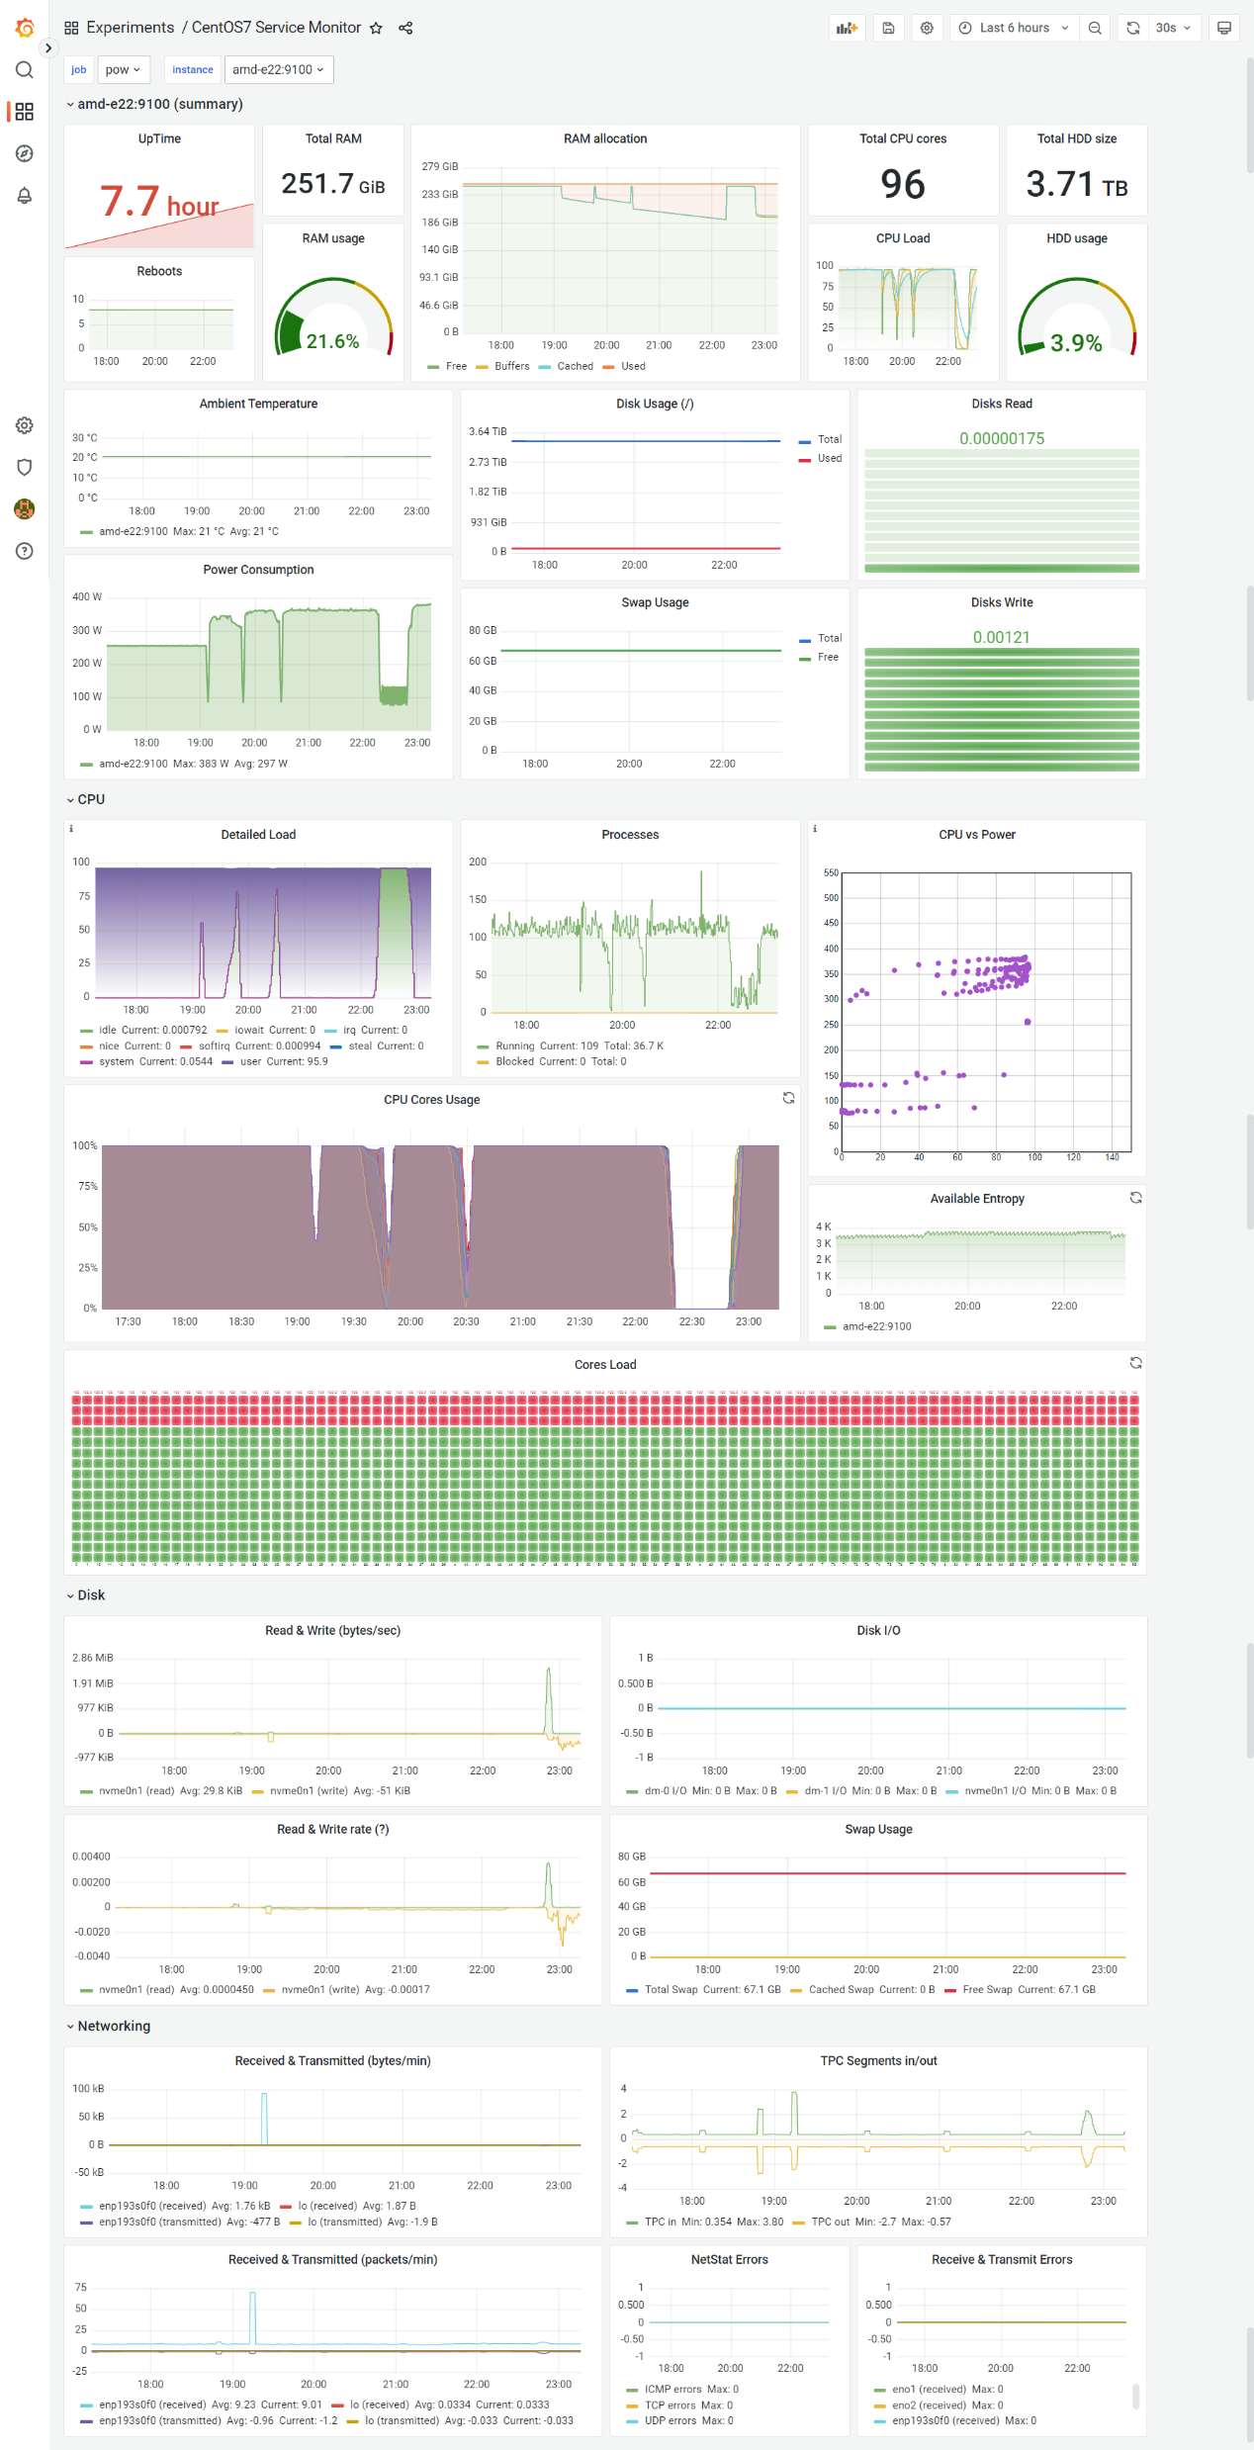
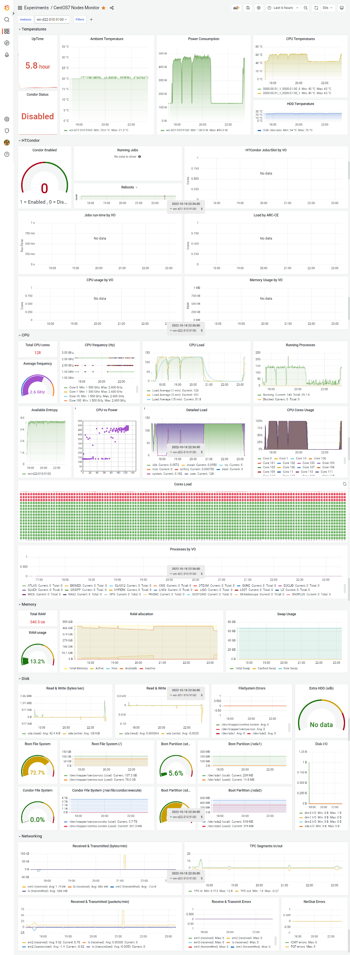
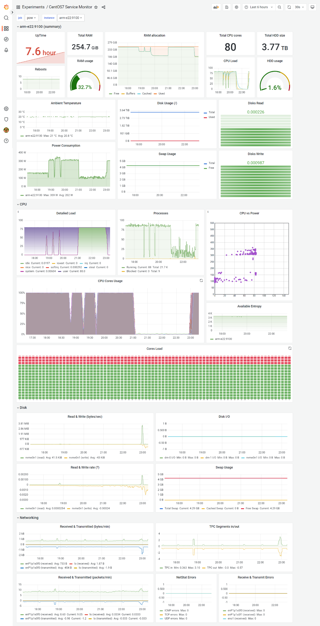
x86*2
x86
arm
Site Monitoring @ vCHEP2021:
https://indico.cern.ch/event/948465/contributions/4323666/attachments/2248127/3813306/MonitoringAndAutomation_vCHEP2021.pdf
6
Notes:
Visualization & monitoring tools: node_exporter + Prometheus + Grafana
See previous work on “A hybrid system for monitoring and automated recovery at the Glasgow Tier-2 cluster” and automation presented at vCHEP2021: https://indico.cern.ch/event/948465/contributions/4323666/attachments/2248127/3813306/MonitoringAndAutomation_vCHEP2021.pdf

Slide 7
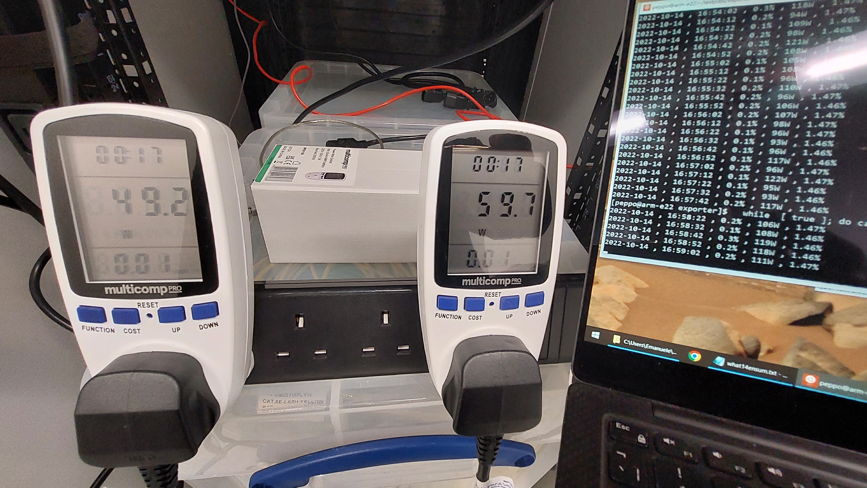
IPMI validation
We have attempted some sort of validation of the IPMI readings using (cheap) metered plugs:
Instantaneous power was impossible to compare, as the number changed too quickly on the metered plugs and they almost never matched the IPMI readings from the machine.
We did an integrated measurement of the total energy for a fixed time idle and for a complete job - which unfortunately did not have the same duration on both machines.
Idle test (30 min.)
x86: 0.04766 kWh ~ 0.046 kWh (=0.021+0.025 kWh) → ∆ = 0.00166 kWh (= -3.5%% of IPMI reading)
arm: 0.05668 kWh ~ 0.054 kWh (=0.024+0.030 kWh) → ∆ = 0.00268 kWh (= -4.7% of IPMI reading)
Job test (x86 ~45 min. ; arm ~30 min.)
x86: 0.25729 kWh ~ 0.263 kWh (=0.128+0.135 kWh) → ∆ = 0.00571 kWh (= +2.2% of IPMI reading)
arm: 0.13418 kWh ~ 0.134 kWh (=0.064+0.070 kWh) → ∆ = 0.00018 kWh (= +0.1% of IPMI reading)
Measurements of energy consumption over a longer duration of at least 30 minutes yielded results which were within ±5% of the values recorded via IPMI, giving us confidence in the validity of our IPMI results.
7
Notes:
Metered plugs (~ 30£ each)

Slide 8

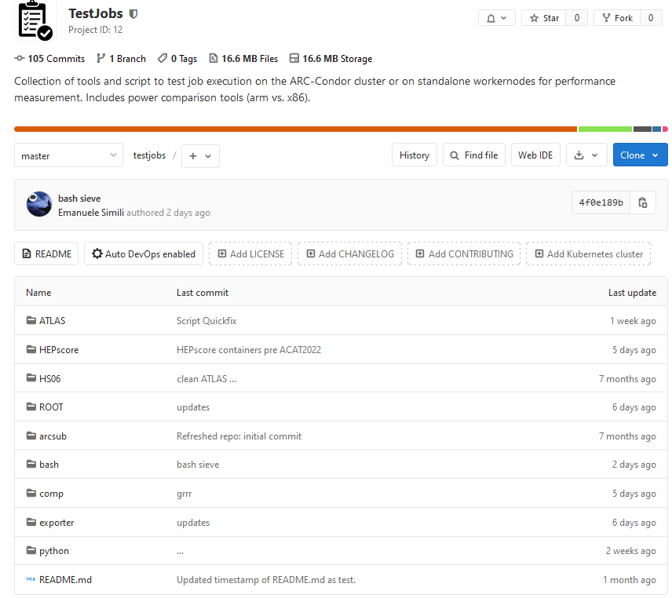
Benchmarks
Idle benchmark:
Idle measurement (sleep)
HEP benchmarks (typical Grid workload):
Full G4MT ATLAS Simulation (sim-digi)
HEP-Score containers (CMS, ATLAS)
We have created a project in our local GitLab repo to
collect test-jobs and benchmarks that we have used
in various occasion to run tests in our Tier2 cluster.
8
Notes:
List of benchmarks (new)

Slide 9
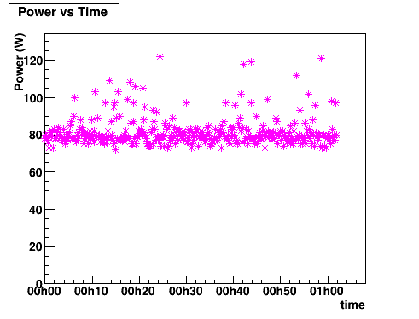
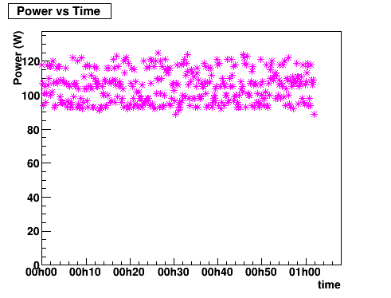
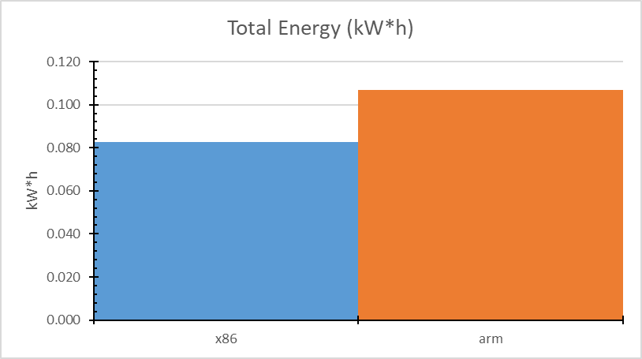
Idle Power
For this measurement we just let the machines idle for 1h, while collecting power metrics. In order to use the IPMI exporter script, we set to execute a sleep job:
$ sleep 3600
Power profiles show that the arm has a higher baseline, and larger oscillations between power states, leading to a higher average *
∆‹P› ~ 22 W
x86
arm
Key result: the arm uses about 30% more energy than the x86 in idle state, making I/O bound tasks slightly less power efficient on arm than on an equivalent x86 server.
lower = better
* Note: the two CPUs have a different number of physical cores !
9
Notes:
E(arm) ~= 1.3 * E(x86)

Slide 10
ATLAS Workload
The chosen version of the software: Athena 23.0.3
(builds available for both x86_64 and aarch64 on CVMFS)
x86
Using Athena/23.0.3 [cmake] with platform x86_64-centos7-gcc11-opt at /cvmfs/atlas.cern.ch/repo/sw/software/23.0
arm
Using Athena/23.0.3 [cmake] with platform aarch64-centos7-gcc11-opt at /cvmfs/atlas.cern.ch/repo/sw/software/23.0
Setting up the ATLAS framework on CVMFS and running the job:
$ export ATLAS_LOCAL_ROOT_BASE=/cvmfs/atlas.cern.ch/repo/ATLASLocalRootBase
$ alias setupATLAS='source ${ATLAS_LOCAL_ROOT_BASE}/user/atlasLocalSetup.sh'
$ setupATLAS
$ asetup Athena,23.0.3
$ ./TTbarSim2022.sh
#!/bin/sh
export MAXEVENTS=10000
export ATHENA_CORE_NUMBER=$(nproc)
inputdatadir=/cvmfs/atlas.cern.ch/repo/benchmarks/hep-workloads/input-data
inputdata=$inputdatadir/EVNT.13043099._000859.pool.root.1
Sim_tf.py \
--inputEVNTFile="${inputdata}" \
--outputHITSFile="TTbar2022.HITS.pool.root" \
--maxEvents=${MAXEVENTS} \
--physicsList=FTFP_BERT_ATL \
--imf=False \
--randomSeed=6163 \
--AMIConfig=s3873 \
--multithreaded=True \
--jobNumber=1 \
TTbarSim2022.sh
Input file:
Geant4 MT full ATLAS detector simulation of a given number of TTbar events (from existing TTbar gen-events file)
We generated samples of 1k and 10k events …
10
Notes:
Version and settings:
[peppo@amd-e22 ~]$ asetup Athena,23.0.3
Using Athena/23.0.3 [cmake] with platform x86_64-centos7-gcc11-opt at /cvmfs/atlas.cern.ch/repo/sw/software/23.0
[peppo@arm-e22 ~]$ asetup Athena,23.0.3
Using Athena/23.0.3 [cmake] with platform aarch64-centos7-gcc11-opt at /cvmfs/atlas.cern.ch/repo/sw/software/23.0

Slide 11
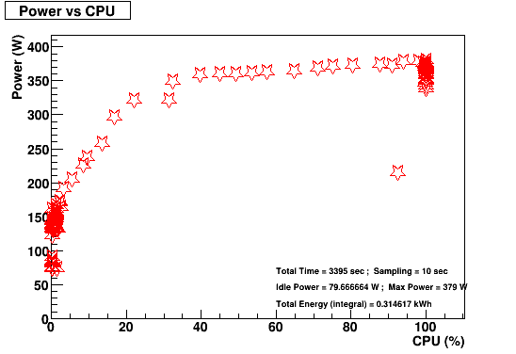
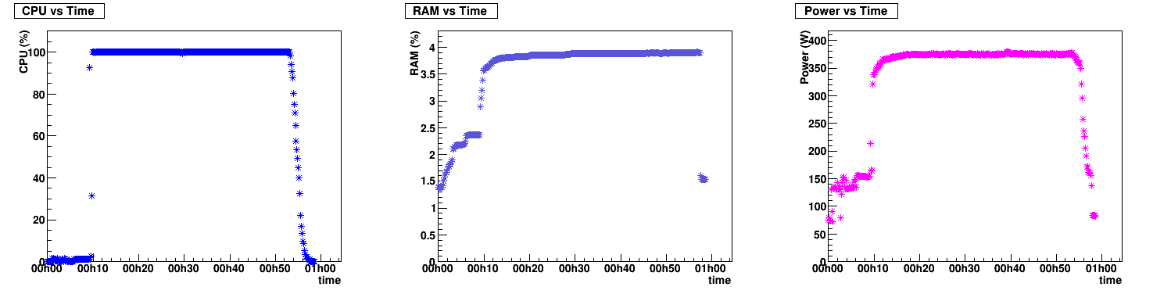
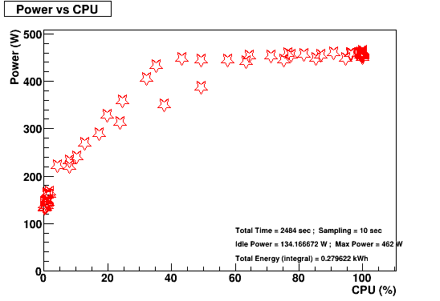
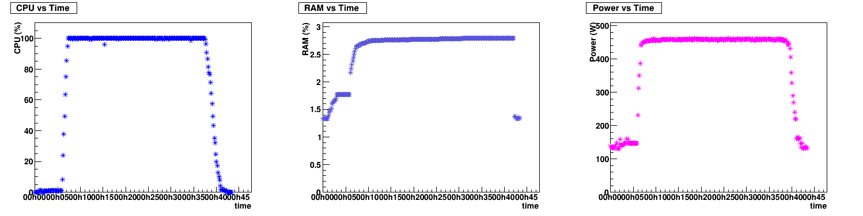
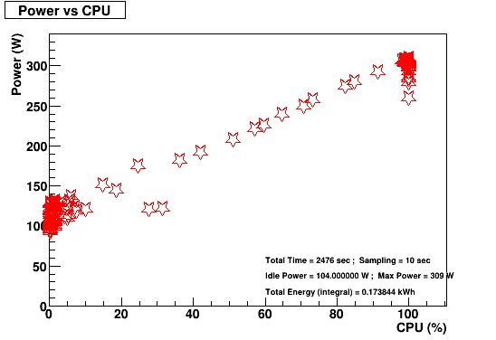
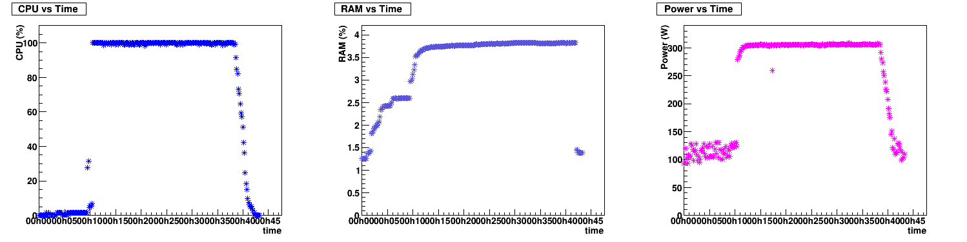
Job Profiles (ATLAS 1k)
x86
idle
x86*2
arm
11
Notes:
Profiles (ATLAS TTbar simulation 1k events) … because they look nicer than the 10k ones
In the first column, we see the effect of hyperthreading on the x86 platform: we’re using all the circuitry at 50% CPU utilisation (because each physical core is acting as two logical cores), whereas the 80 physical cores on the ARM scale more or less linearly. So while you will achieve some (pretty small) power saving by running an ARM CPU between 50% and 100% load, you only really see a power saving on x86 HT at < 50% load.

Slide 12
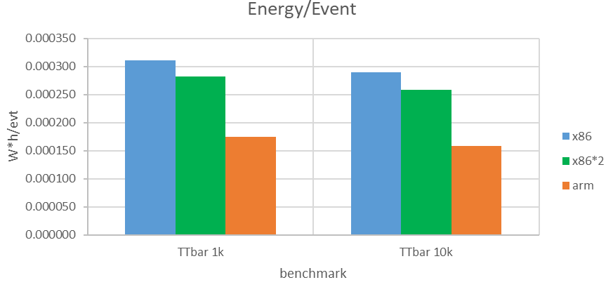
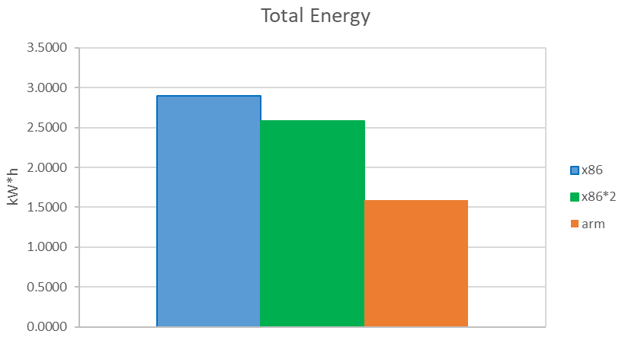
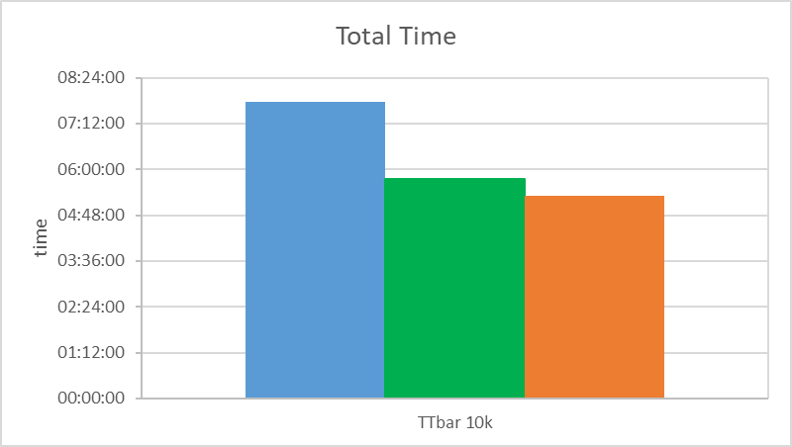
Results (ATLAS 10k)
We compared execution time and integrated energy consumption over the job duration for the 3 types of machines available (x86, x86*2 and arm). Each job was executed three times, we took the average execution time and energy consumption, and their standard deviation as an estimate of the uncertainty.
Arch | Threads | ATLAS sim. | N. events | Time (h) | dT (%) | Energy(kW*h) | dE (%) | idle(W) | max(W) | W*h/event
x86 | 96 | TTbar | 10'000 | 07:46:14 | 0.3% | 2.8966 | 0.6% | 85 | 382 | 0.000290
x86*2 | 128 | TTbar | 10'000 | 05:44:25 | 0.4% | 2.5843 | 0.6% | 133 | 463 | 0.000258
arm | 80 | TTbar | 10'000 | 05:19:07 | 2.2% | 1.5853 | 2.5% | 110 | 309 | 0.000159
The better efficiency of the arm machine compared to both the x86 can be seen in the Total Energy plot or in the Energy/Event plot.
lower = better
Key result:
the arm is slightly faster, and much more energy efficient than x86 !
lower = better
12
Notes:
Results 10k

Slide 13
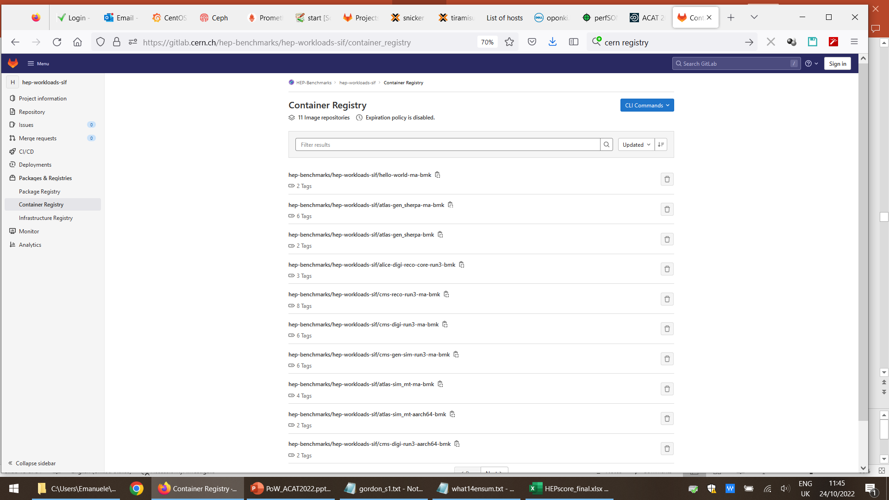
HEP-Score
I started interacting with the HEP-Score Task Force earlier this year, because of mutual interest and partial overlap with my research on power efficiency. In particular:
I have been using the available HEP-Score containers as a standard HEP workload to rate different architectures on power efficiency (which is becoming increasingly important for procurement),
I helped testing HEP-Score containers on our locally available architectures (x86 & arm),
We discussed the option to include power readings in the standard
output of the HEP-Score suite (peak / idle power & integrated
energy consumption for a given workload).
While the full HEP benchmark suite was not yet available for arm, an increasing number of experimental workloads were available as standalone containers
https://gitlab.cern.ch/hep-benchmarks/hep-workloads-sif/container_registry
13
Notes:
HEP-Score task force / HEPiX working group

Slide 14
HEP-Score Containers
HEP-Score containers can run on Singularity (or Docker, which we do not use):
(x86) Singularity-CE 3.9.9-1.el7 (previous version 3.8.7-1.el7 disappeared from EPEL and replaced with AppTainer 1.1.0-1.el7)
(arm) singularity version 3.8.4-1.el7 (still available in EPEL)
Example execution of a containerised HEP-Score job:
$ mkdir –p /tmp/test/results
$ chmod a+rw /tmp/test/
$ singularity run -B /tmp/test:/results oras://registry.cern.ch/hep-workloads/cms-gen-sim-run3-bmk:latest
We used 5 HEP-Score containers from the container_registry:
gitlab-registry.cern.ch/hep-benchmarks/hep-workloads-sif/atlas-sim_mt-ma-bmk:v2.0
gitlab-registry.cern.ch/hep-benchmarks/hep-workloads-sif/atlas-gen_sherpa-ma-bmk:ci-v1.0
gitlab-registry.cern.ch/hep-benchmarks/hep-workloads-sif/cms-reco-run3-ma-bmk:v1.1
gitlab-registry.cern.ch/hep-benchmarks/hep-workloads-sif/cms-digi-run3-ma-bmk:v1.0
gitlab-registry.cern.ch/hep-benchmarks/hep-workloads-sif/cms-gen-sim-run3-ma-bmk:v1.0
ATLAS (2x)
CMS (3x)
Note: the HEP workloads are designed to scale with the number of available threads, therefore power consumption
cannot be directly compared among machines with a different number of cores (/threads), as the machine
with more threads would have done more work …
14
Notes:
HEP-Score containers: https://gitlab.cern.ch/hep-benchmarks/hep-workloads-sif/container_registry
gitlab-registry.cern.ch/hep-benchmarks/hep-workloads-sif/atlas-sim_mt-ma-bmk:v2.0
gitlab-registry.cern.ch/hep-benchmarks/hep-workloads-sif/cms-reco-run3-ma-bmk:v1.1
gitlab-registry.cern.ch/hep-benchmarks/hep-workloads-sif/cms-digi-run3-ma-bmk:v1.0
gitlab-registry.cern.ch/hep-benchmarks/hep-workloads-sif/cms-gen-sim-run3-ma-bmk:v1.0
gitlab-registry.cern.ch/hep-benchmarks/hep-workloads-sif/atlas-gen_sherpa-ma-bmk:ci-v1.0
gitlab-registry.cern.ch/hep-benchmarks/hep-workloads-sif/hello-world-ma-bmk:ci-v1.0

Slide 15
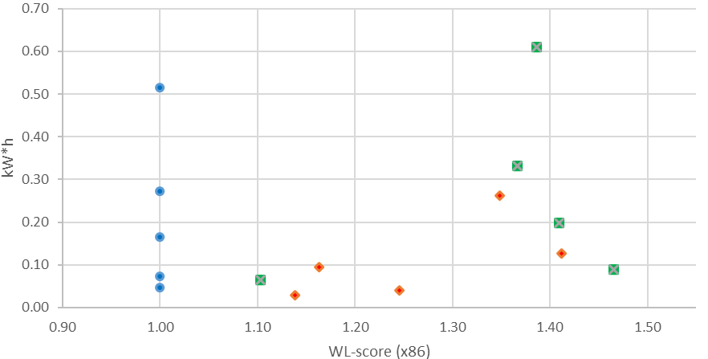
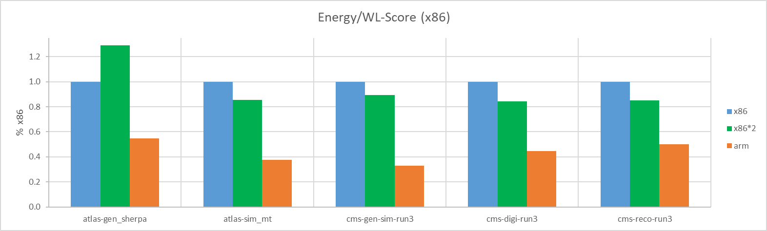
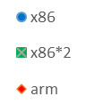
HEP-Score Results
Here the cumulative results of the 5 HEP-Score containers on the 3 machines (x86, x86*2 and arm):
#
#
Arch | Threads | Benchmark | Time (hh:mm:ss) | Energy (kW*h) | RAM max (Gb) | idle (W) | max (W) | WL-Score | WL-Score (wrt x86) | E/WLs (kW*h) | E/WLs (wrt x86)
x86 | 96 | atlas-gen_sherpa | 00:08:21 | 0.04576 | 154.8 | 94 | 390 | 113.3959 | 100.0% | 0.0004 | 100.0%
x86 | 96 | atlas-sim_mt | 01:23:49 | 0.51478 | 54.4 | 82 | 383 | 0.4068 | 100.0% | 1.2655 | 100.0%
x86 | 96 | cms-gen-sim-run3 | 00:44:13 | 0.27235 | 31.3 | 98 | 385 | 3.7347 | 100.0% | 0.0729 | 100.0%
x86 | 96 | cms-digi-run3 | 00:12:31 | 0.07224 | 102.1 | 88 | 392 | 15.0538 | 100.0% | 0.0048 | 100.0%
x86 | 96 | cms-reco-run3 | 00:26:53 | 0.16447 | 119.6 | 86 | 389 | 6.4072 | 100.0% | 0.0257 | 100.0%
x86*2 | 128 | atlas-gen_sherpa | 00:10:11 | 0.06509 | 207.9 | 133 | 488 | 125.0605 | 110.3% | 0.0005 | 129.0%
x86*2 | 128 | atlas-sim_mt | 01:20:58 | 0.6109 | 74.0 | 133 | 473 | 0.5639 | 138.6% | 1.0834 | 85.6%
x86*2 | 128 | cms-gen-sim-run3 | 00:43:14 | 0.3319 | 43.2 | 134 | 477 | 5.1025 | 136.6% | 0.0650 | 89.2%
x86*2 | 128 | cms-digi-run3 | 00:12:41 | 0.08937 | 138.2 | 133 | 494 | 22.0662 | 146.6% | 0.0041 | 84.4%
x86*2 | 128 | cms-reco-run3 | 00:26:03 | 0.19734 | 160.9 | 134 | 483 | 9.0284 | 140.9% | 0.0219 | 85.2%
arm | 80 | atlas-gen_sherpa | 00:06:21 | 0.02856 | 126.4 | 108 | 348 | 129.0706 | 113.8% | 0.0002 | 54.8%
arm | 80 | atlas-sim_mt | 00:56:30 | 0.26156 | 64.1 | 104 | 310 | 0.5486 | 134.9% | 0.4768 | 37.7%
arm | 80 | cms-gen-sim-run3 | 00:26:44 | 0.12691 | 148.8 | 116 | 306 | 5.2721 | 141.2% | 0.0241 | 33.0%
arm | 80 | cms-digi-run3 | 00:09:01 | 0.04008 | 183.9 | 104 | 318 | 18.7561 | 124.6% | 0.0021 | 44.5%
arm | 80 | cms-reco-run3 | 00:20:34 | 0.09574 | 238.0 | 102 | 310 | 7.4504 | 116.3% | 0.0129 | 50.1%
# normalised to x86
bottom right = better (probably)
lower = better
15
Notes:
(note: I re-normalized the scores to make them visible!)

Slide 16
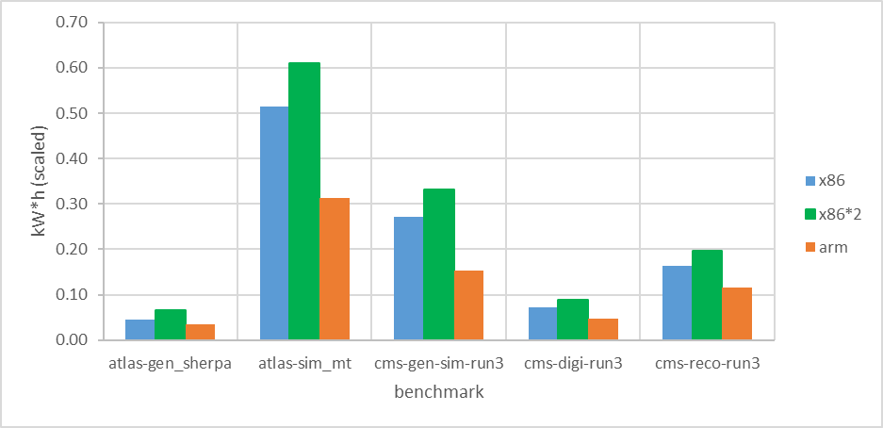
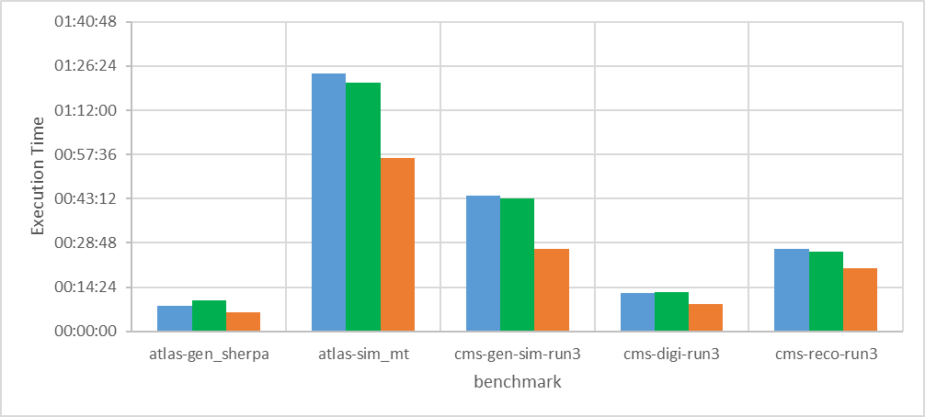
HEP-Score Summary
In conclusion, we compared an arm and x86 processor of very similar specs and almost identical cost.
We found that on average, the arm processor ran ~20% quicker and used ~35% less power per HEP task than the equivalent x86 *
* averages renormalized to the same amount of work (x86 = 1)
Note:
while the HEP-Score geometric average is not yet available (as we did run
standalone containers outside the HEP Benchmarking suite), we struggled
to find an intuitive way to compare the machines …
16
Notes:
Ratios (average)
time (arm/x86): 84.6% → 18.2% faster
energy (arm/x86): 65.6% → 34.4% less energy

Slide 17
Open Issues
Despite the active development within all LHC experiments, support for architectures other than x86 is patchy, at best
…
Same is true for hardware suppliers, at least in our experience: our DELL supplier does not sell any arm server (yet). We ordered it from a small local supplier and it took over 2 months to arrive …
The arm machine seem to score better in speed and energy efficiency, but we never really looked under the hood: e.g., physics output was not validated.
We trust enough our IPMI power readings (± 5%), but we may want a more precise comparison (e.g., by using a metered PDU that allows remote power readings from each plug).
There was no error propagation. We just took the 5% error on IPMI reading as the major source …
All results in this PPT were presented at ACAT last month, and they were a bit rushed due to the delay in the arm server delivery. The next iteration of this study is already ongoing.
17
Notes:
Those I could think about …

Slide 18
Summary & Outlook
This study addressed almost all the limitation that affected of our previous one on power efficiency (ref. GridPP47), as the benchmark were now performed on two almost identical servers installed locally in a closely controlled environment.
In almost all benchmarking tests, we see that for the same price arm architecture gives better performance in term of speed and power efficiency.
We also see that our arm server has a higher energy consumption in its idle state than its x86 counterpart, which makes I/O bound operations slightly less power efficient.
We wish to continue this study by performing a better estimate of all sources of errors, and by doing some sort of validation of the jobs output - to guarantee that the better performance does not come at the cost of a lower accuracy.
We also wish to extend our set of benchmark to GPUs. We already have some hardware available …
18
Notes:
summary

Slide 19
Thanks.
Dr. Emanuele Simili HEPiX Benchmarking Working Group 15 November 2022
Notes:
☺

Slide 20
Exporter Script
TimeStamp: date +"%F , %T"
CPU: top -bn1 | grep "Cpu(s)" | sed "s/.*, *\([0-9.]*\)%* id.*/\1/" | awk '{print 100 - $1}'
RAM: free -t | awk 'FNR == 2 {printf("%.2f"), $3/$2*100}'
GPU: nvidia-smi --query-gpu=power.draw --format=csv,noheader,nounits | awk '{s+=$1} END {print s}’
Power (IPMI): ipmitool dcmi power reading | grep "Instantaneous power reading:"
Notes:
BASH commands to gather the various metrics

Slide 21
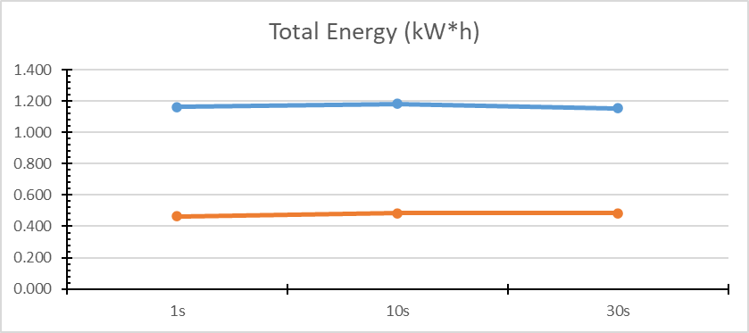
Sampling Frequency
Check that the sampling frequency we chose does not affect the integrated Energy consumption
(the effect is less than 2%).
Prime Number sieve (1 to 100M) using compiled C code with OMP (gcc version 4.8.5 20150623)
IPMI sampling interval = 1sec , 10sec, 30sec
Job | Sampling | threads | Time (s) | Time (h) | Tot. Energy (kW*h) | Peak Power (W) | Idle (W)
x86 | 1s | 96 | 10982 | 03:03:02 | 1.162 | 402.0 | 90.9
 | 10s | 96 | 11002 | 03:03:22 | 1.183 | 402.0 | 84.0
 | 30s | 96 | 11017 | 03:03:37 | 1.154 | 391.0 | 85.5
arm | 1s | 80 | 8259 | 02:17:39 | 0.465 | 215.0 | 103.9
 | 10s | 80 | 8229 | 02:17:09 | 0.483 | 215.0 | 104.5
 | 30s | 80 | 8229 | 02:17:09 | 0.485 | 220.0 | 100.5
dE (x86) | 0.0123 | 1.1%
dE (arm) | 0.0087 | 1.8%
Notes:
IPMI sampling …

Slide 22
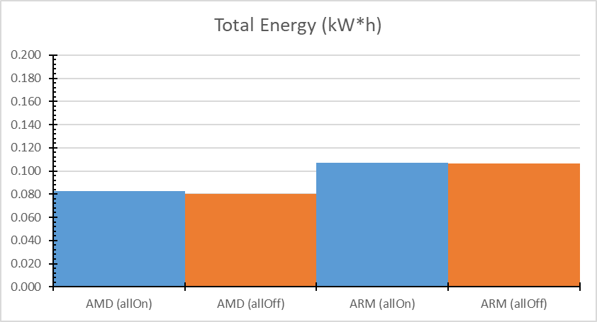
Exporters Effect
Check that the active exporters (node_exporter, PromTail, Pakiti) do not add extra power consumption.
(the effect seems to be about 2% … but it would be better to gather more samples)
Notes:
Exporters …

Slide 23
CPU throttling
Following the suggestions in Rod’s PPT, we tried to run the ATLAS load at different CPU frequencies …
(the goal is to reduce the electricity usage over peak hours, while also not killing jobs)
$ sudo cpupower frequency-set -g performance # conservative # powersave
$ cpupower frequency-info --> current CPU frequency: 2.60 GHz (asserted by call to kernel)
$ nohup ./getStartA.sh &
arm
x86
Running at lower clock speed saves some power (not much) at the expenses of a longer execution time (almost twice on the x86, less on the ARM). There isn't much difference between 'performance' and 'conservative' because the frequency scales up to MAX as soon as the job starts.
new
Notes:
Voluntary Load-shedding During Peaks (by Rodney Walker)
https://indico.cern.ch/event/1162261/contributions/5117873/

Slide 24
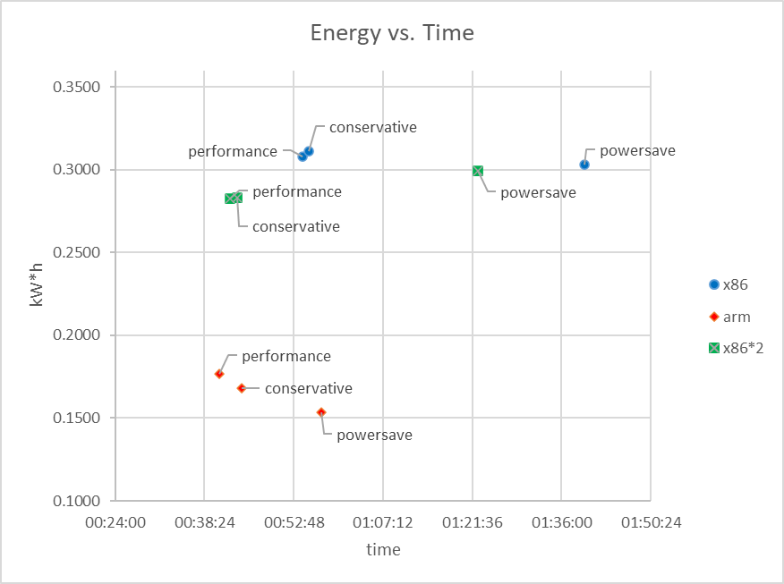
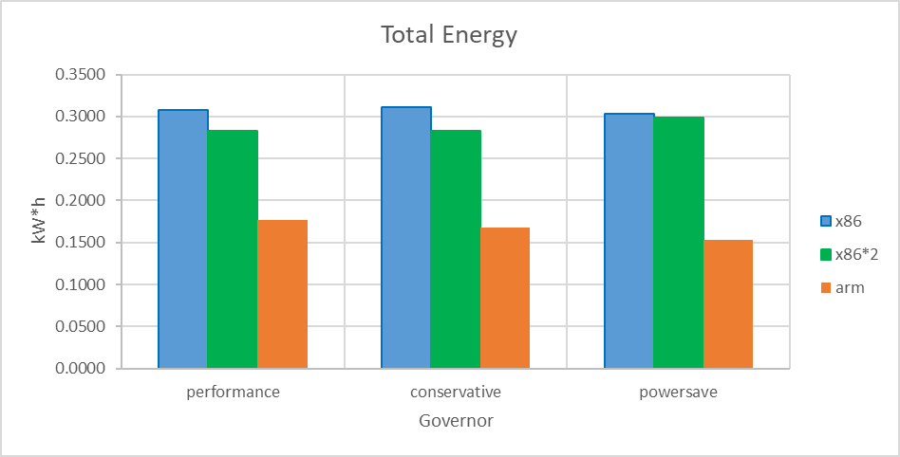
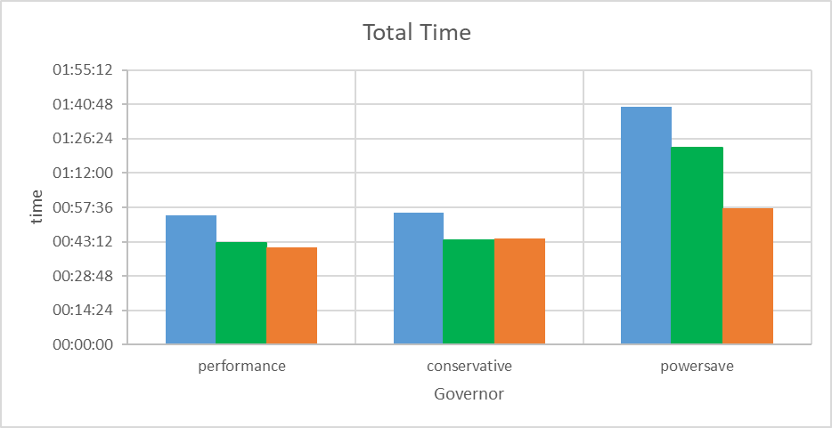
CPU throttling
Here the execution time and integrated energy consumption from the 3 machine considered, with the 3 different Governor settings:
Arch | Threads | Governor | Freequency (GHz) | N. events | Time (h) | Energy(kW*h) | idle(W) | max(W) | W*h/event
x86 | 96 | performance | 2.30 | 1'000 | 00:54:13 | 0.3077 | 85 | 381 | 0.000310
x86 | 96 | conservative | 1.50 - 2.30 | 1'000 | 00:55:15 | 0.3114 | 92 | 381 | 0.000174
x86 | 96 | powersave | 1.50 | 1'000 | 01:39:46 | 0.3029 | 90 | 195 | 0.000170
x86*2 | 128 | performance | 2.60 | 1'000 | 00:42:32 | 0.2827 | 134 | 464 | 0.000181
x86*2 | 128 | conservative | 1.50 - 2.60 | 1'000 | 00:43:44 | 0.2828 | 138 | 462 | 0.000175
x86*2 | 128 | powersave | 1.50 | 1'000 | 01:22:34 | 0.2991 | 130 | 247 | 0.000280
arm | 80 | performance | 3.00 | 1'000 | 00:40:47 | 0.1766 | 102 | 311 | 0.000282
arm | 80 | conservative | 2.00 - 3.00 | 1'000 | 00:44:29 | 0.1681 | 107 | 307 | 0.000283
arm | 80 | powersave | 2.00 | 1'000 | 00:57:20 | 0.1536 | 98 | 179 | 0.000281
new
Notes:
Add-on: CPU throttling
x86_performance (2.30 GHz): time = 3253 sec. , Energy = 0.30766 kWh
x86_conservative (1.50 - 2.30 GHz): time = 3315 sec. , Energy = 0.31141 kWh
x86_powersave (1.50 GHz): time = 5986 sec. , Energy = 0.30293 kWh
arm_performance (3.00 GHz): time = 2447 sec. , Energy = 0.17663 kWh
arm_conservative (2.00 - 3.00 GHz): time = 2669 sec. , Energy = 0.16813 kWh
arm_powersave (2.00 GHz): time = 3440 sec. , Energy = 0.15362 kWh
x86*2_performance (2.60 GHz): time = 2552 sec. , Energy = 0.28265 kWh
x86*2_conservative (1.50 - 2.60 GHz): time = 2624 sec. , Energy = 0.28279 kWh
x86*2_powersave (1.50 GHz): time = 4954 sec. , Energy = 0.29909 kWh

