Slide 1
mPMT Electronics Poland
K. Dygnarowicz
WCTE, 2022-07-21

Slide 2
Hardware Status
HV status
  Few modifications by INFN related to part availability
  Arrived (1500 pcs.); remaining 500 pcs. Possible for Oct/Dec 2022.
Automated HV tester
  Design ready, components purchased, expecting commissioning in August
  Firmware is partially written (for STM32 on Nucleo boards)
FE status
  Schematic and layout complete, Parts ordered and confirmed, PCB for Prototype delivery this week.
  Critical parts purchased for 620 pcs.
  Delayed MCU delivery for remaining 1400 pcs. (was Sept. 2022, now June 2023)
  Firmware complete
    Some fixes related to debugging comm issues with Rev. 1 mainboard
Mainboard status
  Two mainboards in Poland to taking data
  Additional information by M. Nurek
  Remote access to the board is working

Slide 3
MCC status
M. Suchenek
Hardware:
we finished the specification describing the MCC elements and their connection with each other
https://docs.google.com/document/d/1MGmCEbf3xMTG_4EMxsDc7Y85fvLZdGxe/edit
- we are currently working on the electrical diagram and PCB
Software:
- the main function of MCC will be to transfer data between ports, similar to Ethernet hub or switch
- hardware development board will test 2 connections of mPMT to one aggregation. Prototype, 2 to 1 communication, two mPMT "input ports" to one data aggregation "output port" (these are not exactly inputs/outputs - communication is two-way).
- like in an ethernet hub or switch, data from mPMT 1 and 2 goes to the aggregation port, and data from the hub to both mPMT 1 and 2 as in an ethernet hub.
we purchased ethernet phy, a development board ready to use + a typical board with FPGA
adding more mPMT channels will be a copy of the second mPMT

Slide 4
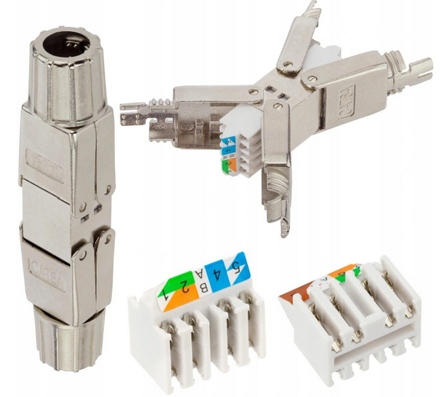
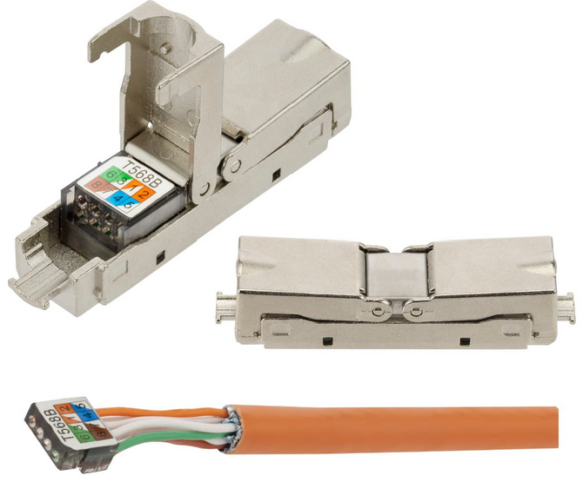
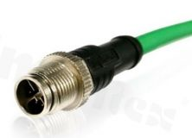
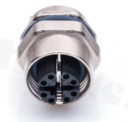
Cable and Connectors
Underwater cable:
  We have a project and quotation for 9.2 mm CAT 6A S/FTP with an HDPE High-Density Polyethylene, We have a sample to do a soak test Benjamin will provide results
  VIIT presented the solution of bending radius of cable (L shape) – can stay on a current project of cable.
  We have to order cable in the first week of August.
Ribbon cables to PMTs:
  Ribbon cable 15 rolls of 300ft was ordered with a specified length between twisted and flat sections (13’’ repeat and 1,5’’ flat) – delayed September
  Micro-Match connectors, 2k female, 4k male (both delivered)
Connection to the mainboard and at feed-through
  Want to avoid RJ45
  Options:
    DIGITUS connector (approx. 8 USD)
      Got samples – not sure if it is fine
    Neku (approx. 12 USD)
      Possibly fine, but not detachable
    M12 X-code connector (approx. 35 USD) - recommended
      Tested and believe that it will work OK
      Assembly requires more work
DIGITUS
NEKU
M12 X-CODE

Slide 5
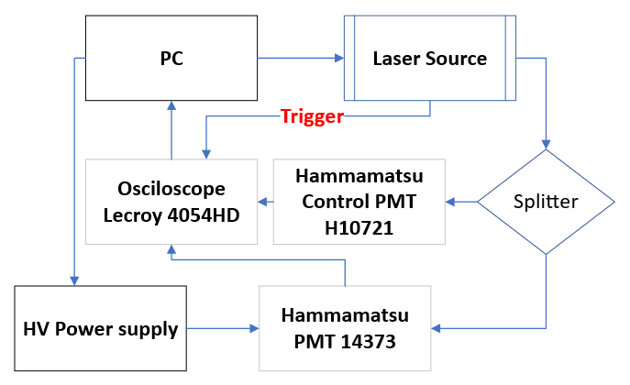
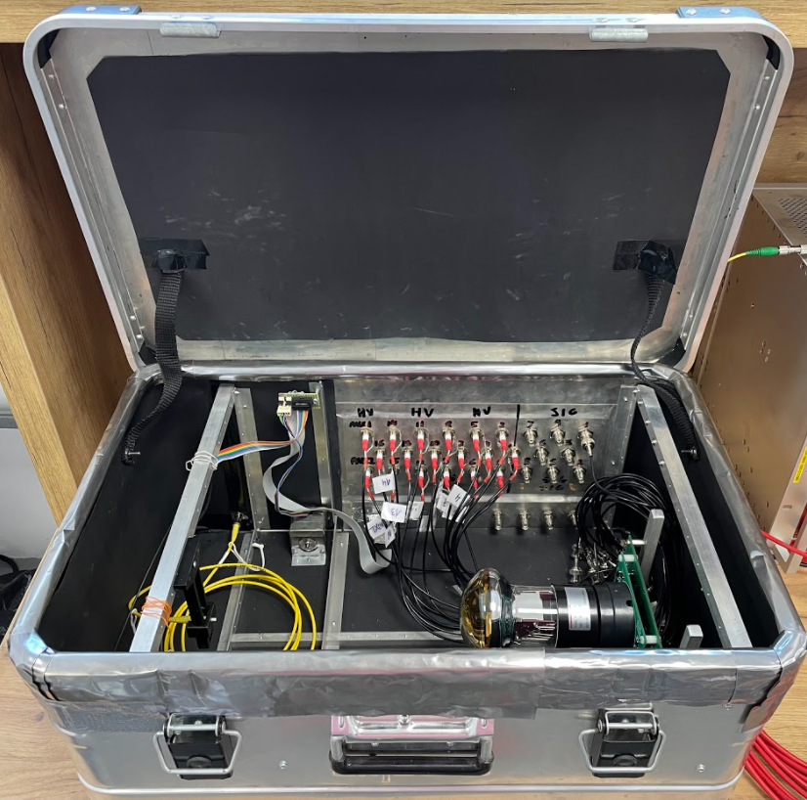
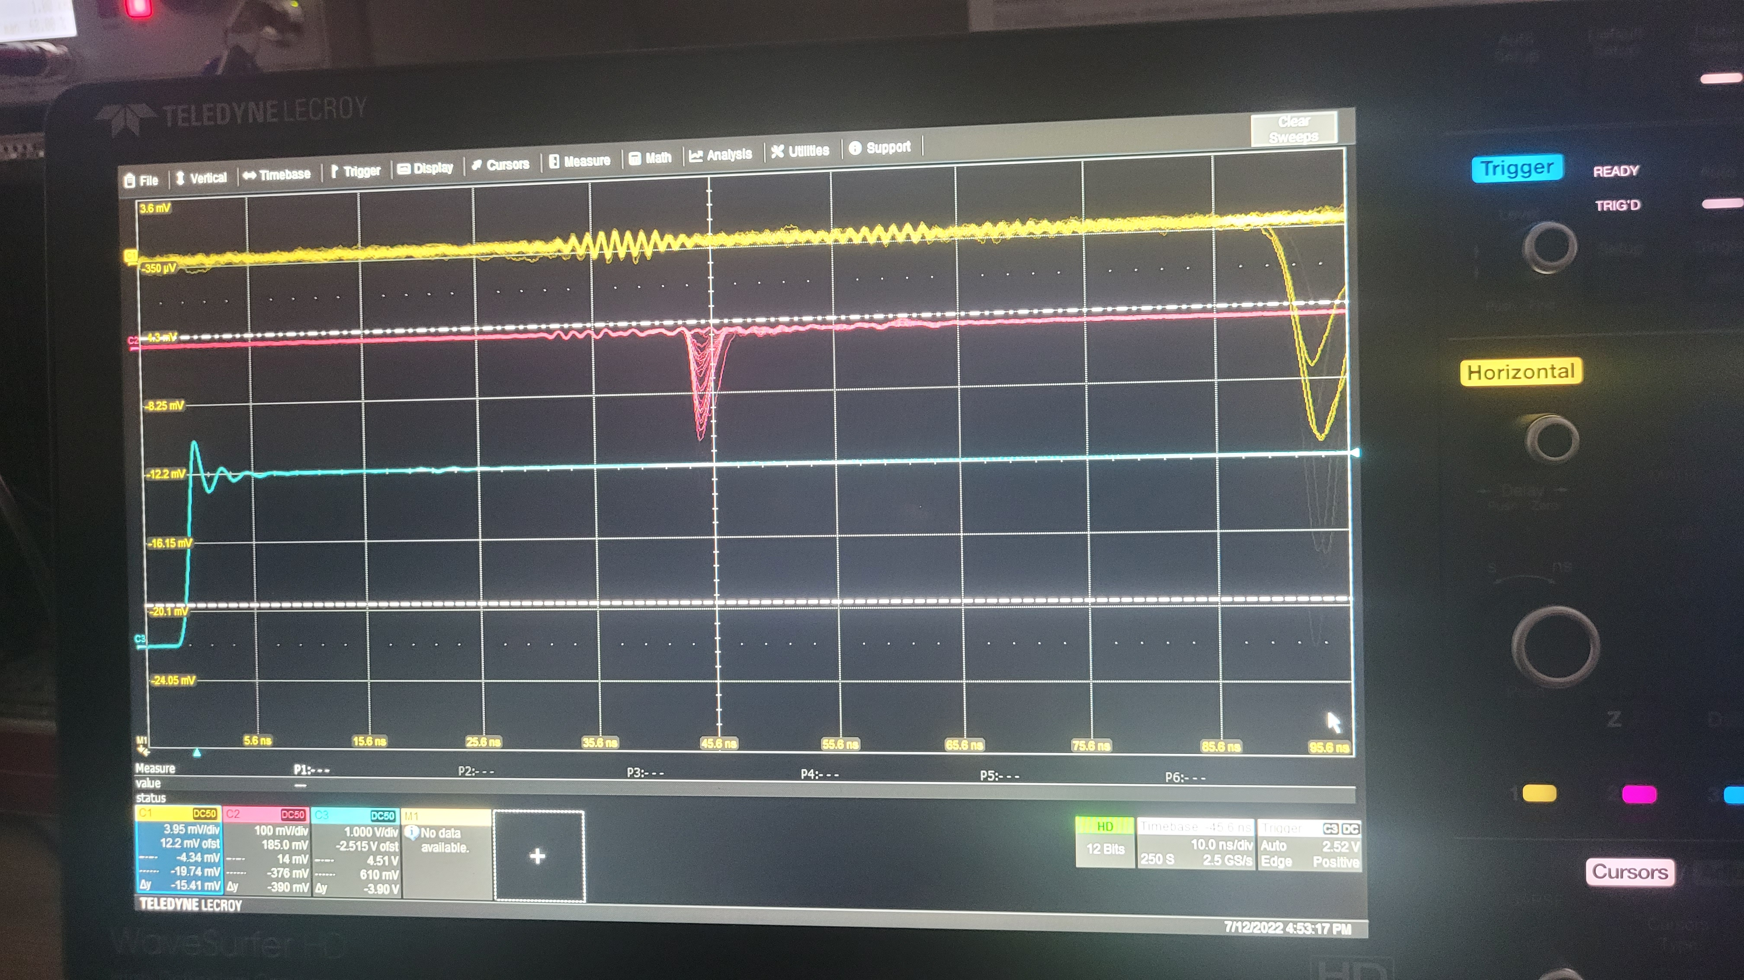
PMT characterization setup

Slide 6
Purpose of analysis
Shape of pulse rise time, fall time, FWHM
Use correlation analysis to extract a model of pulses
Need 1 PE pulse to check gain dependency on voltage
We need to determine what are the pulse shape parameters
  simulate analog filters with Laplace inverted transform (finalize shaping)
  Check if shape is constant (possibility to determine timing using matched filtering)

Slide 7
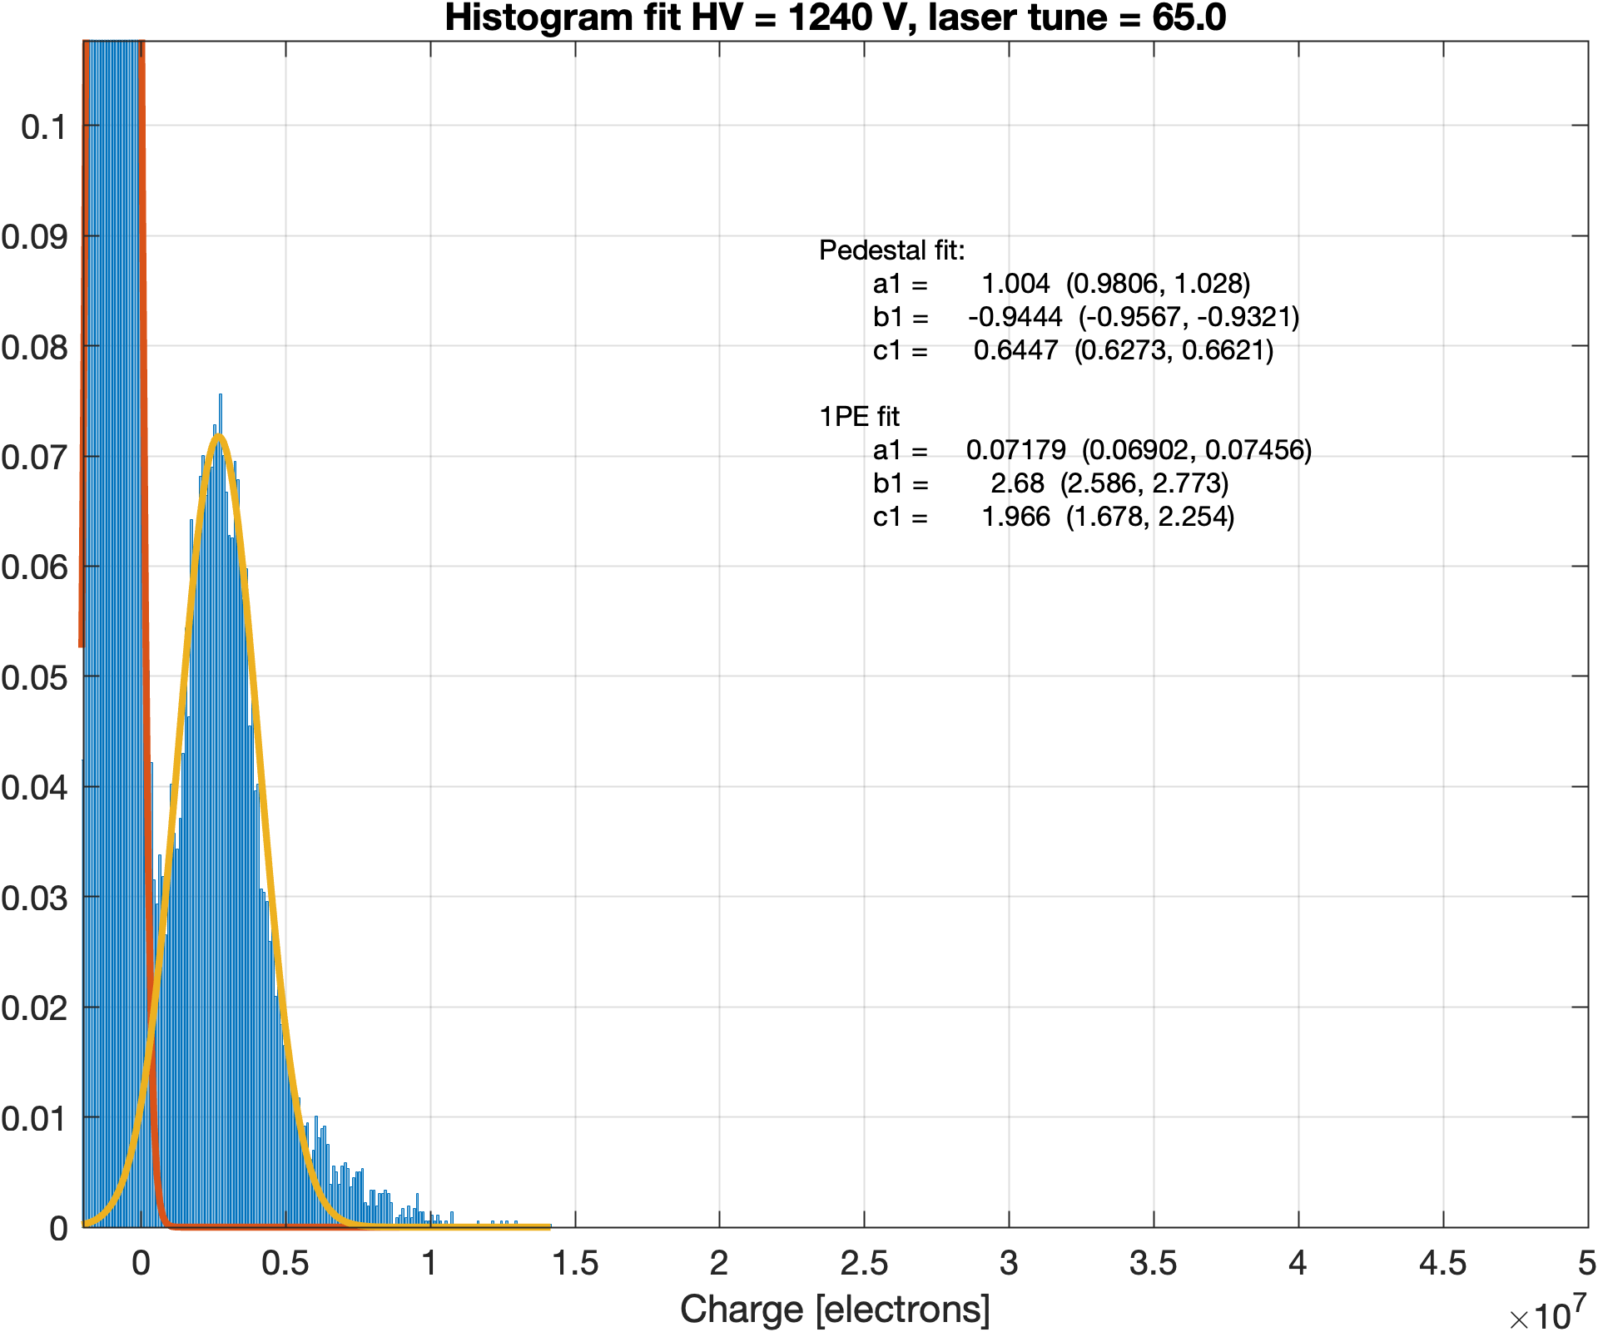
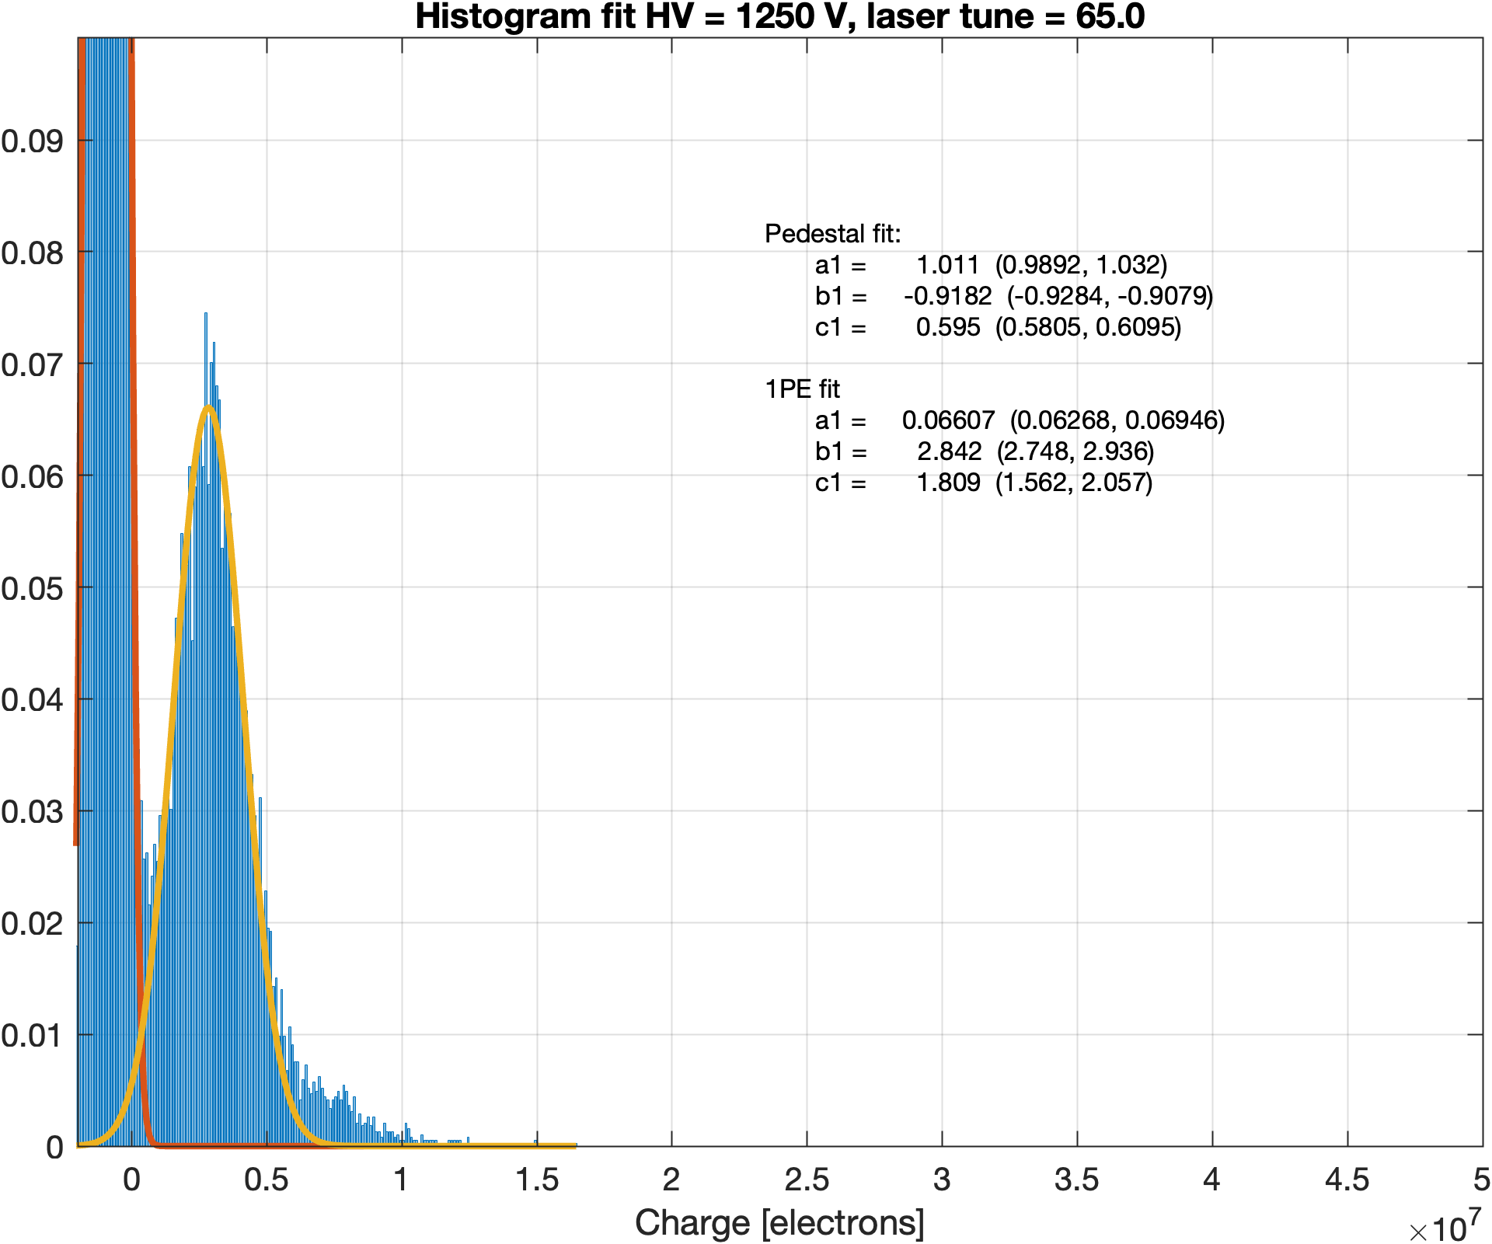
Pulse analysis – histograms of charge

Slide 8
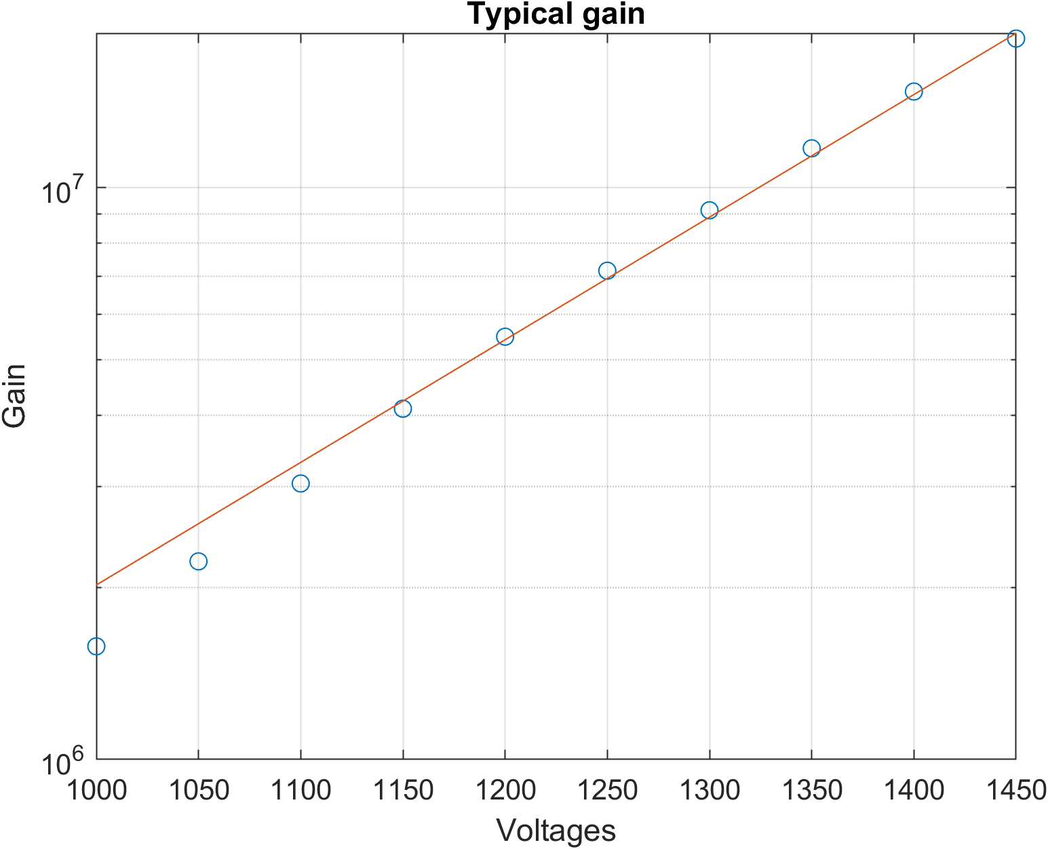
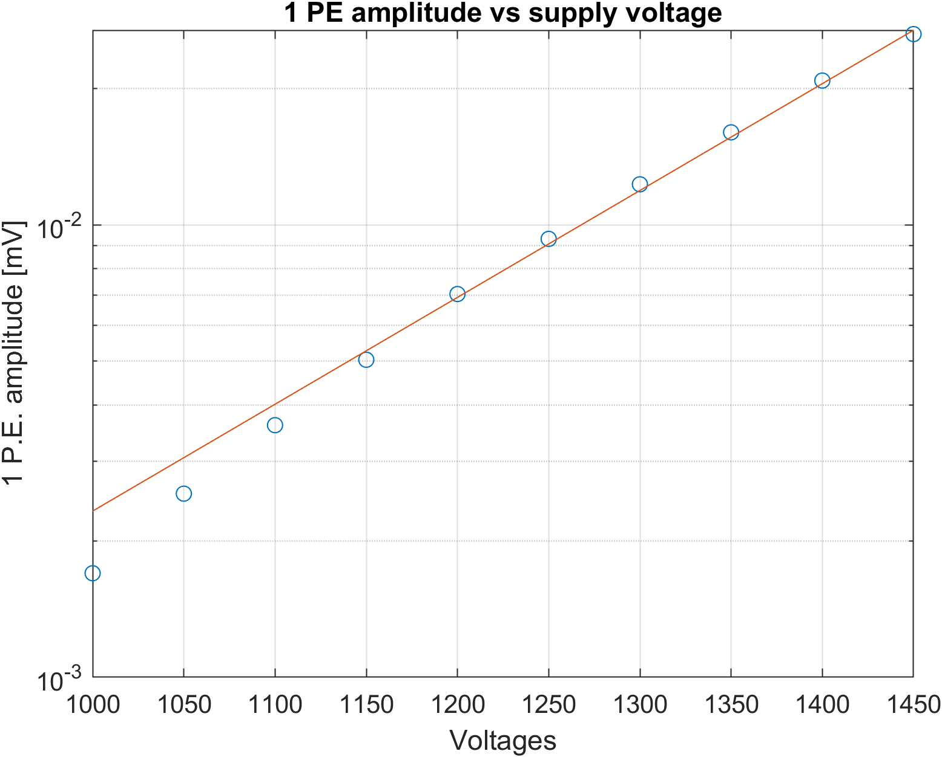
Measured PMT performance

Slide 9
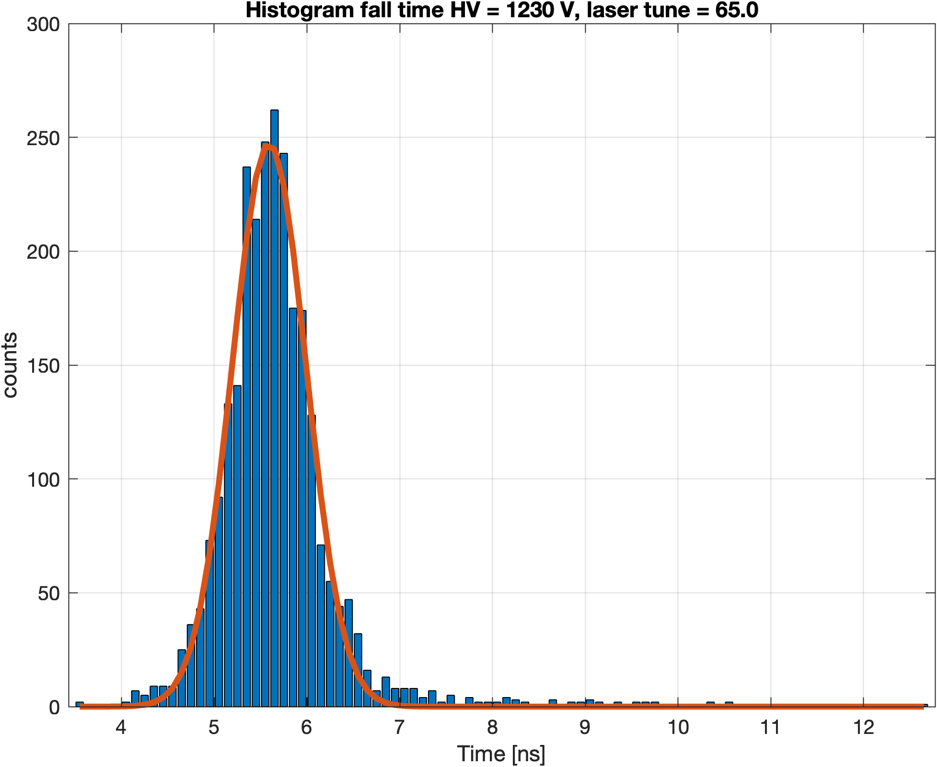
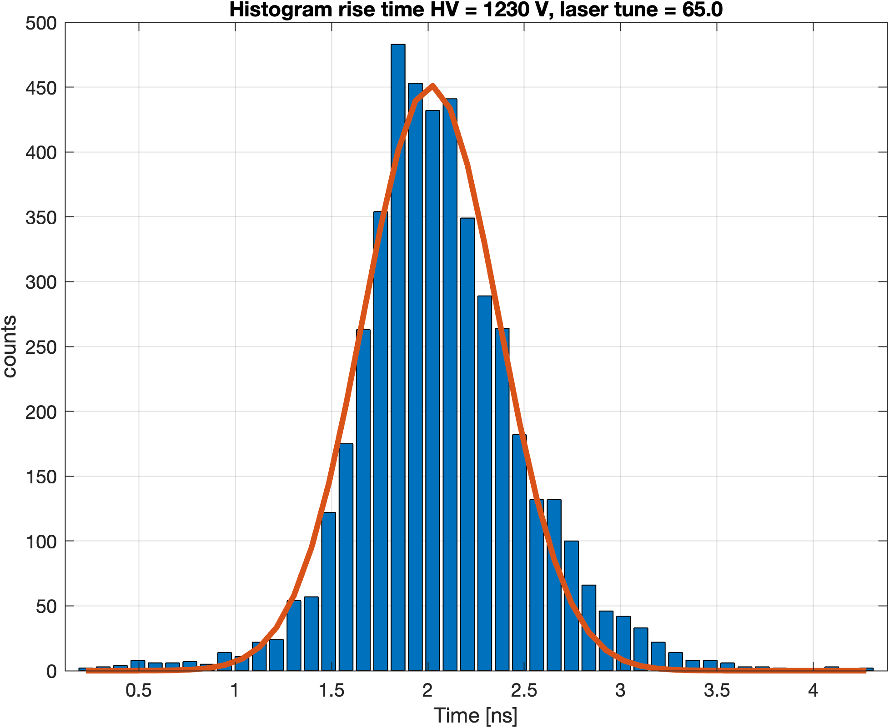
Pulse shape parameters
Rise Time
FWHM 1.3267
mean 5.591
RMS 0.2817
Parameters seem steady for now – need additional data and measurements
Rise Time
FWHM 0.7882
mean 2.514
RMS 0.3941
Rise Time
FWHM 1.1687
mean 2.016
RMS 0.2482

Slide 10
Pulse shape vs HV

Slide 11
Summary
Need to decide on connector. Recommend M12.
  Price manageable, allows for disconnecting
Flat cable ordered; underwater cable to be ordered soon.
HV boards
  Arrived 1500 pcs. for WCTE; Automated tester soon to be commissioned.
  Additional circuits possible in Oct-Dec.
FE boards
  Schematic done – now in final checks; first prototype arriving next week
  Can manufacture 620 pcs. MCU delivery for the remaining pieces delayed till June 2023.
General comment: struggling with component availability.
Need an additional analysis of Pulses – for now, we see we can use pulse correlation techniques

Slide 12
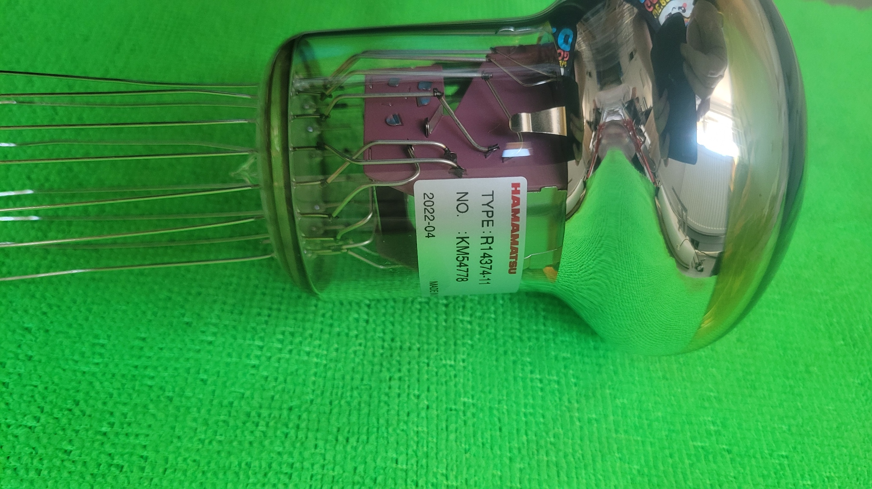
Backups

Slide 13
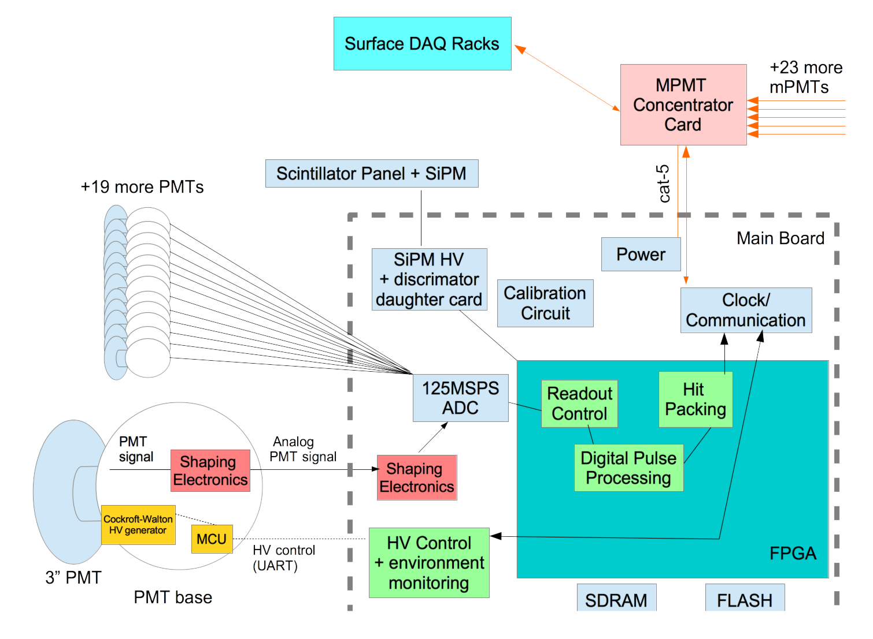
Reminder
MCC
+11 more multi-PMTs
Design based on commercial
components
Good reliability
Target power limit: 10W
Dynamic range: 100 p.e.
Self triggering system
Dead-time free system
Use waveform digitizer:
  Separate hits from
  different bunches
  Ideally separate pulse
  pile-up in the same bunch
Use concentrator modules
for multi-PMTs, to have
architecture similar to the
far detector
Maintain performance of the photo-sensor
On-the-fly feature extraction and estimation of the quality of the estimates;
if unsatisfactory, compress waveform and send full buffer to the DAQ
+18 more PMTs
Cat-6
Underwater cable + connection
Inside the multi-PMT vessel
Twisted pair flat cable
Single ended to differential
(differential)
Cockcroft-Walton generator
(MODBUS)
HV
FE
Mainboard
Notes:
Bunch timing T2K – interval: 560 ns, bunch width: approx. 60 ns

Slide 14
mPMT Mainboard
Timing Resolution vs. PMT Gain
Fully working readout of all ADCs using the
rev-1 Xilinx mainboard.
Readout of Xilinx FPGA junction temperature sensor
  Currently sitting around 75-80C. Within specs, but would be nice to try to reduce that temperature (better reliability)
Have started measurements of timing resolution to help finalize shaping circuit and dynamic
range
Currently doing tests with
circuit with op-amp gain=4.
Will do tests with another op-amp
gains in order to disentangle
intrinsic PMT dependence of TTS
on gain vs worsening TTS because
of signal to noise ratio.
FWHM_{time} (ns)

Slide 15
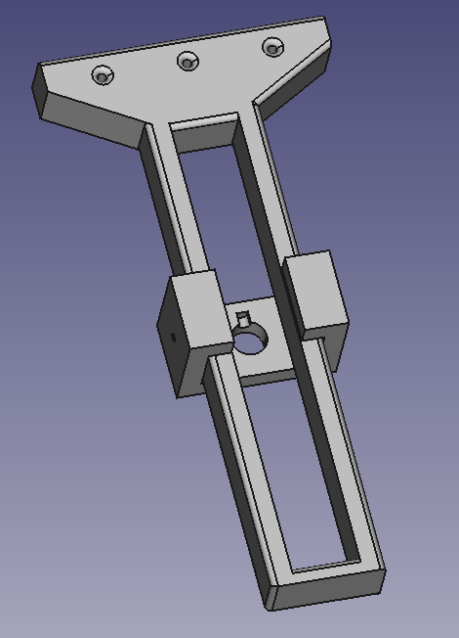
PMT characterisation - setup
HV connections
Box covered with mumetal foil
Photomultiplier
Optical fiber
Optical fiber holder
Notes:
Special designed optical fiber holder to adjust vertical level of laser. box covered with mumetal foil to minimize magnetic field inside the box.

Slide 17
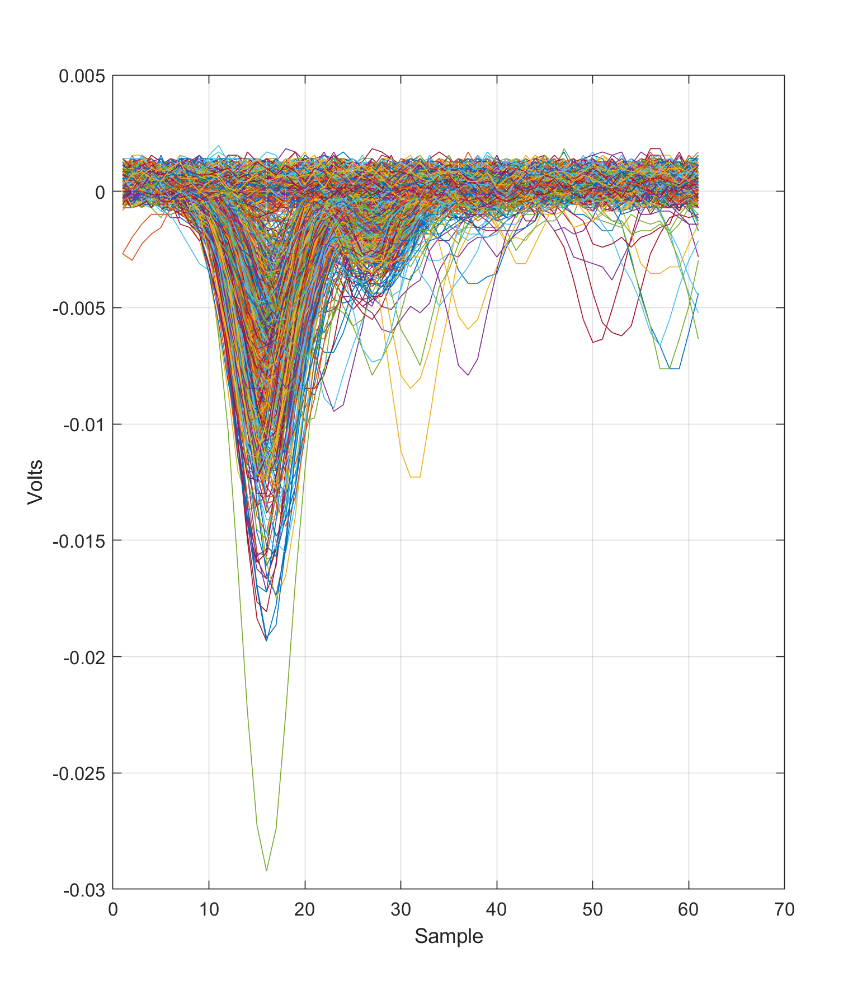
1230V laser tune 65

Slide 18
Pulse shape vs from HV

Slide 19
FWHM
Coefficients
p1 = -0.0005742 (-0.0006794, -0.0004691)
p2 = 3.216 (3.087, 3.346)
Goodness of fit:
SSE: 0.005589
R-square: 0.8057
Adjusted R-square: 0.7992
RMSE: 0.01365

Slide 20
Fall time
Coefficients
p1 = -0.001186 (-0.00132, -0.001052)
p2 = 7.041 (6.876, 7.205)
Goodness of fit:
SSE: 0.009046
R-square: 0.9161
Adjusted R-square: 0.9133
RMSE: 0.01736
Pojedyncze punkty x error barami

Slide 21
Rise Time
Coefficients
p1 = -0.001508 (-0.001736, -0.00128)
p2 = 3.884 (3.603, 4.165)
Goodness of fit:
SSE: 0.02631
R-square: 0.8587
Adjusted R-square: 0.854
RMSE: 0.02962

