Slide 1
Moving system WCTE
Erik Richards

Slide 2
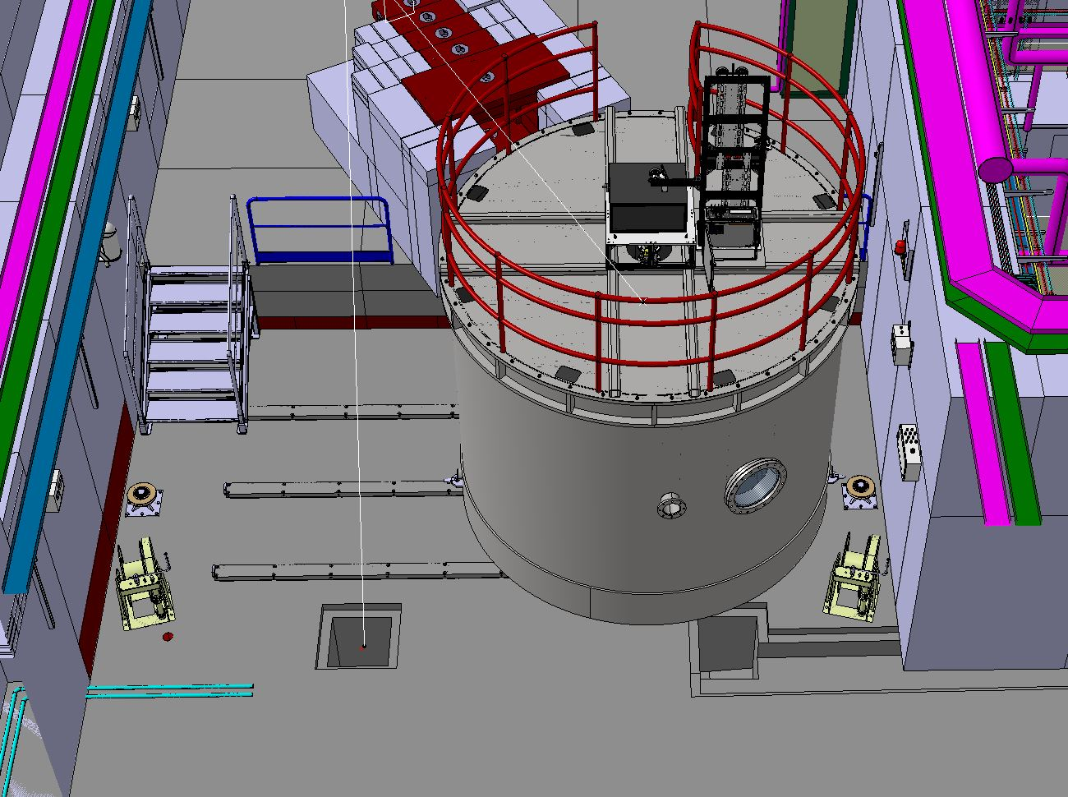
System overview
Pulley
RAILS
Cable
Manual winch

Slide 3
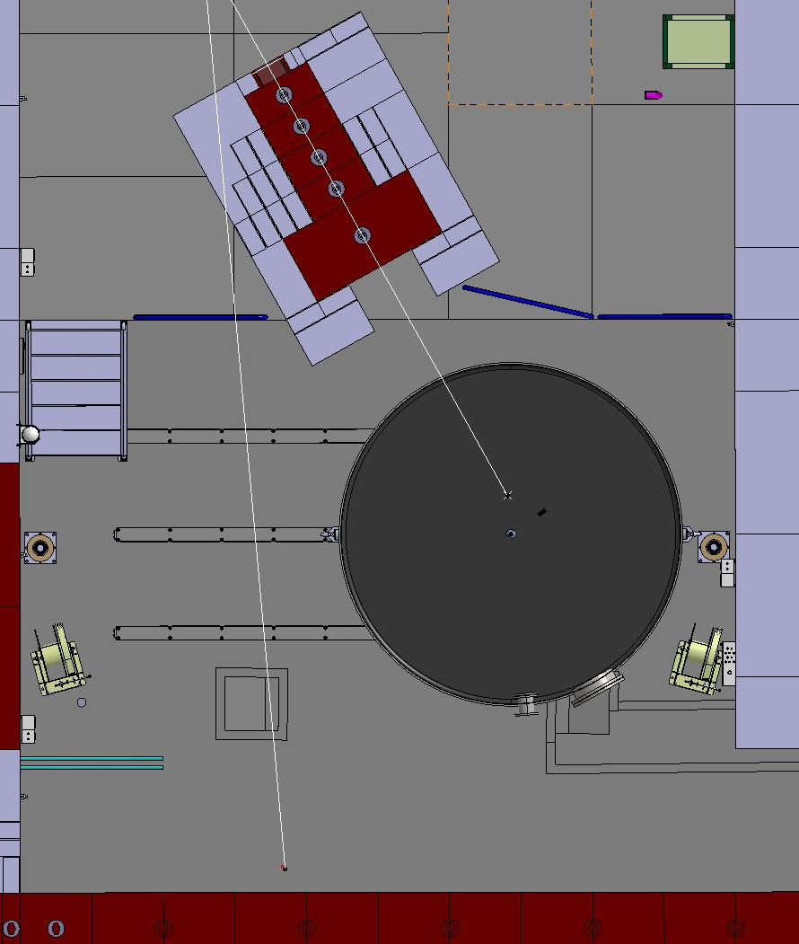
Top view

Slide 4
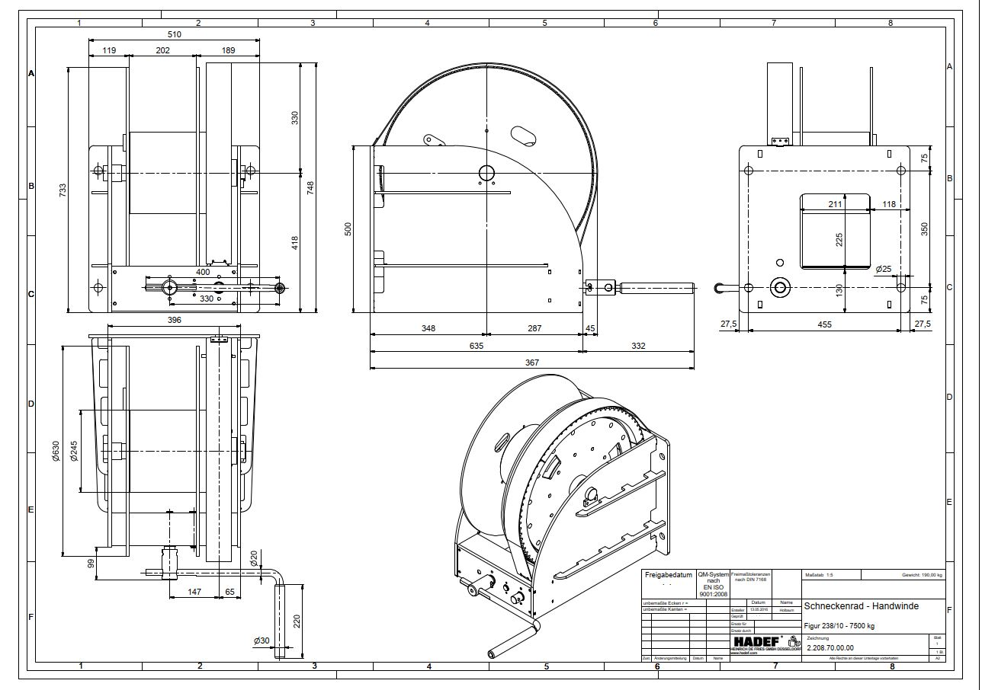

7500kg manual winch

Slide 5
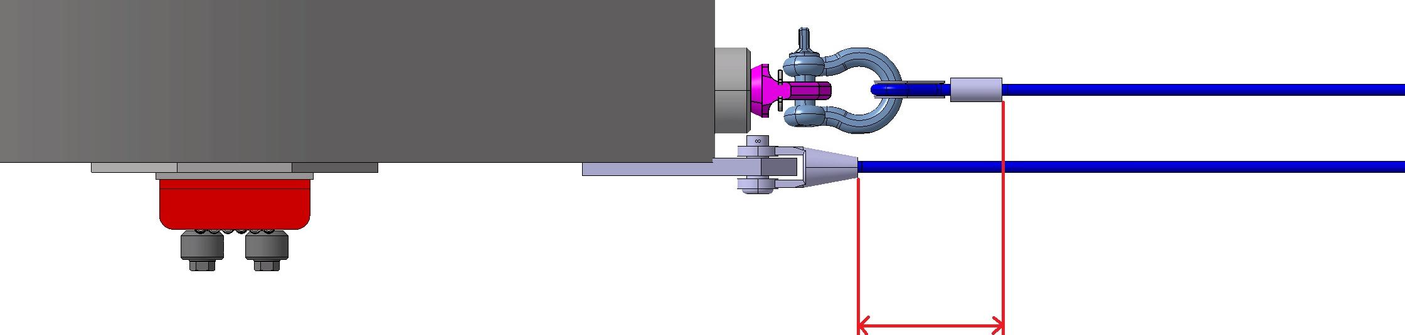
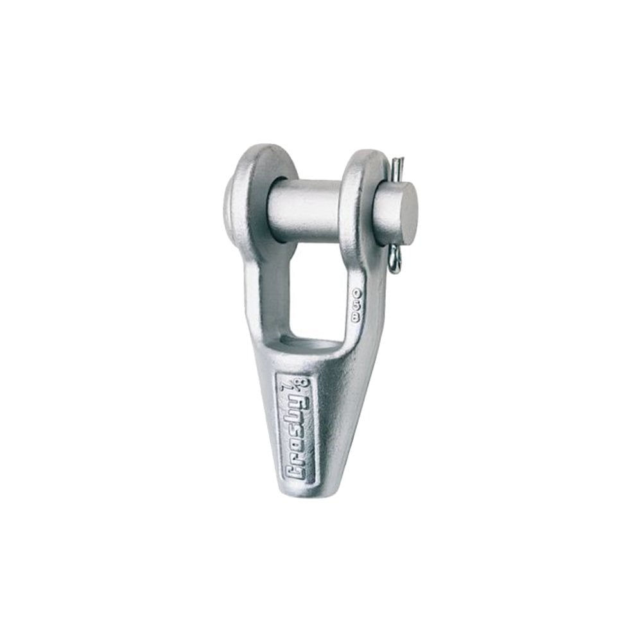
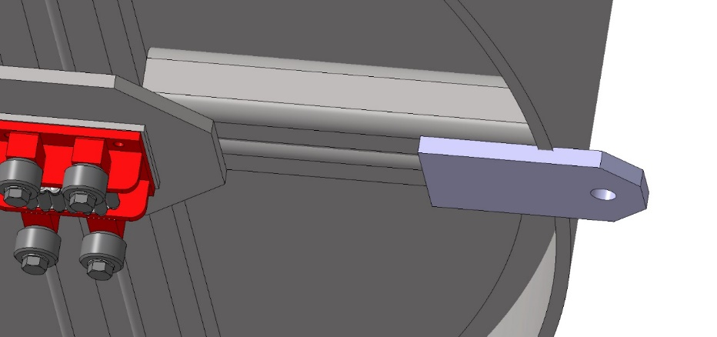
Cable ends
Due to the minimum pulley size 320mm and the available space we need to change the pulling points. The lifting ring plus a shackle plus a classic thimble cable end will not fit. It needs to be changed to a simple plate with a hole and an open swaged socket cable end.

Slide 6
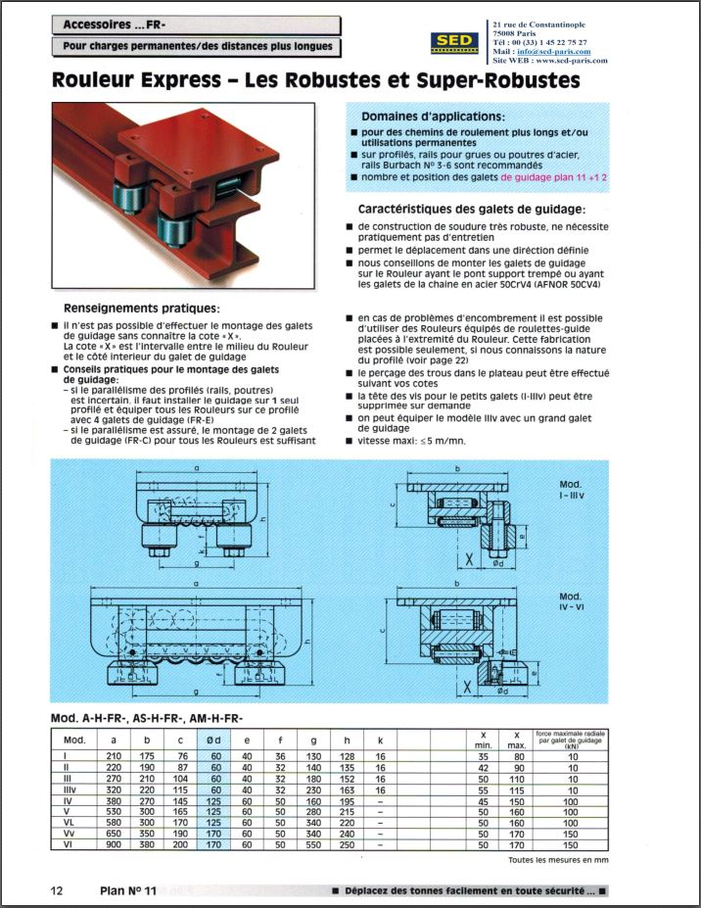
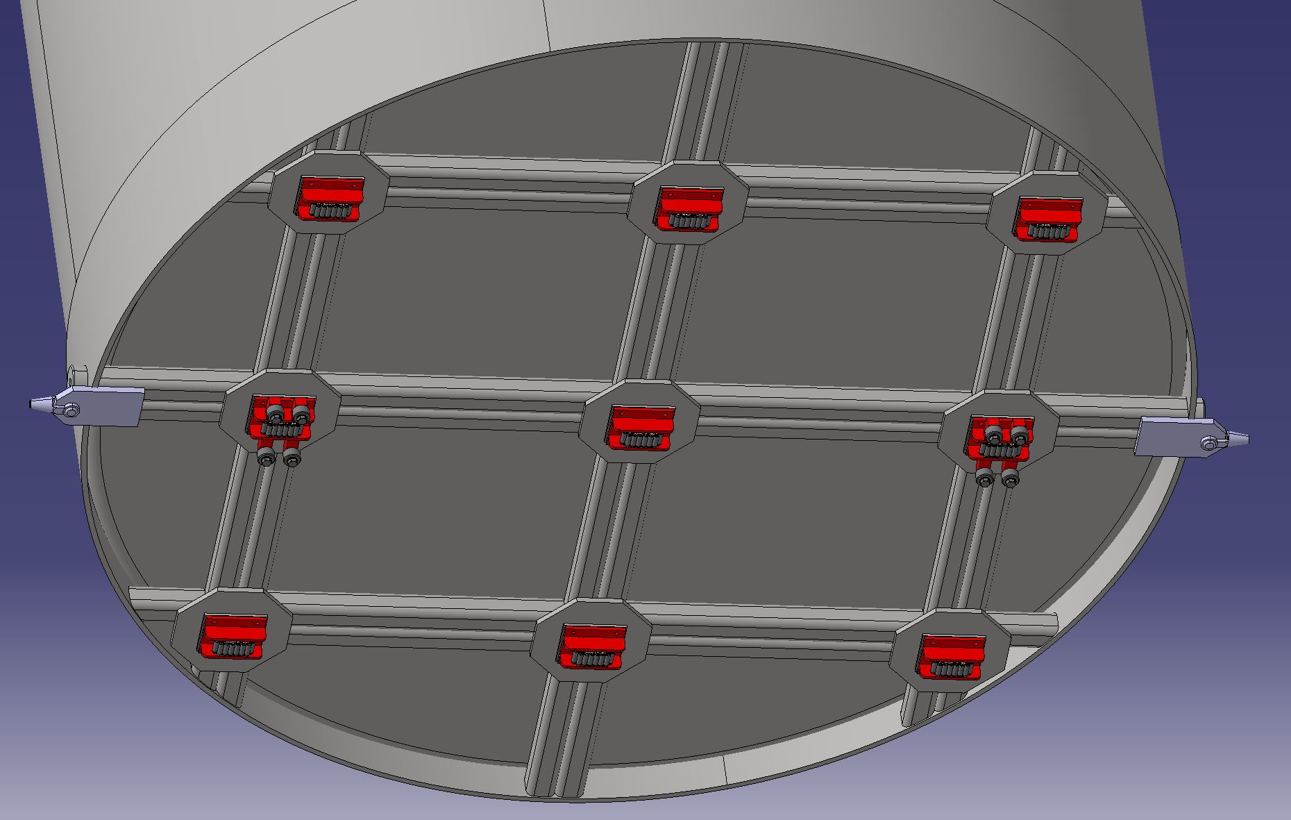
Rollers
2 rollers are guided

