Slide 1

SLHC-PP Reporting
Periodic Report for Period 3
Final Report
Project Closing
Mar Capeans
CERN
SLHC-PP Annual Meeting - Saclay, FR, February 2011

Slide 2
Periodic Report 3
The Periodic Report 3 format is identical to previous years, thus we will follow the same strategy:
  WP leaders and/or PL provide text for the Technical Progress sections
  Contributions are collected by:
    Text from Accelerator WPs (2,6,7): C.Noels
    Text from Detector WPs (3,4,8): K.Ross
  Financials are collected via FORCE (EC IT tool) + Templates for Explanation of Use of Resources
  Collected by: M.Capeans
ALL INFORMATION HAS ALSO TO BE UPLOADED IN THE EC IT TOOL by the Coordinator http://ec.europa.eu/research/participants/portal/appmanager/participants/portal

Slide 3
Periodic Report 3, Sections
 | Chapter | Responsible | Pages
1 | Publishable Summary | R.Garoby | 4
2 | Project objectives for the period | R.Garoby | 2
3 | Work progress and achievements during the period 3.1 Progress within the individual work packages (Summary of progress, Significant results, Deviations from Annex I, Reasons for non achieved objectives, Statement use or resources and deviations, Corrective actions) 3.2 Overall personnel effort in Period 2 | WP leaders M.Capeans | 12
4 | Deliverables and milestones tables | K.Ross | TABLES
5 | Project management Management of the Consortium, Problems occurred, Changes List of meetings and publications Project planning, Impact of deviations in miles. & deliv | M.Capeans WP leaders R.Garoby | 6
6 | Explanation of the use of the resources | M.Capeans | TABLES
7 | Financial statements – Form C and Summary financial report | M.Capeans | FORCE
8 | Certificates of Financial Statements as EC contribution > 375 kE | CERN CEA-SAclay
Templates
T
E
X
T
Templates
Templates
F
I
N

Slide 4
Deadlines
Deadline for Submission: + 60 days after end of Period 3 (May 31st 2011)
Resp. | Action | Date
WP leaders | Text sent to: K.Ross (WP3,4,8) C.Noels (WP2,6,7) | 22.4
K.Ross | Periodic Report Draft 1 available for comments | 2.5
K.Ross | Final Draft sent to all SLHC-PP members | 19.5
Resp. | Action | Date
Mar | Send Table of Personnel Resources to each Institute | 8.4
Partners | Draft Financial Information Form C in FORCE Tables of Explanation of Use of Resources* sent to Mar | 25.4
Mar | Feedback on Financial info to Partners | 27.4
Partners | FINAL FORM C in FORCE 2 originals signed and sent to Mar | 16.5
Mar | Consolidation of Finances | 19.5
M.Capeans | Submission of Periodic Report to EC | 23.5

Slide 5
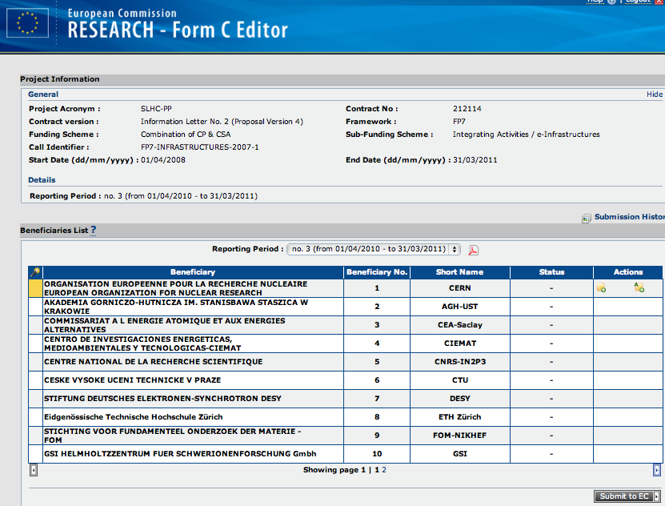
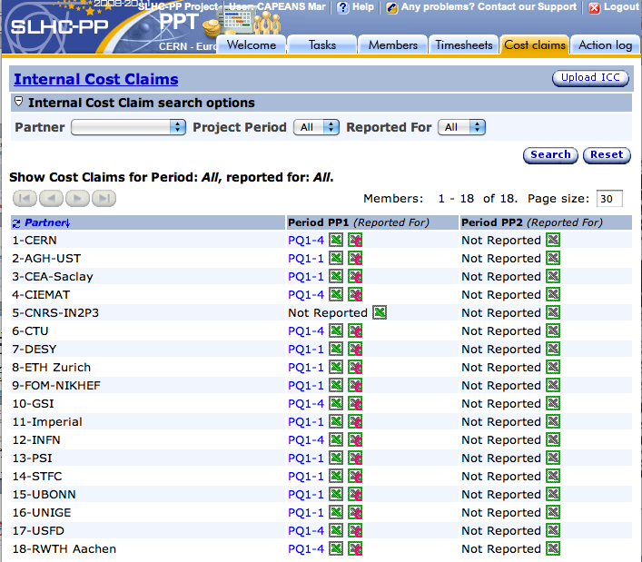
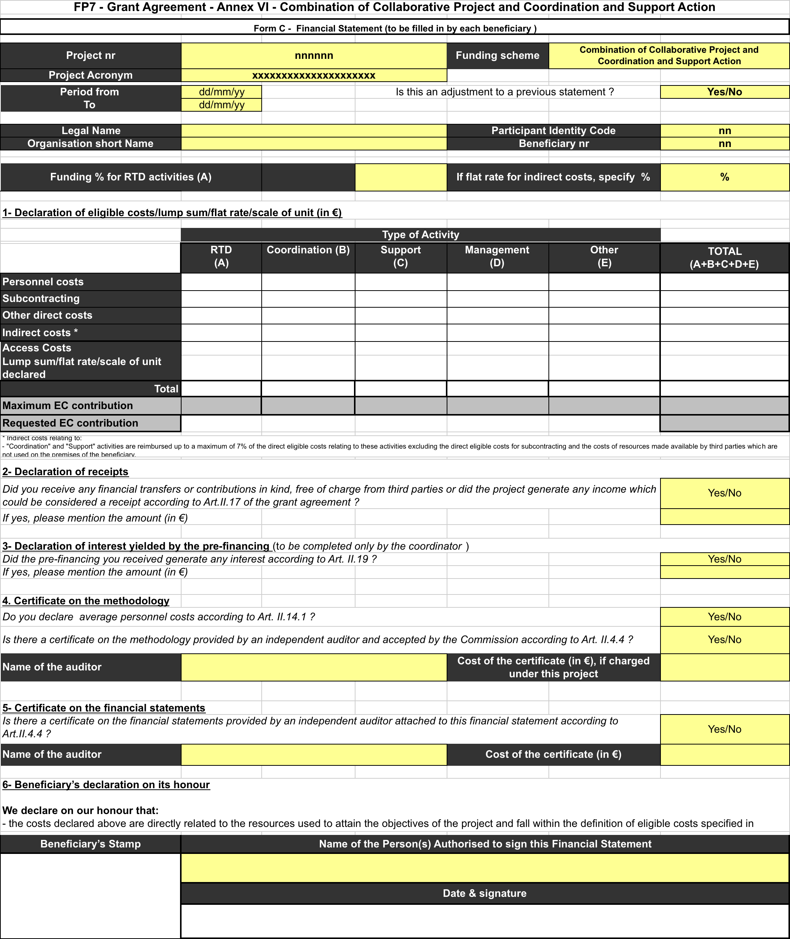
FORM C
Log in to FORCE: https://webgate.ec.europa.eu/FormC
Fill in the Financial data
Submit to the Coordinator
CERN (Mar) will ask you few days later to print the Form and send 2 originals signed
Help: ftp://ftp.cordis.europa.eu/pub/fp7/docs/presentation-force_en.pdf
PPT, only if it helps you
Get the so-called ‘Internal Cost Claim (ICC)’ > Excel file in PPT: https://pptevm.cern.ch/slhcpp/ui/main.do

Slide 6
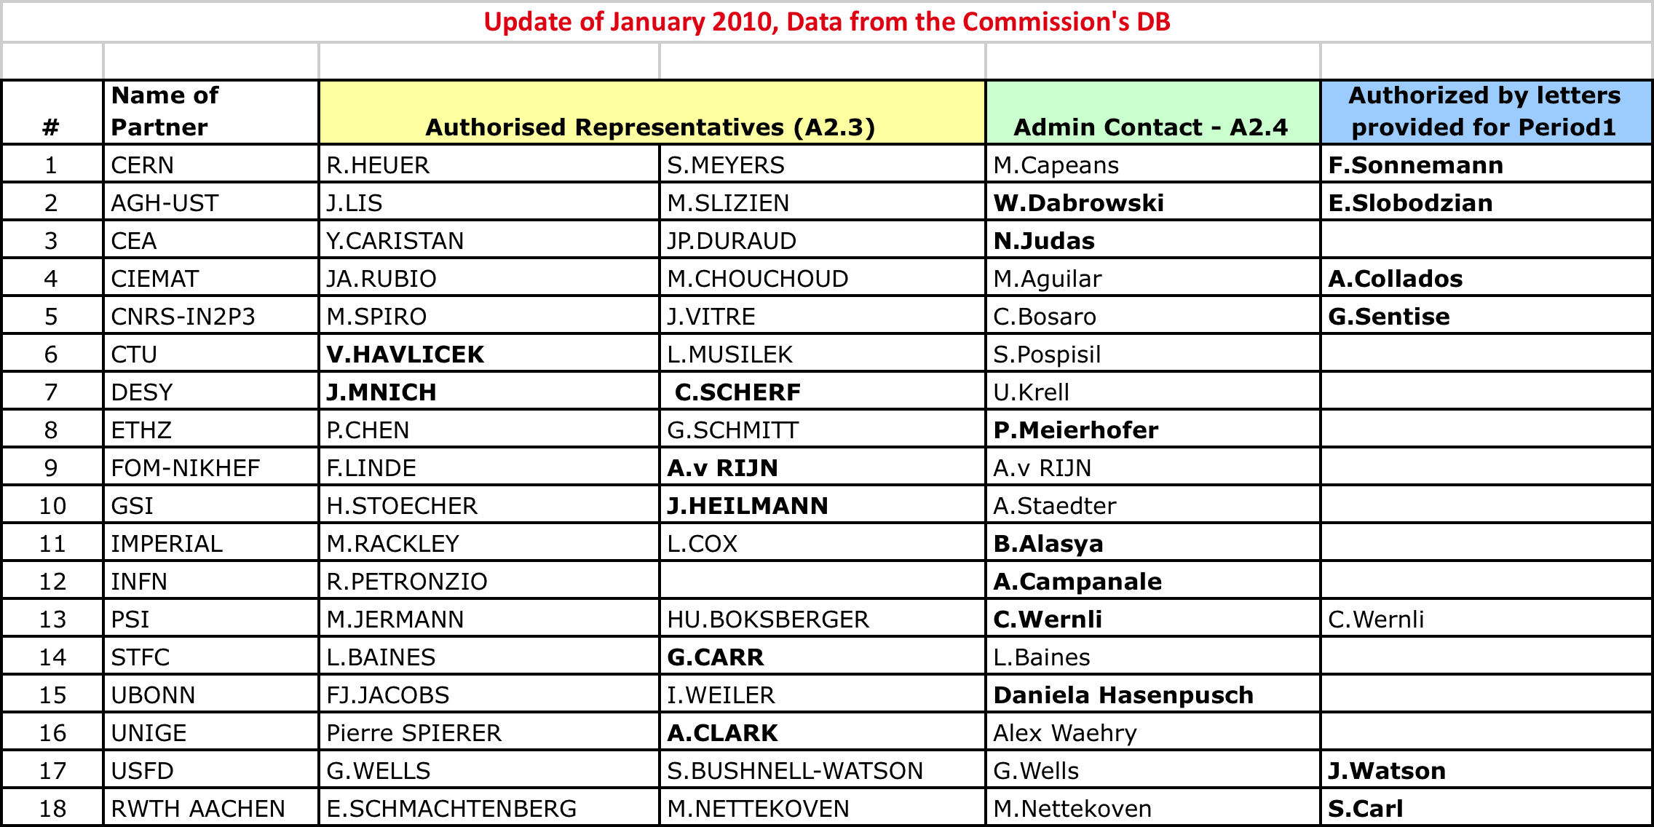
Signatures in Forms C
One signature is sufficient:
Authorized representatives, as on GPF A2.3
Person in charge of administrative, legal an financial aspects in this project, as on GPF A2.4
Anyone that provides an original Authorizing Letter signed by the Authorized Representatives as on GPF A2.3

Slide 7
Exchange Rates
Costs shall be reported in Euro
Apply either:
  The rate of the first day of the month which follows the end of Period 2 (i.e. April 1st 2011)
  The rate on the date that the actual costs were incurred
Use ONLY the exchange rates as published on European Central Bank website.
http://www.ecb.int/stats/exchange/eurofxref/html/index.en.html

Slide 8
Payments
Project Budget | 15,570,973 €
EC contribution | 5,199,992 €
Max. Payment (90%) | 4,679,992.8 €
Pre-financing + Payment P1 | 4,679,992.80
Payment P2 | 0 €
Final Payment (Nov 2011 ?) | 519,999.2 €

Slide 9
Status of Payments
# | Participant | Max Total EC contribution | Ceiling | Prefinancing Received (2008) | Payment 1 (2009) | Total Received | % Received | To be paid to reach ceiling | TO BE PAID @ END
1 | CERN | 3,062,484.0 | 2,756,235.6 | 1,633,324.8 | 1,122,910.8 | 2,756,235.6 | 90% | 0.0 | 306,248.4
2 | AGH-UST | 104,000.0 | 93,600.0 | 55,466.7 | 30,152.9 | 85,619.5 | 82% | 7,980.5 | 10,400.0
3 | CEA-Saclay | 465,460.0 | 418,914.0 | 248,245.3 | 170,668.7 | 418,914.0 | 90% | 0.0 | 46,546.0
4 | CIEMAT | 152,645.0 | 137,380.5 | 81,410.7 | 37,984.0 | 119,394.7 | 78% | 17,985.9 | 15,264.5
5 | CNRS-IN2P3 | 105,600.0 | 95,040.0 | 56,320.0 | 993.7 | 57,313.7 | 54% | 37,726.3 | 10,560.0
6 | CTU | 44,940.0 | 40,446.0 | 23,968.0 | 16,478.0 | 40,446.0 | 90% | 0.0 | 4,494.0
7 | DESY | 99,691.0 | 89,721.9 | 53,168.5 | 1,408.5 | 54,577.0 | 55% | 35,144.9 | 9,969.1
8 | ETH Zürich | 89,131.0 | 80,217.9 | 47,536.5 | 32,681.4 | 80,217.9 | 90% | 0.0 | 8,913.1
9 | FOM-NIKHEF | 64,200.0 | 57,780.0 | 34,240.0 | 23,540.0 | 57,780.0 | 90% | 0.0 | 6,420.0
10 | GSI | 72,225.0 | 65,002.5 | 38,520.0 | 11,593.0 | 50,113.0 | 69% | 14,889.5 | 7,222.5
11 | Imperial | 89,131.0 | 80,217.9 | 47,536.5 | 30,771.0 | 78,307.5 | 88% | 1,910.4 | 8,913.1
12 | INFN | 40,000.0 | 36,000.0 | 21,333.3 | 14,666.7 | 36,000.0 | 90% | 0.0 | 4,000.0
13 | PSI | 108,225.0 | 97,402.5 | 57,720.0 | 30,747.5 | 88,467.5 | 82% | 8,935.1 | 10,822.5
14 | STFC | 489,850.0 | 440,865.0 | 261,253.3 | 76,351.8 | 337,605.1 | 69% | 103,259.9 | 48,985.0
15 | UBONN | 120,000.0 | 108,000.0 | 64,000.0 | 44,000.0 | 108,000.0 | 90% | 0.0 | 12,000.0
16 | UNIGE | 35,310.0 | 31,779.0 | 18,832.0 | 12,947.0 | 31,779.0 | 90% | 0.0 | 3,531.0
17 | USFD | 32,100.0 | 28,890.0 | 17,120.0 | 11,770.0 | 28,890.0 | 90% | 0.0 | 3,210.0
18 | RWTH Aachen | 25,000.0 | 22,500.0 | 13,333.3 | 9,166.7 | 22,500.0 | 90% | 0.0 | 2,500.0
 |  | 5,199,992.0 | 4,679,992.8 | 2,773,329.1 | 1,678,831.4 | 4,452,160.5 | 86% | 227,832.4 | 519,999.2

Slide 10
Partners that could receive >10% at the end of the project, provided….
…the effort reported at the end approaches the commitment expressed in Annex I
Partner | Reported P1 | Requested P1 | Reported P2 | Requested P2 | REPORTED TOTAL | Total Commitment | % Worked
AGH | 40,203.81 | 30,152.86 | 77,007.06 | 57,755.30 | 117,210.87 | 256,000.0 | 46%
CIEMAT | 50,645.30 | 37,983.98 | 72,974.68 | 54,731.01 | 123,619.98 | 397,538.0 | 31%
CNRS | 30,672.78 | 23,004.59 | 134,138.75 | 100,604.06 | 92,460.65 | 320,000.0 | 29%
 | Accepted > | 993.72 | 29,145.15 | 21,858.86
DESY | 2,106.10 | 1,408.45 | 62,321.78 | 41,677.69 | 108,260.83 | 263,520.0 | 41%
 | Adjustment> |  | 43,832.95 | 31,159.29
GSI | 12,248.55 | 11,593.03 | 29,606.25 | 27,602.34 | 39,679.41 | 240,000.0 | 17%
 | Adjustment> |  | -2,175.39 | -2,040.12
Imperial | 46,012.67 | 30,770.97 | 75,253.18 | 50,325.57 | 121,265.85 | 240,000.0 | 51%
PSI | 40,662.41 | 30,747.45 | 34,266.06 | 30,335.08 | 74,928.47 | 324,000.0 | 23%
STFC | 233,769.76 | 165,146.50 | 328,929.49 | 226,503.35 | 562,699.25 | 1,451,625.0 | 39%

Slide 11
Personnel (till 6.2.11)
Black: data for P1 and P2, sent and approved by EC
Red: data P3 till 6.2.11
Blue: Data not available (CEA, CNRS, INFN, STFC)
Beneficiary |  | Management |  |  |  |  | Coordinatiom |  |  |  |  |  |  |  |  |  |  |  |  |  | Support |  |  |  |  | RTD |  |  |  |  |  |  |  |  |  |  |  |  |  | TOTAL |  | % Used
 |  | WP1 |  |  |  |  | WP2 |  |  |  | WP3 |  |  |  | WP4 |  |  |  | Sum |  | WP5 |  |  |  |  | WP6 |  |  |  | WP7 |  |  |  | WP8 |  |  |  | Sum
 |  | Budget | P1 | P2 | P3 | Actual | Budget | P1 | P2 | P3 | Budget | P1 | P2 | P3 | Budget | P1 | P2 | P3 | Budget | Actual | Budget | P1 | P2 | P3 | Actual | Budget | P1 | P2 | P3 | Budget | P1 | P2 | P3 | Budget | P1 | P2 | P3 | Budget | Actual | Budget | Actual | %
1 | CERN | 49 | 17.4 | 23.5 | 13 | 53.9 | 38 | 3.3 | 13.8 | 12.9 | 52 | 5.0 | 12.5 | 12.9 | 48 | 16.6 | 31.0 | 19.6 | 138 | 127.5 | 58 | 16.1 | 45.3 | 34.0 | 95.4 | 72 | 23.4 | 47.4 | 2.3 | 148 | 24.4 | 48.0 | 43.3 | 48 | 20.1 | 33.4 | 20.6 | 268 | 262.9 | 513 | 540 | 105%
2 | AGH-UST |  |  |  |  |  |  |  |  |  |  |  |  |  |  |  |  |  |  |  |  |  |  |  |  |  |  |  |  |  |  |  |  | 36 | 7.4 | 12.6 | 12.6 | 36 | 32.6 | 36 | 33 | 91%
3 | CEA Saclay |  |  |  |  |  | 6 | 0.0 | 0.0 |  |  |  |  |  |  |  |  |  | 6 | 0.0 |  |  |  |  |  | 49 | 16.2 | 43.2 |  | 23 | 15.8 | 63.5 |  |  |  |  |  | 72 | 138.7 | 78 | 139
4 | CIEMAT |  |  |  |  |  | 4 | 0.0 | 3.6 | 0.4 |  |  |  |  |  |  |  |  | 4 | 4.0 |  |  |  |  |  | 30 | 5.5 | 4.4 | 16.4 |  |  |  |  |  |  |  |  | 30 | 26.3 | 34 | 30 | 89%
5 | CNRS-IN2P3 |  |  |  |  |  |  |  |  |  |  |  |  |  |  |  |  |  |  |  |  |  |  |  |  | 18 | 4.1 | 13.7 |  |  |  |  |  |  |  |  |  | 18 | 17.8 | 18 | 18
6 | CTU |  |  |  |  |  |  |  |  |  |  |  |  |  |  |  |  |  |  |  | 18 | 11.1 | 9.0 | 3.7 | 23.8 |  |  |  |  |  |  |  |  |  |  |  |  |  |  | 18 | 24 | 132%
7 | DESY |  |  |  |  |  |  |  |  |  |  |  |  |  | 18 | 1.2 | 6.1 | 2.2 | 18 | 9.5 |  |  |  |  |  |  |  |  |  | 2 | 3.0 | 0.0 |  |  |  |  |  | 2 | 3.0 | 20 | 13 | 63%
8 | ETHZ |  |  |  |  |  |  |  |  |  |  |  |  |  | 15 | 3.7 | 5.2 | 4.6 | 15 | 13.5 |  |  |  |  |  |  |  |  |  |  |  |  |  |  |  |  |  |  |  | 15 | 14 | 90%
9 | NIKHEF |  |  |  |  |  |  |  |  |  | 20 | 6.4 | 6.0 | 4.9 |  |  |  |  | 20 | 17.3 |  |  |  |  |  |  |  |  |  |  |  |  |  |  |  |  |  |  |  | 20 | 17 | 87%
10 | GSI |  |  |  |  |  |  |  |  |  |  |  |  |  |  |  |  |  |  |  | 16 | 1.4 | 4.7 | 3.7 | 9.8 |  |  |  |  |  |  |  |  |  |  |  |  |  |  | 16 | 10 | 61%
11 | Imperial |  |  |  |  |  |  |  |  |  |  |  |  |  | 9 | 3.6 | 6.1 | 3.7 | 9 | 13.4 |  |  |  |  |  |  |  |  |  |  |  |  |  |  |  |  |  |  |  | 9 | 13 | 149%
12 | INFN |  |  |  |  |  |  |  |  |  |  |  |  |  |  |  |  |  |  |  |  |  |  |  |  |  |  |  |  | 7 | 1.7 | 5.4 |  |  |  |  |  | 7 | 7.1 | 7 | 7
13 | PSI |  |  |  |  |  |  |  |  |  |  |  |  |  |  |  |  |  |  |  | 16 | 0.1 | 2.7 | 8.0 | 10.8 |  |  |  |  |  |  |  |  | 16 | 4.2 | 0.0 | 7.2 | 16 | 11.4 | 32 | 22 | 69%
14 | STFC |  |  |  |  |  | 4 | 1.0 | 0.0 |  | 20 | 6.5 | 6.0 |  |  |  |  |  | 24 | 13.5 |  |  |  |  |  | 24 | 2.8 | 0.8 |  | 1 | 0.6 | 0.3 |  | 35 | 15.0 | 14.8 |  | 60 | 34.2 | 84 | 48
15 | UBONN |  |  |  |  |  |  |  |  |  |  |  |  |  |  |  |  |  |  |  |  |  |  |  |  |  |  |  |  |  |  |  |  | 48 | 23.1 | 27.0 | 19.6 | 48 | 69.6 | 48 | 70 | 145%
16 | UNIGE |  |  |  |  |  |  |  |  |  | 10 | 6.4 | 8.3 | 6.0 |  |  |  |  | 10 | 20.8 |  |  |  |  |  |  |  |  |  |  |  |  |  |  |  |  |  |  |  | 10 | 21 | 208%
17 | USFD |  |  |  |  |  |  |  |  |  |  |  |  |  |  |  |  |  |  |  | 8 | 2.9 | 4.0 | 1.6 | 8.5 |  |  |  |  |  |  |  |  |  |  |  |  |  |  | 8 | 8 | 106%
18 | Aachen |  |  |  |  |  |  |  |  |  |  |  |  |  |  |  |  |  |  |  |  |  |  |  |  |  |  |  |  |  |  |  |  | 10 | 2.3 | 6.5 | 4.1 | 10 | 12.9 | 10 | 13 | 129%
TOTAL P-M |  | 49 | 17 | 24 |  | 54 | 52 | 4 | 17 |  | 102 | 24 | 33 |  | 90 | 25 | 48 |  | 244 | 220 | 116 | 32 | 66 |  | 148 | 193 | 52 | 110 |  | 181 | 45 | 117 |  | 193 | 72 | 94 |  | 567 | 617 | 976 | 1038 | 106%
Much Lower than Budget: DESY, GSI, PSI
~ 90%: AGH, CIEMAT, ETHZ, NIKHEF

Slide 12
Form C in P3
Make sure you declare resources as committed in Annex I for P1+P2+P3
  Personnel
  Material & Travel
  … taking into account that there is certain flexibility to transfer funds between categories

Slide 13
Final Report
Deadline: 31 May 2011
3 main Sections:

Slide 14
Final Report
Final publishable summary addressed to general public:
  results
  conclusions
  socio-economic impact
  Pictures
  i.e., promotion of the project
< 40 pages
Editors: Steering Group

Slide 15
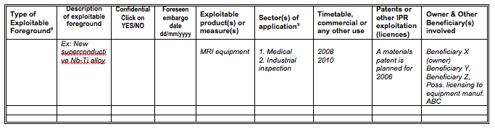
Final Report
2. Use and dissemination of foreground
  2.A Public Section
  Dissemination measures
  Web, Press releases flyers, etc
  Publications, Conferences, Workshops
  Table of Scientific Publications (peer reviewed) starting with the most important ones and according to a template provided by the Commission
  Publications related to the project published after the final report, an abstract and reference must be provided to the Commission, plus an electronic copy!
  2.B Confidential Section
  Table of application for patents, trademarks, registered designs, etc.
  Overview Table with exploitable foreground
Editors: CERN will provide template Tables to every Institute (rep. in the GB)

Slide 16
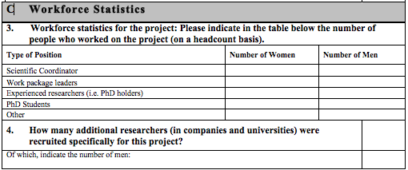
Final Report
3. Report on Societal Implications
Ethics
Workforce statistics
Nb. of researchers recruited for THIS project
Gender aspects
Use and dissemination
Media and communication
Editors: CERN will provide 5 tables to every institute (rep. in GB)

Slide 17
Summary & Recommendations
CERN will send templates to collect information for the two reports
Keep deadlines
For the Explanation of the Use of Resources, the following rules have been sent by the EC Financial officer:
  Justify all direct costs claimed in Form C, to the second digit after the coma (do not to round down/up amounts)
  Provide detailed information on personnel costs (name – person month – amount)
  Provide detailed information on travel costs (who, where, when)
Report as committed in Annex 1
  Check personnel reporting: DESY, GSI, PSI
  Check level of expenditure: CIEMAT, GSI, PSI

