Slide 1
WP5 Progress Report
Th. Otto
7. 2. 2011

Slide 2
WP 5 Deliverables in 2010/11
No. | Title | Due | Status
5.1.2. | Estimation of radiation and activation levels for critical areas of the experiments at SLHC | M26 | o.k. New data available
5.2.1 | Estimation of radiation and activation levels for critical areas of SLHC and its injectors | M24 | Already reported in Madrid, 2010
5.3.1 | Impact Study (dose rates, environmental impact and waste production from activated material) for SLHC | M36 | In progress

Slide 3
5.1.2. Radiation and activation levels for the experiments at SLHC
“Radiation level” is to be understood as equivalent dose rates with the purpose of radiation protection.
Under this presumption, only sAtlas made contributions to this topic.
Elaborate study of radiation levels in ATLAS at ultimate LHC intensity by Ogawa and Zajacova, extrapolation to sLHC luminosity
Main results:
ambient dose rate H*(10) in service cavern 20 – 50 μSv h⁻¹
Classification as simple controlled radiation area
Access only for classified radiation workers !
ambient dose rate H*(10) at top of shafts > 0.5 μSv h⁻¹
Not a public area any longer ?

Slide 4
5.1.2. Radiation and activation levels for the experiments at SLHC
Due to LHC delay, measurement results are late:
- PSI: Measurement of ambient dose equivalent from neutrons
(very useful results in CMS, detectors were in the “shadow” in ATLAS)
Compare with Monte-Carlo estimations of radiation environments from CERN
This would constitute an addendum to deliverable 5.1.2.
Now, other data are available which may be exploited in this direction.

Slide 5
5.3.1. Impact Study: radioactive releases & waste
Studies made for the original scope of sLHC:
release of activated air from LINAC 4
release of activated air from SPL
Release of activated air and stray radiation from PS
activation of ground(water) around SPL dump
stray radiation from SPL dump
These studies will be summarized in the deliverable report SLHC-PP report

Slide 6
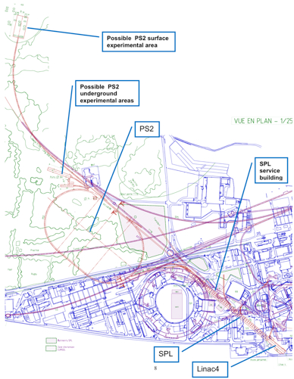
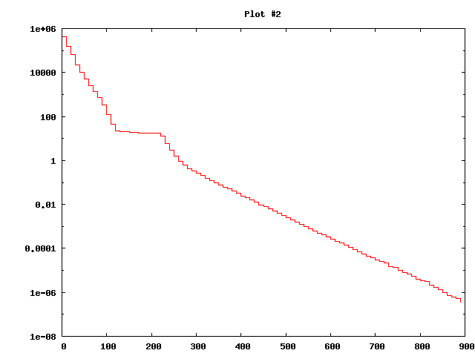

Stray radiation from SPL Dump
Dump location
Factor 10 m⁻¹
17 Sv/h
Dump Air Wall Earth
7 m of earth will reduce
H*(10) to 1.7 μSv h⁻¹
Public area with low frequentation: H*(10) < 2.5 μSv h⁻¹ required

Slide 7
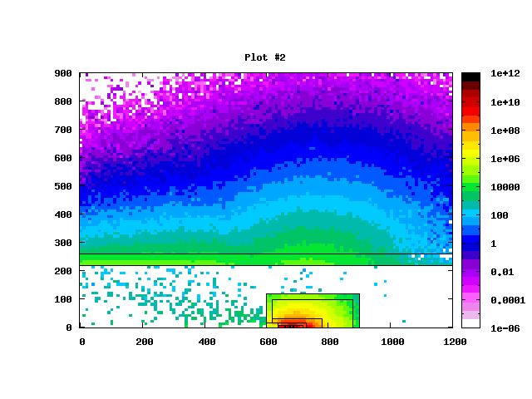
Soil activation
Dump in a 4.4 m wide tunnel
40 cm concrete wall
Several metres of earth
“Stars” (inelastic interactions), leading to activation of matter surrounding the dump
Profile of activity concentration in earth: exponential decline

Slide 8
Ground water contamination
Soluble radionuclides:
H(100%) ²²Na (20%)
In equilibrium:
Production = Activity
Comparison with limits:
Drinking water:
  28 l exceed radioactivity limit
  Don’t source close to SPL
Waste water: (ingress in tunnel)
³H o.k.
²²Na: Factor 3
Covered by conservativism of model

Slide 9
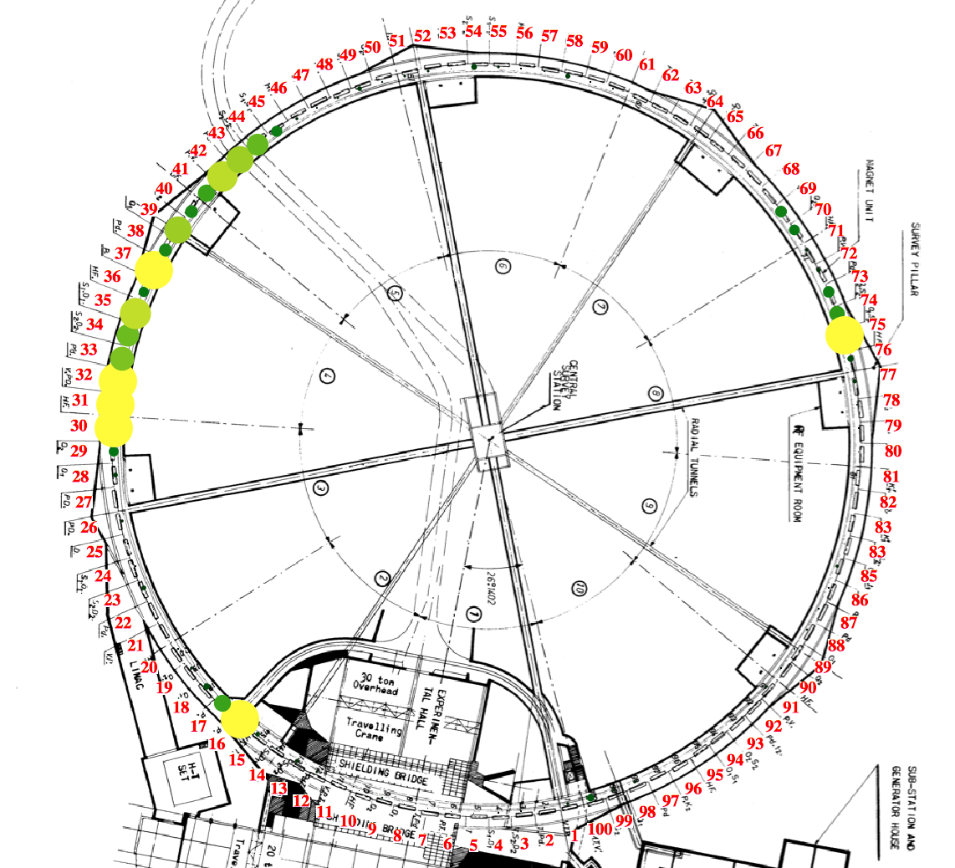
The “venerable” Proton Synchrotron
In the new accelerator strategy, PS is used as an injector for the whole lifetime of LHC and HL-LHC.
What is the environmental impact ?
What measures have to be taken to make it acceptable ?
Locations of beam loss in PS

Slide 10
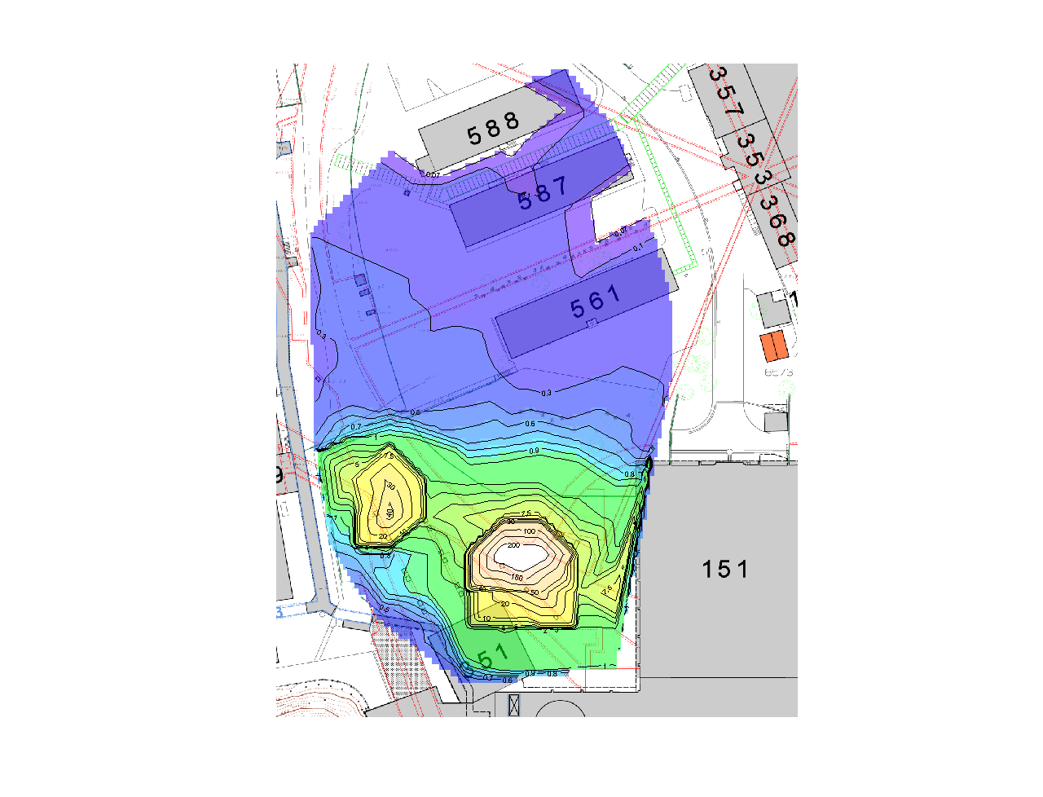
PS Radiation WG
Credible beam intensties
Predominant loss mechanisms
Radiation effects:
stray radiation
activation (water, air, material)
Exposition of personnel
Factors potentially limiting beam intensities, must be addressed one by one.
PSRWG report in final editing stage.
Ambient dose equivalent rate H*(10) in the South-western corner of the Centre of the PS ring. normalized to a reading of the site monitor PAXS 35 of 112 μSv/h

Slide 11
Deliverable 5.3.1. Summary
WP 5 had started in year 1 of SLHC-PP with work on radiation protection aspects of the original injector concept
(SPL and PS2 dump, release of air from LINAC 4, SPL, neutron stray radiation from SPL).
Change of strategy:
Participation in PS Radiation WG
It is too early to make predictions of the environmental impact of HL-LHC . Must await freezing of beam parameters.

Slide 12
WP 5 Summary
All deliverables were … delivered (last one on track)
Two events affected the course of the project:
The LHC sector 3-4 incident delayed data collection for first deliverables
The original wor programme did no longer conform to the new accelerator strategy
In spite of this,
- A lot of useful work has been completed and documented
WP5 allowed a seven (my count) young researchers to participate in (s)LHC-related work
All participants were able to make new contacts which may turn out fruiyful in the future.

