Slide 1

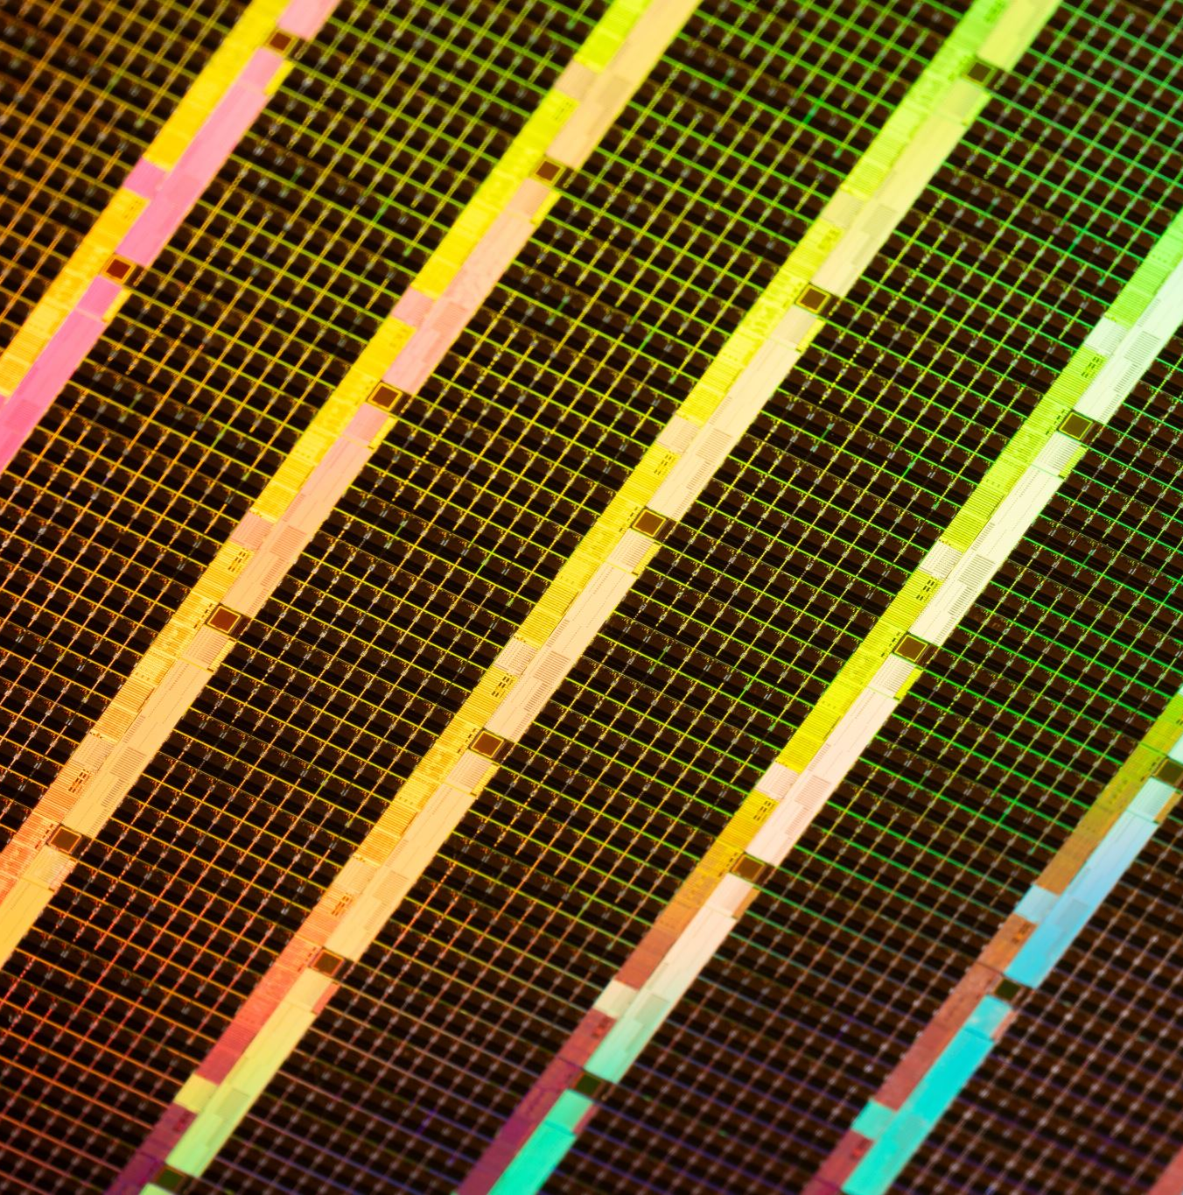
Low Noise Amplifier
Electronic and Mechanical Design
Designer: Wilker Bastos
Supervisor: Stephane Franck Rey
March 2022

Slide 2
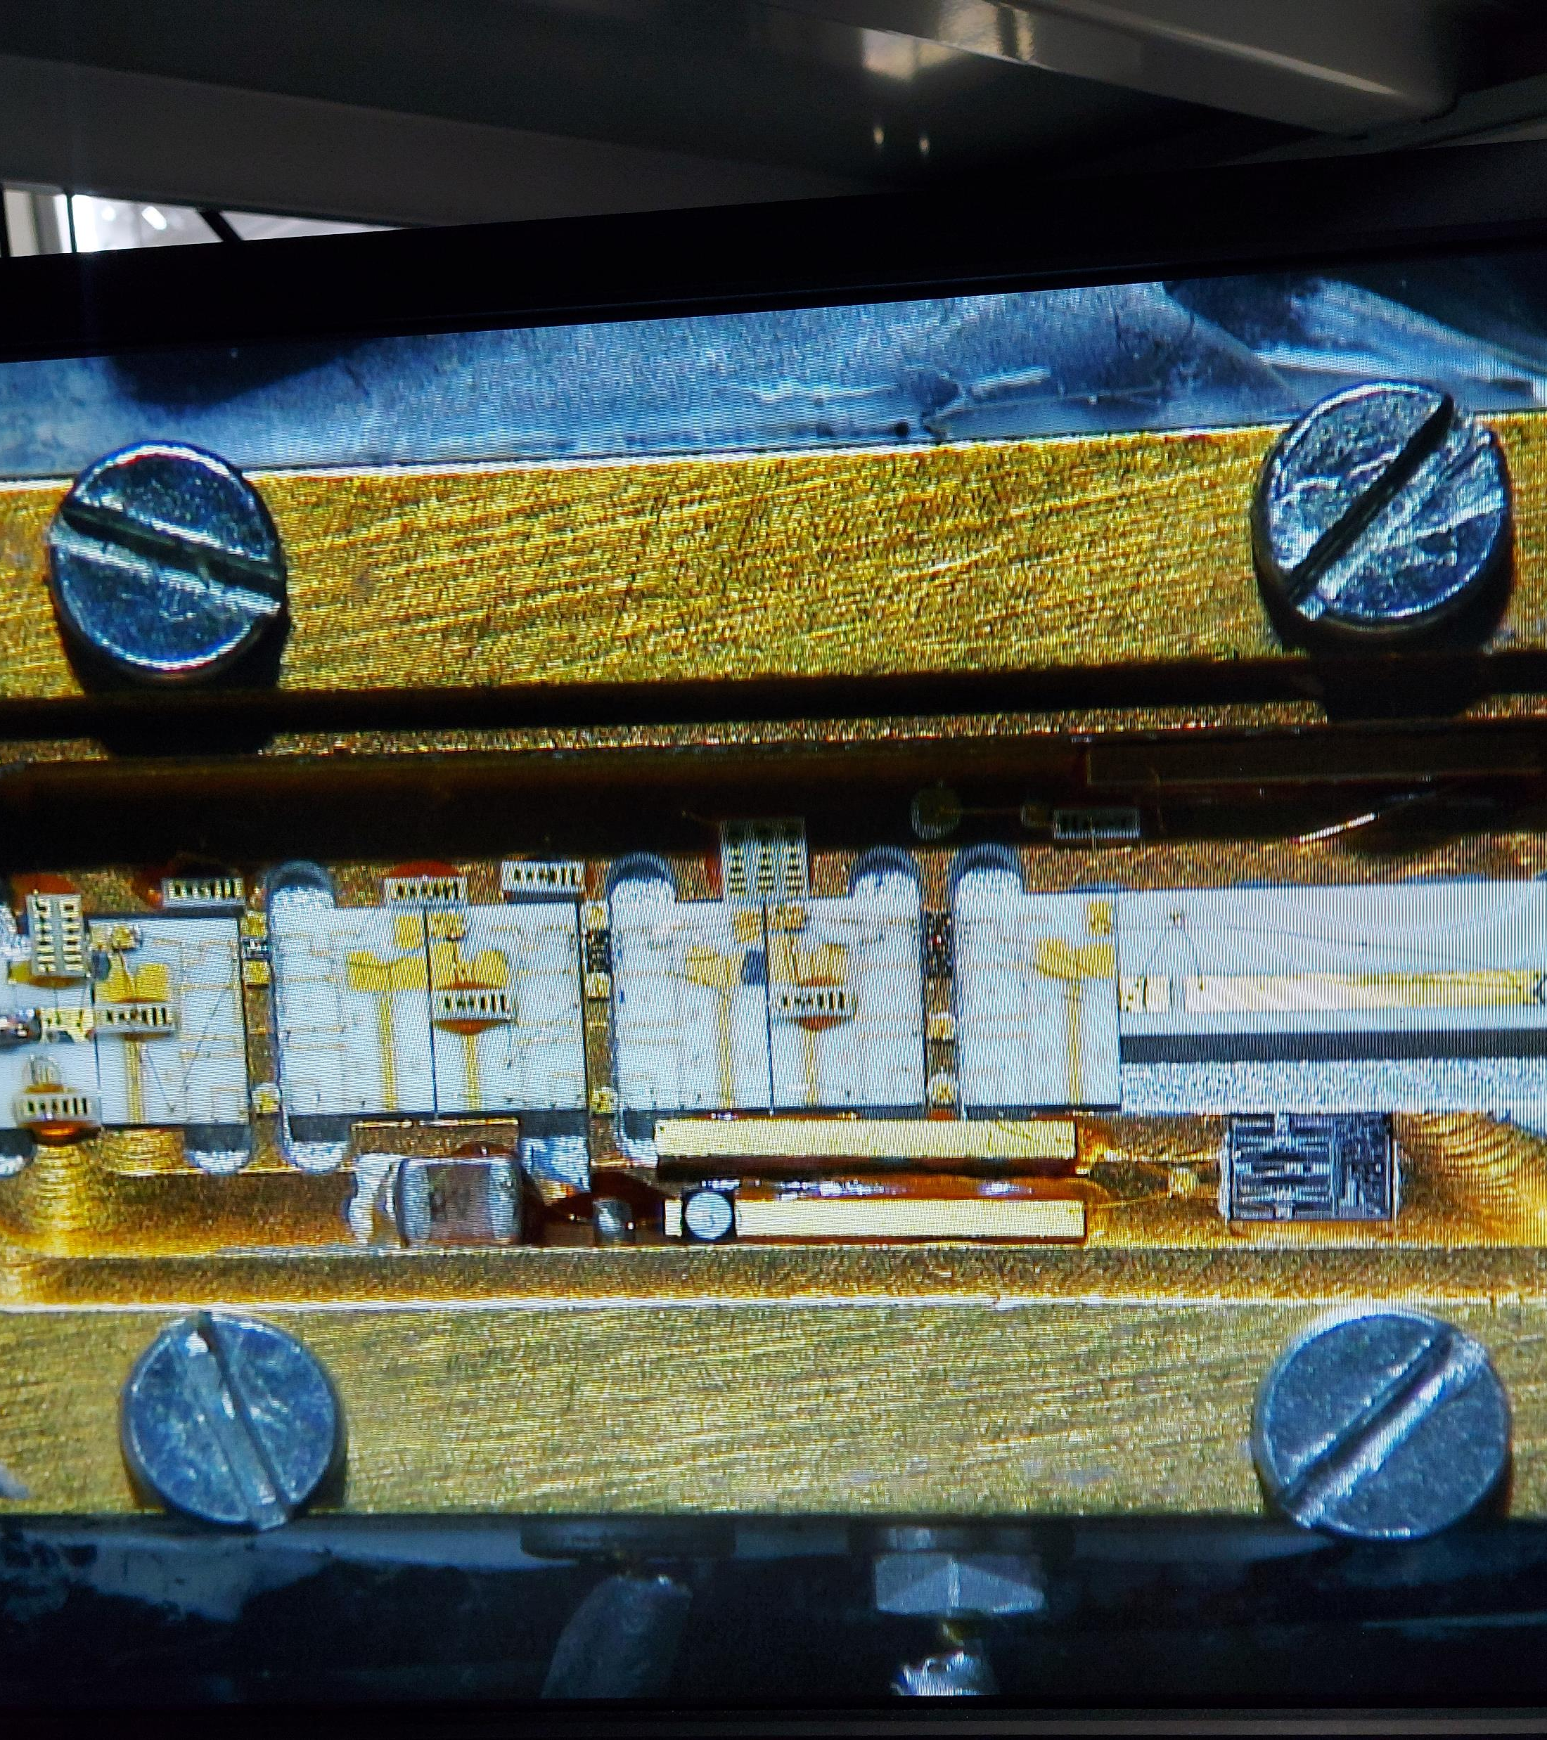
Current Device in operation
Expensive
Production discontinued
Unrepairable
Noise Figure can be upgraded
No documentation available
Device specifications are not characterized
NF <= 0.6dB ?
Gain 35dB ?
Bandwidth ?

Slide 3
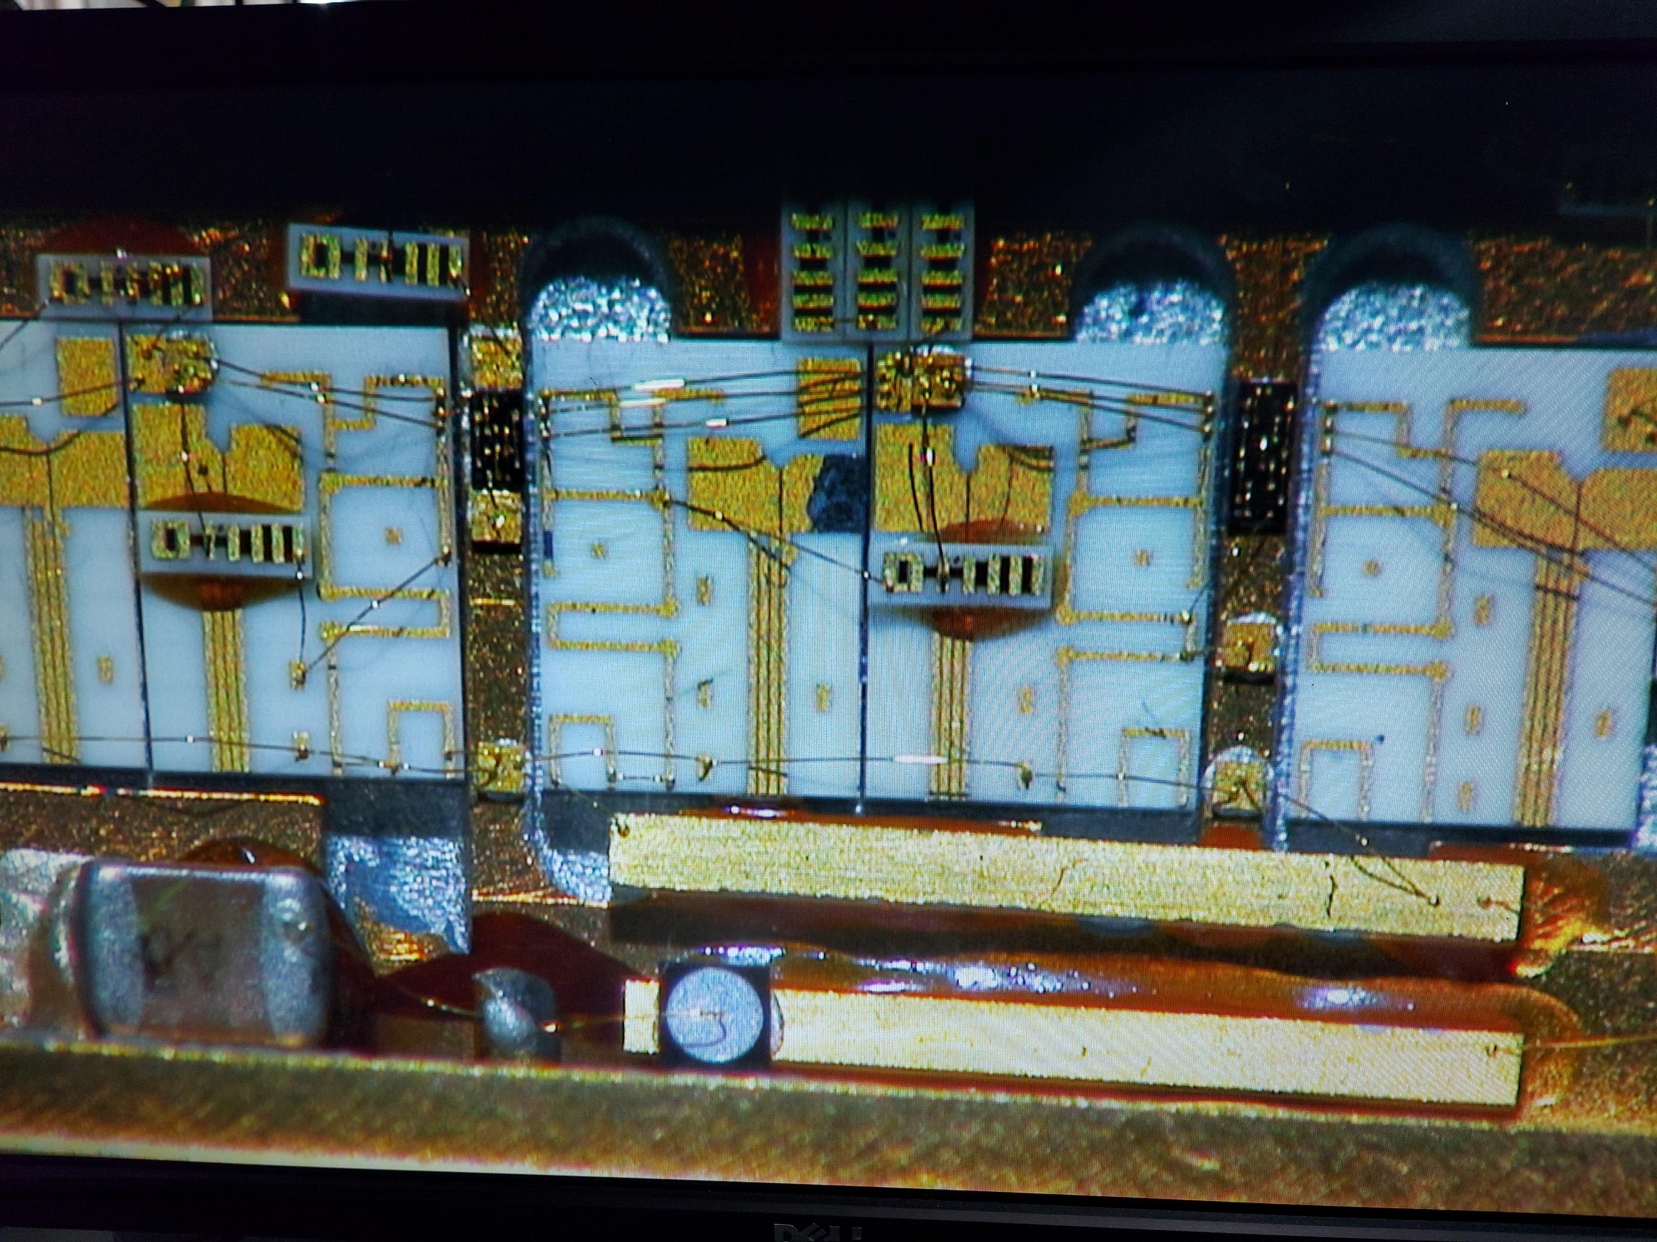
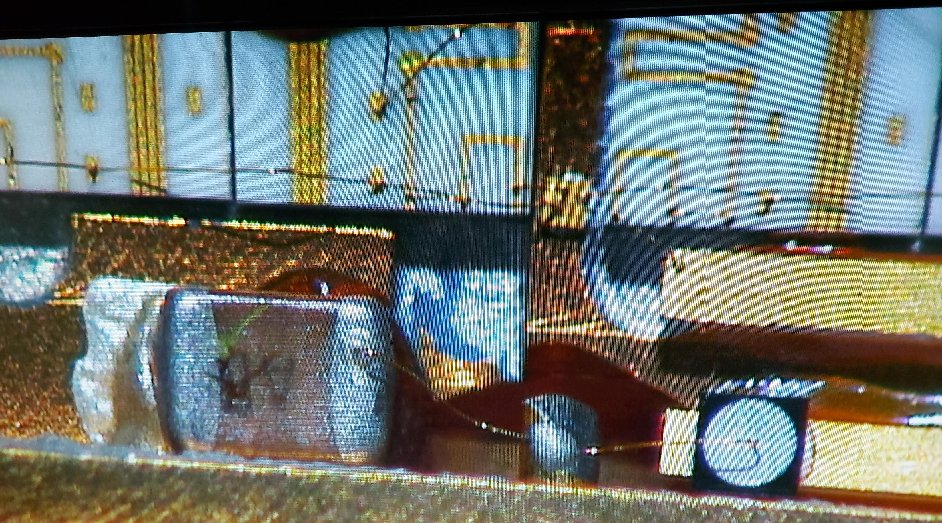
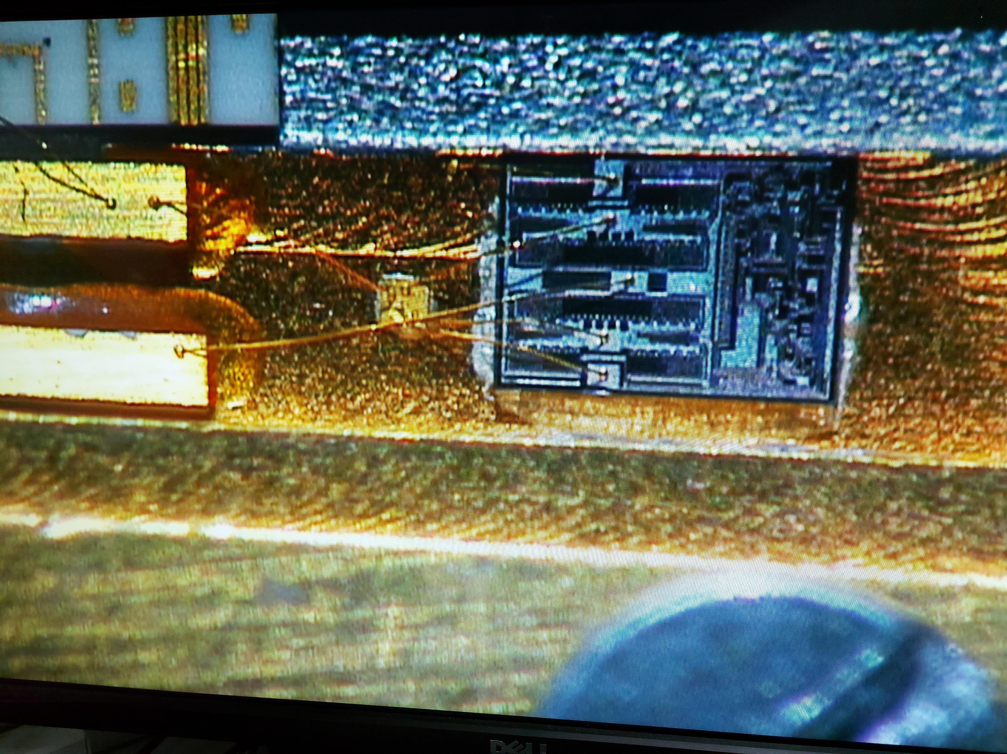

Slide 4
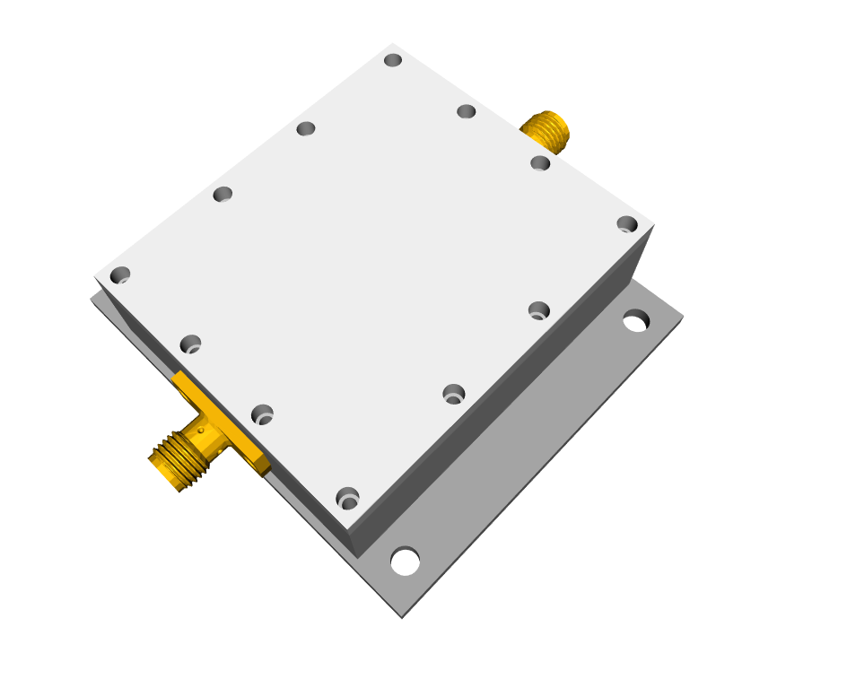
UPGRADE proposal
5 Different versions studied
Potential better noise figure performance
Integrated voltage regulation (3V ~5V)
Less expensive
Can be repaired

Slide 5
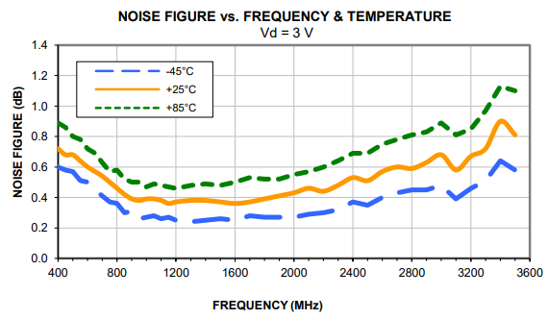
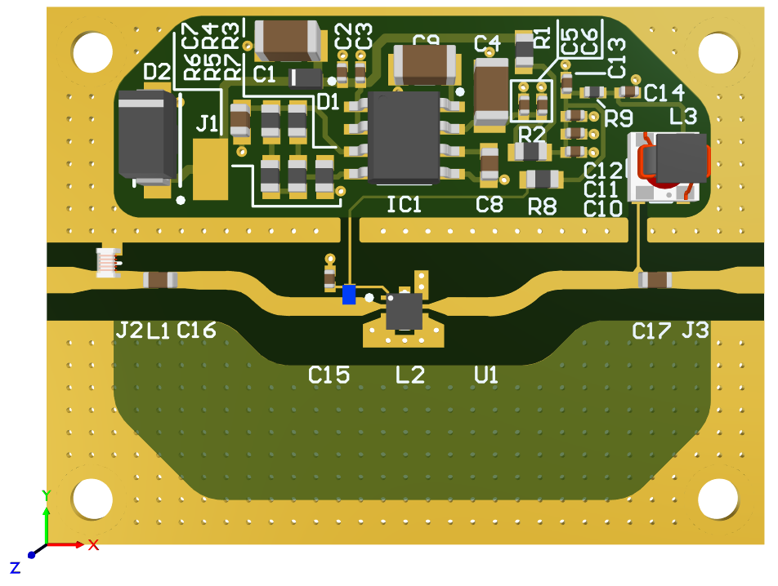

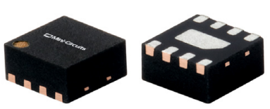
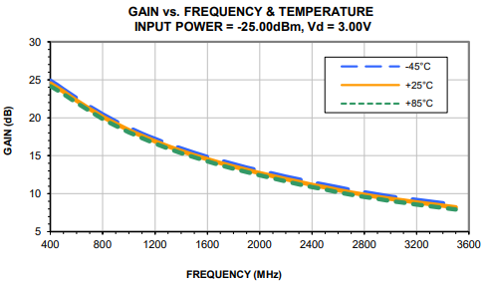

PMA2-33LN+
Bandwidth: 0.4 to 3.0 GHz
Gain: 18 at 1GHz; 12.5dB at 2GHz
Noise Figure: 0.38 dB typ. at 1 GHz; 0.45dB at 2GHz
2nd

Slide 6
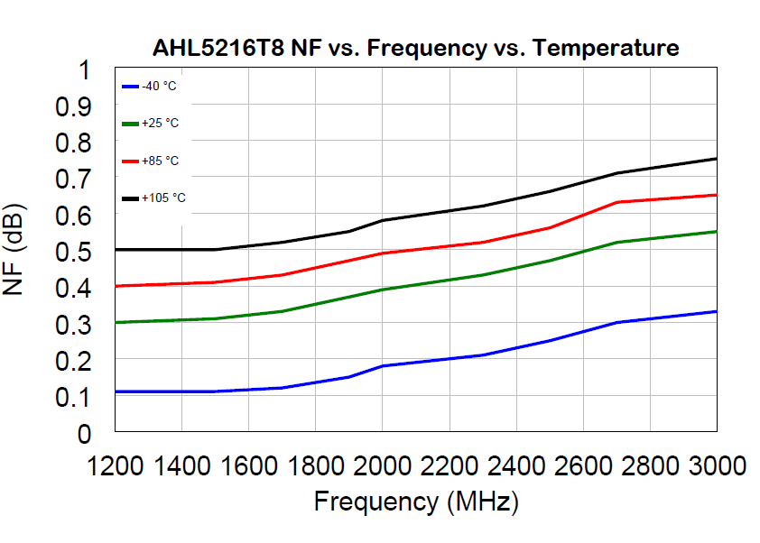
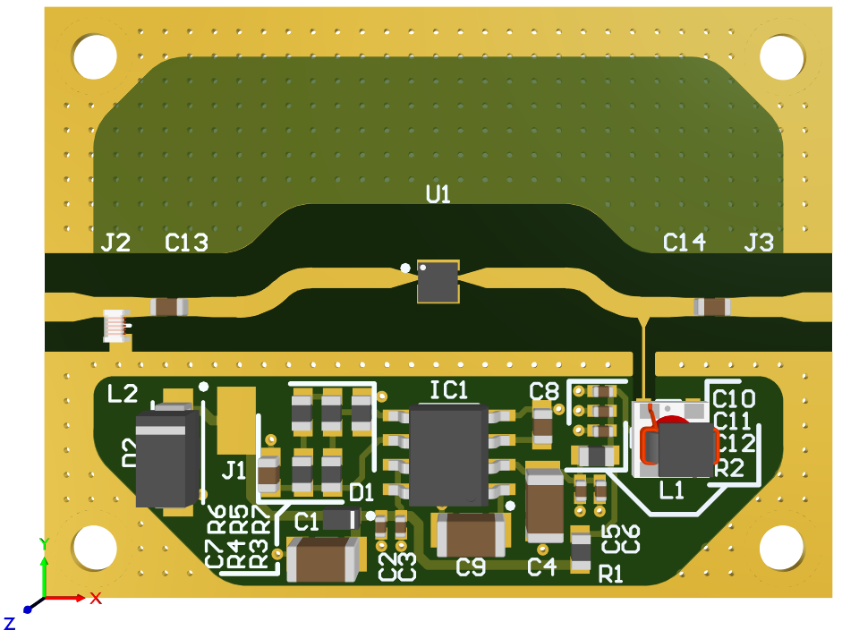

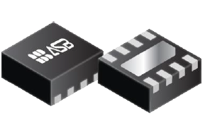
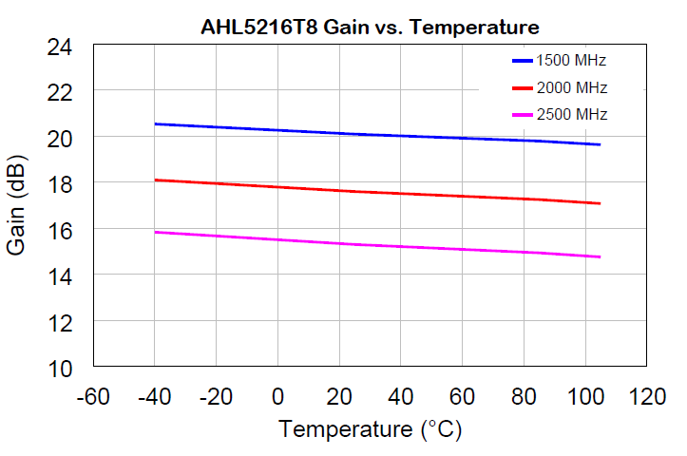

AHL5216T8
Bandwidth: 1.2-3.0 GHz
Gain: 21dB at 1.5GHz; 17dB at 2GHz
Noise Figure: 0.3dB at 1.2GHz; 0.4dB at 2GHz
1st
2nd
1st

Slide 7
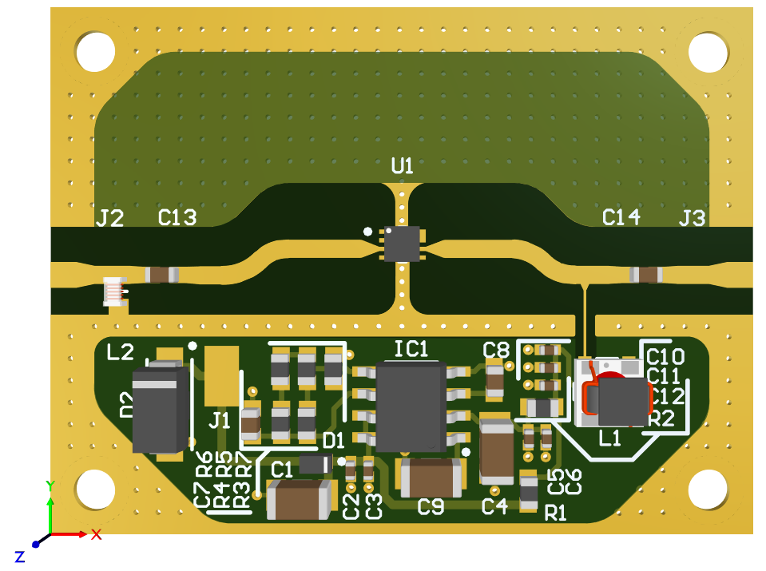
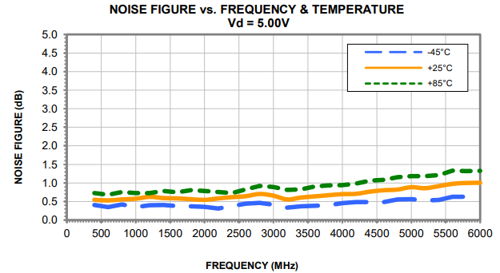
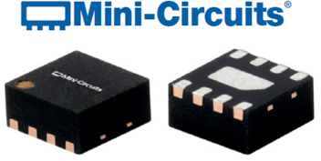
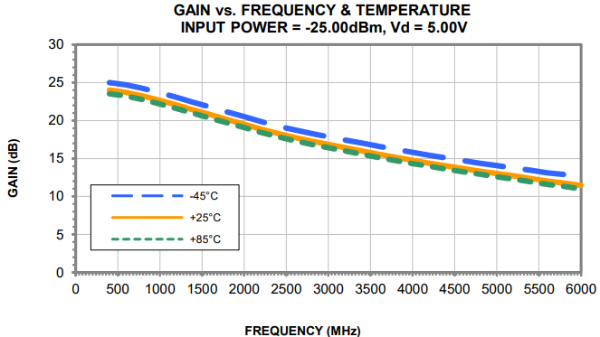
PMA2-63LN+
Bandwidth: 0.4 to 6.0 GHz
Gain: 22.5dB at 1GHz; 19.5dB at 2 GHz
Noise Figure: 0.5 dB typ. at 2 GHz; 0.7 dB typ. at 4 GHz
1st
1st

Slide 8
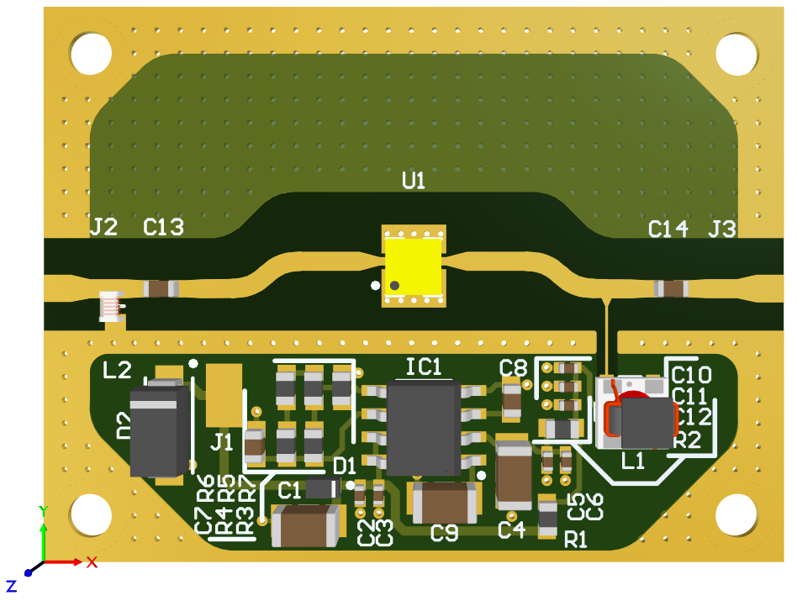
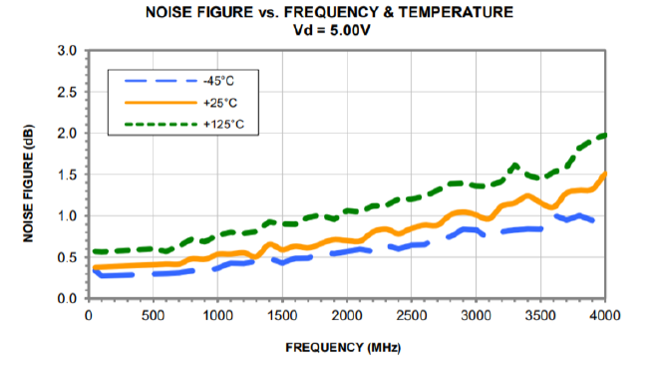
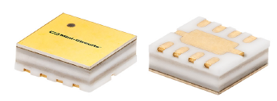
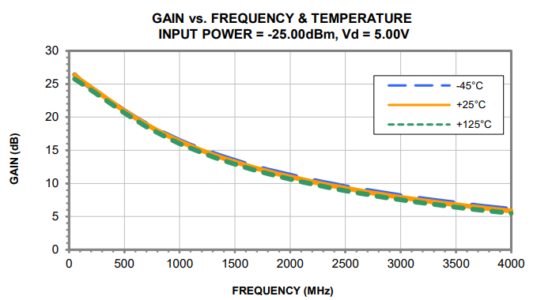
CMA-103+
Bandwidth: 0.05 to 4 GHz
Gain: 16.5dB at 1GHz; 11 dB typ. at 2 GHz
Noise Figure: 0.5 dB up to 1.0 GHz; 0.8 dB at 2 GHz
2nd
1st
2nd

Slide 9
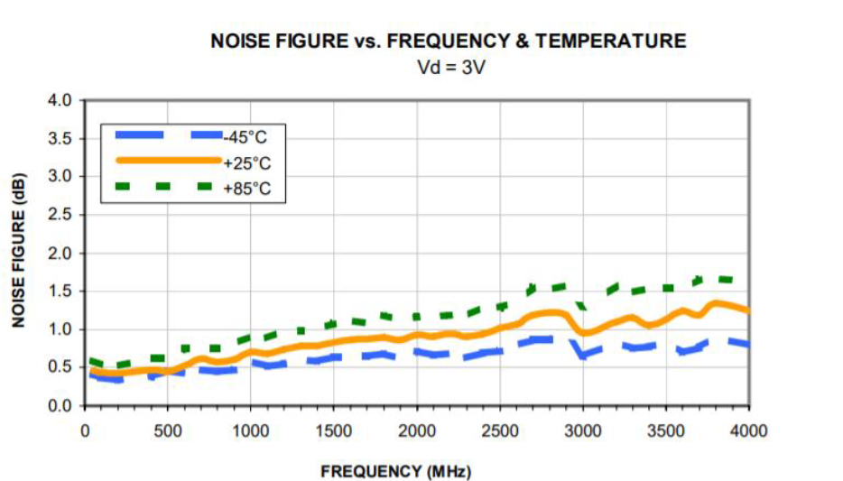
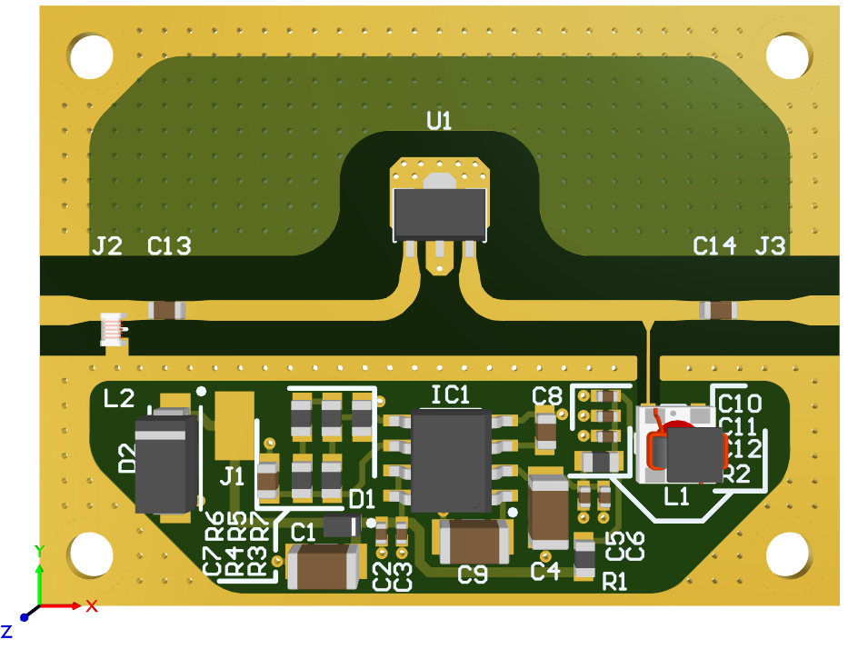
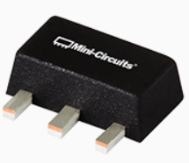
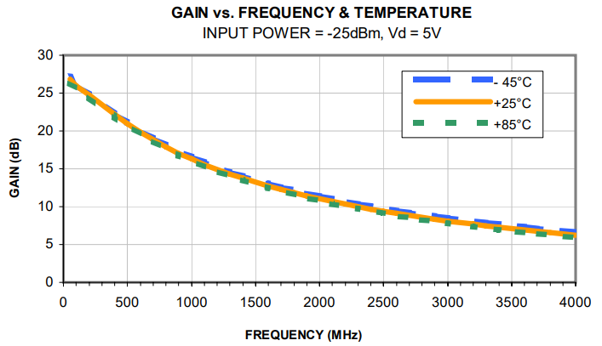
PGA-103+
Bandwidth: 0.05-4 GHz
Gain: 17dB at 1GHz; 12.0 dB typ. at 2 GHz
Noise Figure: 0.7dB at 1 GHz; 0.9 dB at 2 GHz
2nd
2nd
1st

Slide 10



Decision making
LNA's | Cost (5units) | PROS | CONS
PMA2-33LN+ | 459.7 | Good bandwidth; Second Best noise figure; Second best price. | Gain is good but not awesome.
AHL5216T8 | 536.25 | Best noise figure; Second best gain. | Smallest bandwidth; Most expensive.
PMA2-63LN+ | 474.17 | Highest and best bandwidth; Highest gain; Medium price. | Noise figure could be better.
CMA-103+ | 535.37 | Great bandwidth. | Second worst noise figure; Worst gain; Second most expensive.
PGA-103+ | 426.4 | Great bandwidth; Best price. | Worst noise Figure; Second worst gain.

Slide 11
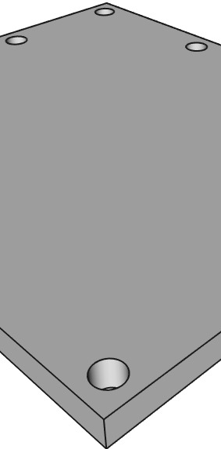
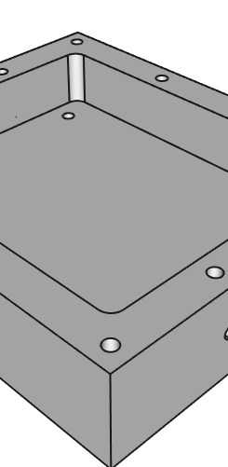
mECHANICal
Casing
Lid

Slide 12
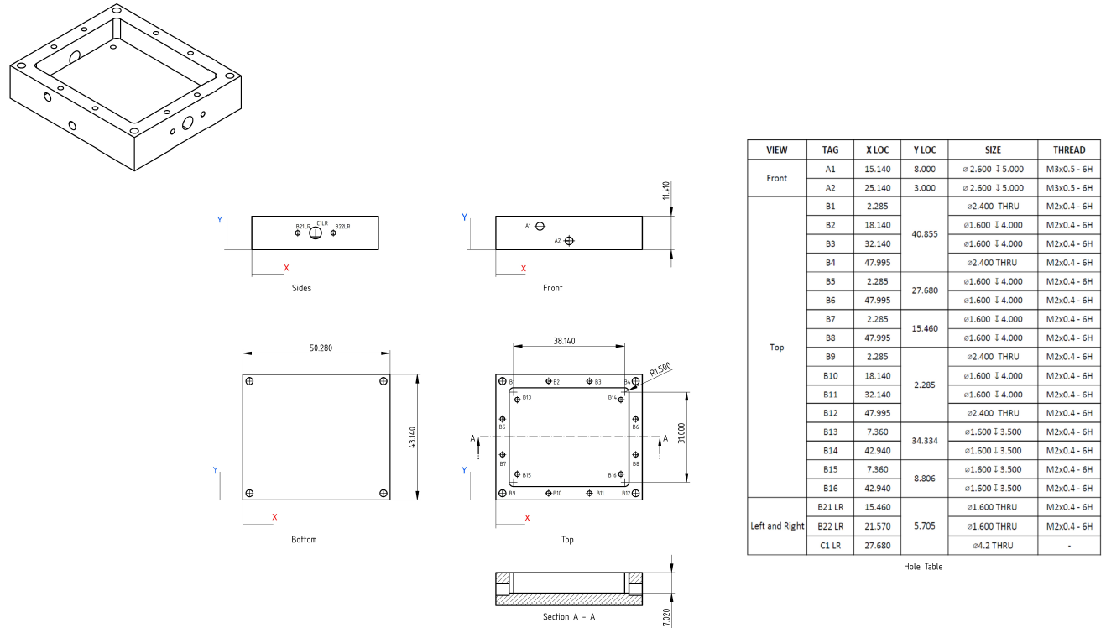

Slide 13
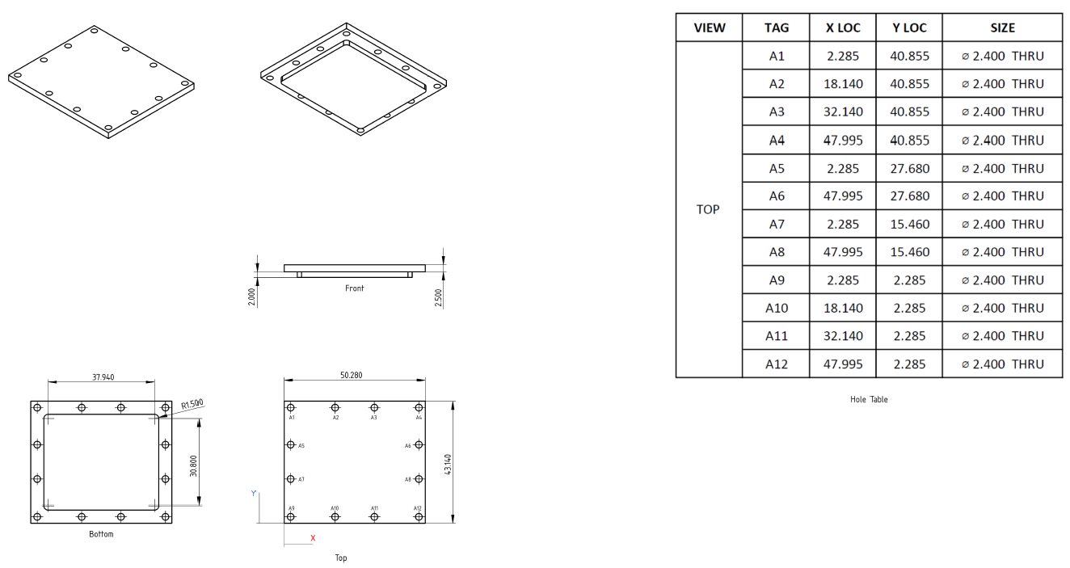

Slide 14
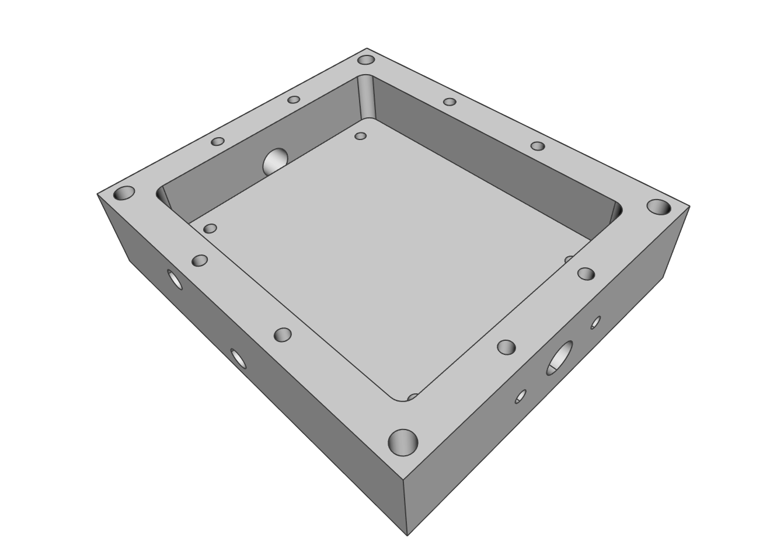
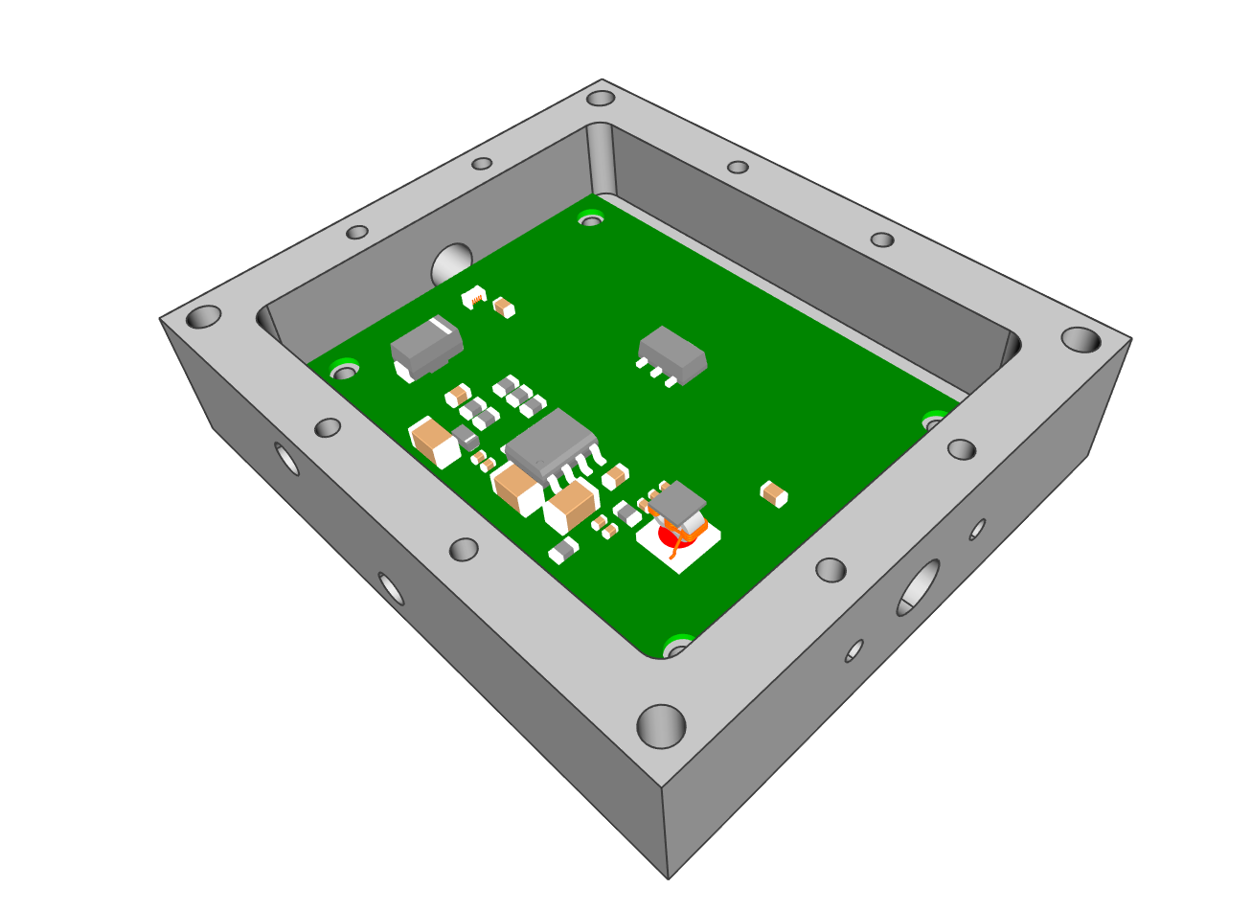
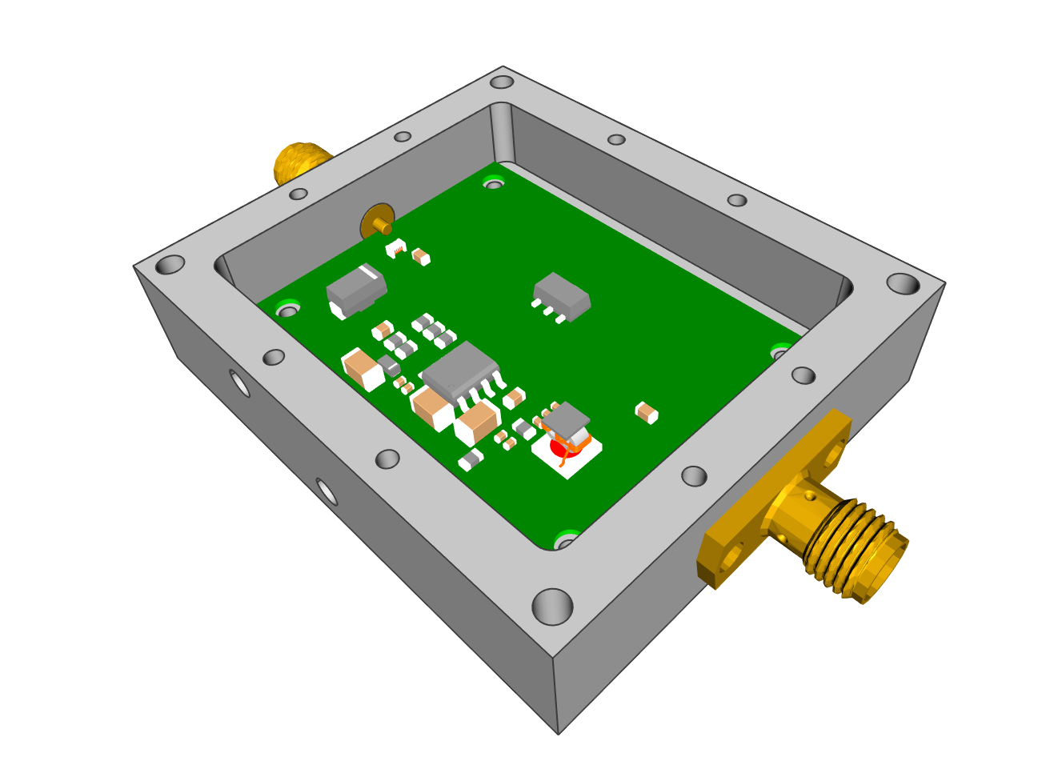
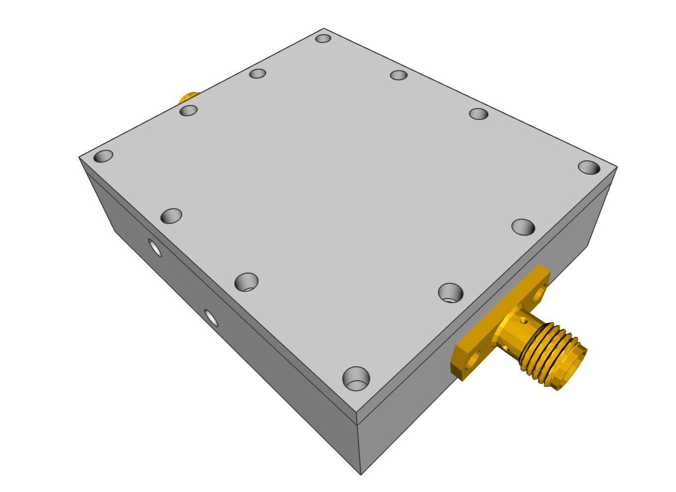

Slide 15
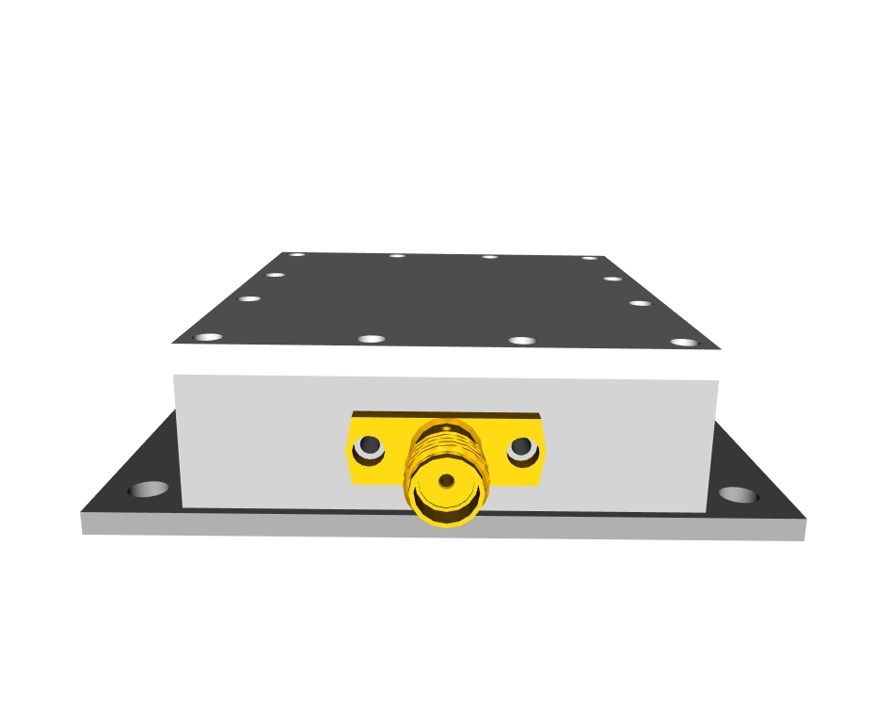
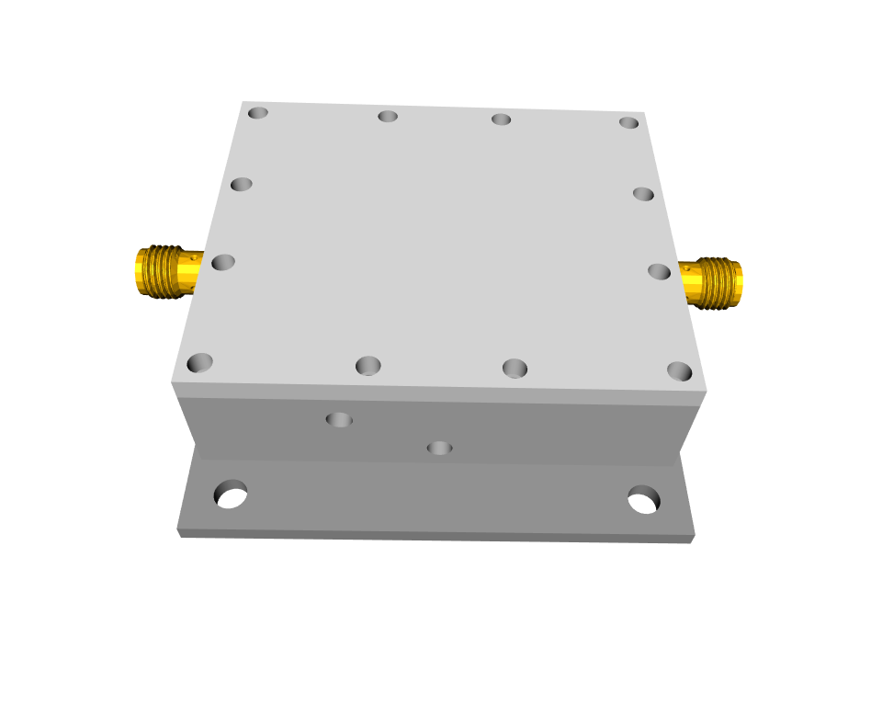
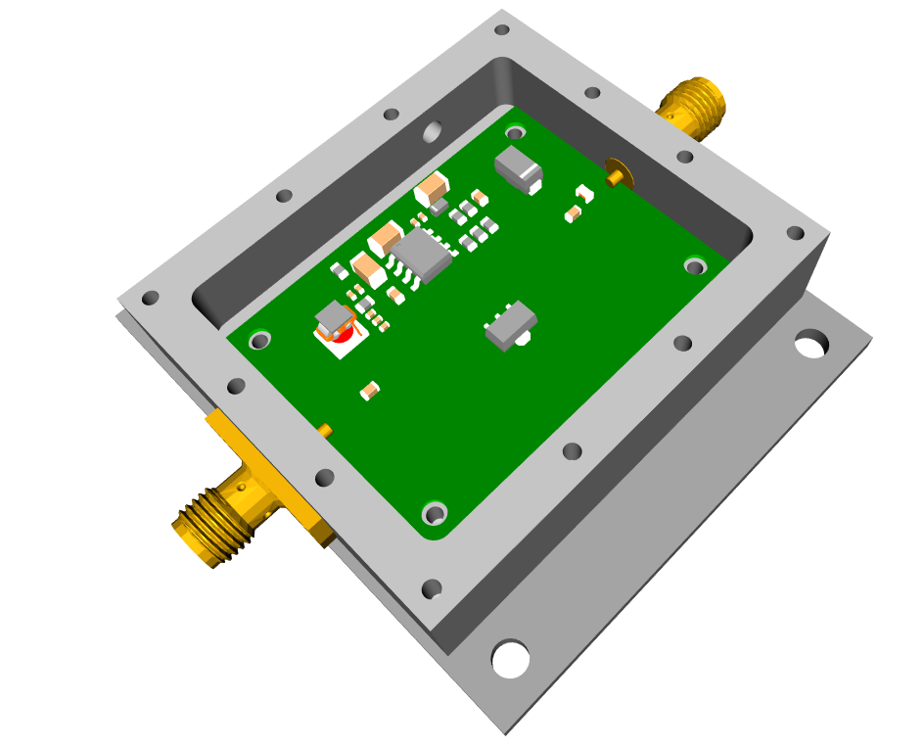
Final Product

Slide 16
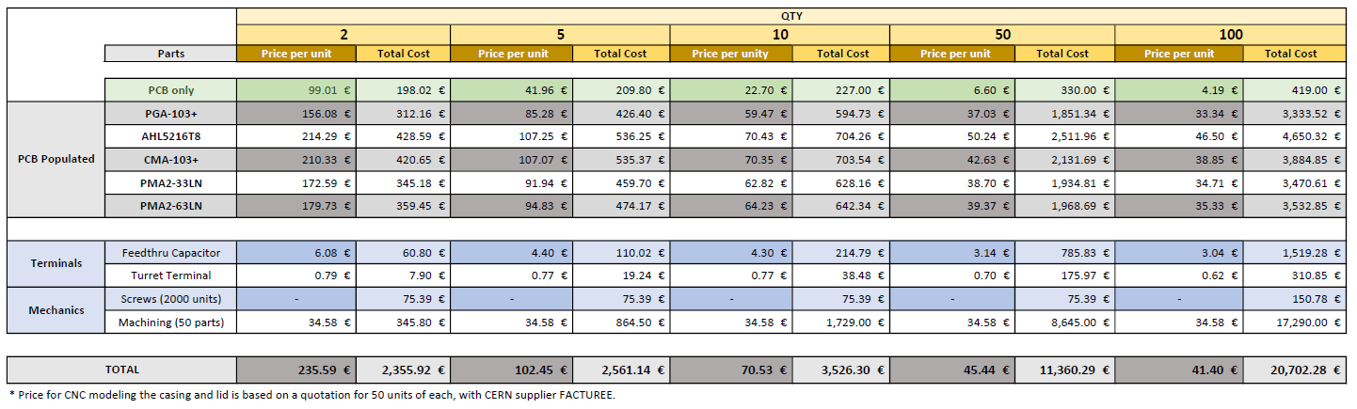
Bill of material

