Slide 1

ALPHA-g Magnets
Claire McDermott
Mentor: Dr. Will Bertsche

Slide 2
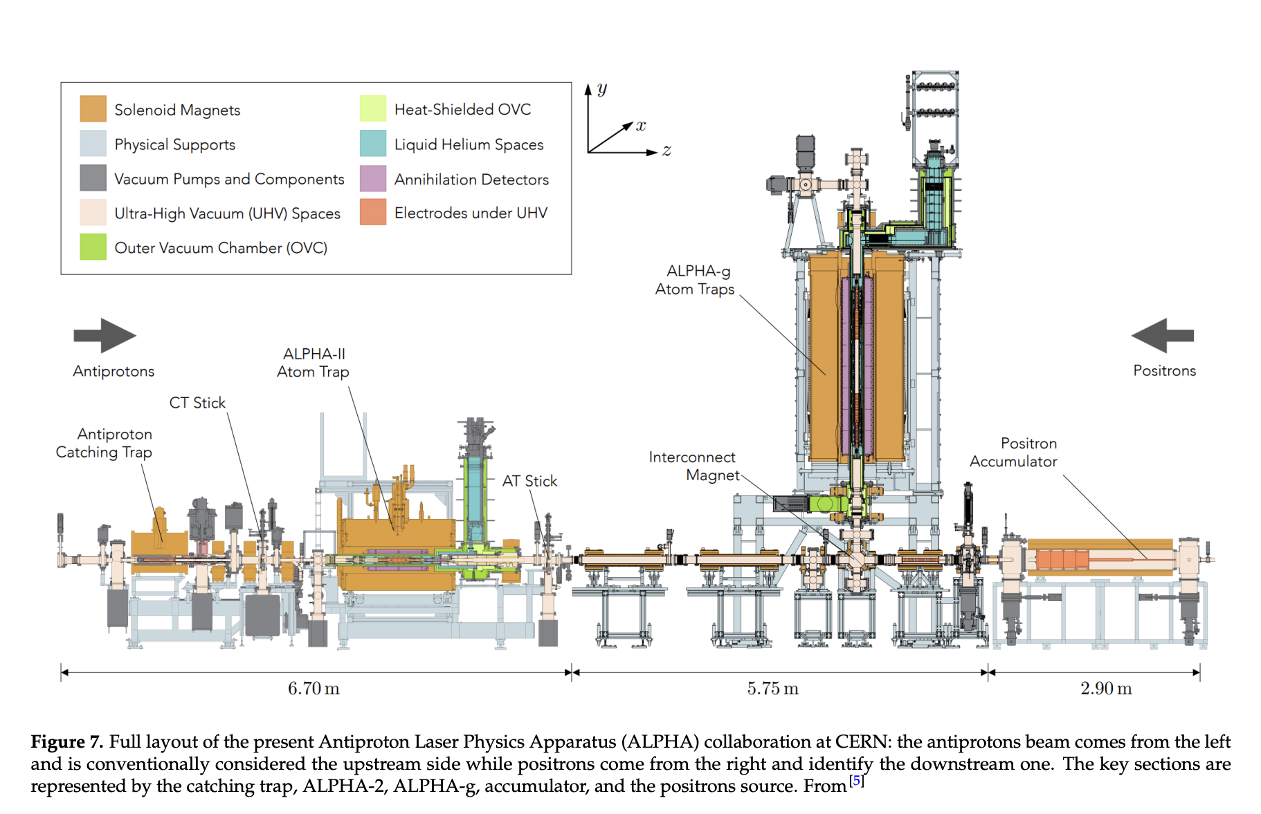

Slide 3
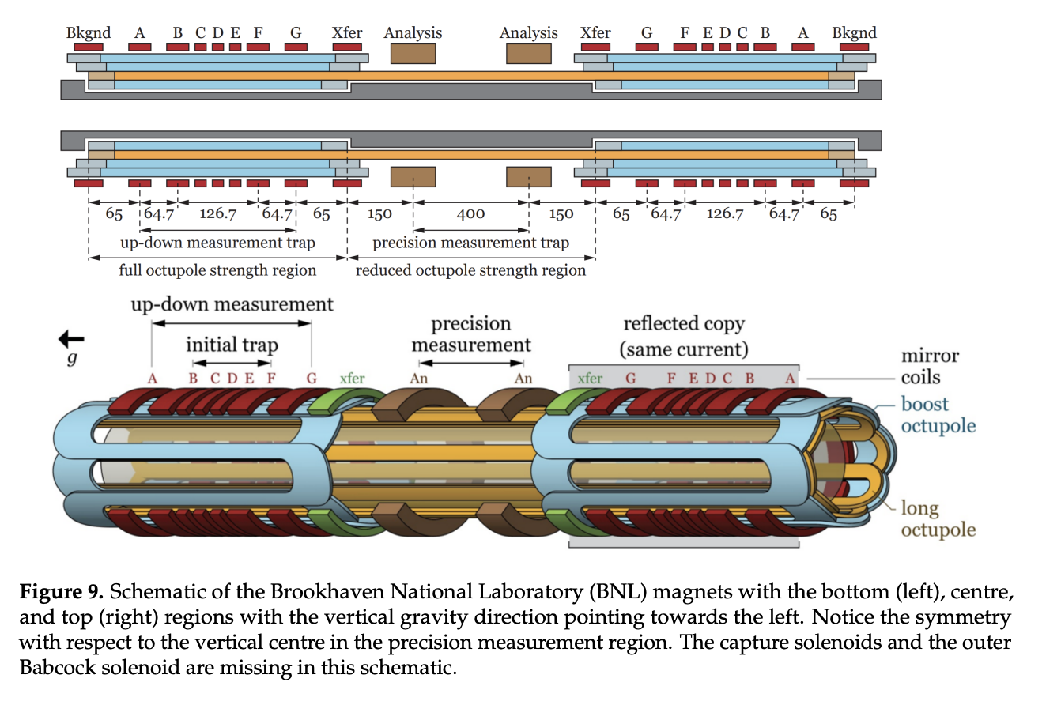

Slide 4
