Slide 1
Boosted VBF 4b Analysis Work
CERN Summer 2022

Slide 2
Project
ATLAS – Thomas Schwarz
Boosted VBF 4b
  2 Higgs produced via Vector Boson Fusion (VBF)
  Focusing on when each Higgs decays into a bottom quark-antiquark pair
  Boosted – affects location and content of the jets
Analysis
  Signal & Background sample generation & work
  Optimization
    Fitting, uncertainties, upper limit plot (constraining variables)

Slide 3
Objectives
Become more familiar with necessary concepts (root, kinematic variables, etc)
Work on tasks as they are generated (many tbd)
Continue work into the fall, use as basis for undergrad honors thesis

Slide 4
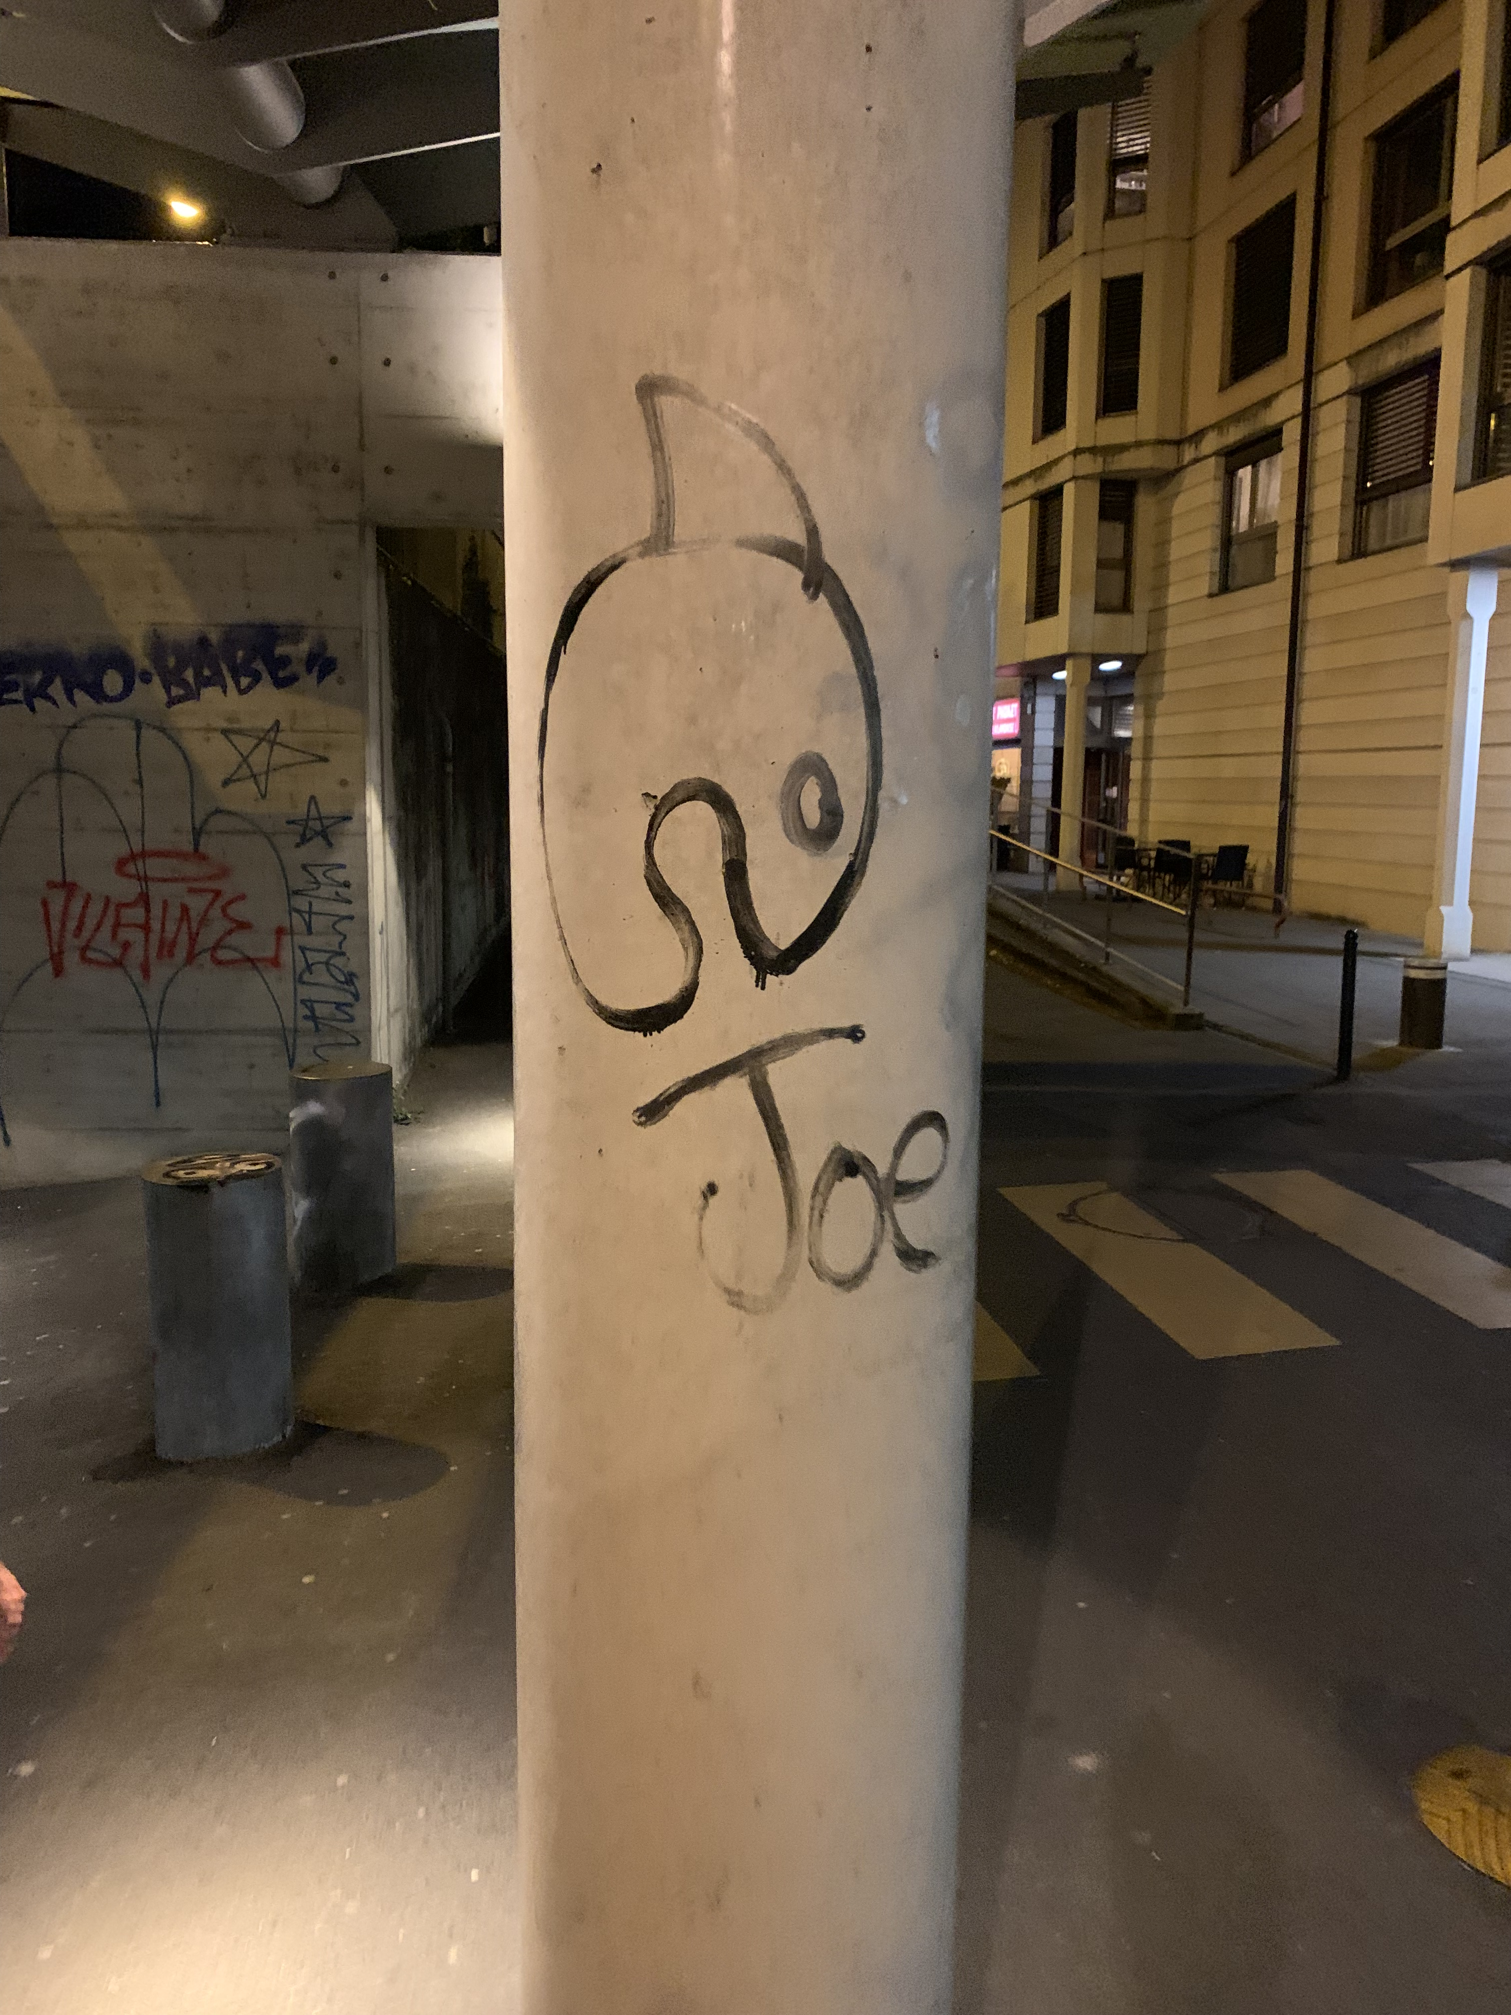
images from excursions
this is joe
5 points for anyone who can find joe
no cheating

Slide 5

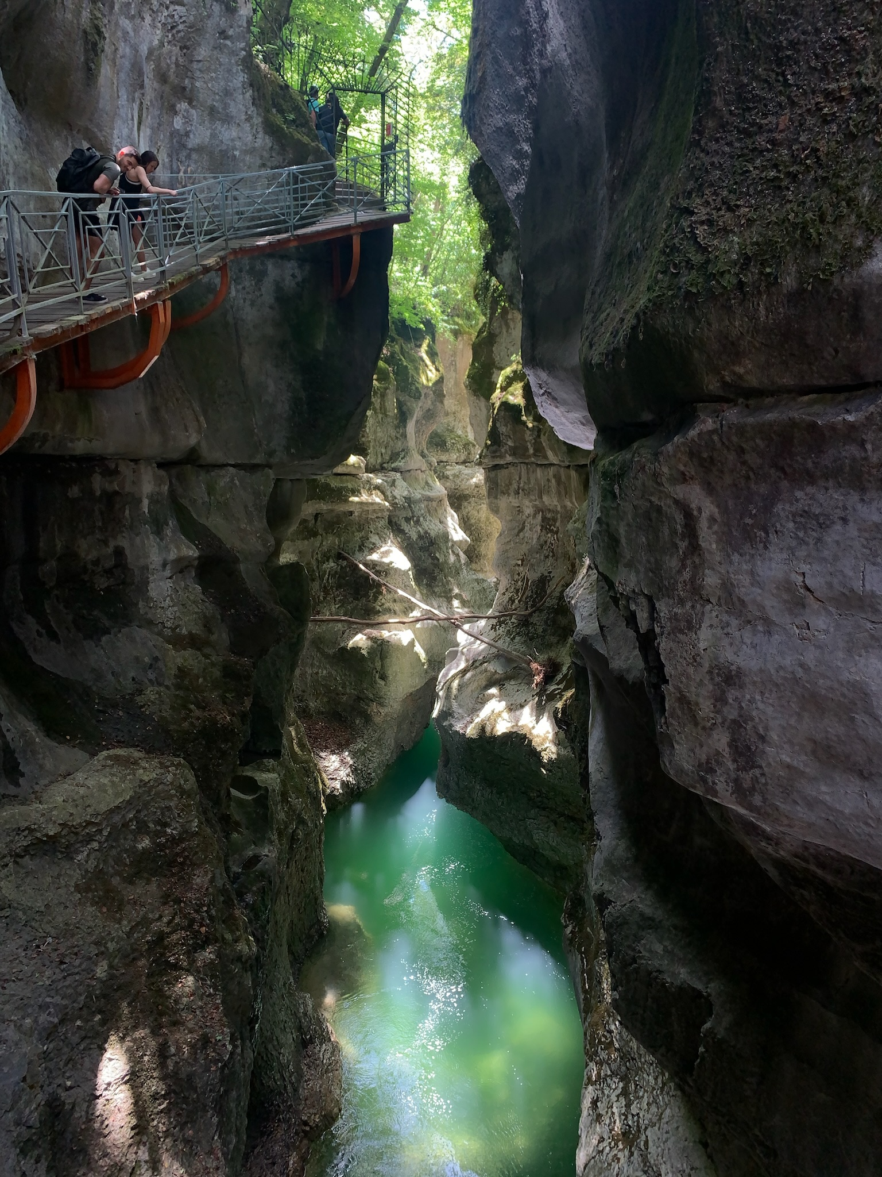
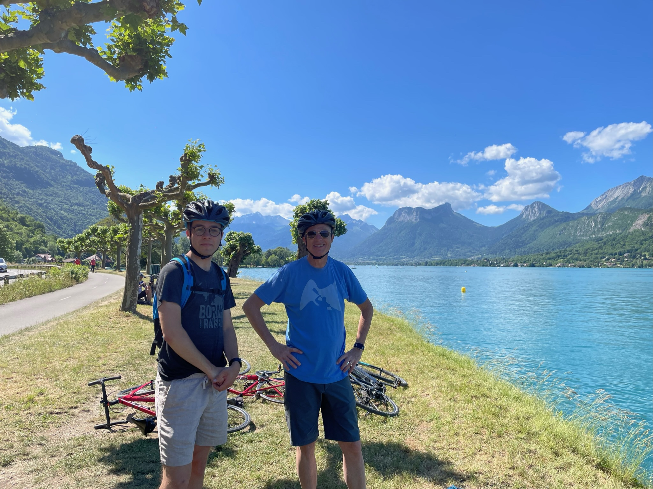
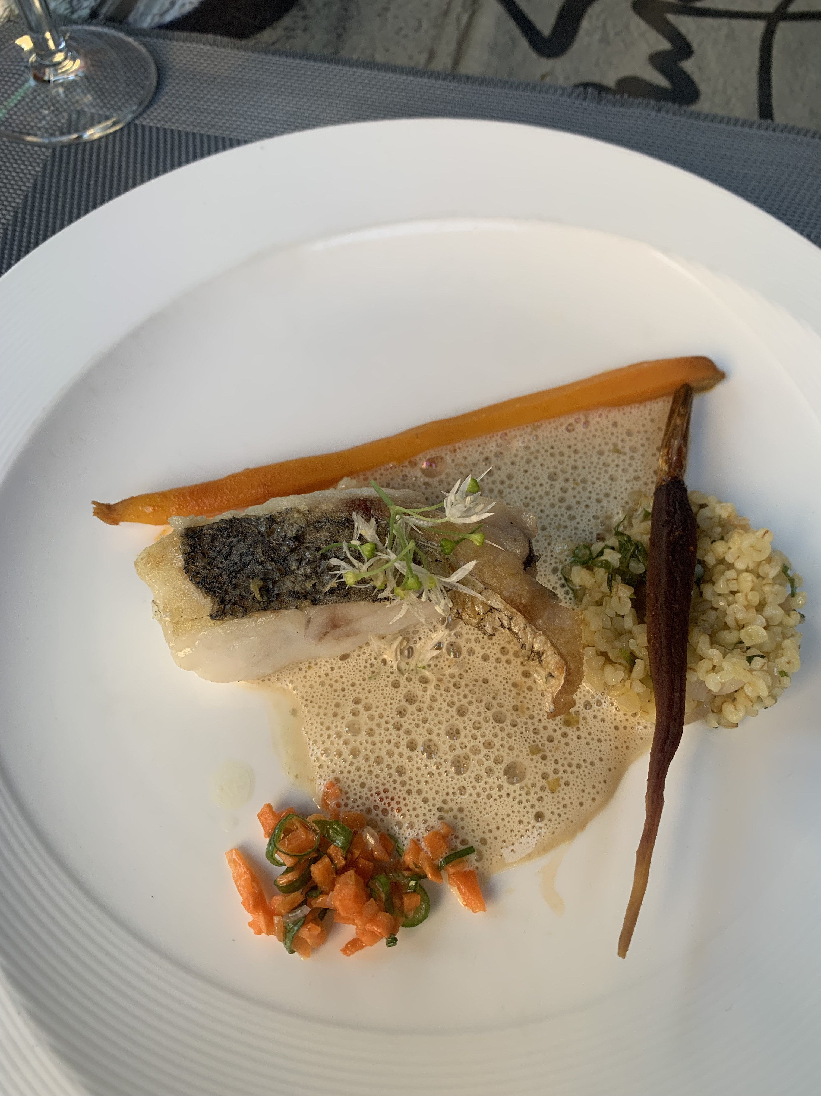
Annecy
Hiking
Biking
Food
etc

