Slide 1
LISA Academic Day
CERN / June 2022
Asar AH Jaradat ESR 2

Slide 2
Agenda
Objectives
Brief Literature Review
Experimental Setup
Future Plans

Slide 3
Objectives
Implementation of the PI-LIST device at ISOLDE
  Design and setup of infrastructure
    Characterization of its performance
      High-resolution laser spectroscopy studies using the PI-LIST
Development of optimal ionization schemes of actinides for ISOLDE
  Using laser spectroscopy of actinide elements
    Collaborations with other ESRs

Slide 4
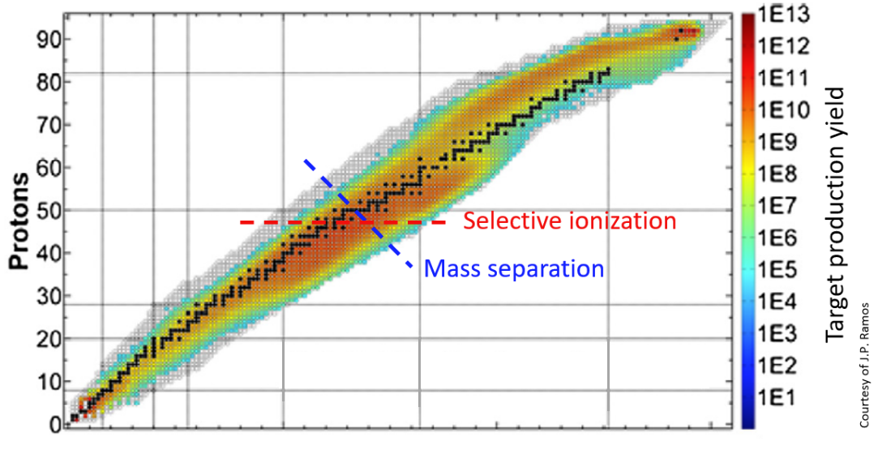
Literature Review

Slide 5
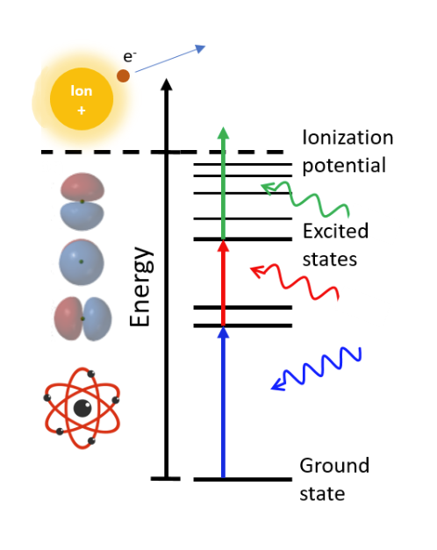
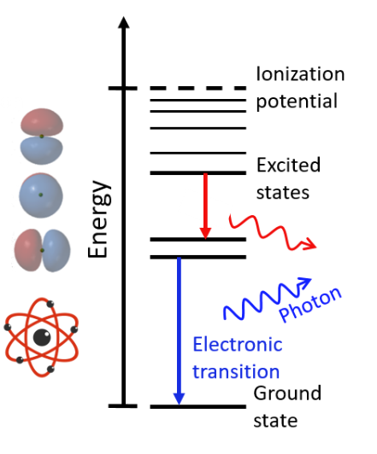
Literature Review

Slide 6
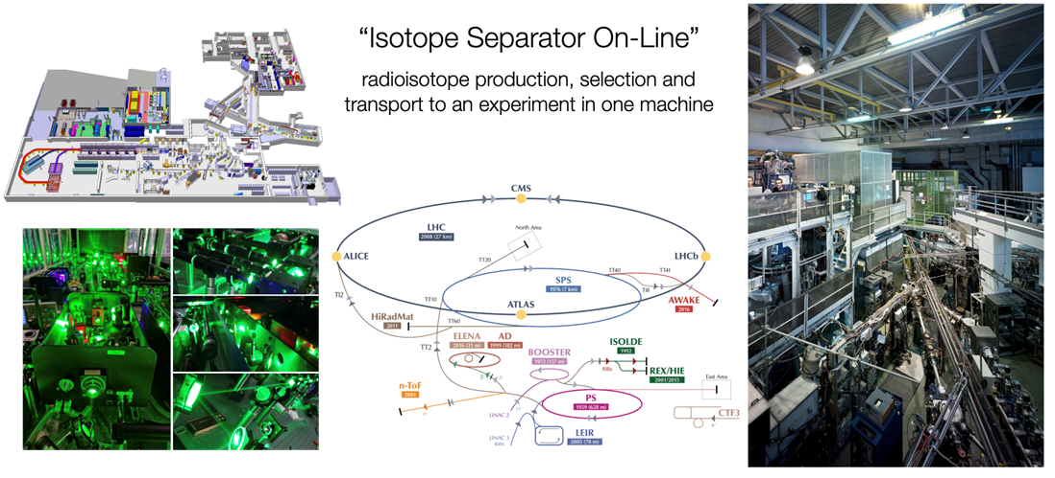
Setup- ISOLDE

Slide 7
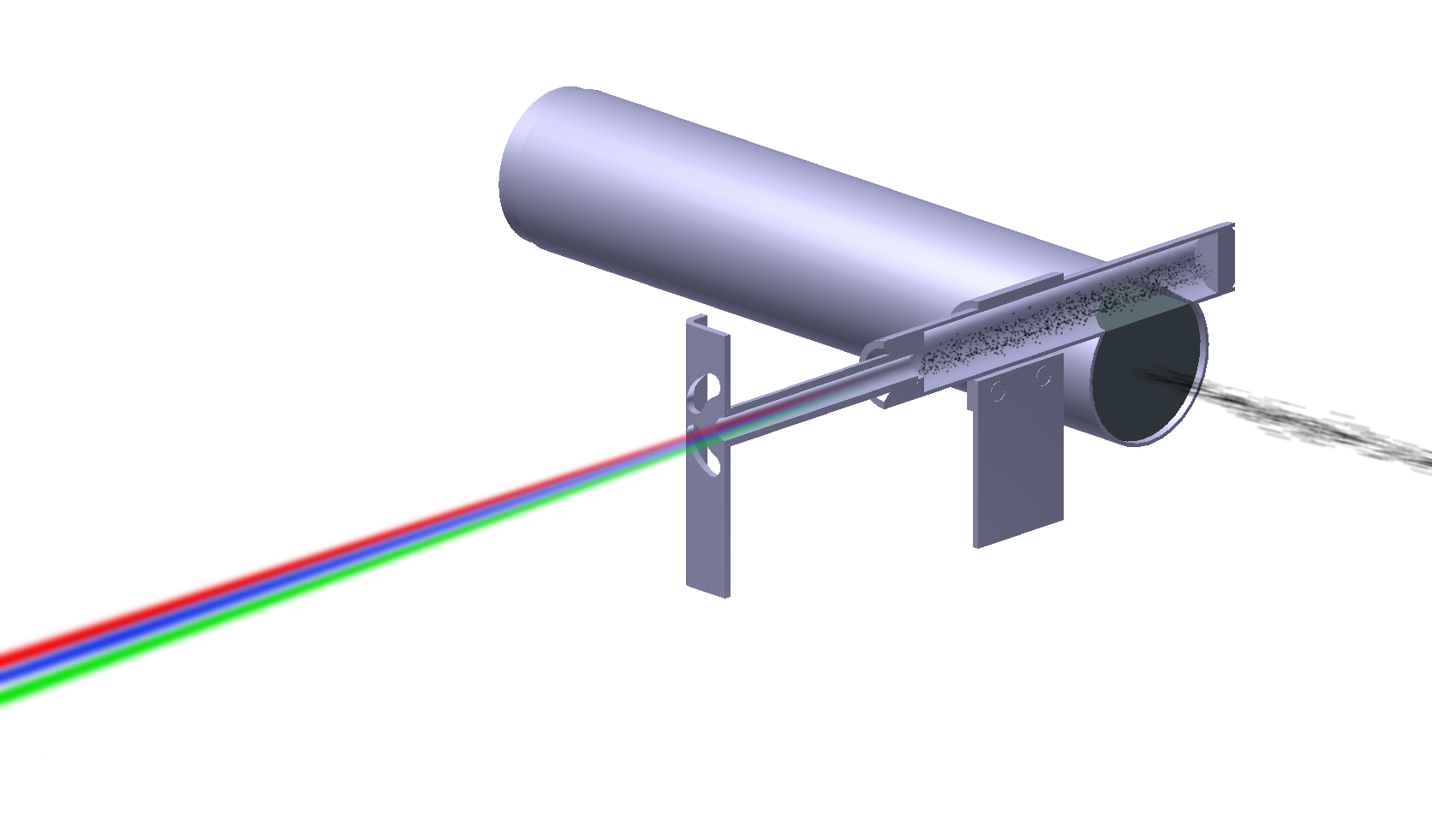
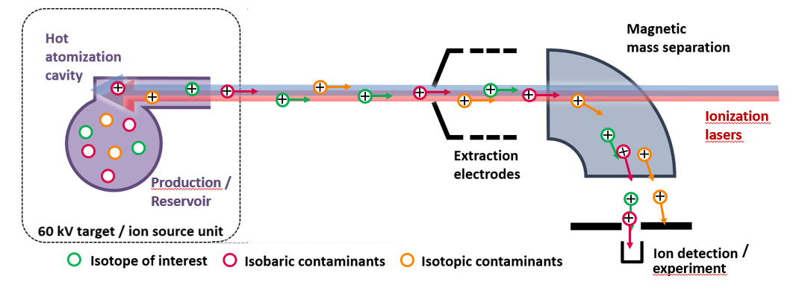
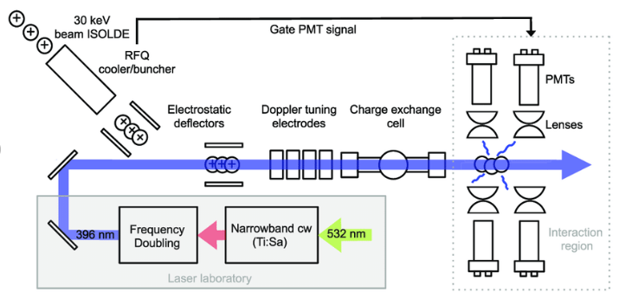
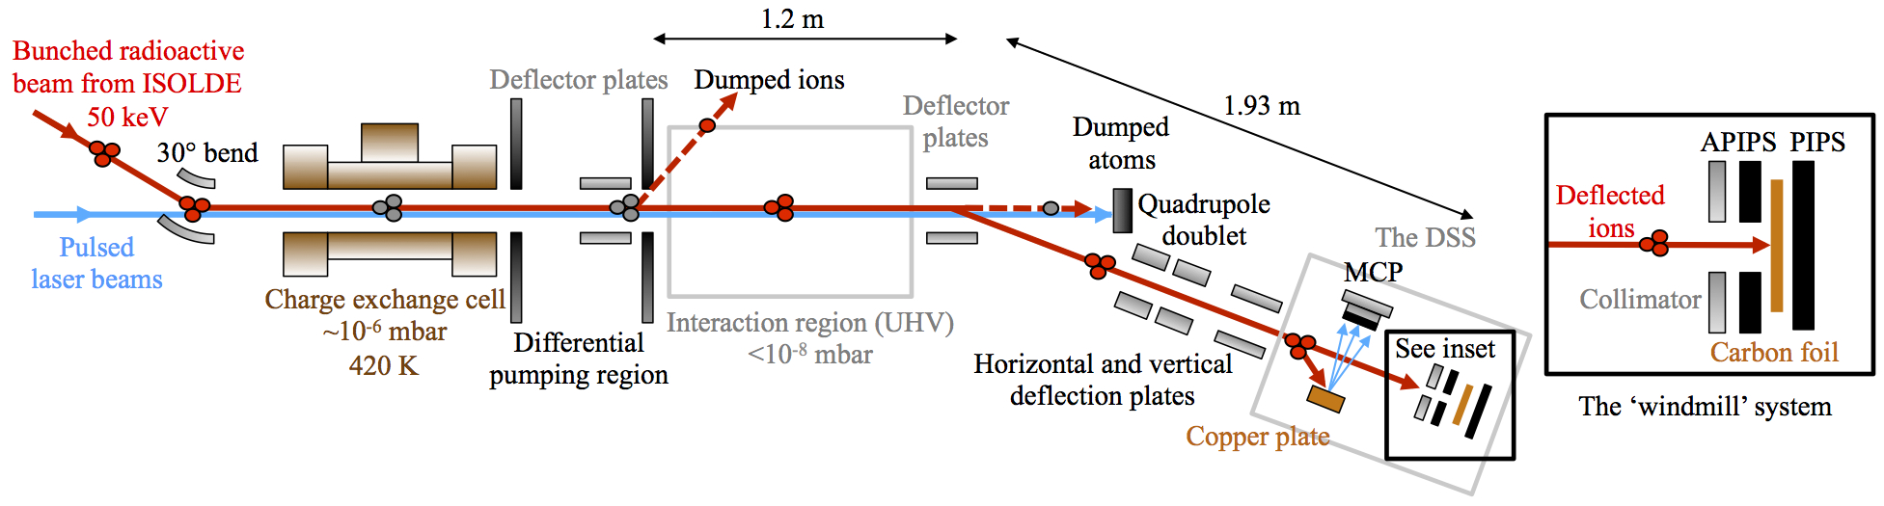
Setups in ISOLDE
RILIS¹
COLLAPS²
CRIS³
RILIS team documentation
High-resolution laser spectroscopy of Al 27 – 32 - Scientific Figure on ResearchGate. Available from: https://www.researchgate.net/figure/Schematic-depiction-of-the-COLLAPS-collinear-laser-spectroscopy-setup-at-ISOLDE-CERN_fig1_348767233 [accessed 15 Jun, 2022]
CRIS website

Slide 8
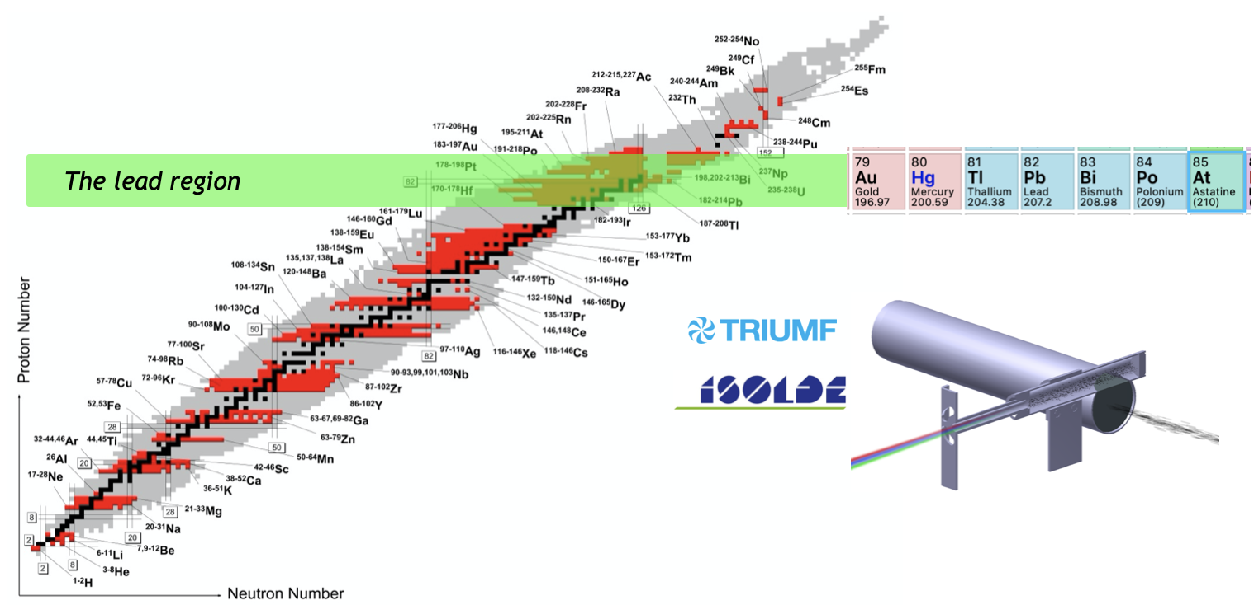
In-Source RIS so far at ISOLDE

Slide 9
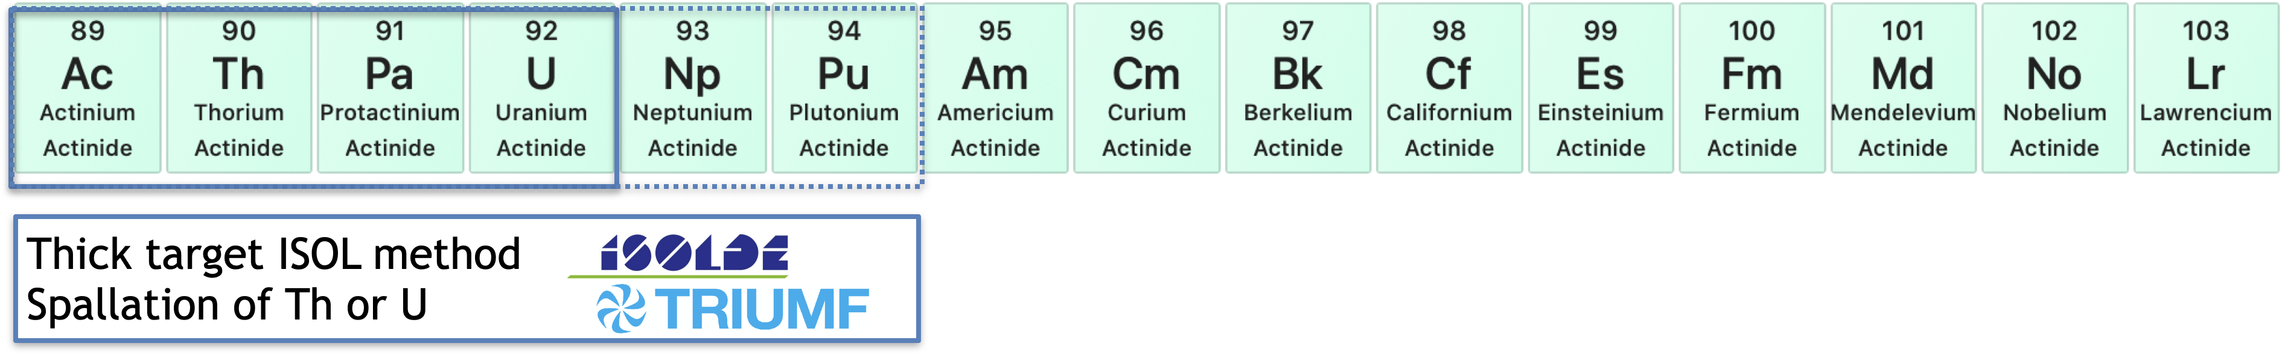
How does ISOLDE fit in to LISA
Laser ionization and spectroscopy of Actiniides
Asar – ESR 2
Production / Extraction of Actinides
Mia Au – ESR 3
New ionization schemes (with M. Kaja, Mainz)
Higher resolution in-source spectroscopy:
New high resolution in-source method (PI-LIST)
New laser technologies (with Mitzi@Hubner and Julius @ M²)

Slide 10
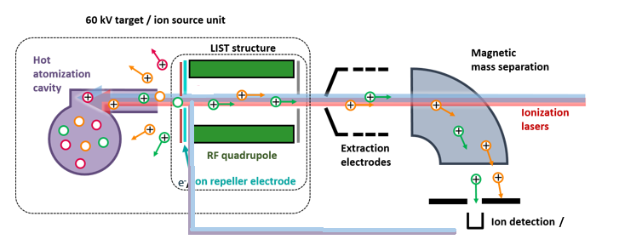
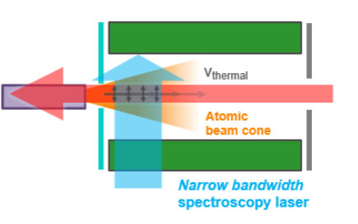
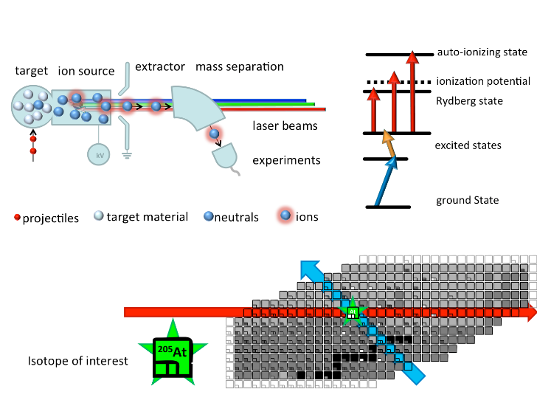
Setup: The Laser Ion Source and Trap LIST
Supression of surface ionized species
Field-free laser ionization region
Confinement during the drift along the field-free region
High-resolution spectroscopy
Proton beam

Slide 11
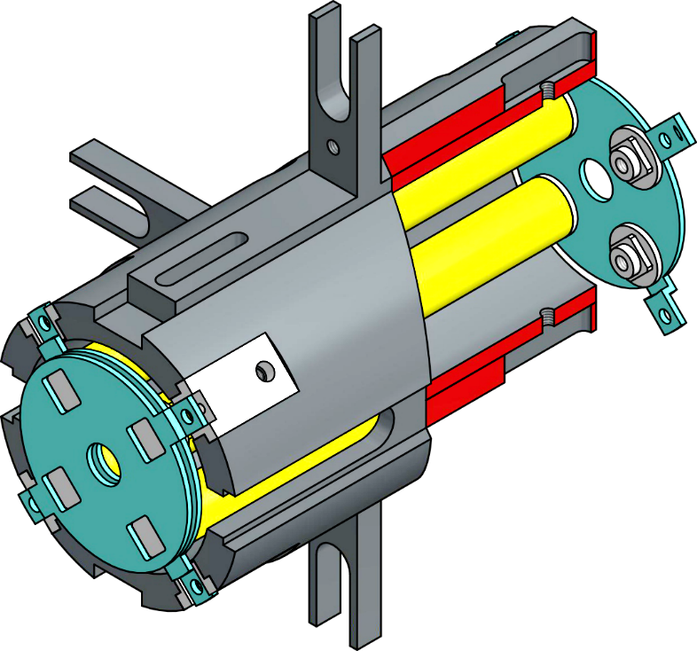
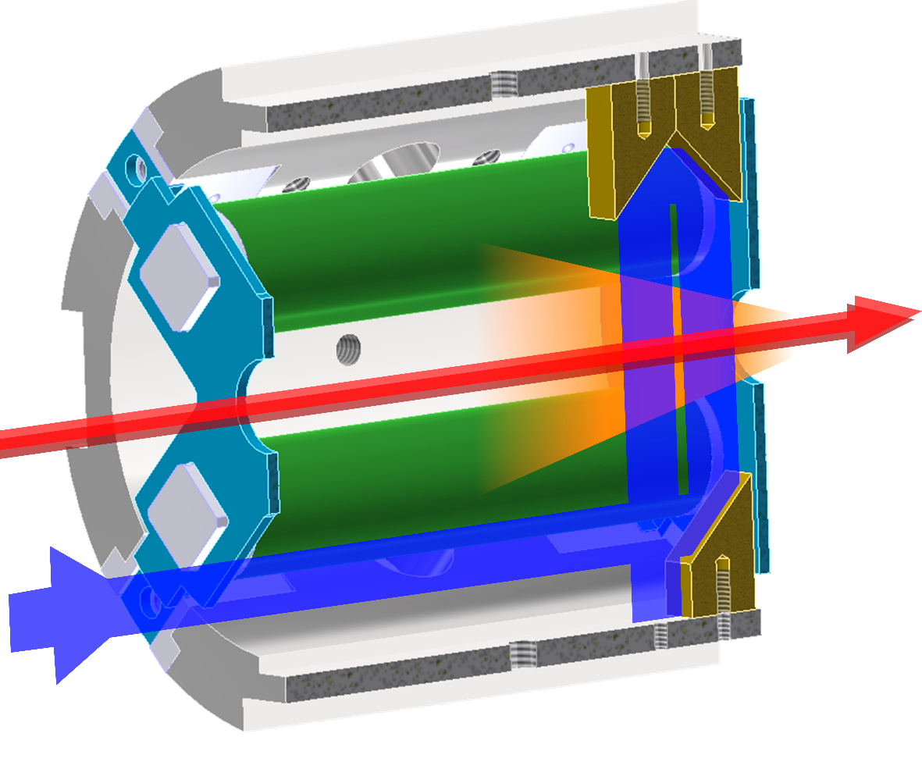
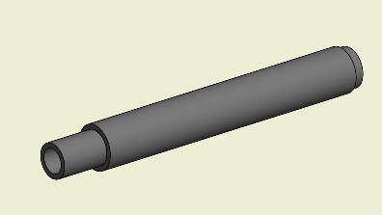
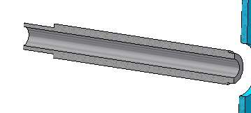
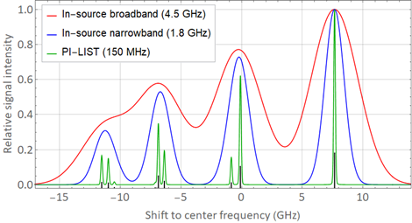
Perpendicular Illuminated Laser Ion Source Trap
Atomizer
[1] Adapted from R. Heinke PhD thesis

Slide 12
 | Broadband (10 GHz) | Narrowband (1 GHz) | Fourier limited (< 100 MHz)
Ion guide | Maximum efficiency, low resolution, no isobar suppression (for general ion beam production when surface ionized isobars are not a concern) | High efficiency, intermediate resolution: for Isomer separation or laser spectroscopy of isotopes with large IS or HFS, and when isobar suppression isnt needed | Not applicable: high resolution laser would not improve experimentally observed linewidth
LIST (collinear) | 20-50 x efficiency loss compared to ion guide, low resolution, good isobar suppression (for general ion beam production when surface ionized isobars are a major concern) | 20-50 x efficiency loss compared to ion guide, intermediate resolution, good isobar suppression: for Isomer separation or laser spectroscopy of isotopes with large IS or HFS, and when isobar suppression isnt needed | Not applicable: high resolution laser would not improve experimentally observed linewidth
PI-LIST | Not applicable. | Improved resolution, but with slight efficiency loss. Experimental resolution will be limited only by the laser linewidth: for use when Doppler broadening is dominant in collinear mode (lighter isotopes or when a slight resolution improvement is needed). | High resolution, but with slight efficiency loss. Experimental resolution will be limited only by the atom beam divergence (~100-300 MHz): for use when resolution is of prime importance (small IS or HFS).

Slide 13
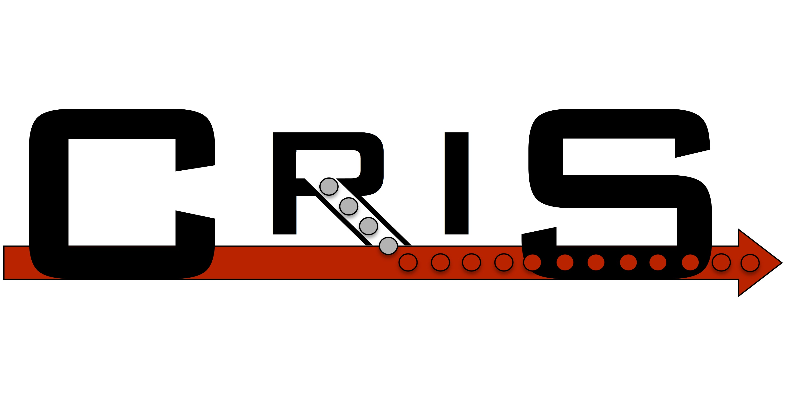
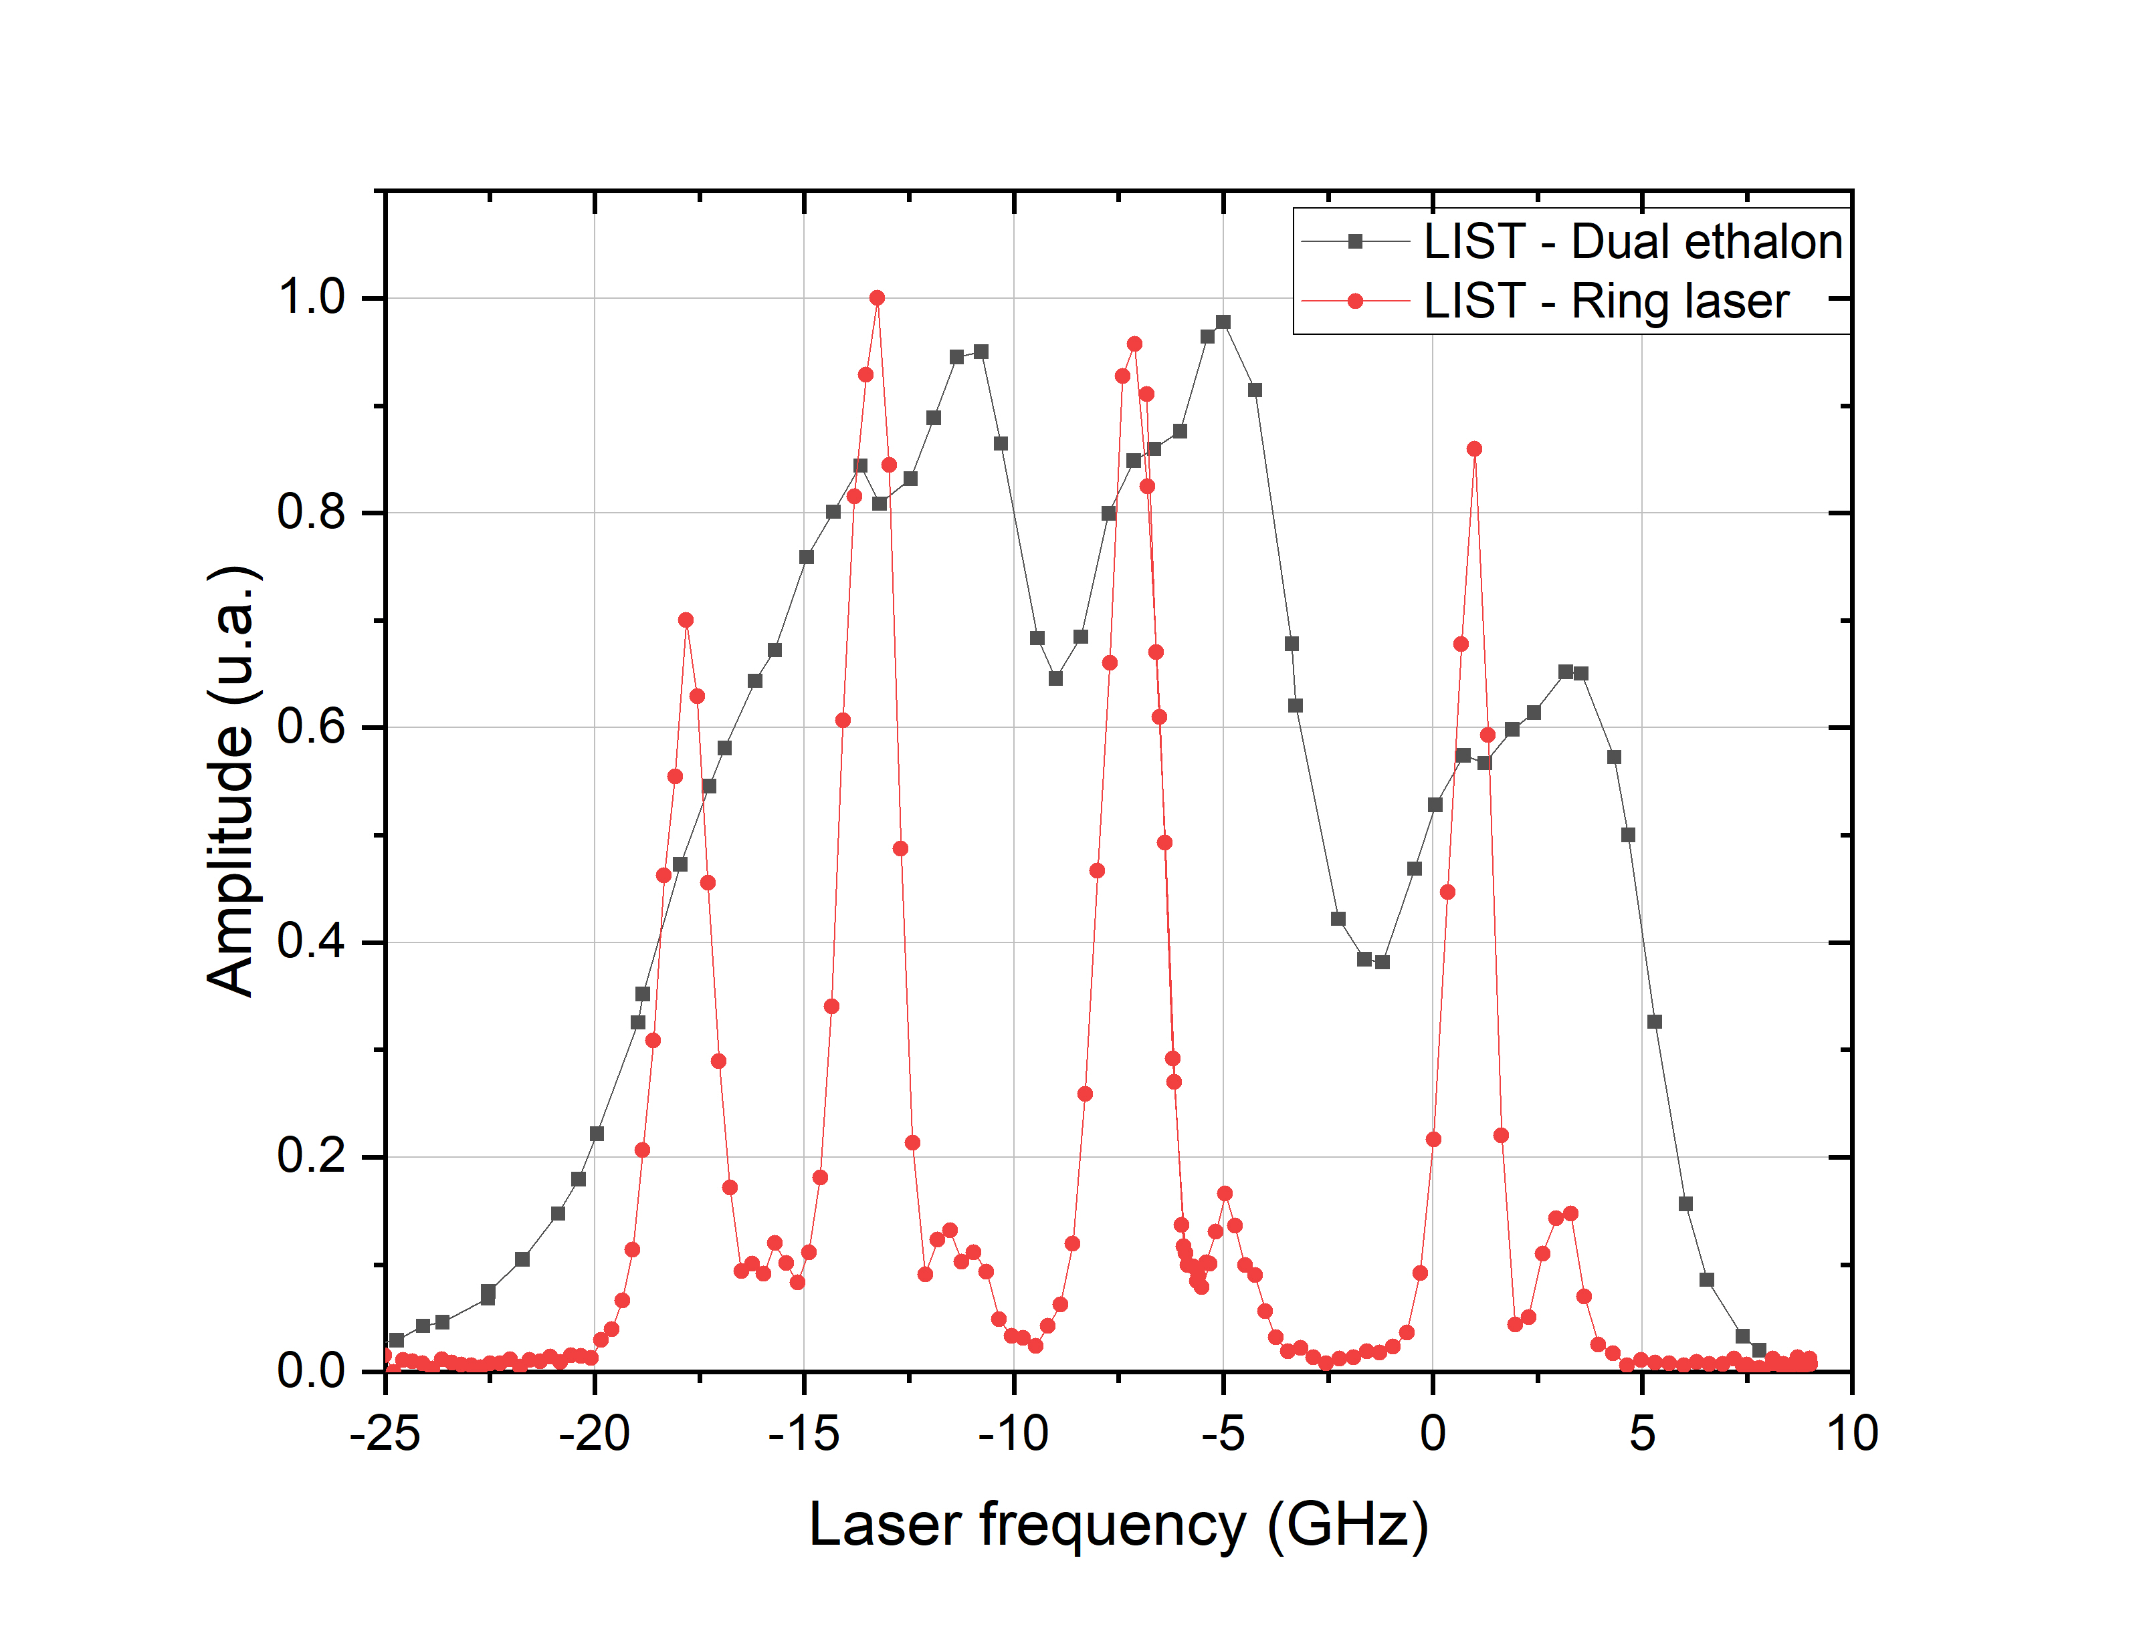
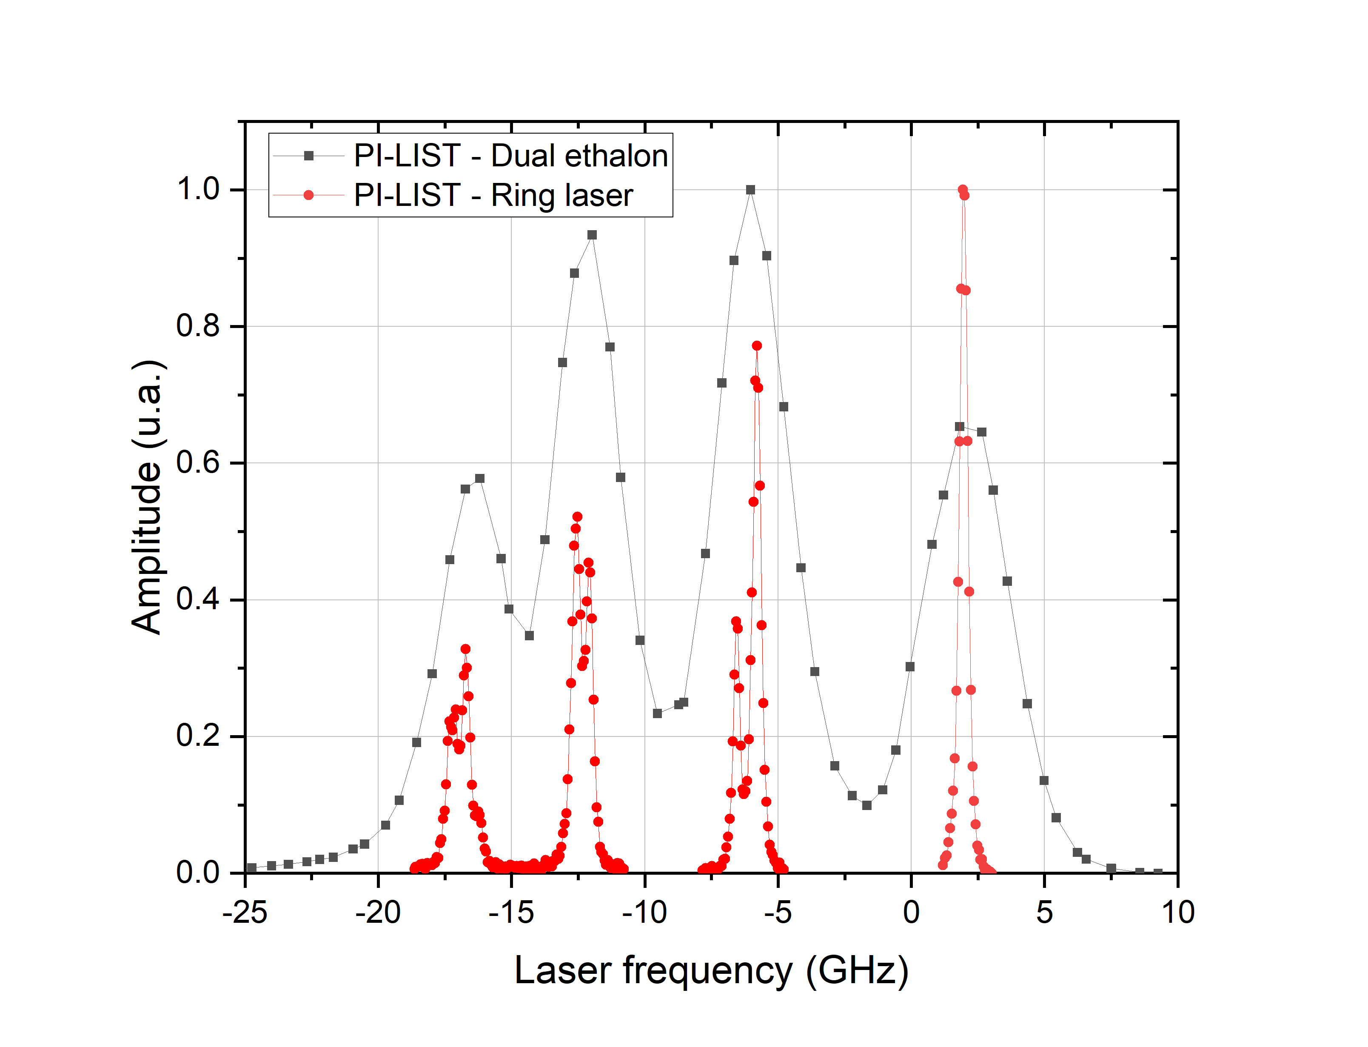
Narrow-band laser system:
CRIS Matisse cw-Tisa
+ RILIS seeded ring cavity
Results
Ac 227
Ac 227
First analysis by Michael Heines
Taken from Cyril Bernerd‎

Slide 14
Conclusion
  Successful initial implementation of the PI-LIST in ISOLDE.
  PI-LIST proof of concept and first high-resolution in-source spectroscopy of Ac.
  Efficiency of perpendicular geometry setup was comparable to collinear setup.

Slide 15
Thank you For Listening ☺

