Slide 1
COMMUNICATION strategy for prismap
PRISMAP social media
Wiktoria Wojtaczka, LISA Academic Day

Slide 2
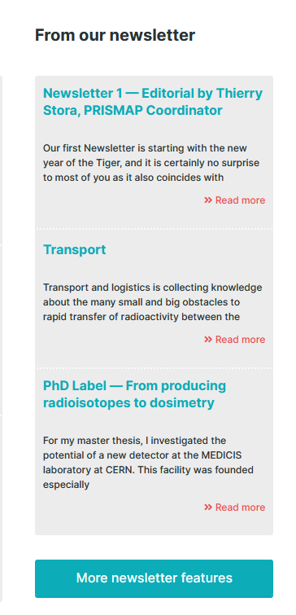
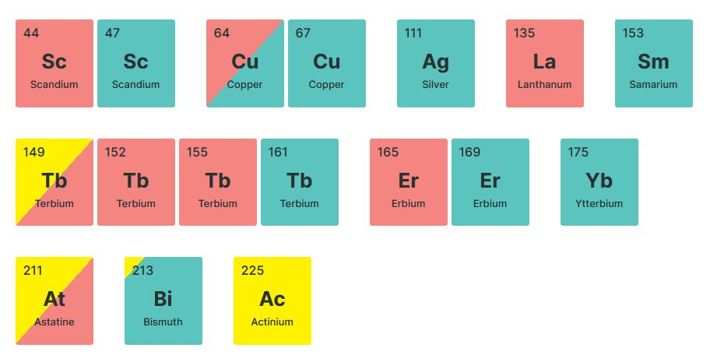
Communication strategy
Structured campaigns

Slide 3




Communication strategy
Structured campaigns
Targeting relevant international days

Slide 4


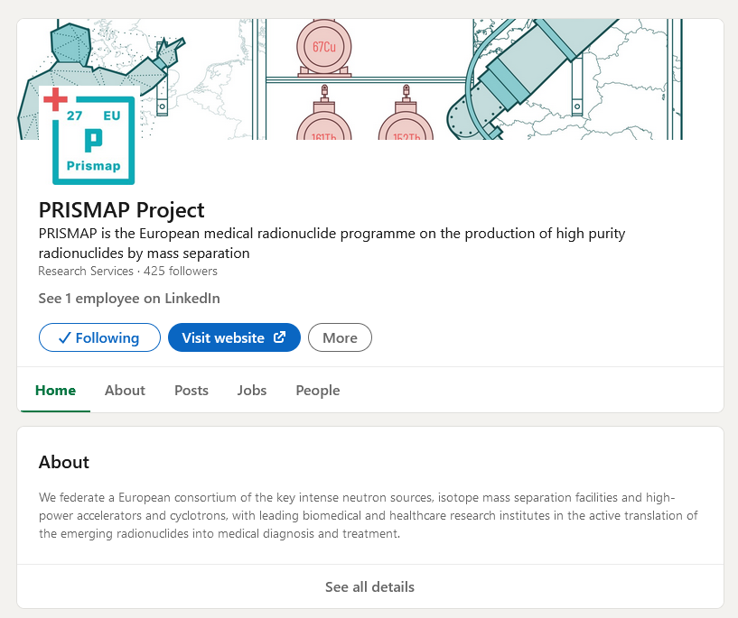
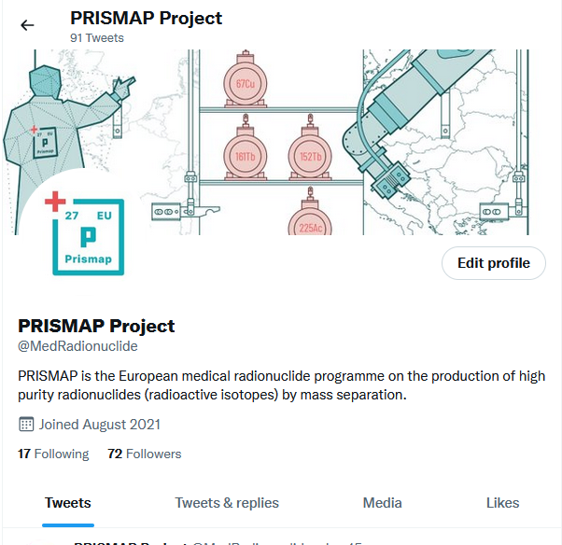
Communication strategy
Structured campaigns
Targeting relevant international days
Using LinkedIn and Twitter in tailored ways

Slide 5
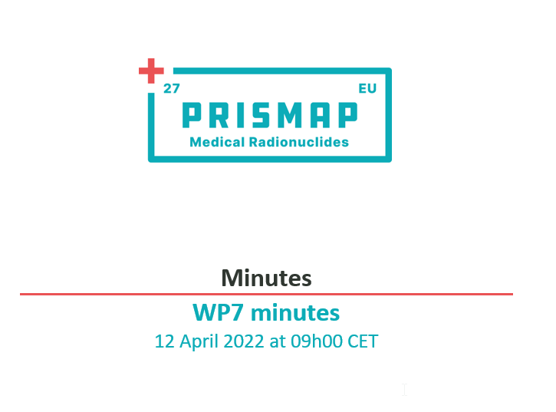
Communication strategy
Structured campaigns
Targeting relevant international days
Using LinkedIn and Twitter in tailored ways
Regular meetings of the social media team

Slide 6
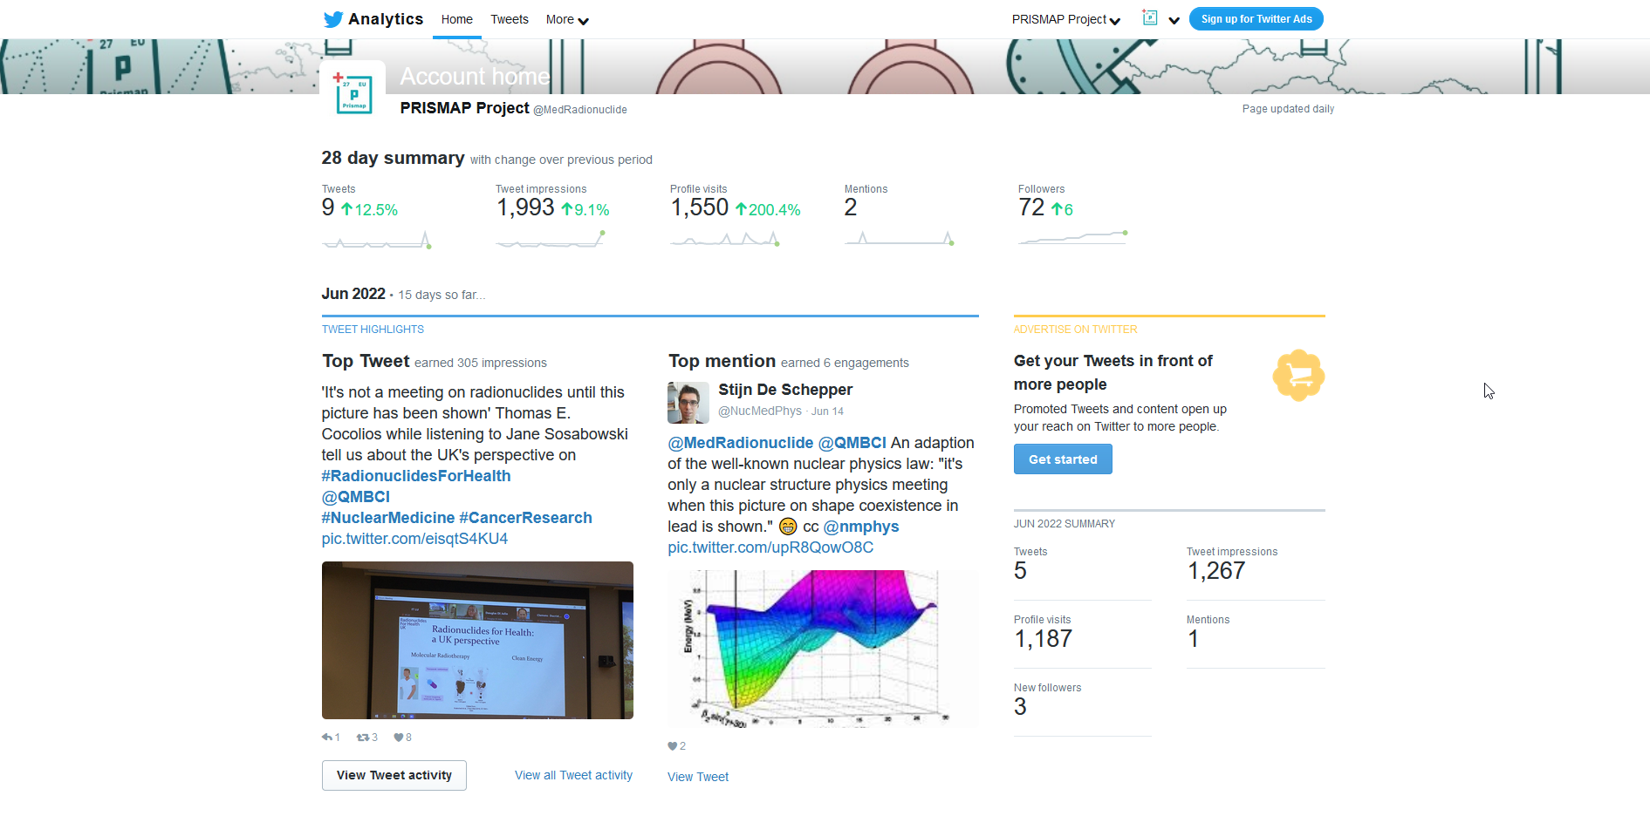

Slide 7
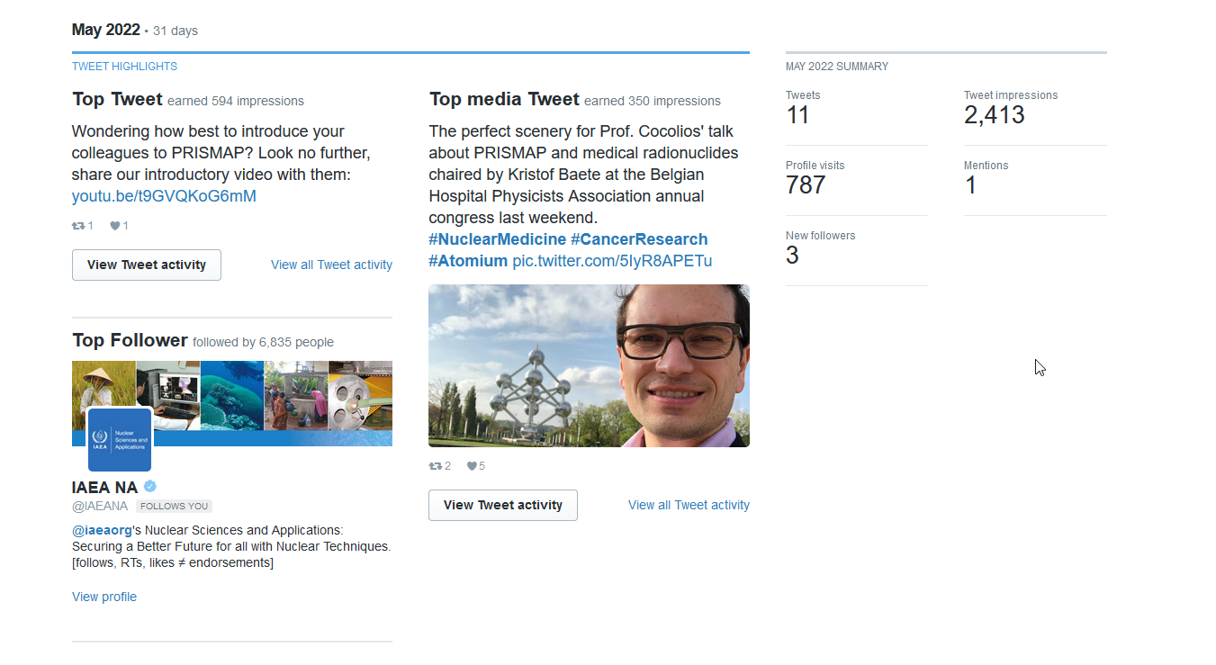

Slide 8
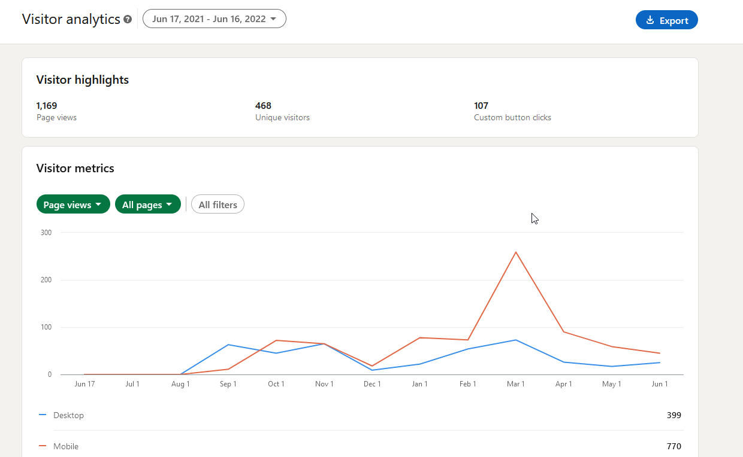

Slide 9
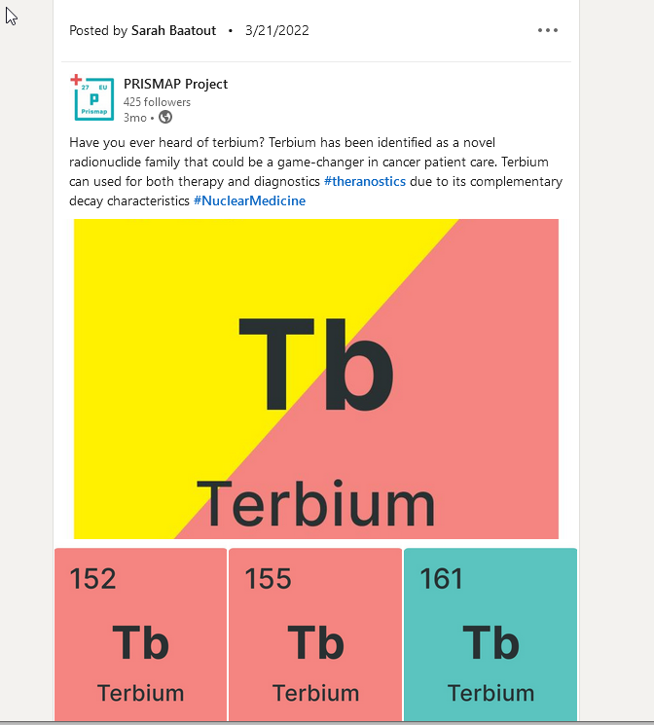

Slide 10
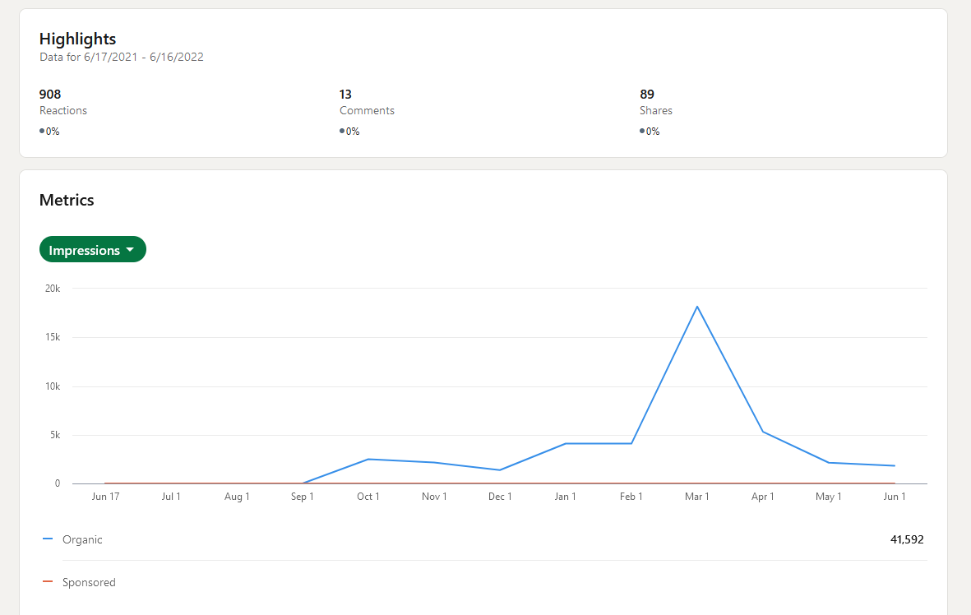

Slide 11
