Slide 1

Maintenance and Operation Categories A & B
LHC RRB Scrutiny Group Spring Meeting 2011
C. Decosse

Slide 2
M&O-A 2010 book closing
M&O-A 2012 preliminary budget and estimates for the period 2013-2015
M&O-B 2012 preliminary budgets and estimates for the period 2013-2015

Slide 3
2010
2010 has been the first full year of ALICE operation, and included a long run of data taking with pp and one month with PbPb.
2010 started with a technical stop of 1.5 month. On Feb 14th the run of data started. These first weeks have been dedicated to the maintenance of gas systems, detectors cooling plants, cooling tower and various electrical maintenance works, which are done during technical stops. In running mode, we had approximately every 6 weeks short technical stops during which maintenance and repair works have been regularly done.
Mid-December, right after the Heavy Ion run, the detector has been opened in order to allow further installation of 3 TRD and 6 EMCal modules. We also used this shutdown to start the consolidation of the ventilation system for the detector central areas, the work on the ventilation will continue in 2011. Many maintenance activities on the ALICE detector were carried out during this Christmas shutdown.

Slide 4
M&O-A incomes and outstanding contributions 2002-2010
Closing date 31/12/2010
Unit: KCHF
Outstanding paid early 2011:
Greece 43 kCHF
Croatia 22 kCHF
Russia 25 kCHF
Still due for 2002-2010
Poland 36 kCHF
Brazil 24 kCHF
China Beijing 13 kCHF
JINR 34 kCHF
Ukraine 41 kCHF
Over paid
Armenia + 5 kCHF
USA DOE + 77 kCHF

Slide 5
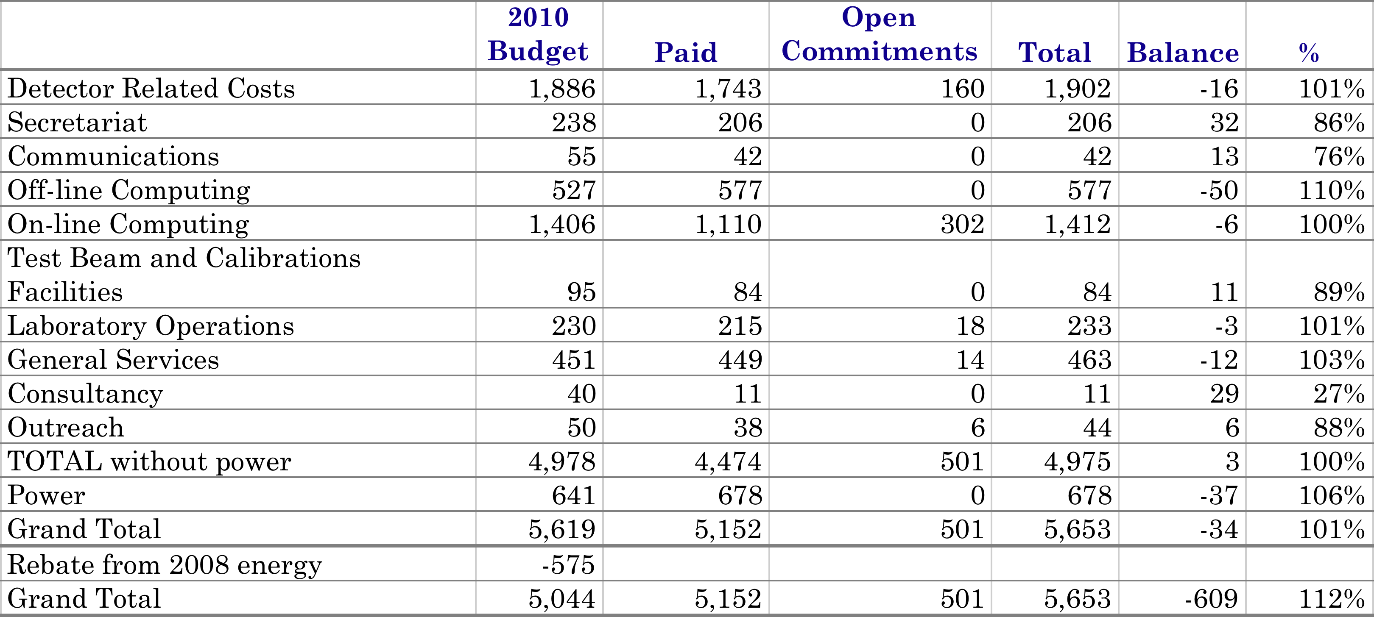
2010 M&O-A expenditure in kchf
2010 has been the first full year of ALICE operation, and included a
long run of data taking with pp and one month with PbPb.
5,152 kCHF paid in 2010, includes 513 kCHF of orders/contracts from 2009.

Slide 6
M&O-A summary 2002-2010
Cash balance: Income and Payments in kchf

Slide 7
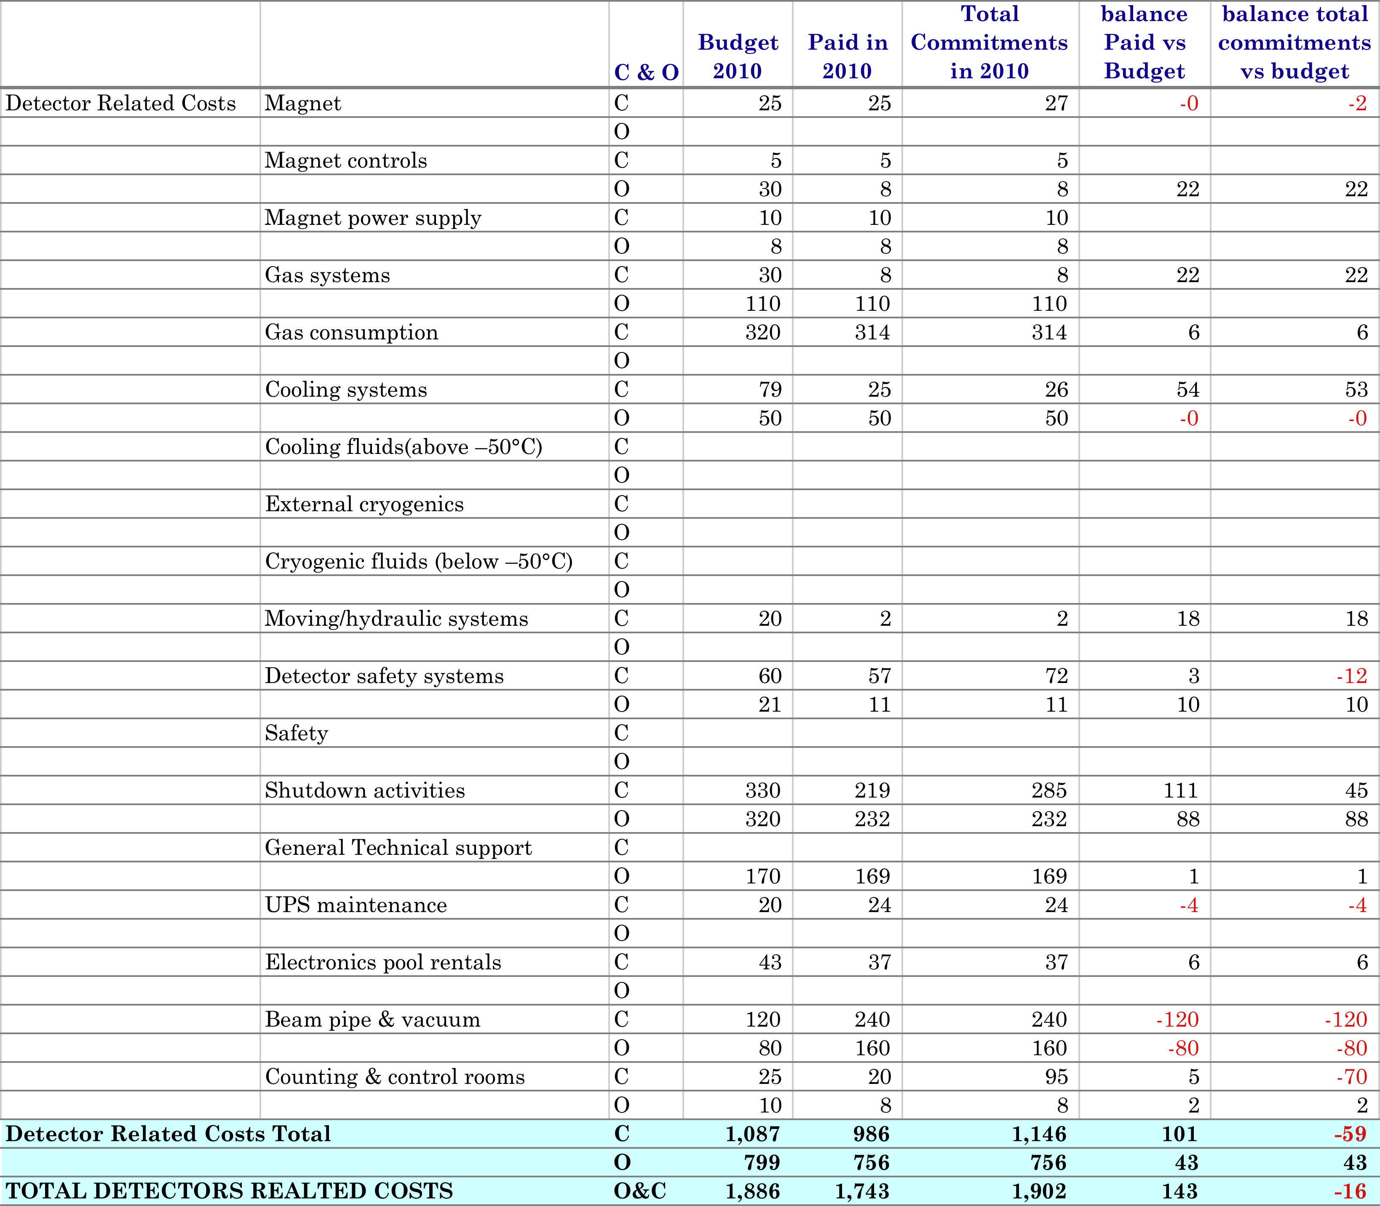
Detector Related Costs
The hydraulic system of the L3 magnet’s doors had to be checked and repaired at the end of 2010 (cost ~21 kCHF).
Safety items are still included under the budget DSS. The maintenance of the sniffers (~ 25 kCHF) and the purchase of RP vacuum cleaner and of measurement devices (~ 10 kCHF) are the main safety expenses done in 2010.
we started the construction of the super-structure, which is needed to put the TPC in parking position to access the beam pipe and the inner detectors, as well as the structure, which will hold the mini-frame during the installation of last TRD modules, which should be installed during the 2011 Christmas shutdown.
SLAs for the maintenance of power converters, magnet control systems, rack control systems and DSS, beam pipe and vacuum (2009 + 2010 paid in 2010), detectors gas and cooling systems have been paid.
more racks have been equipped with cooling doors and their electrical distributions boxed with circuit breakers (~70 kCHF).

Slide 8
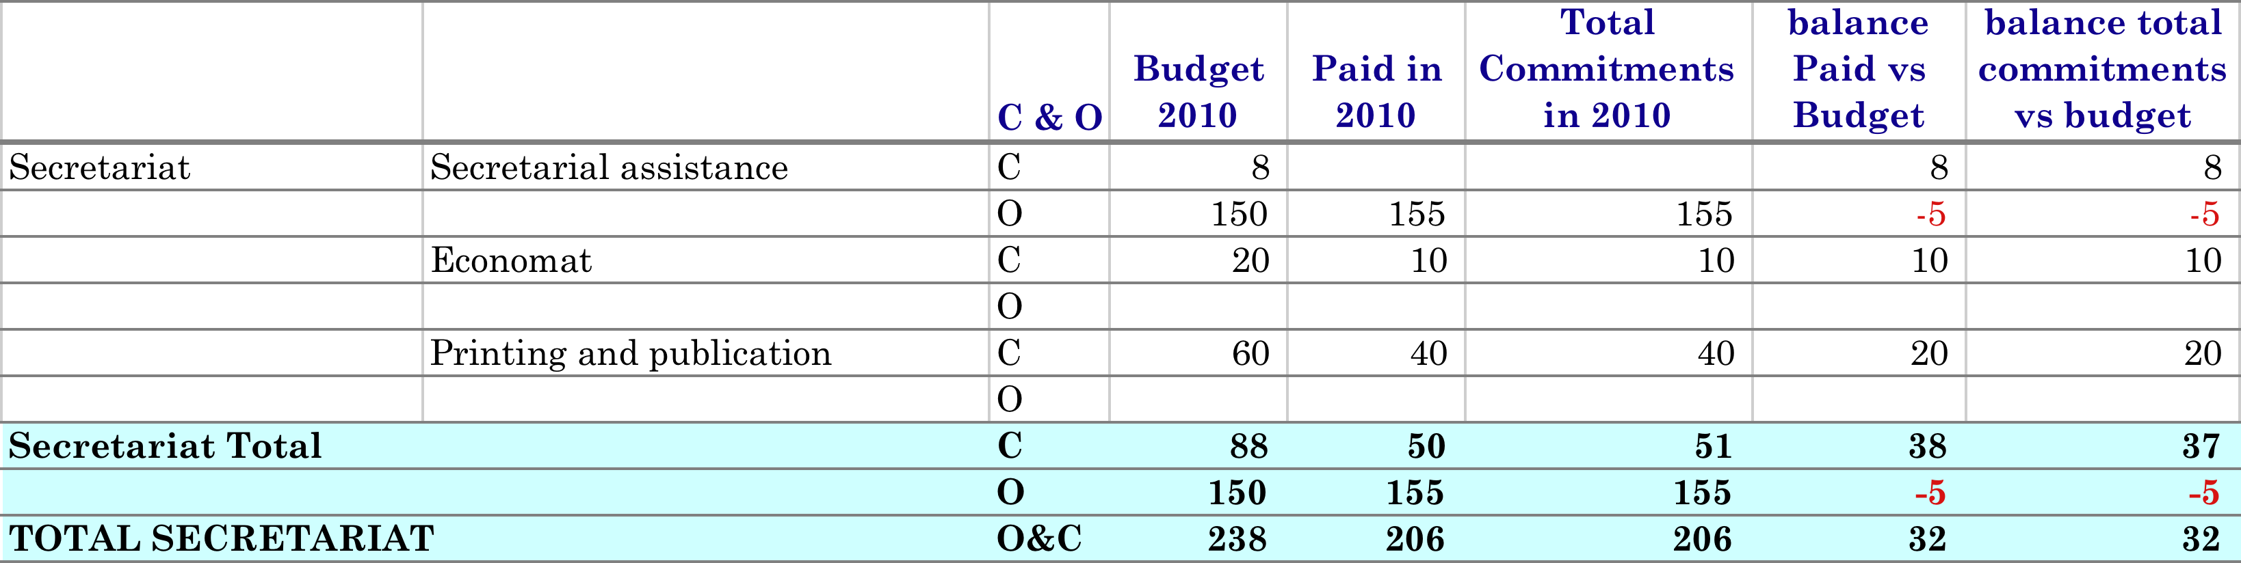
Secretariat

Slide 9
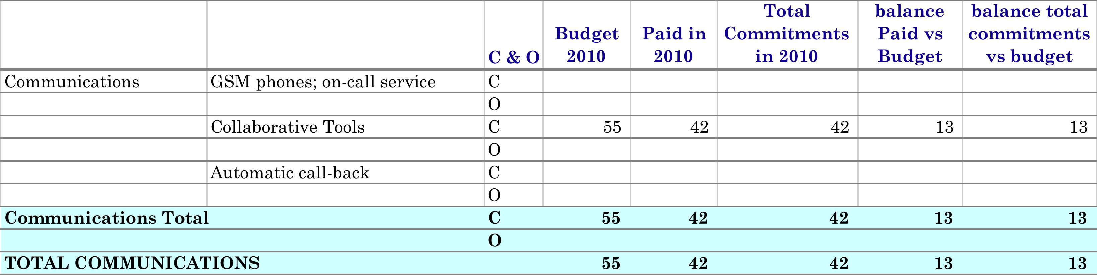
Communication

Slide 10
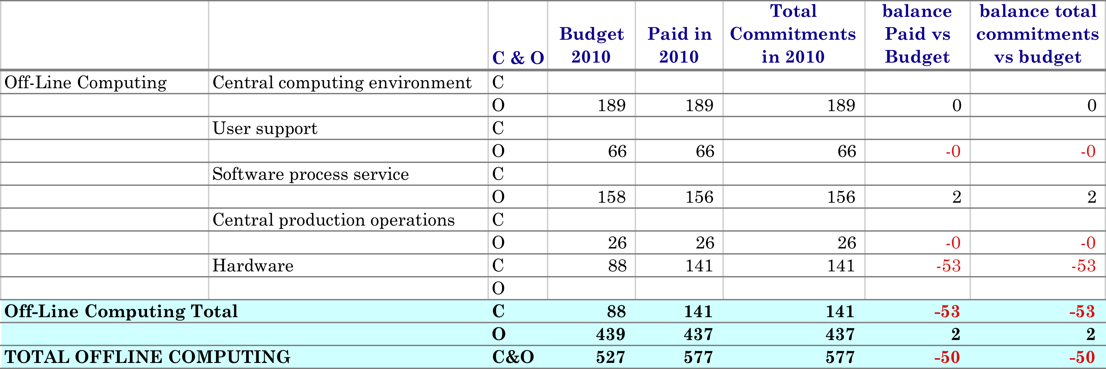
OFFLINE Computing
Offline Grid servers were upgraded following the standard 3 years replacement strategy, with the following exceptions:
2 database servers in 2009 (paid in 2010) in preparation for first physics data taking in 2010. The increased capacity was needed to meet the anticipated high load due to user analysis of first physics data and also as a failover in case of emergency.
2 front-end servers in 2010, preparation for the Heavy Ion run in November-December 2010. The new server were added to the existing pool of data registration servers to assure additional capacity for the increased data volume and sufficient throughput to support data reconstruction and analysis activity during the run.

Slide 11
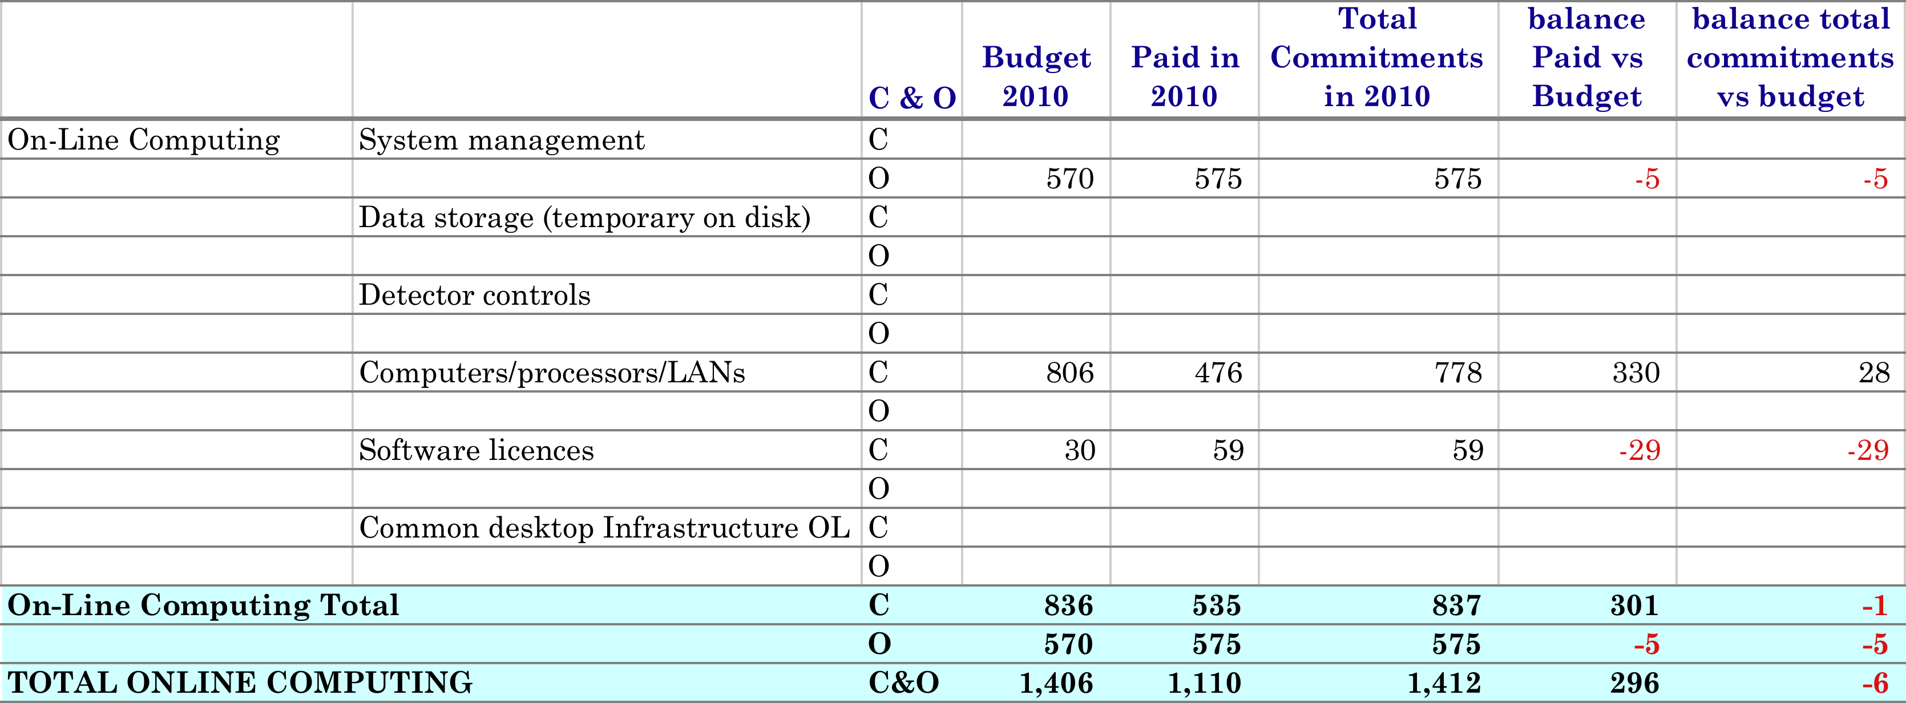
Online Computing
- old DCS system DB hardware renewed by hardware identical to CERN IT Oracle service;
old HLT servers replaced by more compact servers;
- oldest DAQ detector readout PCs replaced with machines able to use the PCI-e version of the DDL adapters and memory has been expanded for all these PCs in view of the 2011 pbpb run;
- old DAQ servers (web and software deployment) replaced by new ones with a 10 GE connection to improve the service and reduce the time to deploy new software;
- DQM (Data Quality Monitoring) old servers replaced by more compact blade servers;
spare DDLs and PCI-e version of the adapters have been ordered.
Commercial software licenses used by DAQ (budget 30 kCHF), we paid in 2010 the maintenance for 2010 and 2011. For future years the maintenance cost will be of the order of 60 kCHF.

Slide 12
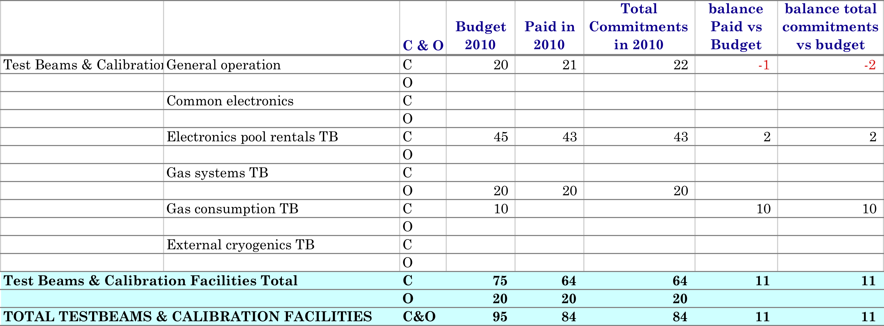
Test Beam and Calibration facilities
Beam tests are carried out both at PS and SPS, and are needed to optimize the working point of present detectors, to calibrate some of them or to understand unexpected behaviour. In addition, they are occasionally used to test prototypes of new detectors or ancillary systems for the R&D of proposed upgrades, or specific improvements of existing detectors for ALICE.
The ALICE facility provides only common used instrumentation while the groups provide all the equipment needed for individual tests.
Main activities in 2010 are explained in the main ALICE report.

Slide 13
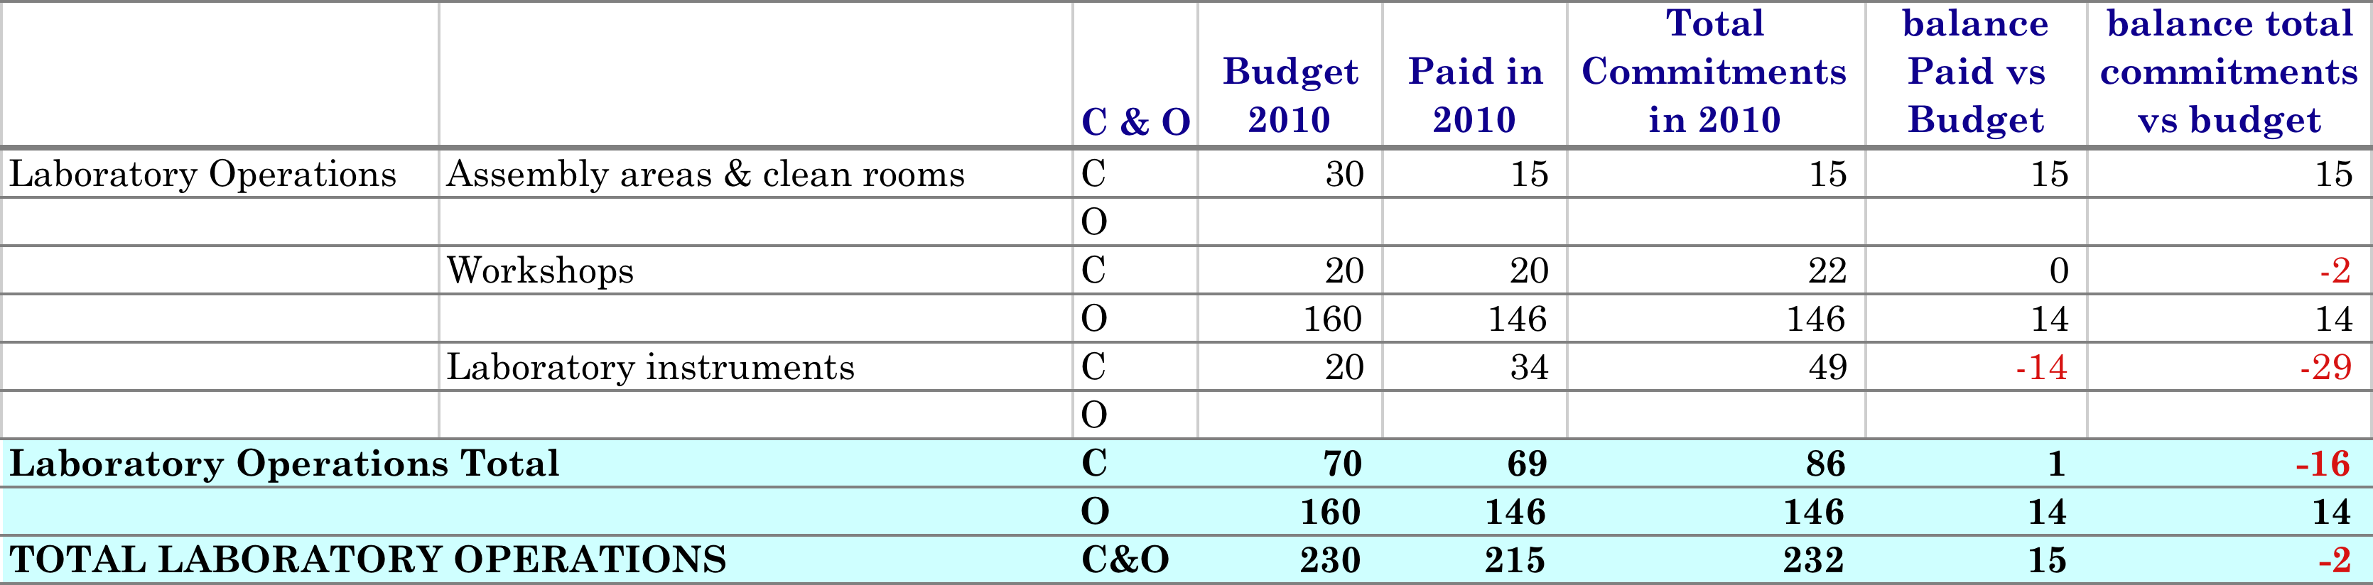
Laboratories Operation
The budget for laboratories operation has been entirely used this year with many activities in the workshop linked to the construction of the superstructures and the preparation of the short but full of activity technical stop at the end of the year.
On laboratory instruments, we had to invest and buy instrumentation to monitor the beam (BPIM acquisition boards), in addition to instruments such as a thermal camera, one oscilloscope, one endoscope and one teslametre.

Slide 14
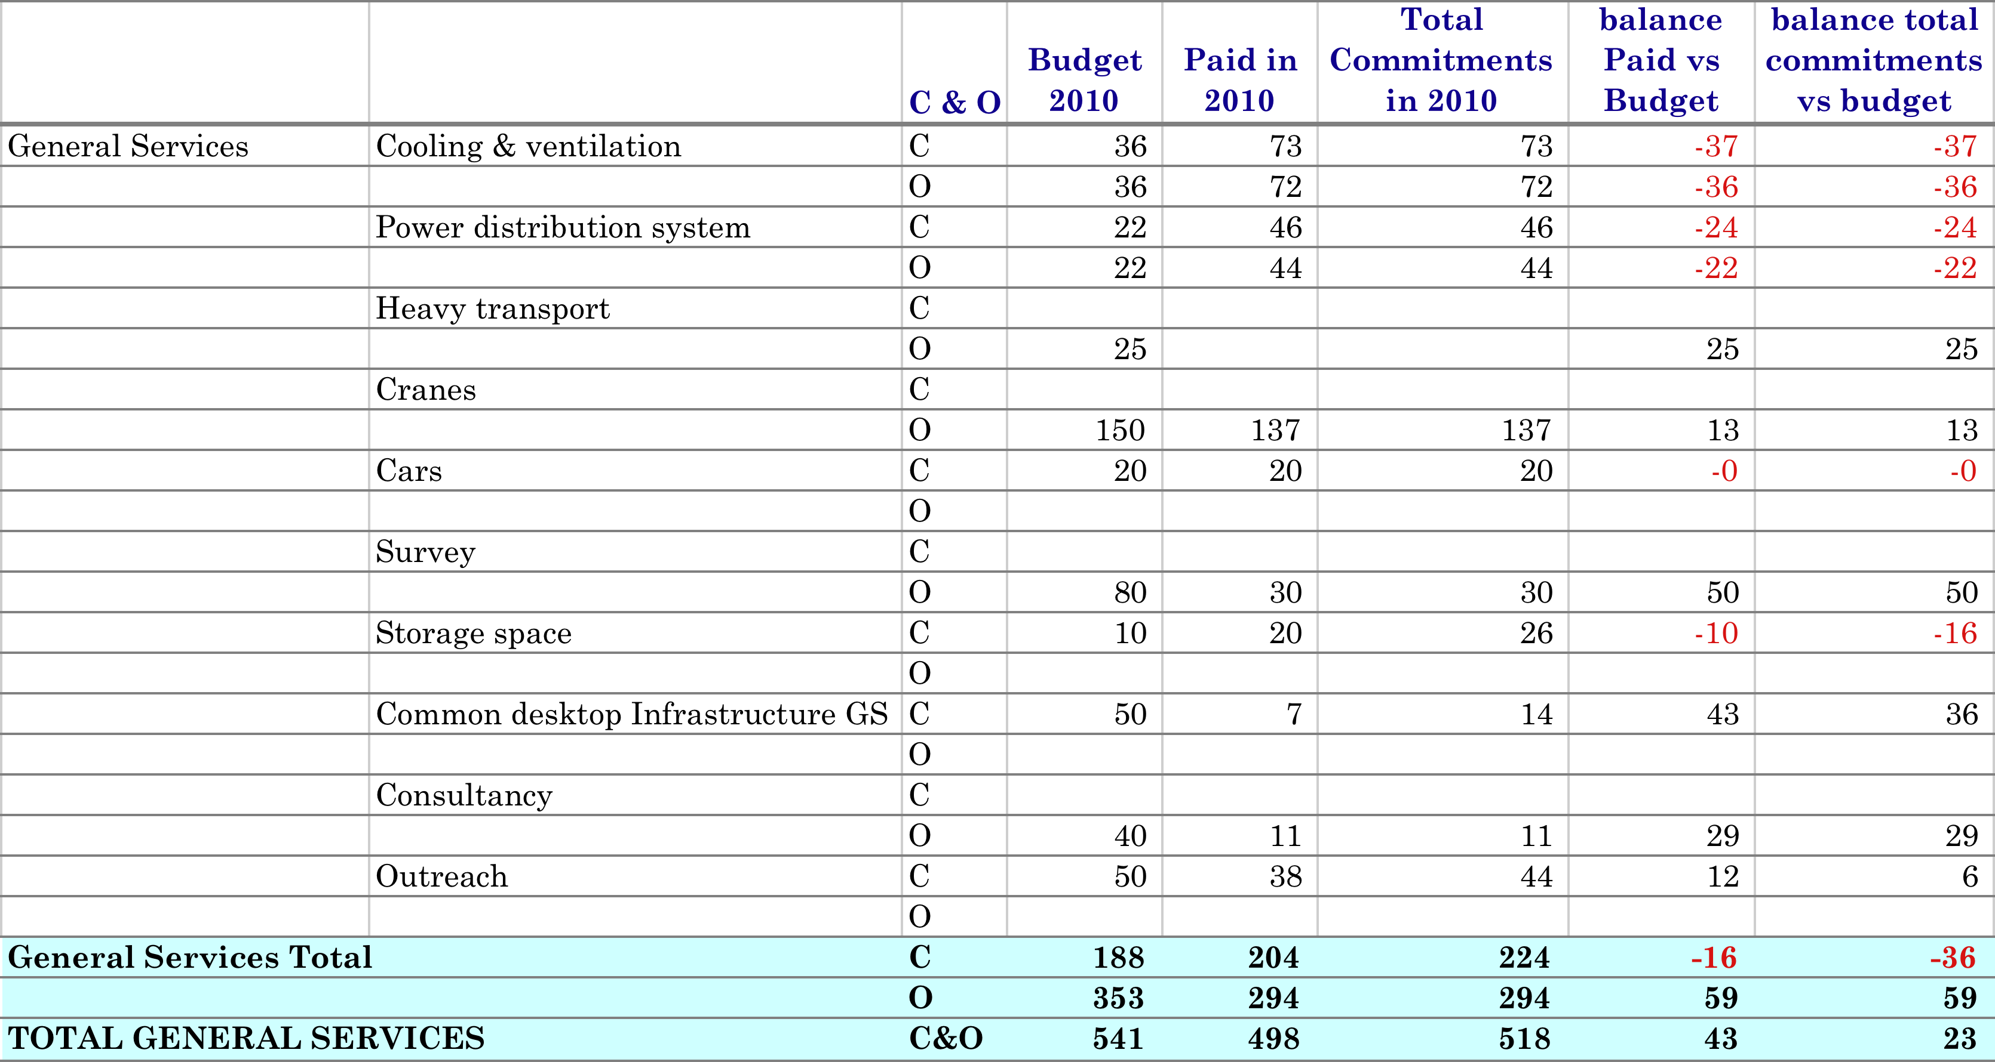
General Services
We have spent most of the budget for crane drivers since we had many activities during the Christmas technical stop, and a team of eight crane drivers working on shifts even during Xmas holidays in order to quickly open the experiment, install TRD and EMCal modules.
We have two service level agreements for the maintenance of the general cooling and ventilation at P2 and for the maintenance of the power distribution systems. In 2010 we paid the bill for 2009 and 2010, this explains the 119 kCHF of overspending on those two budgets.
Waiting for the extension of building 3294 and of a new 300m² storage hall at P2, we still have to pay for the rental of eight barracks, which are needed for the storage of equipment. The overspending corresponds to invoices from 2009 paid in 2010.

Slide 15
Power
The 2010 NMS energy budget was 641 kCHF less 575 kCHF from the 2009 refund for unused energy.
We have spent a total of 678 kCHF with our two large warm magnets operating full time from mid-February to mid-December (> 50,000 MW/hr of which 48,000 MW/hr for the magnets).

Slide 16
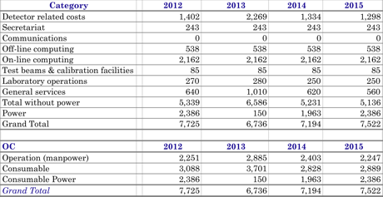
Preliminary 2012 M&O-A budget and cost estimates for 2013-2015 IN KCHF
based on the most recent LHC operating model with a schedule consisting of a 2-months Technical Stop (Jan-Feb 2012) followed by a 9-months Running (Mar-Nov 2012) and a 17‑months Shutdown (Dec 2012-Apr 2014).
2011/2012 technical stop, we plan to open the detector in order to install more TRD. We also expect the DCAL support structure to arrive at CERN during 2011 and a preassembly, load tests and installation tests are foreseen in the ALICE surface buildings.

Slide 17
Manpower @ P2
2012
 | Baseline | Tech Stop | Shutdown | 2012 | COSTS/YEAR | TOTAL
Manpower | Jan-Dec 2012 | Jan-Feb 2012 | Dec-12 | Total man-year | IN KCHF | IN KCHF
Crane drivers (1/5/2.5) | 1 | 0.83 | 0.21 | 2.04 | 92.4 | 188.65
Surveyors (2/1) |  | 0.17 | 0.08 | 0.25 | 120 | 30
Shutdown Team (3) |  |  | 0.25 | 0.25 | 96 | 24
General Technical Support (3) | 3 |  |  | 3 | 120 | 360
TOTAL in man-year | 4 | 1 | 0.54 | 5.54 |  | 602.65
2013
 | Baseline | Shutdown | 2013 | COSTS/YEAR | TOTAL
Manpower | Jan-Dec 2013 | Jan-Dec 2013 | Total man-year | IN KCHF | IN KCHF
Crane drivers (1/2.5) | 1 | 2.50 | 3.50 | 92.4 | 323.4
Surveyors (2) |  | 2.00 | 2.00 | 120 | 240
Shutdown Team (3) |  | 3 | 3.00 | 96 | 288
General Technical Support (3) | 3 |  | 3 | 120 | 360
TOTAL in man-year | 4 | 7.5 | 11.50 |  | 1211.4
2014
 | Baseline | Shutdown | Tech Stop | 2014 | COSTS/YEAR | TOTAL
Manpower | Jan-Dec 2014 | Jan-Apr 2014 | Dec-14 | Total man-year | IN KCHF | IN KCHF
Crane drivers (1/2.5) | 1 | 0.83 | 0.42 | 2.25 | 92.4 | 207.9
Surveyors (2) |  | 0.67 | 0.08 | 0.75 | 120 | 90
Shutdown Team (3) |  | 1.00 |  | 1.00 | 96 | 96
General Technical Support (3) | 3 |  |  | 3 | 120 | 360
TOTAL in man-year | 4 | 2.50 | 0.5 | 7.00 |  | 753.9
2015
 | Baseline | Tech Stop | Tech Stop | 2015 | COSTS/YEAR | TOTAL
Manpower | Jan-Dec 2015 | Jan-Feb 2015 | Dec-15 | Total man-year | IN KCHF | IN KCHF
Crane drivers (1/5/5) | 1 | 0.83 | 0.42 | 2.25 | 92.4 | 207.9
Surveyors (1) |  | 0.17 | 0.08 | 0.25 | 120 | 30
Shutdown Team |  |  |  | 0.00 | 96 | 0
General Technical Support (3) | 3 |  |  | 3 | 120 | 360
TOTAL in man-year | 4 | 1 | 0.50 | 5.50 |  | 597.9

Slide 18
Detector related costs 2012-2015
Description | OC | 2012 | 2013 | 2014 | 2015
Magnet | C | 25 | 40 | 25 | 25
 | O
Magnet controls | C | 7 | 7 | 7 | 7
 | O | 16 | 16 | 16 | 16
Magnet power supply | C | 10 | 10 | 10 | 10
 | O | 8 | 8 | 8 | 8
Gas systems | C | 30 | 60 | 30 | 30
 | O | 110 | 110 | 110 | 110
Gas consumption | C | 280 | 95 | 240 | 300
 | O
Cooling systems | C | 37 | 200 | 37 | 37
 | O | 50 | 50 | 50 | 50
Cooling fluids(above –50°C) | C
 | O
External cryogenics | C
 | O
Cryogenic fluids (below –50°C) | C
 | O
Moving/hydraulic systems | C | 20 | 60 | 20 | 20
 | O
Detector safety systems | C | 25 | 35 | 25 | 25
 | O | 16 | 16 | 16 | 16
Safety | C | 115 | 225 | 95 | 95
 | O
Shutdown activities | C | 60 | 480 | 60 | 60
 | O | 24 | 288 | 96
General Technical support | C
 | O | 180 | 180 | 180 | 180
Electronics pool rentals | C | 43 | 43 | 43 | 43
 | O
Beam pipe & vacuum | C | 120 | 120 | 120 | 120
 | O | 80 | 80 | 80 | 80
Counting & control rooms | C | 30 | 30 | 30 | 30
 | O | 16 | 16 | 16 | 16
UPS and UPS maintenance | C | 100 | 100 | 20 | 20
 | O
Detector related costs Total |  | 1,402 | 2,269 | 1,334 | 1,298
Many items planned last year in 2012 have now been shifted to the long shutdown in 2013:
Cooling system 200 kCHF for the important modifications/consolidation of cooling infrastructure (new pipes for the pixels, PHOS detector)
Shutdown act. 480+288 kCHF
UPS to be installed in 2013 purchase in 2011/2012, distribution panels and cabling infrastructure roughly estimated bt 200 kCHF and 300 kCHF to be paid by CF and CERN.
- Safety (see next slide)

Slide 19
Safety
    Service Level Agreement (SLA) SNIFFERs maintenance costs (EDMS 982727) budget 25 kCHF.
    Sniffer modification for CO2 detection inside L3 magnet (10 kCHF)
    Radioprotection elements: instrumentation as well as protection of areas near beam pipe where people might have to intervene during technical stops (estimated costs 20 kCHF).
    Nitrogen extinguishes system (total cost 200 kCHF)
    We propose to split the cost over 3 years: in 2011 we plan to spend 40 kCHF for some minor works in order to maintain the old infrastructure and to start a full study of the new system. In 2012, we plan 60 kCHF for the installation of the surface system structure. Finally 100 kCHF are needed in 2013 during the long shutdown when all piping will be completed and the system fully installed with the last tranche.

Slide 20
Safety (2)
In addition to 100 kCHF for the Nitrogen extinguish system, we need to invest 110 kCHF for a CO2 rack extinguish system and we ask the SG to accept to fund this items from the accumulated cash rather than increasing the budget.

Slide 21
Secretariat and communication
Description | OC | 2012 | 2013 | 2014 | 2015
Secretarial assistance | C | 8 | 8 | 8 | 8
 | O | 155 | 155 | 155 | 155
Economat | C | 20 | 20 | 20 | 20
 | O
Printing and publication | C | 60 | 60 | 60 | 60
 | O
Secretariat Total |  | 243 | 243 | 243 | 243
GSM phones; on-call service | C
 | O
Collaborative Tools | C
 | O
Communications Total

Slide 22
Offline computing
Description | OC | 2012 | 2013 | 2014 | 2015
Central computing environment | C
 | O | 189 | 189 | 189 | 189
User support | C
 | O | 158 | 158 | 158 | 158
Software process service | C
 | O | 26 | 26 | 26 | 26
Central production operations | C
 | O | 66 | 66 | 66 | 66
Hardware | C | 98 | 98 | 98 | 98
 | O
Off-line computing Total |  | 538 | 538 | 538 | 538
Manpower model detailed in the document on the sharepoint
Hardware replacement follows online machine replacement model

Slide 23
Online computing
Description | OC | 2012 | 2013 | 2014 | 2015
System management | C
 | O | 575 | 575 | 575 | 575
Data storage (temporary on disk) | C
 | O
Detector controls | C
 | O
Computers/processors/LANs | C | 1,522 | 1,522 | 1,522 | 1,522
 | O
Software licences | C | 65 | 65 | 65 | 65
 | O
Common desktop infrastructure OL | C
 | O
On-line computing Total |  | 2,162 | 2,162 | 2,162 | 2,162
6 FTE/year (2 DAQ / 2 DCS / 2 HLT) are in charge of system management of the online systems, installation of computing hardware, installation and configuration of system (Linux and other commercial software), installation and configuration of application software, as well as contributing to the ‘on-call’ interventions for the DAQ, the DCS and the HLT.
SLA with IT dpt for online Oracle Database Services (75 kCHF/year)

Slide 24
Online computing cont.
The M&O budget for online computing presented in this document is based on the latest model agreed between the RRB (RRB-2011-059) Scrutiny Group and the 4 experiments (see Annex 5) and the experience accumulated so far. There were different reasons for purchasing equipment (PCs, network and storage equipment used for dataflow and online triggering) on the M&O budget:
Some equipment out of warranty exhibit some fault and has become unserviceable.
The second reason is the technology change. A typical example concern some computers with only PCI-X slots that had to be replaced by a recent generation including I/O slots in PCI-e and PCI-X standards. This is the case of some DAQ machines that are interfaced to the detectors via optical links using PCI-X adapters. A new batch of spare adapters has been produced for PCI-e which is today’s standard I/O bus.
The third reason is the need for capacity increase with identical functionality. This is for example the case for the PCs in charge of event-building and data recording which must be more powerful than anticipated and require the last generation of CPUs

Slide 25
Online Computing cont.
The plans for the 2012 online computing maintenance are the following:
The oldest DCS worker nodes will have to be replaced.
Given the experience of last year which a substantially higher data throughput than anticipated, the disk buffer located at Point 2 has to be expanded to take into account the actual data throughput and the autonomy recommended by the IT department. At the same occasion the oldest storage arrays will also to be replaced.
The DAQ and HLT capacities will also be adapted to make data compression in order to reduce the total data volume.
A first production of a more compact DDL adapter will be launched.

Slide 26
TEST BEAMS AND CALIBRATION FACILITIES
Description | OC | 2012 | 2013 | 2014 | 2015
General operation | C | 20 | 20 | 20 | 20
 | O
Common electronics | C
 | O
Electronics pool rentals TB | C | 35 | 35 | 35 | 35
 | O
Gas systems TB | C
 | O | 20 | 20 | 20 | 20
Gas consumption TB | C | 10 | 10 | 10 | 10
 | O
External cryogenics TB | C
 | O
Test beams & calibration facilities Total |  | 85 | 85 | 85 | 85
In 2012, the activity will continue along the same lines with a mixture of tests, calibration and R&D activities.

Slide 27
Laboratory Operations
Description | OC | 2012 | 2013 | 2014 | 2015
Assembly areas & clean rooms | C | 50 | 30 | 30 | 30
 | O
Workshops | C | 20 | 50 | 20 | 20
 | O | 180 | 180 | 180 | 180
Laboratory instruments | C | 20 | 20 | 20 | 20
 | O
Laboratory operations Total |  | 270 | 280 | 250 | 250
The budget includes maintenance and transformations of existing facilities: modifications (ex. partitioning), electrical installations, air conditioning etc. In addition we expect 2 new structures at P2 (paid by CERN project estimated to ~ 700 kCHF) the installation of a 1st floor on building 3294 and a storage hall. We might have to contribute for small works (for example network cabling, small ) this is why we have added 20 kCHF in 2012 to the existing budget.

Slide 28
General Services
SLA with EN-CV for the maintenance and operation of cooling and ventilation equipment. The total cost is 83.3 kCHF (small increase from 72 kCHF to 83 kCHF with the new version of the SLA).
As agreed by the SG last year, we have to invest 200 kCHF to redo the ventilation inside the L3 magnet. We will buy the machine in 2012 (cost ~ 100 kCHF) and install it in 2013 during the long shutdown (installation estimated to ~ 100 kCHF).
SLA with EN-EL for the maintenance and operation of the power distribution (small decrease of the cost from 44 kCHF to 42 kCHF
Description | OC | 2012 | 2013 | 2014 | 2015
Cooling & ventilation | C | 108 | 108 | 8 | 8
 | O | 75 | 75 | 75 | 75
Power distribution system | C | 21 | 21 | 21 | 21
 | O | 21 | 21 | 21 | 21
Heavy transport | C
 | O | 25 | 50 | 25 | 25
Cranes | C
 | O | 190 | 325 | 210 | 210
Cars | C | 20 | 20 | 20 | 20
 | O
Survey | C
 | O | 30 | 240 | 90 | 30
Storage space | C | 10 | 10 | 10 | 10
 | O
Academic subsistence | C
 | O | 40 | 40 | 40 | 40
Outreach | C | 50 | 50 | 50 | 50
 | O
Common desktop infrastructure GS | C | 50 | 50 | 50 | 50
 | O
General services Total |  | 640 | 1,010 | 620 | 560
).

Slide 29
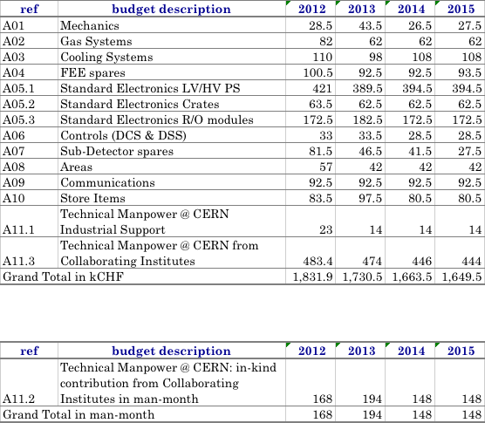
M&O-B

Slide 30
M&O-B 2012

