Slide 1
kick-off Workshop
on detector optimisation
CERN 22/06/2022
The IDEA detector concept
Paolo Giacomelli
INFN Bologna

Slide 2
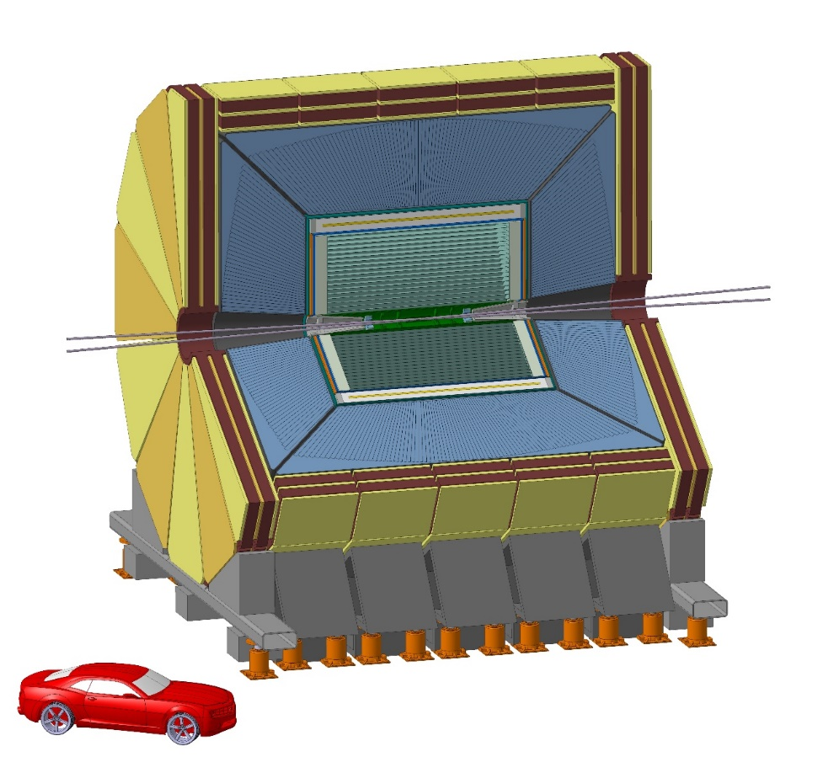
The IDEA detector concept
New, innovative, possibly more cost-effective concept
  Silicon vertex detector
  Short-drift, ultra-light wire chamber
  Dual-readout calorimeter
  Thin and light solenoid coil inside calorimeter system
    Small magnet ⇒ small yoke
  Muon system made of 3 layers of μ−RWELL detectors in the return yoke
https://pos.sissa.it/390/
IDEA concept (proposed in FCC CDR)
Innovative Detector for e⁺e⁻ Accelerator
Acknowledgments
I need to thank many colleagues, in particular:
P. Azzi, F. Bedeschi, and R. Santoro

Slide 3
IDEA detector layout
Beam pipe: R∼1.5 cm
Vertex:
5 MAPS layers
R = 1.7-34 cm
Drift Chamber: 112 layers
4 m long, R = 35-200 cm
Outer Silicon wrapper:
Si strips
Superconducting solenoid coil:
2 T, R ∼ 2.1-2.4 m
0.74 X0, 0.16 λ @ 90°
Preshower: ∼1 X0
Dual-Readout Calorimeter:
2m / 7 λint
Yoke + Muon chambers

Slide 4
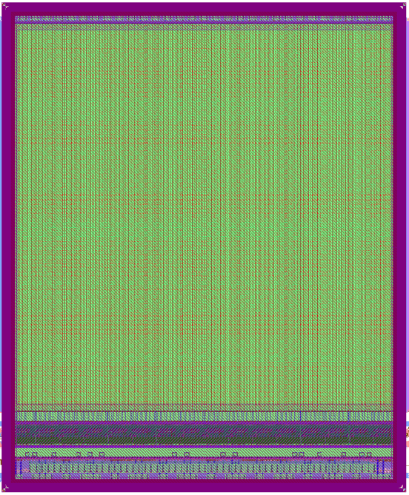
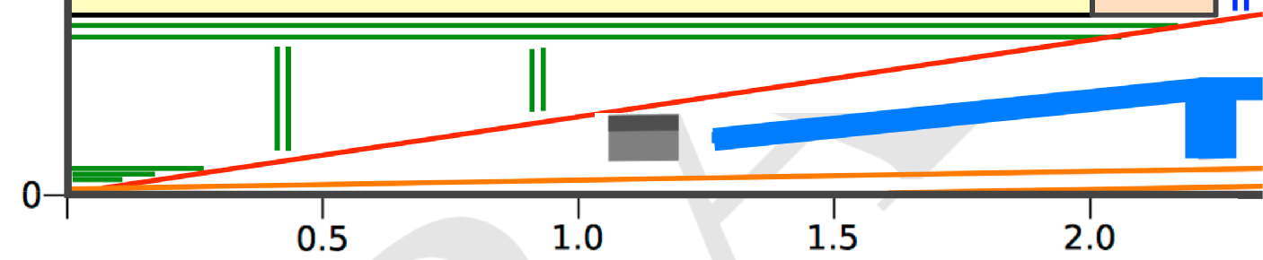
Vertex detector: IDEA
Inspired by ALICE ITS based on MAPS technology, using the ARCADIA R&D program
  Pixels 20 × 20 μm²
Light
  Inner layers: 0.3% of X₀ / layer
  Outer layers: 1% of X₀ / layer
Performance:
  Point resolution of ~3 μm
  Efficiency of ∼100%
  Extremely low fake rate hit rate
5 MAPS layers:
R = 1.7 - 2.3 - 3.1 cm
Pixel size: 20 x 20 μm²
R = 32 - 34 cm
Pixel size: 50 x 100 μm²

Slide 5
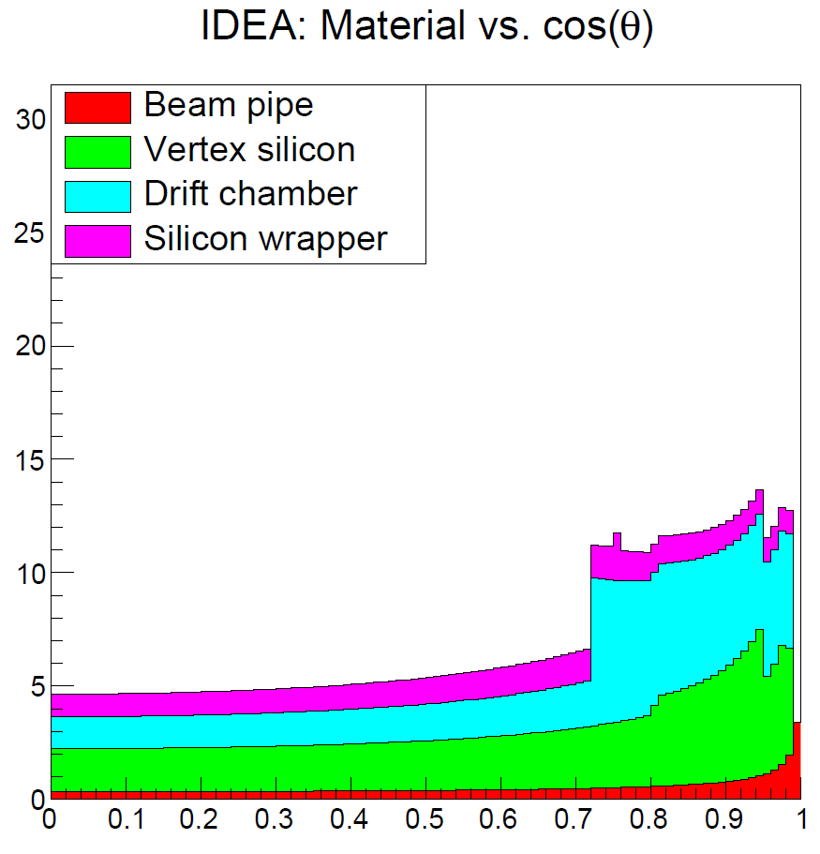
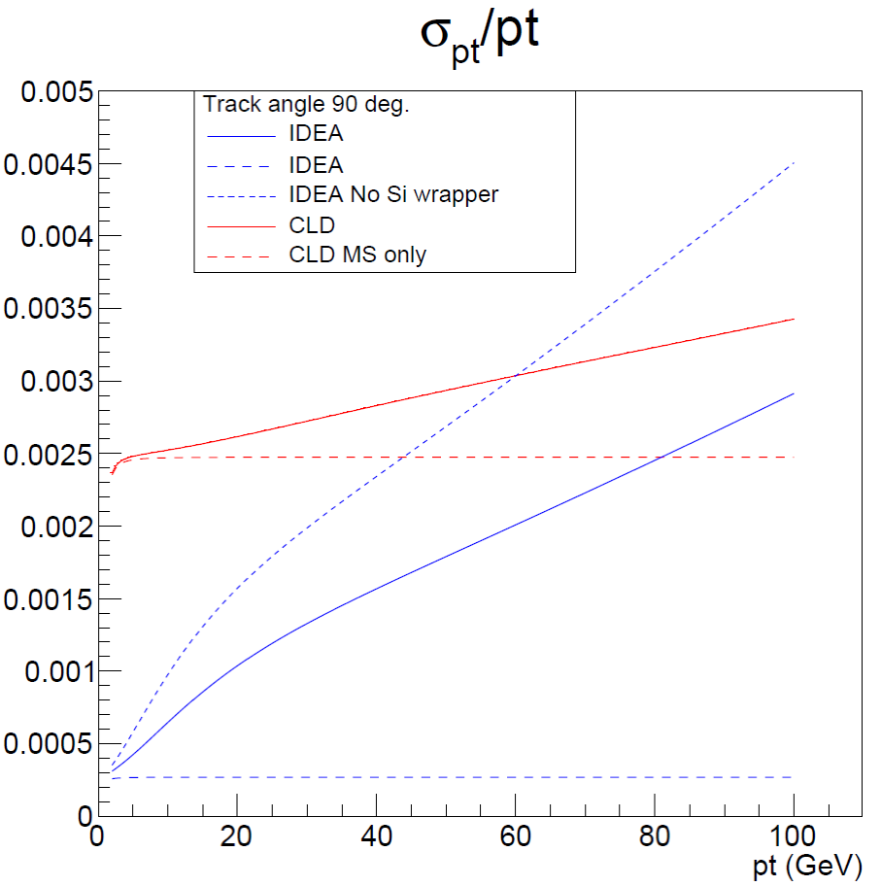
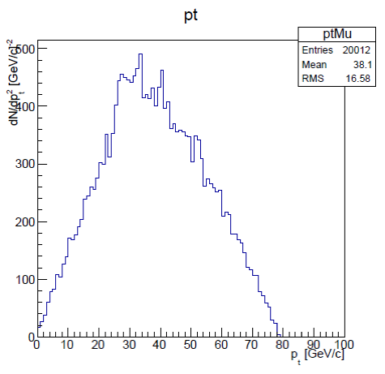
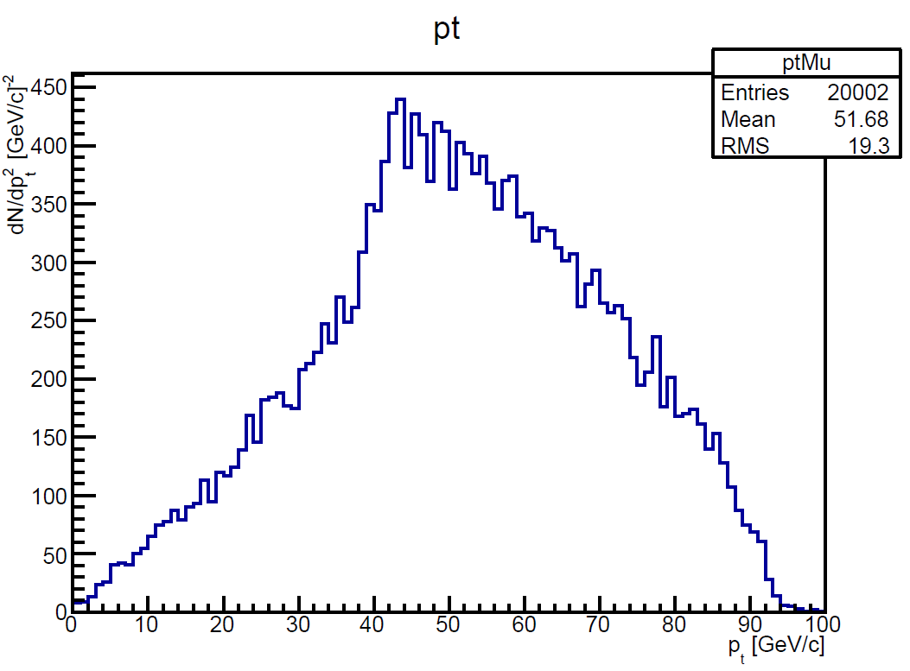
Momentum measurement
Z or H decay muons in ZH events have rather low pt
  Transparency more important than asymptotic resolution
MS only
ZH (H→μμ)
Muon pt
ZH (H→μμ)
Muon pt
ZH (Z→μμ)
Muon pt
90 degree

Slide 6
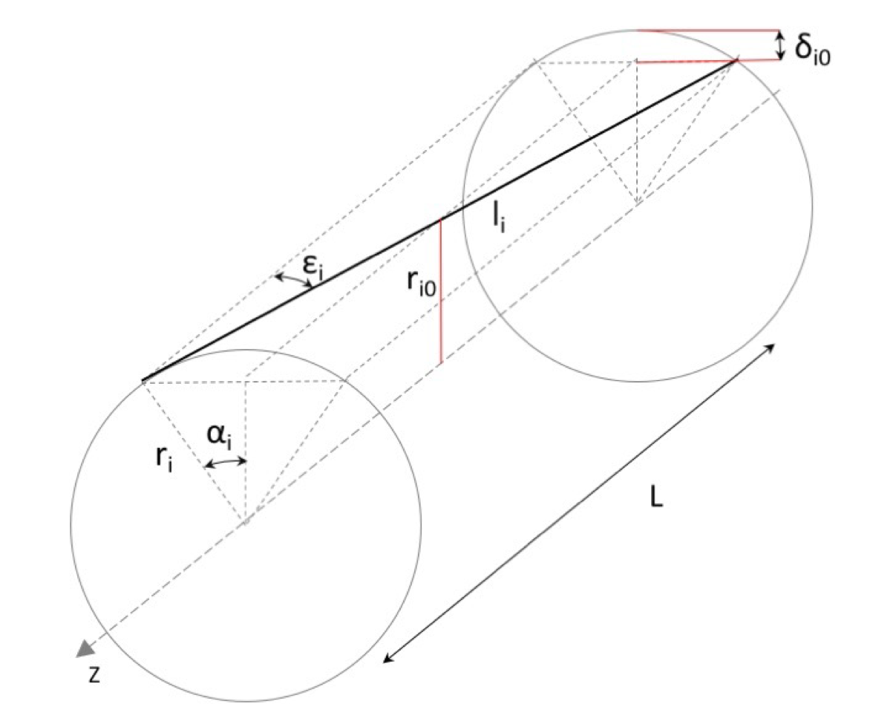
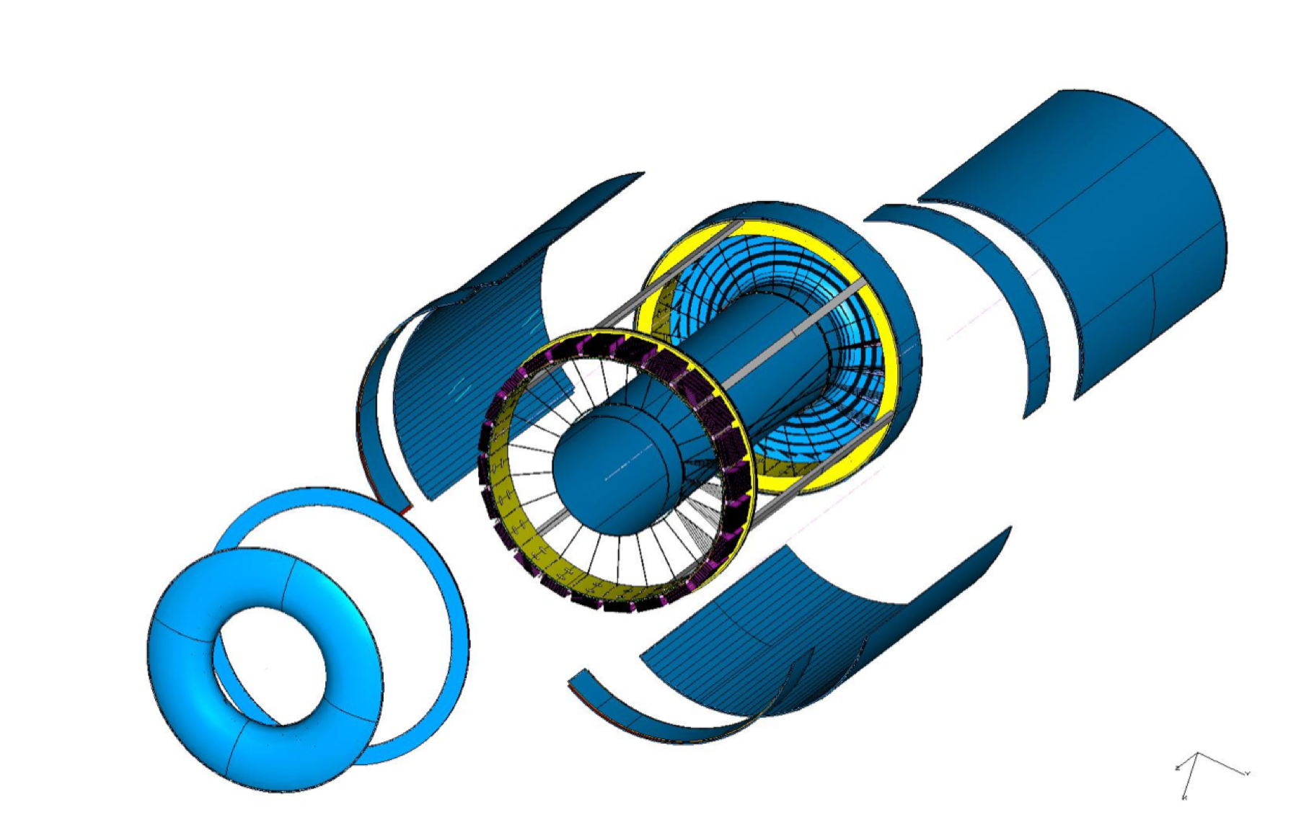
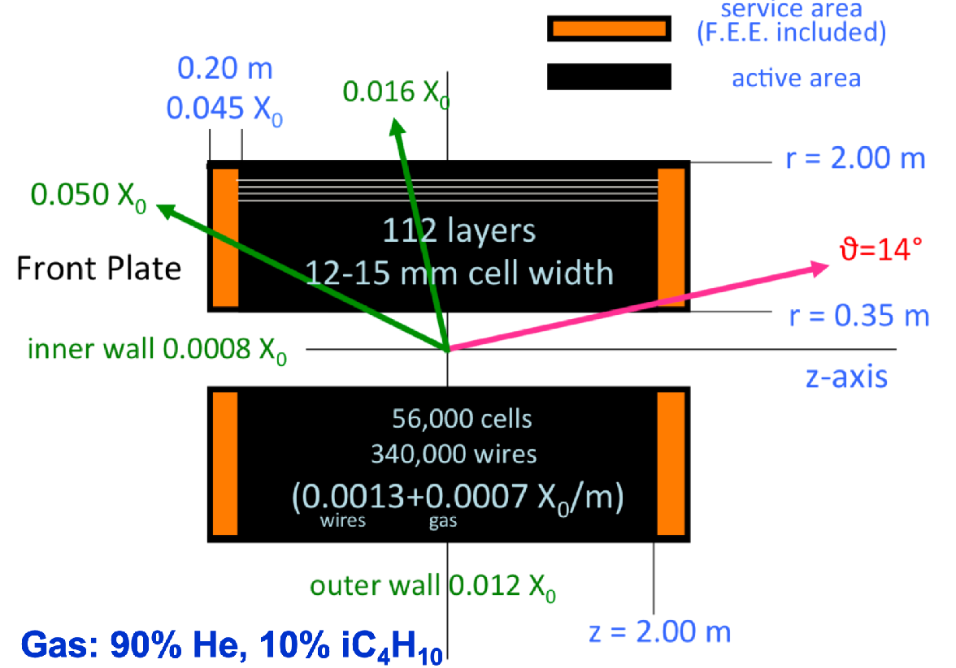
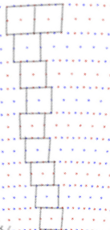
Drift chamber
IDEA: Extremely transparent Drift Chamber
  Gas: 90% He – 10% iC₄H₁₀
  Radius 0.35 – 2.00 m
  Total thickness: 1.6% of X₀ at 90º
    Tungsten wires dominant contribution
  112 layers for each 15º azimuthal sector
  max drift time: 350 ns
IDEA DC

Slide 7
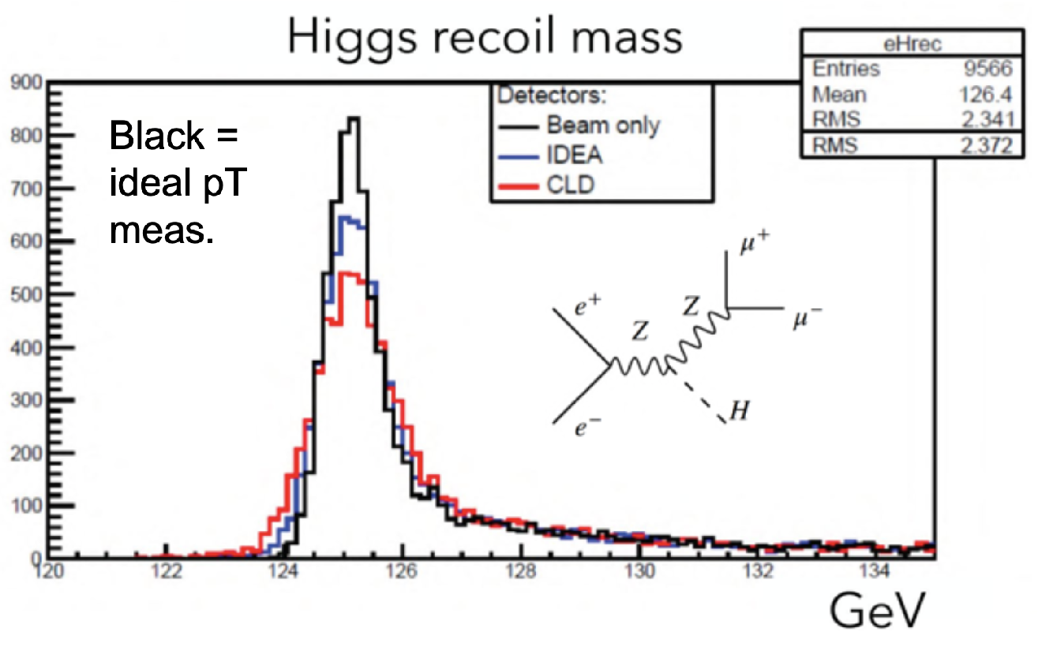
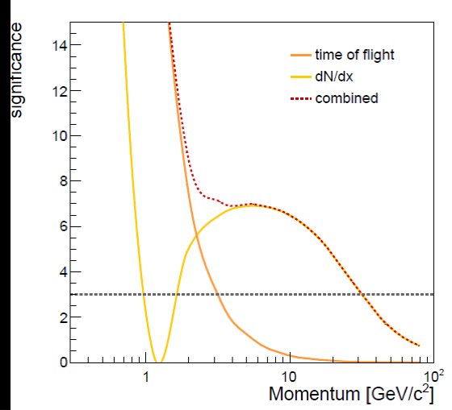
Drift chamber
In general, tracks have rather low momenta (p_{T} ≲ 50 GeV)
  Transparency more relevant than asymptotic resolution
Drift chamber (gaseous tracker) advantages:
  Continuous tracking: reconstruction of far-detached vertices (K⁰_{S} , Λ, BSM, LLPs)
  Outstanding particle separation via cluster counting (dN/dx) or dE/dx
    >3σ K/π separation up to ~35 GeV
dN/dx from Garfield++

Slide 8
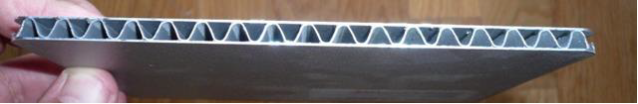
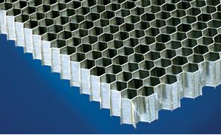
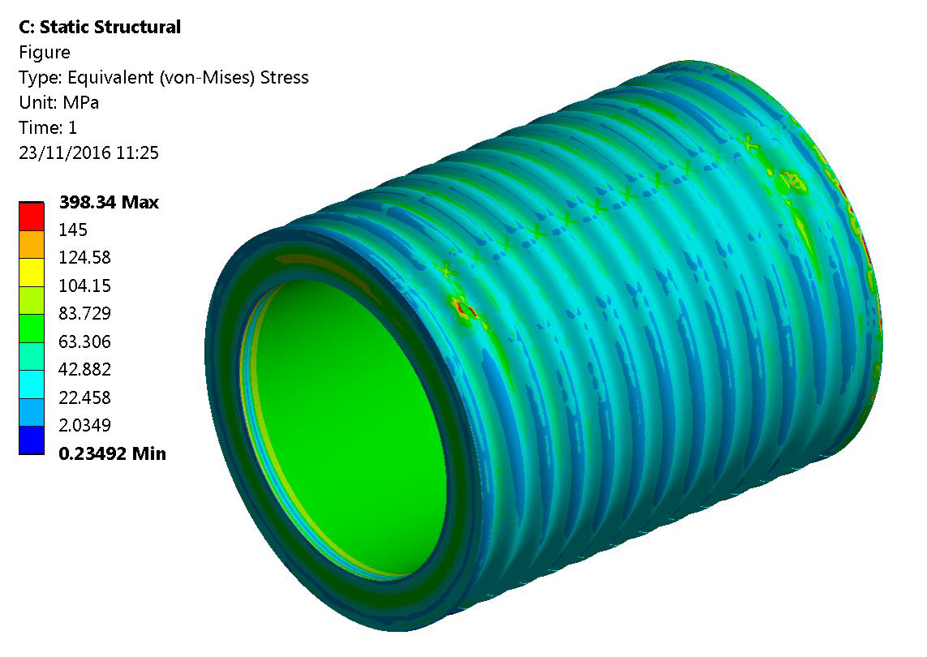
Superconducting solenoid
Ultra light 2 T solenoid:
  Radial envelope 30 cm
  Single layer self-supporting winding (20 kA)
    Cold mass: X₀ = 0.46, λ = 0.09
  Vacuum vessel (25 mm Al): X₀ = 0.28
    Can improve with new technology
      Corrugated plate: X₀ = 0.11
      Honeycomb: X₀ = 0.04
Courtesy of H. TenKate

Slide 9
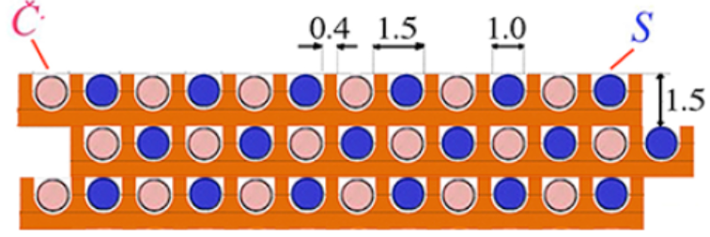
Dual Readout Calorimetry
Alternate
Cherenkov fibers
Scintillating fibers
~2m long capillaries
Measure simultaneously:
  Scintillation signal (S)
  Cherenkov signal (Q)
Calibrate both signals with e⁻
Unfold event by event f_{em} to obtain corrected energy
Newer DR calorimeter
( bucatini calorimeter)
$$S=E[f_{em}+(h/e)_{S}(1-f_{em})]$$
$$C=E[f_{em}+(h/e)_{C}(1-f_{em})]$$
$$E=\frac{S-χC}{1-χ}$$
with:
$$χ=\frac{1-(h/e)_{S}}{1-(h/e)_{C}}$$

Slide 10
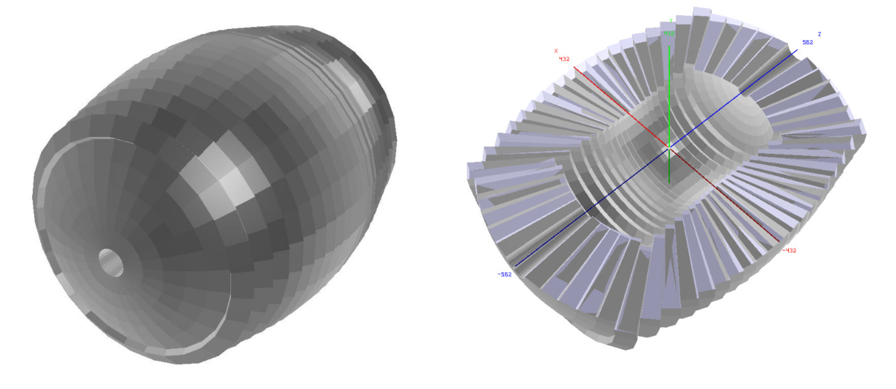
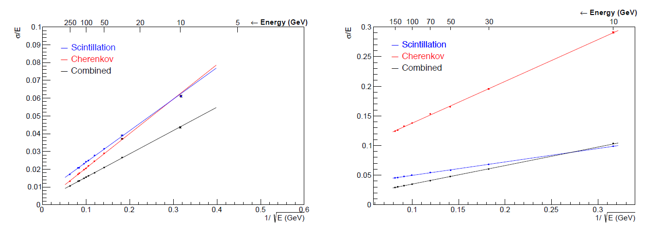
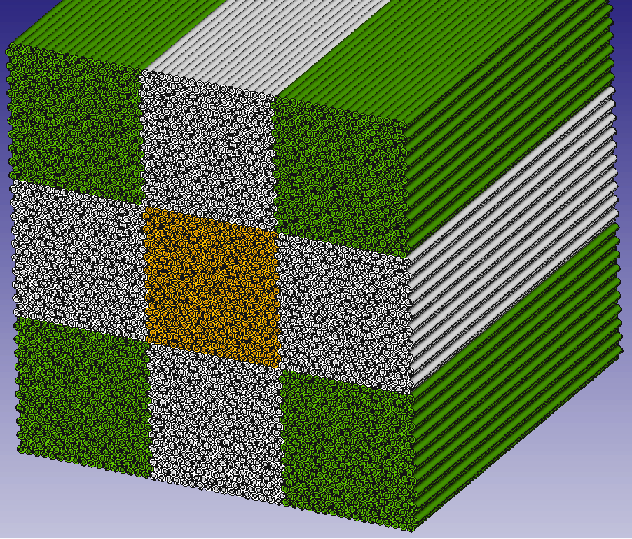
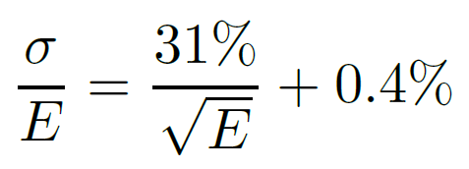
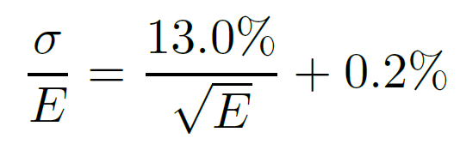
Dual Readout Calorimeter
Full GEANT4 implementation of the DR calorimeter
HAD
EM

Slide 11
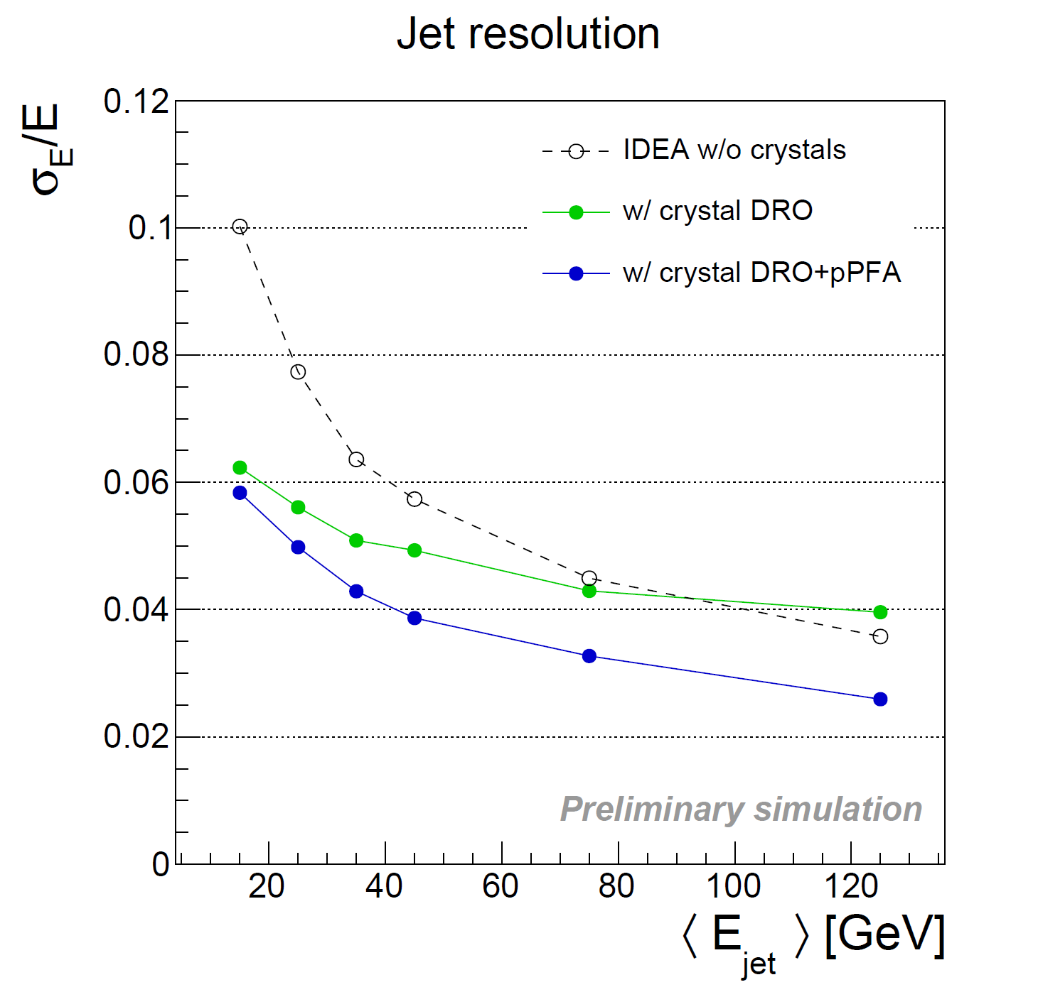
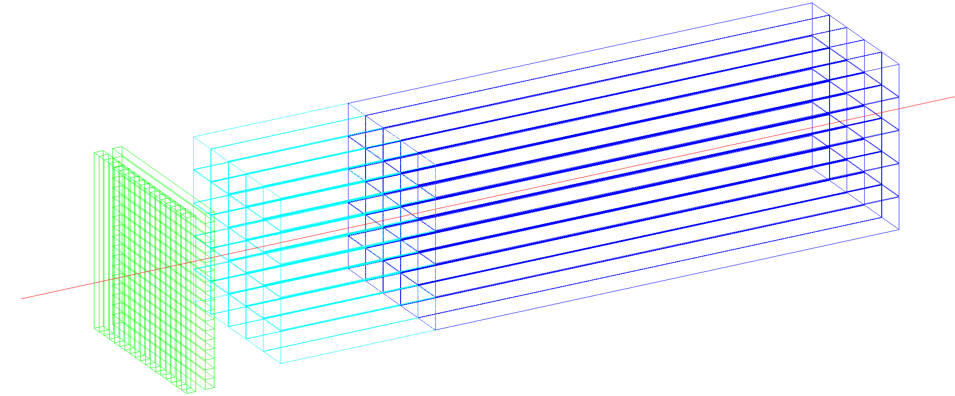
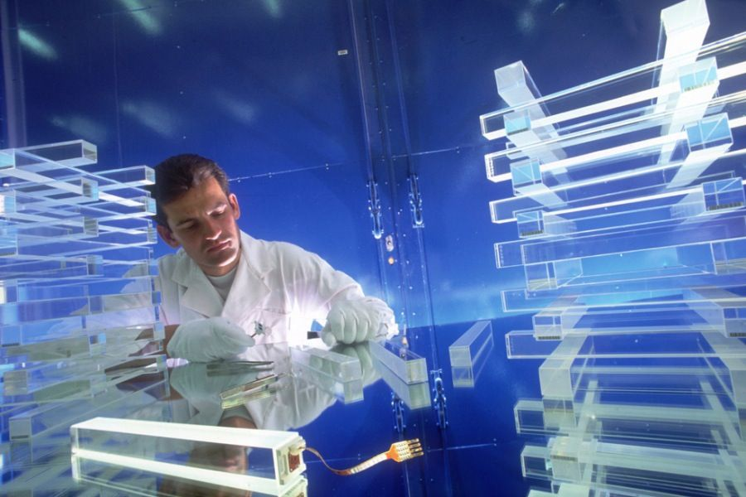
Crystal option
~20 cm PbWO₄
s_{EM} ≈ 3%/$\sqrt{E}$
DR w. filters
Timing layer
  LYSO 20-30 ps
PF for jets
ECAL layer:
  PbWO crystals
  front segment 5 cm (~5.4 X₀)
  rear segment for core shower
  (15 cm ~16.3 X₀)
  10x10x200 mm³ of crystal
  5x5 mm² SiPMs (10-15 um)
1x1x5 cm³
PbWO
1x1x15 cm³
PbWO

Slide 12

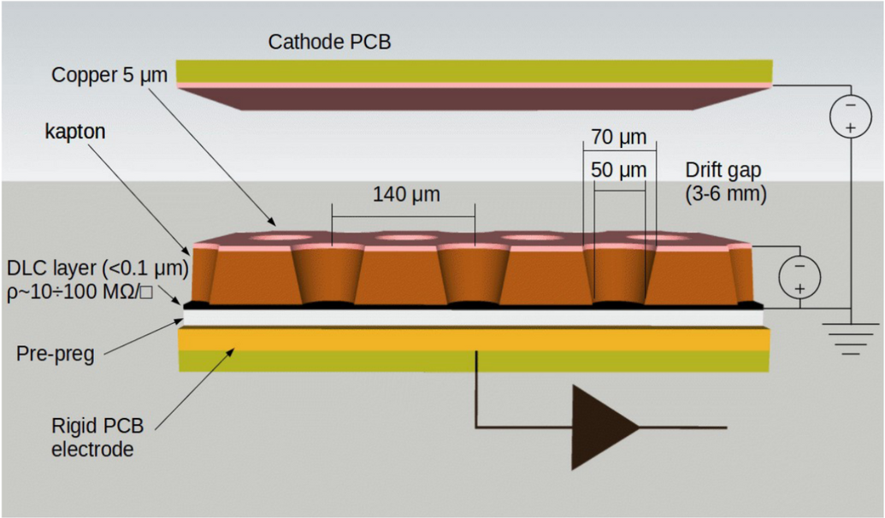
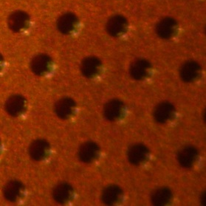
μ-RWELL technology
The μ-RWELL is composed of only two elements:
μ-RWELL_PCB
drift/cathode PCB defining the gas gap
μ-RWELL_PCB = amplification-stage ⊕ resistive stage ⊕ readout PCB
μ-RWELL operation:
  A charged particle ionises the gas between the two detector elements
  Primary electrons drift towards the μ-RWELL_PCB (anode) where they are multiplied, while ions drift to the cathode
  The signal is induced capacitively, through the DLC layer, to the readout PCB
  HV is applied between the Anode and Cathode PCB electrodes
  HV is also applied to the copper layer on the top of the kapton foil, providing the amplification field
LNF
BOLOGNA
FERRARA
TORINO
(*) G. Bencivenni et al., “The micro-Resistive WELL detector: a compact spark-protected single amplification-stage MPGD”, 2015_JINST_10_P02008)

Slide 13
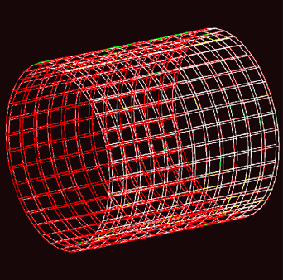
Preshower and muon detector
Preshower Detector
Muon Detector
High resolution before the magnet
to improve cluster reconstruction
Identify muons and search for LLPs
Efficiency > 98%
Space Resolution < 100 μm
Mass production
Optimization of FEE channels/cost
Efficiency > 98%
Space Resolution < 400 μm
Mass production
Optimization of FEE channels/cost
Barrel Preshower
Endcap Preshower
Detector technology: µ-RWELL
50x50 cm² 2D tiles to cover more than 4330 m²
Preshower
pitch = 0.4 mm
FEE capacitance = 70 pF
1.5 million channels
Muon
pitch = 1.5 mm
FEE capacitance = 270 pF
5 million channels
Similar design for the Muon detector
Similar design for the Muon detector

Slide 14
Ongoing R&D
Click here for more R&D information

Slide 15
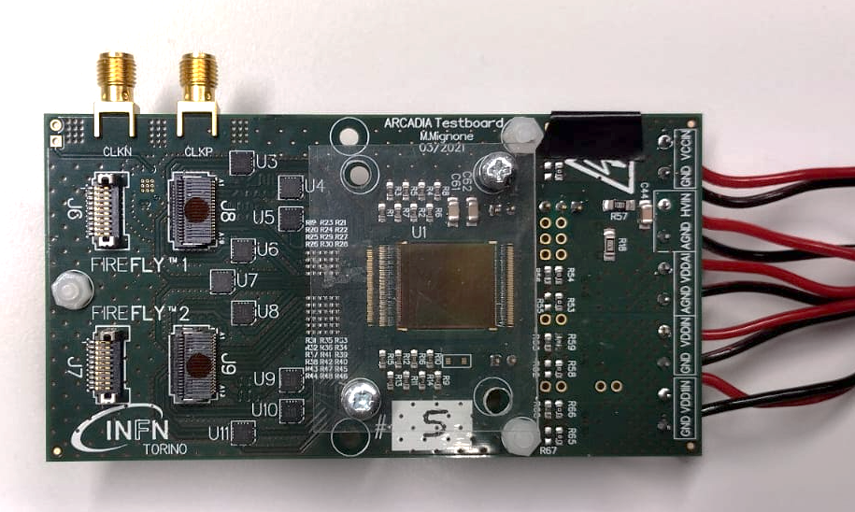
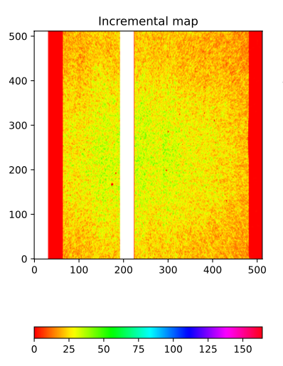
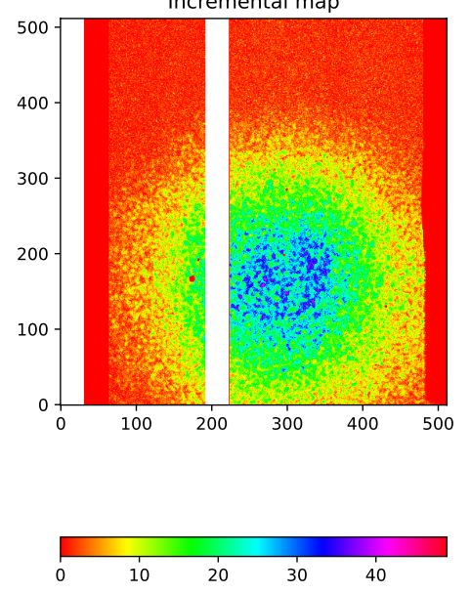
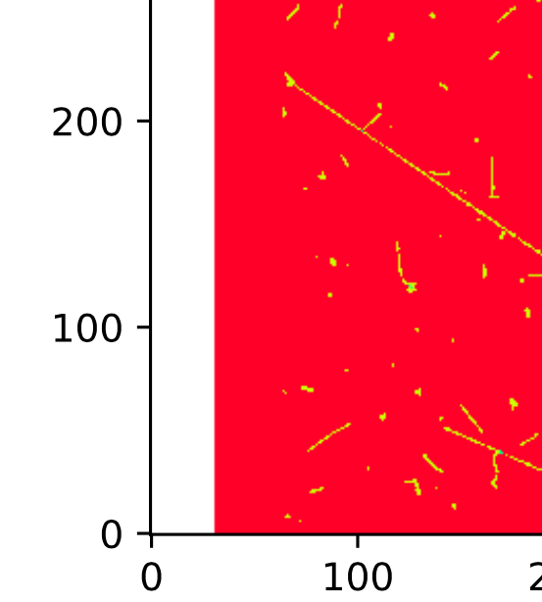
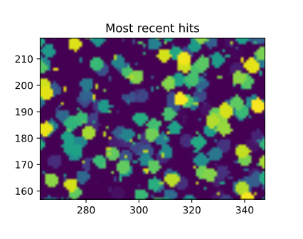
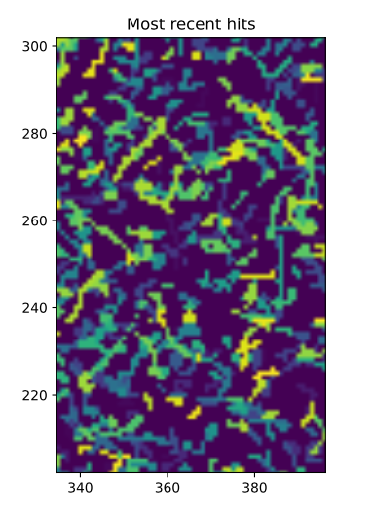
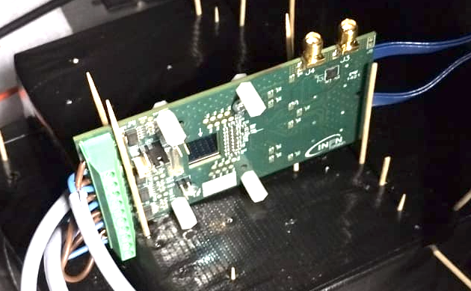
ARCADIA MD1 test
Preliminary results: on-line QA-plots
Few cosmic tracks
(Tilted sensor)
s
90Sr
110 nm CMOS CIS technology, high-resistivity bulk, operated in full depletion mode
Pixel size = 25x25 $μm$²
Matrix = 512 x 512
Thickness = 200 $μm$
Few events (zoom)
Few events (zoom)

Slide 16
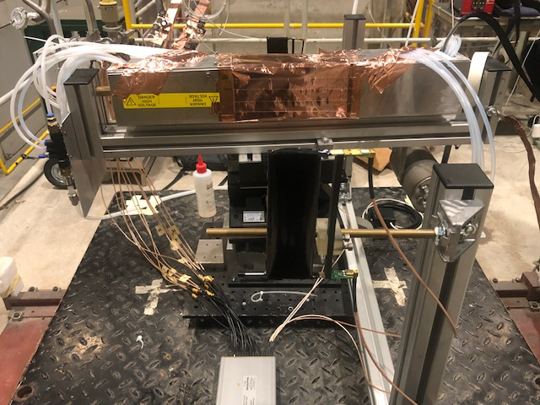
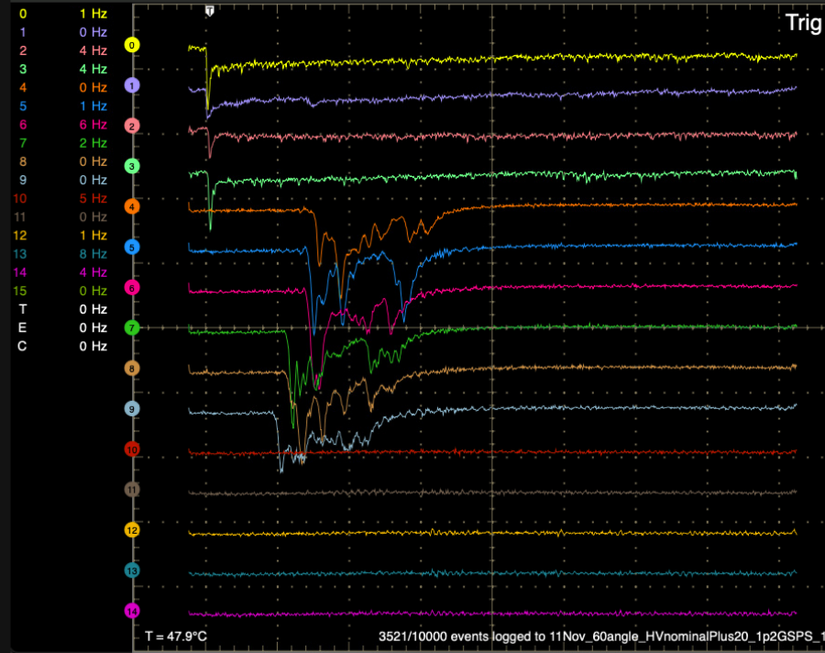
Wire chamber: Cern test beam 11-2021
The experimental setup
at CERN H8 beam
November 2021
downstream
trigger tile
HV distr.
box
Drift tubes pack
signal
box
1 cm
3 cm
2 cm
outlet gas
manifold
Event display
HV cable
inlet gas
manifold
signal cables
(40 cm)
upstream
trigger tile
DRS

Slide 17
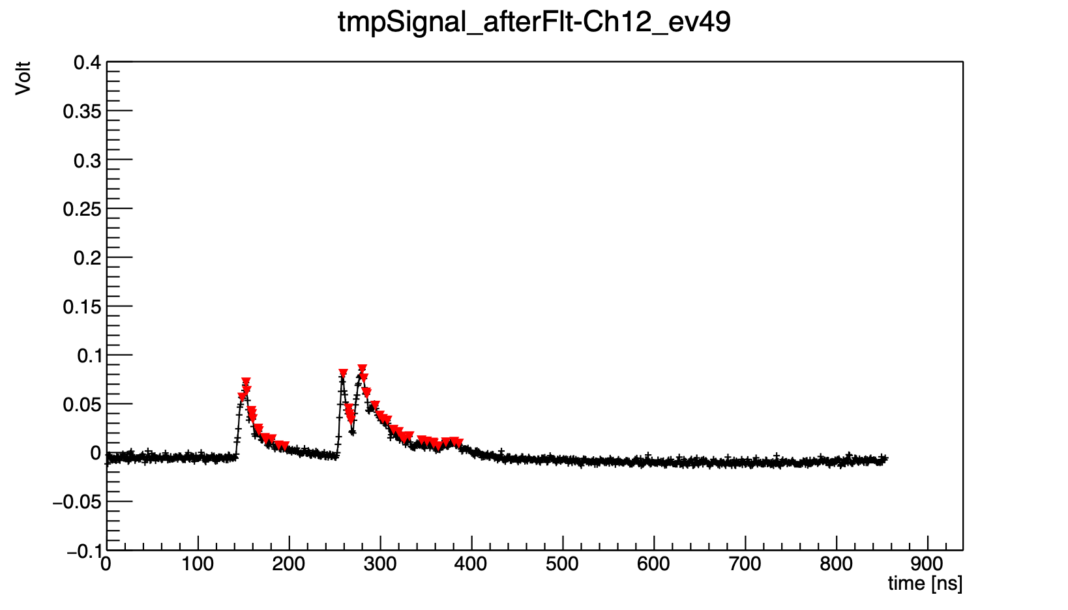
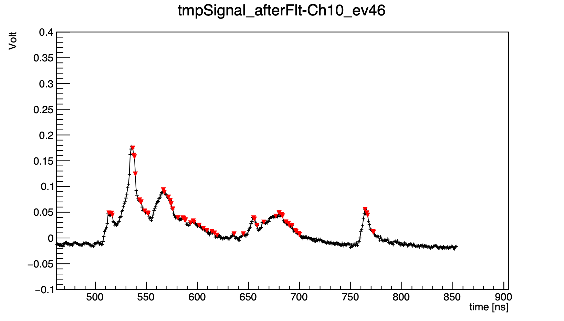
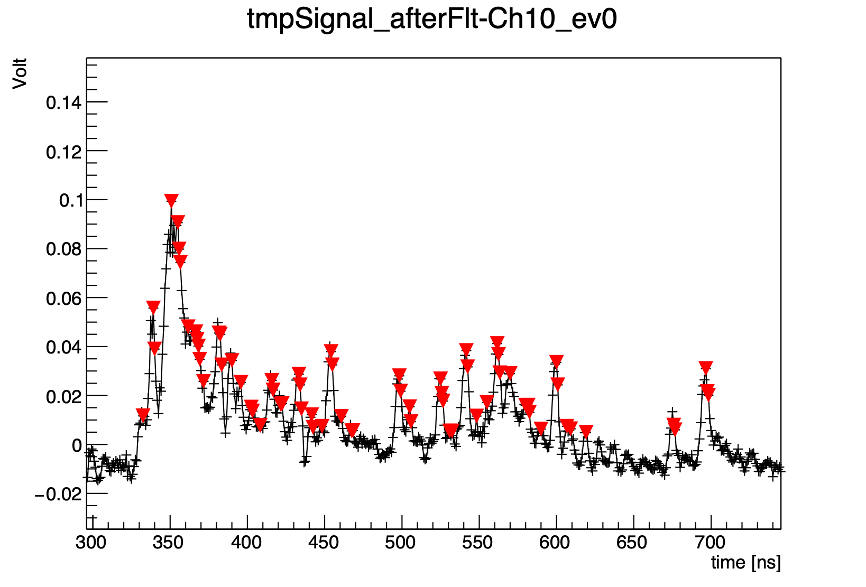
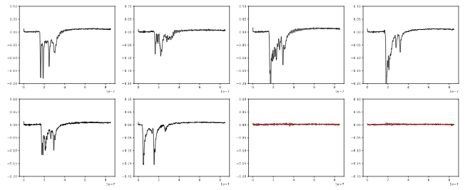
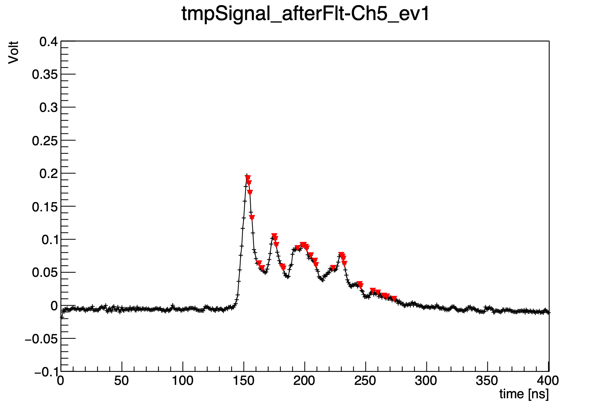
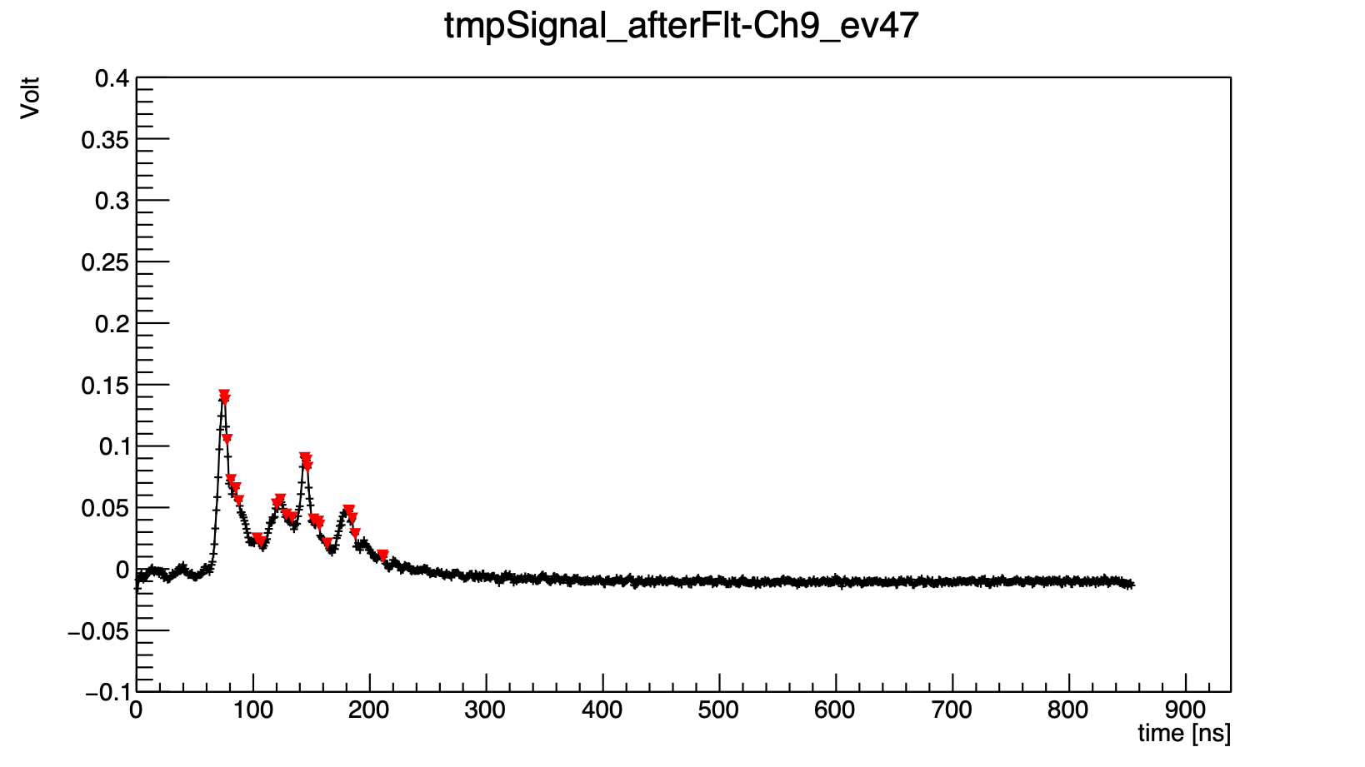
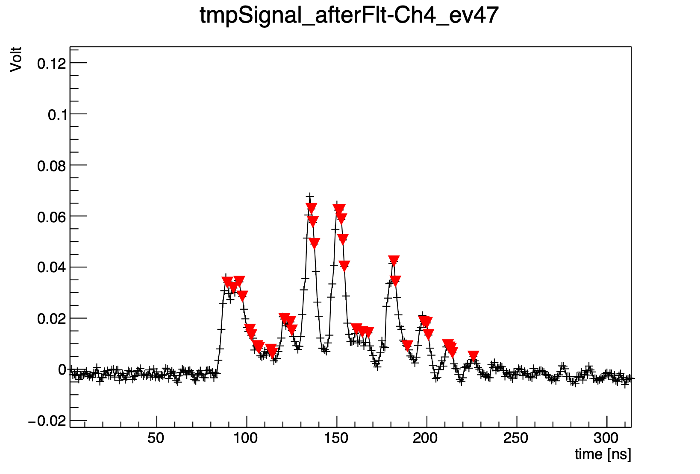
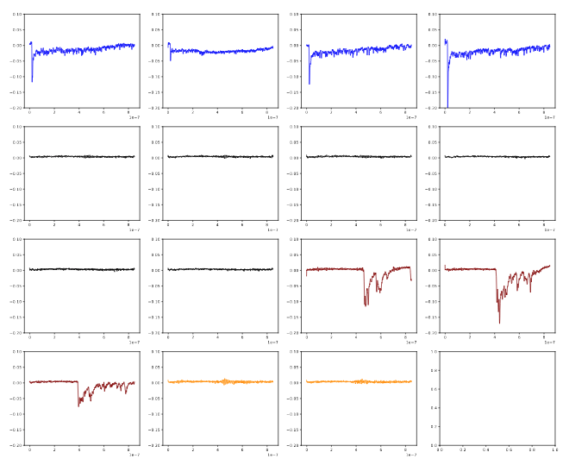
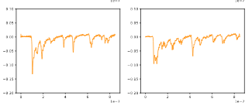
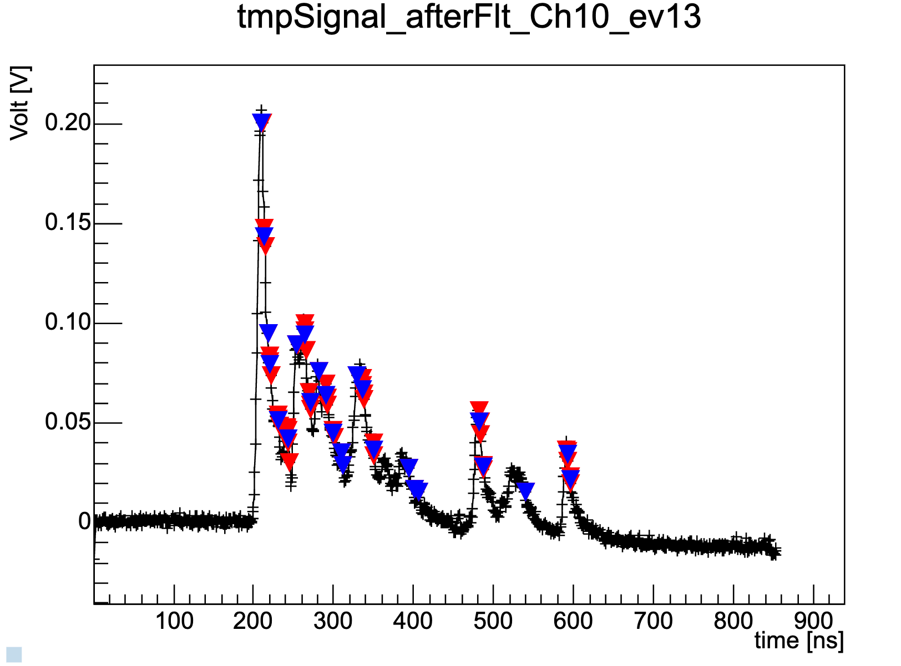
Wire chamber
Typical pulse spectra
Electron peak finding
90%He - 0° - 2cm
90%He - 60° - 2cm
80%He - 60° - 2cm
90%He - 60° - 1cm
90%He - 45° - 1cm
80%He - 60° - 1cm
1 cm tube
2 cm tube
3 cm tube
Ionization clusters ( ) and
single electron pulses ( )

Slide 18
Future activities
Beam test scheduled for next June at CERN H8 aimed at:
  measuring the cluster density as a function of βγ at different muon beam momenta
  defining the relativistic rise and the Fermi plateau of dE/dx and dN/dx in He based gas mixtures (lack of experimental data and discrepancies among different simulation models)
Checking the particle identification performance with cluster counting and with dE/dx using as a benchmark the CP violating process:
B_{s} → D_{s} K
Plenty of scope for new collaborators!

Slide 19
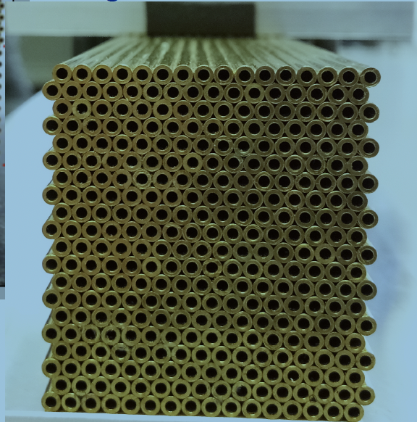
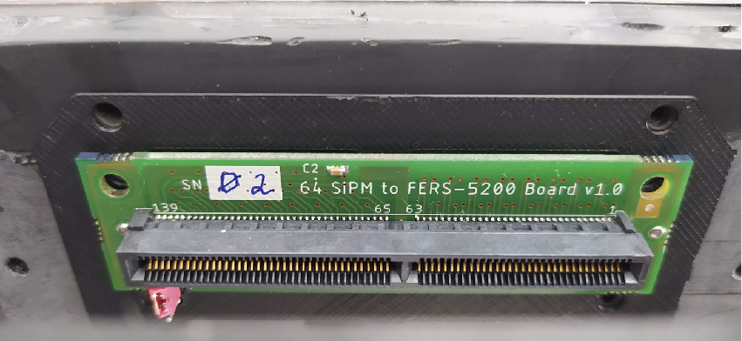
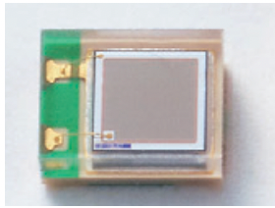

2020 Dual Readout prototype
Full prototype - 9 towers
Single tower
Electromagnetic dimensions of 10x10x100 cm³
“Bucatini calorimeter”
9 towers containing 16x20 capillaries (160 C and 160 S)
Capillary tube with outer diameter of 2 mm and inner diameter of 1.1 mm 1-mm-thick fibers
Front end board
housing 64 SiPM
Fiber guiding system
Hamamatsu SiPM: S14160-1315
PS Cell size: 15 μm
Readout Boards CAEN A5202

Slide 20



2020 Dual Readout prototype
Two test beams in 2021: DESY and CERN
DESY with e⁻ 1-6 GeV
SPS with e⁺ 10-125 GeV
Preliminary - no filters used
Preliminary
yellow filters used over scintillating fibers,
neutral filters used over clear fibers
Front end board
housing 64 SiPM

Slide 21

DR future prototypes
HiDRa2
Full hadronic shower containment calorimeter
1 Mini-Module (MM):
32 x 16 channel ( 512 ch )
17 modules, ~ 65 x 65 x 200 cm³
- 2 central modules with SiPMs
→ ~ 10 k SiPMs, ~ 20 FEE boards
- all others with PMTs
→ ~ 150 PMTs
1 Module:
2 x 5 MMs
→ 10 FEE boards
(8-channel grouping)
~ 13 x13 x 200 cm³

Slide 22
Plate based + 3D printing calo (Korea)
“Short-term plan”
“Mid-term plan”
Copper (3D printed)
Building more and
more modules
2022-2025
Strong collaboration on DR calorimetry between INFN, Korea and USA

Slide 23

Crystal ECAL with DR calorimeter
M. Lucchini

Slide 24




Crystal ECAL with DR calorimeter
Event display
crystals + IDEA w/o DRO
crystals + IDEA w/ DRO
crystals + IDEA w/ DRO + pPFA
Sensible improvement in jet resolution using dual-readout information combined
with a particle flow approach → 3-4% for jet energies above 50 GeV
M. Lucchini

Slide 25







μ-RWELL: Test beam 2021
H8 Test beam 11/2021
New μ-RWELL prototypes with 40 cm long strips
a) Design optimization:
- different HV filter applied
b) Detector characterization
- HV scan at 0°
- HV scan at different angles and drift field
strips
7 μ-RWELL prototypes with resistivity varying between
10 and 80 MOhm/£
will allow to define best resistivity for final 50x50 cm² detector
1- Signal shape
(cluster charge, cluster size)
2 - Detector performance
(efficiency, space resolution)
beam
LNF
BOLOGNA
FERRARA
TORINO

Slide 26




Results from test beam data

Slide 27


Status of Simulation of IDEA concept
FASTSIM Delphes IDEA card used for performance studies FCCSW
Very sophisticated compared to default.
Latest additions: Vertexing, LLP, PID, dN/dx, dE/dx
FULLSIM: standalone GEANT4 description
Fully integrated geometry
Output hits and reco tracks converted to EDM4HEP
Ready for PFlow development and other reconstruction frameworks/algorithms (ACTS, Pandora etc) in FCCSW

Slide 28
Question 1
How do we assure that the proposed concept fulfills physics requirements?
Simulation of benchmark processes
Some examples:
  Track momentum resolution:
  Higgs with Z → μ μ recoil
  Higgs → μ μ invariant mass
  Heavy Flavour final states separation
  Track spatial resolution:
  b/c tagging performance
  τ ID
  PID:
  HF physics: Bs → Ds K vs Bs → Ds π
  Same/opposite side K flavour tagging
  s tagging performance
  EM resolution:
  π⁰ reconstruction
  τ reconstruction
  Jet resolution:
  W/Z/H separation
        Validation of assumed detector performance with prototypes/test beams

Slide 29
Question 2
How do we handle benchmark processes
Use generator level studies to set the stage
Use fast/simple detector simulation whenever possible for speed to get results out
Validate fast detector simulations with full simulation on smaller data sets
Use full detector simulation when really needed

Slide 30
Question 3
How do we eventually optimise each concept to get the “maximal physics per Euro”
This a complex process due to many correlations. Examples;
                How large a tracking radius?
                Track accuracy, dN/dx, but bigger calorimeter/coil/Si wrapper
                How many tracking layers?
                Redundancy vs cost.
                How deep the calorimeter?
                Resolution vs cost.
                EM crystals or not?
                Large cost, but lots of physics
                Problems is ill posed unless constraints (e.g. a price cap) is given. Maybe a few scenarios should be given:
                Cheap (Fiat 500)
                Good (BMW)
                Super (Ferrari)
                Other constraints should be clearly stated: maximum dimensions allowed in cavern, weight limitations, total power... any other operational constraints
                In any case one needs a cost model with some variables that can be changed for each “concept”

Slide 31




Conclusions
FCC-ee will be a fascinating machine, allowing to achieve unprecedented precision on EW measurements and Higgs couplings
  The IDEA detector concept could be an excellent choice for one of the IPs
    Very good momentum measurement
    Outstanding PID with cluster counting from the drift chamber
    Excellent calorimetry
    Precise and efficient muon detector
Need for significant R&D in the next 4-5 years
  A lot of ongoing activities on all IDEA sub-detectors
  Profiting from several national funding schemes, EU projects, etc.
  INFN was central in all these R&D activities and started many of them
  Now several International colleagues have joined these efforts
Lots of possibilities for moreInternational colleagues to join IDEA and help on all these developments!!

Slide 32
Backup

Slide 33


DR calorimeter
Scintillation
Čerenkov
Copper (3D printed)
Front
Rear

Slide 34



2D μ-RWELL ideas
μ-RWELL with 2D anode readout
Good performance
but need higher gain wrt. to 1D
μ-RWELL
More complex PCB construction
2 stacked 1D μ-RWELL
1 view per μ-RWELL
easy PCB construction
2D performance to be measured
μ-RWELL with strips
on top and anode
HV on DLC,
TOP to ground
2D performance to be measured
y strip
y strip
x strip
y strip
x strip
x strip

Slide 35


Technology transfer with ELTOS
DLC sputtering with new INFN-CERN machine @ CERN
Step 1: producing μ-RWELL_PCB
- with top patterned (pad/strip)
- without bottom patterned
Step 2: DLC patterning
- in ELTOS with BRUSHING-machine
Step 3: DLC foil gluing on PCB
- double 106-prepreg (~2x50 μm thick) (already used in ELTOS)
- pre-smoothing + 106-prepreg (~50 μm thick)
- single 1080-prepreg (~75 μm thick)
Step 4: top copper patterning
Finalization
Step 5: Kapton etching on small PCB
Detector @ CERN for final preparation

Slide 36


Test with TIGER electronics
Test with TIGER ASIC
Developed for BESIII CGEM-IT
Prepare new readout card based on System On Modules (SOM)
Aim
Develop dedicated ASIC for μ-RWELL

Slide 37


μ−RWELL-based detectors
2022-2024 R&D program
Ø Define the best resistivity of the DLC for both µRWELL fundamental tiles and build the 50×50 cm² prototypes for the pre-shower and muon systems.
Ø Optimize the engineering mass construction process together with the ELTOS industry.
Ø Develop a custom-made ASIC for the µRWELL with the experience obtained from the TIGER chip and to test the µRWELL prototypes.
Ø Develop a new reconstruction algorithm, ML-based, to improve the resolution of µRWELL.
Ø Simulation of the CEPC decay channels of interest to optimize the detector design with special emphasis on Long Lived Particles to show the impact of a performing tracked in the muon system instead of a tagger.
Development of a new ASIC
Ø Two large microRWell chambers M4 in Bologna;
Ø Ferrara has procured the Tiger electronics;
Ø Plan to start equipping the M4s with the TIGER next spring;
Ø Use a cosmic telescope to characterize the detector and the electronics and later to expose the chamber with the TIGER electronics to a test beam;
Ø Funding received to develop a new ASIC starting from the experience of the TIGER.
Strip length
~22.5 cm

