Slide 1
Progress on ARC
Kick-Off Workshop on Detector Optimisation and Benchmarking for FCC-ee
23 June 2022
Roger Forty (CERN)
ARC is a novel RICH detector concept, first presented at the FCC week last year [link]
as a candidate solution for the particle identification requirements of an FCC-ee experiment
Focused on achieving a compact and low-mass detector with excellent resolution
→ considered pressurizing the radiator gas, and developed a light-weight vessel
Given the limited radial space, use many similar cells each with its own photosensor
→ name Array of RICH Cells (or Aerogel RICH Cells, if aerogel is used as a dual radiator)
Report on progress on optimizing the optical layout + update expected performance
(after a short recap, based on the previous slides)

Slide 2
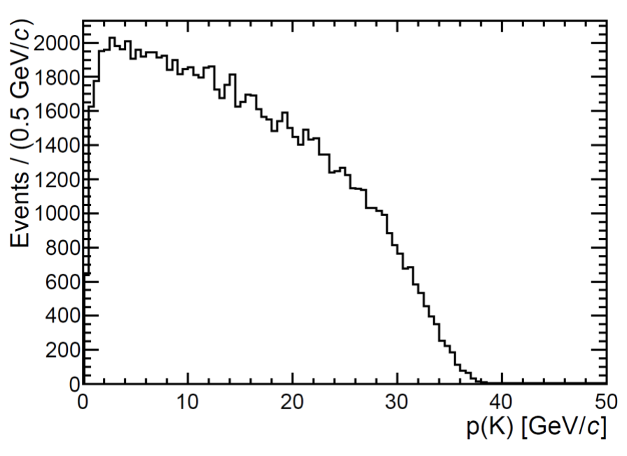
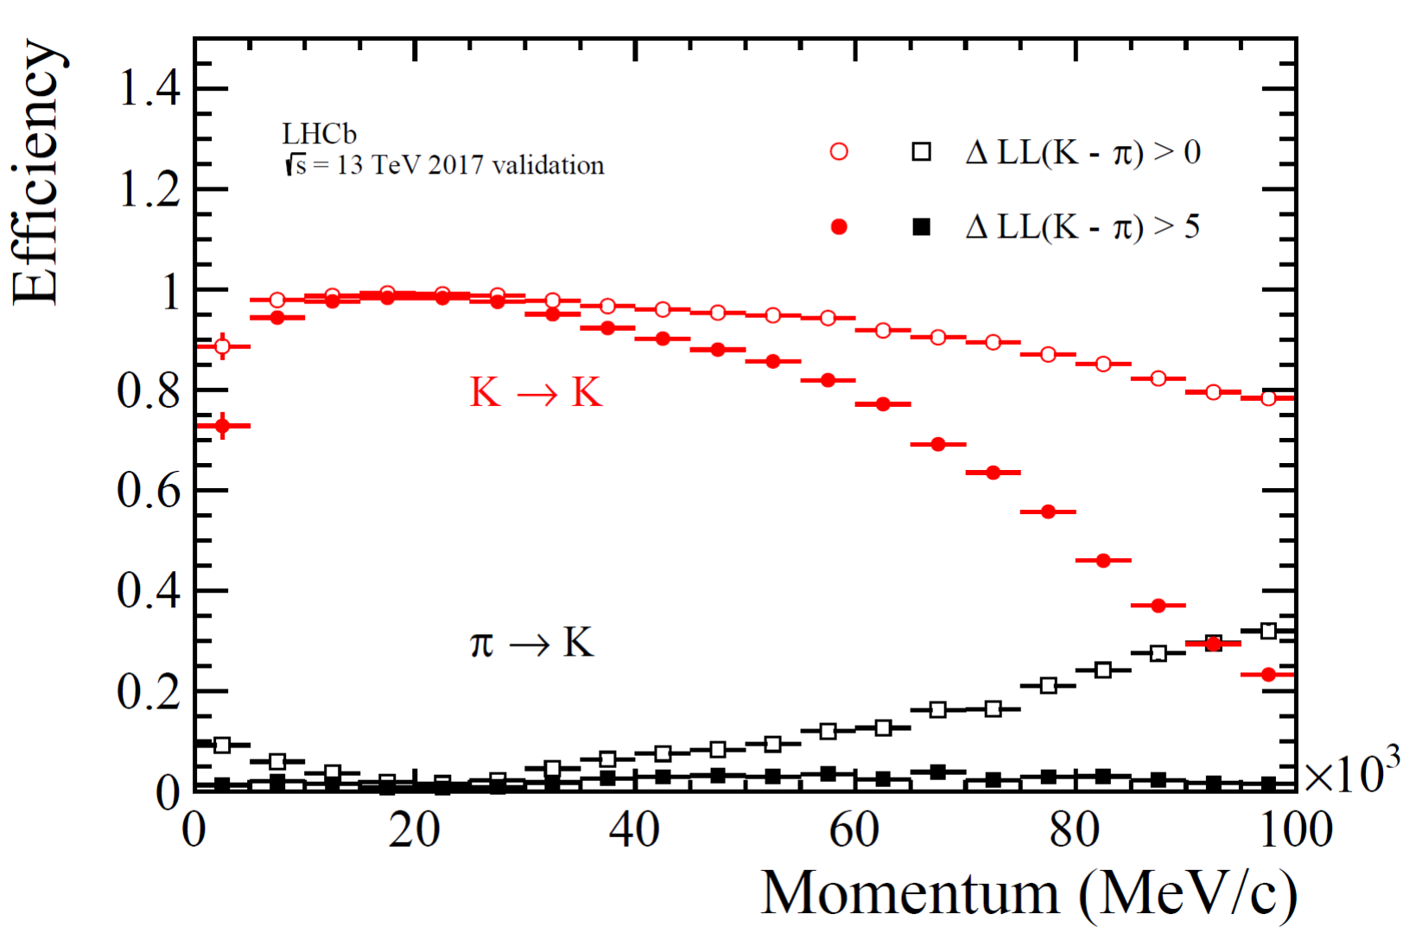
Motivation
B_{s} → D_{s}K simulation in Z events
The physics programme of FCC-ee requires charged hadron particle identification (separation of π, K, p)
Essential for flavour physics at the Z (b, c, τ)
Also important for separating Higgs decays to bb, cc, ss
Baseline requirement: K-π separation for momenta 1– 35 GeV
IDEA concept aims for good separation from dN/dx in drift chamber, supplemented with TOF for the cross-over region
(challenging, performance remains to be demonstrated)
CLD concept currently lacks PID beyond regular dE/dx
RICH detectors are the reference for high momentum PID
→ see if a RICH detector like those of LHCb could fit into CLD
Potential interest from recent Noble Liquid concept also welcome, or from whatever experiment is proposed for the 4th IP
[IAS-HEP, 15/1/2021]
LHCb RICH performance
Efficiency

Slide 3
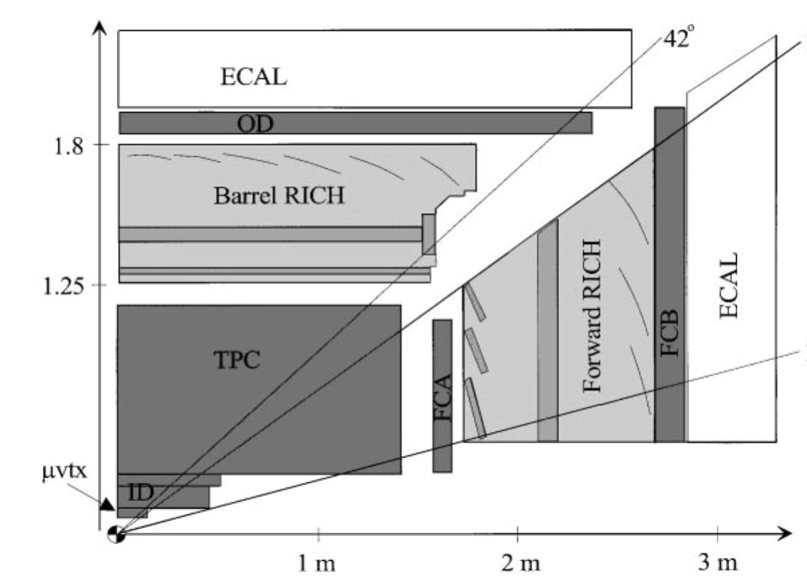
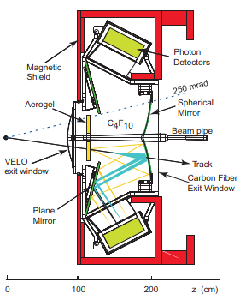
4π RICH detector
Previous instances DELPHI and SLD: highly challenging, delicate systems, significant issue was the space required
LHCb RICH1 dual radiator in original design: aerogel + C₄F₁₀ gas
Aerogel later removed, due to high track density at the LHC
Modern photosensor developments: compact, higher efficiency, insensitive to magnetic field → no shielding
Depending on photosensor efficiency, may need to reduce gas radiator depth from 85 cm in LHCb → consider pressurization
At 3.5 bar (abs) same photon yield achieved in 3.5x less depth
Current optimization indicates that (with assumptions made about photosensors, background, etc.) an unpressurized gas radiator may be sufficient—however, having the possibility of pressurization allows other gas radiator options to be explored
Aerogel photons focused by same mirror as those from gas onto
same sensor plane “for free”→ concentric rings if track above both thresholds: efficient use of same sensors for both radiators
DELPHI
LHCb

Slide 4
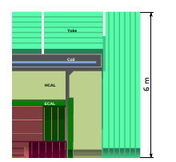
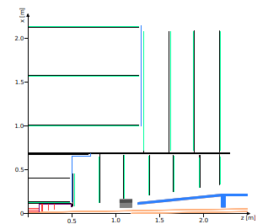
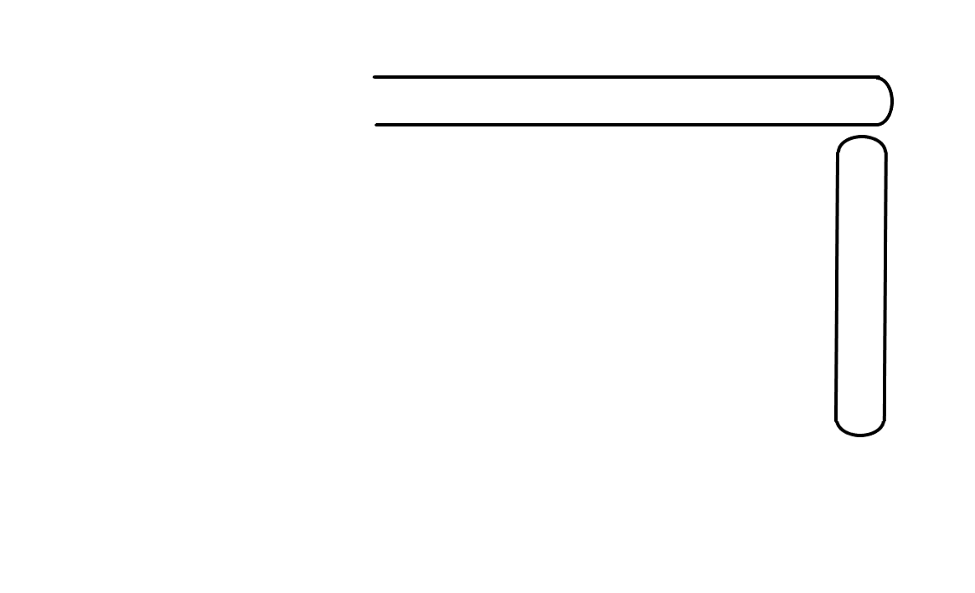
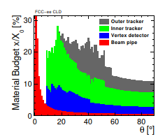
RICH layout for FCC-ee
CLD
To be concrete, based the design on the current CLD experiment concept for FCC-ee [N. Bacchetta et al., arXiv:1911.12230]
Target a radial depth of 20 cm, and material budget of 10% X₀
CLD tracker
2.2 m
Barrel
20 cm
RICH pressure vessel
(Barrel + Endcaps)
= solids of revolution
around the beam axis
Tracker would need
to be re-optimized using
10% less radial space
(already studied in
Appendix B of CLD note:
intended to make calorimeter
smaller and save money…)
2.1 m
Endcap
1.6 m

Slide 5
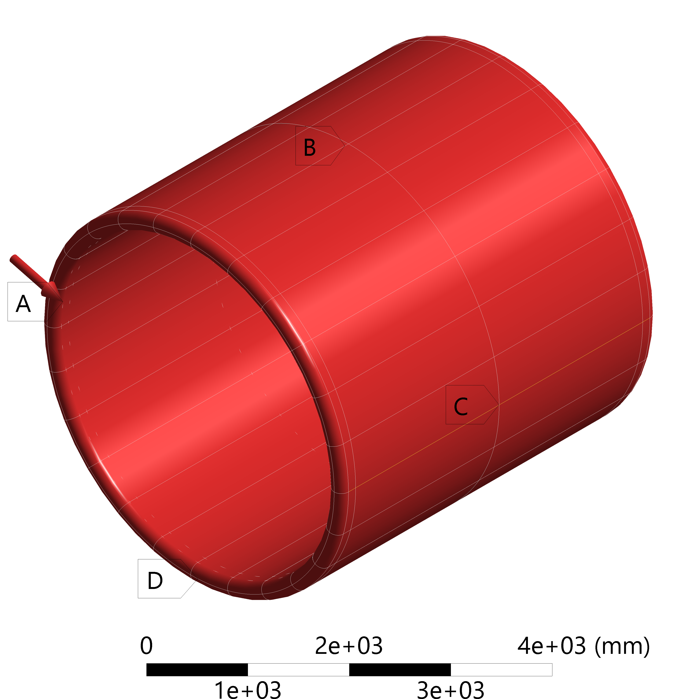
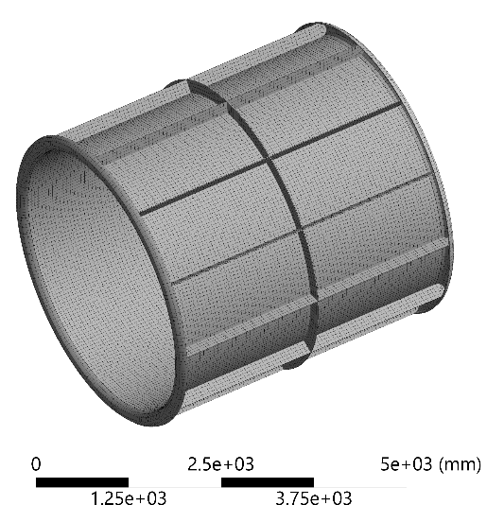
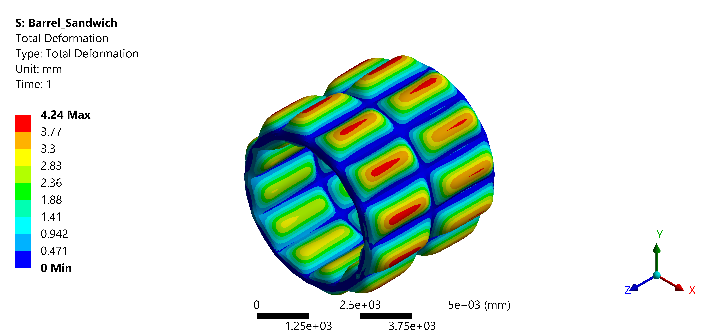
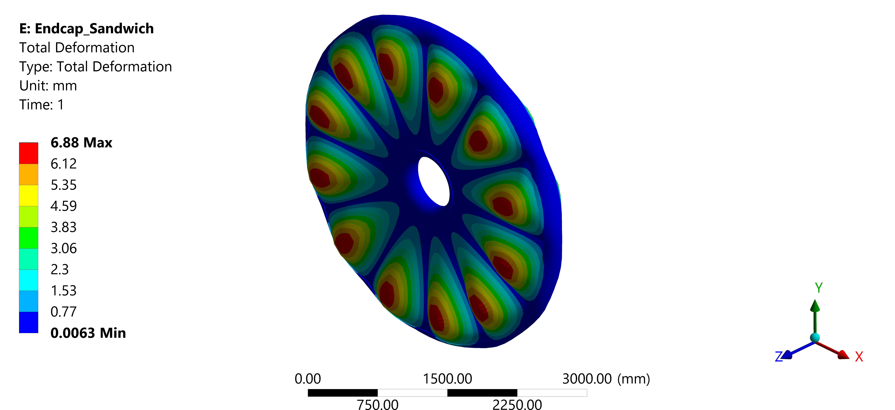
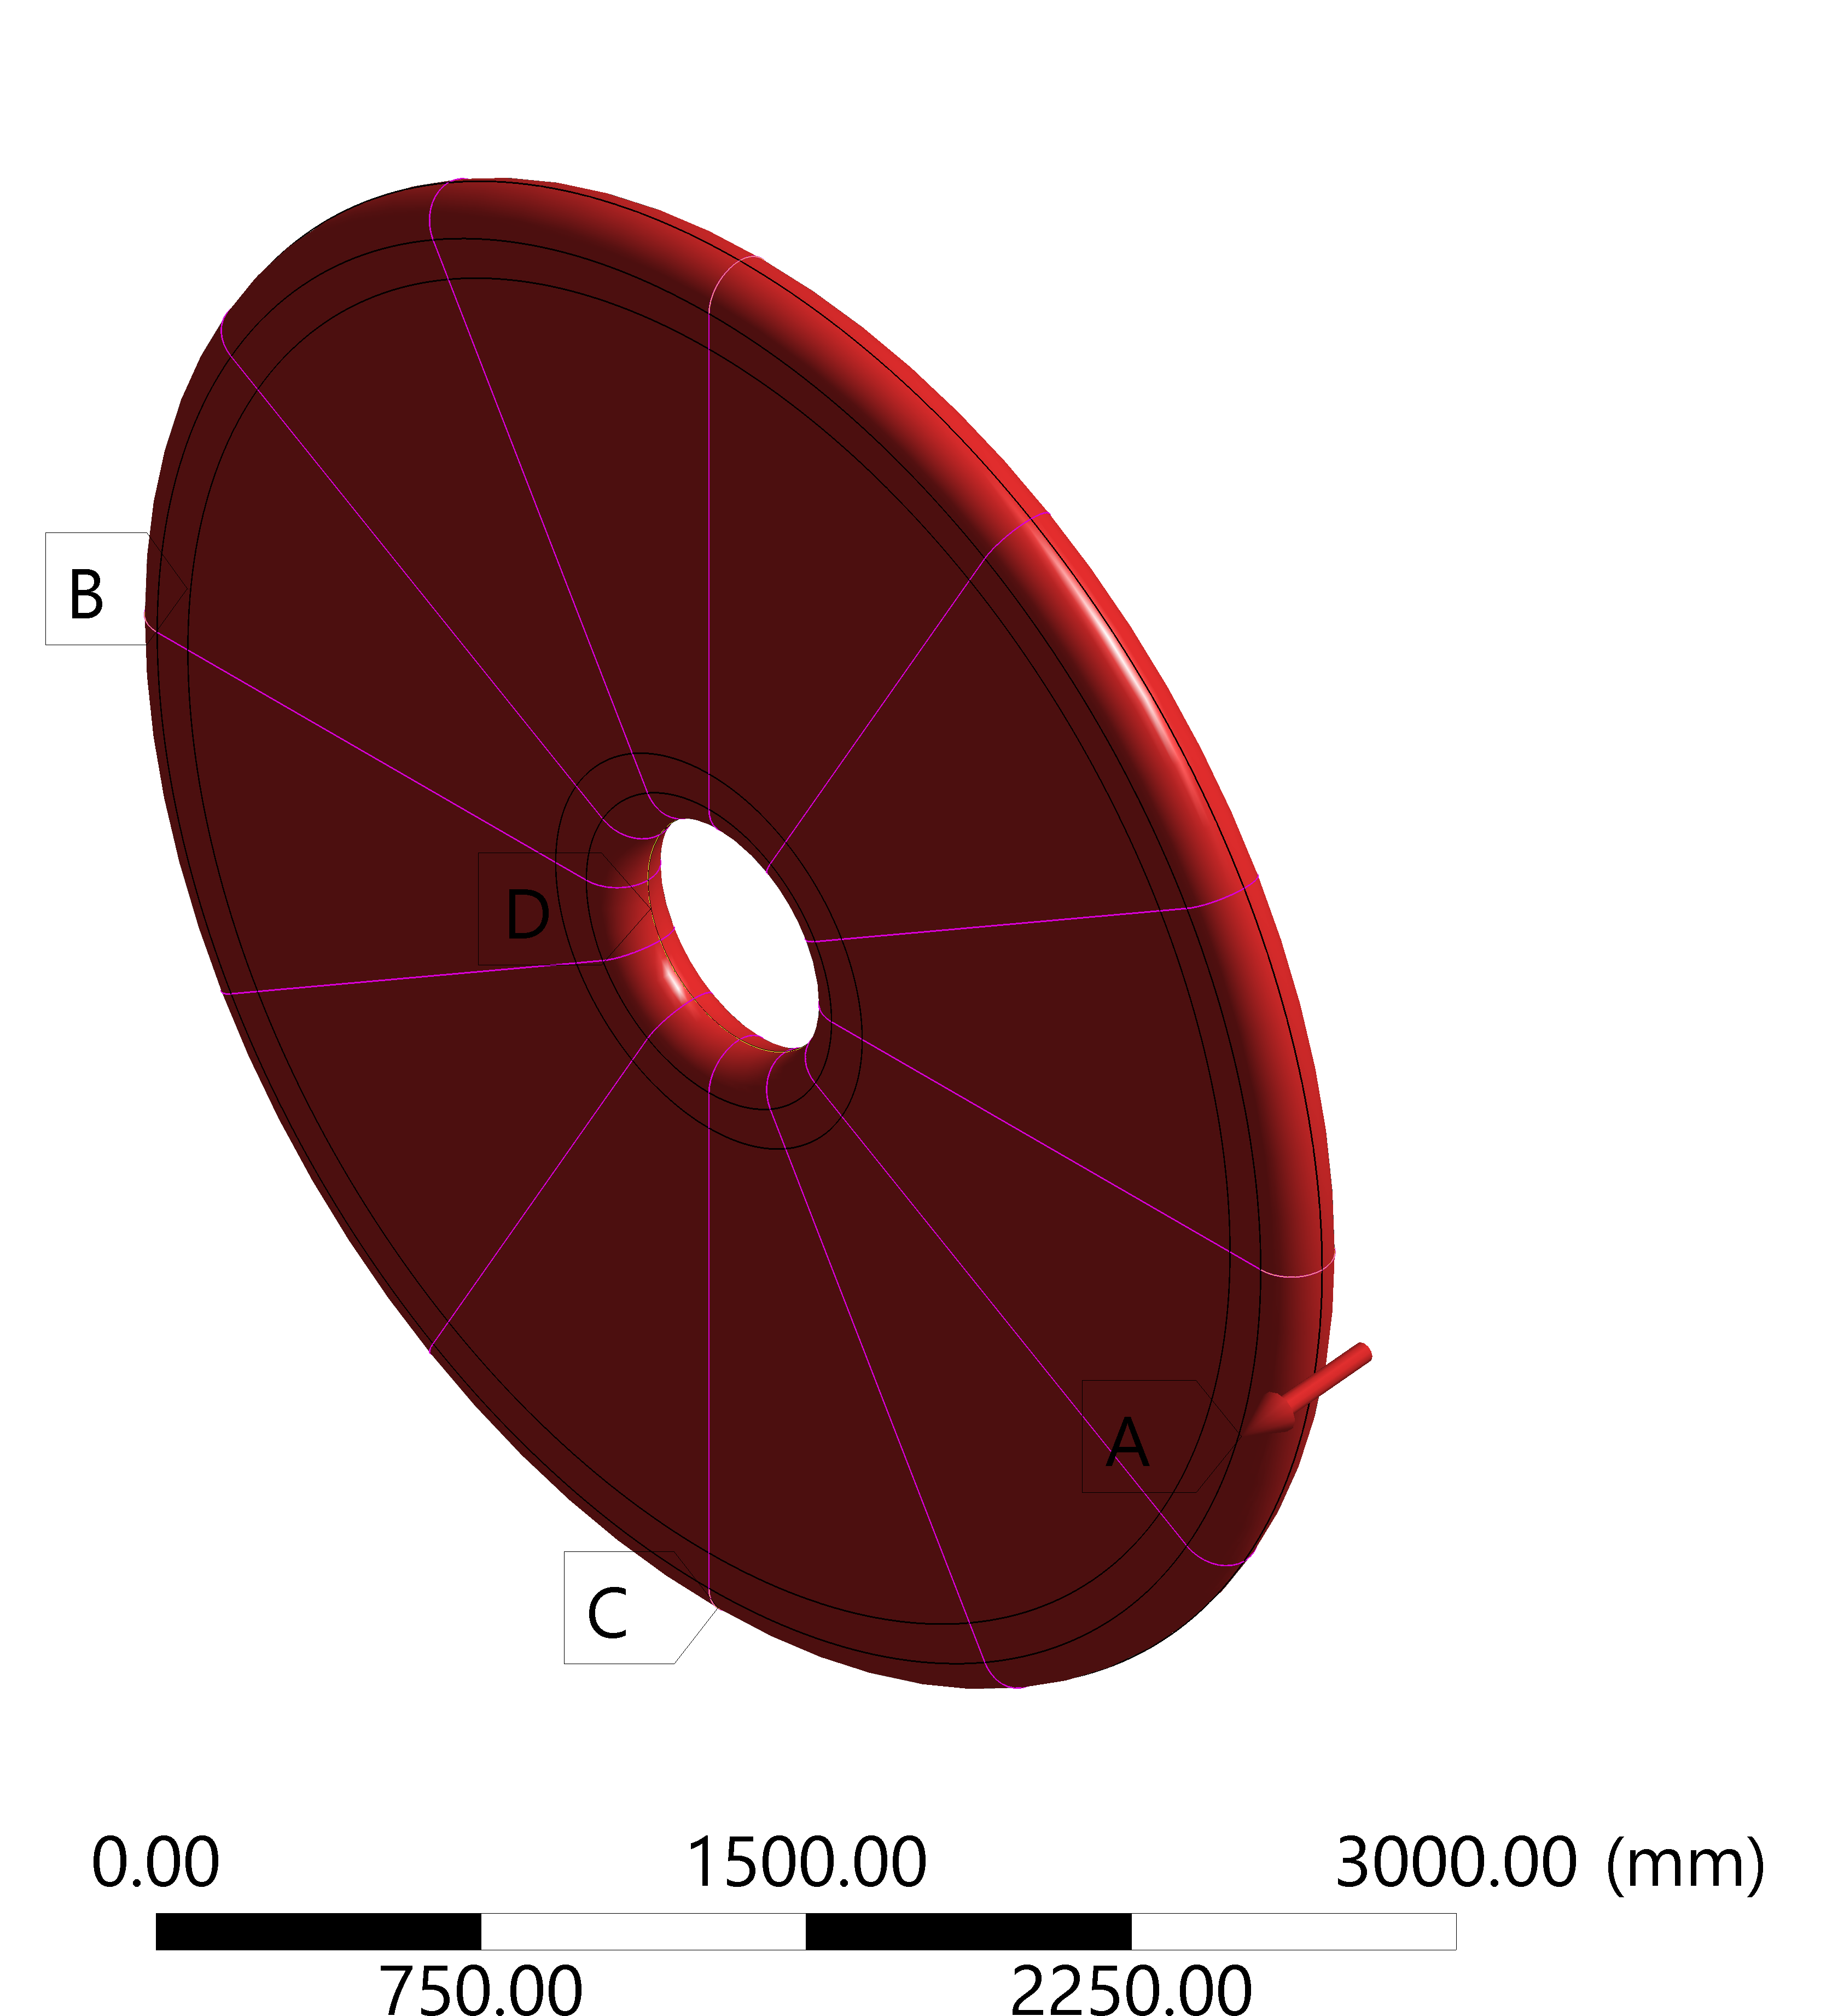
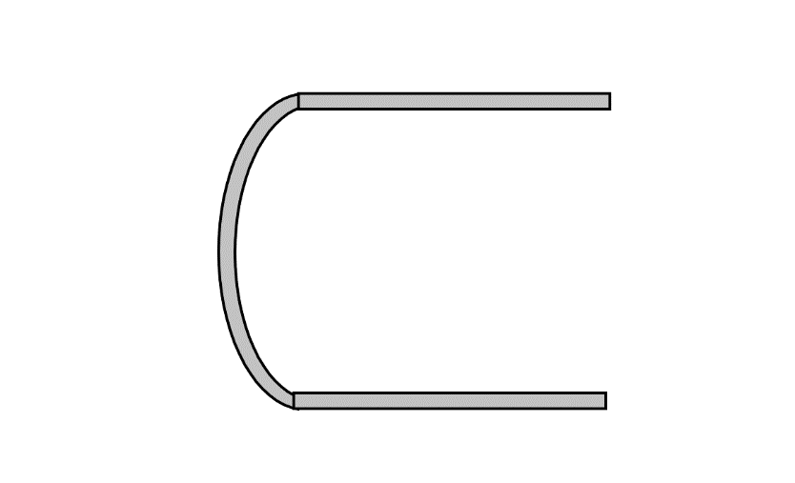
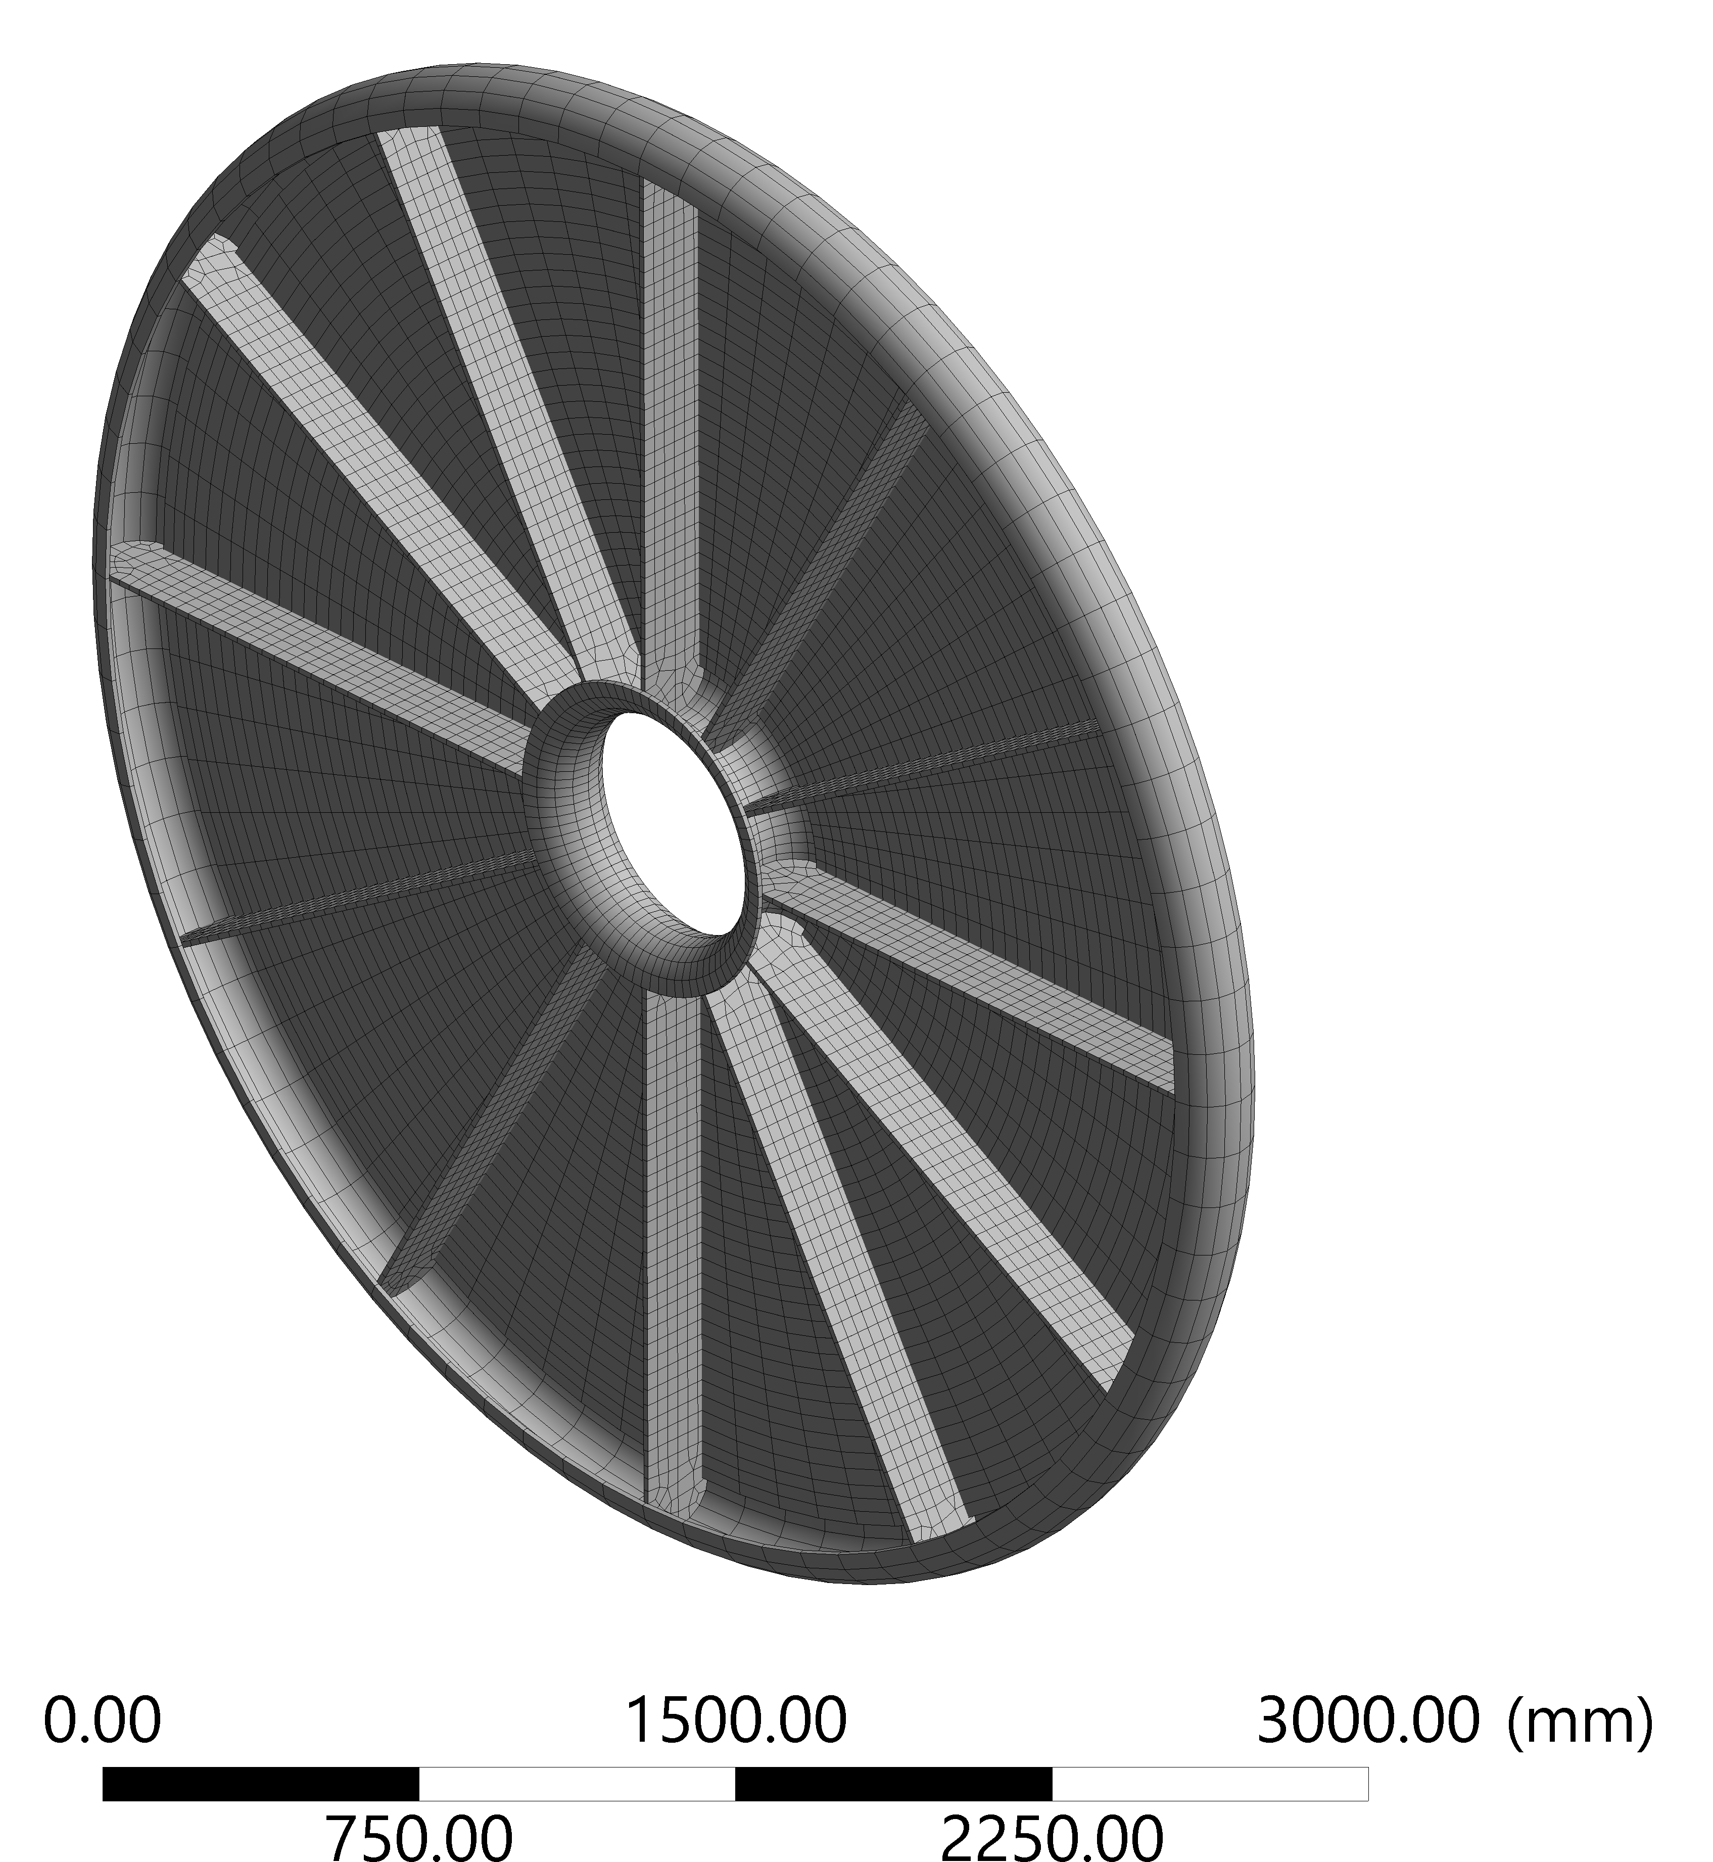
Detector vessel
External wall hidden
to show reinforcing ribs
CAD study: deformation at 4 bar
(safety factor 2)
Barrel
Lightweight vessels for cryostats currently under intensive R&D, strong synergy with aerospace (e.g. for composite fuel tanks)
Working group in CERN-EP strategic detector
R&D programme led by Corrado Gargiulo
He has developed a first design for this application: sustains pressure up to 4 bar
Carbon-fibre composite sandwich, foam core
12-fold symmetry adopted for stiffening ribs
→ sectors
B
A
B
D
Endcap
Side-view at end:
removable
semi-elliptical caps
50 mm
200 mm
Flange

Slide 6
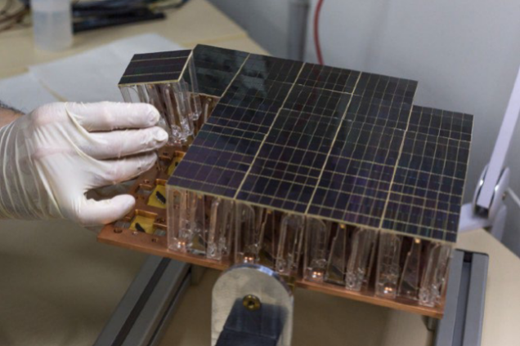
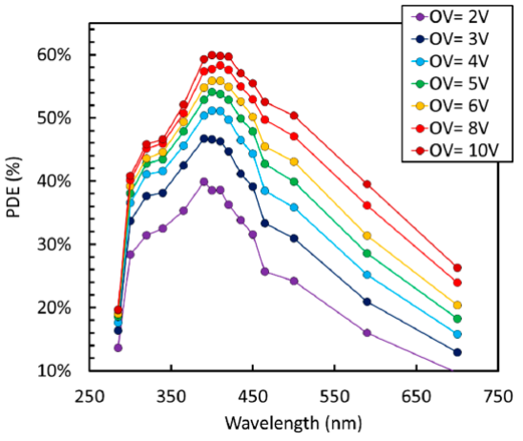
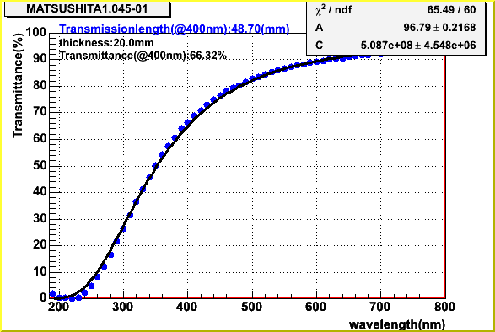
Photosensors + aerogel
Silicon PMs have come of age: widely adopted e.g. in MEG,
DarkSide (30 m² area!), LHCb SciFi, CMS Barrel Timing Layer
Excellent photon detection efficiency > 50% possible, mostly in visible
Extremely compact, assume can fit the photosensor (and its readout electronics) in a few mm-thick layer
Excellent granularity (sub-mm possible, e.g. 250 µm for SciFi)
and fast timing resolution at ~ 10 ps level
High clarity, large area aerogel tiles developed by Belle for ARICH
[I. Adachi, ECFA TF4, 6/5/2021] (other recipes also available): assume
1 cm thick tiles of clarity C = 0.005 µm⁴/cm, n = 1.03 → θ_{C} ≈ 240 mrad
A. Kish, CERN Detector Seminar, 28/5/2021
DarkSide
Assume
this PDE
A. Gola et al, Sensors 19 (2019) 308
Belle aerogel tiles
Highlight changes
150 x 150 x 20 mm³
T = T₀ exp(-Cd/λ⁴)
C = 0.005 μm⁴/cm
NUV-HD 40 𝜇𝑚 cell

Slide 7
Gaseous radiator
red
blue
UV
C₄F₁₀ was baseline assumption: well-known, used in LHCb RICH1
Refractive index increases with pressure (n – 1 ∝ density)
n = 1.0014 at room temp, n = 1.0049 at 3.5 bar → θ_{C} ≈ 100 mrad Chromatic dispersion also increases, but still excellent
This is why fluorocarbons used, despite being greenhouse gases (GWP ~ 8000); chromatic dispersion is even lower in the visible
At 3.5 bar pressure, boiling point of C₄F₁₀ increases to 33 °C
→ would need to maintain gas volume at ~ 40 °C
Xenon is not a greenhouse gas, and stays in gas phase at room temperature up to over 20 bar
However, lower refractive index (n = 1.0007) so would need higher pressure than C₄F₁₀, and somewhat worse dispersion
Have now investigated its use instead of C₄F₁₀ : performance illustrated here using xenon at 3.5 bar, as an example
For such a new gas choice, R&D needed to ensure suitability
aerogel
n - 1
xenon (1 bar)
n – 1 (x 10⁴)
C₄F₁₀ (0.5 bar)
Photosensor PDE
before/after
aerogel transmission
PDE (%)
Photon energy [eV]
[my fit to data from refractiveindex.info]

Slide 8
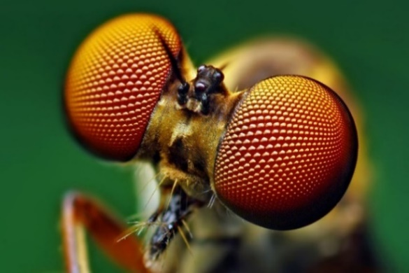
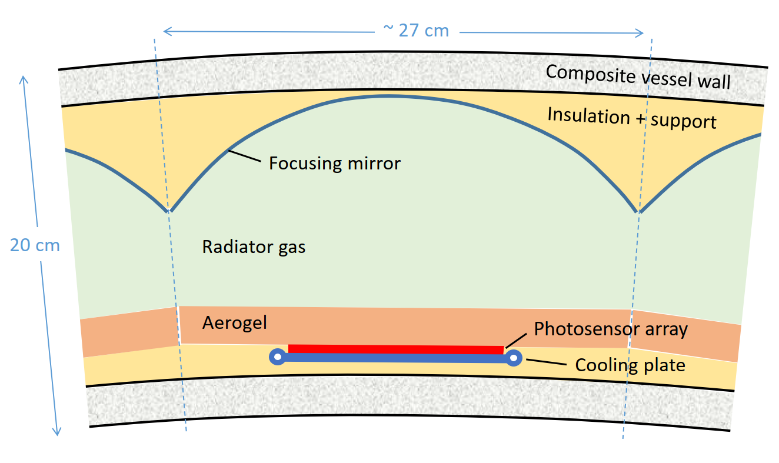
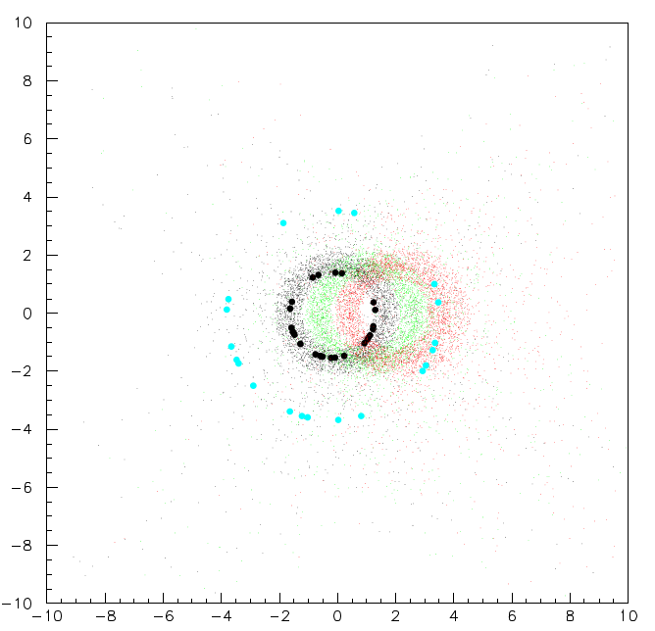
Detector cell
Note hexagonal structure…
Challenge to arrange optical elements so that Cherenkov light focused onto a single sensor plane, as the detector radial thickness is reduced
Concept inspired by the compound-eye of an insect: tile the plane with many separate cells, each with its own mirror and sensor array
Use spherical focusing mirrors: focal length = radius-of-curvature/2
→ select radius-of-curvature R ≈ 30 cm for radiator thickness of 15 cm
https://www.findlight.net/blog/2019/01/23/artificial-compound-eyes/
Simulate tracks from IP crossing detector uniformly over acceptance and ray trace Cherenkov photons to sensor plane:
(here for θ ≈ 90°)
Ring radii = R∙θ_{C} /2 = 1.1 cm (3.6 cm)
for gas (aerogel)
Detected photons from:
aerogel + gas at high p / 10 / 5 GeV
y_{det} (cm)
Assume 8 x 8 cm² sensor plane
(area required still to be optimized)
ARC detector (one cell)
x_{det} (cm)

Slide 9
Optical layout
This turned out not to work well: resolution
> 5 mrad → would limit performance (R)
Instead find optimum
with tilted mirrors (L)
As move away from normal incidence, i.e. θ = 90° (Barrel) or 0° (Endcap), need to adjust focusing
Either mirrors kept parallel, radius-of-curvature adjusted (R-half); or tilted and/or parabolic mirrors (L)
For first solution, add a plane mirror at the end, to keep ring images inside the detector volume
Barrel
side view
Easier to integrate cooling plate and aerogel if sensors lie on a plane
But focusing quality might oblige tilting — optimization in progress
Sensor array
Cooling plate
Mirror outline
~105 cm
Endcap
28 (11) cells per Barrel (Endcap) sector
24 (24) sectors → 936 cells in total
If each has 10 x 10 cm² sensor array
→ ~ 10 m² total area to instrument
220 cm
Barrel sector plan view
IP

Slide 10
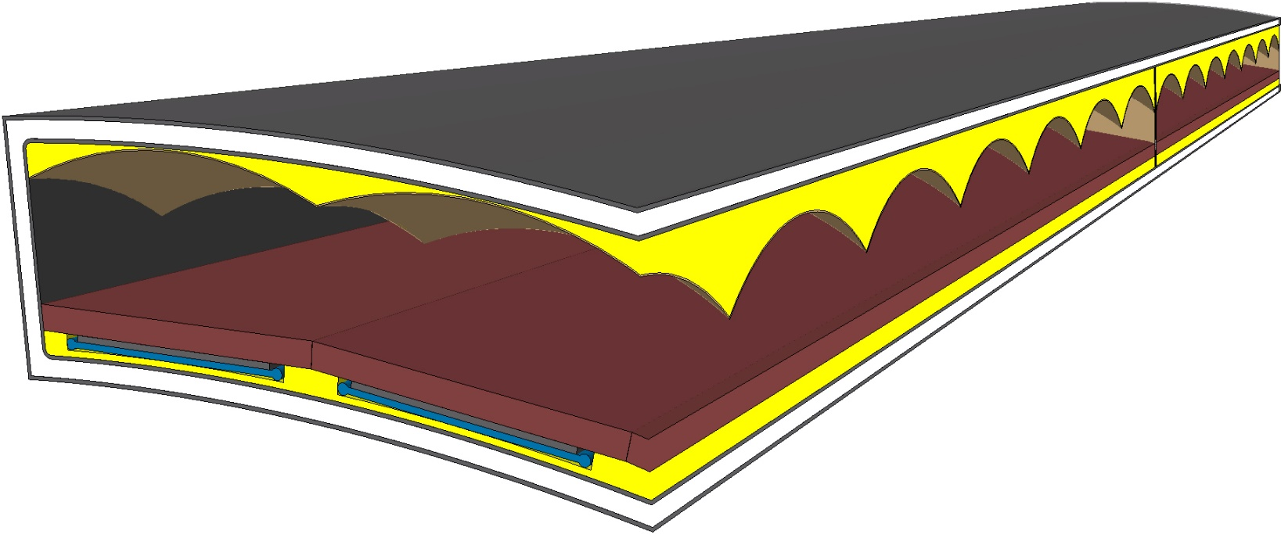
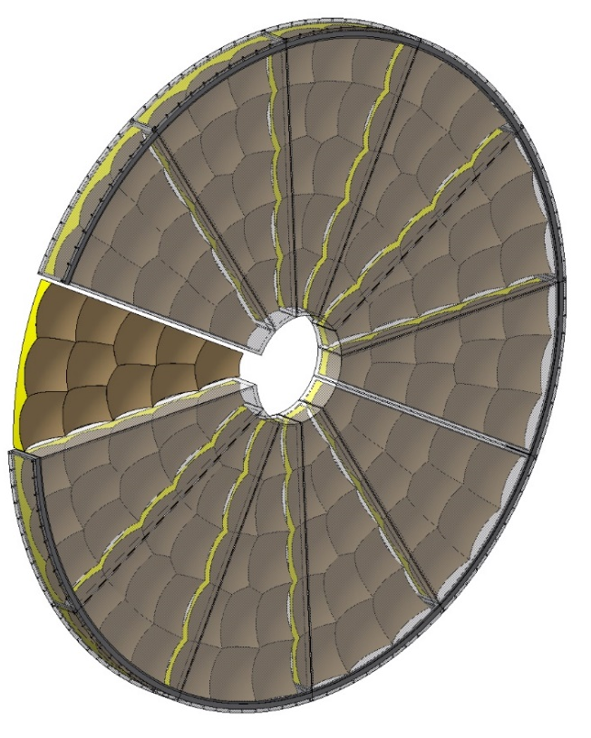
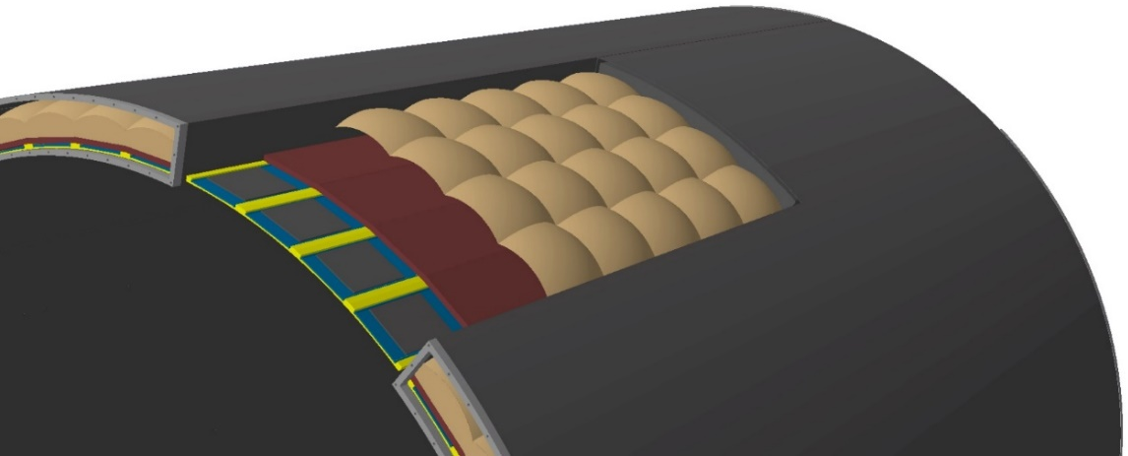
ARC detector details
Focusing aberrations worst at corners → move to
hexagonal close-packed mirrors for barrel
CAD views from Corrado
Thermal insulation around the mirror and sensor array would be very low mass (MLI: the shiny stuff that satellites are wrapped in)
Vessel-Outer- Wall
mirror
mirror support + thermal shield
C₄F₁₀
Vessel Circumferential rib
gas volume
3.5 bar
Aerogel
Endcap mirrors
SiPM array
+ cooling plate
thermal shield
To be updated…
Vessel-Inner-Wall
Material budget estimate
Detector component | X/X₀
2 x vessel wall | 5 %
Photosensor array/electronics | 1 %
Cooling plate (3 mm CF) | 1 %
Aerogel (2 cm, n = 1.03) | 1 %
C₄F₁₀ gas (13 cm @ 3.5 bar) | 1 %
Focusing mirror | 1 %
Total | 10 %
Barrel sector and integration
1 cm
xenon?

Slide 11
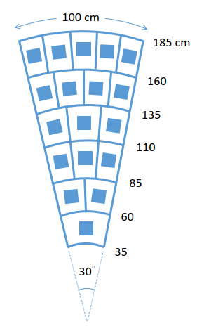
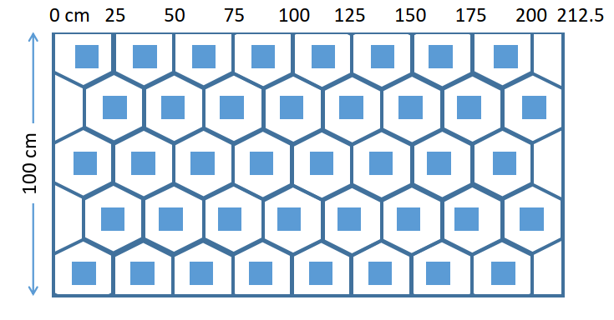
Updated sector layout
Endcap sector
Hexagonal cells in the barrel sectors, but stay with ≈ rectangular for endcaps (in cylindrical coords.)—not obvious how hexagonal cells could be made compatible with the endcap sector geometry: instead adjust cell width per row to match resolution achieved in the barrel
Size slightly reduced: 25 cm height (at entrance window)
Reduced sensor area per cell → total area of sensor reduced
Profit from azimuthal symmetry: only have to optimize 15 mirrors
Barrel sector
Updated cell count
40 (18) cells per Barrel (Endcap) sector
24 (24) sectors → ~ 1400 cells in total
If each has 8 x 8 cm² sensor array
→ ~ 9 m² total area to instrument

Slide 12
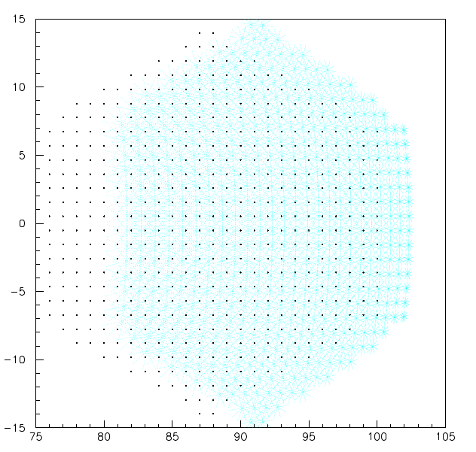
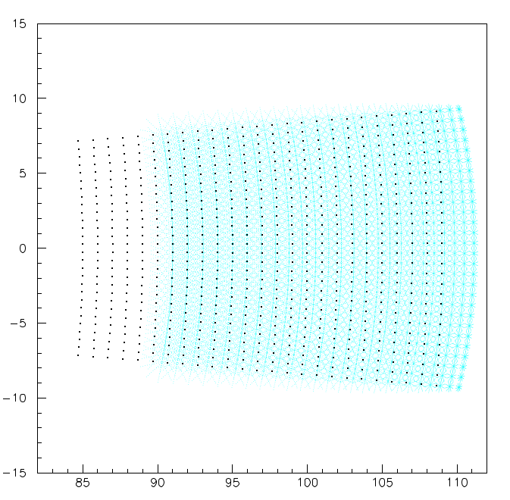
Ray tracing
track impact points
on entrance window
Barrel cell
Use a stand-alone (home made) ray tracing program
Procedure is quite labour intensive, since many parameters to adjust, while optimizing the focusing quality (emission-point error) but not losing too much radiator length… then iterate—would be a nice project for a student to optimize with machine learning
Scan tracks from the IP across each cell in turn
ray trace photons at constant Cherenkov angle (θ,φ)
reflect off mirror, find point of minimal spread
y [cm]
photon impact
points on mirror
z [cm]
Endcap cell
track from IP
y [cm]
Cherenkov photons
radiator gas
mirror
focus (point of minimal spread)
r [cm]

Slide 13
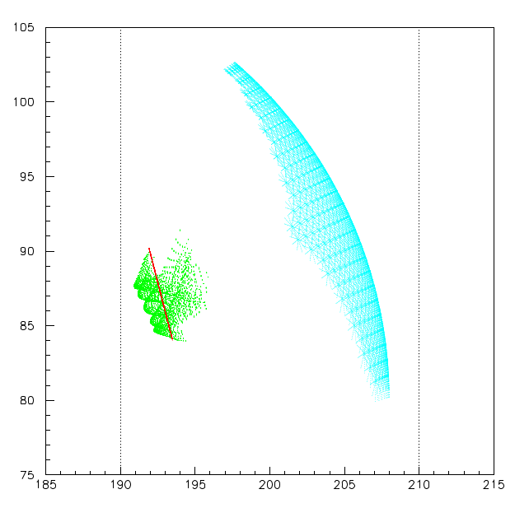
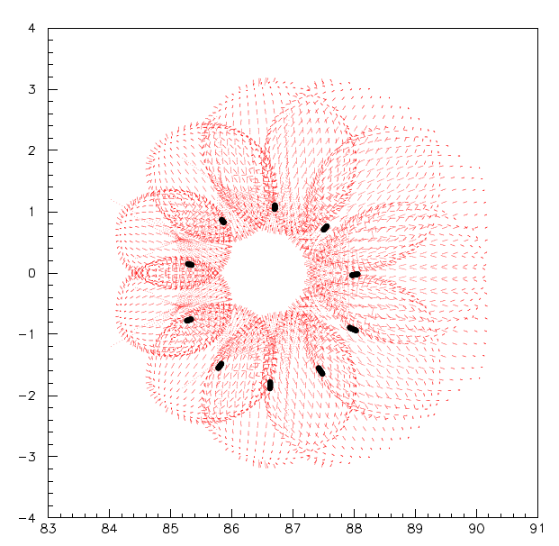
Optimizing the optics
Side view of a barrel cell
Photon focus points form a cloud, into which the sensor plane is adjusted
Parameters: mirror curvature, offset, tilt, sensor plane offset, tilt
Constraints: vessel limits, radiator length
Image on sensor plane: pretty pattern is an artefact of the stepwise changes in (θ,φ)
radiator length
mirror
sensor plane
z [cm]
Photon impact points
on sensor plane
focus points
y_{sensor} [cm]
highlighted points are
from a single track
vessel limits
x_{sensor} [cm]
r [cm]

Slide 14
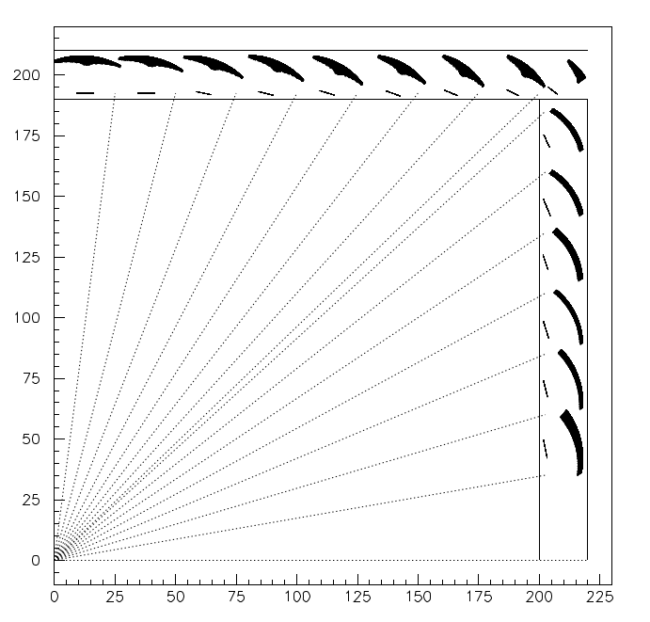
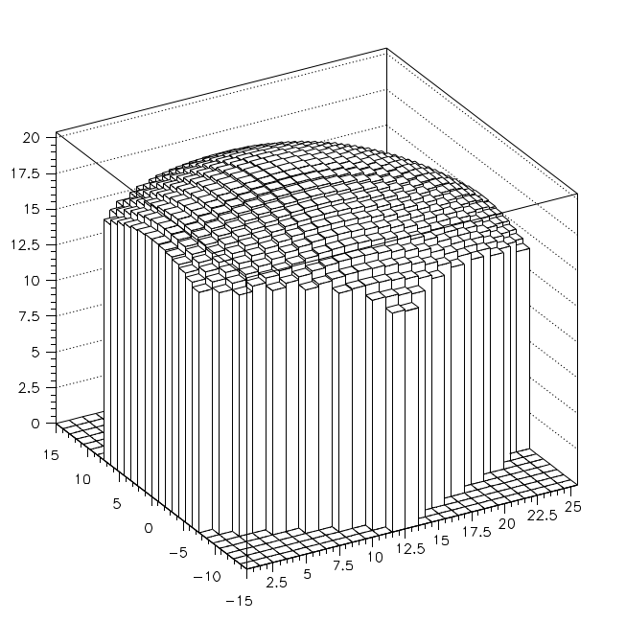
Optimized layout
Mirror and sensor images are from the final set of ray-traced photons
Use only spherical mirrors (simplicity, cost)
Best fit radii-of-curvature range 27–33 cm
Half cell used to cover the overlap region
Determine photon yield as a function of track impact point:
r (cm)
N_{pe} (gas radiator)
beam axis
IP
z (cm)
Position in cell [cm]

Slide 15
Updated performance
xenon (3.5 bar)
Photon yield summed over full detector, may still be
room for improvement of tail to low yield
Performance in terms of K-π separation presented
last time looked suspiciously good…
It was indeed too good to be true: resolution σ_{θ} = σ_{photon}/√N_{pe}
was implemented missing out the square-root… (sorry)
Was also based on the target for optical resolution of 1 mrad
can now use actual resolution achieved for the full detector
In addition, the number of photons from aerogel was underestimated
→ rearrange to use a thinner layer: 1 cm instead of 2 cm
Scattering in aerogel now implemented both for the photons generated as the track passes through it, as well as for all photons that pass back through it on their way to the photosensor
To recover resolution at the high-momentum end, reduce refractive index of gas radiator
Could keep C₄F₁₀ and reduce pressure (shown later), but initially use xenon at 3.5 bar
Other changes: hexagonal cells in barrel, extra row of cells in endcaps; photosensor and its readout squeezed to 5 mm in radial depth (to be confirmed whether this is reasonable)
mean = 16
N_{pe} (gas radiator)

Slide 16
Updated resolution
Chromatic error (xenon, 3.5 bar)
Chromatic dispersion in the radiator is the fundamental limit
once the bandwidth of the photosensors has been chosen
→ 1.3 mrad (2.4 mrad) for gas (aerogel), per detected photon
Reasonably low, due to targeting of visible light with SiPM
Emission-point uncertainty: reflects quality of the focusing
(i.e. how well photons emitted at different points along the track are brought to the same focus on the sensor)
1.3 mrad achieved for gas image at high momentum
Better for aerogel: reduced thickness compensates larger rings
Pixel size chosen to avoid limiting the angular resolution
for d = 0.5 x 0.5 mm² (square pixels) → 2d/ √12 R ≈ 1 mrad
(factor √12 for the RMS of a top-hat distribution)
→ ~ 25,000 pixels per SiPM array, total channel count ~ 35 M*
Track angular resolution error must be good enough not to limit RICH performance: requires σ_{track} << σ_{photon} / √N_{pe} ≈ 0.5 mrad
(given 4-25 billion silicon channels in CLD tracker, should be OK)
1.3 mrad
Emission-point error (now for full detector)
1.3 mrad
Reconstructed Cherenkov angle [rad]
Overall resolution per photon:
σ_{photon} = σ_{chromatic} ⊕ σ_{emission} ⊕ σ_{pixel}
≈ 2.0 mrad (2.7 mrad) for gas (aerogel)
* If cost is part of the optimization, probably use 1 mm pixels → reduce to 9 M channels

Slide 17
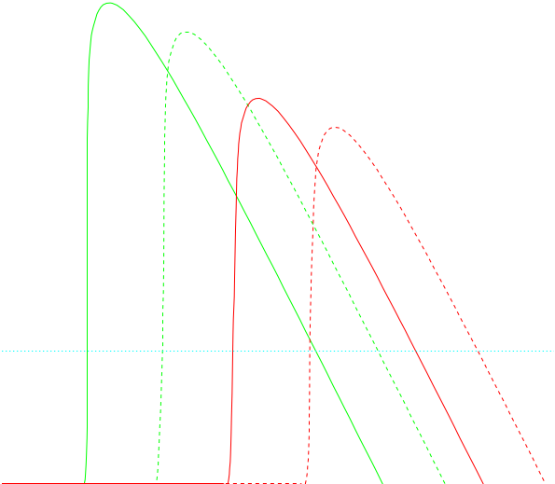
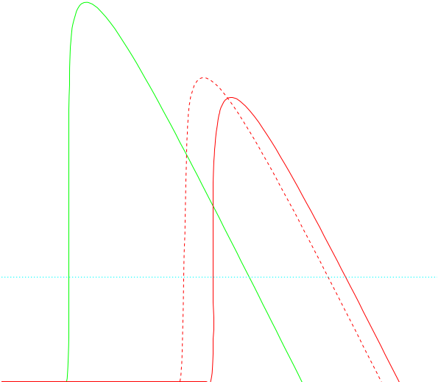
Performance
ARC
Analytic calculation, without background
aerogel
gas
K-π
Number of detected photons N_{pe} = A L ∫ ε sin² θ_{C} dE
where L is radiator length, A = α² / r_{e}m_{e}c² = 370 cm⁻¹ eV⁻¹
Efficiency ε = PDE ∙ active area ∙ mirror reflectivity ∙ aerogel transmission, as a function of photon energy E
Assume SiPM active area = 0.8, mirror reflectivity 0.9,
other values as given above → ⟨N_{pe}⟩ = 16 (12) for gas (aerogel)
Larger θ_{C} of aerogel compensates for lower radiator thickness
Angular resolution per track from combining photons:
σ_{θ} = σ_{photon} / √N_{pe} ⊕ σ_{track} ≈ 0.5 (0.8) mrad for gas (aerogel)
Significance of K-π separation: N_{σ} = |m_{K}² – m_{π}²|
2 p² σ_{θ} √n²-1
Threshold for K, p to give light: 7, 13 (2, 4) GeV for gas (aerogel)
Dual radiator in ARC → performance is combination of both
p-K
Separation (N_{σ})
3σ
Momentum (GeV)
Pushing to higher momentum:
aerogel
K-π
xenon (3.5 bar)
C₄F₁₀ (1 bar)
Separation (N_{σ})
3σ
→ Excellent particle identification performance should
be achieved over the full momentum range required
Momentum (GeV)

Slide 18
Parameter scan
For this optimized detector layout, study systematically the dependence on gas type and pressure
Two working points for performance shown on previous slide indicated
C₄F₁₀ at atmospheric pressure gives better upper limit to K-π separation, at a cost of higher threshold and lower photon yield…
Optimal point may be expected to change in the presence of background
C₄F₁₀
3σ K-π separation upper limit
xenon
Resolution σ_{photon} [mrad]
CF₄
CF₄
xenon
Limit from pixel error
Momentum [GeV]
C₄F₁₀
C₄F₁₀
K threshold
Photon yield
xenon
CF₄
xenon
CF₄
C₄F₁₀
Pressure [bar]
Pressure [bar]

Slide 19
Conclusions
A first cycle of optimization has been completed for the optical layout of the ARC detector
using its application to CLD as an example—could easily be adapted to other geometries
The cellular concept works well, providing good quality focusing in limited radial space,
at the cost of a mild increase in the number of cells; performance estimation now more robust (hopefully): excellent K-π separation over 1 – 35 GeV remains, satisfying the requirements
Made a case study of xenon as gas radiator instead of C₄F₁₀: would avoid environmental issues (greenhouse gas availability/cost/eventual ban) + doesn’t require heating—stays gaseous
Interest/support from a proto-collaboration is important to take concept further, giving feedback
on balance between critical parameters: radial extent, material budget, momentum coverage etc.
Many interesting R&D aspects could be followed: xenon as a potential RICH radiator, SiPM in the single-photon detection regime, detector vessel optimization, aerogel compatibility, …
Optimized ARC layout is ready to be integrated into common Geant4 simulation, if there is interest:
can also help in cross-fertilization with other concepts e.g. that presented by Valentina Cairo [link]
If the viability of an unpressurized gas radiator is confirmed, it opens the possibility of
extremely light construction: a total budget of a few percent X₀

