Slide 1

“Where is the wisdom we have lost in knowledge?
Where is the knowledge we have lost in information?”
TS Eliot
Wisdom lost in knowledge
Science fiction and poetic technologies
Una McCormack
20th June 2022

Slide 2

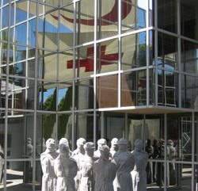

Slide 3
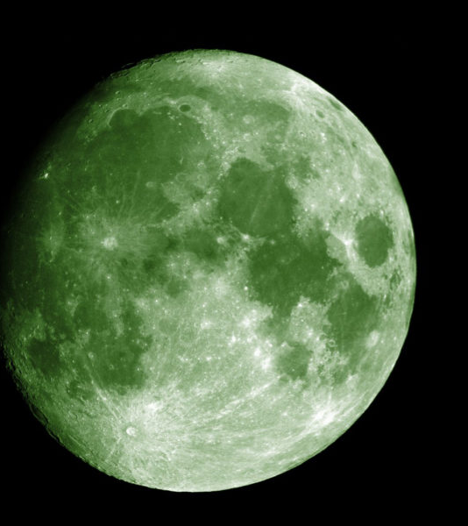
Poetic and bureaucratic technologies
David Graeber

Slide 4
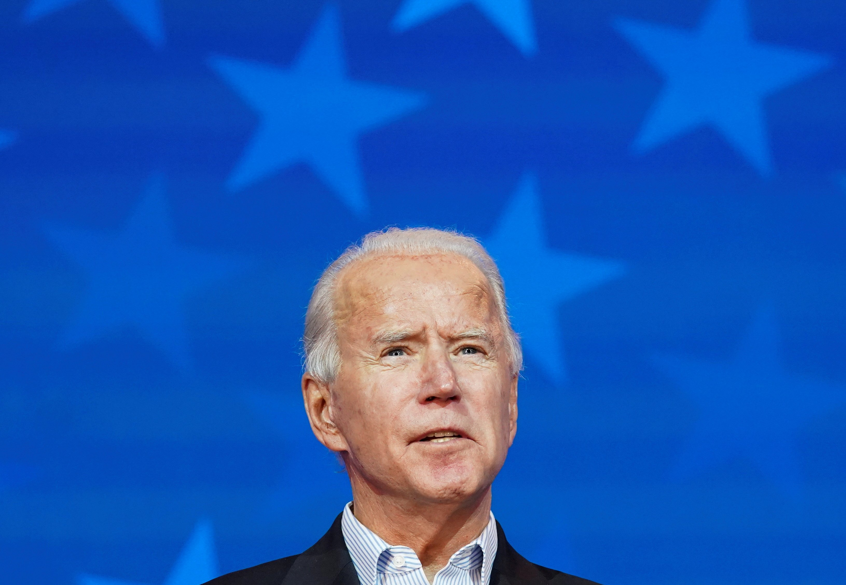
“But some of us are looking at the stars…”
Oscar Wilde

Slide 5
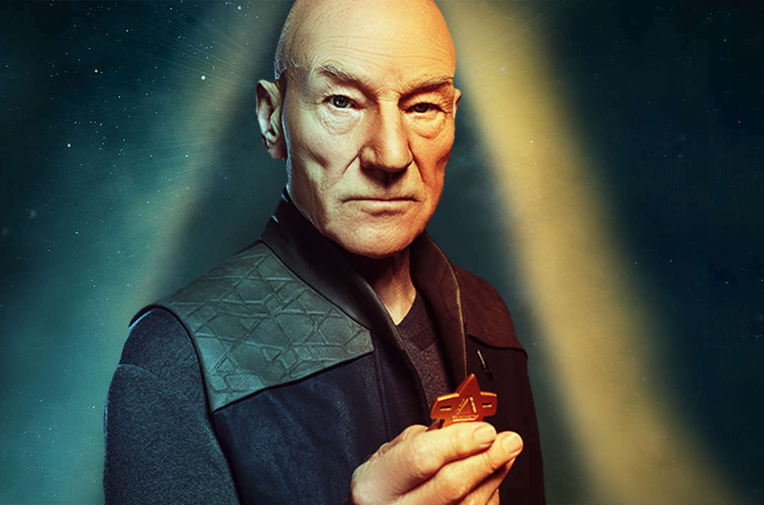

Nostalgia for lost futures
Mark Fisher

Slide 6

“Hard times are coming, when we’ll be wanting the voices of writers who can see alternatives to how we live now, can see through our fear-stricken society and its obsessive technologies to other ways of being, and even imagine real grounds for hope.
We’ll need writers who can remember freedom – poets, visionaries – realists of a larger reality.”
Ursula K. Le Guin

