Slide 1

BGV Integration Brainstorming
BGV team: H. Guerin, B. Kolbinger, J. Storey (SY-BI-XEI)
With input from: G. Breggliozzi, D. Hynds, R. Kersevan, R. De Maria, R. Plackett, D. Prelipcean, T. Ramos Garcia, G. Schneider, G. du Troit,
R. Veness, T. Lefevre, B. Salvant, A. Salzburger, H. Sandberg
03/06/2022

Slide 2
Outline
Introduction
Locations & Space reservation
Preliminary layout
Aperture profile
Gas target system
Radiation levels study
Detector concept and dimensions
Detector read-out
Racks reservation
Ancillaries

Slide 3
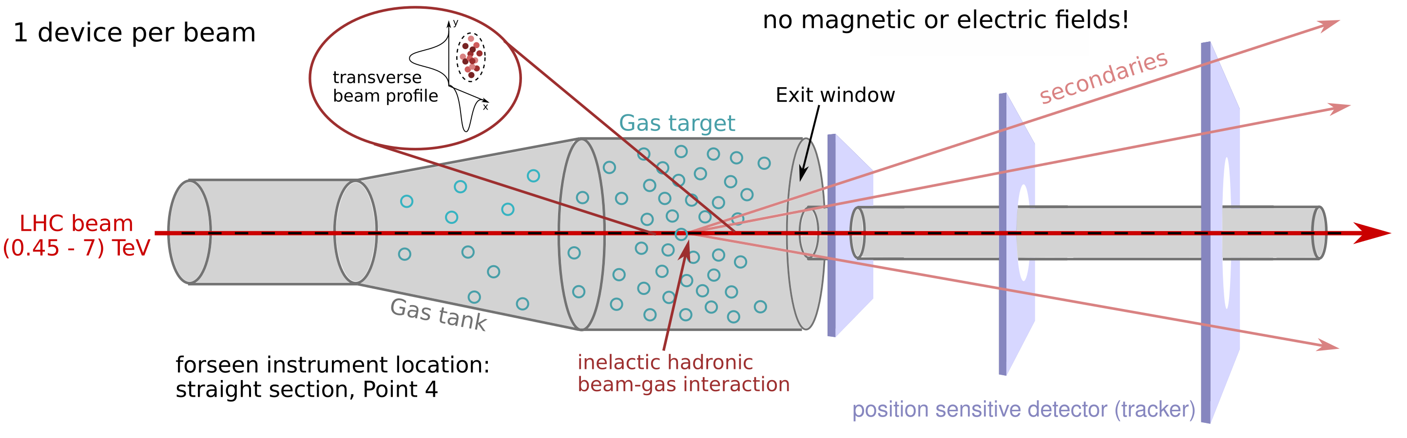
Introduction
Non-invasive transverse beam profile monitor based on the reconstruction of vertices of inelastic hadronic beam-gas interactions.
Provide continuous emittance and beam profile measurement throughout the LHC accelerator cycle (450 GeV to 7 TeV).
Consists of: a gas target, a forward tracking detector and computing resources dedicated to event reconstruction.
Transverse beam profiles inferred from density of reconstructed primary vertices of beam-gas interactions.

Slide 4
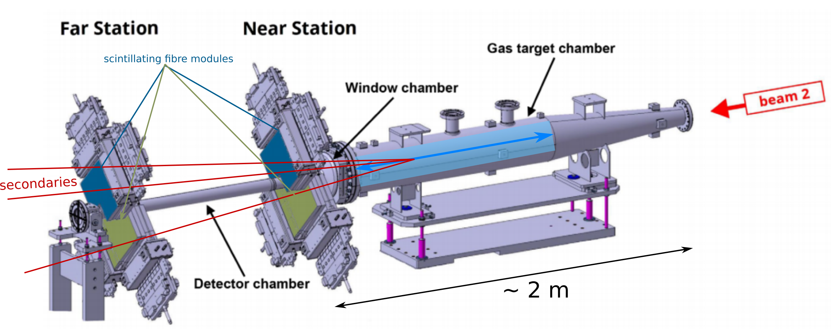
History - demonstrator BGV
Installed, commissioned and operated in LHC Run 2 LHC-BGV-EC-0002 PhysRevAB
Tracking detector based on scintillating fibre stations (LHCb SciFi tracker).
Neon gas target of ~ 1.8 m length and 10⁻⁷ mbar
Proved that the method can be used for beam size measurement throughout the full LHC energy cycle.
Reconstruction of beam-gas interaction vertices not possible ⭬ no beam profile measurement.
Future instrument in early design phase for beam size and profile measurement.
⭬ Design report by summer 2022, review in September 2022.

Slide 5
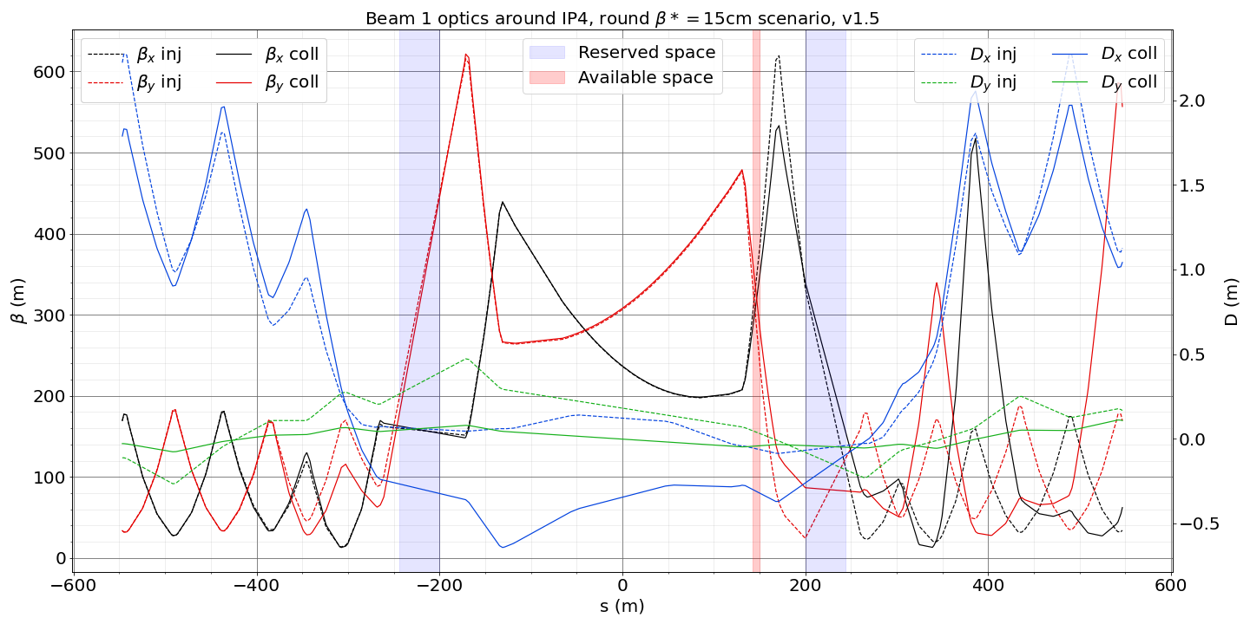
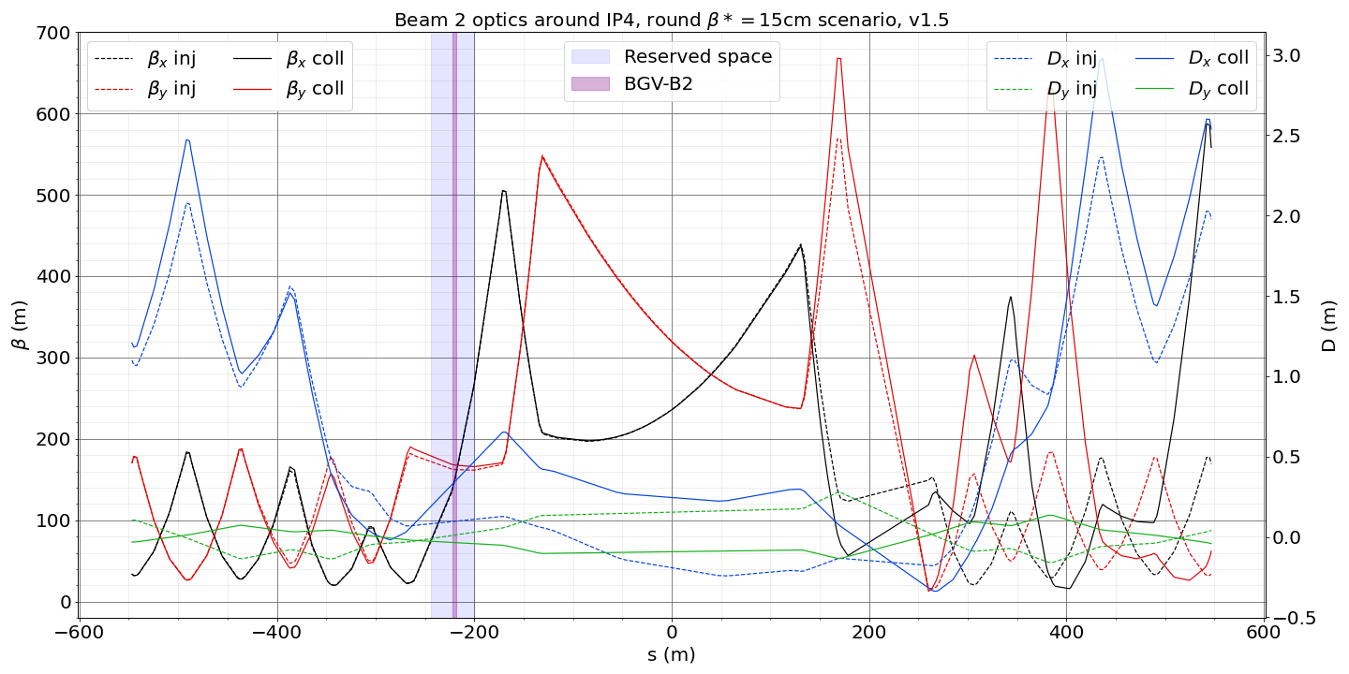
Location and space reservations
Initial space reservation from LHC-BGV-EC-0001
B2-BGV is foreseen to be installed where the demonstrator is on left of IP4, with space reservation [-244, -200]m
([9753.081, 9797.081]m DCUM) w.r.t IP4 centre
The initially foreseen location for B1-BGV was symmetric to IP4 centre [200, 244]m but now shows too demanding beam optics for instrument vertex resolution
The new foreseen location is now [141.052, 148.572]m ([10138.133, 10145.653]m DCUM) w.r.t IP4 centre for B1-BGV.
Possibly additional 1.2m on each side of this location, currently occupied by disconnected BQKH&V. To be discussed with Thibaut.

Slide 6
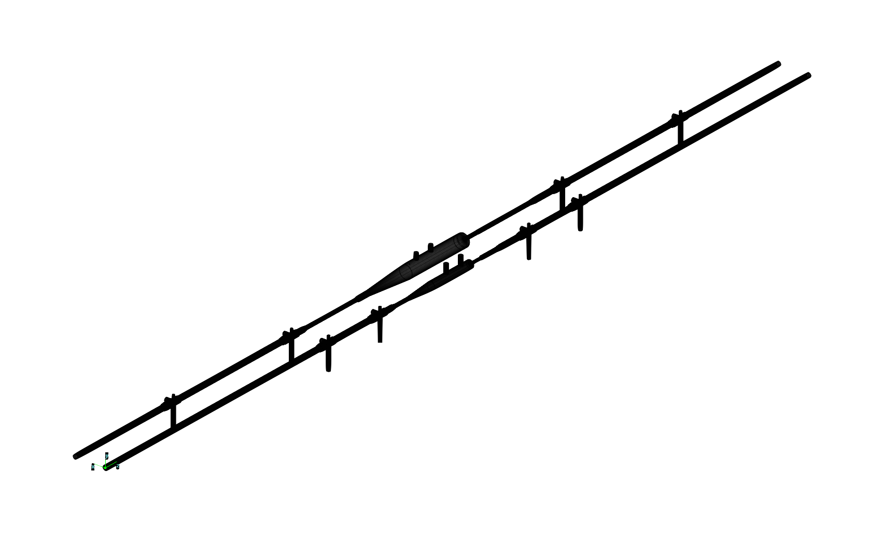
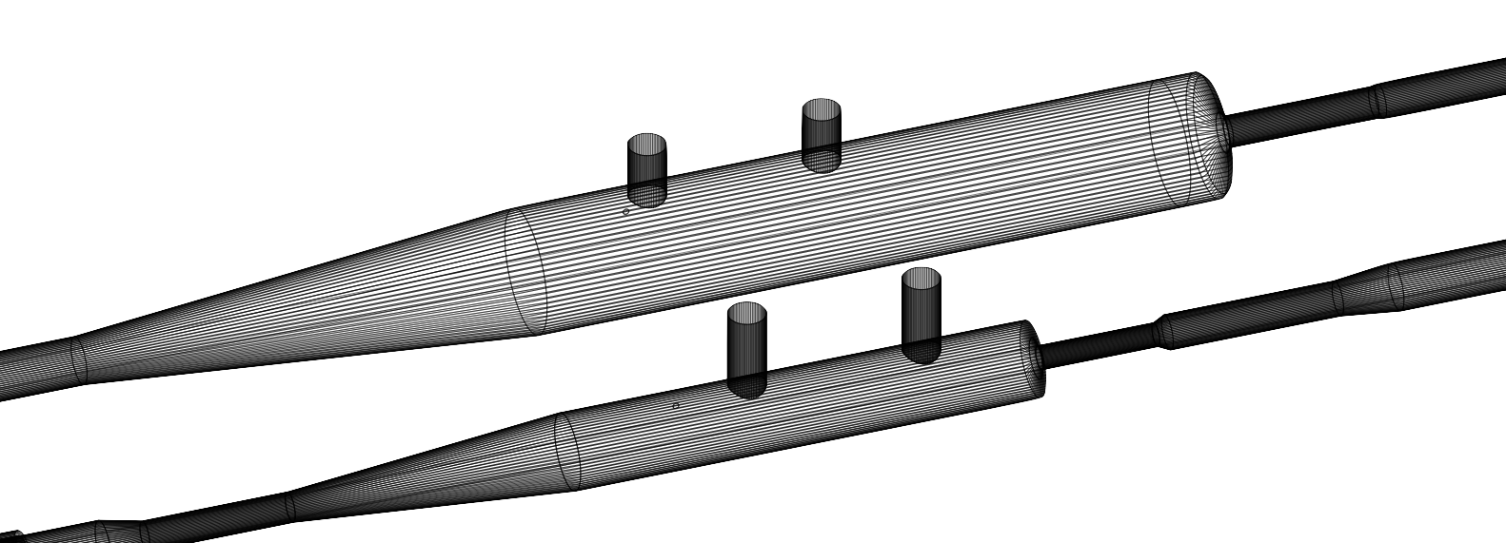
Preliminary layout
The beam chamber layout has been modified compared to the demonstrator device:
Smaller aperture of the downstream small radius beam pipe to maximise track acceptance
Smaller gas tank diameter to reduce beam-coupling impedance
Shorter total length (upstream taper, distance between pumps), to fit into the new B1-BGV location and reduce the radiations due to the longitudinal gas density profile tails.
Old and new design shown side-by-side for comparison:
Demonstrator
Future BGV
 |  | Cone 1 | Upstream chamber | Upstream taper | Tank cylinder | Exit window | Detectors beam pipe | Cone 2 | Transition beam pipe | Cone 3
Demonstrator | ID (mm) |  | 52 |  | 212 |  | 52 |  | 58
 | length (mm) | 48 | 1108 | 815 | 1185 | 50 | 251 | 12 | 988 | 44
Future BGV | ID (mm) |  | 50 |  | 130 |  | 45 |  | 50
 | length (mm) | 50 | 250 | 477 | 700 | 11 | 200 | 12 | 350 | 100
+ 500mm beam pipes at each pump connection + 750mm between pumps for the future instrument (vs. 2000mm demonstrator) -> total length ~5.5m (vs. ~10m total demonstrator length)

Slide 7
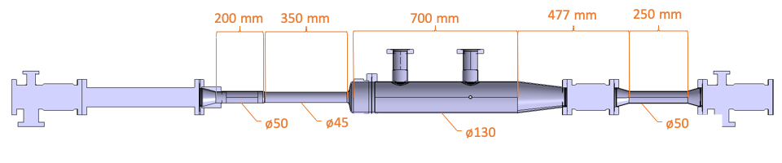
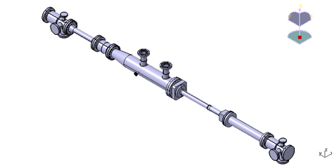
Preliminary layout
Drawing from T. Ramos Garcia
350mm
200mm
Beam direction
Beam direction

Slide 8
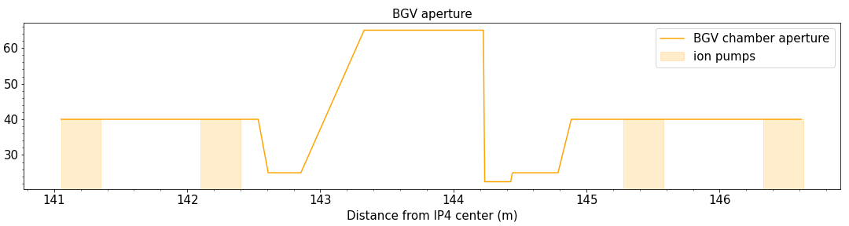
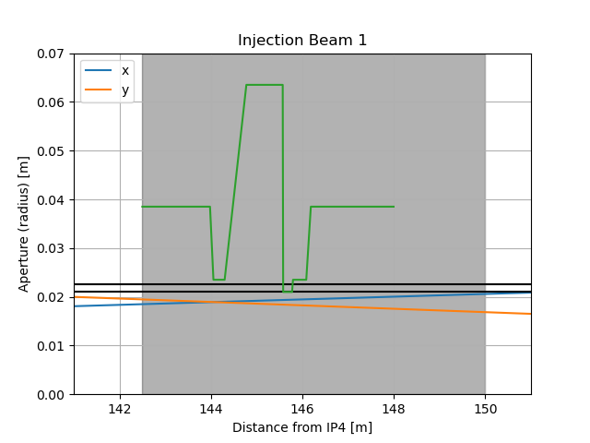
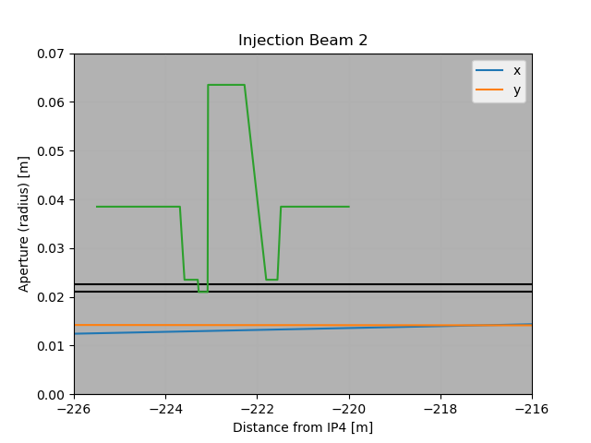
Aperture profile
Preliminary aperture profile of B1-BGV (position can be shifted), total length ~5.5m:
aperture radius (mm)
Reduced-diameter beam pipe placement (preliminary: position can be shifted):
Plots by Riccardo de Maria (BE-ABP-LNO).
Tolerance budget: 1.5 mm (estimation from demonstrator page 6: LHC-BGV-EC-0002).
Smallest aperture size: 22.5 mm (inner radius).
Ok from ABP (if tol. can be guaranteed).
See: initial discussion (2020), WP2 meeting (2022) and recent follow-up discussion.
aperture profile
aperture profile
aperture (0.0225 m)
aperture+tol. (0.0225 m + 0.015 m)

Slide 9
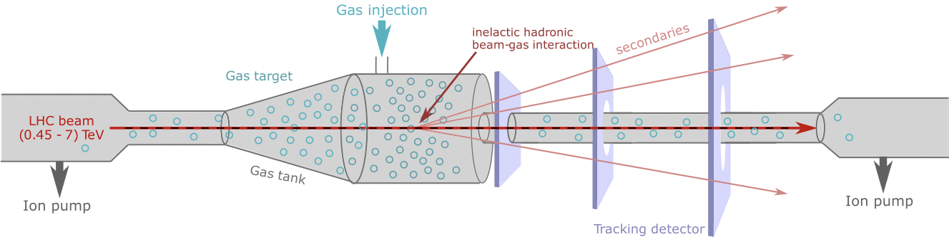
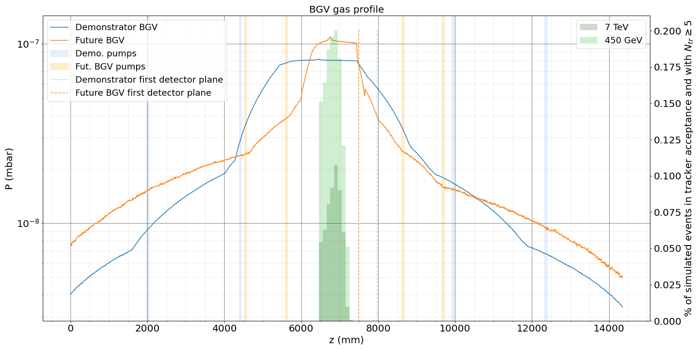
Gas target system
The BGV target baseline is to use the same Gas Injection System as was used for the demonstrator (LHC-BGV-EC-0002):
Neon gas injected on the tank via a capillary
The gas tank is surrounded by restricted aperture beam pipes
Four pumping groups: 2 on each side of the tank
=> Distributed gas target, with density plateau in the gas tank.

Slide 10
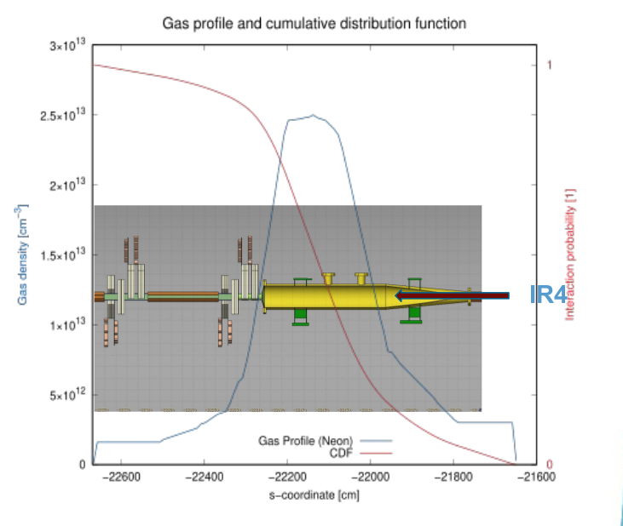
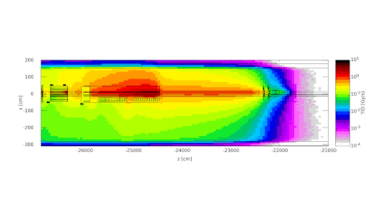
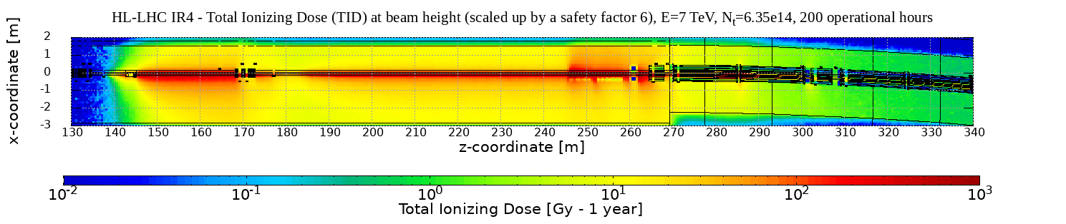
Estimated radiation levels by beam-gas interactions
FLUKA simulations by D. Prelipcean
HL-LHC predictions based on benchmark using BLM and RadMON measurements during demonstrator BGV Run 2 up time, and simulations of the BGV demonstrator.
BGV demonstrator
Study: total ionizing dose, fluence, heat loads in inner coils of magnets
see also D. Prelipcean’s presentations:
HL-LHC TCC (Feb 22),
BGV-Meeting (Mar 22),
On-going - to update with gas density profile, adjust operation time, and discuss with concerned equipment owners
BGV demonstrator
HL-LHC BGV on beam 1:

Slide 11
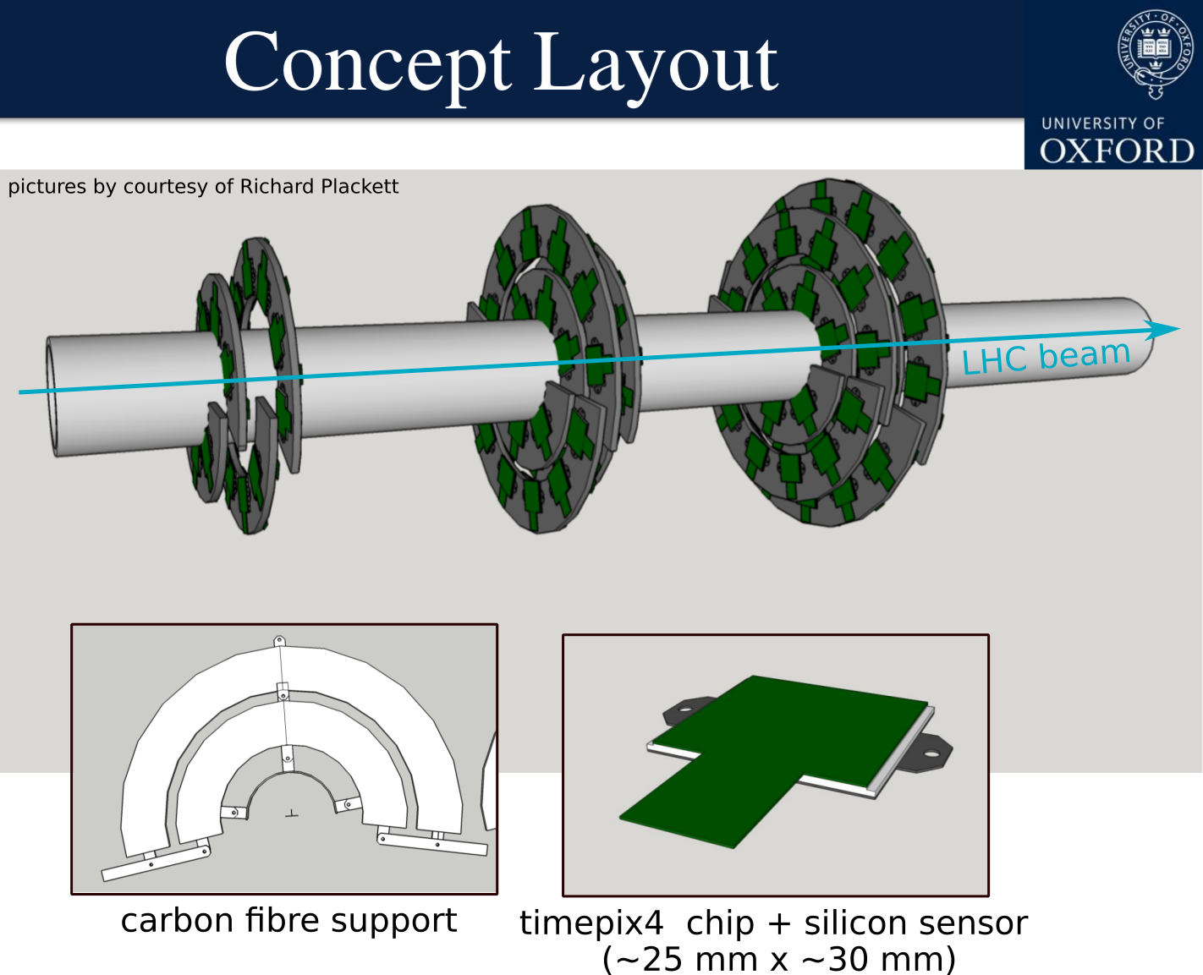
Detector concept
Collaboration with Oxford University: D. Hynds and R. Plackett
Concept design of a BGV tracker based on Timepix4 hybrid pixel detectors.
Timepix technology: well known, robust and widely used detectors. There exists a great amount of experience within the BI group.
Design will be based on the ATLAS ITk HiLumi upgrade.
Project planning on-going:
  Module design & building, support structure @Oxford.
  Read-out, reconstruction software, commissioning @CERN.
  Installation foreseen in 2028.

Slide 12
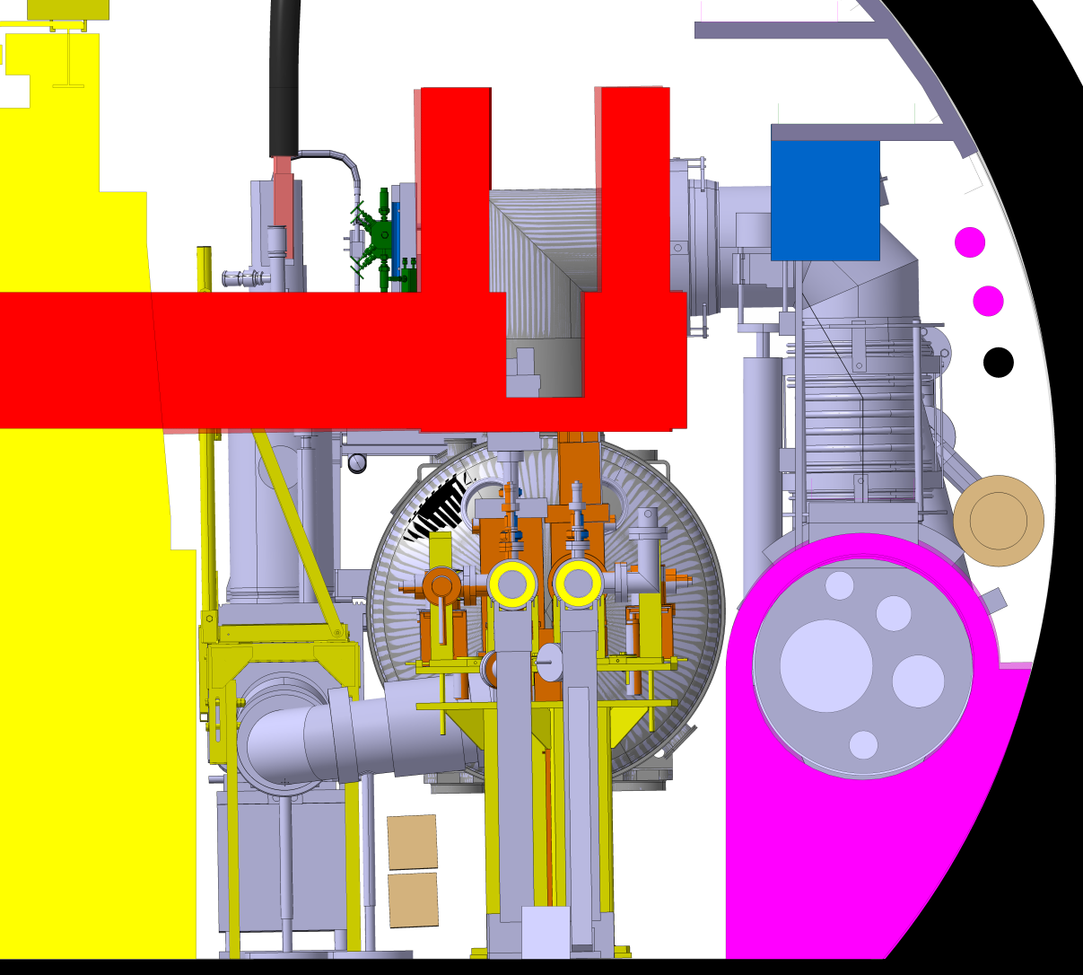
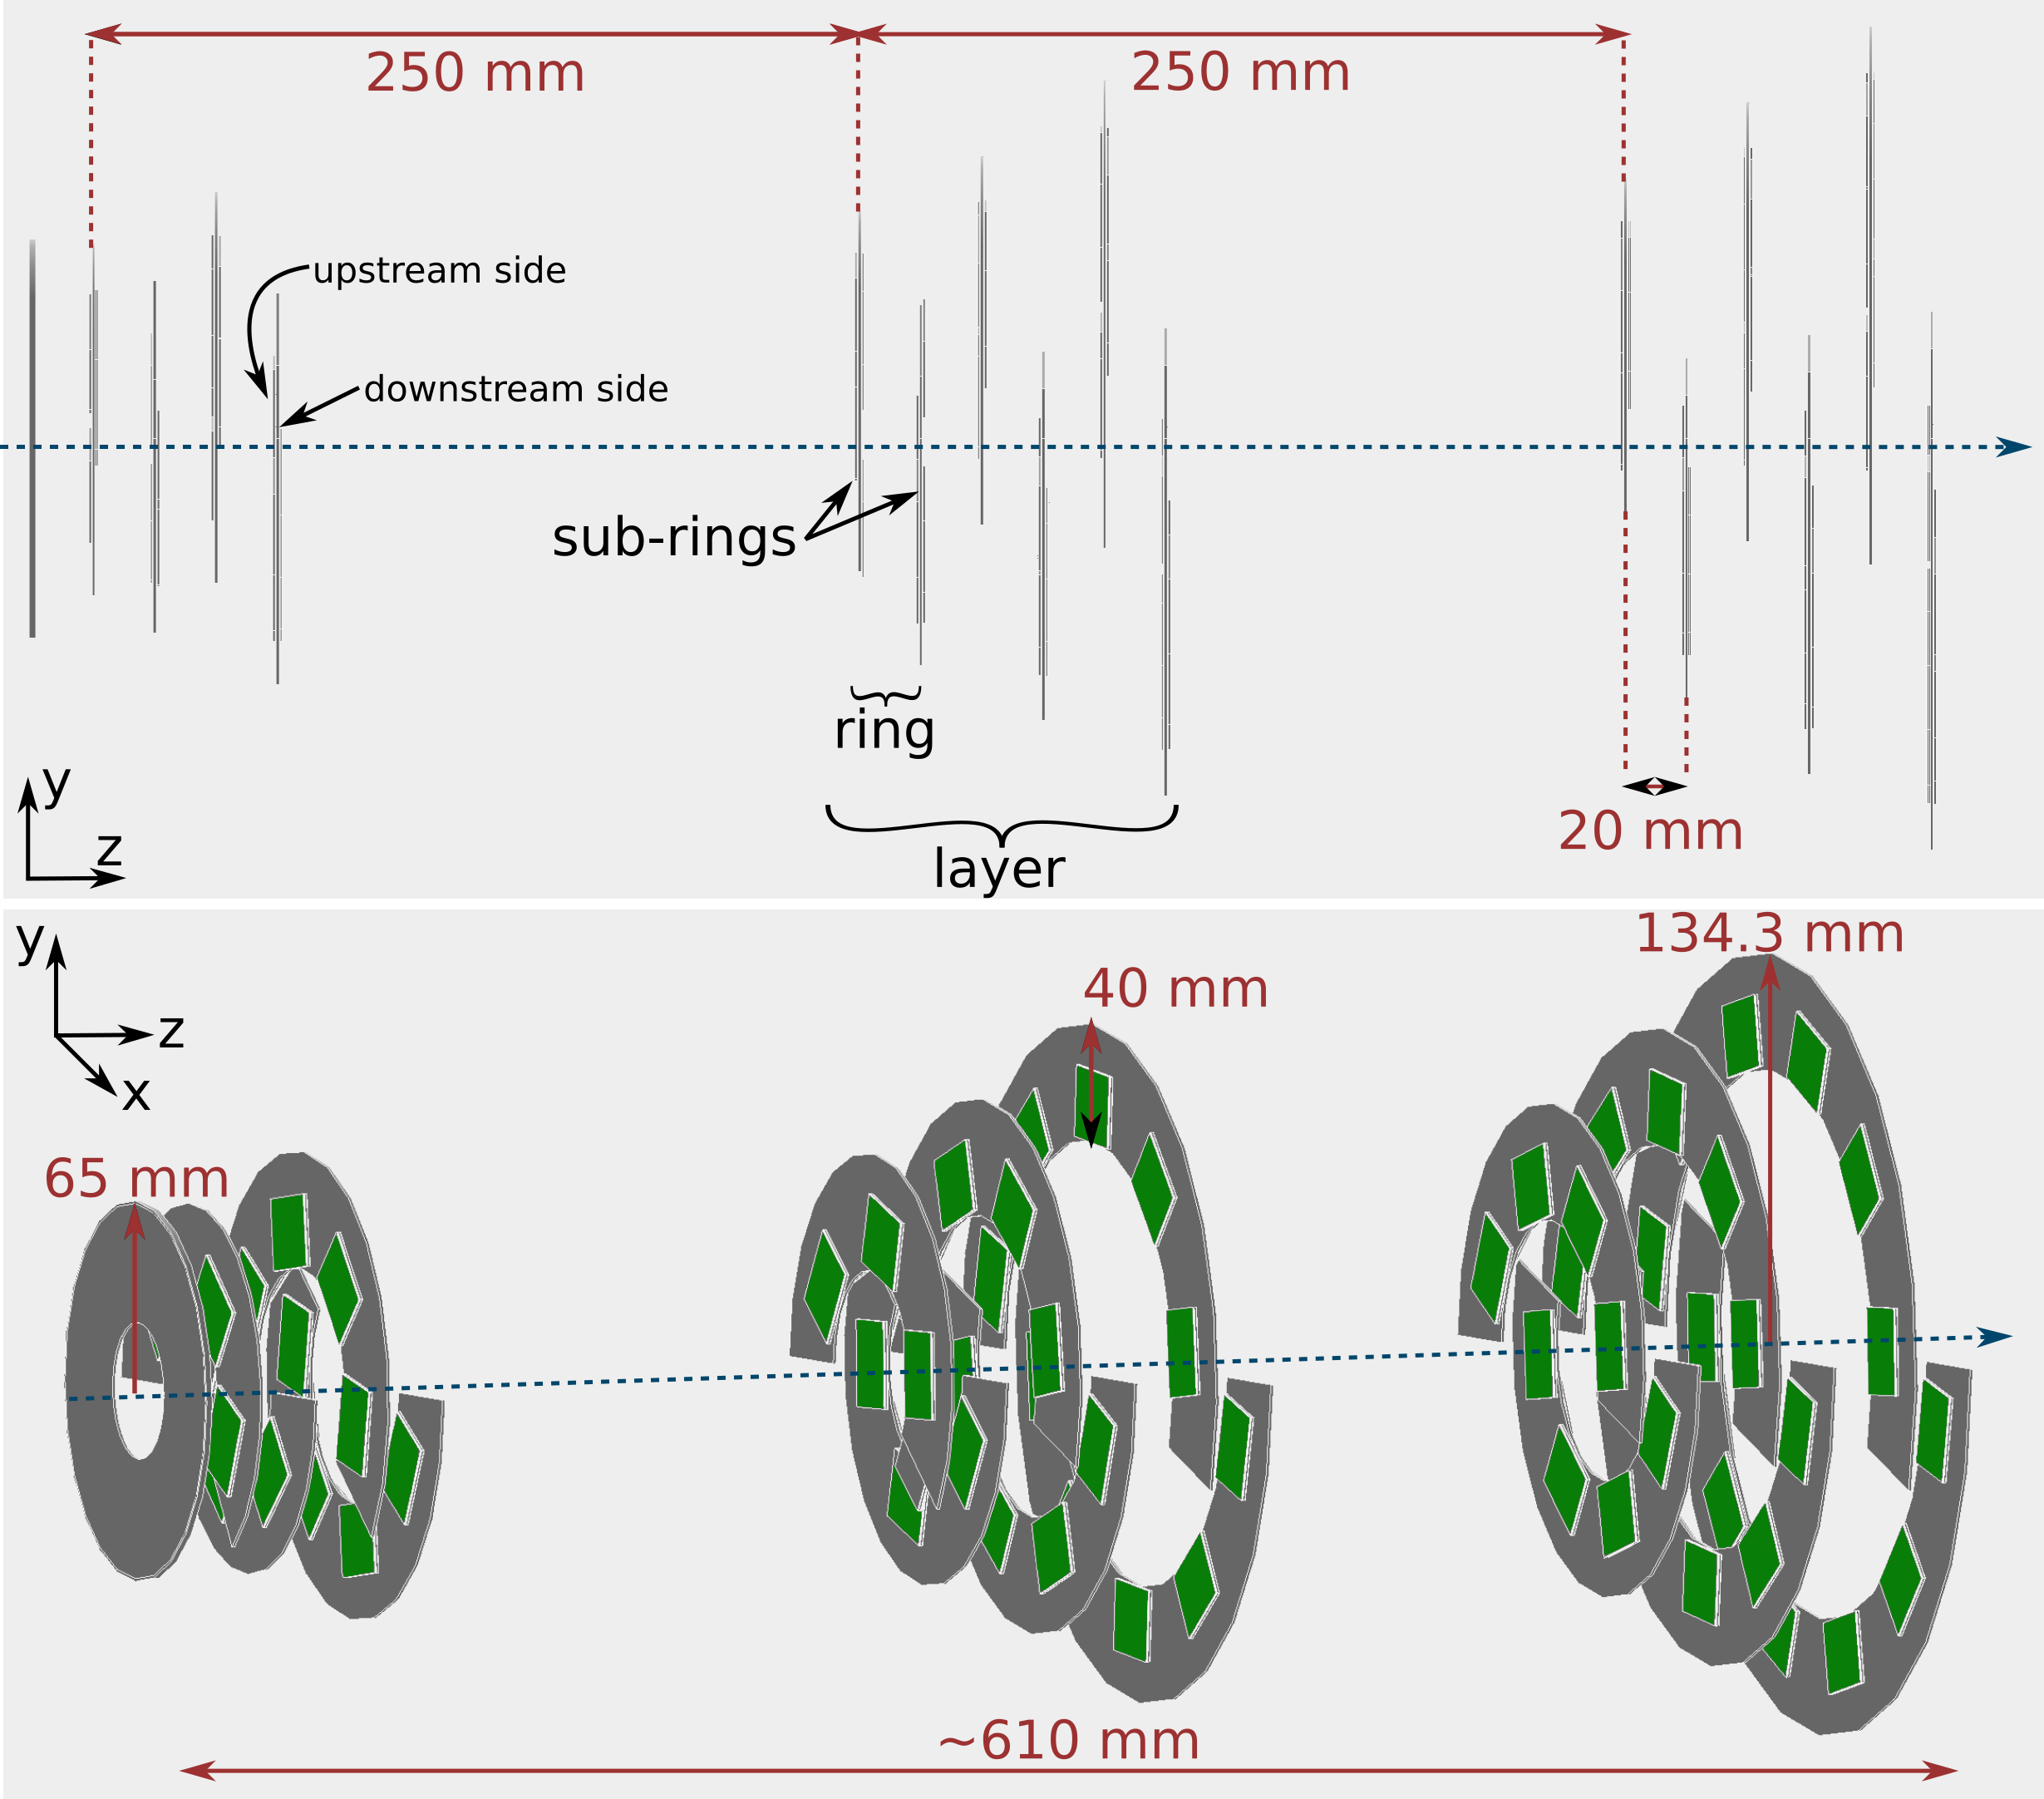
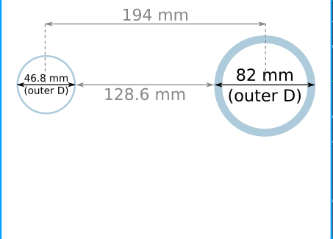
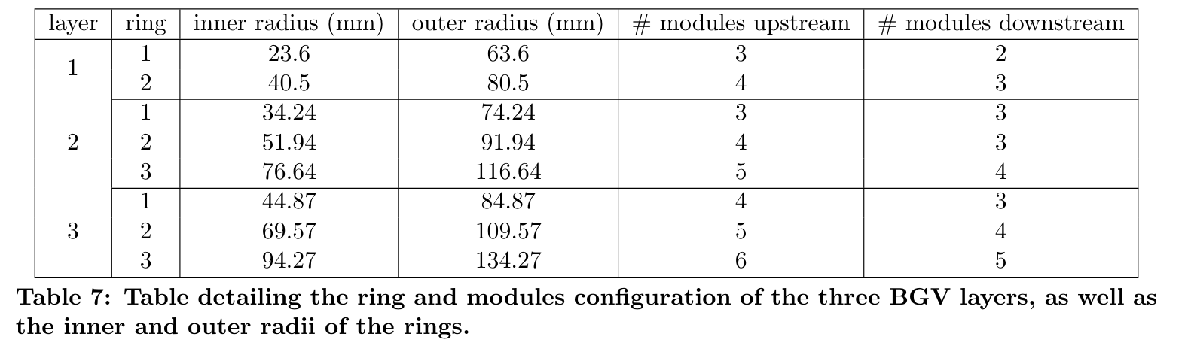
Detector dimensions
tunnel cross section, BGV 1 location (right side of IP4)
picture provided by J. Oliveira
Preliminary dimensions from Geant4 model.
Read-out system, support structure, cables etc. still need to be considered space-wise.
Take space constraints in tunnel into account for design of support.
The current vacuum chamber in this area has an ID of 80 mm and an OD of 84 mm and radial space reservation for the bake out jackets of 25 mm.
survey space reservation
transport
space
reservation
447 mm
928 mm
436 mm
QRL space
reseveration
outer radius of largest layer in current Geant4 geometry:
~134.3 mm (see table). leaves 17.7 mm to spectator beam pipe
1100 mm
y
x

Slide 13
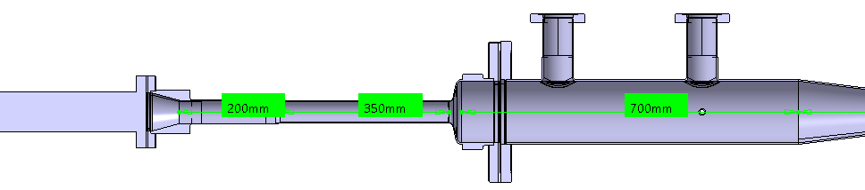
Detector placement constraints
Placement of detector layers is crucial for performance.
Especially first detector layer should be radially as close to reduced-diameter beam pipe as possible. And in z as close to the exit window as possible.
350mm
200mm
Therefore: space around detector beam pipe, especially around the exit window needs to stay clear during runs.
Detector support structure plan: have a top and a bottom “half-shells” that can be lifted up and down → allow access to beam pipe for e.g. baking prior to runs.

Slide 14
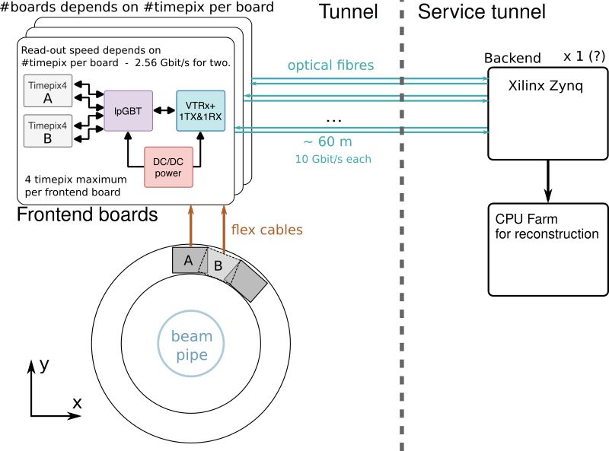
Detector read-out
Read-out system mock-up based on BGI read-out by H. Sandberg.
Around 120 timepix4 modules.
Frontend: Low Power Giga Bit Transceiver (lpGBT) + an optical link module for data transmission (VTRx+) + DC/DC power supply.
Backend: Based around a system-on-chip (SoC) from Xilinx: contains both programmable logic (FPGA) and processors - Flexibility to process data in both gateware and software without having to move data to and from an external computer.
Analyse selected events on a CPU farm similar to demonstrator (92 CPUs).

Slide 15
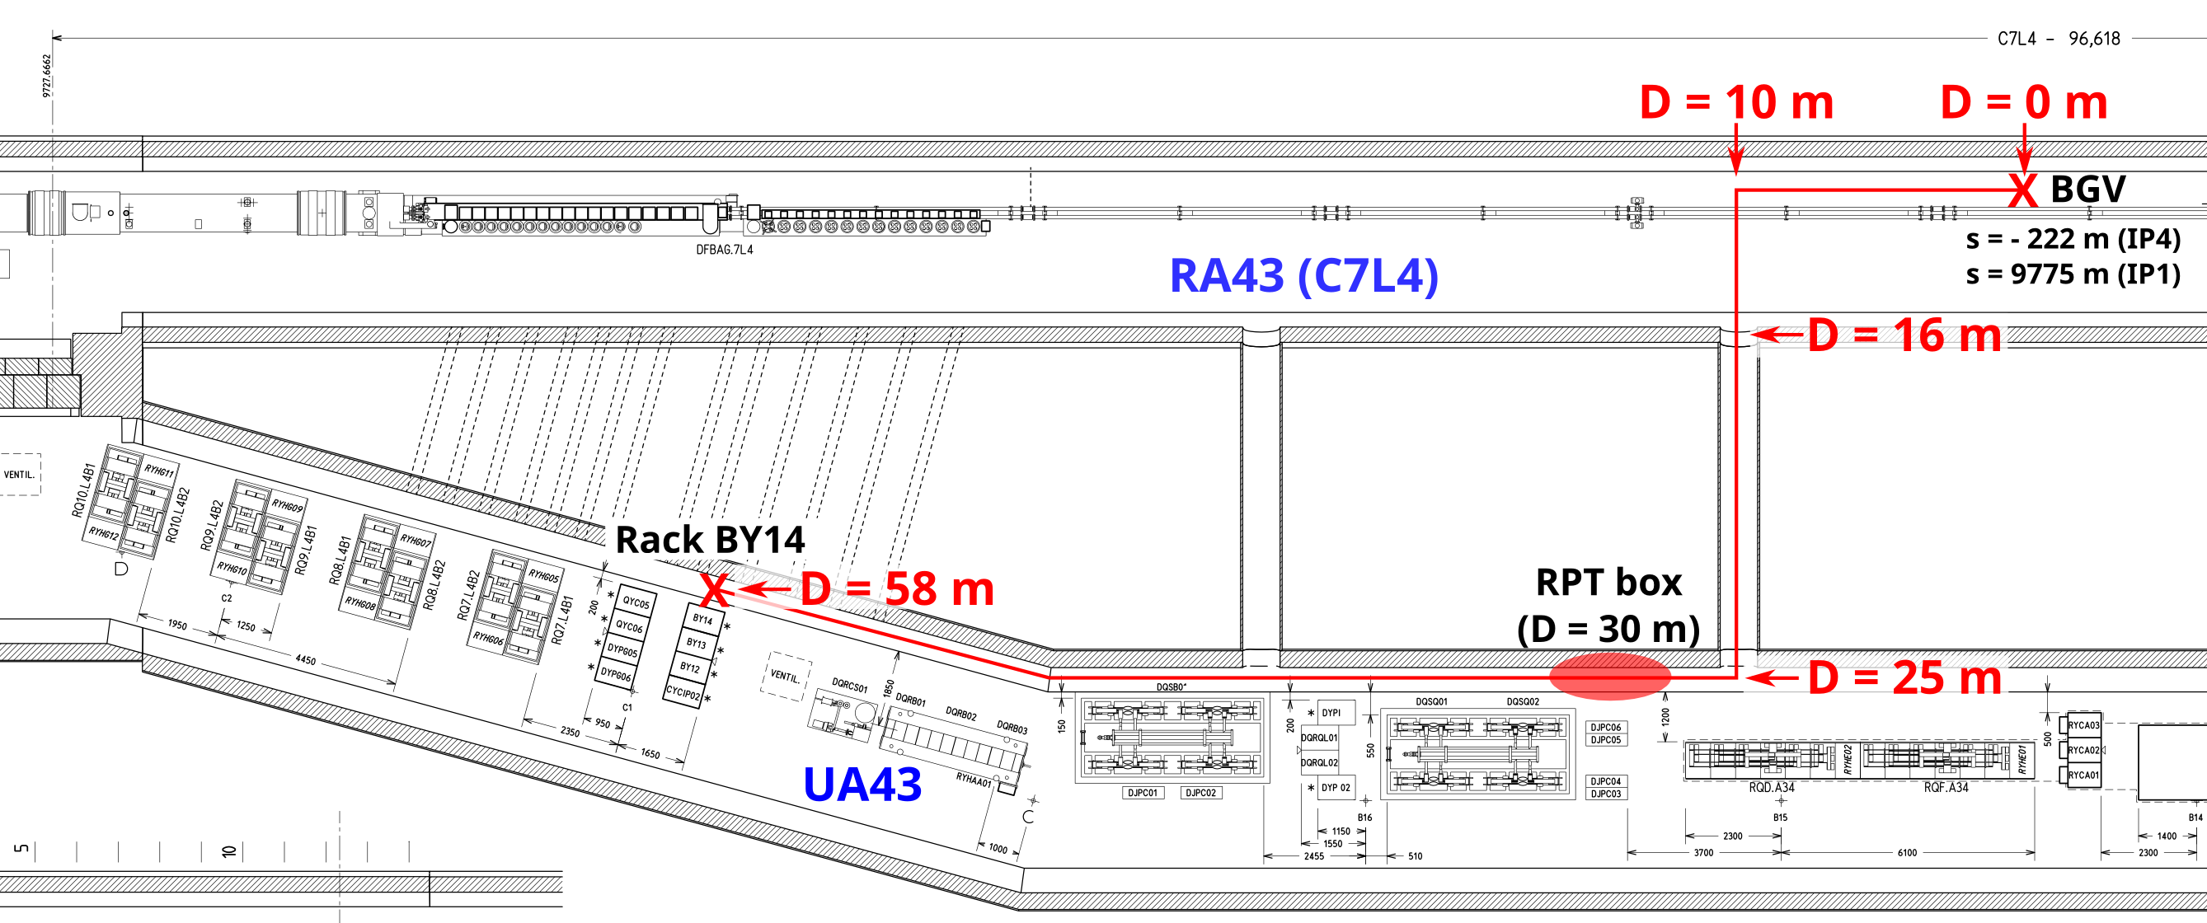
Racks reservation
Full racks in the service tunnel:
2x racks in UA43 for BGV.B2.L4
  Demonstrator : BY13, BY13 and vacuum-related equipment in VY004, VY20
2x racks in UA47 for BGV.B1.R4
Mini-racks (size tbd.) in the tunnel for front-end electronics installed at BGV.B1.R4 and BGV.B2.L4.

Slide 16
Ancillaries
Vacuum:
Material already available for B2-BGV; BGI GIS could be used for B1-BGV (also ion pumps?)
Sectorisation already done for B2-BGV; probably not enough space to make one for B1-BGV but this is not a showstopper according to Giuseppe Breggliozzi
Cooling:
De-mineralised cooling water for TPX4 = 3.5W per TPX4 * 120 TPX4 = 420W per instrument
Power:
Tracking detector (120x TPX4, 30x lpGBT, 30x VTRx, 300x FEAST) = 30W per 4x TPX4 module * 30 modules = 900W per instrument
Gas injection system + pumps = ? (TE-VSC)
Read-out electronic (optical fiber, location)
Single mode optical fibers from BGV.B1.R4 and BGV.B2.L4 to UA47 and UA43 racks respectively
Copper cables from BGV.B1.R4 and BGV.B2.L4 to respective service tunnels for:
  DC power for FEAST DC/DC modules (12V/75A)
  Copper cables for silicon signal bias (70V/100mA)

Slide 17
Thank you for your attention

