Slide 1
UR15/55 integration
FOLLOW UP
WP15 MEETING 25/05/2022
S. Maridor, J. Oliveira, P. Pinheiro
on behalf of HL-LHC WP15.1 – Integration

Slide 2
UR15/55 INTEGRATION WHAT’S NEWS ?
position 3 racks cryo/ IP side modified (WP9)
Add 1 rack PIC / IP side (+new arrangement) (WP7)
updated dimension of 600A Power Converter (WP6B)

Slide 3
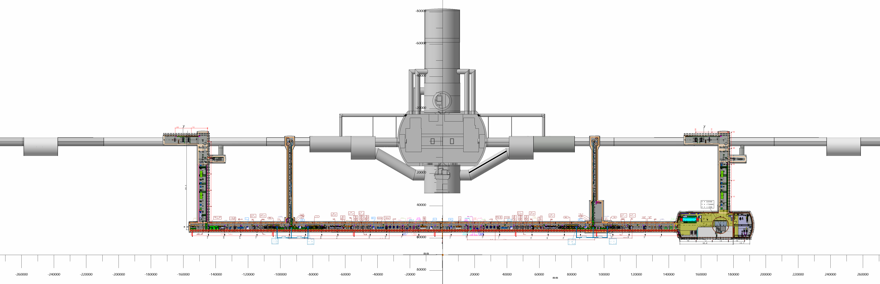
3 racks
3 racks
+ 1 rack PIC
≈ 65 m
≈ 45 m
NEWS :
UR15/55:
Add 1 rack PIC
Position 3 rack cryo
Point 1 :
UR15_1102_INTEGRATION : ST1120748_01 a.06 25/05/2022(in work)
Point 5 :
UR55_1503_INTEGRATION : ST1120275_01 a.03 25/05/2022(in work)

Slide 4
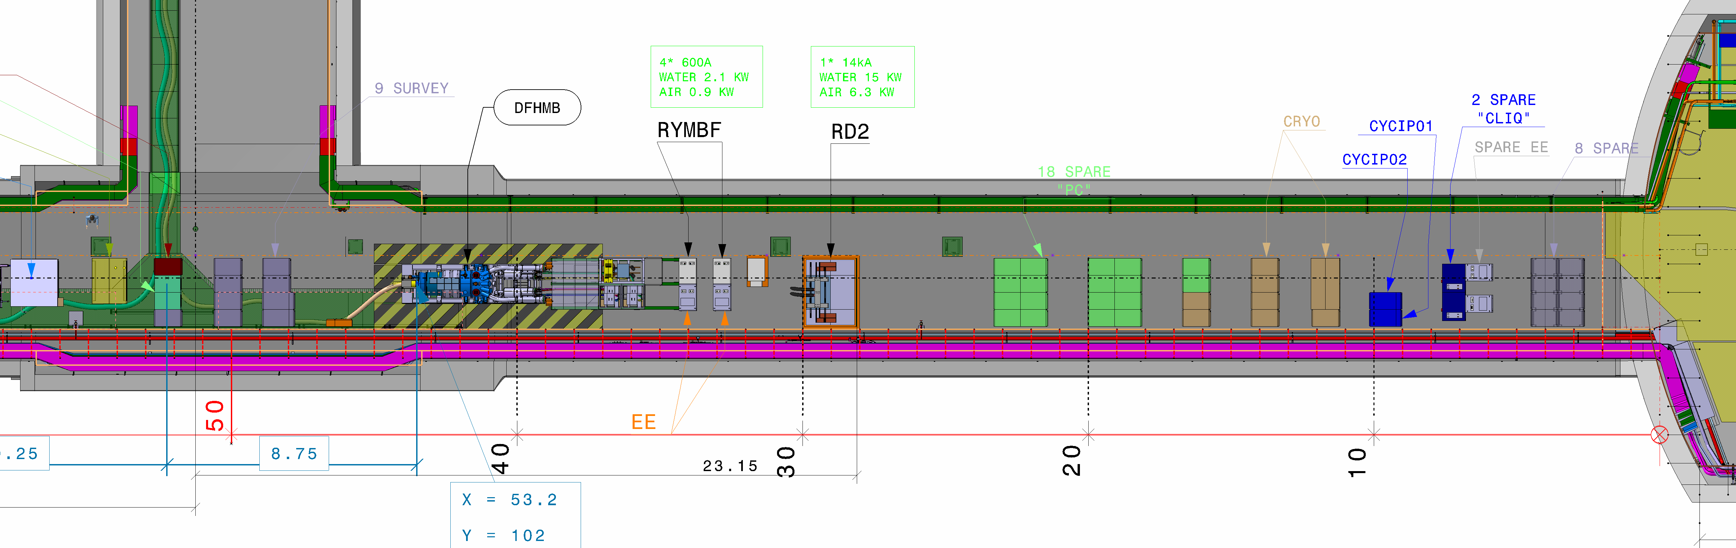
3 racks cryo

Slide 5
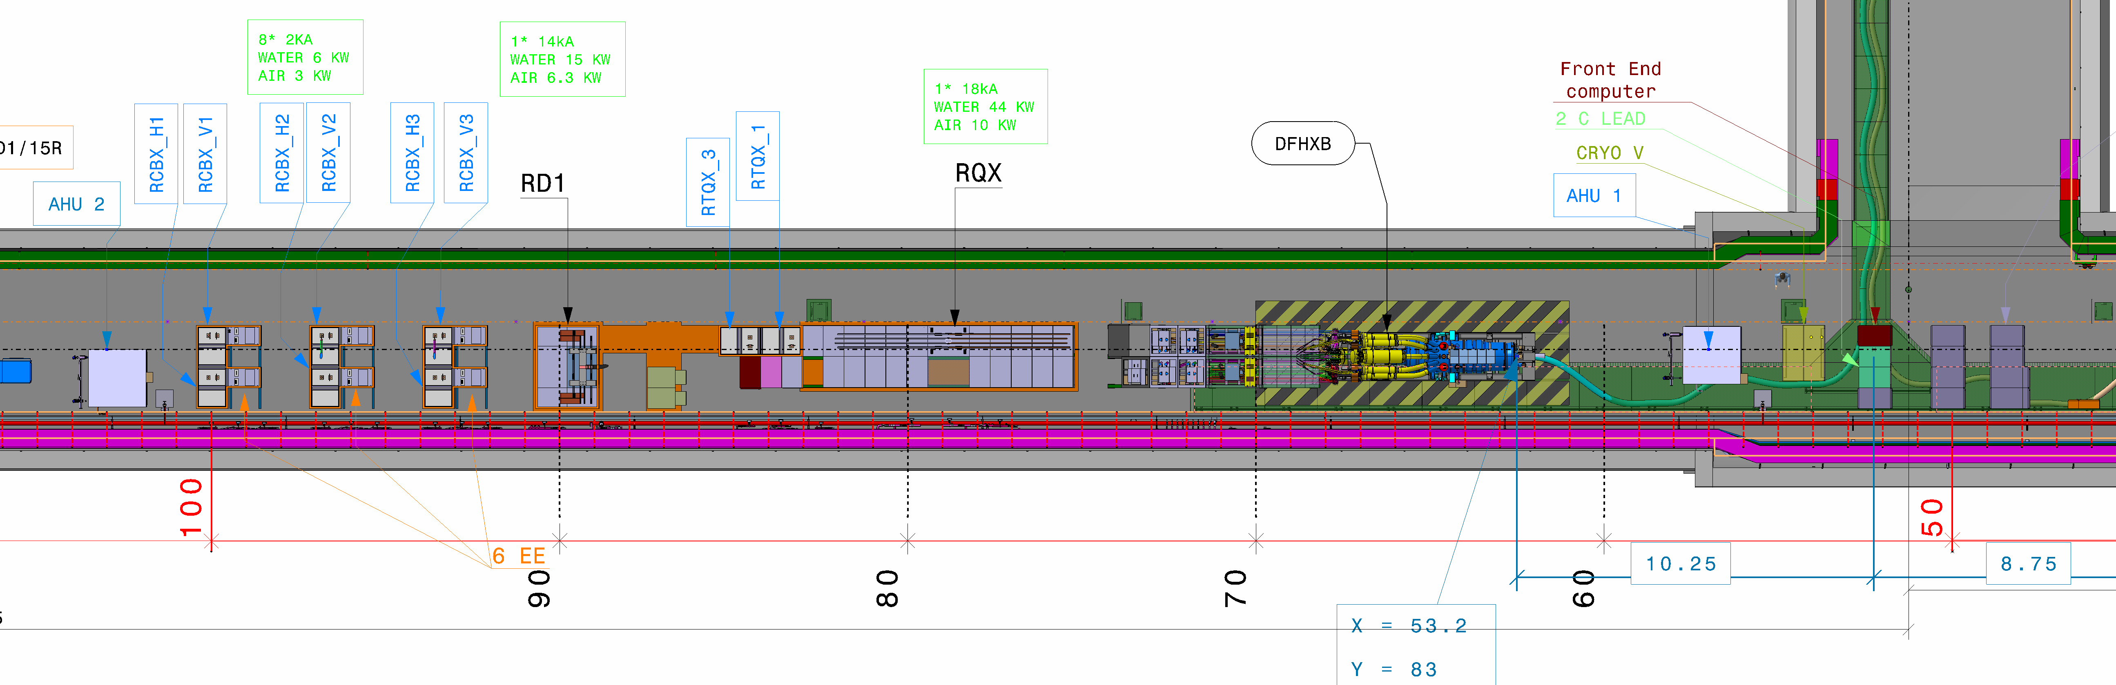
ULx7

Slide 6
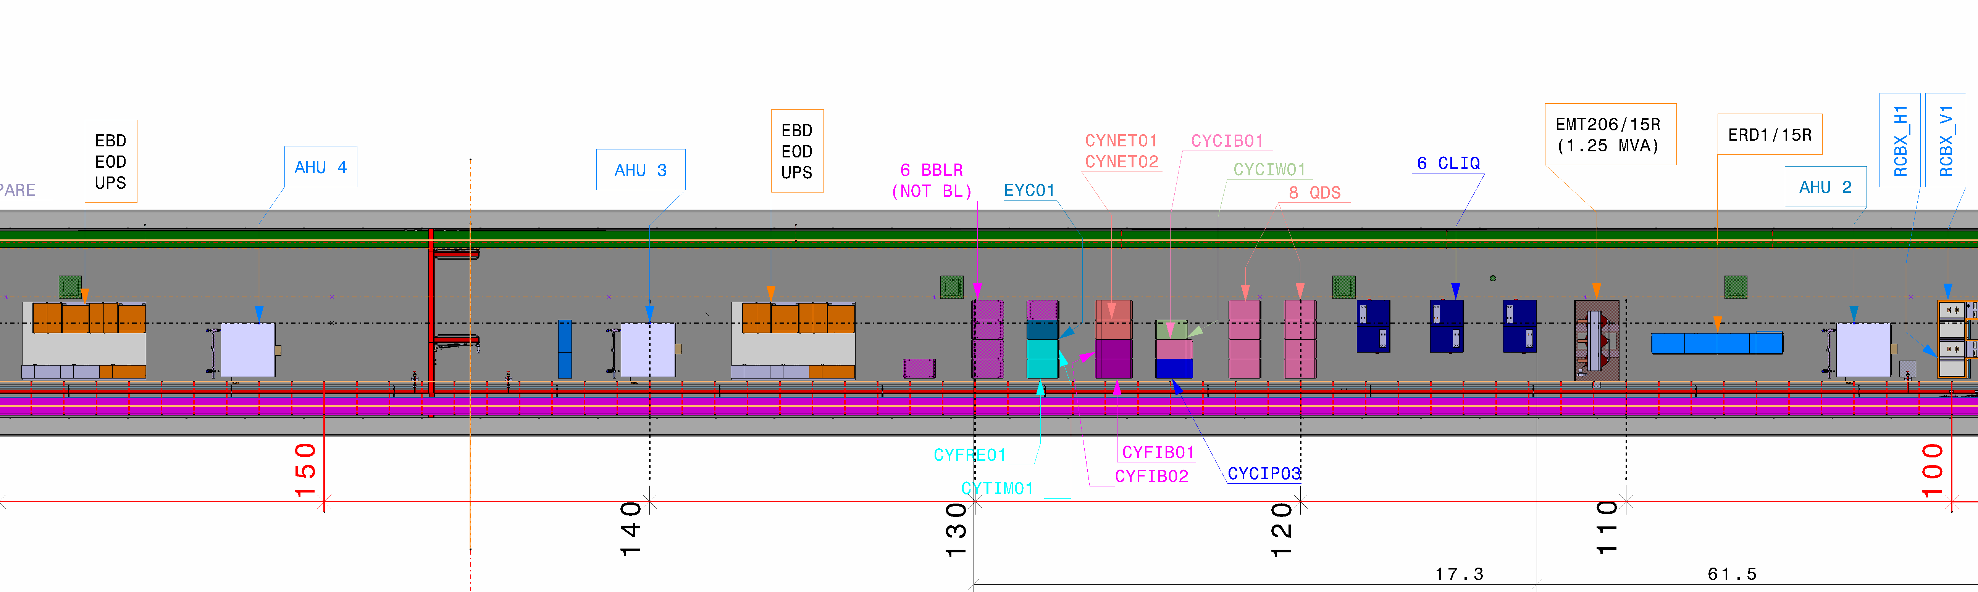
ULx7
+ 1 rack PIC
+ NEW LAYOUT
US

Slide 7
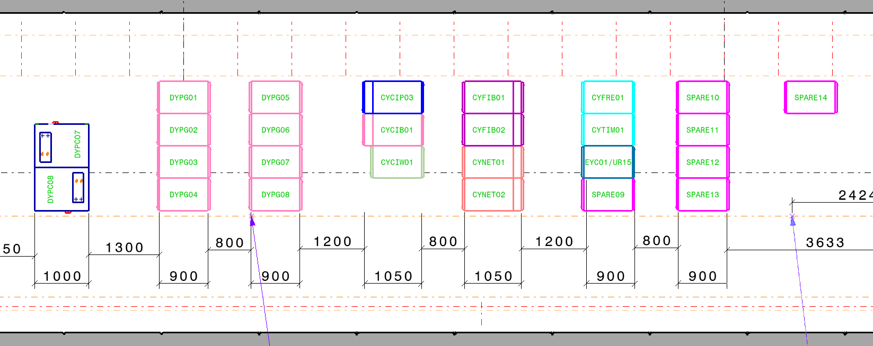
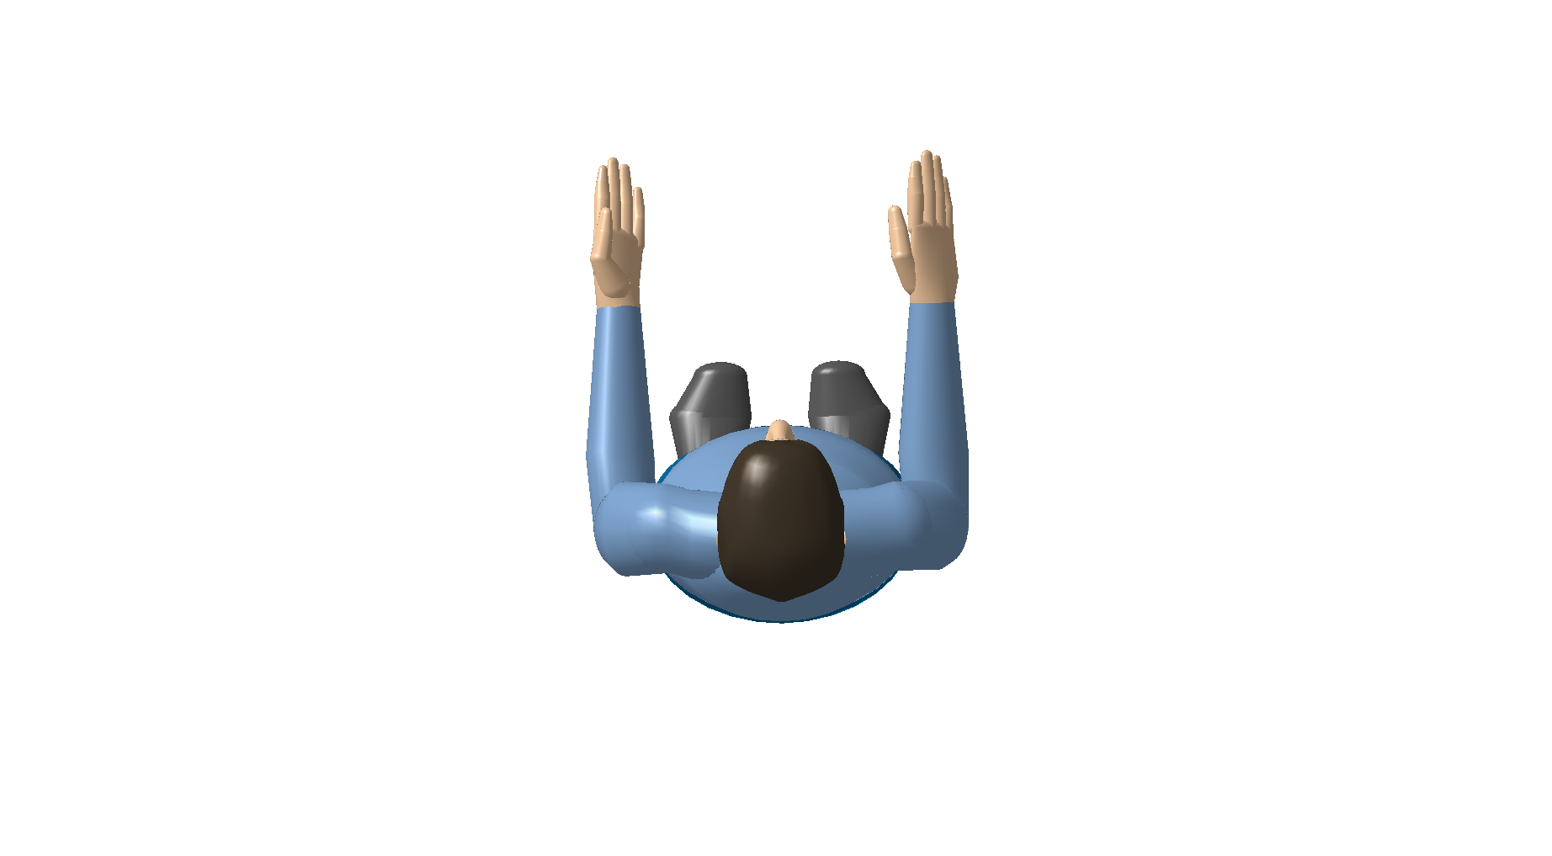
ULx7
US
( picture turnned 180 ⁰ )
Extracted from installation drawing

Slide 8
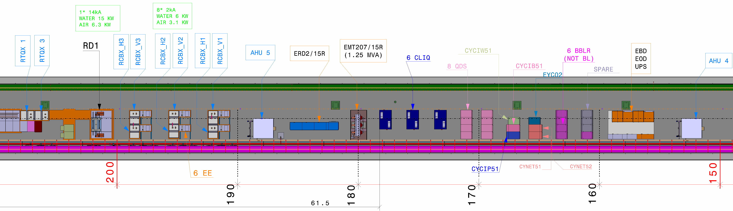
ULx7
+ 1 rack PIC
+ NEW LAYOUT
ULx3
US

Slide 9
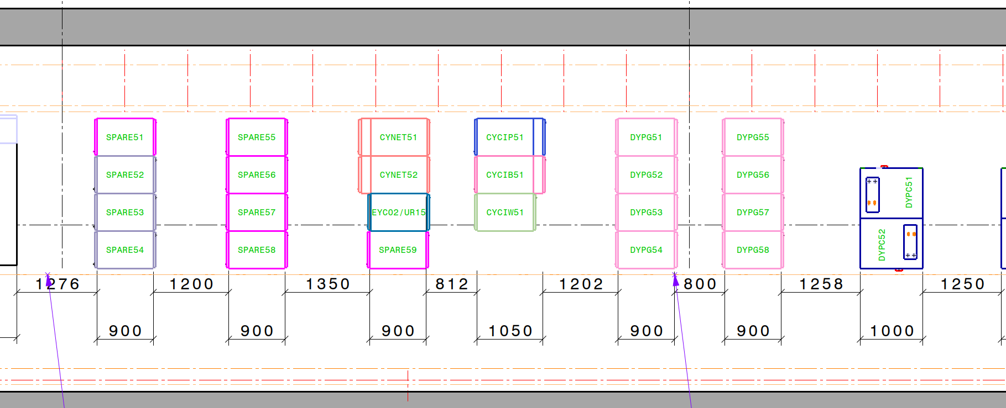
US
( picture turnned 180 ⁰ )
Extracted from installation drawing
ULx3

Slide 10
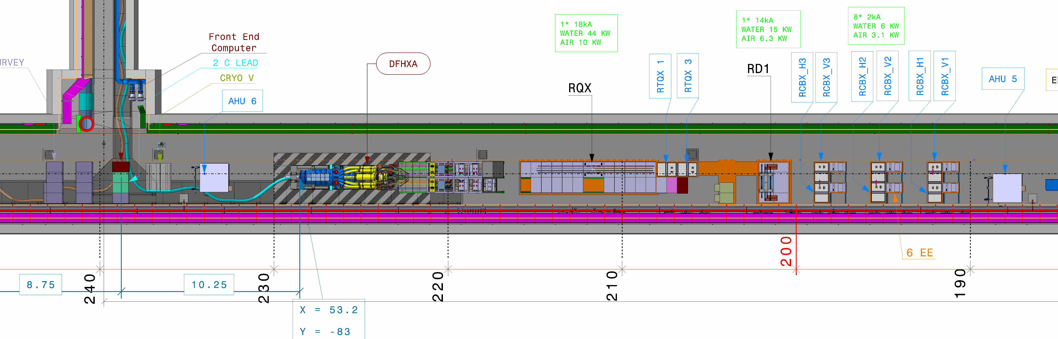
ULx3

Slide 11
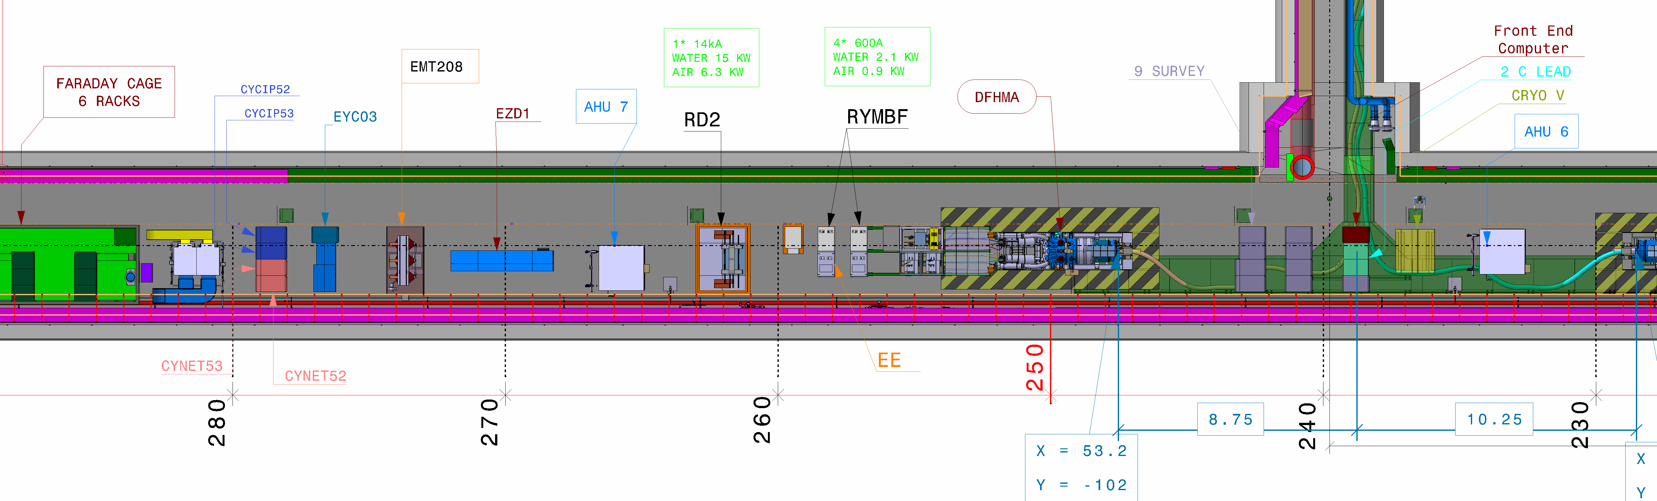
ULx3

Slide 12
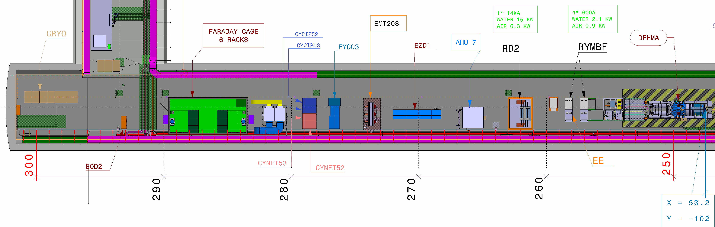
3 racks cryo
UA13
UR15

Slide 13
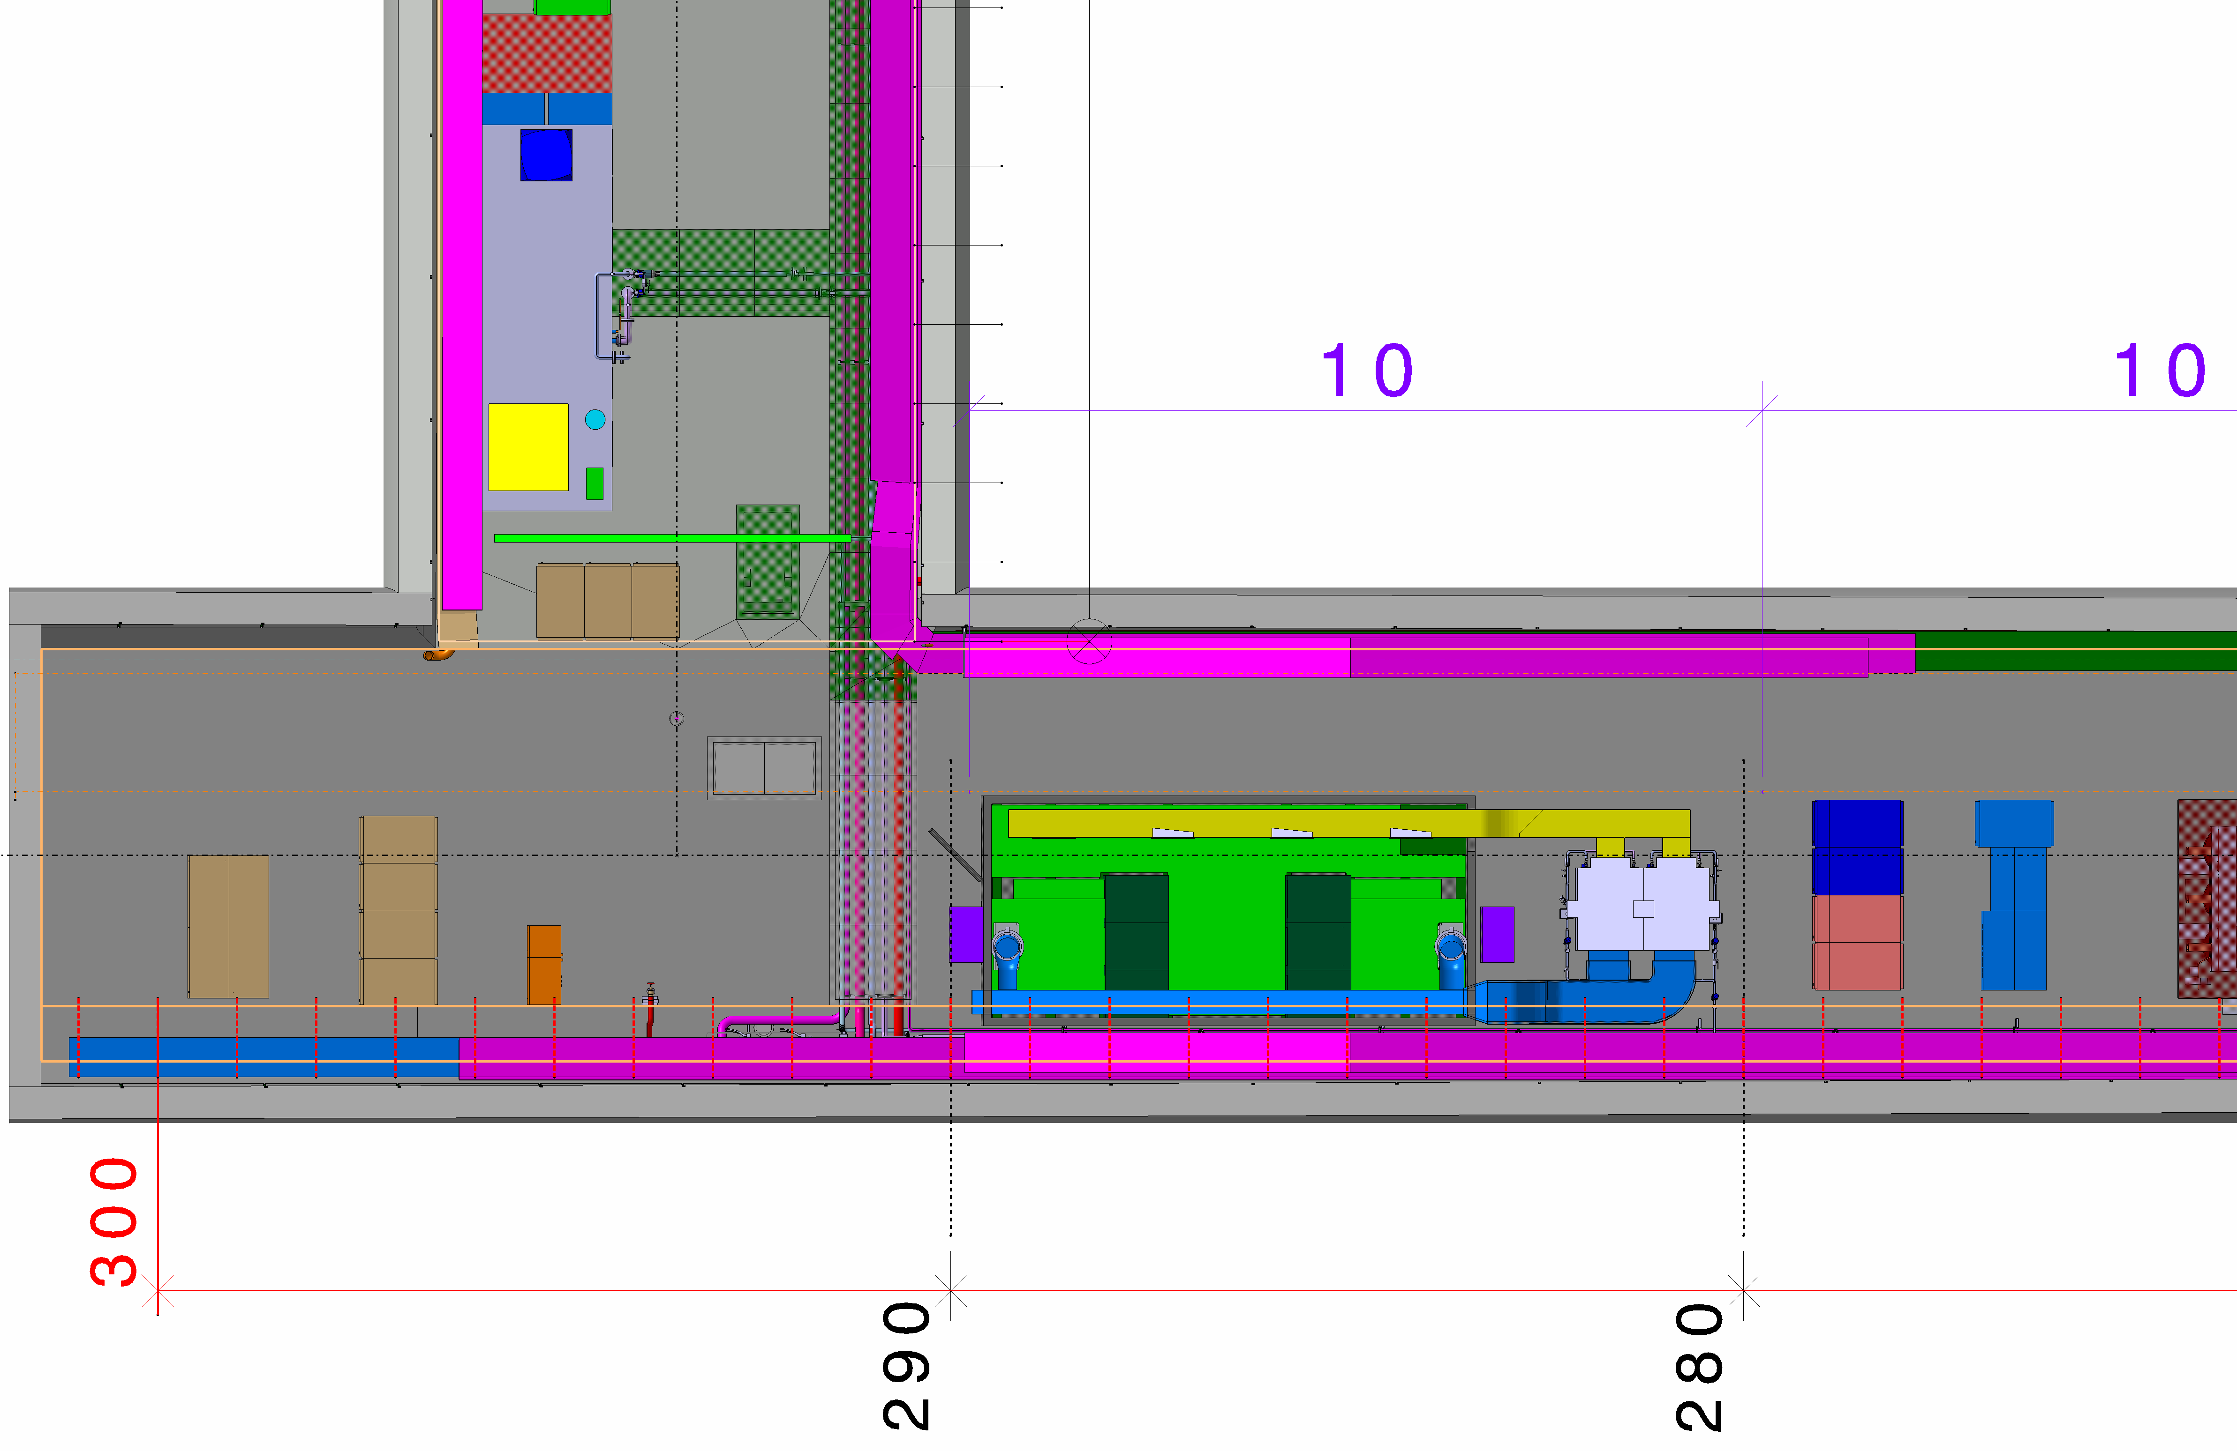
3 racks cryo
UA53
UR55

Slide 14
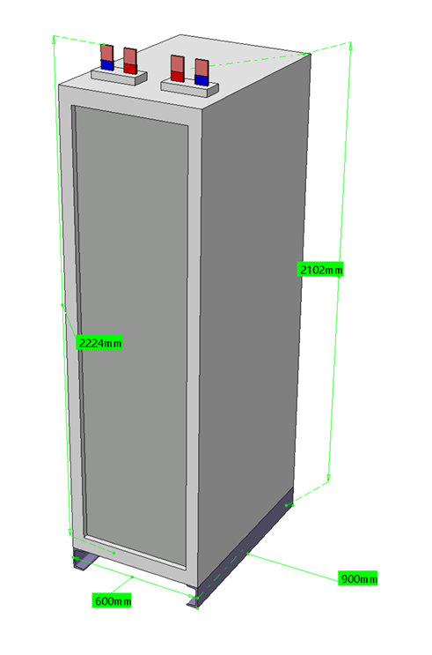
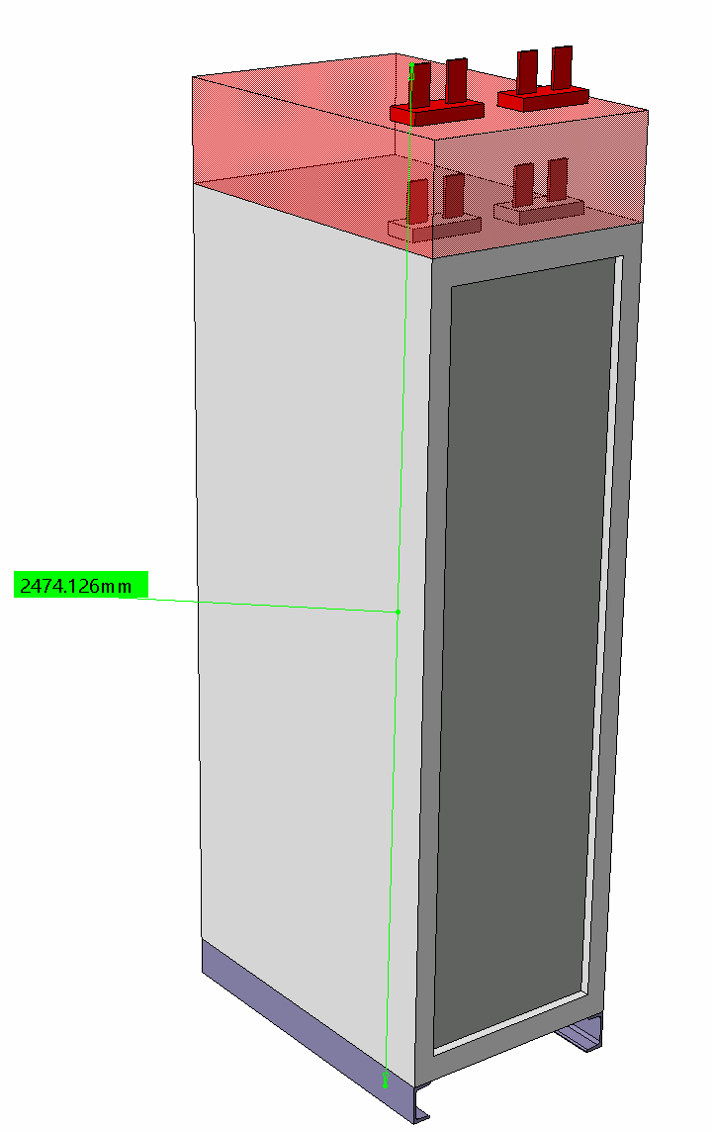
position 3 racks cryo/ IP side
Add 1 rack PIC / IP side (+new arrangement)
updated dimension of 600A Power Converter
ST1295104_01 a.00:
Convertisseur 600A 10V LHC version 2020
+250
MODIF.
+5 U (44.45*5=222.25)
Soit ≈ + 250 mm

Slide 15
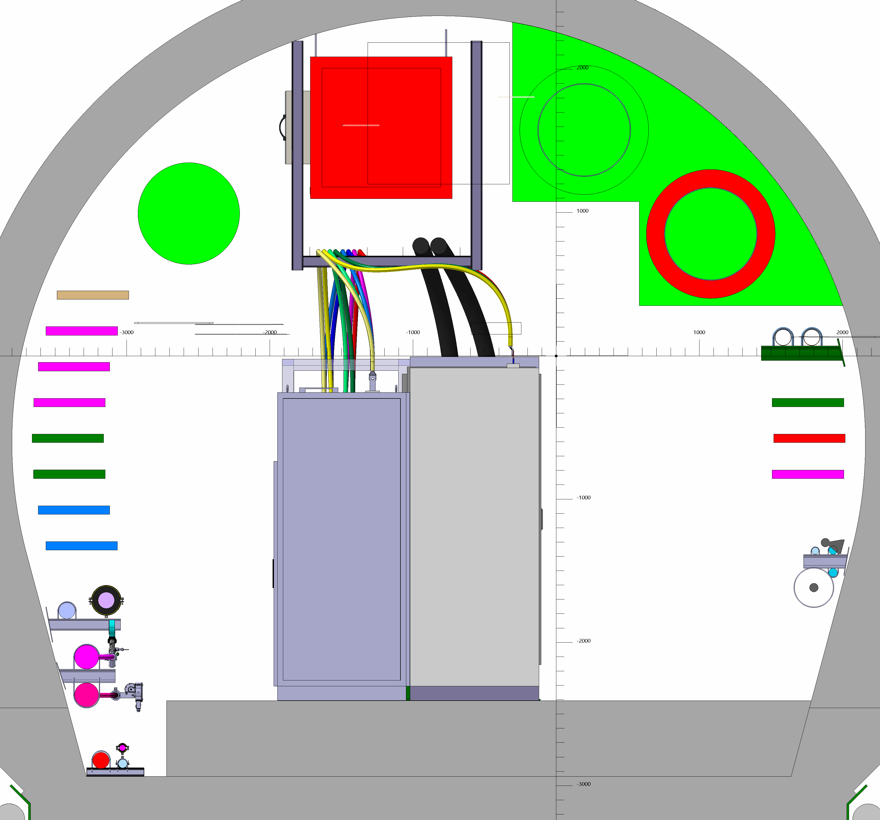
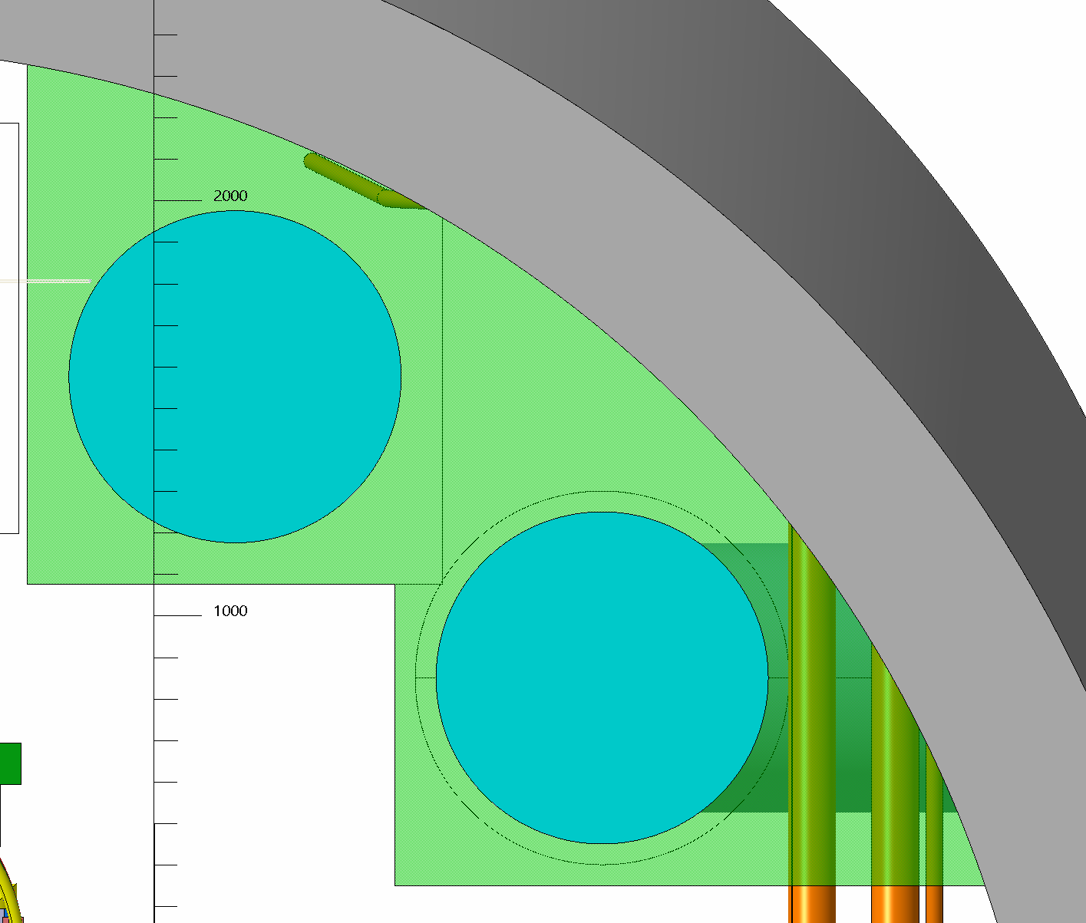
Modification cables tray and cables routing :
No impact

Slide 16
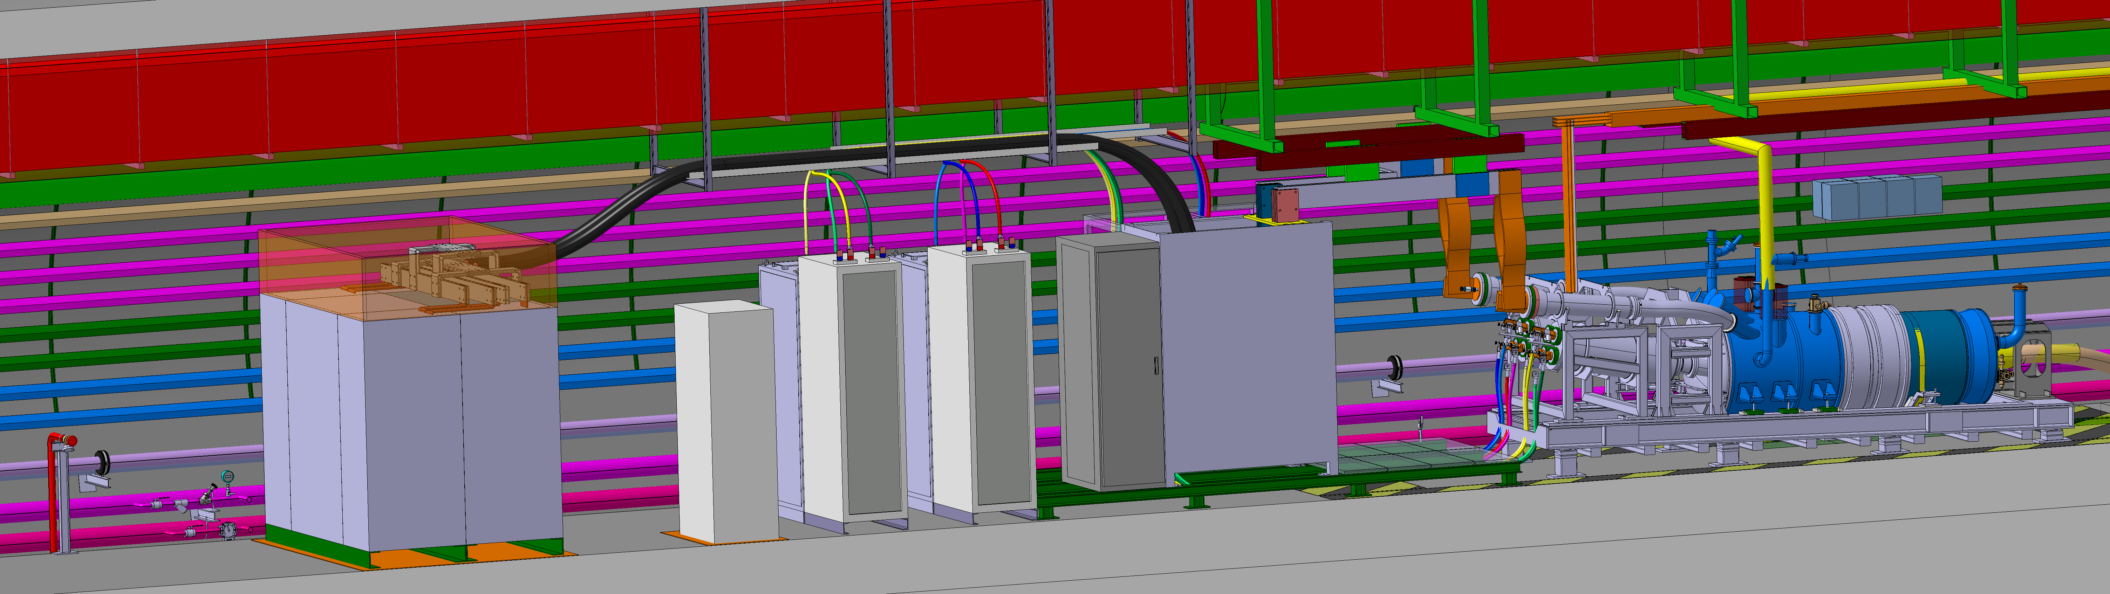
Modification cables tray and cables routing :
No impact

Slide 17
EXTRA SLIDES :
Section type UR15

Slide 18
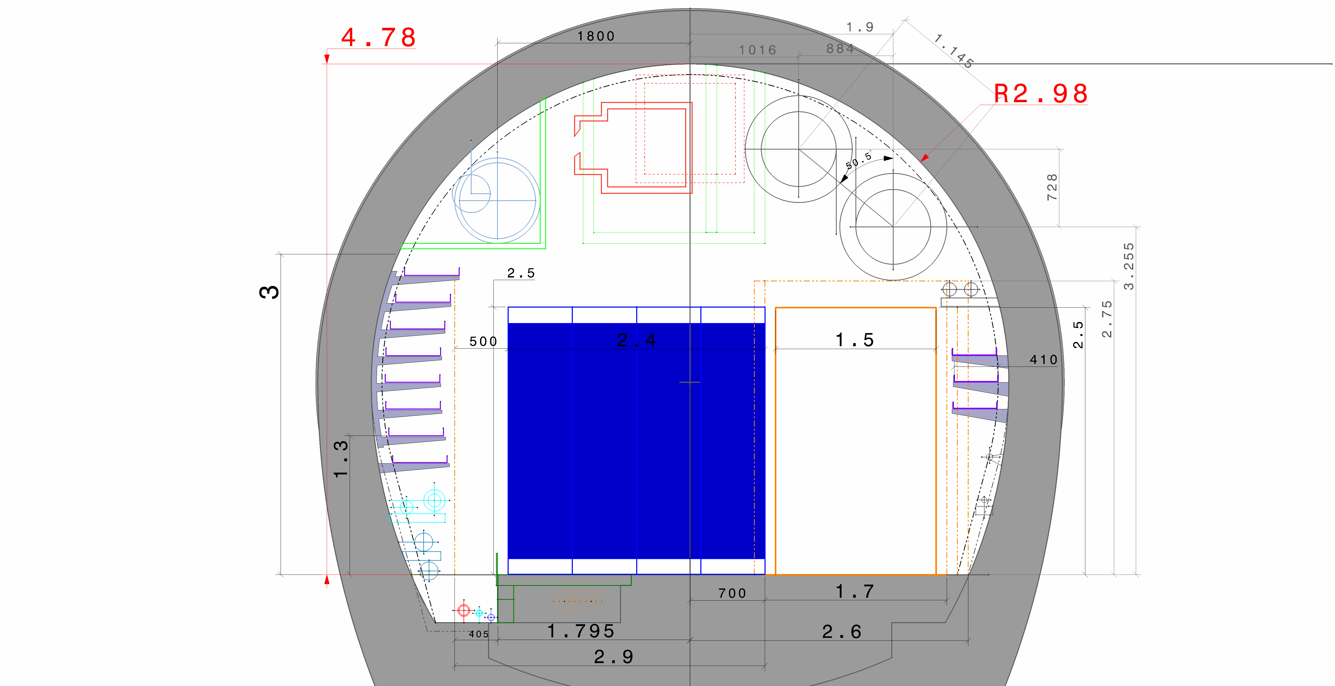
2 QXL

Slide 19
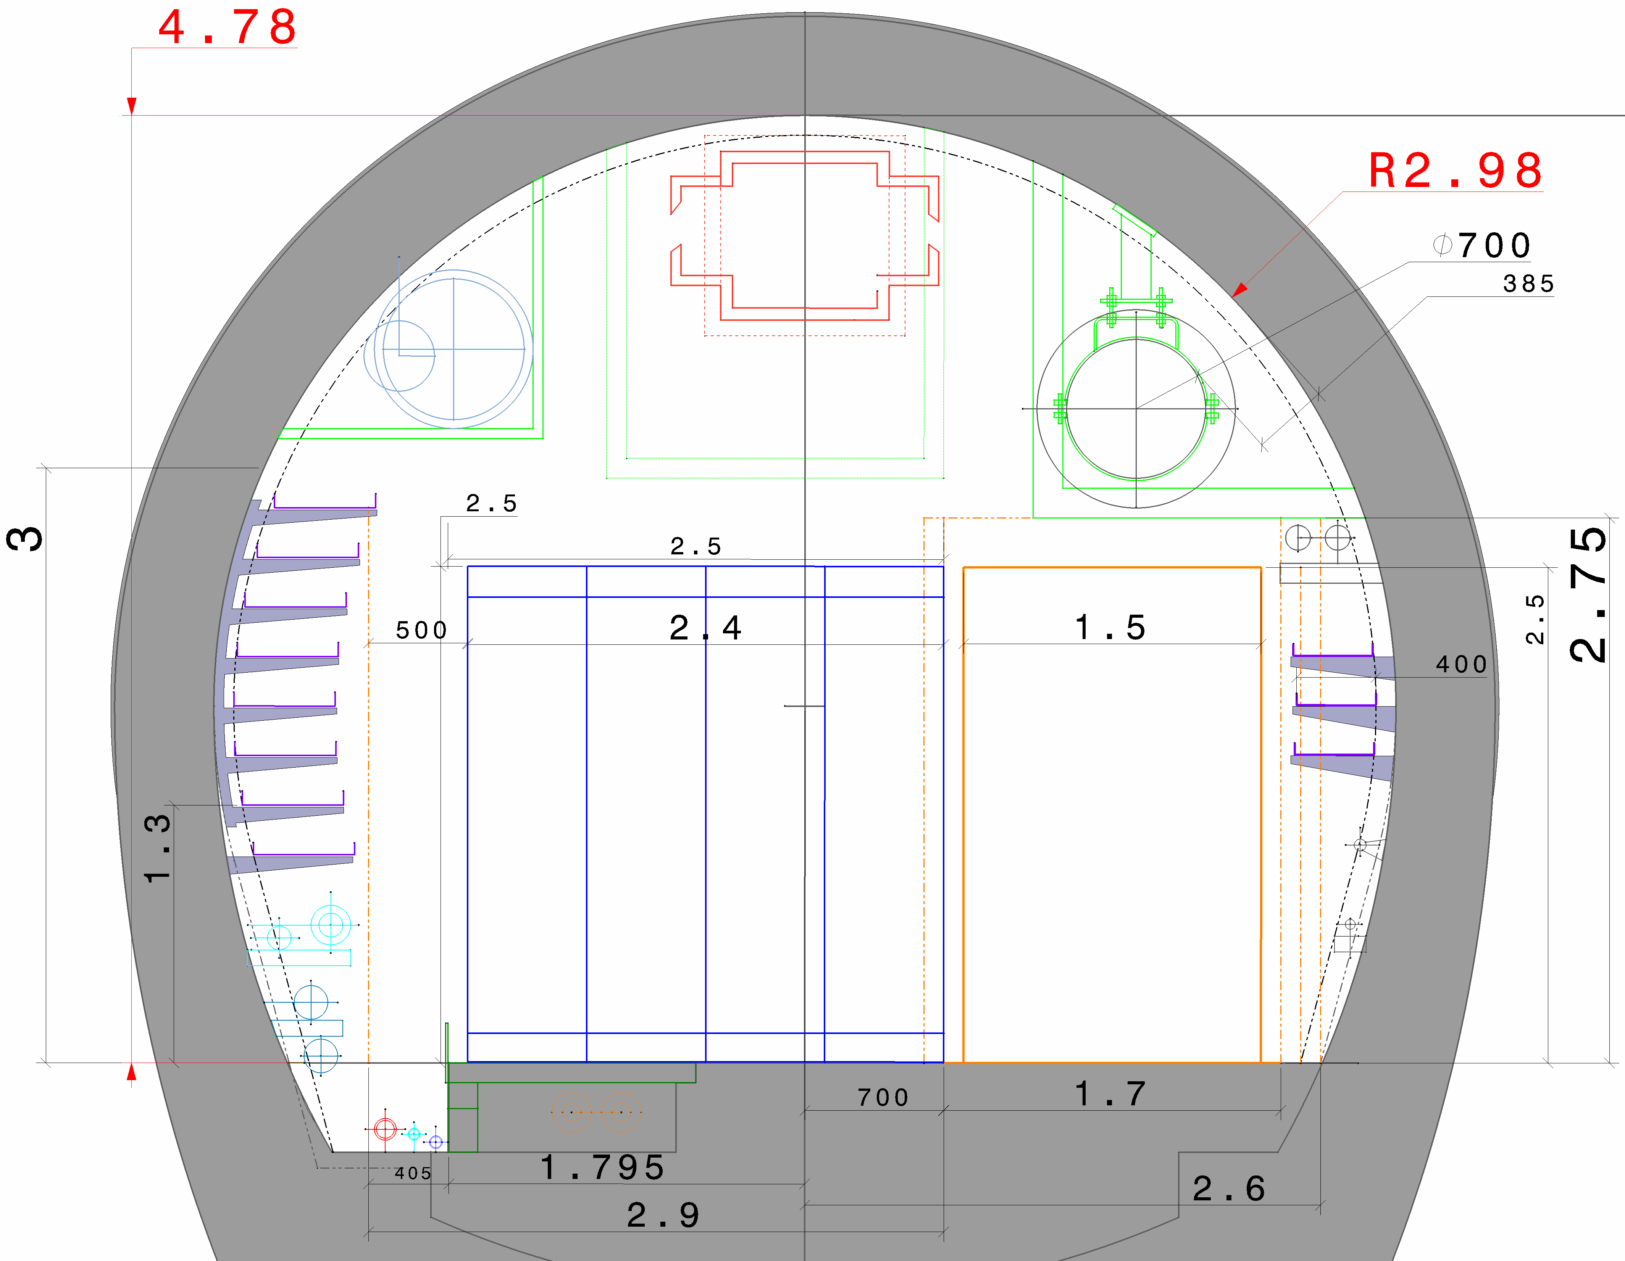
1 QXL

Slide 20
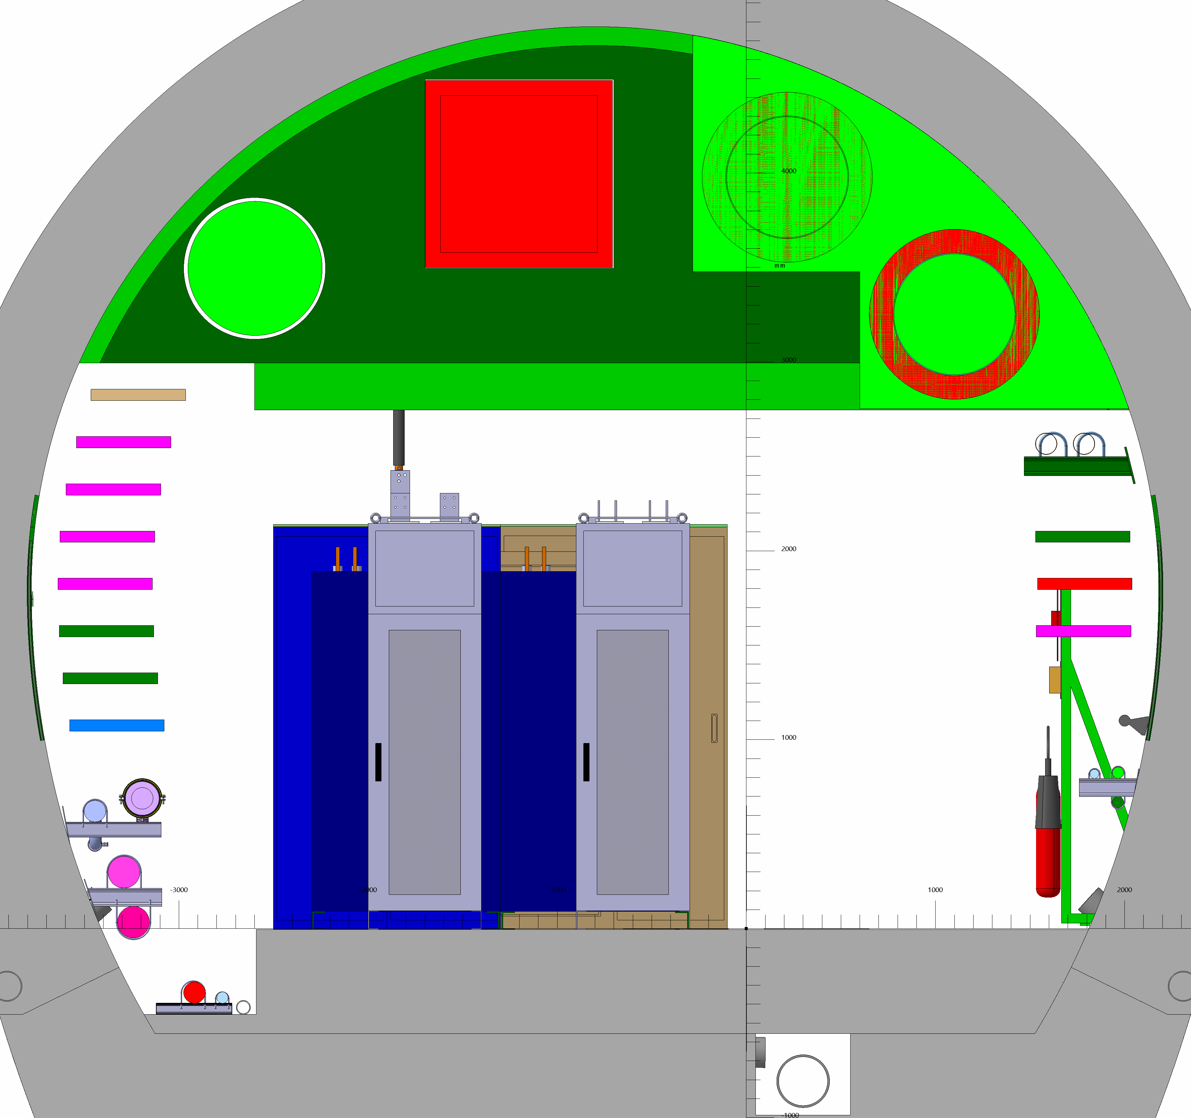
UR15

Slide 21
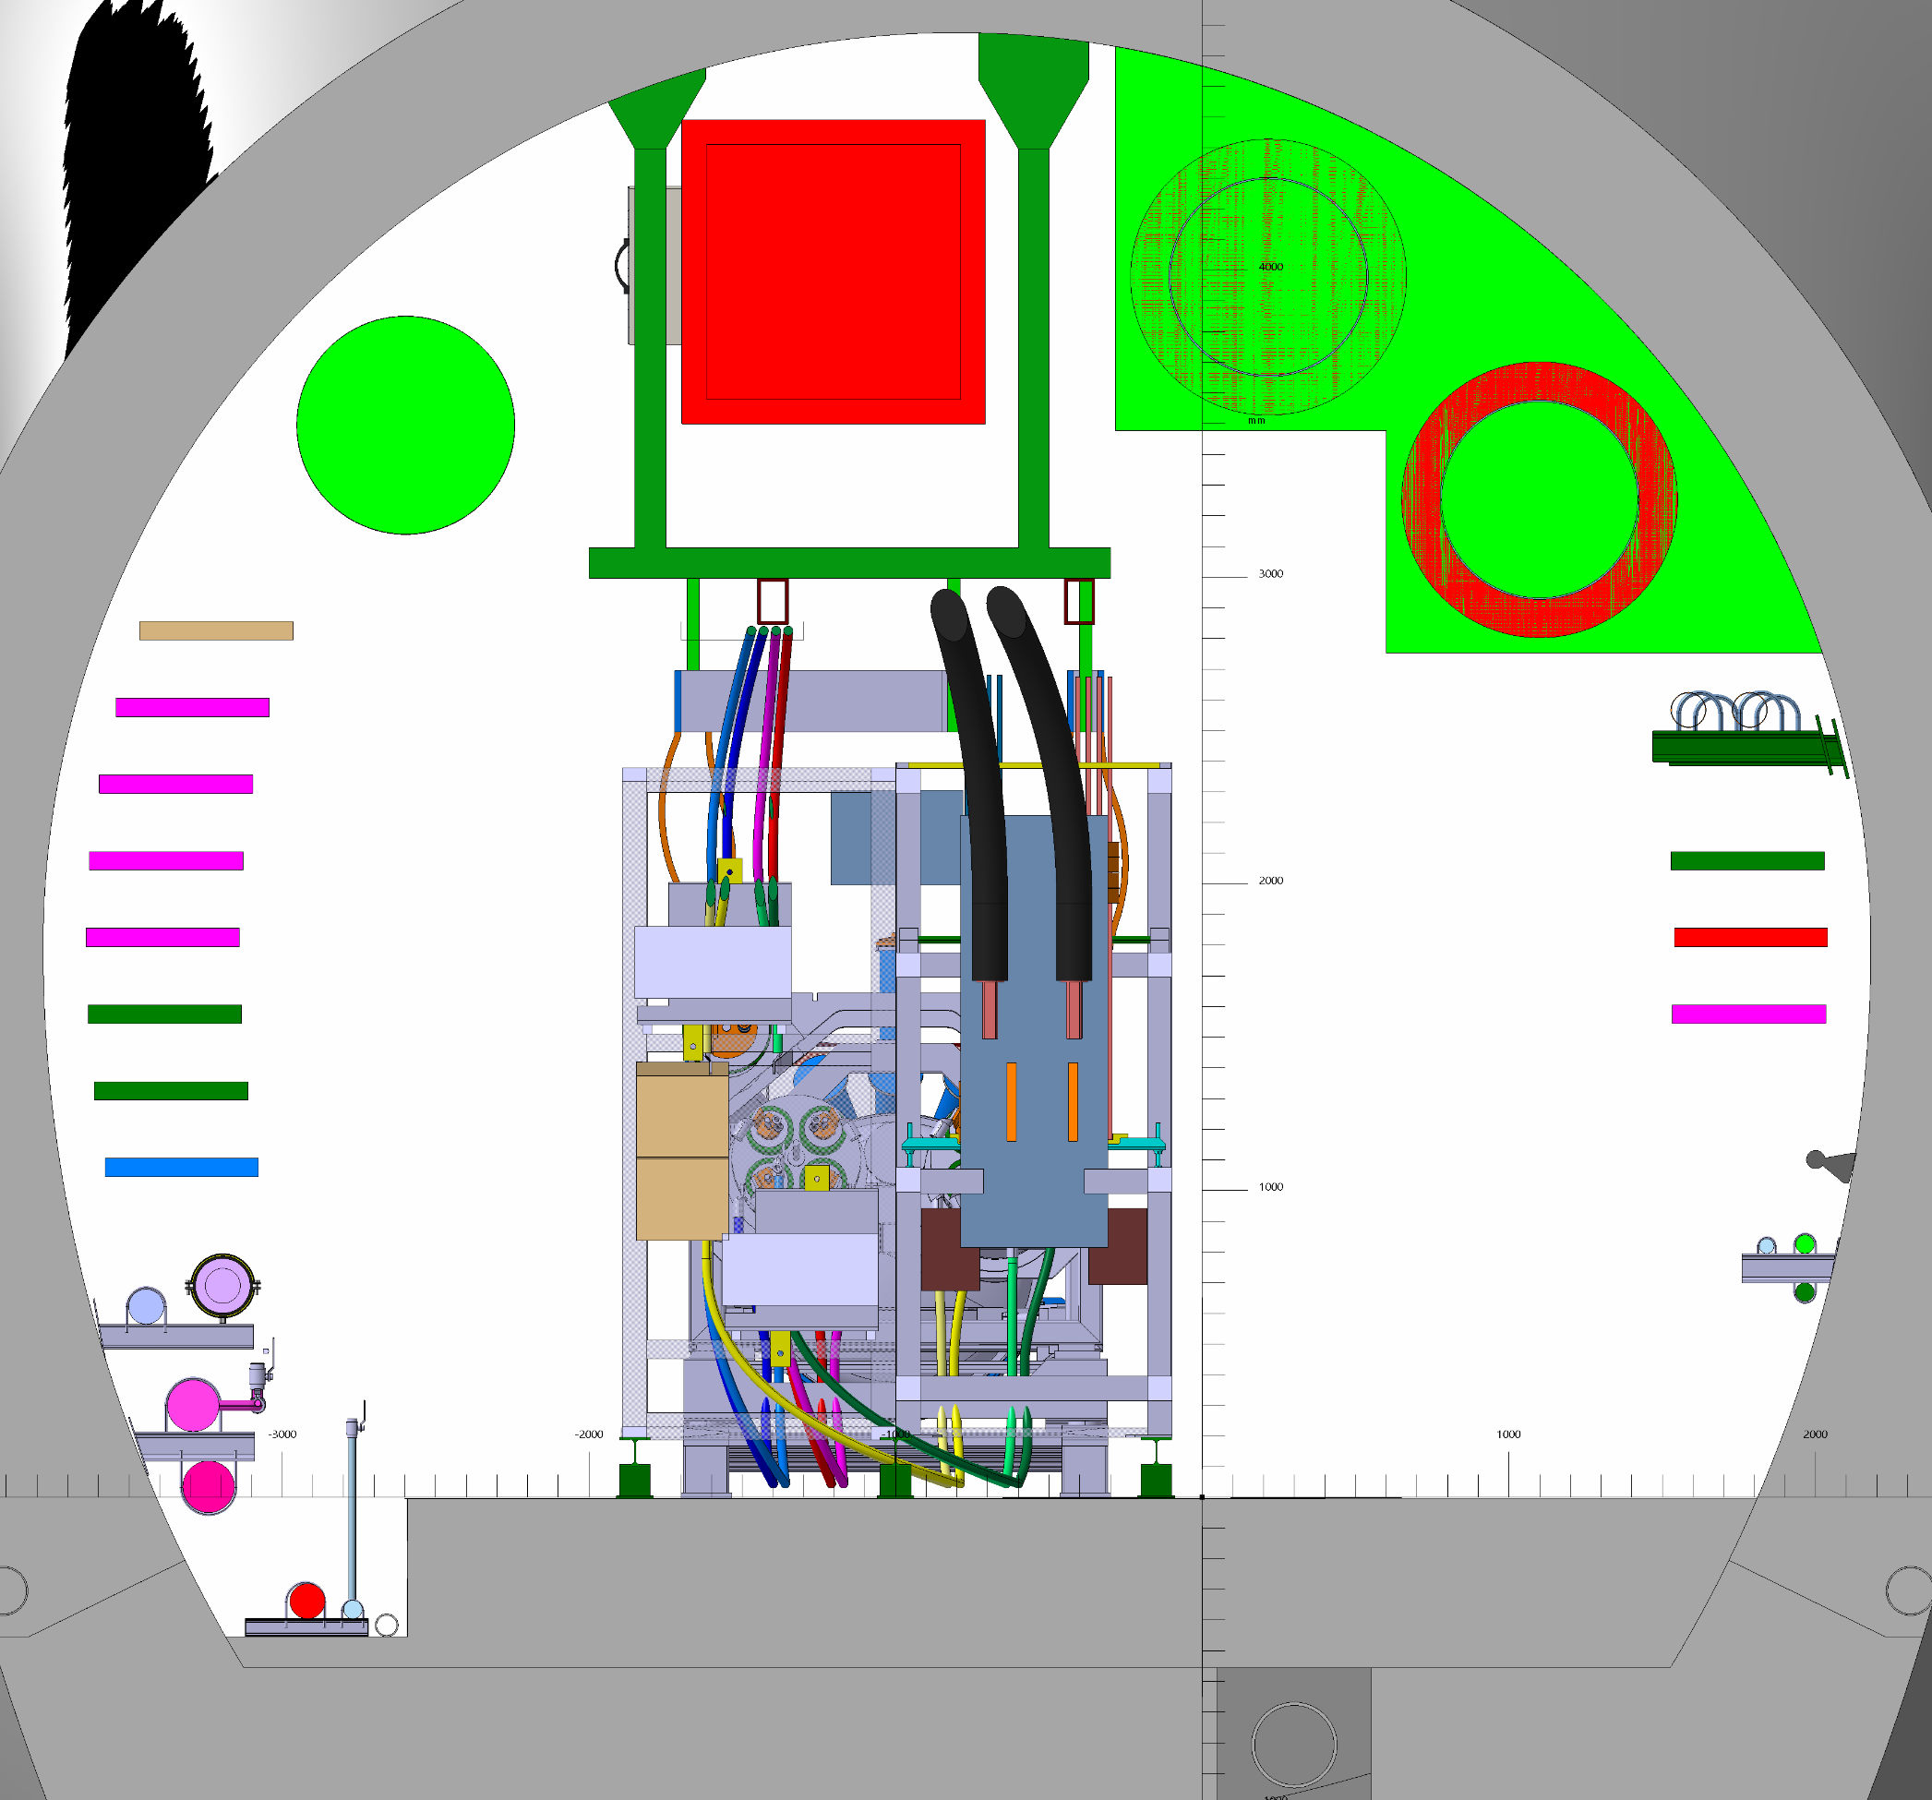
UR15

Slide 22
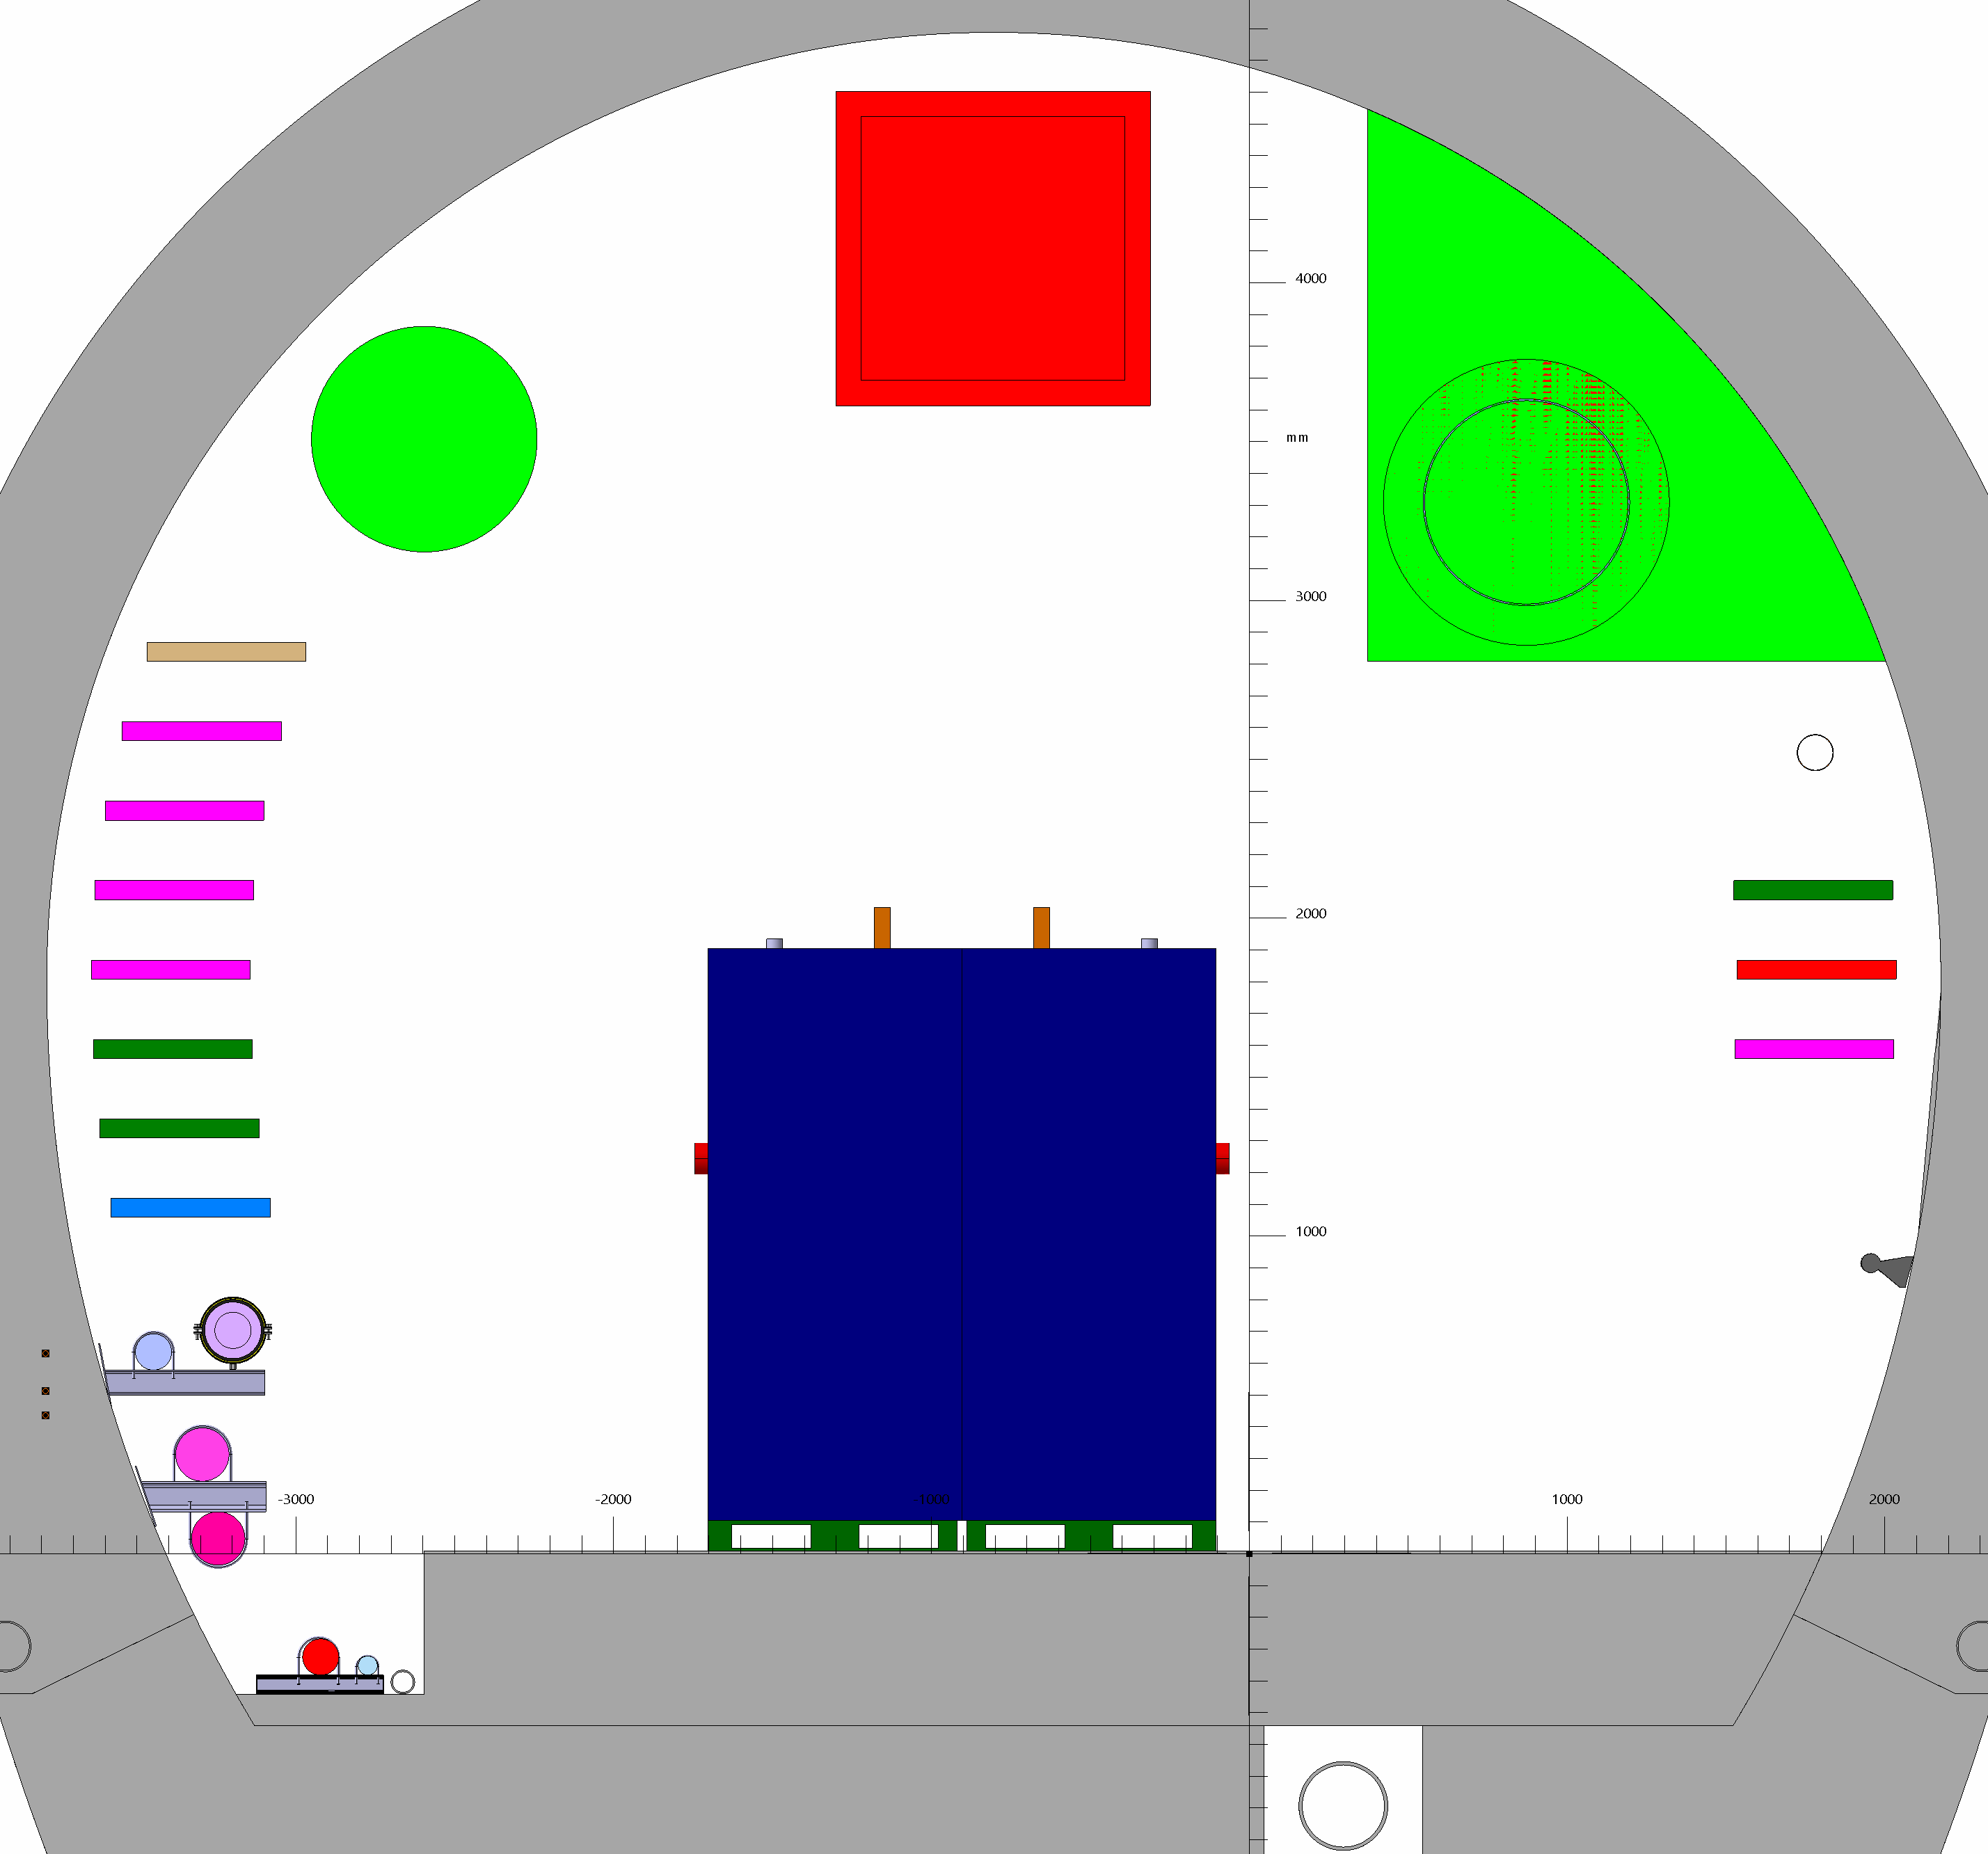
UR15
RACK CLIQ

Slide 23
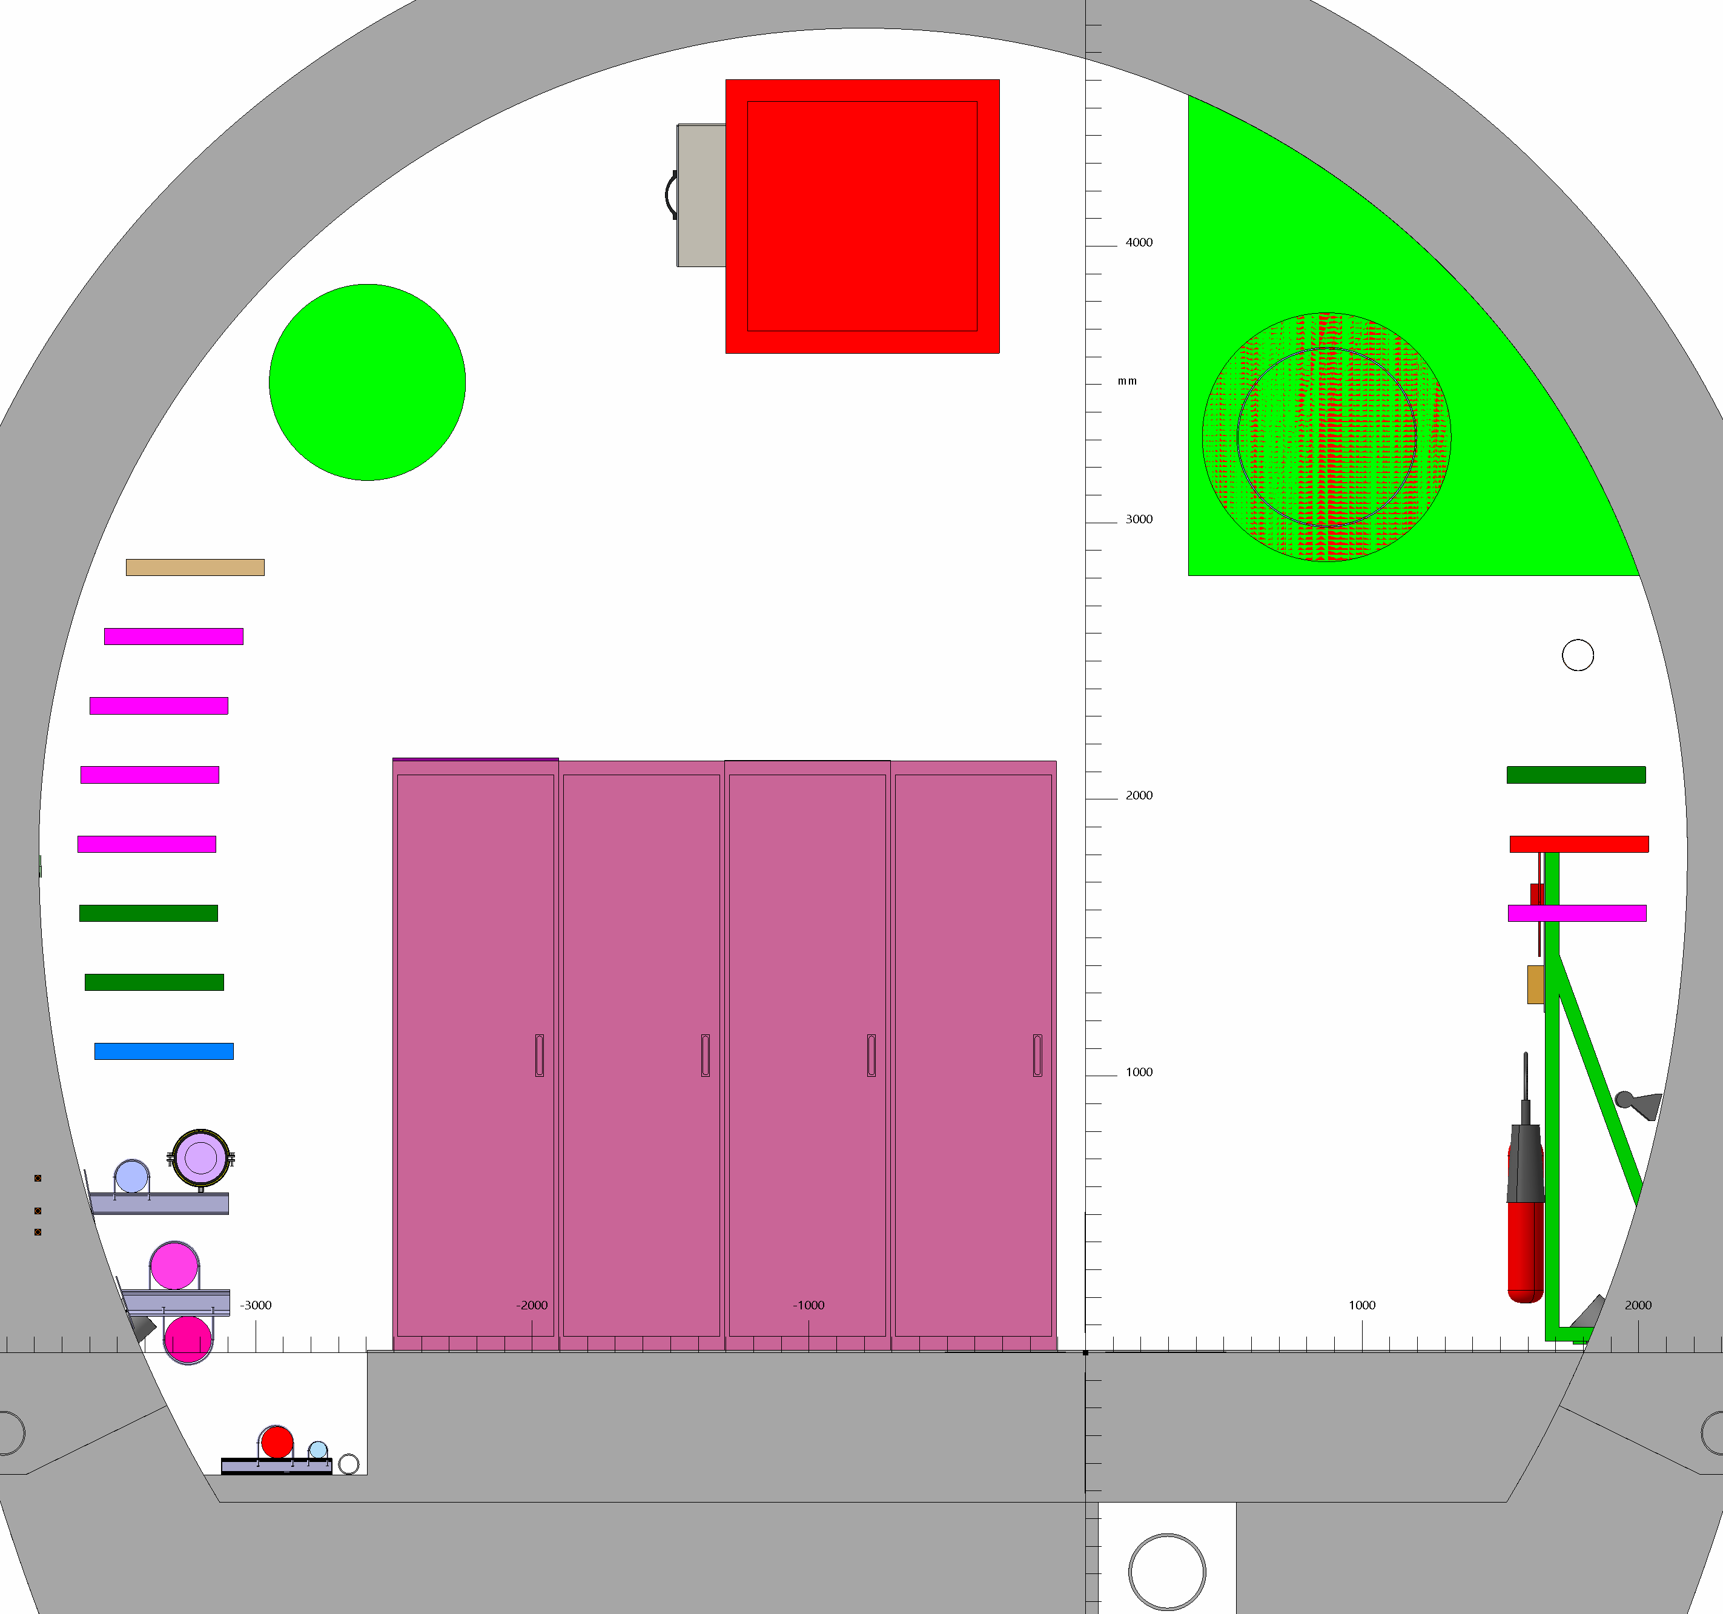
UR15
RACK DYPG

Slide 24
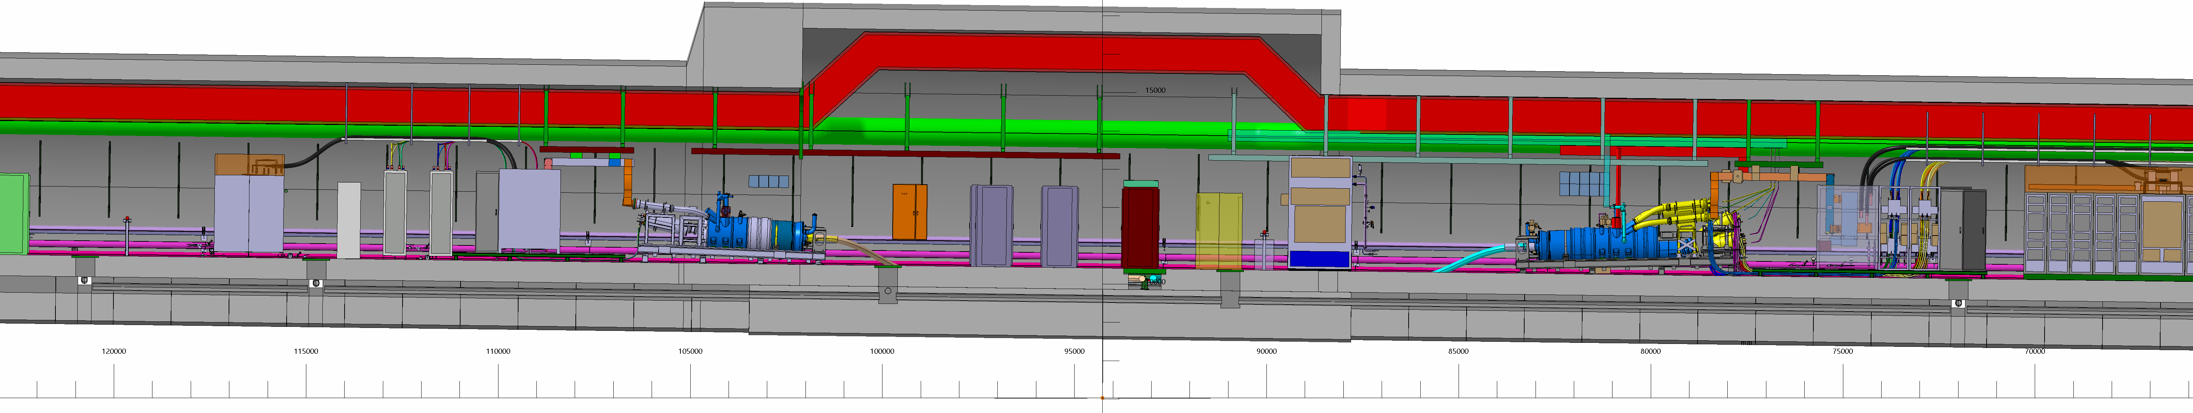
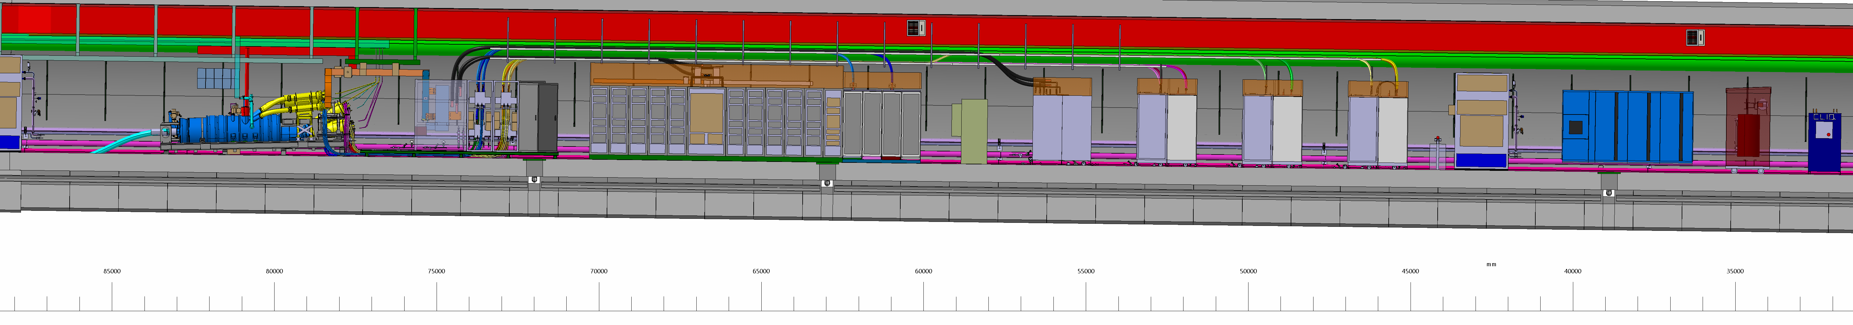
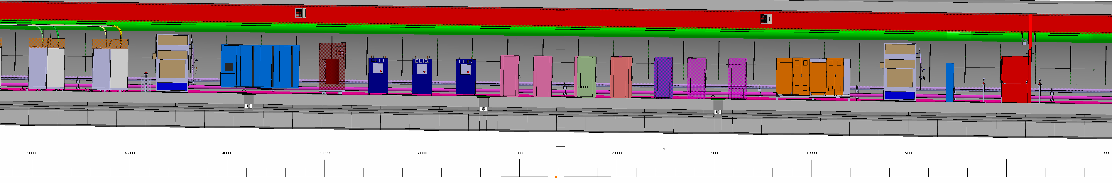
UR15
UL17

