Slide 1


Conventional spectroscopy at LHCb
Mengzhen Wang (INFN di Milano)
2022/10/20
On behalf of the LHCb collaboration
Implications of LHCb measurements and future prospects 2022
19-21 Oct 2022, CERN

Slide 2
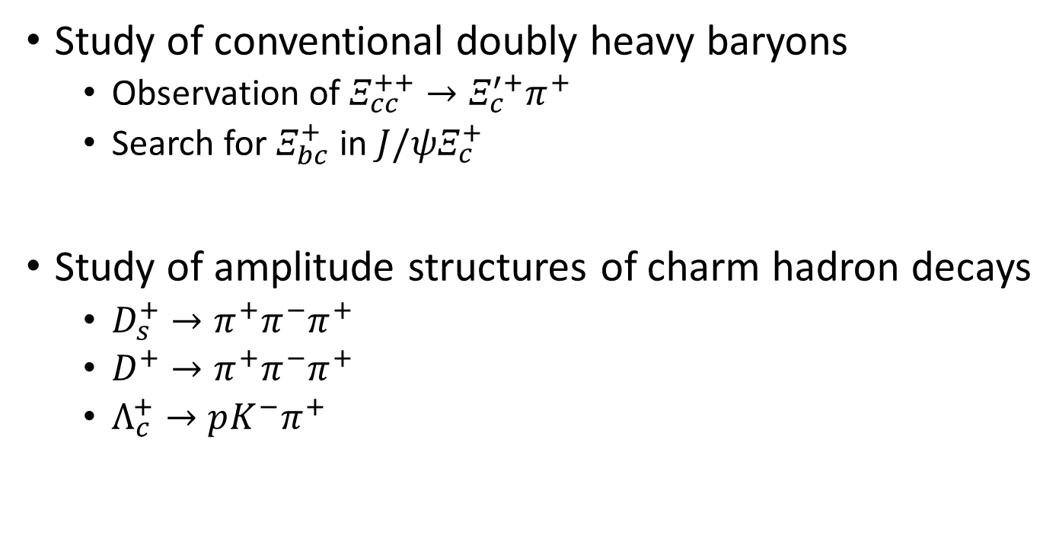
Introduction
Study of conventional doubly heavy baryons
  Observation of $Ξ_{cc}^{++}→Ξ_{c}^{′+}π^{+}$
  Search for $Ξ_{bc}^{+}$ in $J/ψΞ_{c}^{+}$
Study of amplitude structures of charm hadron decays
  $D_{s}^{+}→π^{+}π^{−}π^{+}$
  $D^{+}→π^{+}π^{−}π^{+}$
  $Λ_{c}^{+}→pK^{−}π^{+}$
JHEP05(2022)038
arXiv: 2204.09541
arXiv: 2208.03300
arXiv: 2209.09840
arXiv: 2208.03262, accepted by PRD

Slide 3
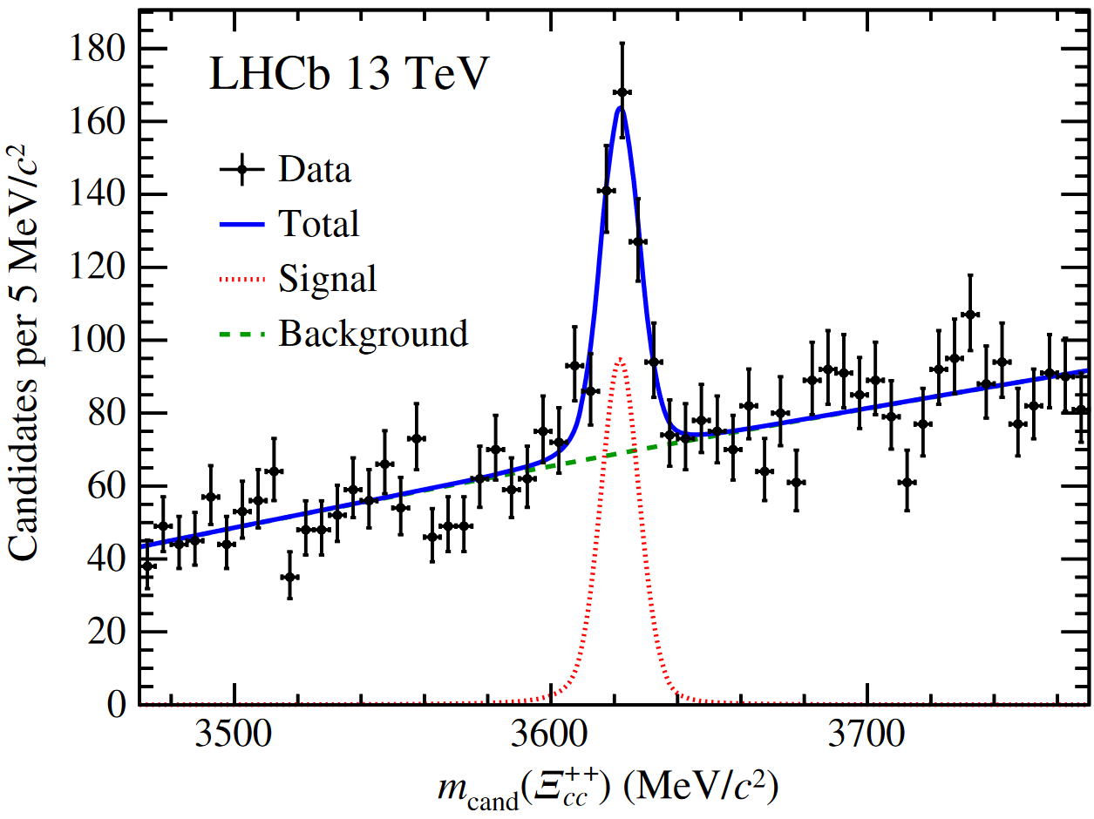
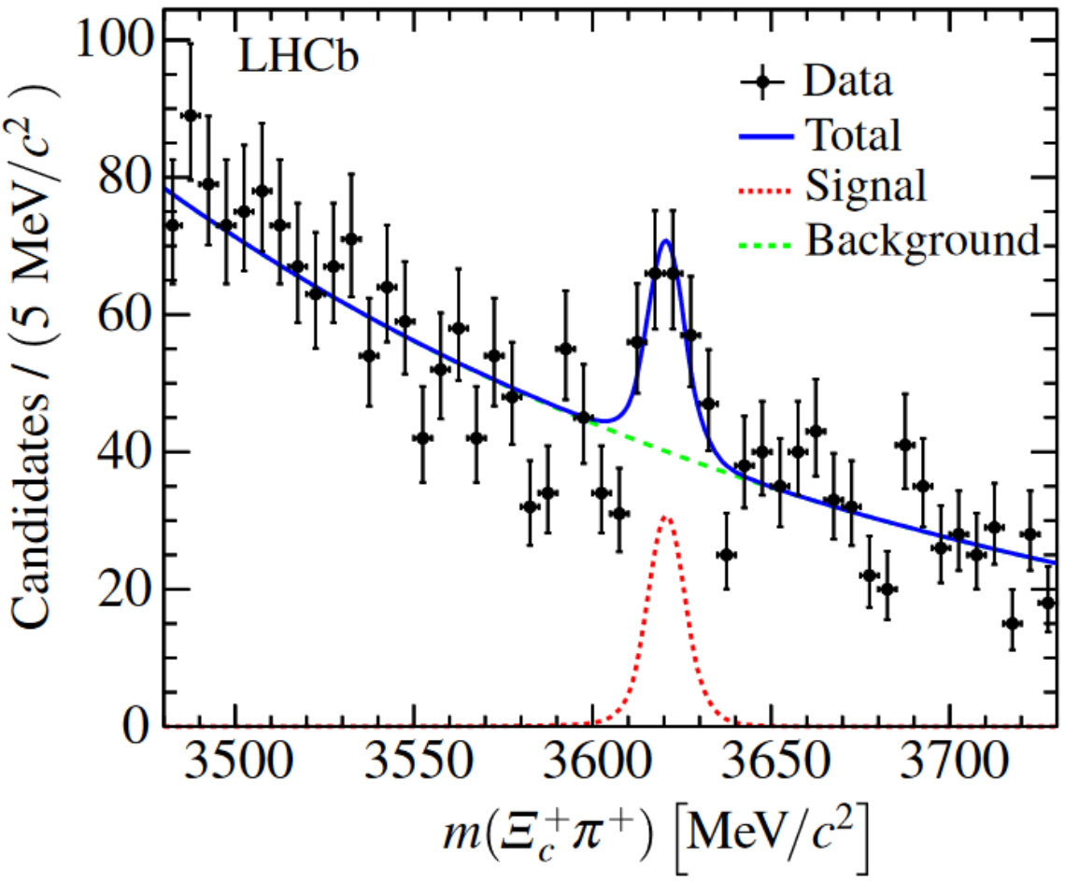
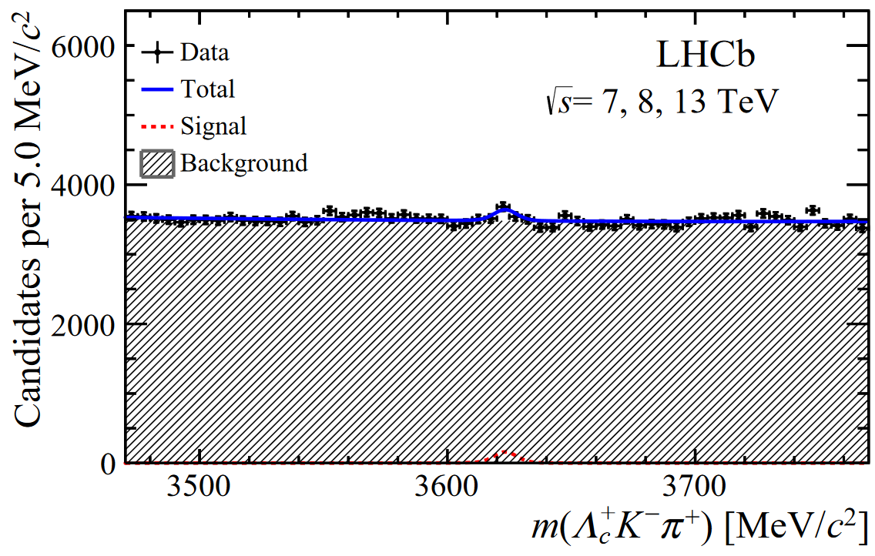
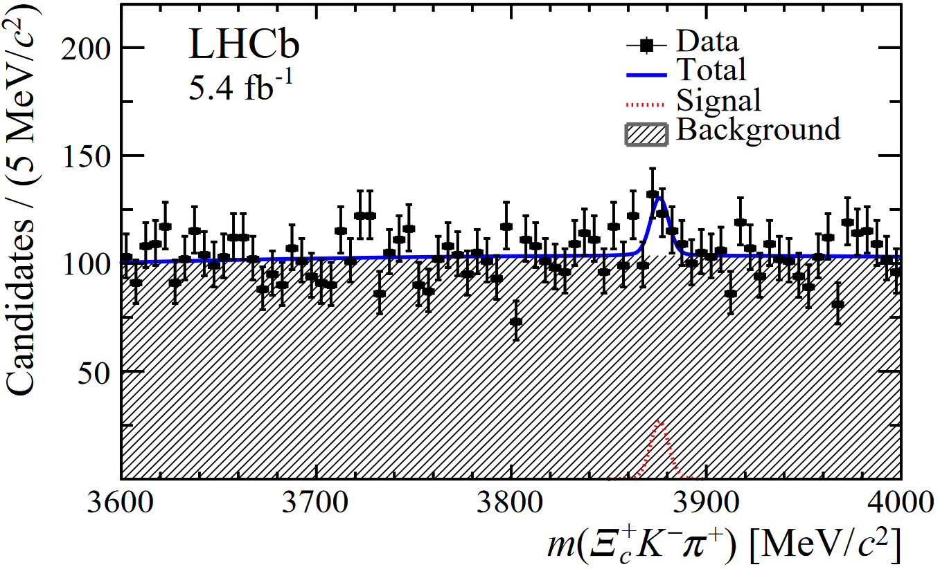
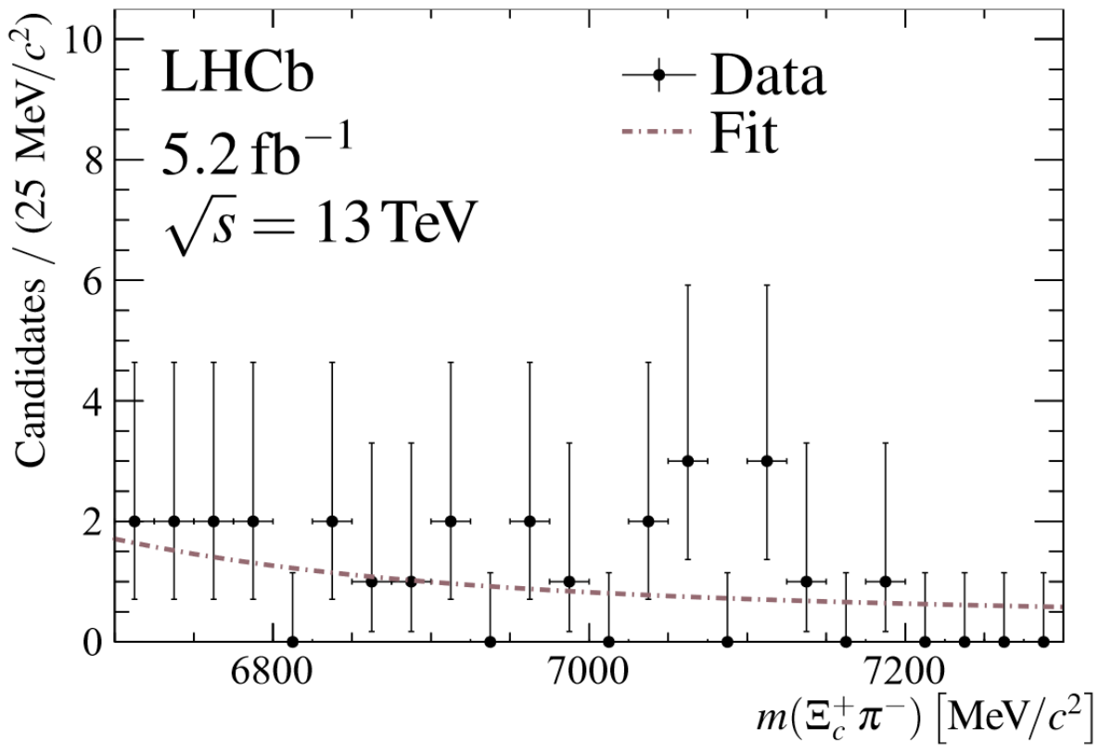







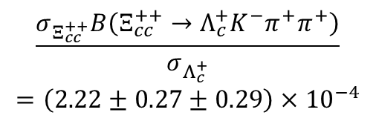

Conventional doubly heavy baryons @ LHCb
Observation of $Ξ_{cc}^{++}$
New decay: $Ξ_{cc}^{++}→Ξ_{c}^{+}π^{+}$
$Ξ_{cc}^{++}$ Property measurement
JHEP 02(2020)049
$$m=3621.55±0.23±0.30 MeV$$
PRL 121(2018)052002
$$τ={0.256}_{−0.022}^{+0.024}±0.014 ps$$
Chin.Phys.C 44(2022)022001
$$\frac{σ_{Ξ_{cc}^{++}}B\left(Ξ_{cc}^{++}→Λ_{c}^{+}K^{−}π^{+}π^{+}\right)}{σ_{Λ_{c}^{+}}}$$
$$=\left(2.22±0.27±0.29\right)×{10}^{−4}$$
PRL 119(2017)112001
PRL 121(2018)162002
Search for other doubly-heavy baryons, for example:
$$Ξ_{cc}^{+}→Λ_{c}^{+}K^{−}π^{+}$$
$$Ω_{cc}^{+}→Ξ_{c}^{+}K^{−}π^{+}$$
$$Ξ_{bc}^{0}/Ω_{bc}^{0}→Ξ_{c}^{+}π^{−}$$
Sci. China-Phys. Mech. Astron. 63(2020)221062
(LHCb-PAPER-2019-029, Supplementary)
Sci. China-Phys. Mech. Astron. 64(2021)101062
Chin.Phys.C 45(2021)093002

Slide 4

Study of $Ξ_{cc}^{++}→Ξ_{c}^{′+}π^{+}$
JHEP05(2022)038

Slide 5
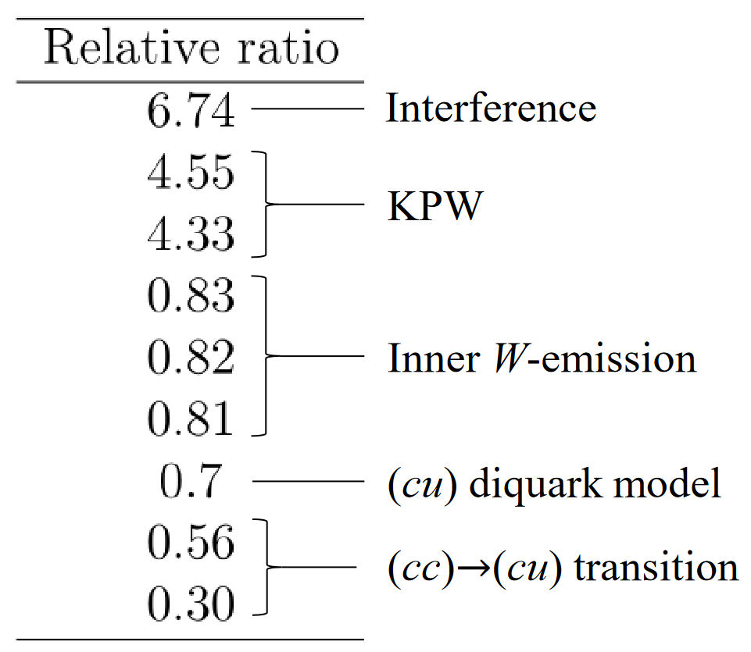
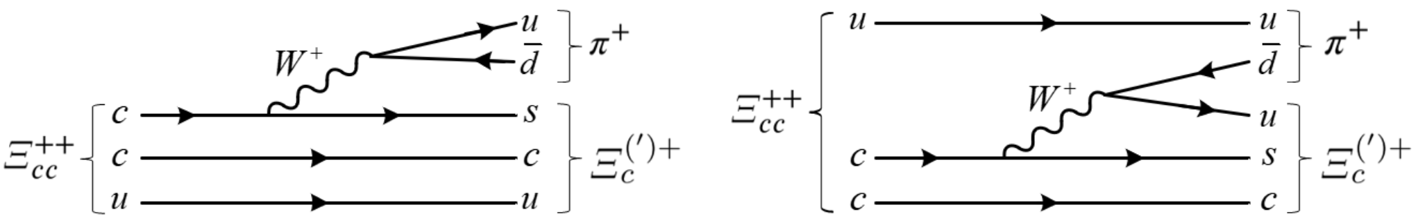



Study of $Ξ_{cc}^{++}→Ξ_{c}^{′+}π^{+}$
${\left[\frac{B\left(Ξ_{cc}^{++}→Ξ_{c}^{′+}π^{+}\right)}{B\left(Ξ_{cc}^{++}→Ξ_{c}^{+}π^{+}\right)}\right]}_{predict}$ vary between $0.3 \sim 7$
Search for $Ξ_{cc}^{++}→Ξ_{c}^{′+}π^{+}$ and measure branching fraction
  $Ξ_{c}^{′+}→$ $Ξ_{c}^{+}γ$, partial Rec. signal in $m(Ξ_{c}^{+}π^{+})$
  Similar efficiency & comparable production as $Ξ_{cc}^{++}→Ξ_{c}^{+}π^{+}$
  Full Run2 data available now, a promising search
PRD 96(2017)113006, PRD 100(2019)037015, Chin.Phys.C 45(2021)053105, PRD 101(2020)034034, PRD 96(2017)054013, PRD 100(2019)114037, PRD 99(2019)056013, Phys.Part.Nucl. 51(2020)678
Observed using $\sim 1/3$ of Run2 data

Slide 6
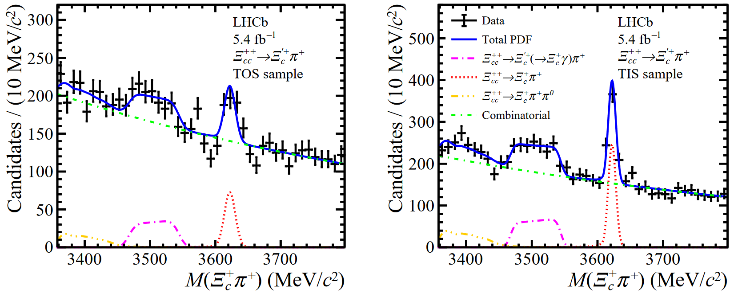
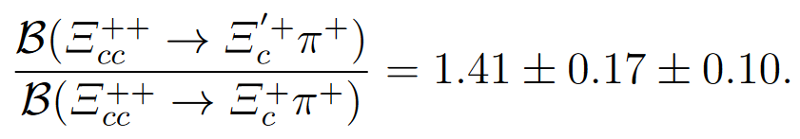



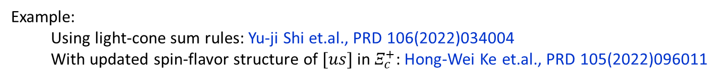

Observation of $Ξ_{cc}^{++}→Ξ_{c}^{′+}π^{+}$
JHEP05(2022)038
2016-2018 data, $ℒ\sim 5.4 {fb}^{−1}$. “Turbo” stream
  Offline-like real-time rec.&sel. for events with good $Ξ_{c}^{+}→pK^{−}π^{+}$ candidate
Significance (stat.) $>9σ$
1st observation of $Ξ_{cc}^{++}→Ξ_{c}^{′+}π^{+}$
$$Ξ_{cc}^{++}→Ξ_{c}^{+}π^{+}$$
$$Ξ_{cc}^{++}→Ξ_{c}^{′+}π^{+}$$
Inconsistent with any previous theoretical predictions
A useful input to improve future calculations
Example:
Using light-cone sum rules: Yu-ji Shi et.al., PRD 106(2022)034004
With updated spin-flavor structure of $[us]$ in $Ξ_{c}^{+}$: Hong-Wei Ke et.al., PRD 105(2022)096011

Slide 7

Search for $Ξ_{bc}^{+}→J/ψΞ_{c}^{+}$
arXiv: 2204.09541

Slide 8
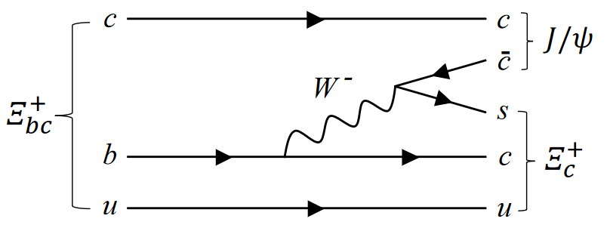
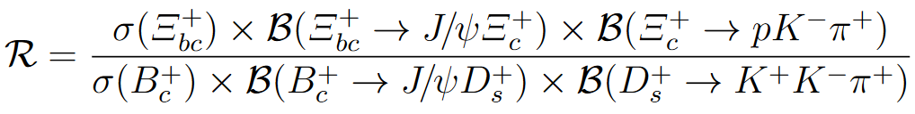

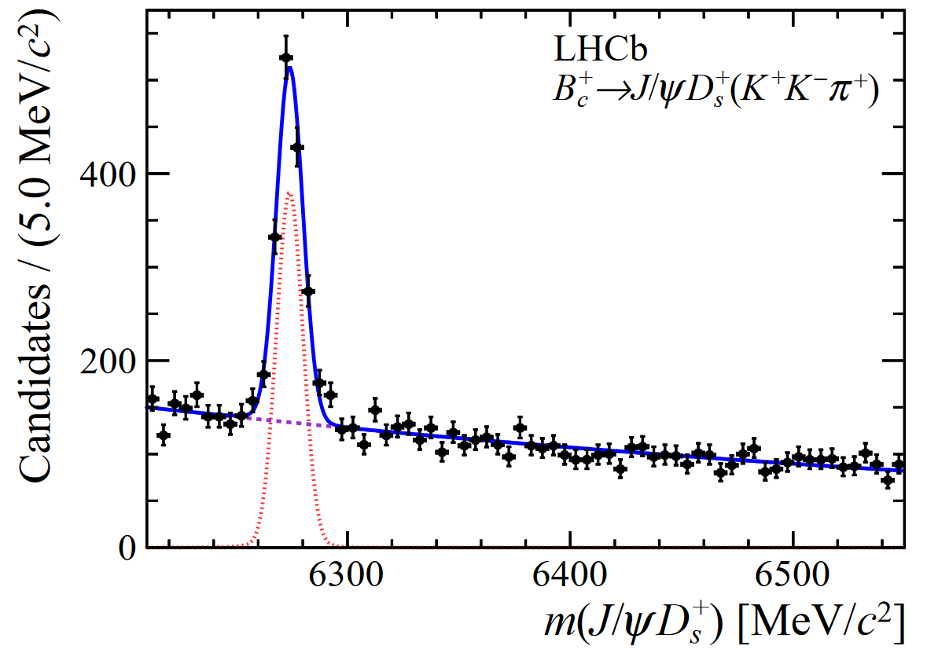
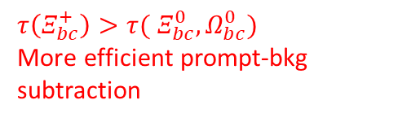










Study of $Ξ_{bc}^{+}→J/ψΞ_{c}^{+}$
Advantages of $Ξ_{bc}^{+}→J/ψΞ_{c}^{+}$
Yield estimation: $B_{c}^{+}→J/ψD_{s}^{+}$ as normalization mode
“golden channel” for signal identification (online & offline)
$τ\left(Ξ_{bc}^{+}\right)>τ($ $Ξ_{bc}^{0}, Ω_{bc}^{0})$
More efficient prompt-bkg subtraction
$$→μ^{+}μ^{−}$$
Phys.Usp.45(2022)455, Nul.Phys.A 895(2012)59,
EPCJ 16(2000)461, PRD 98(2018)113004,
PRD 99(2019)073006
$$→pK^{−}π^{+}$$
No other Cabbibo suppression than $V_{bc}$. Relatively large branching fraction
$\sim 0.015$
PRD 83(2011)034026,
EPJC 38(2004)267
Chin.Phys.Lett. 27(2010)061302
$\sim \frac{1}{3}$ (color suppression)
From PDG
$N_{rec\&sel}\left(B_{c}^{+}→J/ψD_{s}^{+}\right)\sim 1000$ in Run1-2 dataset
$$ℒ=9{fb}^{−1}$$
Expect $N_{rec\&sel}\left(Ξ_{bc}^{+}→J/ψΞ_{c}^{+}\right)\sim 15$
JHEP 07 (2020) 123
A promising search, especially in high-mass region with low combinatorial background

Slide 9
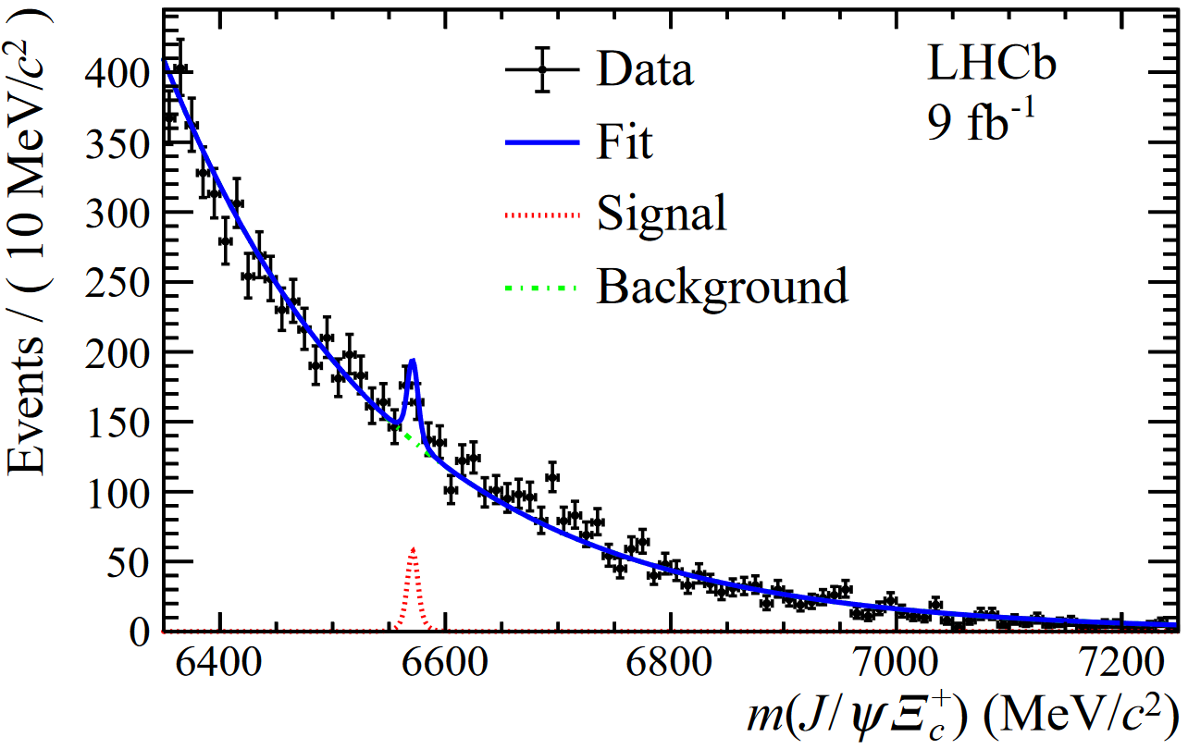
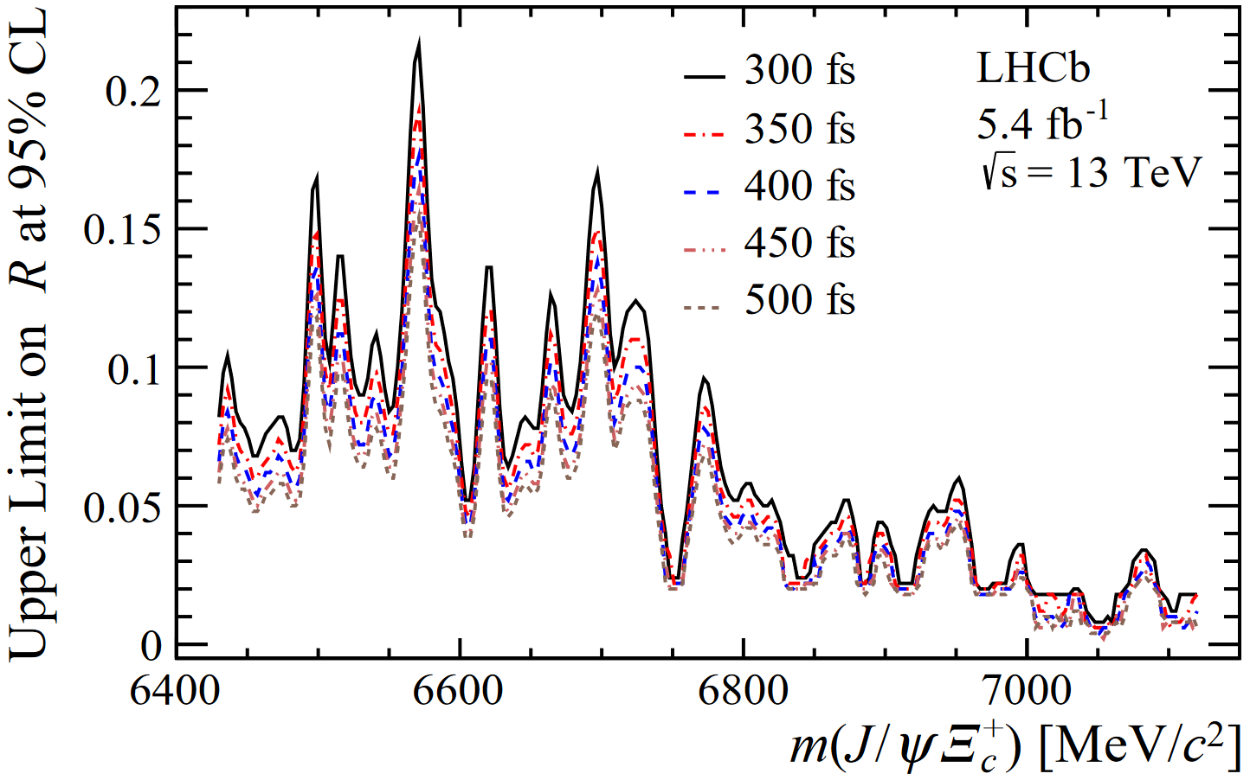



Search for $Ξ_{bc}^{+}→J/ψΞ_{c}^{+}$
arXiv: 2204.09541
Full dataset. Dimuon-based online + MVA-based offline selections
Upper limit assigned cannot exclude any mass regions
  Stay tuned with upcoming Run3 dataset
Hint of a bump in mass spectrum
Upper Limit(UL) of $R$ assigned as $f(m, τ)$
Largest global significance:
2.8$σ$ for peak @ 6571 MeV
Predicted value

Slide 10
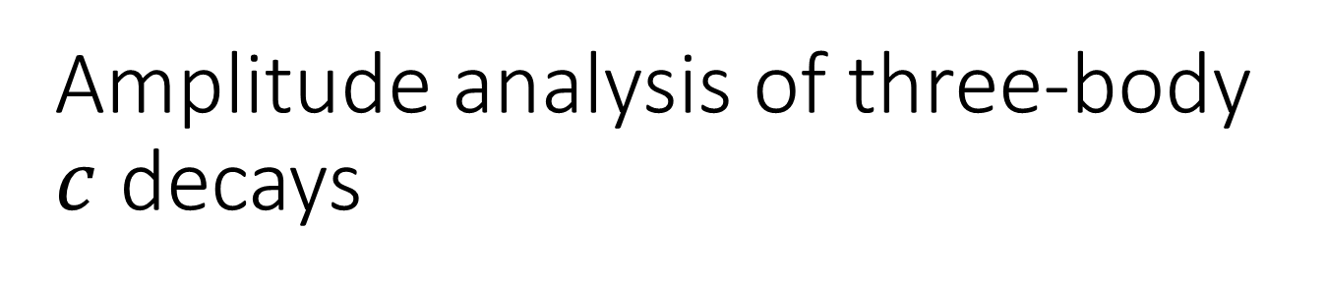
Amplitude analysis of three-body $c$ decays
LHC: good charm factory
LHCb: good at reconstruction of charm decays
Investigate charm-decay amplitudes with competitive precisions

Slide 11

$$D^{+}(D_{s}^{+})→π^{−}π^{+}π^{+}$$
arXiv:2208.03300, arXiv:2209.09840

Slide 12
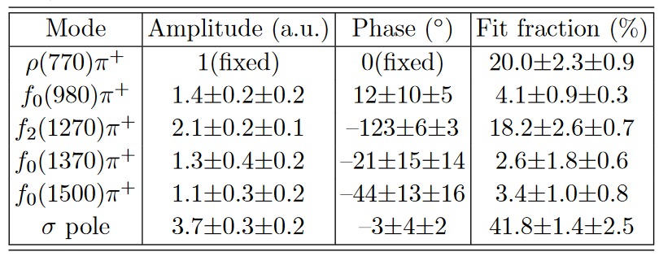
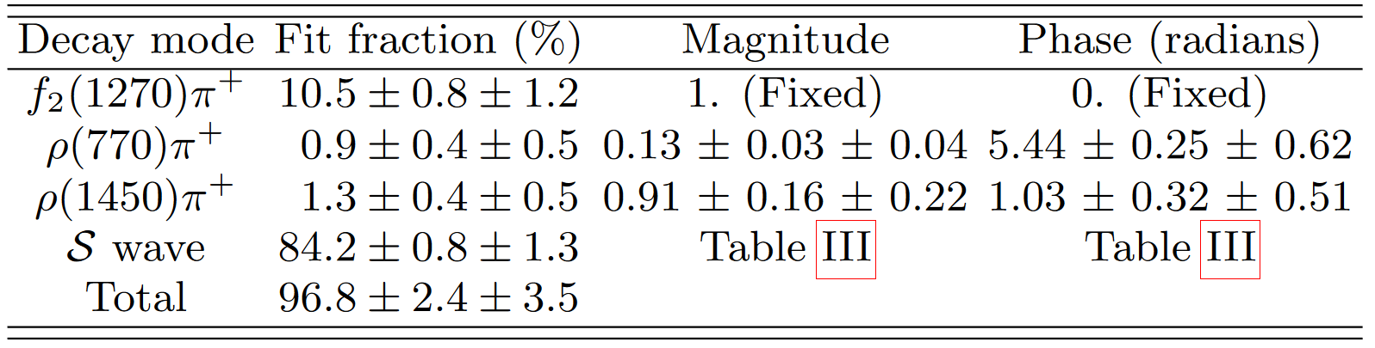

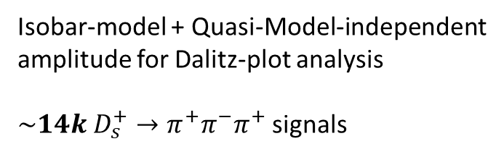
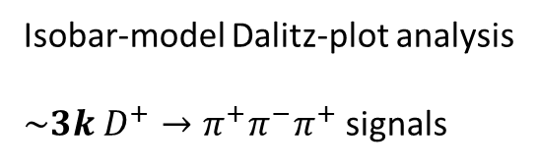
Previous knowledge of amplitudes
$D^{+}→π^{+}π^{−}π^{+}$ (most recent):
$D_{s}^{+}→π^{+}π^{−}π^{+}$(most recent):
Phys.RD 76 (2007) 012001, CLEO experiment
Isobar-model Dalitz-plot analysis
$\sim 3k$ $D^{+}→π^{+}π^{−}π^{+}$ signals
arXiv: 2108.10050, submitted in 2021 by BESIII collaboration
Isobar-model + Quasi-Model-independent
amplitude for Dalitz-plot analysis
$\sim 14k$ $D_{s}^{+}→π^{+}π^{−}π^{+}$ signals
Quasi-model-independent amplitude. Details in arXiv: 2108.10050

Slide 13
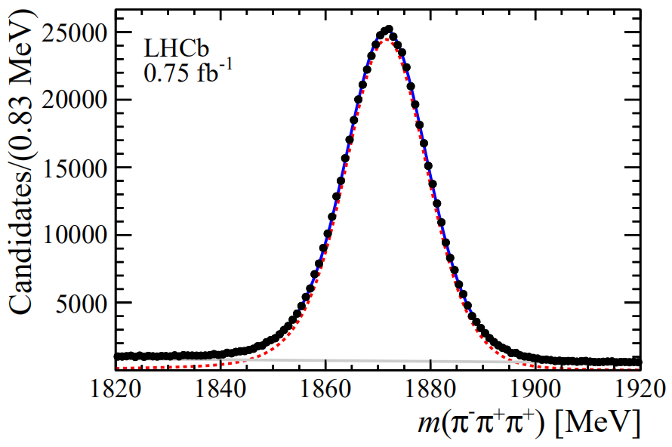
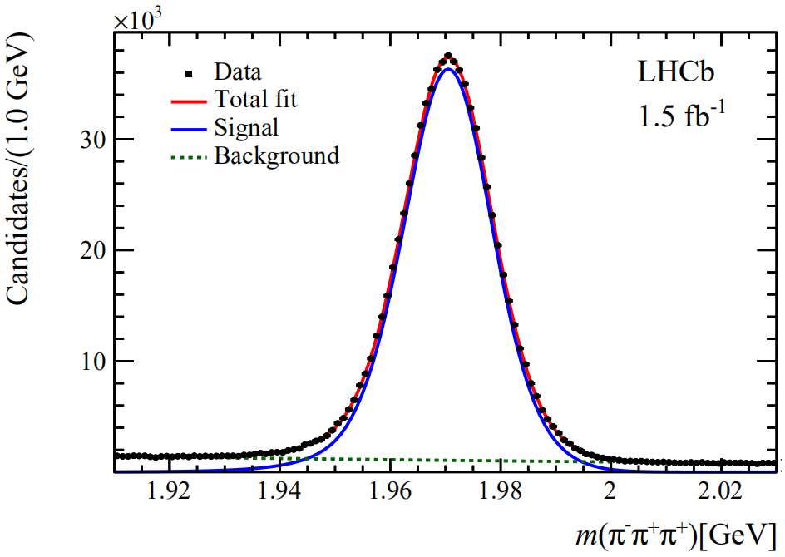




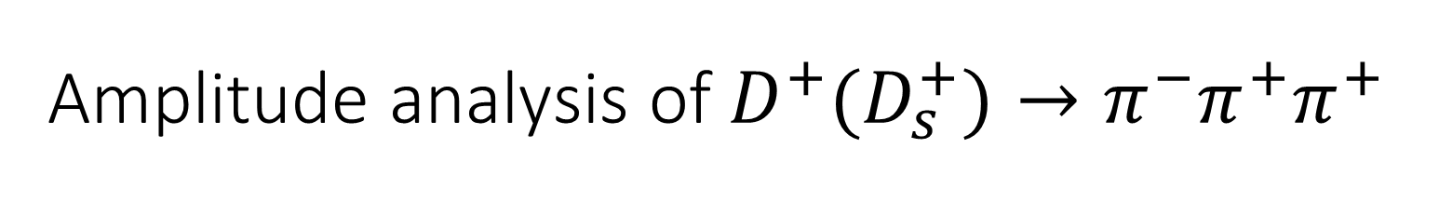

Amplitude analysis of$D^{+}(D_{s}^{+})→π^{−}π^{+}π^{+}$
arXiv:2208.03300, arXiv:2209.09840
2012 data$,𝓛=1.5 {fb}^{−1}$. Promptly produced $D$ mesons
  Competitive statistical power
Methodology for amplitude construction
  S-wave: Quasi-Model Independent approach (QMIPWA)
    $c_{k}, φ_{k}$: Generic functions determined by fit to data
  Isobar model for spin-1, spin-2 components
$$N\left(D^{+}\right)\sim 600k$$
$$N\left(D_{s}^{+}\right)\sim 700k$$

Slide 14
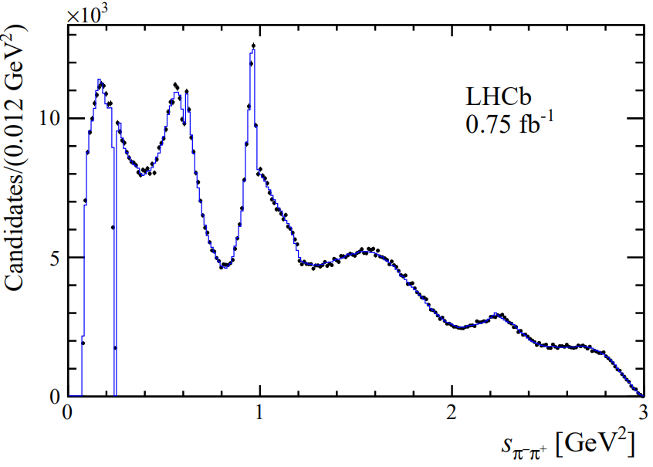
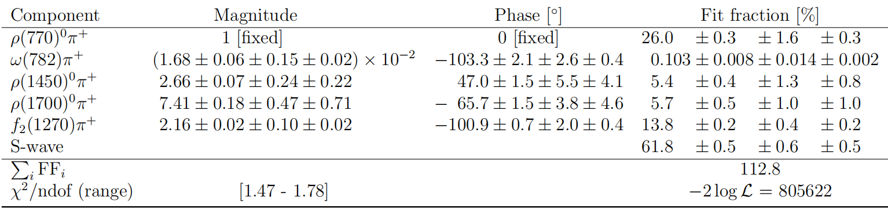
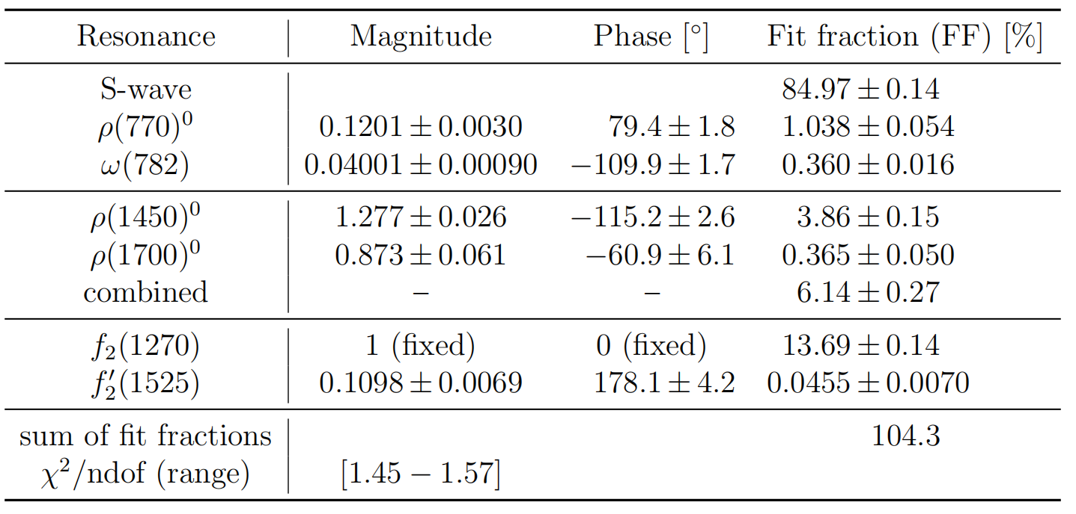
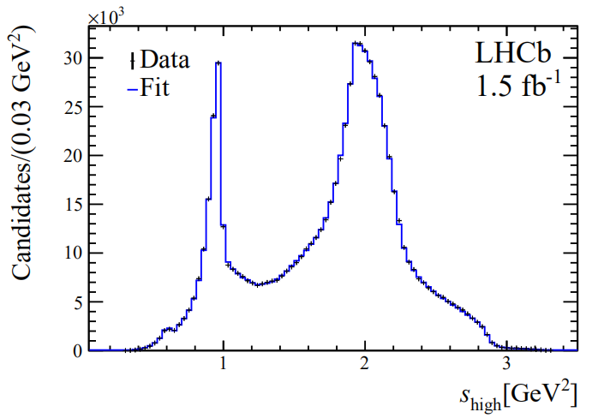
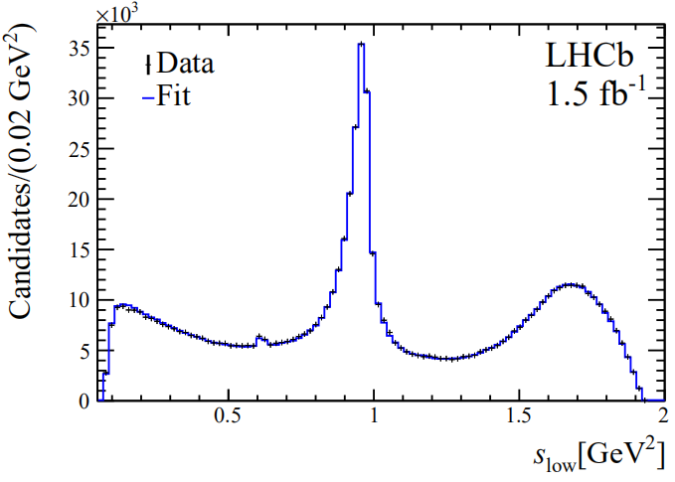

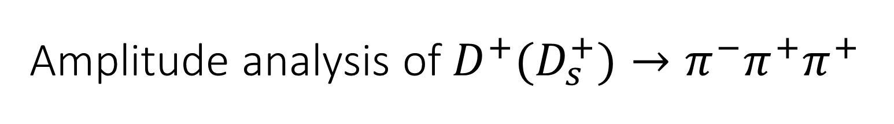


Amplitude analysis of$D^{+}(D_{s}^{+})→π^{−}π^{+}π^{+}$
arXiv:2208.03300, arXiv:2209.09840
$D^{+}→π^{−}π^{+}π^{+}$
$D_{s}^{+}→π^{−}π^{+}π^{+}$
Dominated by S-wave, followed by $ρ{\left(770\right)}^{0}π^{+}$ and $f_{2}{\left(1270\right)}^{0}π^{+}$
Contribution from $(ω\left(782\right)→π^{+}π^{−})π^{+}$ observed for the first time
Dominated by S-wave, followed by spin-2 resonances
Contribution from $(ω\left(782\right)→π^{+}π^{−})π^{+}$observed for the first time

Slide 15
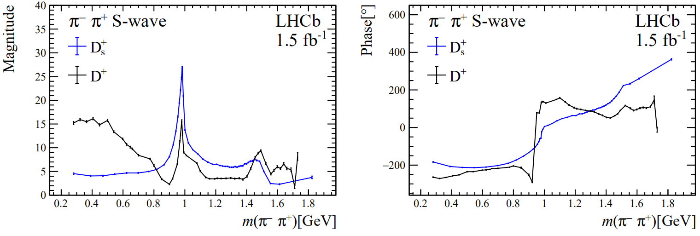
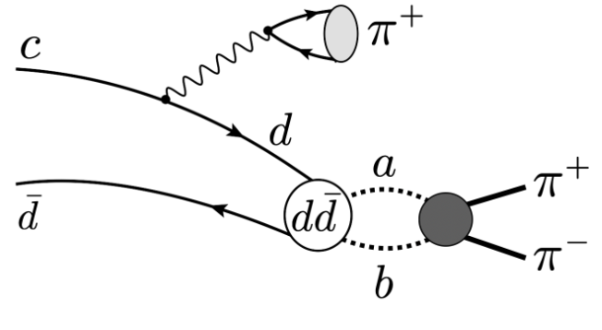
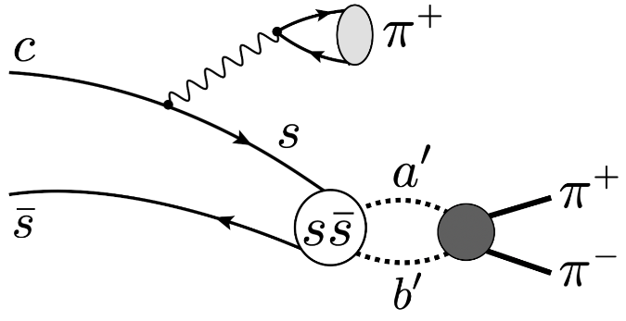
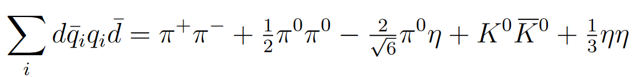
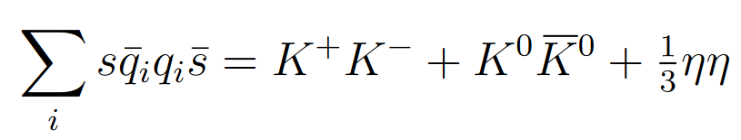






Comparison of S-wave amplitudes
arXiv:2208.03300, arXiv:2209.09840
Potential interpretation of the difference:
$f_{0}(980)$ dominate $D_{s}^{+}$ S-wave
$f_{0}(500)$ in $D^{+}$
$f_{0}(980)$: sharpe phase variation
unitary chiral model, Int. J. Mod. Phys. 25(2016)1630001
$$D^{+}$$
$$D_{s}^{+}$$
Indicating $f_{0}(500)$ as dynamical pole of $ππ→ππ$ rescattering ?
$f_{0}(980)$ strongly couples to $KK$ channel

Slide 16

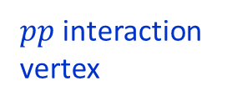

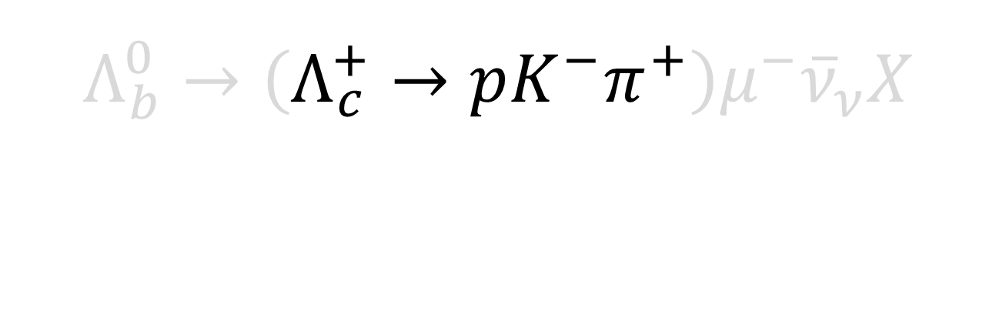
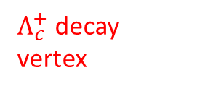




$$Λ_{b}^{0}→\left(Λ_{c}^{+}→pK^{−}π^{+}\right)μ^{−}{\overline{ν}}_{ν}X$$
arXiv:2208.03262, accepted by PRD
Prompt $π, K, p……$
$$p$$
$pp$ interaction vertex
$Λ_{c}^{+}$ decay
vertex
$$K^{−}$$
$$π^{+}$$
$μ^{−}$ (tag)
$b$-decay vertex

Slide 17
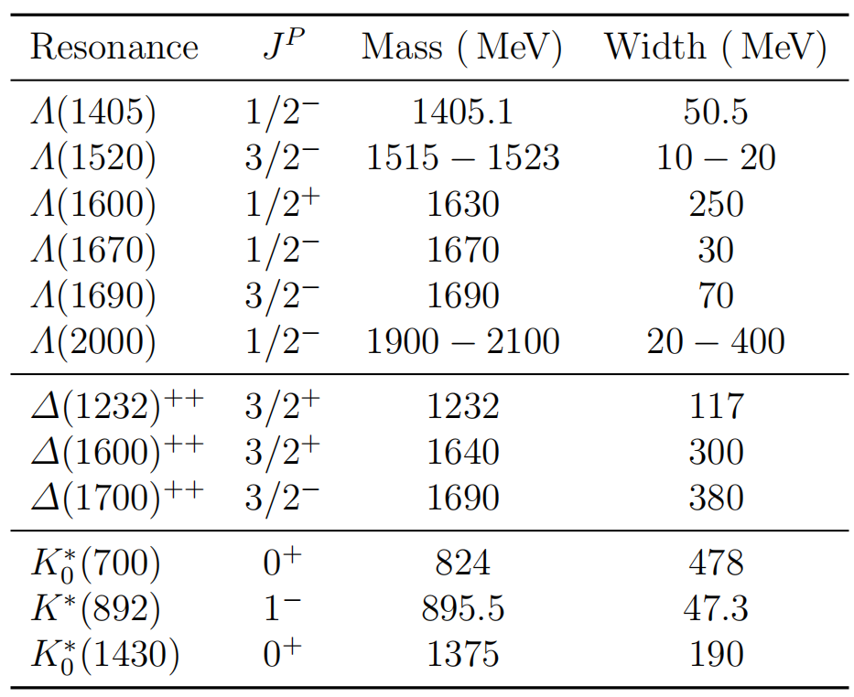
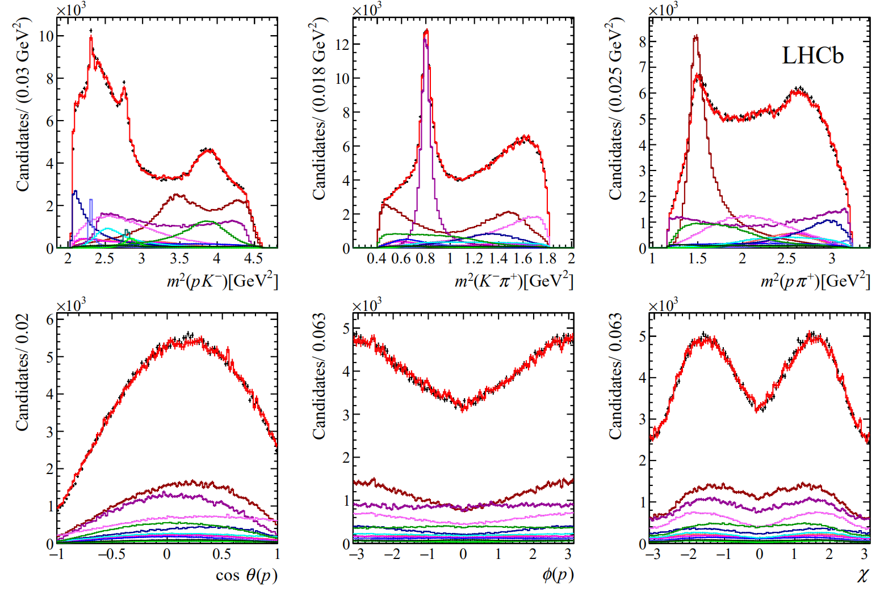
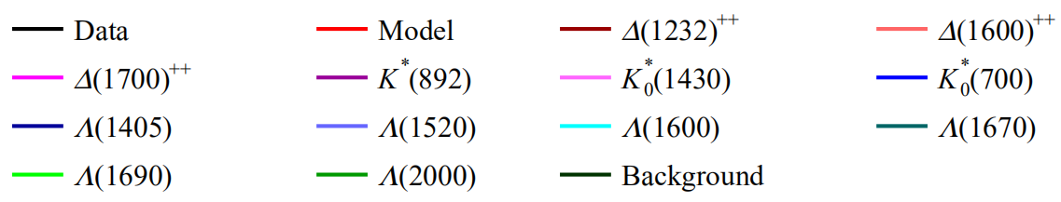





$Λ_{c}^{+}→pK^{−}π^{+}$ amplitude analysis
arXiv:2208.03262, accepted by PRD
2016 data$,𝓛=0.5{fb}^{−1}; \sim 400k$ signals; helicity-based Am.An.
All parameters of amplitude model reported
Mass and width of $Λ(2000)$ determined
$$Λ(2000)$$

Slide 18








$Λ_{c}^{+}$ Polarization measurement
arXiv:2208.03262, accepted by PRD
Large interference improves sensitivity to initial polarization
Final-state kinematics
Initial spin structure of $Λ_{c}^{+}$
Advances in High Energy Physics (2020) 7463073
Large interference between $Δ{\left(1232\right)}^{++}$ and $K^{∗}(892)$
$Λ_{c}^{+}$ polarization from semileptonic $b$-decays measured, with 2 different definitions of initial spin axis
Model dependency contributes to the largest syst. uncertainty (second term)

Slide 19
Summary & prospects

Slide 20




Summary
Many new results about conventional spectroscopy @ LHCb
Observation of $Ξ_{cc}^{++}→Ξ_{c}^{′+}π^{+}$
Search for $Ξ_{bc}^{+}→J/ψΞ_{c}^{+}$
JHEP05(2022)038
arXiv: 2204.09541
Amplitude analysis of $D^{+}→π^{+}π^{−}π^{+}, D_{s}^{+}→π^{+}π^{−}π^{+}, Λ_{c}^{+}→pK^{−}π^{+}$
arXiv:2208.03300, arXiv:2209.09840
arXiv:2208.03262

Slide 21
Doubly-heavy hadron study in Run3

Slide 22





New opportunities
Significantly improved integrated luminosity
Improved performance of subdetectors
Run2
Run3
LHCb-TDR-013
Fully software-based trigger system
$\sim 50\%$ efficiency lost for fully hadronic modes at hardware trigger
Example:
Better vertex resolution in Run3 Velo
Better separation between prompt background & $b,c$ decay signals
Boost $Ξ_{cc}^{+}$ selection power to that of $Ξ_{cc}^{++}$ at Run2 ?
More efficient $bc$-baryon Rec.&Sel. ?

Slide 23
Need good collaboration with theory friends
Predictions of mass, lifetime, branching fractions…
Important inputs to help organize the resources of computing, storage & human power
Theory
Experiment
Keep searching for new states/decay modes and
measure their properties
Validate theoretical predictions & provide new inputs for calculations

Slide 24

The future of $Λ_{c}^{+}→pK^{−}π^{+}$

Slide 25




Studies using $Λ_{c}^{+}$ polarization
Currently already a good precision, further improvement possible
  Further improve using quasi-model-independent amplitude ?
    Feasibility established in $D,D_{s}^{+}→π^{+}π^{−}π^{+}$ analysis
    Used also for several other on-going $b,c$ decay Dalitz analyses
What we can learn from $Λ_{c}^{+}$ polarization ?
  Study the spin structure of $b→clν$ ?
  An on-going study: $Λ_{c}^{+}$EDM/MDM measurement by quantifying $Λ_{c}^{+}$ spin-precession in strong EM field
    A recent workshop about this topic: [link]
$$=$$
arXiv:2208.03262, accepted by PRD
Due to model dependency
Sensitive tag to New Physics
Effectively provided by bent crystal
Impact the $Λ_{c}^{+}$ polarization

Slide 26
Thank you for your attention !
Any questions or comments ?

Slide 27




Study of $Ξ_{cc}^{++}→Ξ_{c}^{′+}π^{+}$
${\left[\frac{B\left(Ξ_{cc}^{++}→Ξ_{c}^{′+}π^{+}\right)}{B\left(Ξ_{cc}^{++}→Ξ_{c}^{+}π^{+}\right)}\right]}_{predict}$ vary between $0.3 \sim 7$
PRD 96(2017)113006, PRD 100(2019)037015, Chin.Phys.C 45(2021)053105, PRD 101(2020)034034, PRD 96(2017)054013, PRD 100(2019)114037, PRD 99(2019)056013, Phys.Part.Nucl. 51(2020)678
Significant $Ξ_{cc}^{++}→Ξ_{c}^{+}π^{+}$ peak, 2016 data
$Ξ_{cc}^{++}→Ξ_{c}^{′+}(→Ξ_{c}^{+}γ)π^{+}$ V.S. $Ξ_{cc}^{++}→Ξ_{c}^{+}π^{+}$
Partially reconstructed $Ξ_{c}^{+}π^{+}$ final state
  Similar efficiency
Comparable production yield
Full Run2 data available $(𝓛×3)$
PRL 121(2018)162002
Promising to study partially reconstructed $Ξ_{cc}^{++}→Ξ_{c}^{′+}π^{+}$ signals in $m(Ξ_{c}^{+}π^{+})$ spectrum !

