Slide 1
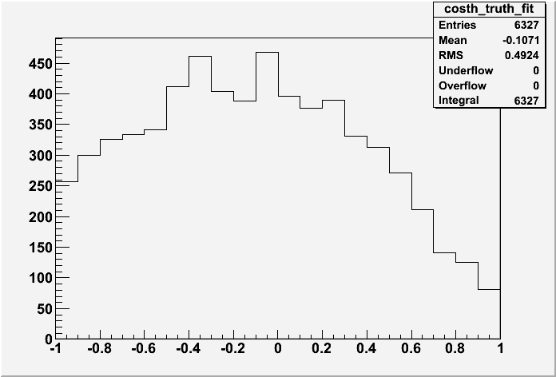
ISU Weekly Report
Cos(θ*) made by keeping those parameters closest to truth values

