Slide 1
TCDQ/TCDS for Run 3 and HL-LHC: Characterization, Simulations and HRMT-56 Preliminary Results.
P. Andreu Munoz, F-X.Nuiry, J.Maestre, E. Maria Farina, A. Lechner

Slide 2
Agenda
Geometries and in-operation Assessment
Strategy
Simulations Package Results
HRMT-HED – Experiment Results part 1
Conclusions

Slide 3
Geometries & In-operation Assessment

Slide 4
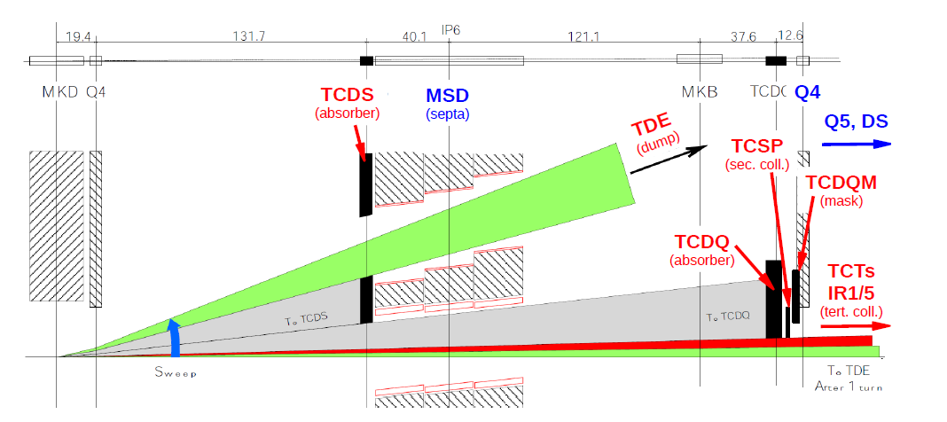
TCDQ/ TCDS: overview
TCDS – A fixed diluter block installed immediately upstream of the MSD magnets (IR6)
TCDQ – A mobile diluter block to protect the Q4 magnets, (IR6)
→Asynchronous firing of MKD kickers would cause the beam to sweep over the septum walls

Slide 5
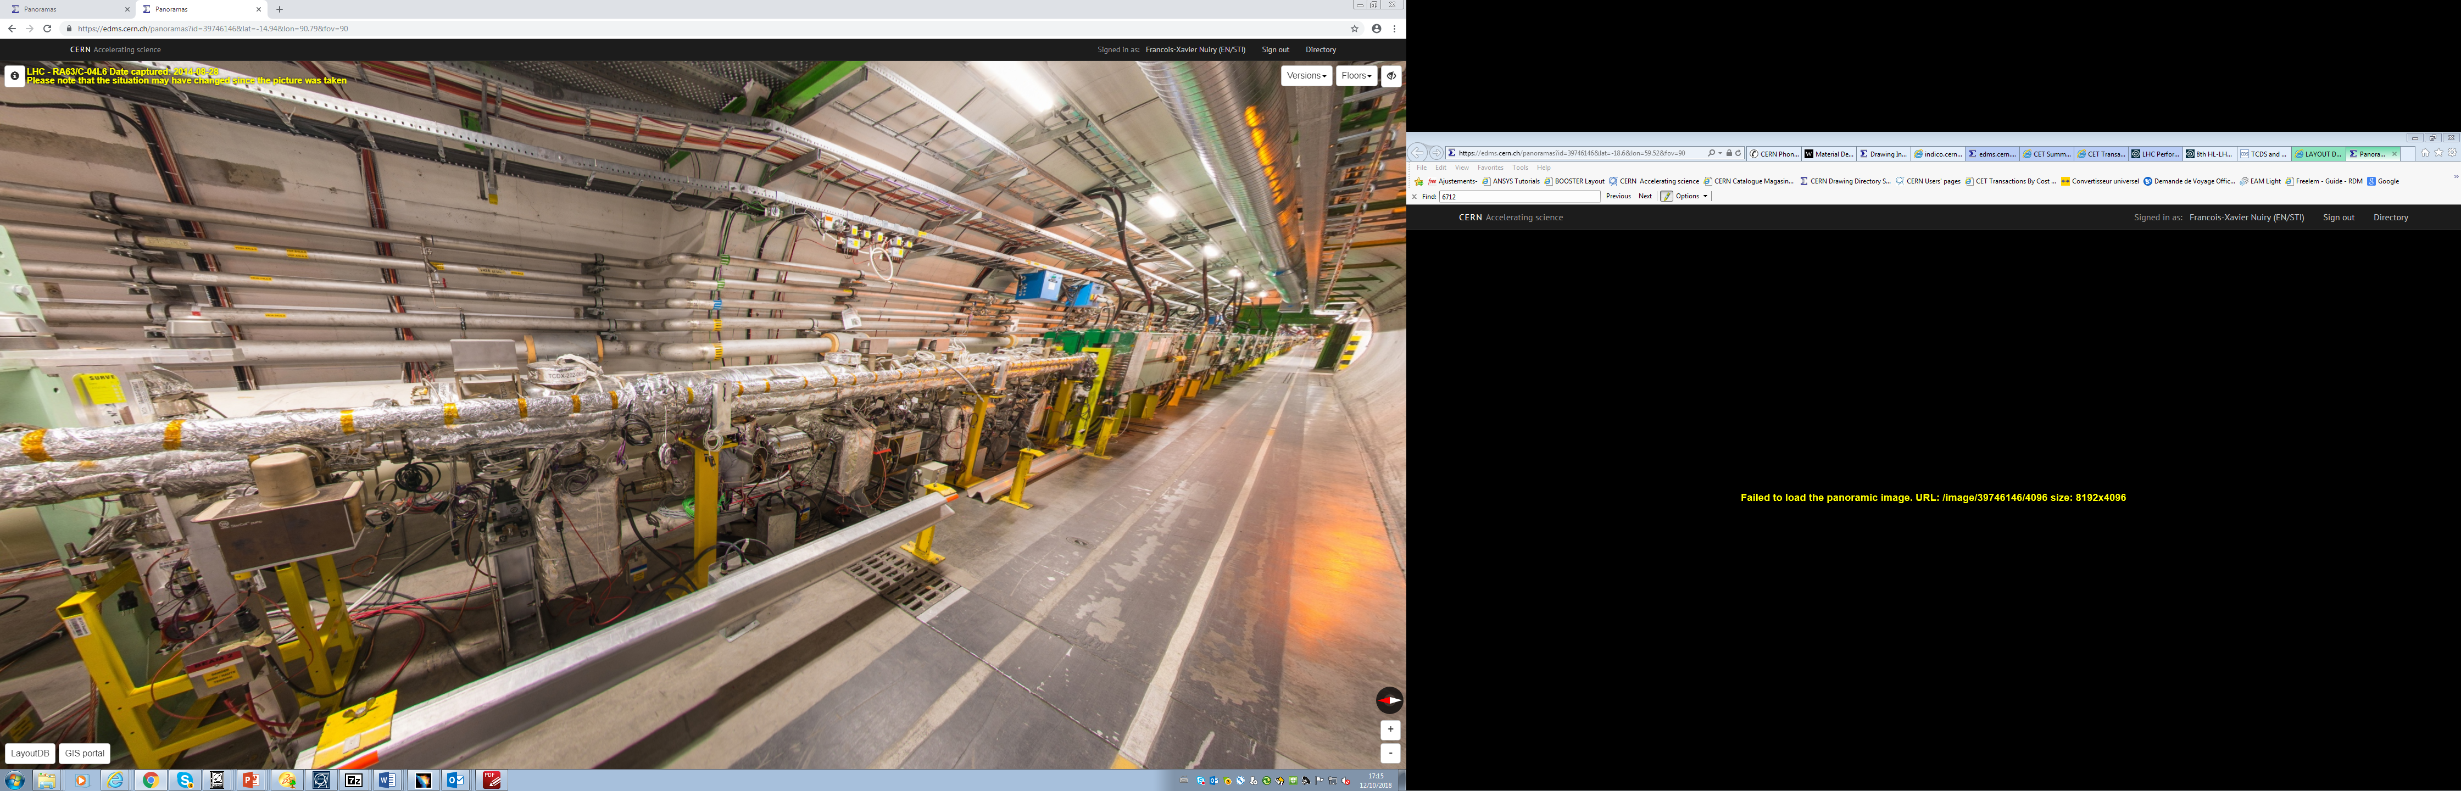
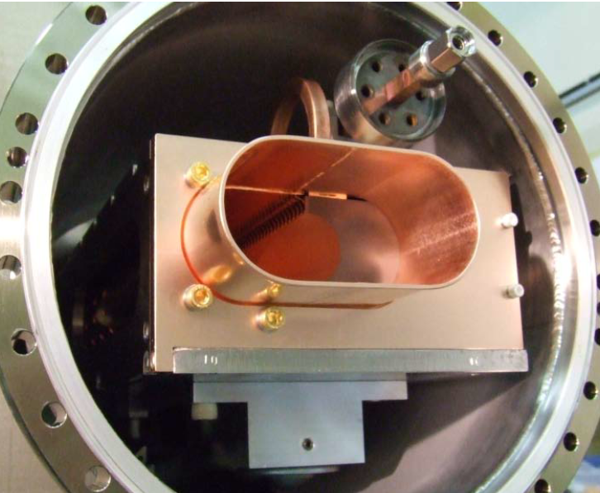
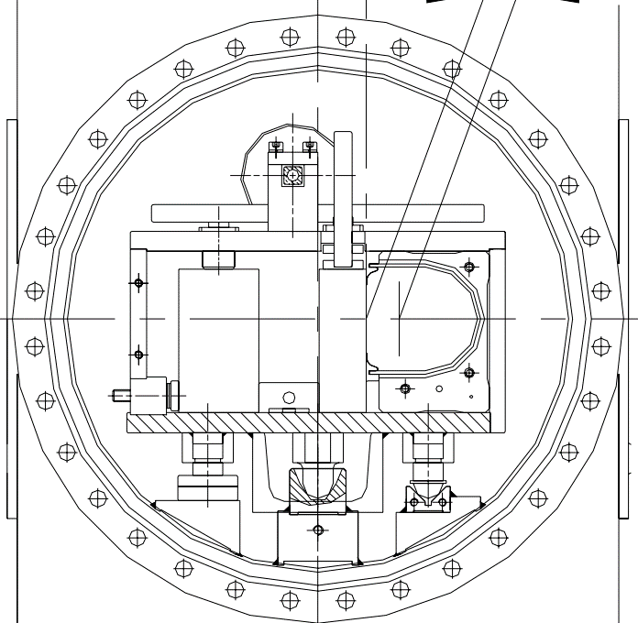
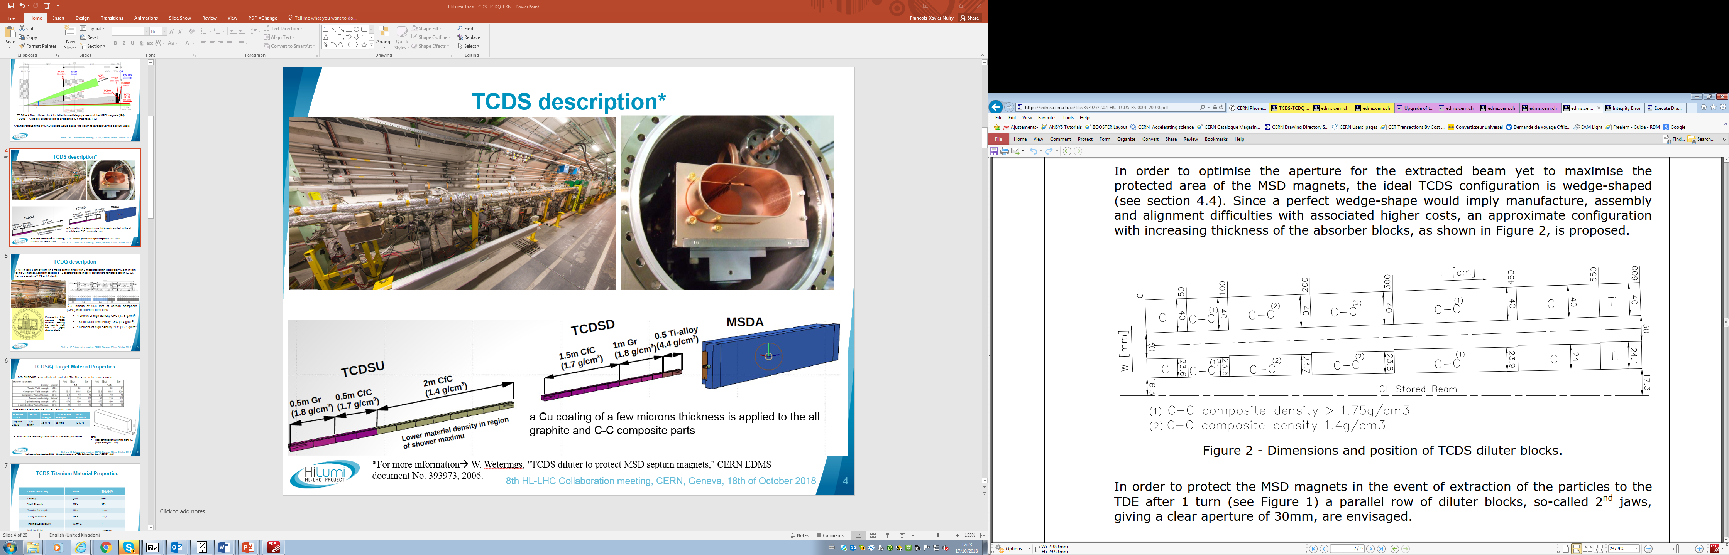
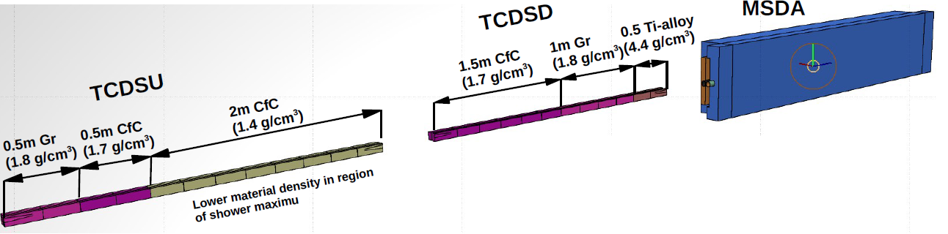
TCDS description
Target Collimator Dump Septum
Two jaws
6 m long absorbers
Beam to TDE
Stored Beam
Cu coating of a few microns thickness is applied to the all graphite and C-C composite parts
*For more information→ W. Weterings, "TCDS diluter to protect MSD septum magnets," CERN EDMS document No. 393973, 2006.

Slide 6

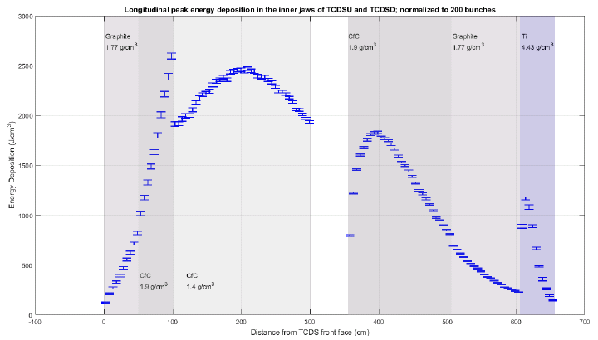
TCDS Energy deposition (single MKD module pre-fire)
Parameters | HL-LHC25ns
Bunch intensity | 2.3e11
Number of bunches | 65
Total pulse intensity | 1.5e13
Beam energy | 7 TeV
Pulse length | 1.1 µs
Beam emittance | 2.1 µm
Block 19
Block 23
Block 9
Block 4
Beam
Block 9
Graphite (1.77 g/cm³)
CfC (1.75) g/cm³
Block 2
Failure scenario: Erratic extraction of the kickers (not firing synchronous with abortion gap)
→ Bunches are kicked with partial strength
→ These bunches are swept across aperture
(intercepted by TCDQ and TCDS)
Less important on TCDS the type of failure due to it being further away from beam
Block 19
Block 23
CfC (1.75) g/cm³
CfC (1.4) g/cm³
Block 4

Slide 7
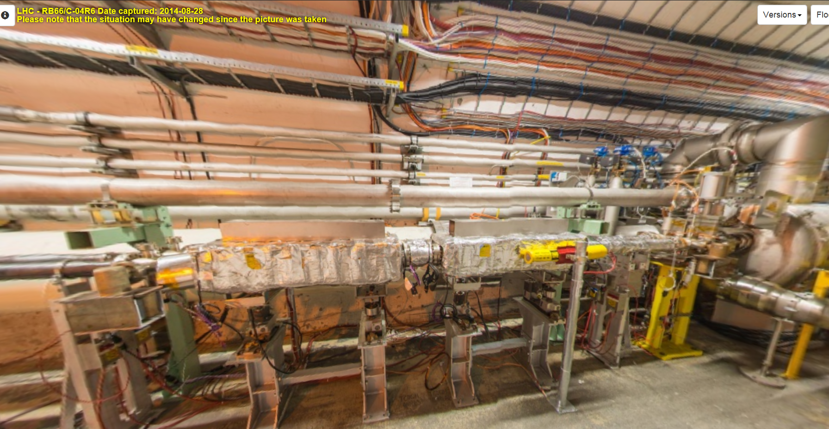
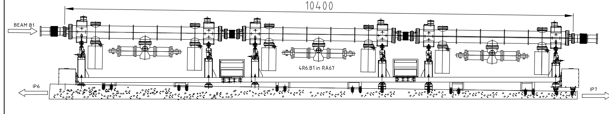
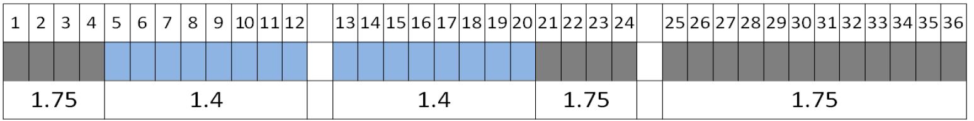
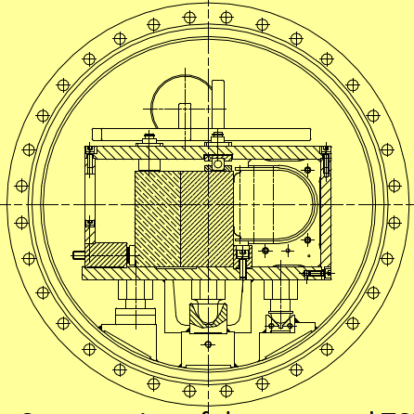
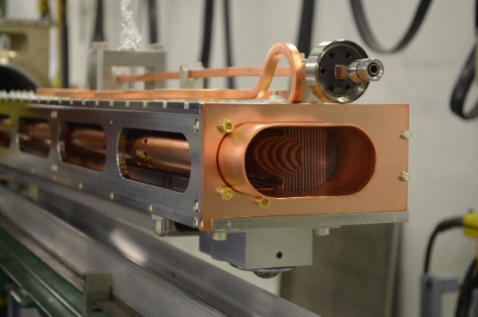
TCDQ description
A 10.4 m long 3-tank system, on a mobile support girder, with 9 m absorber length installed at ~12.5 m in front of the Q4 magnet. Each tank consists of 12 absorber blocks, made of carbon fibre reinforced carbon (CFC), having a density of 1.75 or 1.4 g/cm³.
Cross-section of the TCDQ structure showing the graphite (left) and CFC (right) absorber blocks
  →36 blocks of 250 mm of carbon composite (CFC) with different densities:
    4 blocks of high-density CFC (1.75 g/cm³)
    16 blocks of low-density CFC (1.4 g/cm³)
    16 blocks of high-density CFC (1.75 g/cm³)

Slide 8
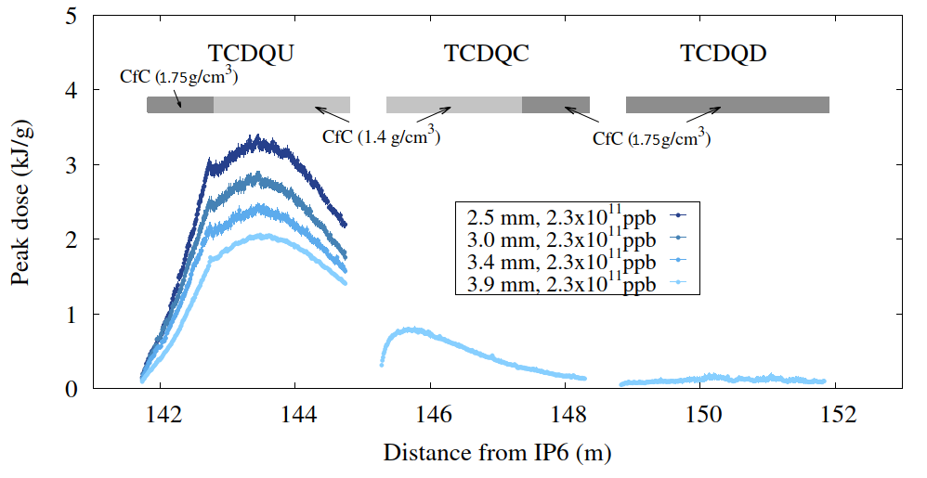
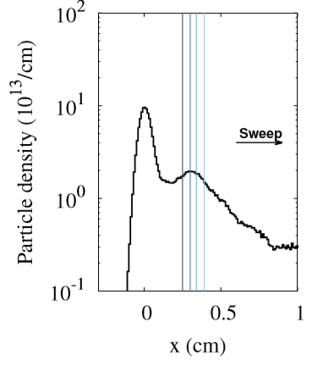
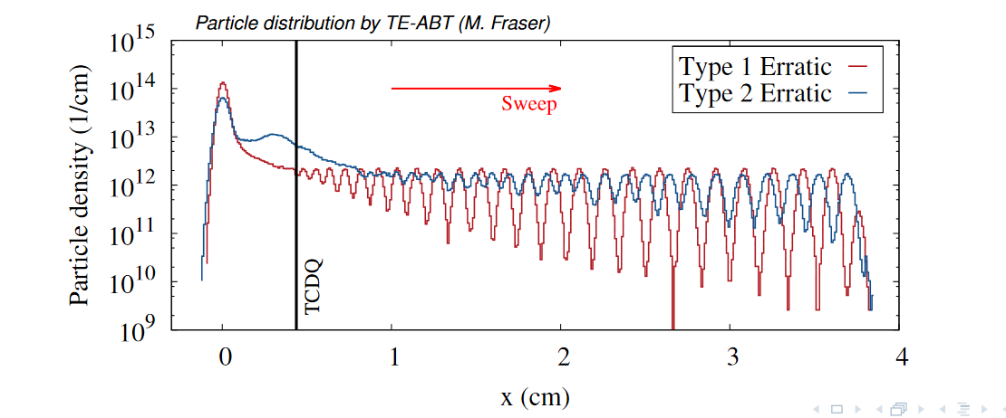
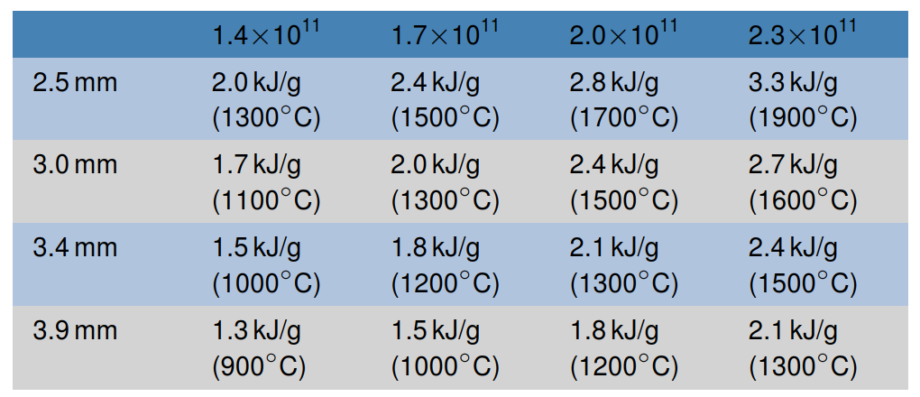
TCDQ Energy density deposition
Beam Parameters | HL-LHC25ns
Bunch Intensity | 2.3E11
Number of bunches | 50
Beam energy | 7 TeV
Pulse length | 950ns
Beam emittance | 2.1 µm
Table 1. Beam parameters
Failure scenario: Erratic extraction of the kickers (not firing synchronous with abortion gap)
→ Bunches are kicked with partial strength
→ These bunches are swept across aperture
(intercepted by TCDQ and TCDS)
CFC Block 8
CFC Block 4
Fig. 1. Energy deposition distribution [2] Courtesy of M. I Frankl.
The TCDQ gap affects the energy deposition.
From the mechanical point of view, the 4th and 8th blocks (high- and low-density CFC blocks, respectively) are the most affected.
Table 2. Peak doses as function of the gap and beam intensity [3]
[2] A. Lechner, C. Bracco, M. Calviani, S. Gilardoni, C. Di Paolo, M. Fraser, M. Frankl, B. Goddard, F.X Nuiry, A. Perillo Marcone, T. Polzin, C. Wiesner , Run III limitations TCDQ, TCDS, TDE (related to beam impact), CERN indico
[3] A. Lechner, M. Atanasov, C. Bracco, J. Borburgh, M. Calviani, C. Di Paolo, M. Fraser, M. Frankl, B. Goddard, A. Perillo Marcone, C. Wiesner, W. Weterings , Energy deposition and thermo-mechanical studies for IR6 protection devices and downstream magnets/septa, CERN indico

Slide 9
Strategy

Slide 10
Multi-disciplinary approach
Past problems:
Available characterization incomplete
Material data as homogeneous material → Material is not isotropic → Moreover LHC beam impact is within 1 layer
Not representative of operational case
Solutions:
Actual material installed in the machine re-characterized → Layered dedicated characterization
Virtual models fed with “oriented” properties and (when possible) mono-layer results → Simulations results gotten on layered models, showing interfaces and possible flaws.
Testing and results assessment during HRMT-56 experiment (beam end 2021) of representative samples and engineered beam impacts

Slide 11
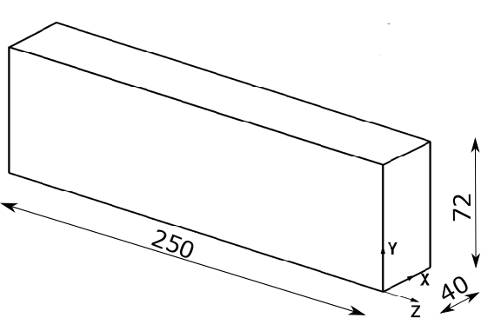
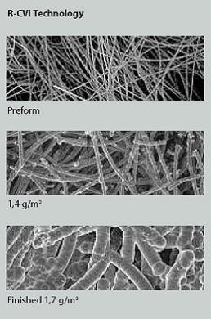
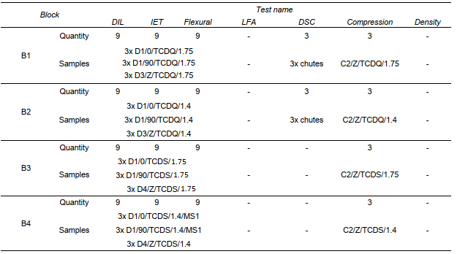
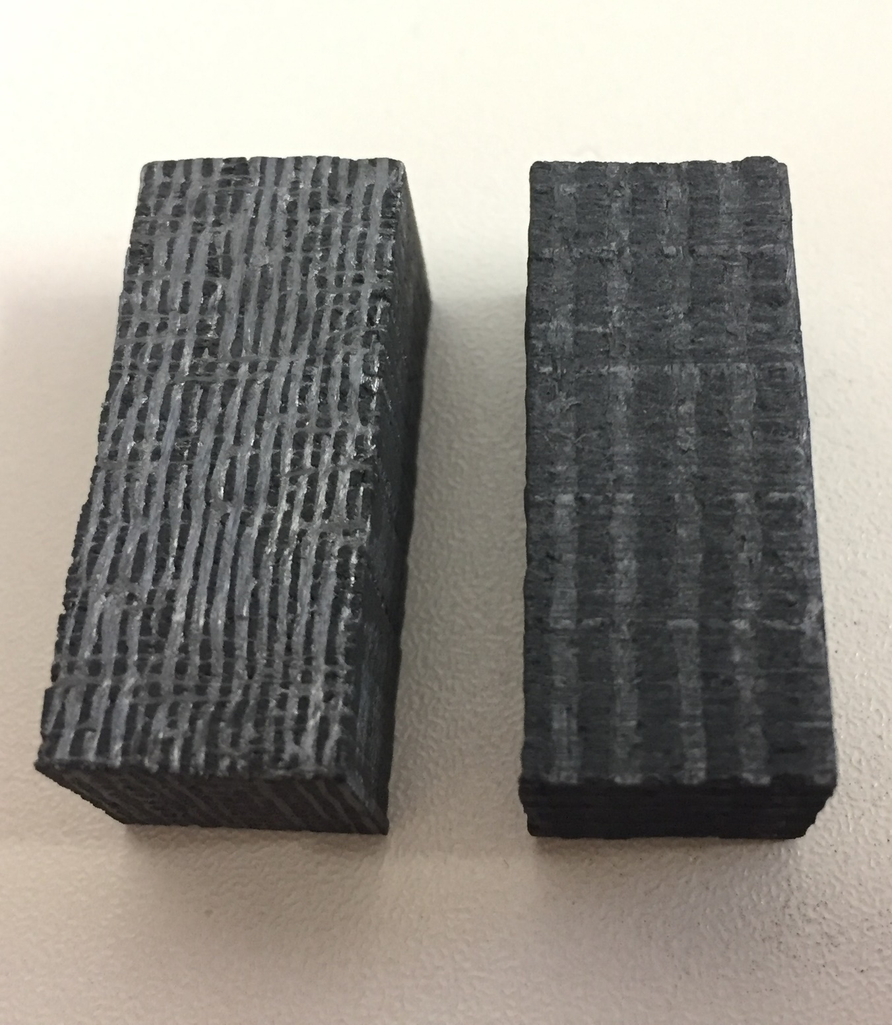
TCDQ/S Blocks: Materials Properties
RNFF = Rapid-CVI Needled Fiber-Fabric
CfC RNFF-SG/SAG (from CVT) is an orthotropic material. The fibers are in the y and z axes (+ small fibers in X).
Characterization campaign of CFC
Beam
B1: RNFF-sag version 2012 material with the 1.75g/cm3 density,
B2: RNFF-sg version 2012 material, with the 1.4g/cm3 density
B3: RNFF-sag version 2005 material with the 1.75g/cm3 density
B4: RNFF-sg version 2005 material with the 1.4g/cm3 density
Simulations are very sensitive to material properties, especially Young’s Modulus and CTE

Slide 12
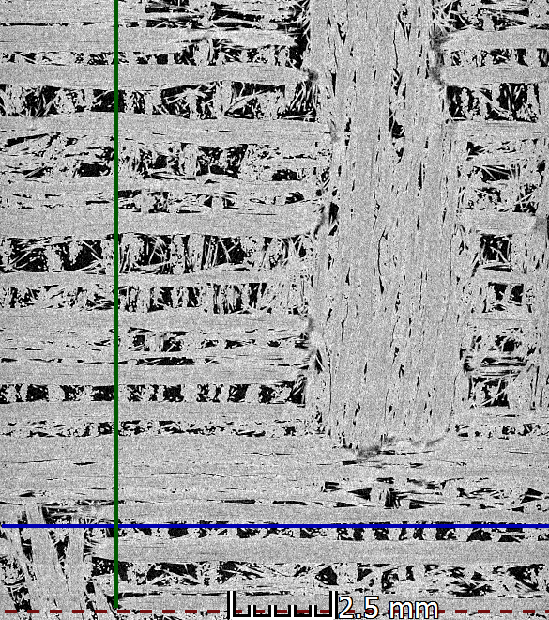
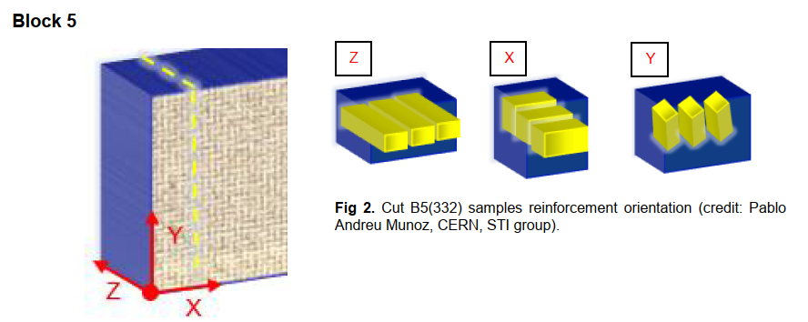
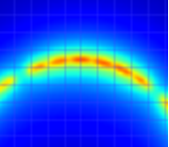
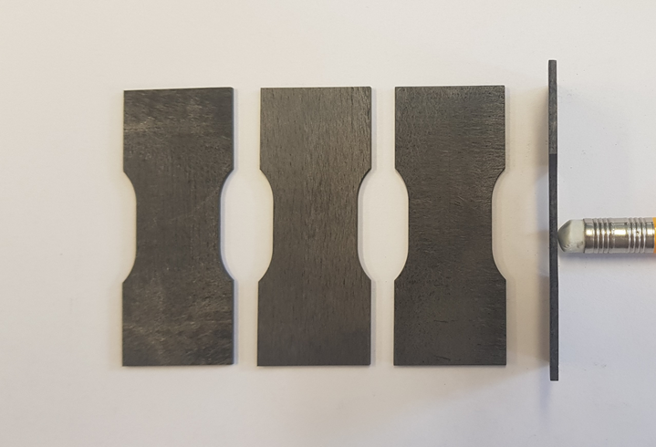
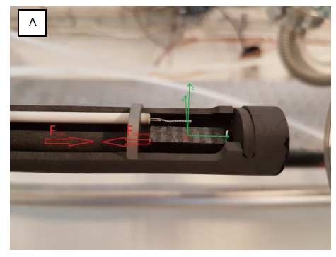
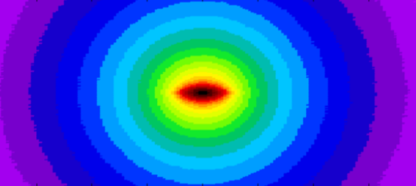
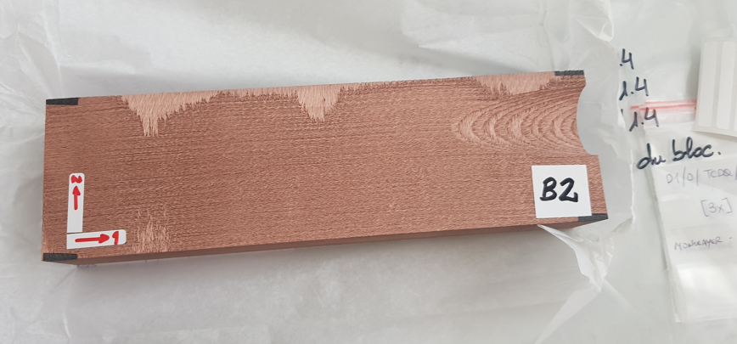
TCDQ/S Blocks: Characterization
Layered characterization based on:
DSC tests (Specific heat)
DIL tests (CTE)
Flexural Tests (+ DIC)
Tensile Tests (+ DIC)
Compression Tests
(IET tests)

Slide 13
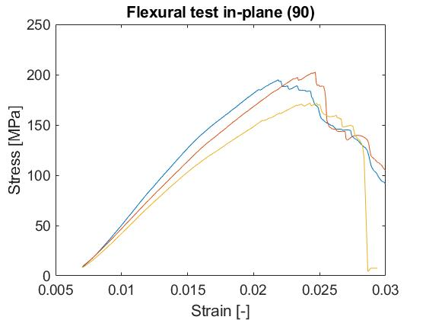
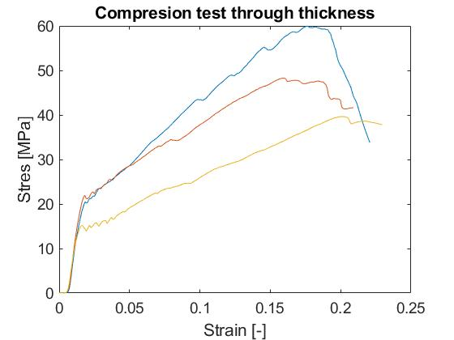
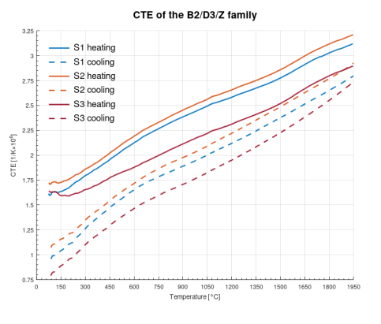
CFC Layered-Characterization: example
Ex B2: CVT RNFF-sg version 2012 material / 1.4g/cm³ density
Damage evolution
Failure
Starting of the damage
Starting of the damage
Failure
Unlike Graphite, CFCs exhibit a long pseudo-plastic regime of damage evolution until complete failure
Sets of mechanical and thermo-mechanical data from layered-characterization that served as input for material numerical models

Slide 14
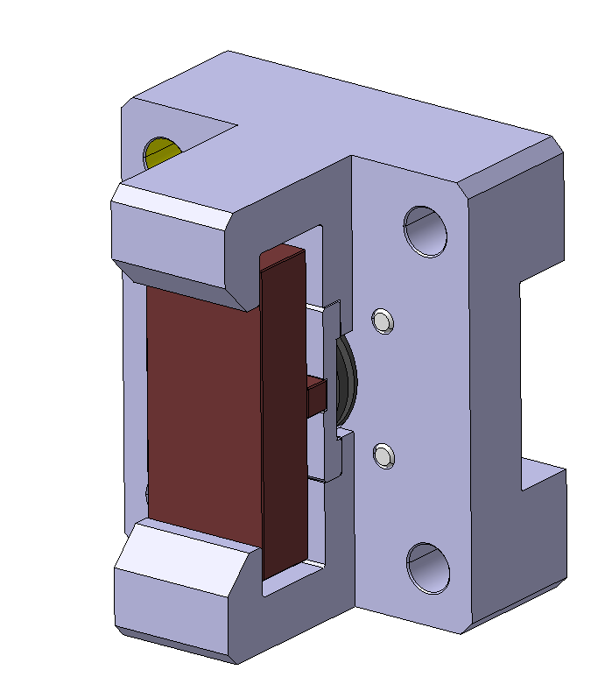
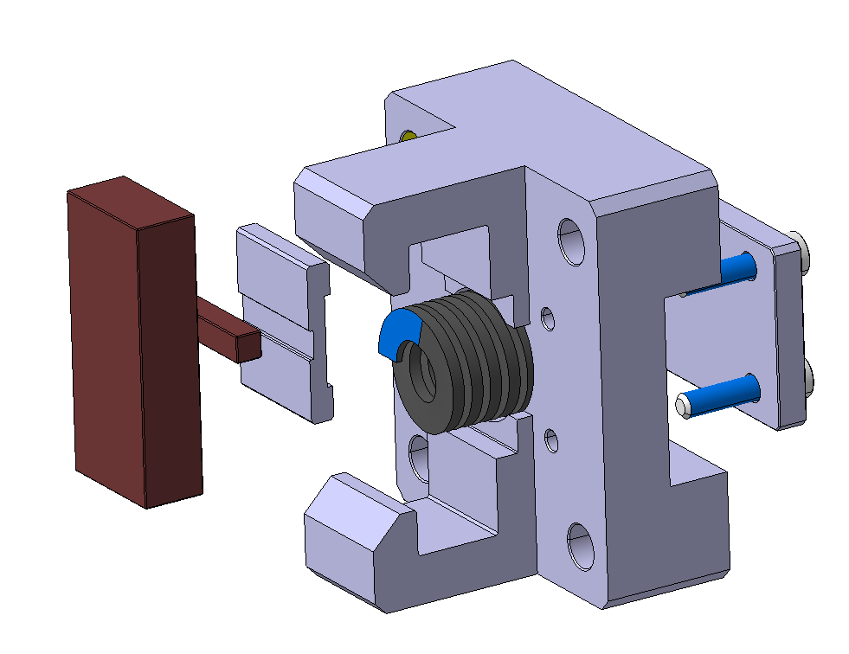
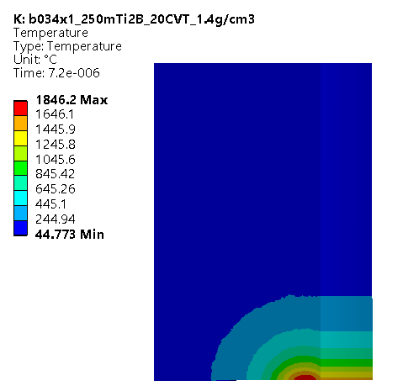
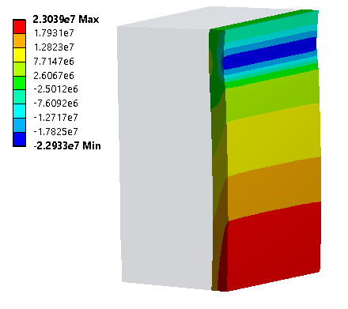
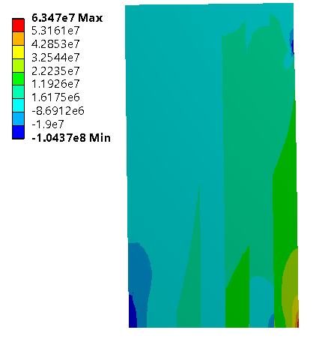
TCDQ/S Blocks: HRMT-HED target design
Ref: SPSXTHED0119
5
Thermo-mechanical analysis
1
2
3
6
Max stress in-plane [Pa]
Max stress in-plane [Pa]
46 mm
Grazing Beam
10.5 mm
4
7
800 N
800 N
MATERIAL DESCRIPTION
1 – C/C TCDQ target (1.4-1.75 g/cc)
2 – C/C pusher
3 – Alu C pusher (EN-AW 6082 T6)
4 – Compression spring (800 N)
5 – Alu Target holder (EN-AW 6082 T6)
6 – Alu back plate (EN AW 6082 T6)
7 – Screws
Temp
Pre-load
After beam pulse
→ Model at the level of the layers (symmetry)
 | layer conf | beam size | Interlaminar shear stress[Mpa] | Max. traction on surface [Mpa] | Max compression in beam direction [Mpa]
TCDQ block 8 | 0/90 (vertical) | 2.5 mm gap 2.3e11 ppb | 6 | 61 | 78
HRMAT standard | 0/90 (vertical) | 0.6x0.6mm | 2.4 | 40 | 68
HRMAT + 3p bending conf. beam impact on center | 0/90 (vertical) | 0.34x1mm (center) | 3 (3.5 intra-laminar) | 63.7 | 68
HRMAT 3p bending conf. beam impact on mid top | 0/90 (vertical) | 0.34x1mm (mid top) | 4.5 | 55 | 68
C/C mass (1.4 -1.75 g/cc)= 13.5-16.9 kg
Full frame mass= 258 g
03/06/2022
14

Slide 15
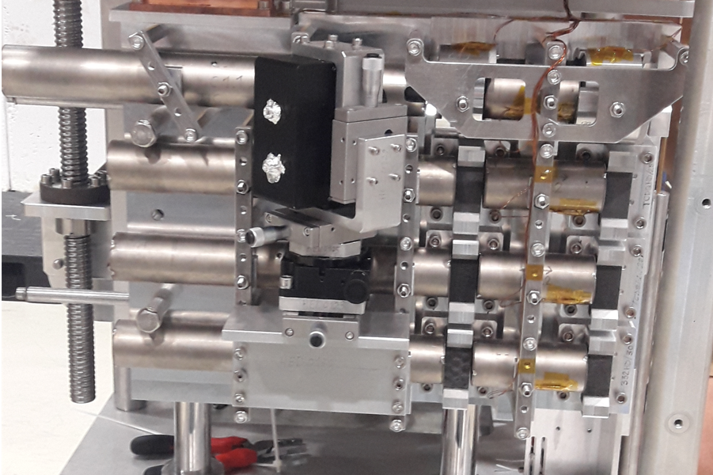
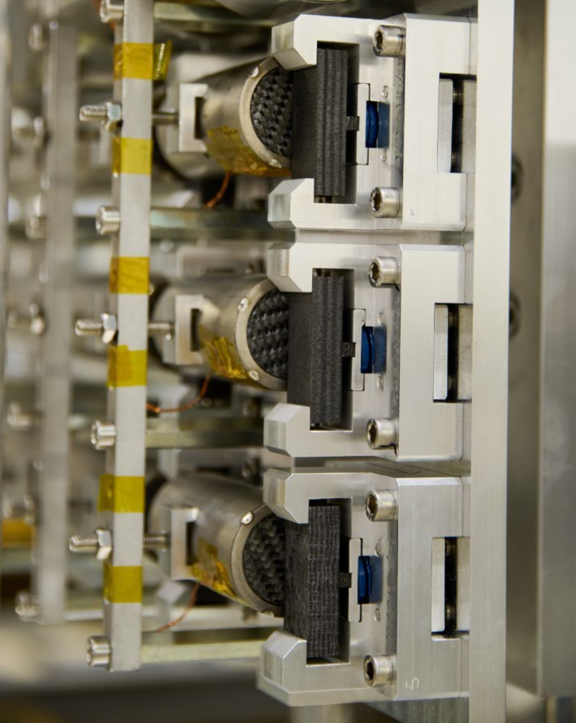
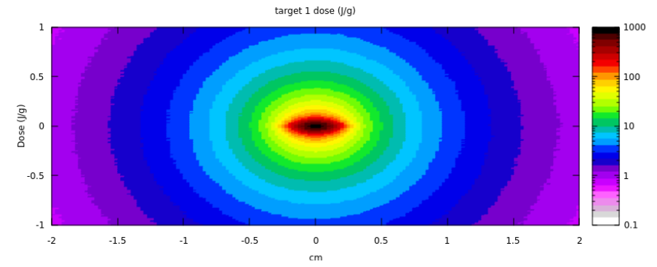
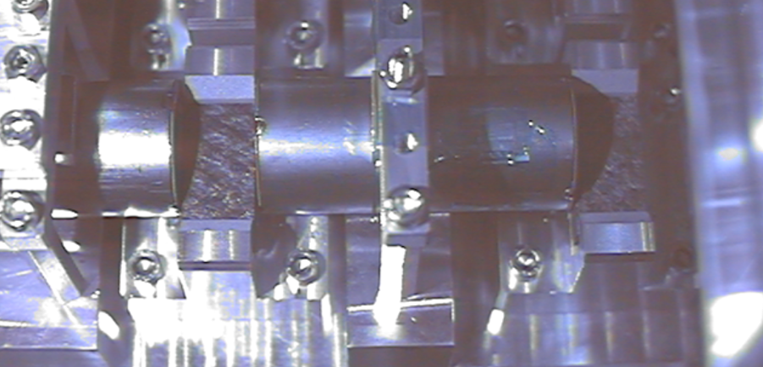
TCDQ/S Blocks: Real Testing under Beam (HRMT-HED)
|Beam 1x0,34 mm|

Slide 16
Simulations Package Results

Slide 17
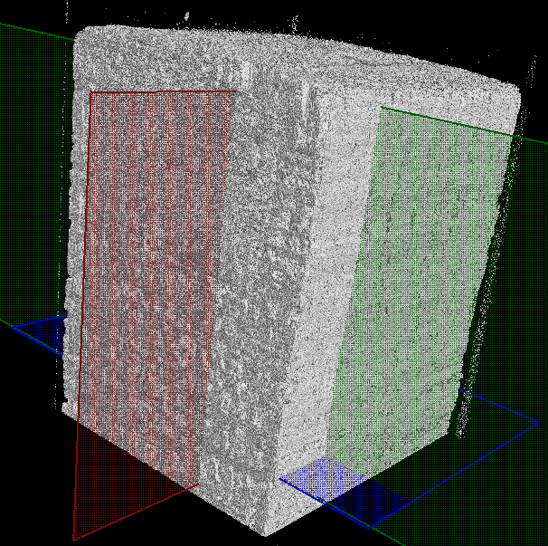
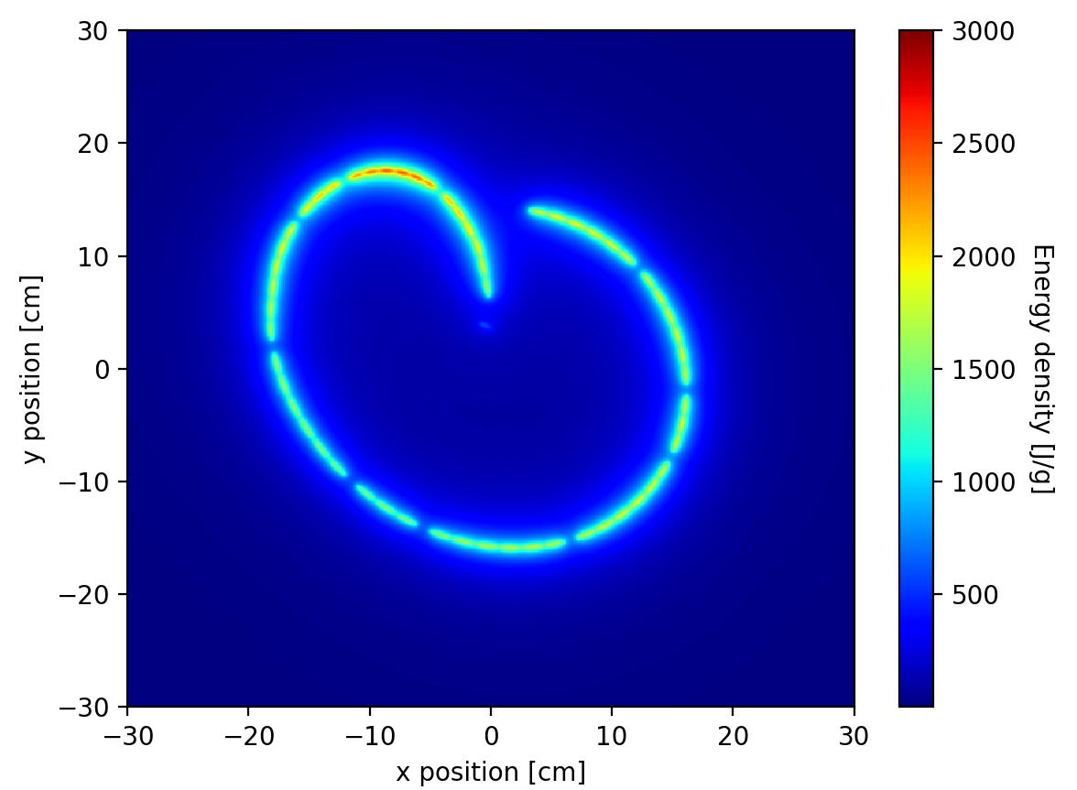
Numerical models
Challenges
Beam energy
Non-homogeneous material
Micro-features may play a role

Slide 18
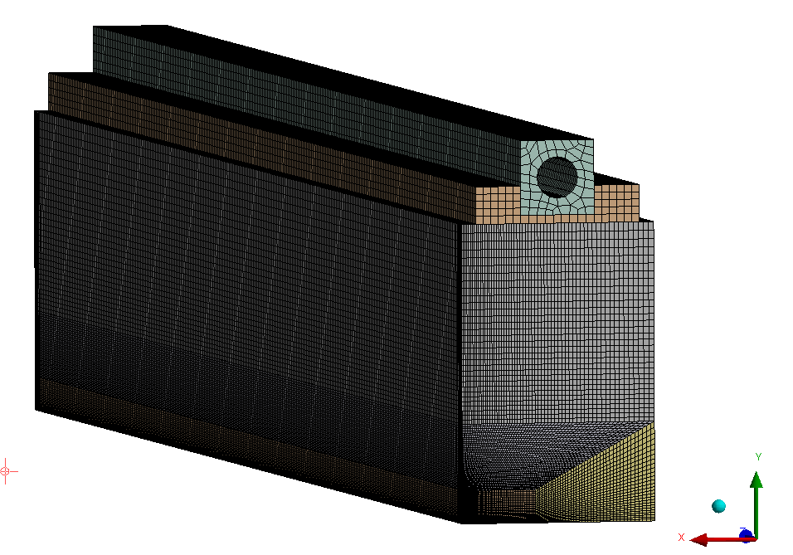
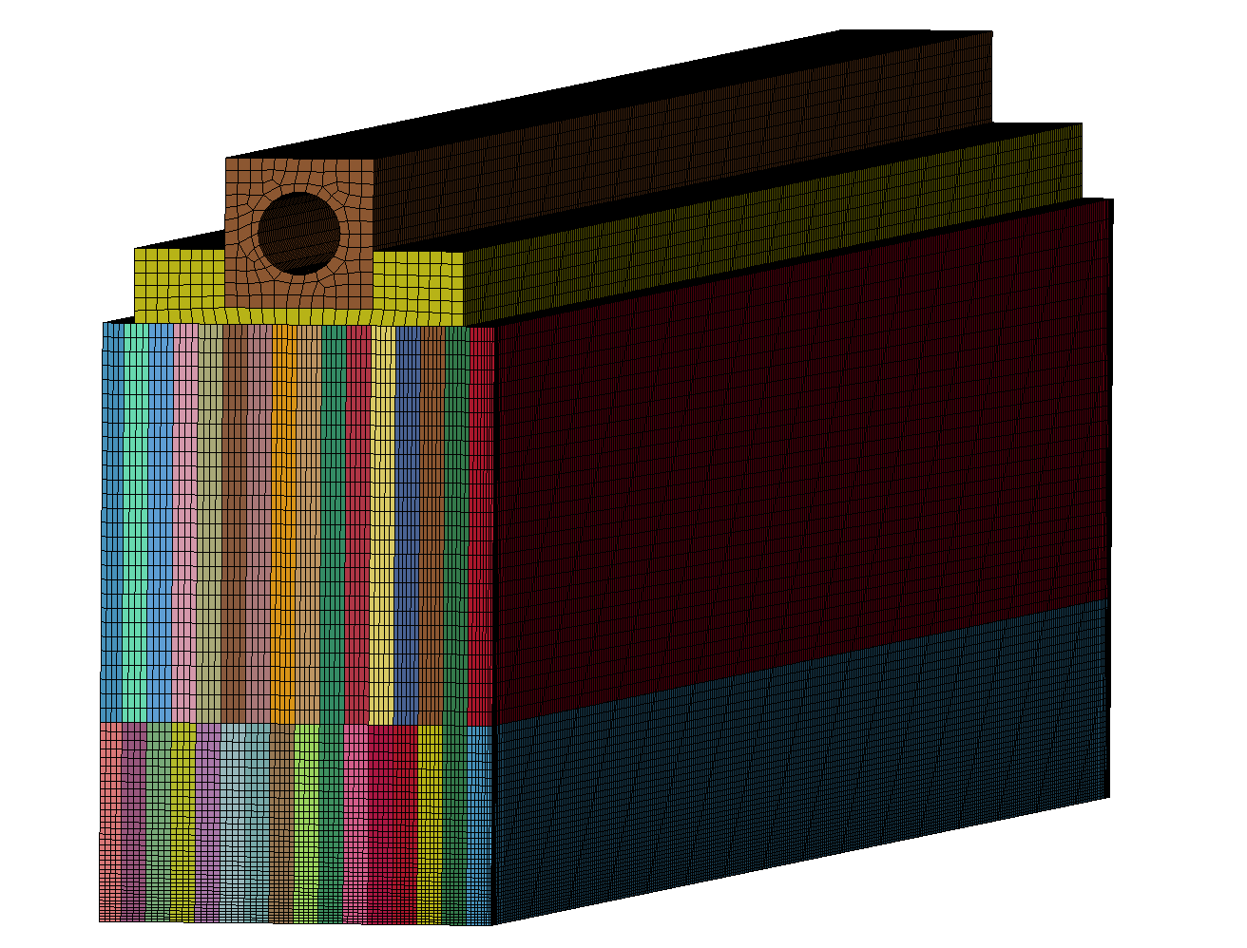
TCDS analysis: 2th block (C2020) / 9th block (CC)
~ 2 M DoF. 1st order elements. Full integration
Symmetrical model
Viscous-elastic model is included in order to consider the viscous energy dissipation
~ 2 M DoF. 1st order elements. Full integration
Layered technology 0/90 conf.
Symmetrical model

Slide 19
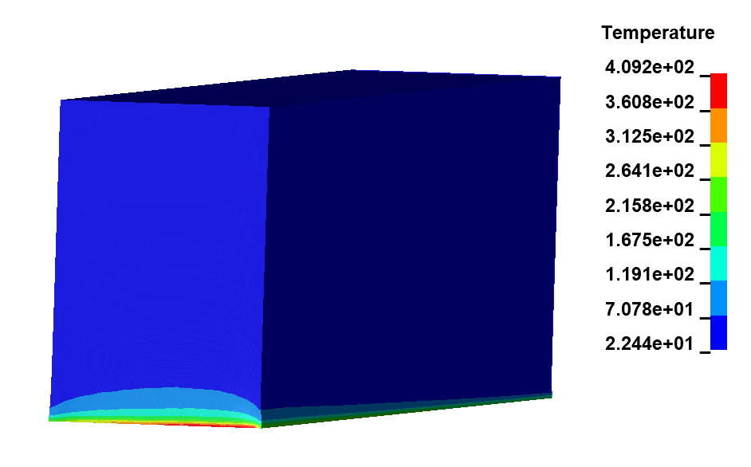
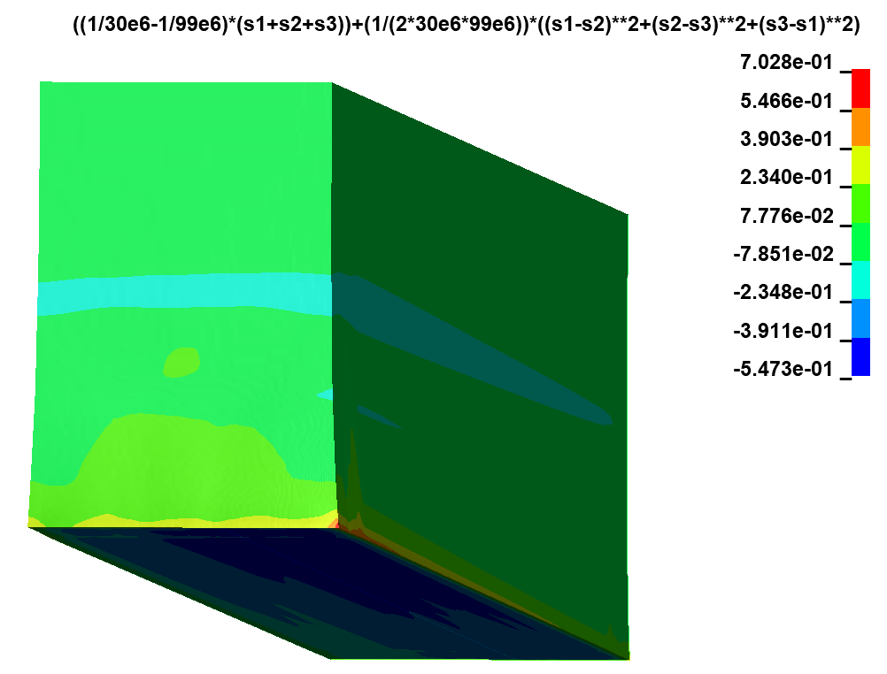

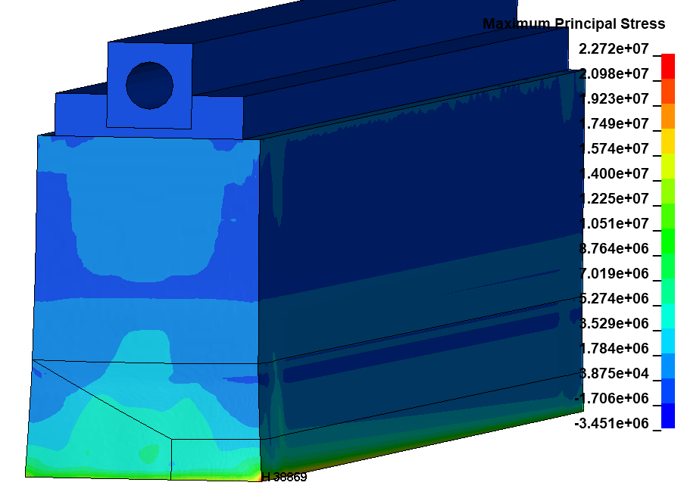
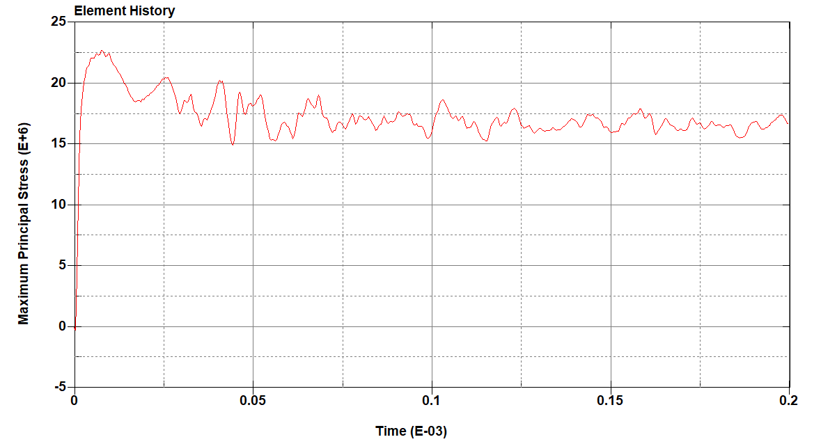
TCDS Blocks [2nd block – C2020]
Temperature field [C]
Inverse Damage Criterion (Christensen)
Y
X
Maximum principal stresses [Pa]
Y
Y
X
X
Note: No damage is detected

Slide 20
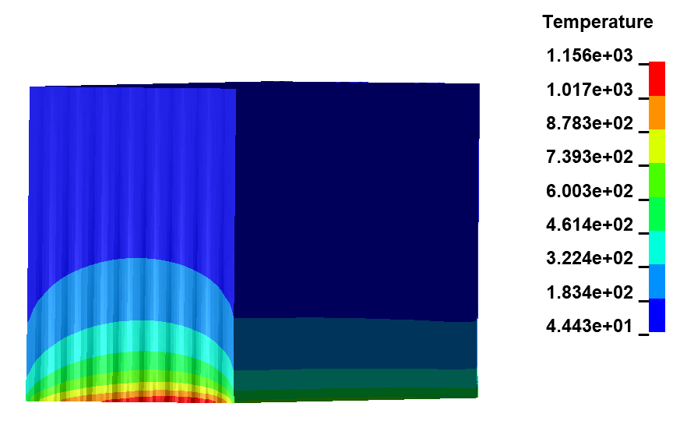
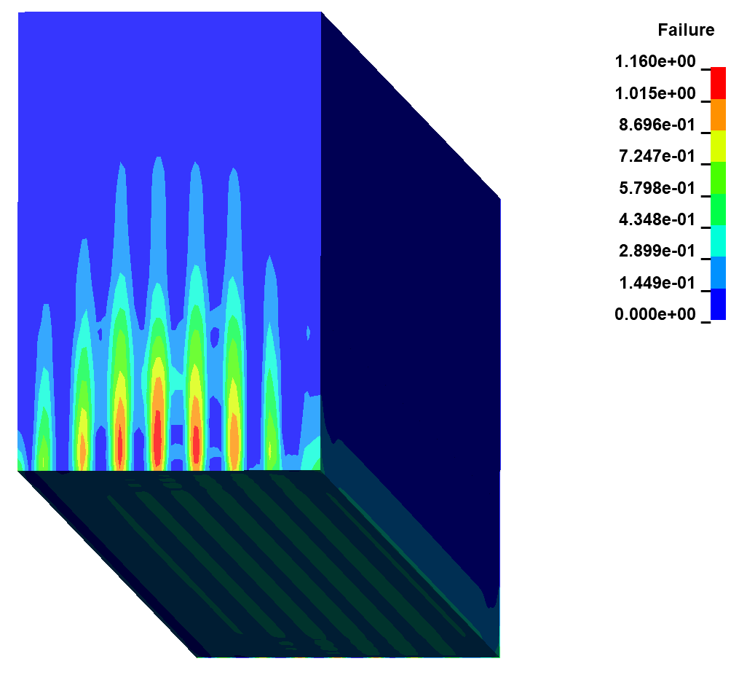

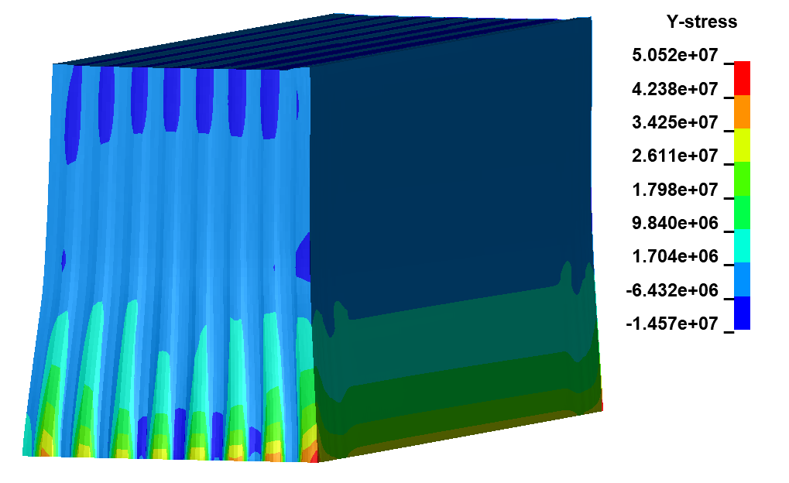


TCDS Blocks [9th block – 1st layer ┴ or // beam]
Temperature field [C] - (┴ beam)
Damage according to Max. stress criterion - (┴ beam)
Note:
← Possible due to tractions ┴ fibers.
Very localized in the entrance/exit face
Possible damage at entrance/exit face.
Very localized on the edge
Y
X
Y
Y
Stress in the vertical direction (y) [Pa] - (┴ beam)
X
Damage according to Max. stress criterion – (// beam)
X
Y
X

Slide 21






TCDS Blocks [19th block – C2020]
Temperature field [C]
Christensen failure criterion [-]
Christensen with 25MPa of traction limit gives a SF of 1.25. in this case we can expect a block failure.
Section
Y
X
Y
Maximum principal stresses [Pa]
X
Y
X
Note: values higher than one means failure
Christensen criterion implemented Mersen material properties

Slide 22
TCDS summary
CFC block
Block | layer conf | Max temp | Interlaminar shear stress[MPa] | Max. Traction // fibers [MPa] | Max. traction ⟂ fibers [MPa] | Max. compression ⟂ fibers [MPa] | Max. compression // fibers [MPa] | Hydrostatic [MPa] | Inv. safety factor
# 9 | ** y/z | 1156 | 3.76 | 50.2 @1st layer | 12@ y+ layers at entrance | -18 @ z+ layers | -23@z+ layers central region | 16.5 @z+layers | 1.16
# 9 | ** z/y | 1169 | 4.3 | 55.1 @ y+ layer at edge | 13@ 1st z+ layer (and y+ layers at entrance) | -18.7@ z+ layers | -22.2 @ z+ layers | 16.8 @ z+ layers | 1.31
Strength |  | // fibers | ⟂ fiber
B4 (1.4g/cc) | Tensile Strength [Mpa] | 96 | 10.3
 | Comp Strength [MPa] | 96* | 55.3
→ The CfC is expected to be safe and not trigger operational issues. Localized damages not propagating
Graphite C2020
Block | Material | Max temperature | Max. traction [MPa] | Max compression [MPa] | Christensen failure for brittle [MPa]
TCDS block 19 | GR 2020 (Mersen) | 391 | 20 | 26 | TS_25:1.25; TS_30:0.98; TS_35:0.78
TCDS block 19 | GR 2020 (N. Simos) | 391.4 | 11 | 14 | TD_25:0.67
TCDS block 2 | GR 2020 (Mersen) | 409 | 22 | 21 | TS_25:0.89, TS_30:0.7
Note: Graphite materials are considered brittle materials, which means sudden fracture when the maximum strength is reached
Gr C2020 | Reference | Strength
Tensile strength [MPa] | L. Massidda’s report (2006) | 30-40
 | Mersen data sheet | 30
 | N. Simos et al | 25
Compressive strength [MPa] | L. Massidda’s report (2006) | 35
 | Mersen data sheet | 99
→ No critical failure is expected
However, Christensen criteria with 25MPa of traction limit gives a SF of 1.25.
In this case we can expect a block failure (associated with uncertainties on material properties).

Slide 23


TCDQ Numerical model details (CCs)
~ 5 M DoF. 1st order elements. Full integration
Local refinement at free surfaces and edges. Characteristic element size ~ 70 μm
Time step 0.9 Courant N ~ 1ns
Simulation time 0.4ms→ enough time to capture wave reflections
1,5 mm

Slide 24





TCDQ Blocks [4th block – 1st layer ┴ or // beam]
Temperature field [C] - (┴ beam)
Damage according to Max. stress criterion - (┴ beam)
Note: Possible damage at the entrance edge due to tractions.
Very localized.
Y
X
Y
Stress in the vertical direction (y) [Pa] - (┴ beam)
Damage according to Max. stress criterion – (// beam)
X
Y
Y
X
X
4 / 8
Resumee slide summary

Slide 25







TCDQ Blocks [8th block – 1st layer ┴ or // beam]
Temperature field [C] - (┴ beam)
Damage according to Max. stress criterion - (┴ beam)
Y
Note: Possible damage at entry/exit due to tractions. Possible damage on 2nd layer due to compressions.
X
Y
Z
X
Stress in the vertical direction (y) [Pa] - (┴ beam)
Damage according to Max. stress criterion – (// beam)
Y
Y
X
Z
X
4 / 8
Resumee slide summary

Slide 26
TCDQ Blocks - Summary
Block | layer conf | Max temp | Interlaminar shear stress[MPa] | Max. Traction // fibers [MPa] | Max. traction ⟂ fiber [MPa] | Max. compression ⟂ fiber [MPa] | Max. compression // fiber [MPa] | Hydrostatic [MPa] | Inv. safety factor
# 4 | ** y/z | 1563 | 3.7 @ between 1st and 2nd layer | 54.8 @ 1st layer (75.4@edge) | not-relevant | -17.9@1st layer | -38.5@2nd layer | -24.6 Mpa @2nd layer | 1.039
# 4 | ** z/y | 1553 | 4 @ between 1st and 2nd layer | 14.7 @ 2nd layer (48 @ exit) | 18.0 @ 1st layer (28.6@ exit edge) | -16.1 @2nd layer | -42 @ 1st layer | -26.5 @ 1st layer | 1.56
# 8 | ** y/z | 1848 | 6.3 (@ between 2nd and 3rd layer) | 44 (81@edge) | 4.7@edge | -24 @ first layer | -52.5@ second layer (central region); | -29.0 @ second layer | 1.308
# 8 | ** z/y | 1854 | 5.4 @ between 1st and 2nd layer | 79.8 @ 2nd layer at entrance | 11.6@1st layer (23.5 @ edge) | -24 @ 2nd layer | -54 @ 1st layer central region | -29.5 @ 1st layer | 2.14
Strength |  | // fibers | ⟂ fiber
B1 (1.75g/cc) | Tensile Strength# [Mpa] | 72.2 | 17.7 / 9.4
 | Comp Strength [MPa] | 94* | 94
B2 (1.4g/cc) | Tensile Strength [Mpa] | 178 | 10.3
 | Comp Strength [MPa] | 178* | 18.6
*deduced from other tests. # from flexural tests
Note:
→ Values of the inverse safety factor higher than one means possible damage.
In all the cases the damage is very localized.
Even when predicting damage, it does not mean failure of the block necessary thanks to the pseudo-plastic behaviour.
HRMT-56 LDV (Laser-Doppler Vibrometer) gatehered data to be used for reverse engineering the block responses
Conclusion:
→Block 4: It is expected to be safe and not trigger operational issue.
→Block 8: The most loaded. The compression in the first layer, although high, is very localized along a line and expected to be safe for operation.

Slide 27
HRMT-HED – Experiment Preliminary Results part 1

Slide 28

TCDQ/S Blocks: HRMT-HED Ts. C
Target Train | Target material | Density & Weight | Layout
10 | Graphite/ FCCee | 1.8 g/cc – 152.8g | [1x] D60x30 mm thick
 | CC/ FCCee | 1.75 g/cc – 198.1g | [1x] D60x40 mm thick
11 | CC/ CVT RNFF-sag TCDQ | 1.75 g/cc – 14.7g | [1x] 46x20x10.5 mm thick
 | CC/ CVT RNFF-sg TCDQ | 1.4 g/cc – 11.8g | [1x] 46x20x10.5 mm thick
12 | CC/ CVT RNFF-sag TCDS | 1.75 g/cc – 14.7g | [1x] 46x20x10.5 mm thick
 | CC/ CVT RNFF-sg TCDS | 1.4 g/cc – 11.8g | [1x] 46x20x10.5 mm thick
13 | CC/ TCDQ/S alt. | 1.75 g/cc – 14.7g | [1x] 46x20x10.5 mm thick
 | CC/ TCDQ/S alt. | 1.4 g/cc – 11.8g | [1x] 46x20x10.5 mm thick
FCC-ee & TCDQ/s material targets
03/06/2022

Slide 29
TCDQ/S Blocks: HRMT-HED target design
Ref: SPSXTHED0119
5
Thermo-mechanical analysis
1
2
3
6
Max stress in-plane [Pa]
Max stress in-plane [Pa]
46 mm
Grazing Beam
10.5 mm
4
7
800 N
800 N
MATERIAL DESCRIPTION
1 – C/C TCDQ target (1.4-1.75 g/cc)
2 – C/C pusher
3 – Alu C pusher (EN-AW 6082 T6)
4 – Compression spring (800 N)
5 – Alu Target holder (EN-AW 6082 T6)
6 – Alu back plate (EN AW 6082 T6)
7 – Screws
Temp
Pre-load
After beam pulse
→ Model at the level of the layers (symmetry)
 | layer conf | beam size | Interlaminar shear stress[Mpa] | Max. traction on surface [Mpa] | Max compression in beam direction [Mpa]
TCDQ block 8 | 0/90 (vertical) | 2.5 mm gap 2.3e11 ppb | 6 | 61 | 78
HRMAT standard | 0/90 (vertical) | 0.6x0.6mm | 2.4 | 40 | 68
HRMAT + 3p bending conf. beam impact on center | 0/90 (vertical) | 0.34x1mm (center) | 3 (3.5 intra-laminar) | 63.7 | 68
HRMAT 3p bending conf. beam impact on mid top | 0/90 (vertical) | 0.34x1mm (mid top) | 4.5 | 55 | 68
C/C mass (1.4 -1.75 g/cc)= 13.5-16.9 kg
Full frame mass= 258 g
03/06/2022
29

Slide 30








HRMT-HED Results (TCDQ HD.)
No damages observed on any 4 grades under up-to-date Post-IE Analysis – ongoing process
Resolution – 28 um
10,5 mm
20 mm
46 mm
TCDQ HD / sample 25 – Upst / Front / Dwst - PreIE
1 shot
3 shots
3 shots
TCDQ HD / sample 25 – uCT - PreIE (left) / Post IE (right)
Material / sample | Mass (PreIE) [g] | Mass (PostIE) [g] | Δm [%]
TCDQ HD / s25 | 17,3918 ± 0,0001 | 17,3895 ± 0,0001 | - 0,01
TCDQ LD / s27 | 14,2862 ± 0,0001 | 14,2800 ± 0,0001 | - 0,04
TCDS HD / s28 | 16,0949 ± 0,0001 | 16,0904 ± 0,0001 | - 0,03
TCDS LD / S29 | 13,7189 ± 0,0001 | 13,7005 ± 0,0001 | - 0,01
TCDQ HD / sample 25 – Upst / Front / Dwst - PostIE

Slide 31

CT-Scan of CVT block

Slide 32








HRMT-HED Results (TCDQ LD.)
No damages observed on any 4 grades under up-to-date Post-IE Analysis – ongoing process
Resolution – 28 um
10,5 mm
20 mm
46 mm
TCDQ LD / sample 27 – Upst / Front / Dwst - PreIE
1 shot
3 shots
TCDQ LD / sample 27 – uCT - PreIE (left) / Post IE (right)
Material / sample | Mass (PreIE) [g] | Mass (PostIE) [g] | Δm [%]
TCDQ HD / s25 | 17,3918 ± 0,0001 | 17,3895 ± 0,0001 | - 0,01
TCDQ LD / s27 | 14,2862 ± 0,0001 | 14,2800 ± 0,0001 | - 0,04
TCDS HD / s28 | 16,0949 ± 0,0001 | 16,0904 ± 0,0001 | - 0,03
TCDS LD / S29 | 13,7189 ± 0,0001 | 13,7005 ± 0,0001 | - 0,01
TCDQ LD / sample 27 – Upst / Front / Dwst - PostIE

Slide 33








HRMT-HED Results (TCDS HD.)
No damages observed on any 4 grades under up-to-date Post-IE Analysis – ongoing process
Resolution – 28 um
20 mm
10,5 mm
46 mm
TCDS HD / sample 28 – Upst / Front / Dwst - PreIE
1 shot
3 shots
TCDS HD / sample 28 – uCT - PreIE (left) / Post IE (right)
Material / sample | Mass (PreIE) [g] | Mass (PostIE) [g] | Δm [%]
TCDQ HD / s25 | 17,3918 ± 0,0001 | 17,3895 ± 0,0001 | - 0,01
TCDQ LD / s27 | 14,2862 ± 0,0001 | 14,2800 ± 0,0001 | - 0,04
TCDS HD / s28 | 16,0949 ± 0,0001 | 16,0904 ± 0,0001 | - 0,03
TCDS LD / S29 | 13,7189 ± 0,0001 | 13,7005 ± 0,0001 | - 0,01
TCDS HD / sample 28 – Upst / Front / Dwst - PostIE

Slide 34








HRMT-HED Results (TCDS LD.)
No damages observed on any 4 grades under up-to-date Post-IE Analysis – ongoing process
10,5 mm
Resolution – 28 um
20 mm
46 mm
TCDS LD / sample 29 – Upst / Front / Dwst - PreIE
1 shot
3 shots
TCDS LD / sample 29 – uCT - PreIE (left) / Post IE (right)
Material / sample | Mass (PreIE) [g] | Mass (PostIE) [g] | Δm [%]
TCDQ HD / s25 | 17,3918 ± 0,0001 | 17,3895 ± 0,0001 | - 0,01
TCDQ LD / s27 | 14,2862 ± 0,0001 | 14,2800 ± 0,0001 | - 0,04
TCDS HD / s28 | 16,0949 ± 0,0001 | 16,0904 ± 0,0001 | - 0,03
TCDS LD / S29 | 13,7189 ± 0,0001 | 13,7005 ± 0,0001 | - 0,01
TCDS LD / sample 29 – Upst / Front / Dwst - PostIE

Slide 35
Conclusions

Slide 36
Conclusions
No operational limitations during Run3 for TCDQ:
CC expected to be robust enough
TCDQ material (all CC) is forecasted to be OK for HL-LHC:
Local damage on CC not expected to involve operational limitations
TCDS Graphite & CC are OK for Run3
TCDS Graphite blocks integrity is not fully guaranteed for HL-LHC:
    C2020 grade has material prop. uncertainties (T_{s}). Simulations for failure results gotten from conservative models
    Replacement of Graphite blocks within TCDS with CC blocks could be considered (contacts & alternatives tested available).
    C2020 samples could unfortunately not be included in HRMT-56 (HED)
TCDS Titanium blocks integrity:
    Induced distortion remains acceptable for asynchronous beam at 1,8e11 ppb
    – to be seen if cumulative effect of multiple asyn. beams can still be tolerated (more simulations)
    Simulations show plastic strain reaching 1,2% for HL-LHC intensity (2,3e11 ppb)
    - although necking point is still far (~10%), material integrity for several accidental shots should be assessed.

Slide 37
Thank you for
your attention!

Slide 38
Back-up slides

Slide 39
TCDQ/S CFC Material Inventory
BLOCKS
TCDQ |  | DRAWING NUMBER | inventory (26/08/2020) | Block to be tested | MME characterization | DAI number | Date
 | HD = 1.75 g/cc | LHCTCDQA0030 | 1 | 0 |  | 5004416 | Jul-12
 | HD = 1.75 g/cc | LHCTCDQA0034 | 2 | 0 |  | 5004416 | Jul-12
 | HD = 1.75 g/cc | LHCTCDQA0035 | 2 | 1 | B1 | 5004416 | Jul-12
 | LD = 1.4 g/cc | LHCTCDQA0032 | 2 | 0 |  | 5004416 | Jul-12
 | LD = 1.4 g/cc | LHCTCDQA0033 | 2 | 1 | B2 | 5004416 | Jul-12
 | LD = 1.4 g/cc | LHCTCDQA0028
 | LD = 1.4 g/cc | LHCTCDQA0029
TCDS
 | HD = 1.75 g/cc | LHCTCDSA0008 | 1-23.6 / 2-23.9 | 1 | B3 | 1967821 & 2067495 | Sep-05 | Jan-06
 | 1.9 g/cc | LHCTCDSA0007
 | LD = 1.4 g/cc | LHCTCDSA0032 | 1-23.7/ 1-23.8 | 0
 | LD = 1.4 g/cc | LHCTCDSA0051 | 1 | 1 | B4 | 1967821 | Sep-05
 | GRAPHITE 1.77 g/cc | LHCTCDSA0009
 | GRAPHITE 1.77 g/cc | LHCTCDSA0031 | 4
Currently with STI-TCD (P. Andreu B864/2-A01)

Slide 40

TCDQ/S Blocks: Materials Properties
RNFF = Rapid-CVI Needled Fiber-Fabric
CfC RNFF-SG/SAG (from CVT) is an orthotropic material. The fibers are in the y and z axes (+ small fibers in X).
Characterization campaign of CFC
NOT Known, assumption: taking data from
1.75 g/cc grade
Beam
B1: RNFF-sag version 2012 material with the 1.75g/cm3 density,
B2: RNFF-sg version 2012 material, with the 1.4g/cm3 density
B3: RNFF-sag version 2005 material with the 1.75g/cm3 density
B4: RNFF-sg version 2005 material with the 1.4g/cm3 density
Simulations are very sensitive to material properties, especially Young’s Modulus and CTE
*Main source: Luca Massidda, CRS4 – “Structural Analysis of the TCDS Collimator New Design” (EDMS 716298)

Slide 41


C2020 Mechanical Properties
Mersen Isostatic Graphite C2020
Mersen datasheet
N. Simos et al. [1]
Brittle material
Mechanical properties
CTE at RT | 2.6e-6 [1/C°]
Tensile strength | 25 Mpa
Young’s Modulus | 5.9 GPa
Graphite TCDS | Density | Tensile strength | Compressive strength | Young Modulus
Graphite C2020* | 1,77 g/cm³ | 35 MPa | 99 Mpa | 10.7 GPa
“’The erratic nature of C-2020 mechanical behaviour is attributed to its microstructure and is further supported by the wide scattering of the mechanical data of the unirradiated material’’
[1] N. Simos et al. Proton irradiated graphite grades for a long baseline neutrino facility experiment. PHYSICAL REVIEW ACCELERATORS AND BEAMS 20, 071002 (2017)

Slide 42
TCDS Titanium Material Properties
Properties (at RT) | Units | Ti6Al4V
Density | g/cm³ | 4,43
Yield Strength | MPa | 925
Tensile Strength | MPa | 1120
Young Modulus E | GPa | 113,8
Thermal Conductivity | W/m·°C | 7
Melting Point | °C | 1604-1660
Specific Heat | J/kg·°C | 513
All the properties modelled as a function of the temperature
The titanium was modeled as a plastic material. (Multilinear kinematic hardening)
Main source: MIL-HDBK-5J, DEPARTMENT OF DEFENSE HANDBOOK: METALLIC MATERIALS AND ELEMENTS FOR AEROSPACE VEHICLE STRUCTURES

Slide 43


Slide 44
Post-process of Material properties

Slide 45
TCDS analysis: 2th block (C2020)
~ 2 M DoF. 1st order elements. Full integration
Local refinement at free surfaces and edges. Characteristic element size ~ 82 μm
Time step 0.9 Courant N
Simulation time 0.4ms→ enough time to capture wave reflections
Symmetrical model
Cooling system is included via frictional contact
Viscous-elastic model is included in order to consider the viscous energy dissipation
Non-reflective boundary on top of the cooling system

Slide 46

TCDS analysis: 9th block (//beam)
~ 2 M DoF. 1st order elements. Full integration
Layered technology 0/90 conf.
Local refinement at free surfaces and edges. Characteristic element size ~ 130 μm
Time step 0.9 Courant N
Simulation time 0.4ms→ enough time to capture waves reflections
Symmetrical model
Cooling system is included via frictional contact
Y
Z
X

Slide 47
TCDQ Numerical model details (CCs)
~ 5 M DoF. 1st order elements. Full integration
Local refinement at free surfaces and edges. Characteristic element size ~ 70 μm
Time step 0.9 Courant N ~ 1ns
Simulation time 0.4ms→ enough time to capture wave reflections
1,5 mm

Slide 48
TCDQ Summary
Block | layer conf | Max temp | Interlaminar shear stress[MPa] | Max. Traction // fibers [MPa] | Max. traction ⟂ fiber [MPa] | Max. compression ⟂ fiber [MPa] | Max. compression // fiber [MPa] | Hydrostatic [MPa] | Inv. safety factor
# 4 | ** y/z | 1563 | 3.7 @ between 1st and 2nd layer | 54.8 @ 1st layer (75.4@edge) | not-relevant | -17.9@1st layer | -38.5@2nd layer | -24.6 Mpa @2nd layer | 1.039
# 4 | ** z/y | 1553 | 4 @ between 1st and 2nd layer | 14.7 @ 2nd layer (48 @ exit) | 18.0 @ 1st layer (28.6@ exit edge) | -16.1 @2nd layer | -42 @ 1st layer | -26.5 @ 1st layer | 1.56
# 8 | ** y/z | 1848 | 6.3 (@ between 2nd and 3rd layer) | 44 (81@edge) | 4.7@edge | -24 @ first layer | -52.5@ second layer (central region); | -29.0 @ second layer | 1.308
# 8 | ** z/y | 1854 | 5.4 @ between 1st and 2nd layer | 79.8 @ 2nd layer at entrance | 11.6@1st layer (23.5 @ edge) | -24 @ 2nd layer | -54 @ 1st layer central region | -29.5 @ 1st layer | 2.14
Strength |  | // fibers | ⟂ fiber
B1 (1.75g/cc) | Tensile Strength# [Mpa] | 72.2 | 17.7 / 9.4
 | Comp Strength [MPa] | 94* | 94
B2 (1.4g/cc) | Tensile Strength [Mpa] | 178 | 10.3
 | Comp Strength [MPa] | 178* | 18.6
*deduced from other tests. # from flexural tests
Note:
→ Values of the inverse safety factor higher than one means possible damage.
In all the cases the damage is very localized.
Even when predicting damage, it does not mean failure of the block necessary thanks to the pseudo-plastic behaviour.
Post-damage analysis requires of ad-hoc complex characterization and complex material model fitting (reverse engineering) out of scope of present analysis.
Conclusion:
→Block 4: It is expected to be safe and not trigger operational issue. Shear to be confirmed with CVT.
→Block 8: The most loaded. The compression in the first layer, although high, is very localized along a line and expected to be safe for operation. Shear is higher (6.3 MPa) to be confirmed with CVT.

Slide 49
TCDS summary
CFC block
Block | layer conf | Max temp | Interlaminar shear stress[MPa] | Max. Traction // fibers [MPa] | Max. traction ⟂ fibers [MPa] | Max. compression ⟂ fibers [MPa] | Max. compression // fibers [MPa] | Hydrostatic [MPa] | Inv. safety factor
# 9 | ** y/z | 1156 | 3.76 | 50.2 @1st layer | 12@ y+ layers at entrance | -18 @ z+ layers | -23@z+ layers central region | 16.5 @z+layers | 1.16
# 9 | ** z/y | 1169 | 4.3 | 55.1 @ y+ layer at edge | 13@ 1st z+ layer (and y+ layers at entrance) | -18.7@ z+ layers | -22.2 @ z+ layers | 16.8 @ z+ layers | 1.31
Strength |  | // fibers | ⟂ fiber
B4 (1.4g/cc) | Tensile Strength [Mpa] | 96 | 10.3
 | Comp Strength [MPa] | 96* | 55.3
The CfC is expected to be safe and not trigger operational issue. Shear to be confirmed with CVT.
Graphite C2020
Block | Material | Max temperature | Max. traction [MPa] | Max compression [MPa] | Christensen failure for brittle [MPa]
TCDS block 19 | GR 2020 (Mersen) | 391 | 20 | 26 | TS_25:1.25; TS_30:0.98; TS_35:0.78
TCDS block 19 | GR 2020 (N. Simos) | 391.4 | 11 | 14 | TD_25:0.67
TCDS block 2 | GR 2020 (Mersen) | 409 | 22 | 21 | TS_25:0.89, TS_30:0.7
Note: Graphite materials are considered brittle materials, which means sudden fracture when the maximum strength is reached
Gr C2020 | Reference | Strength
Tensile strength [MPa] | L. Massidda’s report (2006) | 30-40
 | Mersen data sheet | 30
 | N. Simos et al | 25
Compressive strength [MPa] | L. Massidda’s report (2006) | 35
 | Mersen data sheet | 99
→ No critical failure is expected
However, Christensen criteria with 25MPa of traction limit gives a SF of 1.25. in this case we can expect a block failure.

Slide 50

Ongoing studies: PLAN B for TCDQ/S
S362-01 from Ariane Group:
Cylindrical pre-form (as for TCDIL collimators);
Density between 1.72 and 1.79 g/cc;
0.35 mm thick layers;
Characterization available;
Homogeneous properties usable for this problem (thin layers);
Non-linear behavior dominated by fracture: linear elastic simulation performed with Ansys (conservative);

Slide 51


Ongoing studies: PLAN B for TCDQ/S
S362-01 from Ariane Group: Thermo-mechanical results
→A CfC 1.75 g/cc alternative!
Missing material data for 1.4 g/cc!
Preliminary results
Tensile strength @(1500-2000°C)= 174-188 MPa
Min. safety factor (compression dir. beam) > 1.03

Slide 52
Conclusions
TCDQ Block #4
Expected to be safe and not trigger operational issue.
Shear (4 MPa) to be confirmed with CVT.
TCDQ Block #8
The most loaded. The compression in the first layer, although high, is very localized along a line and expected to be safe for operation. Shear is higher (6.3 MPa) to be confirmed with CVT.
Shear?
TCDS
→CfC Block #9: expected to be safe and not trigger operational issue. Shear (3.6 ??MPa) to be analyzed with CVT.
→Graphite shall break if the most conservative properties from different sources are selected.
Run#3
TCDS Graphite (both blocks 2 and 19) and CfC block #9 are expected to survive fo Run#3 (1.8e11ppb)

Slide 53
CVT discussion on material properties
Interlaminar shear strength depends strongly on the density and thermal treatment:
  Low density at 1.6 g/cc →20-22 MPa
  High density above 1.75 g/cc → 35-40 MPa
The supplied batches in 2012 were thermally treated:
  Low density at about 2000°C
  High density at about 2400-2500°C
There is not information about previous batches
Reduction of the ILS about 20% when thermally treated above 2200°C

