Slide 1
Year of Environmental awareness: outcome and future perspectives
CERN, 15 September 2022
Luisa Ulrici
HSE-ENV Deputy Group Leader

Slide 2

Year of Environmental Awareness: review of special actions
Focus on the Tidy-up week and the Energy Idea Box
Year of Environmental Awareness: communication campaign

Slide 3
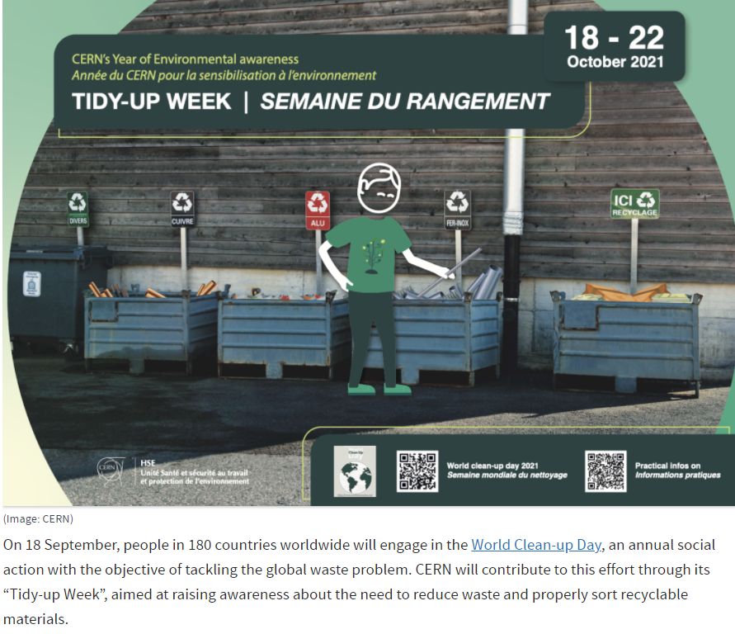
The Tidy-up Week
Thank you for your participation!
Ran from 18 to 22 October 2021
Objective: to raise awareness about reducing waste and properly sort recyclable materials
Organised in collaboration with DSOs / TSOs and operational support services (transport and waste management services)
15 (+2) buildings as test
Centralisation of the communication/requests by the organising committee.
Availability of an operational team composed of:
  2 transport agents (FOSELEV),
  1 mover (SERCO)
  1 RP technician (CERAP).

Slide 4
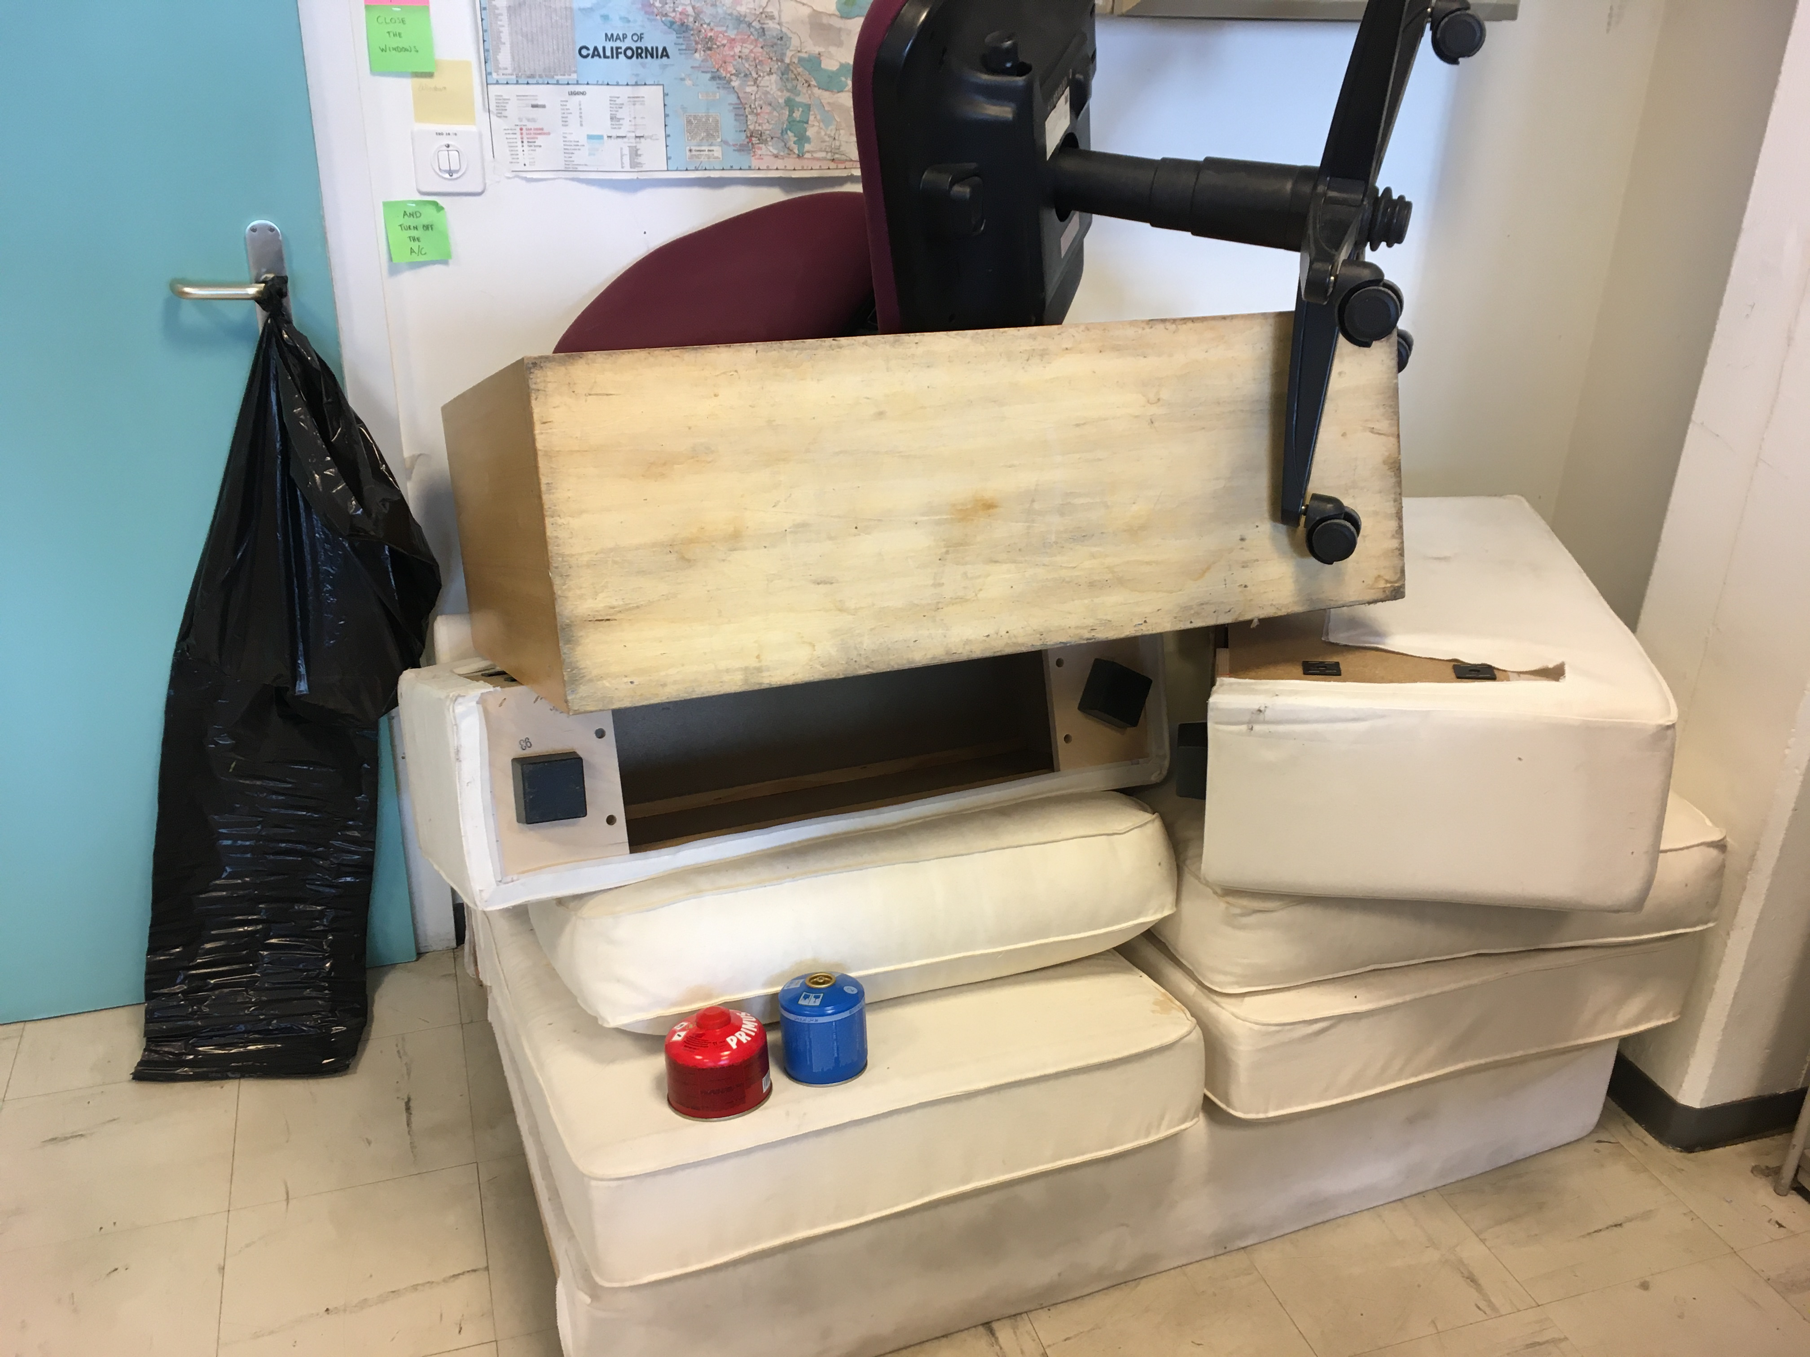
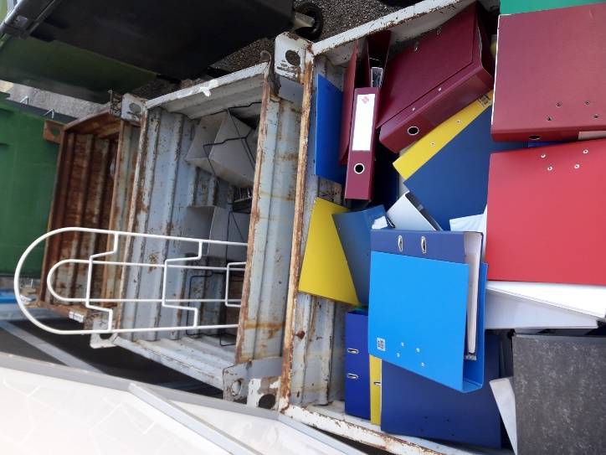
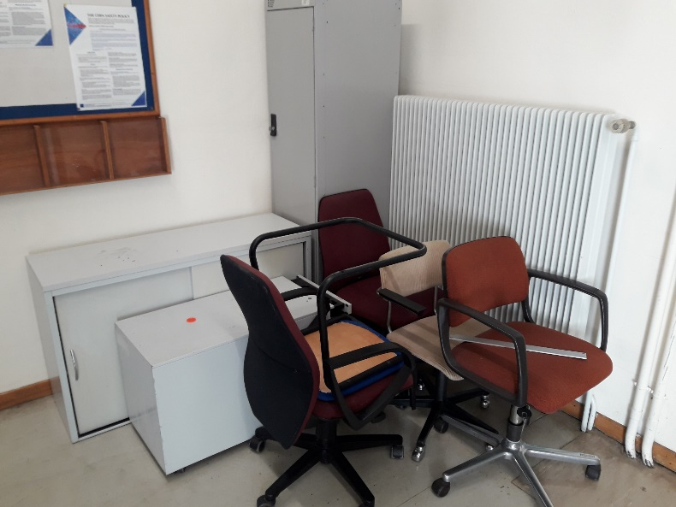
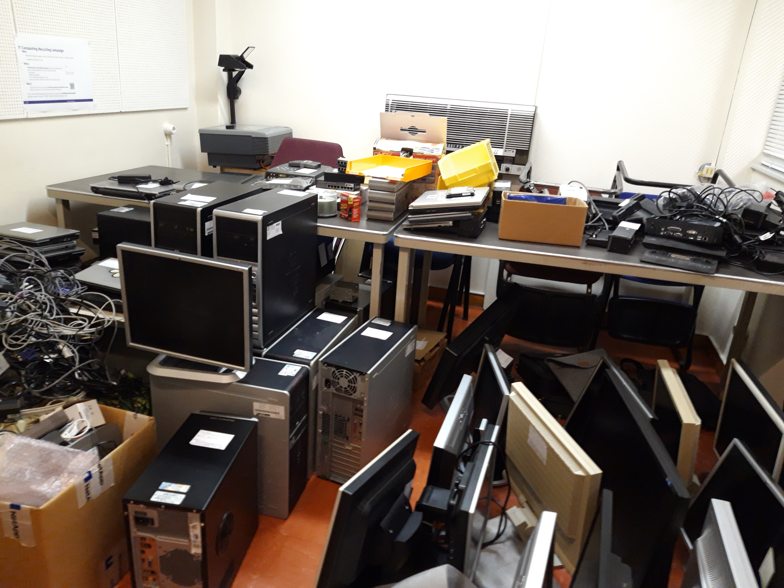
The week in pictures…
And in numbers… collected waste
30 m³ furniture (cupboards, chairs, tables)
30 m³ plastic
8 m³ folders (2 m³ recyclable)
4-5 m³ IT material.
3 m³ electronic waste
5 m³ cables
2 m³ aluminium
6 m³ metal
4 m³ household appliances (fridges, ovens)
6 glass pieces
35 kg batteries
Cardboard: About 3T (on top of the average 5 to 6 T per week)
Alu cans: about 70 kg (on top of the average 50 kg / week)
Folder collection
Impressive quantities

Slide 5
The Tidy-up week: lessons learnt
  Improvement of conventional waste collection
  Feedback provided to SCE on simplification of the collection of some specific waste types
  First collection of folders successful
  Occupants of about 15 further buildings have approached the organising team and are on a “waiting list”.
  Maintain the coordination team but simplify the preparatory work by simple exchanges with the TSOs.
  Organise the event in a period of availability for the service involved (transport, waste reception, radiation protection):
    Outside technical stops and YETS/EYETS and avoiding summer period
  The respect of the ADR transport requirements is mandatory

Slide 6
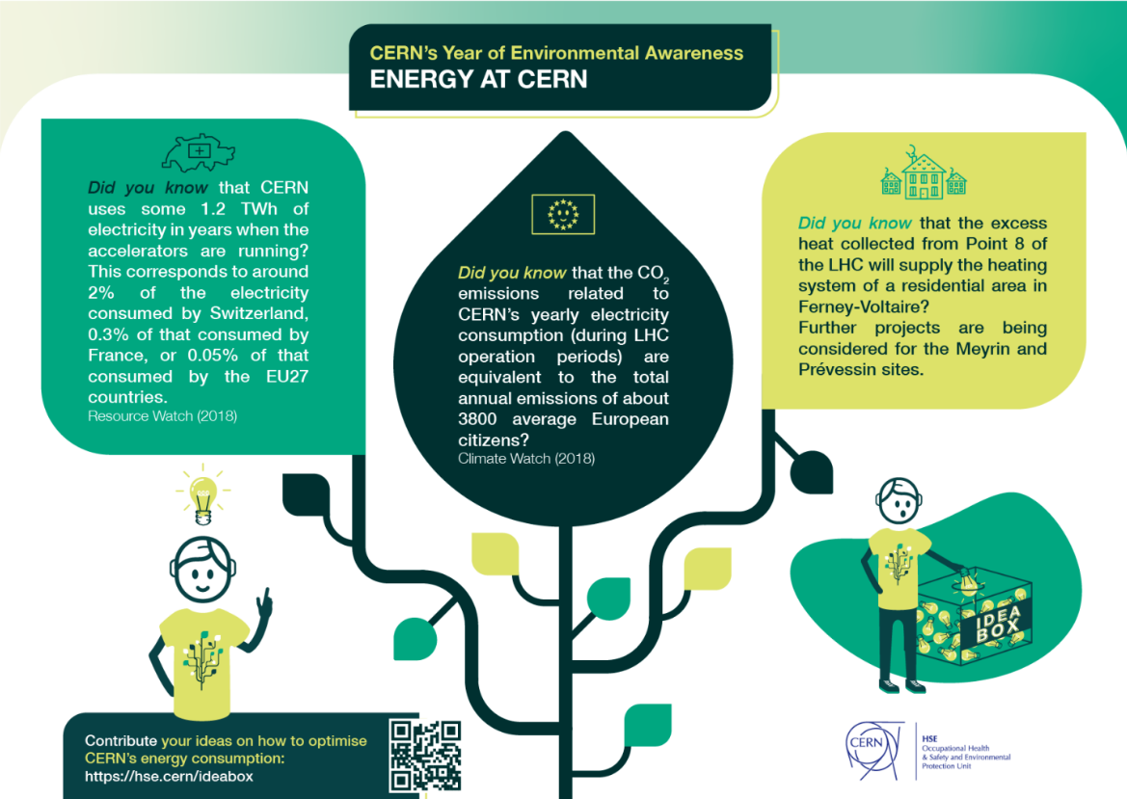
Idea Box: optimising CERN’s energy consumption
Thank you for taking part!
Ran from 2 to 30 June 2022
Objective: to identify feasible ideas for CERN to optimise our energy consumption
42 ideas received
39 identified for follow up further to first review by the HSE campaign team
Submitted for assessment of feasibility and applicability to a jury of 3 people:
  The chair of the Energy Management Panel,
  The Energy Coordinator
  The Infrastructure Section Leader (Site and Civil Engineering group)

Slide 7
The Idea Box – submissions
  Main feedback:
  Lighting
  Heating/cooling/heat recovery
  Equipment energy efficiency and saving (including IT)
  Responsible behaviour for saving energy
  Some concerns (not directly related to energy):
  Mobility
  Water consumption

Slide 8
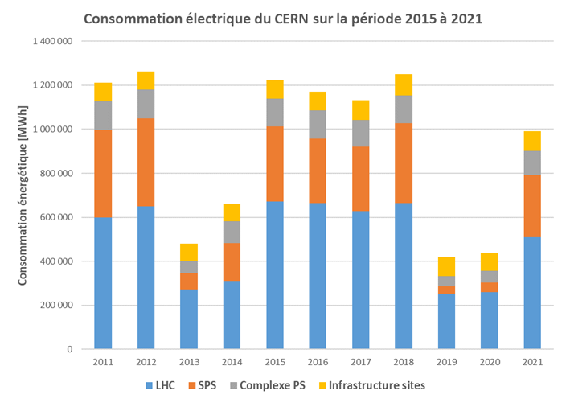
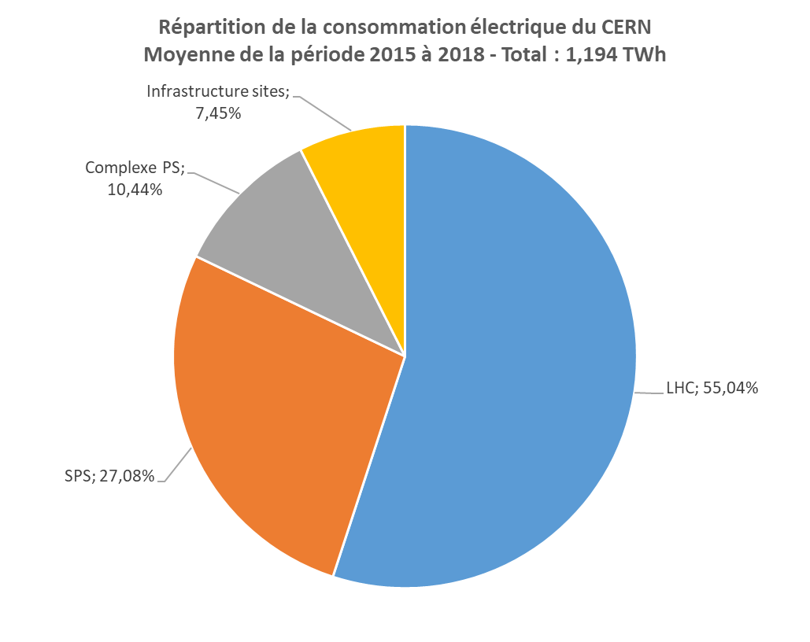
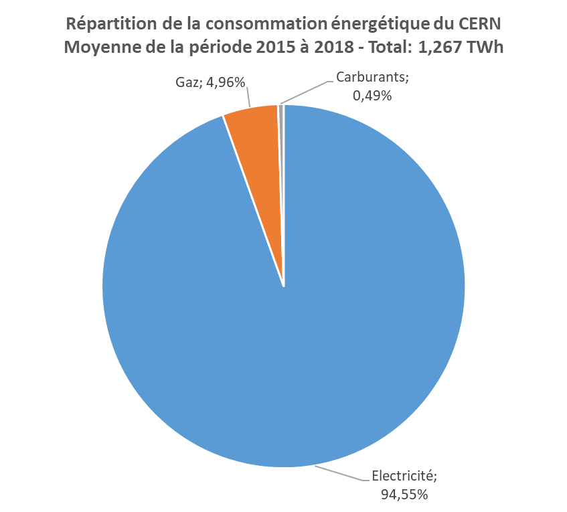
The Idea box – some figures
  Consolidated global figures – established in the framework of the energy performance plan prepared in view of the ISO 50001 Certification
CERN’s energy consumption 2011 - 2021
  Main tool to monitor electricity use – WebEnergy (energy.cern.ch)

Slide 9
The Idea Box – feedback
  Action plan for the next 5 years includes:
  Optimisation of energy consumption for accelerators: ~ 50 GWh for LHC cryogenics in 2022 to start with, adjustment of YETS (length & timing) for up to ~100 GWh/yr
  75 building consolidation projects: ~ 10 GWh/year of expected savings (thermal + electrical)
  Heat recovery projects:
      Ferney-Voltaire: ~ 20 GWh/year made available for neighbours
      Meyrin and Prévessin: 30+ GWh/year of expected savings on gas consumption
  Many other studies (with ROI) to be done to assess potential future savings
  As part of the ISO 50001 certification, occasions will be provided to the CERN community to provide ideas and feedback
  CERN & the environment workshop October 12-13:
  will include presentation of axes for reducing
  energy consumption, improving efficiency and
  increase energy recovery.

Slide 10
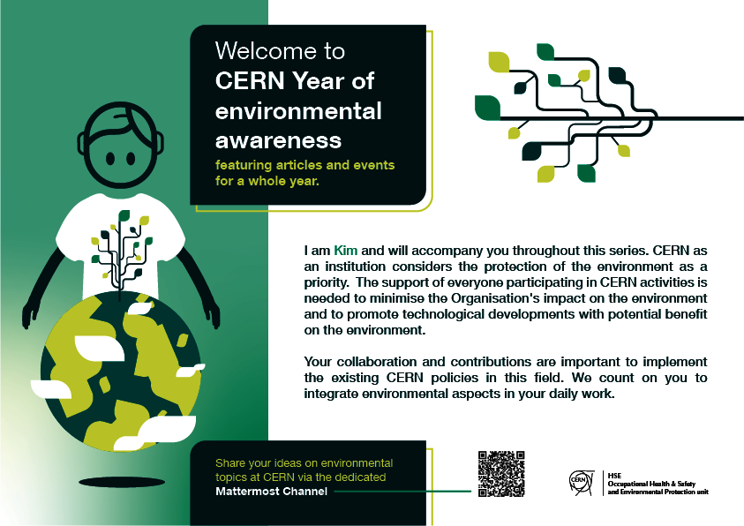
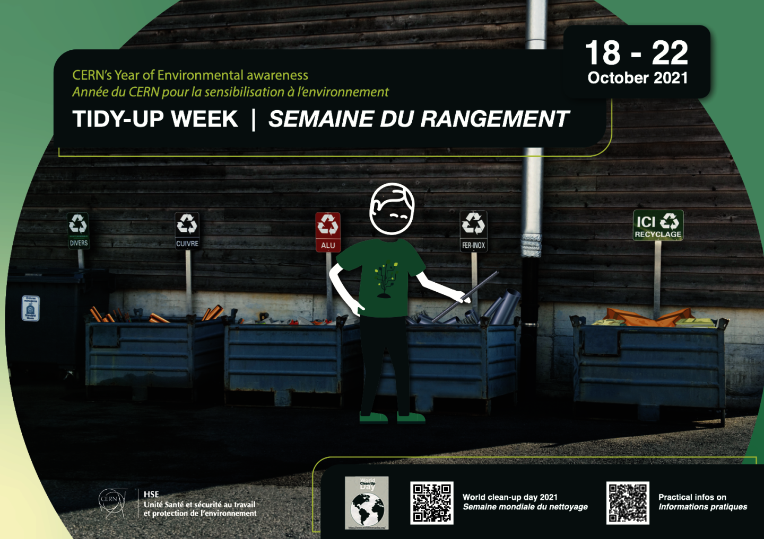
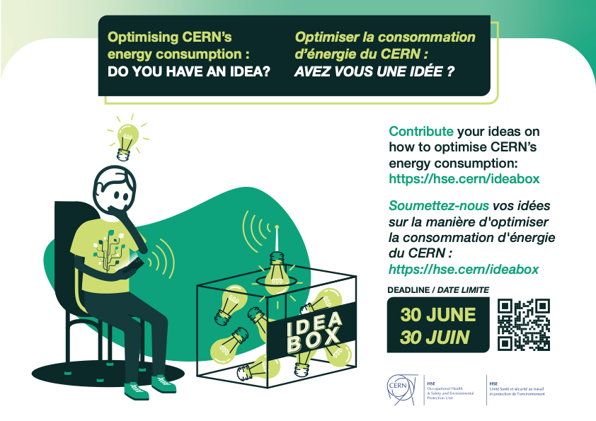
Events (survey outcome 1/2)
Event | Participation (over 232 answers) | Satisfaction (1-4; 4: very satisfied)
Launch event | 5% | 2.43
Tidy-up week | 16% | 2.63
Energy consumption idea box | 4% | 2.54
Satisfaction was above average for every event.
NB: answers from the survey are not representative of the actual participation.

Slide 11
Perspective on future events (survey outcome 2/2)
«Other» includes: explanations of CERN's strategic development goals and targets for new projects (and existing facilities), ad hoc workshops and campaigns to raise awareness about specific issues, concrete initiatives engaging the groups/sections, more hackathons.
Percentages do not add up to 100% as participants could provide several answers

Slide 12
Excellent collaboration: A BIG THANK YOU!
SY
EP
SCE
dss⁺
Articles,
survey
TH
IT
ATS/
FCC
TE
CERN departments
and units
Kevin Moles
Graphics
IPT
EN
HR
IPT/
KT
BE
IR
FAP
Year of environmental awareness
Project team
Visual
identity
DH
HSE
IR/ECO
TS
group
Internal comm
ENV
group
CEPS
(funding)
DG/TMC:
translation
Media comm
DSOs

Slide 13


