Slide 1


Mar CAPEANS
“CERN Year of Environmental Awareness: outcome and future perspectives”
15 September 2022

Slide 2


















3
IMPLEMENTATION AXIS IN SCE
Sustainability integrated into operations
Projects of large impact
Pilots of scalable projects
GHG Emissions
Reduction by 28%
Energy Consumption
Limit raise by 5%
Water Consumption
Limit raise by 5%
Noise
Restrict
Commuting
Constant
Waste
Increase recycling rate
Biodiversity
Protect

Slide 3
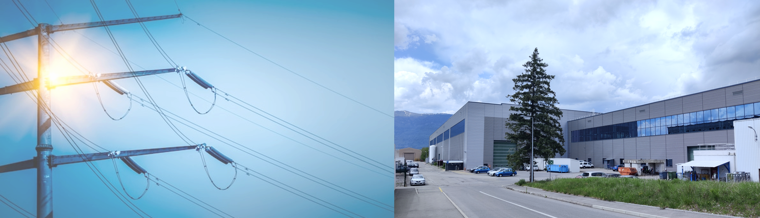

Sustainability integrated into operations
GHG Emissions
Reduction by 28%
Energy Consumption
Limit raise by 5%
Site Consolidation programme
The mission is to plan capital investments and carry out, in a rolling time window of 10 years, the pre-emptive repairs and improvement of infrastructures assets that are essential for CERN’s scientific programme
40% invested into environmental actions:
Global renovation of 2 buildings/y with energy efficiency improvement >60%
Building envelope actions: roofs, windows, facades
Change of indoor and public lighting, HVAC systems, automation, monitoring
Energy saving on Campus
Target: 5% reduction of electricity & gas consumption on campus operations
Actions: optimization of district heating, reduced public lighting, accelerated replacement to LED lighting, sleep-mode for unoccupied infrastructures…

Slide 4
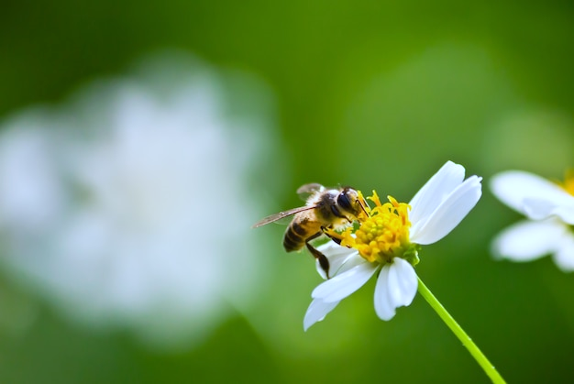
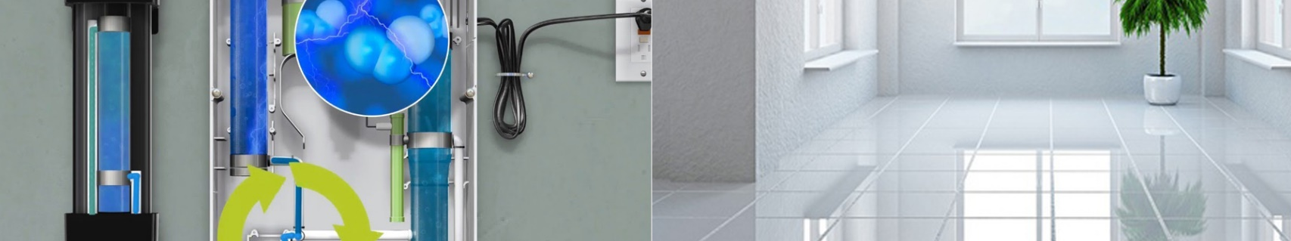
Sustainability integrated into operations
Biodiversity
Protect
Biodiversity conservation included into every new project
Analysis of impact on Biodiversity for all construction projects
Green compensation fund
Chemical-free cleaning
Ozone water treatment
The cleaning process begins with the creation of ozone in a generator which is then injected into water, and immediately starts oxidizing and eliminating contaminants, such as bacteria and rust.
Piloted in Prévessin, moving to Meyrin at the end of 2022

Slide 5
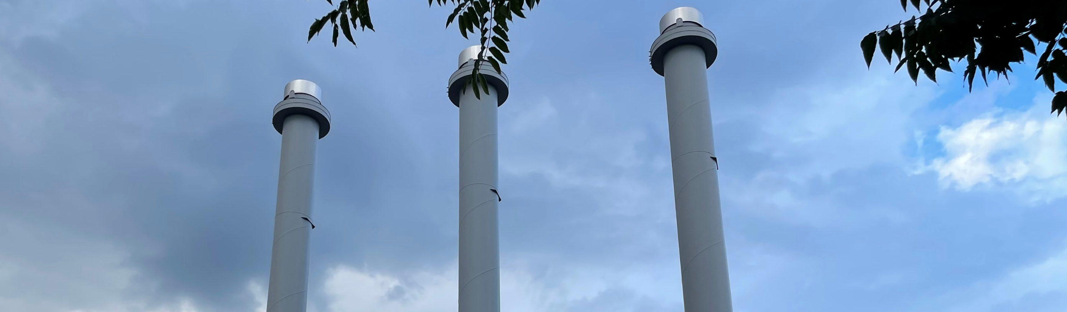
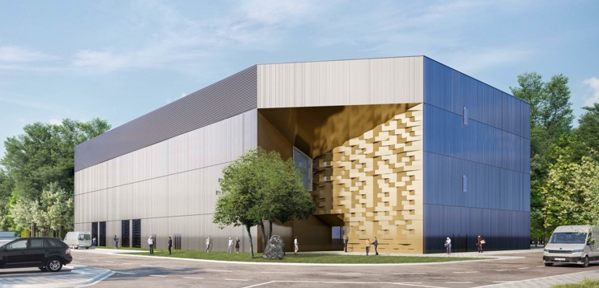
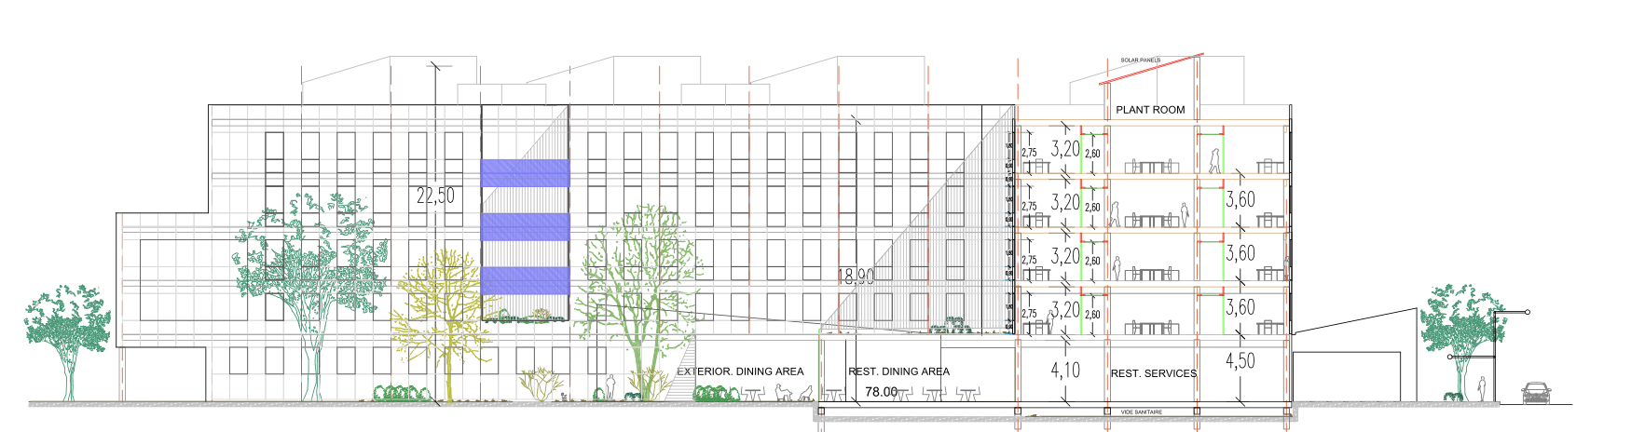
Projects of large impact
GHG Emissions
Reduction by 28%
Energy Consumption
Limit raise by 5%
Sustainable heating plants from 2026/27
Prévessin: up to 4 MW recovered from the new PCC (~100% reduction of CO2 emissions at full capacity)
Meyrin: up to 10 MW recovered from LHC cooling towers at Point 1 (~80% reduction of CO2 emissions at full capacity)
Sustainable buildings
Net-zero/passive buildings as compared to conventional buildings:
5% more expensive at construction
25-35% less energy consumption
15% lower maintenance costs
20-85% less GHG emissions
Average figures in the field

Slide 6

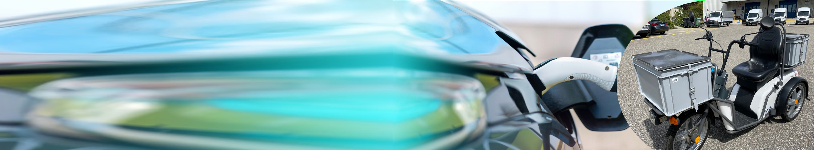



Pilots of scalable projects
GHG Emissions
Reduction by 28%
80 shared e-bikes
Car Fleet reduction (25% target) in 2024
- 500 tCO₂e/y
Gradual replacement of thermal cars by e-cars
2022
3 kyburz e-Trolley for mail delivery
2 e-transit vans for internal transport
1-2 shuttles for people transport
1 truck for waste collection
5 to 8 e-cars for the sharing scheme
-15.4 tCO₂e
Waste: global and local actions
Reduce, Reuse, recycle
Central collectors of office waste (8 buildings)
Laboratory waste pilot (2 buildings)
Biowaste pilot (R3 and 2 office buildings)
Coffee capsules
Measure

Slide 7

SCE AMBITIONS
40’000 m² Green buildings
40’000 m² Renovated buildings
Sustainable heating plants
(heat recovery)
Prévessin -1’900 tCO₂e/y
Meyrin ~6’000tCO₂e/y
100% Inventory of CERN areas of biological interests
25% Reduction of car fleet
-500 tCO₂e/y
5% Energy reduction for Campus activities
Control water effluents Retention basins FR & CH
2021
2022
2023
2024
2025
2026
2027

