Slide 1

Overview
Neutrons are currently produced in large scale facilities and used to explore material properties for a large range of applications. One is the determination of batteries and fuel cells electrodes structure and composition under working conditions. This takes advantages of the unique capability of neutrons to penetrate through thick metallic containers.
Broadening access to neutrons as a material property probe requires compact, industrial and affordable neutron sources. This can be done in a compact facility using accelerated electrons, which are converted into neutrons when impinging a target-moderator assembly (TM).
This project aims to develop a compact pulsed neutron facility, suitable for implementation in an industrial environment, and optimized for in-situ analysis of battery and fuel cell electrodes.
It does this by bringing together:
The knowledge of DAES (industrial partner) of the market and their expertise in neutron production targets and overall facilities.
With the expertise of CERN in compact electron linacs (CLIC) and by making use of the CLEAR facility.

Slide 2

Tentative parameters

Slide 3
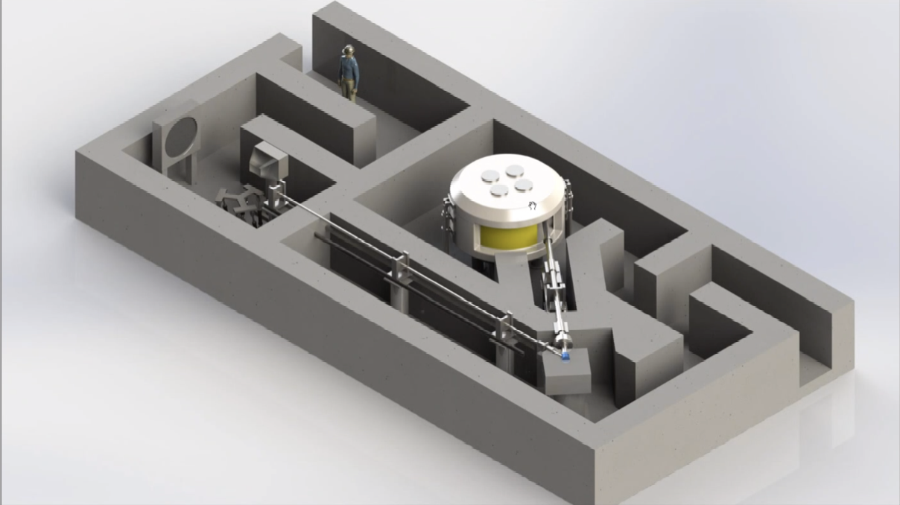
Compact Pulsed Neutron facility
Accelerator, protons in this picture, change to electron linac for short pulses, design/optimise with CERN, manufacture in industry
Neutron “imaging” area
Target for neutron production. Target-Moderator (TM) – designed and manufactured by DAES, tested in CLEAR

Slide 4
Compact Material Analysis for Batteries & Fast Fuel Cell Development
Team composition
Project leader
Steinar Stapnes – ATS/DO (presenter today)
Project contributors
Walter Wuensch – SY/RF/MKS
Roberto Corsini – BE/ABP/LAF
External partner:
DAES, avenue des Grandes Communes 8, 1213 Petit-Lancy, CH – Contact Person : François Plewinski, Associate Director.

Slide 5
The project – specific work with DAES
The specific project goals are:
Qualifying an innovative target-moderator assembly on a 40-100MeV electron pulsed beam available at CERN.
Developing a compact and affordable electron accelerator specifically designed for short-pulsed beam at medium energy, low power and high efficiency.
The CERN technology / facility / expertise on which the project is based
CLIC technology, CLEAR electron acceleration, VESPER facility in CLEAR (or equivalent) for tests of the TM
DAES will prepare the TM Sept 22-Feb 23
CERN contribution to the experiment will be:
2022:
An initial feasibility study of tests of the TM in CLEAR. The initial feasibility study will determine the detailed requirements for points 1-3 below.
In addition, conceptual design of the optimized electron accelerator and ancillaries for such neutron source.
CLEAR measurements: prepare 2022-23, data in 2023/possibly also 2024, covering:
Availability of the Electron beam irradiation facility including overall control systems (machine protection, safety, diagnostics…), hardware and software
Contribute to establishing and installing neutron and radiation monitoring systems for measuring performances of the target-moderator assembly
Connexions and Monitoring system for the embedded sensors of the TM assembly, as well as cooling of the Moderator (liquid nitrogen tank)

Slide 7
Overall goal and expected results
Neutrons as probe for characterization of Fuel cells and batteries electrodes are used in large scale scientific facilities such: ILL (Institut Laue Langevin) in Grenoble-France, ISIS in Oxfordshire, UK, The SINQ neutron facility in Paul Scherrer Institute, Switzerland, Japanese Spallation Neutron Source in JPARC, Japan, Spallation Neutron Source in Oakridge, USA.
The overall aim would be design and development of turn-key facility that can be purchased and installed locally in industry or academics institutes for a modest cost and footprint.
Specifically, the project aims at the development of a compact material analysis facility targeted at the development of clean technologies, with a focus on energy storage (Li-ion batteries and fuel cells).
This project is a key milestone to “democratize” and accelerate R&D on fuel cells and batteries, as experimental results will be exploitable by batteries and fuel cells specialists without the intervention of an neutron instrument specialist;
The selected technology allows to investigate energy batteries and fuel cells electrodes under real working conditions (loads, power charge, temperature and pressure etc…);
The specific work above focuses in tests in CLEAR and electron beam system optimisation to demonstrate performances of the neutron source (brightness, neutron time structure…) of the future facility.

Slide 8
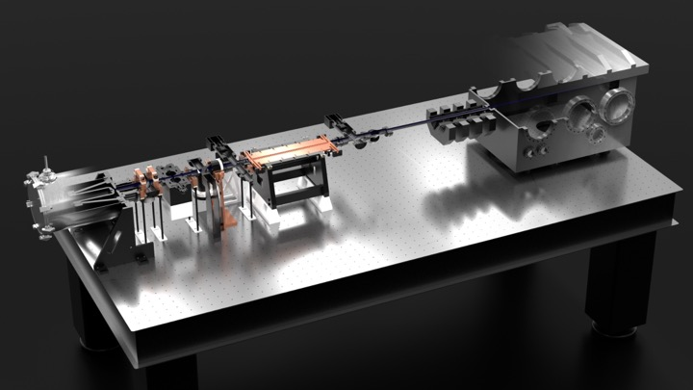
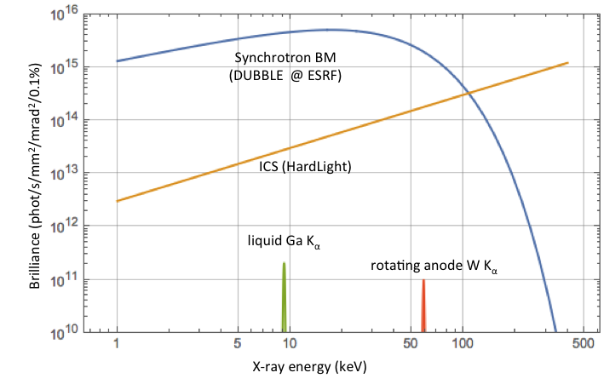
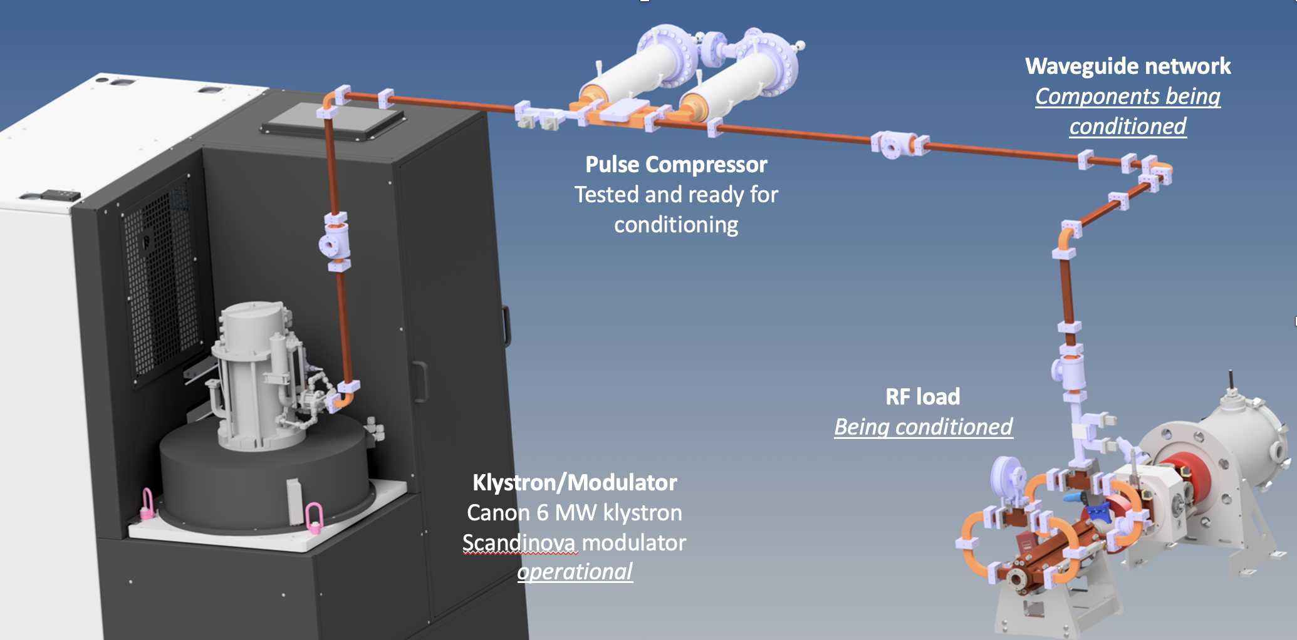
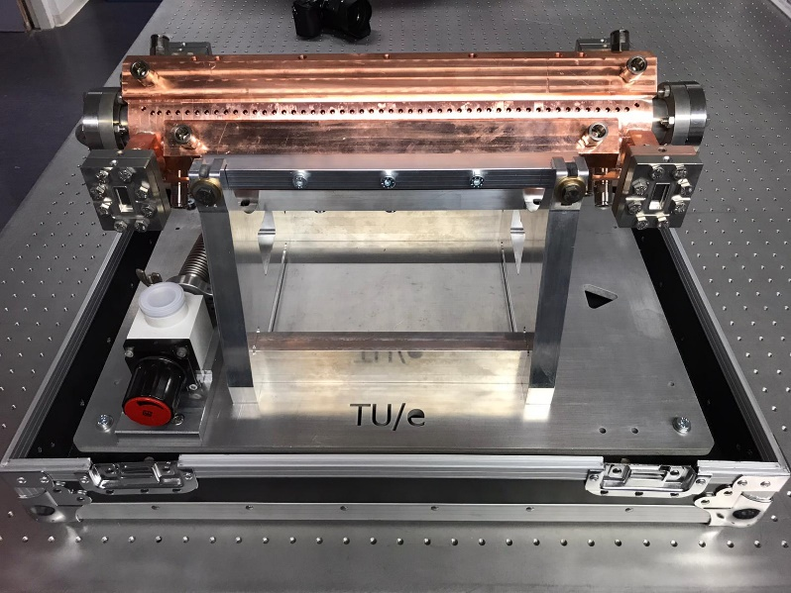
Eindhoven University of Technology with CERN (and industries)
- as a reminder: a similar concept for a compact light source -

Slide 9
Implementation
Important next steps: “feasibility/implementation in CLEAR”, electron linac design, and on DAES and collaborators side, more studies of the performance parameters needed/desirable for these type of applications
Request a fellow in next round (autumn) assuming the above are all ok.
The fellow will need to be hired this year and start late 2022 or early 2023. We have also estimated a preliminary material costs of 40k.
The second year of the fellow will come from LC or CLEAR budgets and the fellow will be shared between this project and other LC/CLEAR measurements.
Presented on behalf of the DAES and CERN “team” involved in the planning so far, some key names are included in the slides

