Slide 1
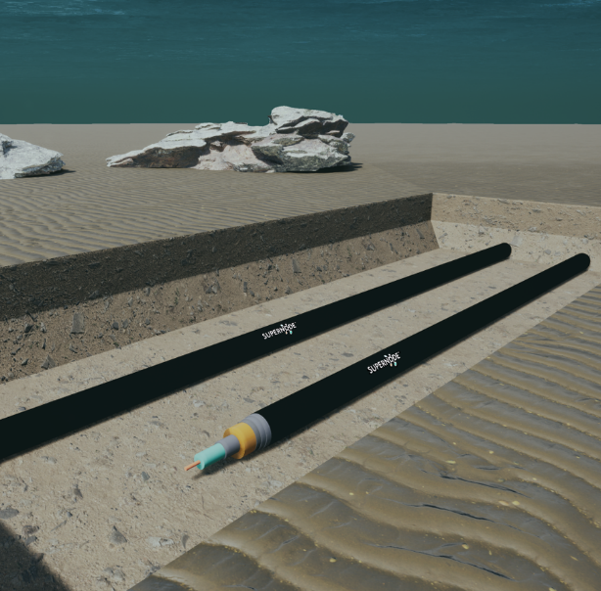
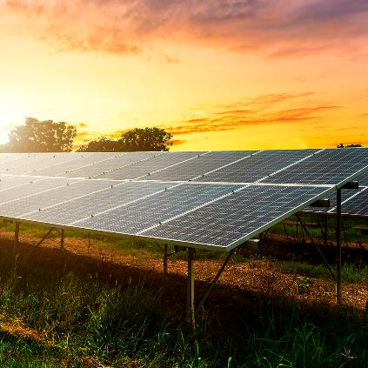

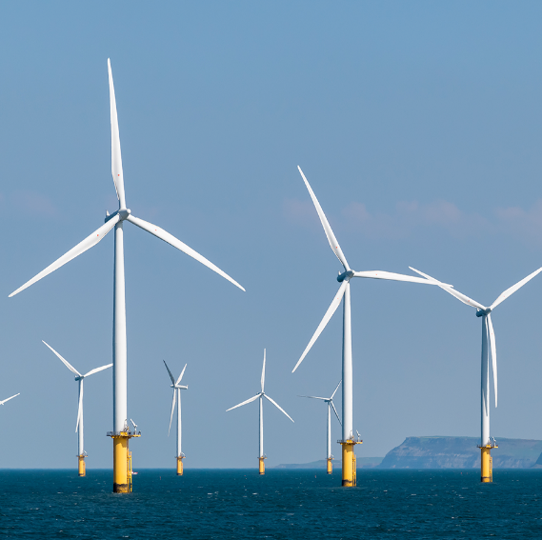
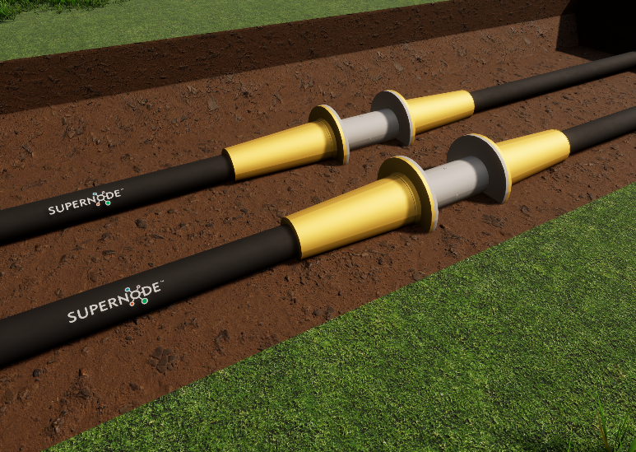
IVAC-RED
Insulation Vacuum of SC Cables for Renewable Energy Distribution

Slide 2
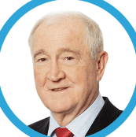

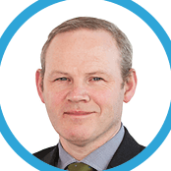

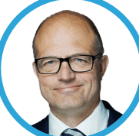

WHO ARE WE?
EDDIE O’CONNOR
Founder, Chairman and Owner
KJELL INGE RØKKE Director
(Owner
of Aker ASA)
JOHN FITZGERALD CEO
(Ex director of Grid Dev
and Interconnection
EirGrid)
PAT COX
Director
(Former President of
EU Parliament)
KARL-PETTER LØKEN
Director
(Investment Director,
Aker Horizons)
AKER HORIZONS
(50% ownership)

Slide 3
Vision and mission
Our vision
People should have access to secure, affordable and renewable energy.
OUR MISSION
To develop and market innovative transmission technology based on superconductors, carrying vast amounts of energy over long distances in interconnected grids, requiring less infrastructure, materials and space.

Slide 4






Why is New Transmission Technology Needed?
Global decarbonisation by 2050
Electrification is the key vector for decarbonisation
Decarbonisation requires the Adoption of integrated infrastructure development plans globally
Electrical
energy demand
will triple
by 2050
compared to
today’s
demand
More than
800 GW
of new solar
power will be
required
Transmission
is a major constraint
on the level of renewables required for deep decarbonisation
More than
450 GW
of offshore wind power will be
needed
The best renewable resources
are found at the PERIPHERIES of
Europe
No clarity on transmission capacity
for future
past 2030

Slide 5
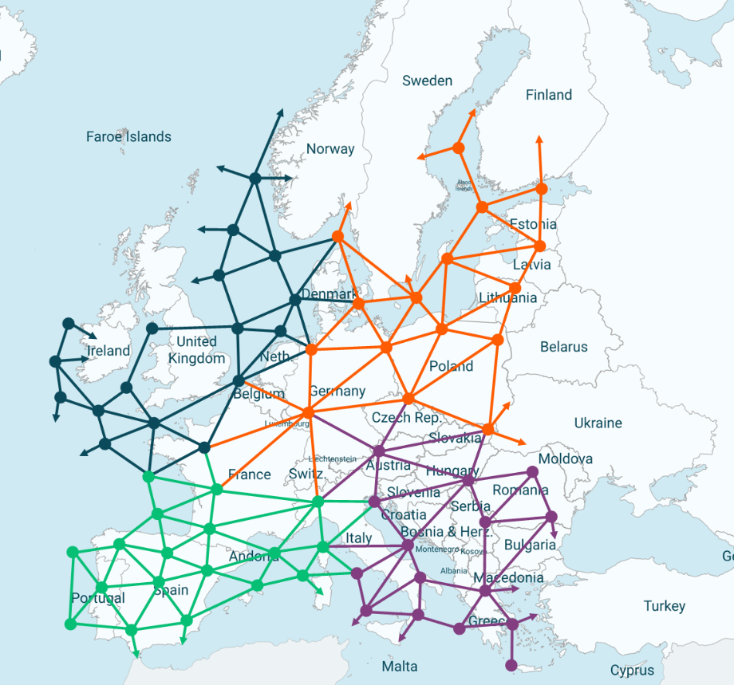
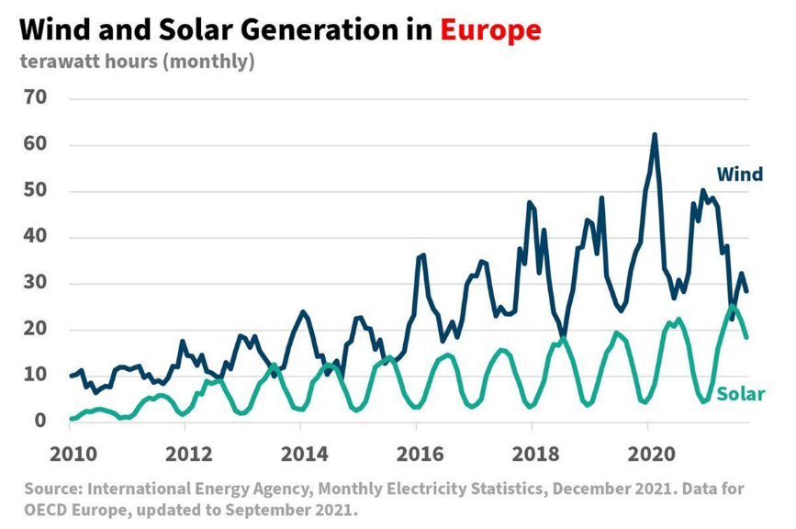
EUROPE NEEDS A SUPERGRID
  Europe needs to connect 2,000 GW
  of renewable resources by 2050
    SuperNode’s transmission technology
    can be applied to offshore and terrestrial applications

Slide 6
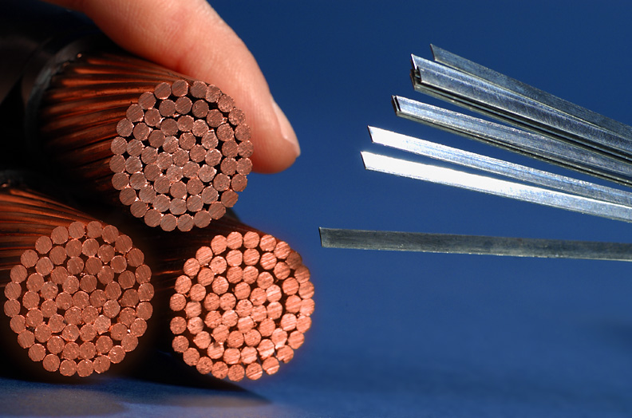
Comparison of conductors: HTS Tape to copper
1g HTS Tape = 150+g Copper [for 1 kilo-amp-meter (kA.m)]
Therefore, the HTS tape requires ~150 times less raw material by weight to carry 1 kA in a metre
This electrical performance is primarily due to ReBCO

Slide 7
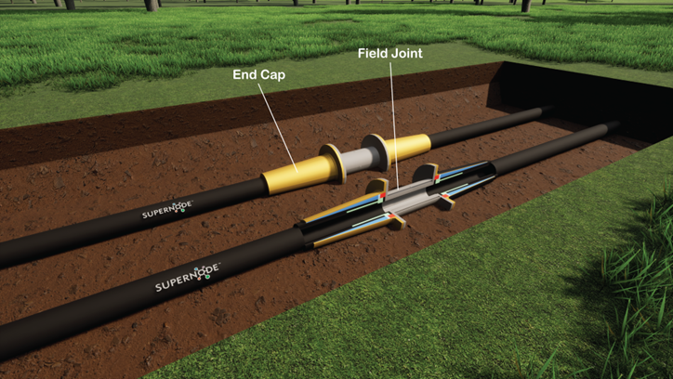
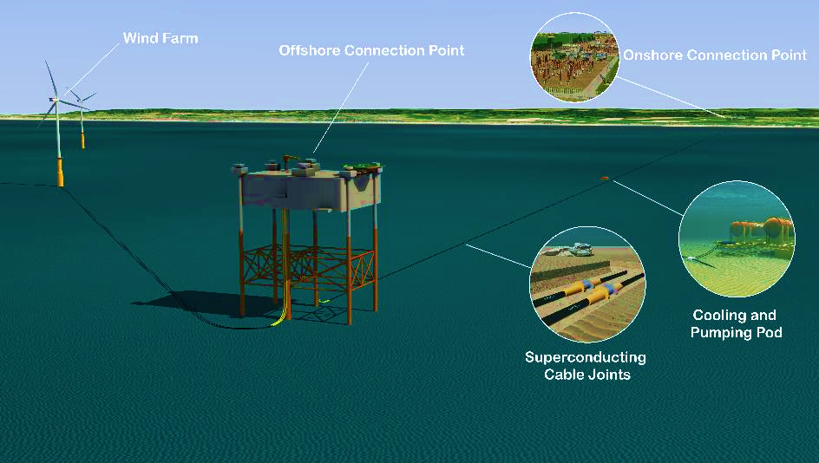
Onshore and offshore application

Slide 8
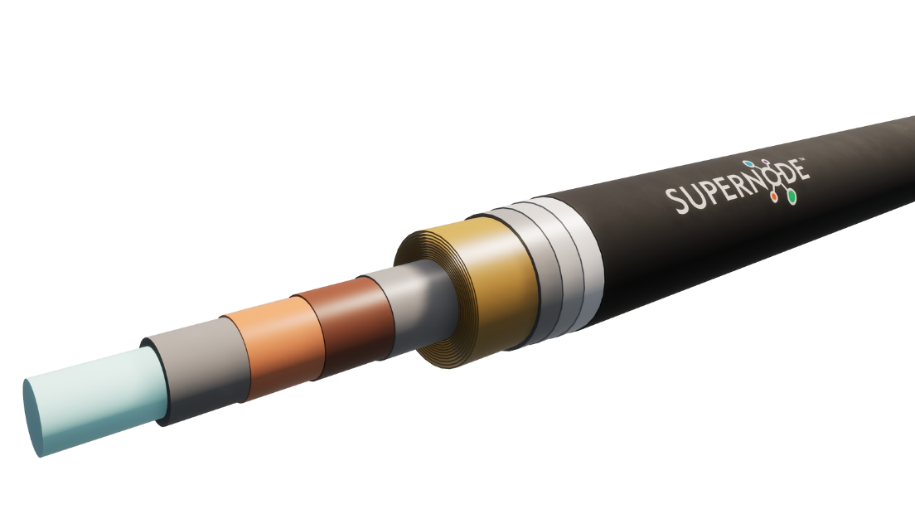
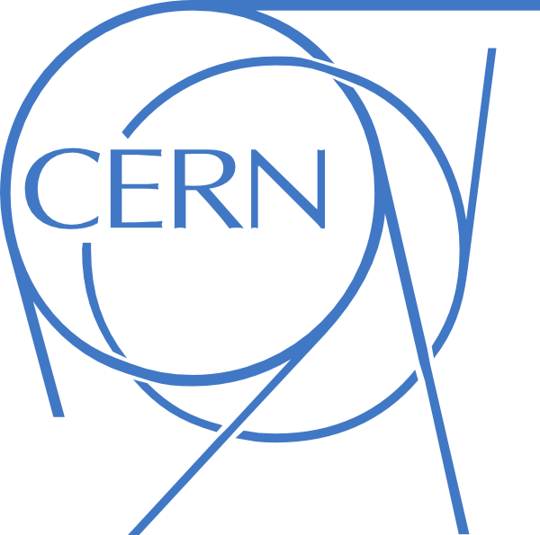
Cryostat design and importance of vacuum
Insulation
Outer Cryostat
HTS Conductor
Vacuum
Inner Cryostat
Liquid Nitrogen
Characterizing the cryostat vacuum is essential to ensure performance durability.

Slide 9
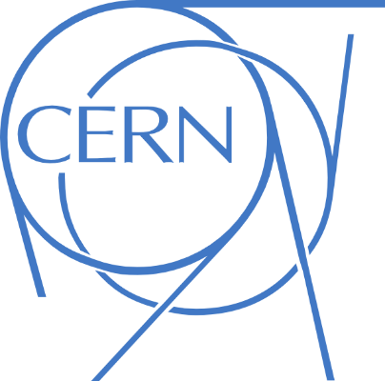

Unique cern competencies and capabilities
Materials permeability characterization
Vacuum degradation prediction
Cryostat lifetime simulation

