Slide 1



CIPEA Innovation Day
CERN Clean Cooling and Heating
Pierre BARROCA (NTNU), Pierre HANF (CERN EN-CV)
27th June 2022
https://indi.to/bmDNV

Slide 2
Proposal: CERN Clean Cooling and Heating coupled with thermal energy storage
Replace current chillers by clean long-term solutions
Develop a clean cooling/heating cluster based on CO₂ for CERN and surrounding infrastructure
Demonstrate innovative and economic solutions to reduce demand for primary energy (reduction of energy bill and peak demand)
TOWARDS A SUSTAINABLE MANAGEMENT OF RESOURCES

Slide 3
Current CERN Cooling and Heating Infrastructure
Some CERN Yearly numbers:
Chillers : ~100 units and 85 000 kW
Heat rejected to water*: 224 000 kWh
Heat provided by fuel boilers**: 60 000 kWh
Cooling water consumption***: 2 000 million liters
Energy demand: 1 200 000 MWh
“Nothing is lost, nothing is created,
everything is transformed”
Antoine Lavoisier
* Value based on EN-CV 2019 Report on power dissipated in water cooling towers
** Rough estimate for Meyrin + Prevessin sites. Replacement for heat pumps under studies
*** Value based on EN-CV 2019 Report on Water Consumption. Water mostly lost by evaporation on cooling towers.

Slide 4
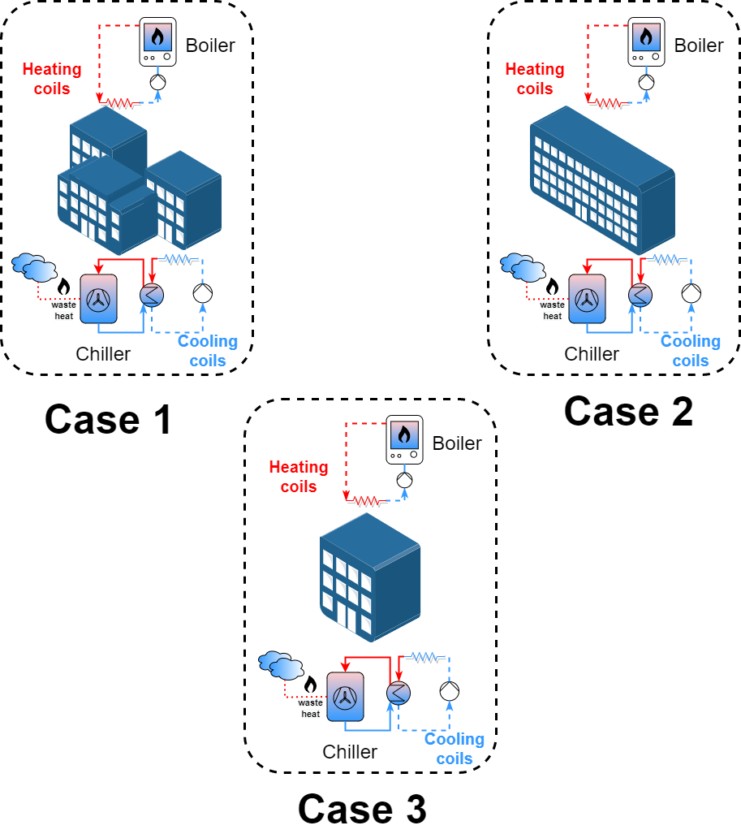
Project Roadmap
2022-2023
Dedicated fuel boilers and chillers with pumped water circuits

Slide 5
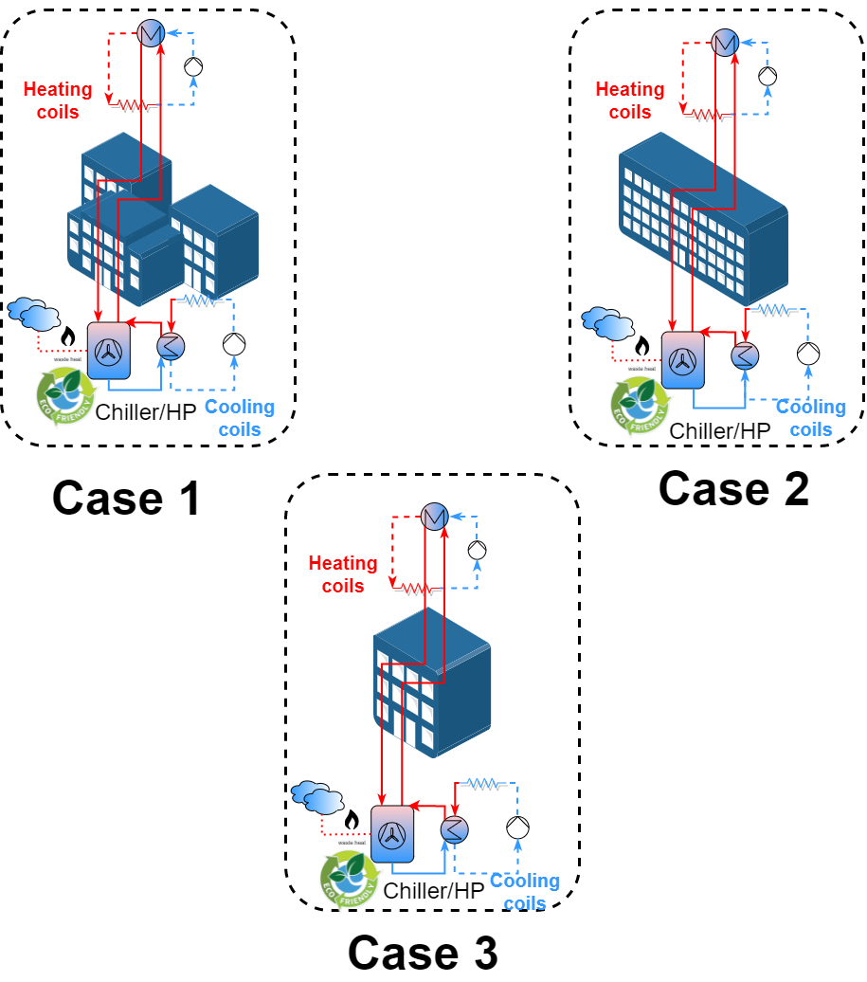
Project Roadmap
* Replacement of fuel boilers currently under studies
2022-2023
Dedicated fuel boilers and chillers with pumped water circuits
2023-2024: Reduce energy demand and greenhouse gas emissions
Replace current chillers by clean alternatives (natural refrigerants) providing useful surplus heat
Replace electrical heaters and fuel fired boilers by heat pumps (reversed chillers) providing useful surplus cooling*

Slide 6
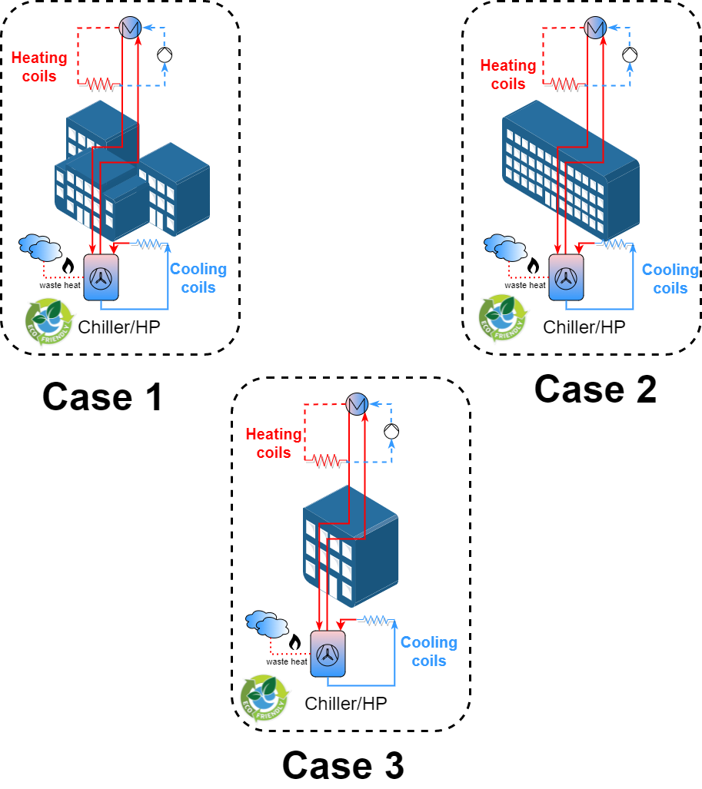
Project Roadmap
* Replacement of fuel boilers currently under studies
2022-2023
Dedicated fuel boilers and chillers with pumped water circuits
2023-2024: Reduce energy demand and greenhouse gas emissions
Replace current chillers by clean alternatives (natural refrigerants) providing useful surplus heat
Replace electrical heaters and fuel fired boilers by heat pumps (reversed chillers) providing useful surplus cooling*
2024-2025: Reduce energy and water demand
Demonstrate innovative Direct Expansion distribution network
* Replacement of fuel boilers currently under studies

Slide 7
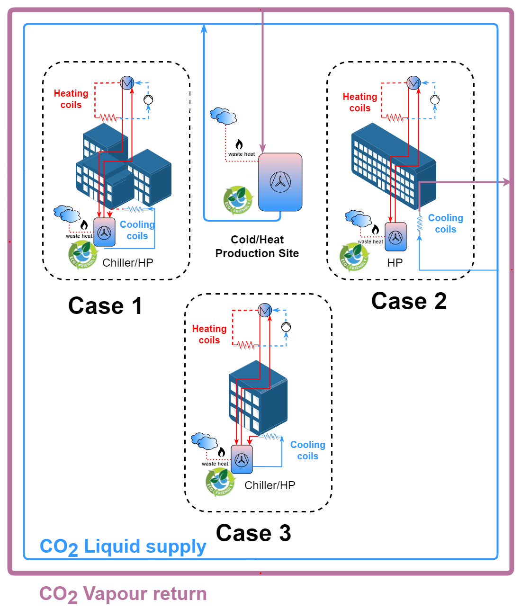
Project Roadmap
* Replacement of fuel boilers currently under studies
2022-2023
Dedicated fuel boilers and chillers with pumped water circuits
2023-2024: Reduce energy demand and greenhouse gas emissions
Replace current chillers by clean alternatives (natural refrigerants) providing useful surplus heat
Replace electrical heaters and fuel fired boilers by heat pumps (reversed chillers) providing useful surplus cooling*
2024-2025: Reduce energy and water demand
Demonstrate innovative Direct Expansion distribution network
2025-2026: Reduce energy demand and waste heat
Centralized cold/heating production site with cooling network based on distributed CO₂

Slide 8
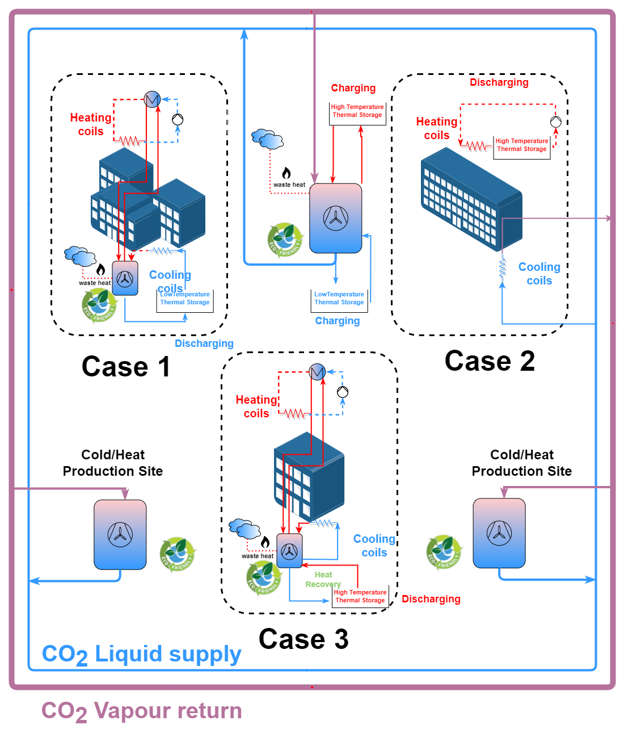
Project Roadmap
2022-2023
Dedicated fuel boilers and chillers with pumped water circuits
2023-2024: Reduce energy demand and greenhouse gas emissions
Replace current chillers by clean alternatives (natural refrigerants) providing useful surplus heat
Replace electrical heaters and fuel fired boilers by heat pumps (reversed chillers) providing useful surplus cooling*
2024-2025: Reduce energy and water demand
Demonstrate innovative Direct Expansion distribution network
2025-2026: Reduce energy demand and waste heat
Centralized cold/heat production site with cooling network based on distributed CO₂
2026-2027: Reduce energy demand and smart utilization of cold and heat surplus
Distributed cold/heat production sites
Modular thermal energy storage units

Slide 9




Beyond CERN
Preliminary discussions with:
Workshop to gather other potential partners planned for Q4 2022:
(examples below)
Hotels in the Grand Geneve for utilization of waste heat
Heat Exchanger manufacturers
District Heating and Cooling Services
Norwegian equipment
manufacturer
Integration
Design studies and simulation

Slide 10
Summary
CERN and environmental benefits:
Reduction of energy and water consumption
Reduction of waste heat
Reduction of installed cooling capacity and water pumping systems
Technological innovation opportunities:
CO₂ DX Evaporators in HVAC systems
On-demand cooling capacity control strategies
Smart management of distributed cold production sites and charging/discharging of thermal storage units
Plug&Play modular thermal energy storage containers
Local partners:
CERN Infrastructure can provide Heat and Cooling as a service for interested local users

Slide 11

Thank you questions?
https://indi.to/bmDNV

