Slide 1
CIPEA Innovation Day
Introduction
Enrico Chesta
CIPEA Coordinator
27/06/2022

Slide 2
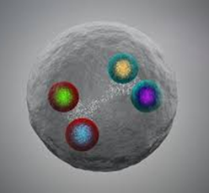

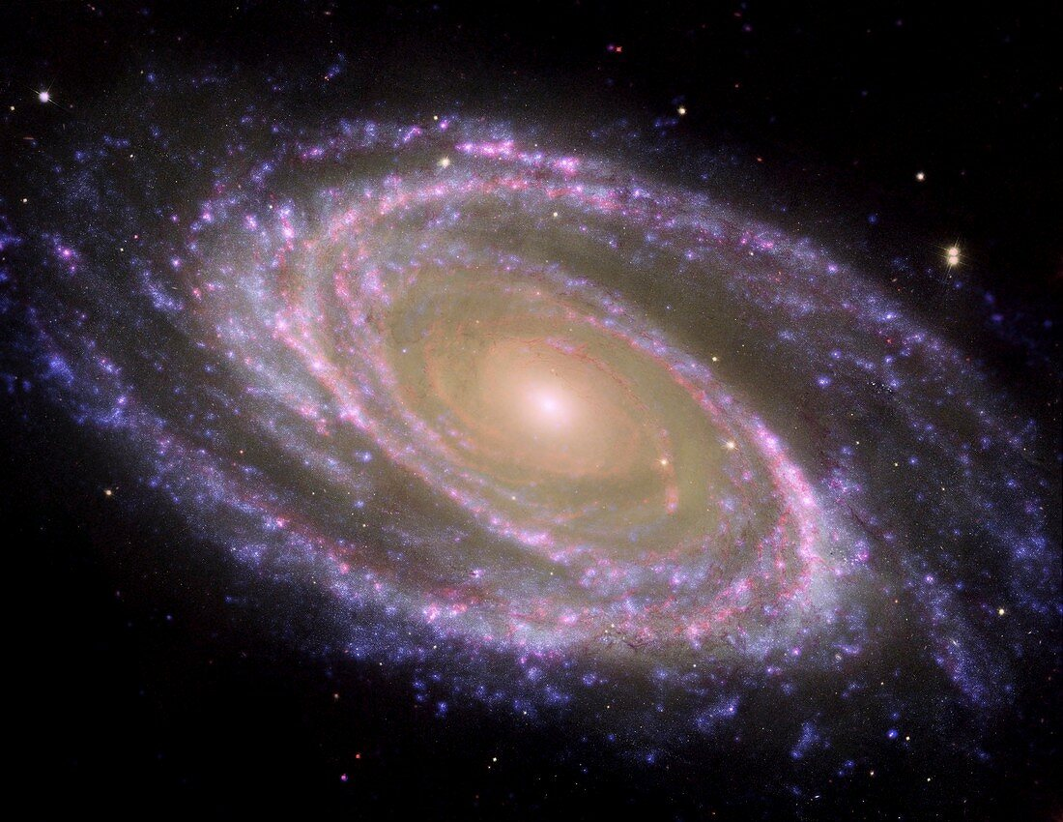
The Question
10⁻³²
10⁻²⁸
10⁻²⁴
10⁻²⁰
10⁻¹⁶
10⁻¹²
10⁻⁸
10⁻⁴
10⁴
10⁸
10¹²
10¹⁶
10²⁰
10²⁴
10²⁸
[cm]
Big Bang
Proton
Atom
Radius of Earth
Earth to Sun
Radius
Galaxies
Universe
CERN can help to explore the secrets of matter
CERN can help to understand the mysteries of the universe
Can CERN help to tackle climate and environmental issues on a global scale?

Slide 3
The Challenge
Observed and simulated change in global surface temperature as a function of time and cumulative CO₂ emissions (GtCO₂)

Slide 4

The Answer
Additional Sobriety
Technology Improvement
Innovative Disruption
Harnessing CERN’s unique skillset to help preserve the planet
Initiative endorsed by the Director General and the Enlarged Directorate in January 2022
Supported by HSE in the frame of CERN’s Year of Environmental Awareness
Coordinated by the Knowledge Transfer group to maximise positive impact on society
Entirely based on the ingenuity and expertise of CERN technical departments and community

Slide 5

Environment: a clear priority for CERN
Identify and develop CERN’s technologies that may contribute to mitigating the impact of society on the environment
Minimise the Laboratory’s impact on the environment
Pursue actions and technologies aiming at energy saving

Slide 6
Environmental Applications: Key Areas for CERN

Slide 7

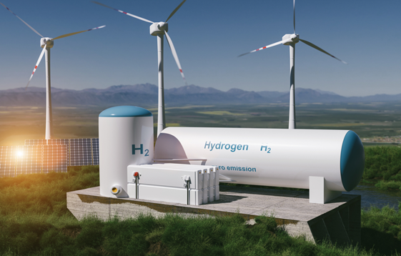

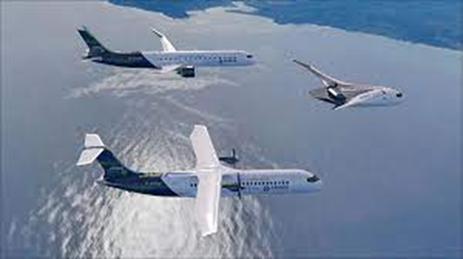

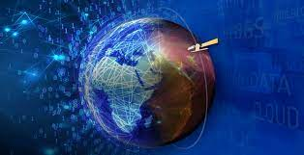

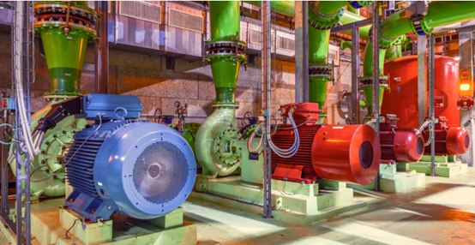
Examples of projects under implementation
RENEWABLE AND
LOW-CARBON ENERGY
Technologies for green hydrogen storage and transportation
CLEAN TRANSPORTATION AND FUTURE MOBILITY
Advanced power distribution systems for future electric/hybrid planes
CLIMATE CHANGE AND
POLLUTION CONTROL
Artificial Intelligence and big data expertise for Earth Observation
Infrastructure operation optimisation based on motor sensors
SUSTAINABILITY AND
GREEN SCIENCE

Slide 8
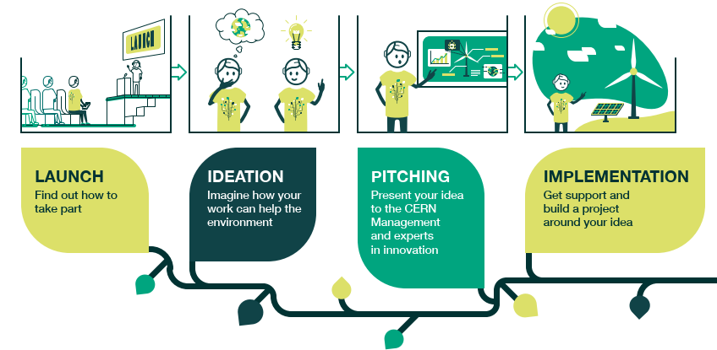
CIPEA: a very enriching ideation phase

Slide 9




CIPEA submitted proposals
SF6
SF6-free S-band circulator for photo injectors
eHighLO: ROOT based methods to protect energy market against fraud
CERN Clean Cool: Clean cooling and heating systems coupled with plug&play thermal storage batteries
Web Energy: Energy, water and gas monitoring and forecasting platform
Platform for green data analysis based on AI and real-time energy optimized federated learning
EMP2: Environmental Modelling and Prediction Platform
Compact and low-cost light simultor for indoor photovolataic cells development
Fully Autonomous Self Powered Wireless Radiation Sensor
Development of innovative immersion cooling technologies for data centers
UTMOST CLEEN: Development of membranes for ships EBFGT (electron beam flue gas treatment)
Compact Material Analysis for Batteries & Fast Fuel Cell Development
Power consumption of HEP-Benchmarks workloads
Injection locked magnetrons for particle accelerators and industrial dielectric heating
IVAC-RED: Insulation Vacuum of SC Cables for Renewable Energy Distribution
Optical interrogator for Fiber-Optic Sensors in Sustainable Agriculture
HFC² CO₂
u
d
d

Slide 10



CIPEA submitted proposals
HFC² CO₂
SF6

Slide 11








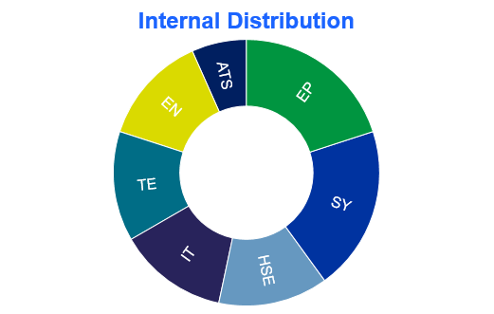
CIPEA ideation phase overview
15 high quality proposals submitted in the 4 target areas
More than 30 ideas discussed (many postponed)
Large variety in terms of origin / technologies / ambitions / needs
Several external partners (industrial and academic) involved

Slide 12
Bundling efforts to increase efficiency and visibility
Technologies for Hydrogen storage and handling
SC technologies for on-board and long distance energy distribution
Fast, autonomous long distance transportation
Compact Fusion Energy Systems
Protection systems for SC based energy generators
Technologies for fuel cells, batteries and PV efficiency improvement
Accelerator Driven Nuclear Systems
Accelerator technologies for on-board and industrial pollution reduction
Fast, low-power, advanced ML/DL
based computing
Energy saving techniques based on digital twins
Efficient, low GHG thermal control systems
AI platforms for environmental modelling
Platforms for consumption and emissions monitoring and optimization
Detectors and instruments for environmental monitoring

Slide 13
CIPEA phases
IDEATION
PITCHING
IMPLEMENTATION
March-May 2022
June 2022
Starts in July 2022
Define support strategies
Discuss and celebrate selected projects (today)
Identify new ideas (done)

Slide 14
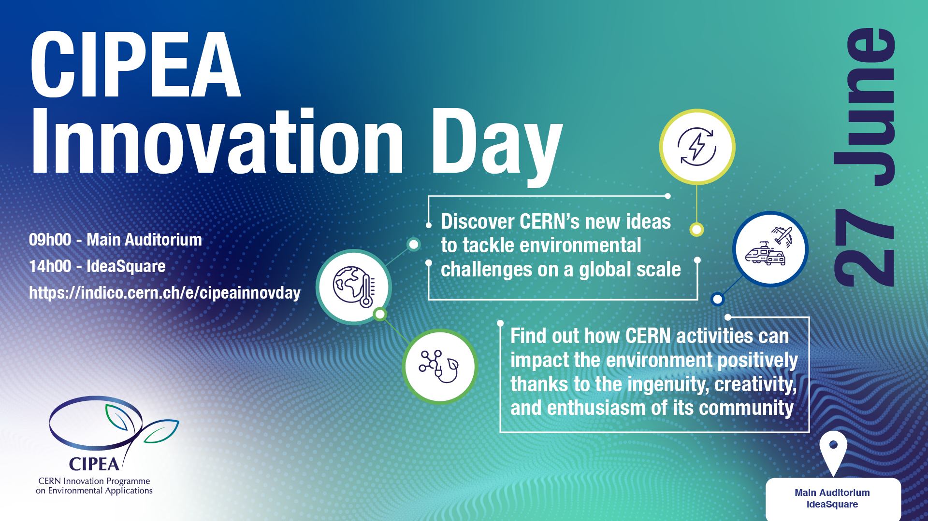

Slide 15
CIPEA Innovation Day Agenda
Main Auditorium
IdeaSquare

Slide 16
Session 1
New Ideas in Area 1 «Renewable and Low-Carbon Energy» and 2 «Clean Transportation and Future Mobility»

Slide 17
Session 2
Examples and new ideas in Area 3 «Climate Change and Pollution Control» and 4 «Sustainability and Green Science»
HFC² CO₂

Slide 18
Session 3
New Ideas in Area 3 «Climate Change and Pollution Control»

Slide 19
Session 4
New Ideas in Area 4 «Sustainability and Green Science»
SF6

Slide 20
Thank you!
https://kt.cern/environment/CIPEA

