Slide 1
Design of the new bunching and accelerating system for
AWAKE Run 2
J. Arnesano, S. Doebert

Slide 2
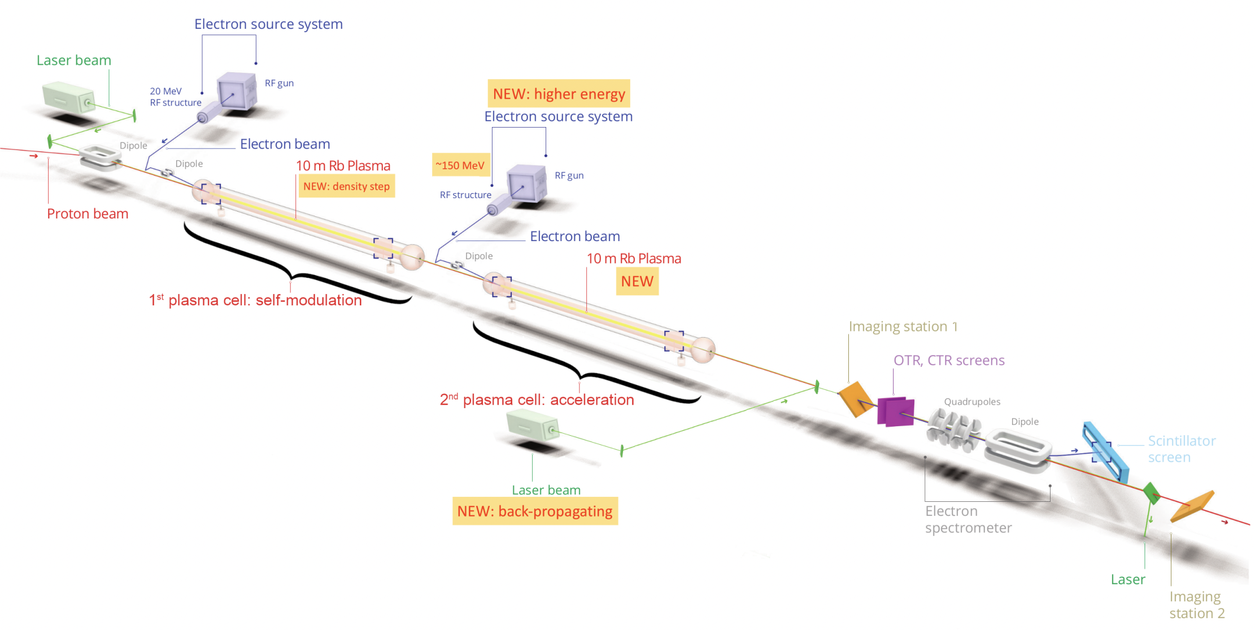
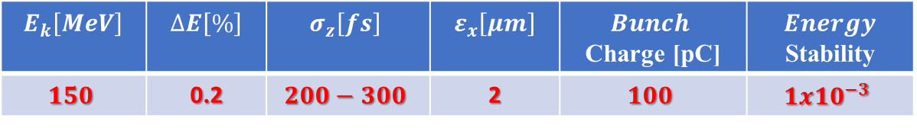
The new Injector for AWAKE Run 2
Injector Parameters
$$E_{k}\left[MeV\right]$$ | $$ΔE\left[\%\right]$$ | $$σ_{z}\left[fs\right]$$ | $$ε_{x}\left[μm\right]$$ | $$Bunch$$ Charge [pC] | $$Energy$$ Stability
$$150$$ | 0.2 | $$200−300$$ | 2 | $$100$$ | $$1x{10}^{−3}$$

Slide 3
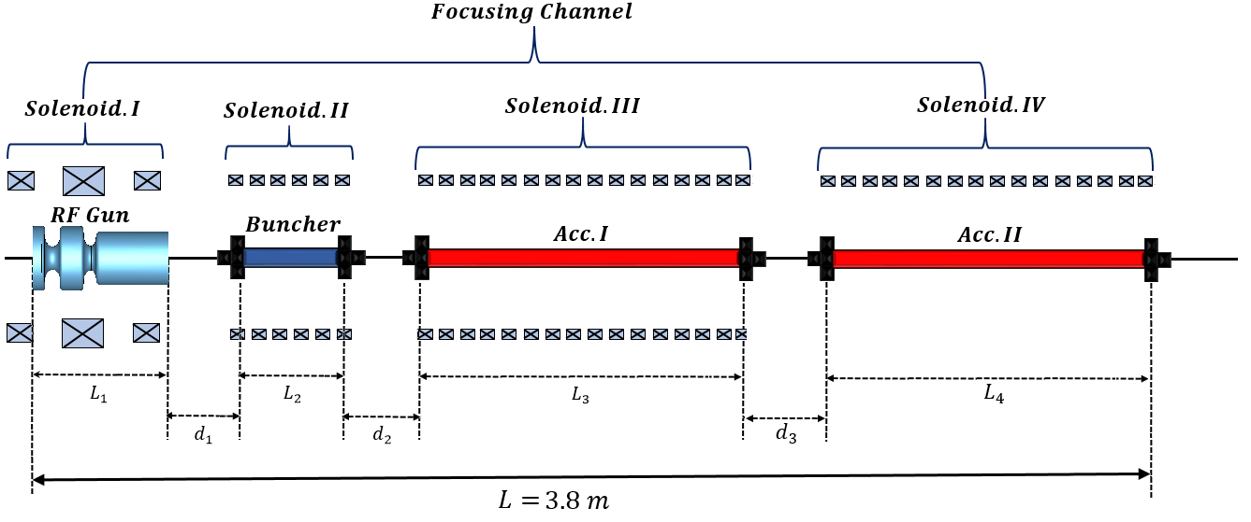
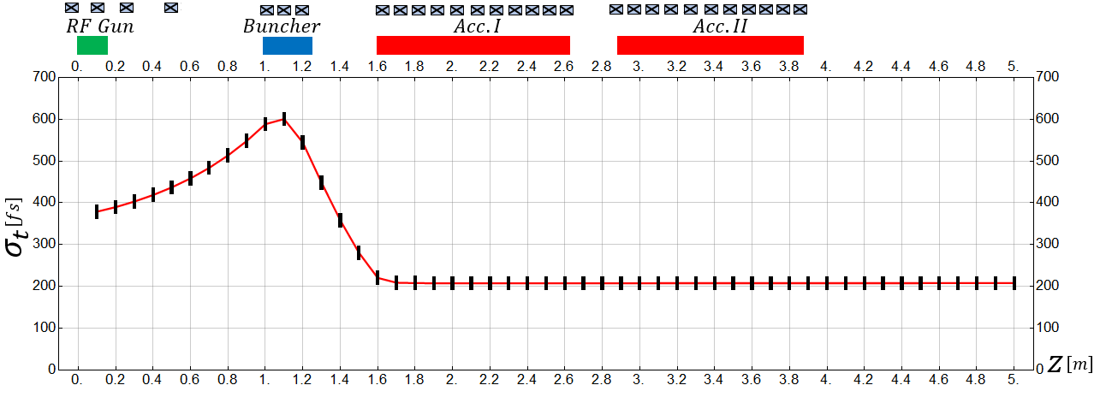
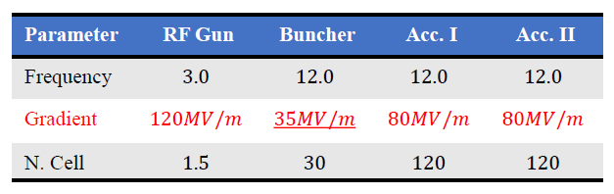
First Reference Design
𝑬_{𝒌}[M𝒆𝑽] | 𝝈_{𝒓}[𝒎𝒎] | 𝝈_{𝒕}[𝒇𝒔] | 𝜺_{𝒙}[𝝁𝒎] | 𝝈_{𝑬}% | 𝑰_{𝒂𝒗}[A]
𝟏𝟔𝟓 | 0.14 | 𝟐𝟎𝟕 | 0.44 | 𝟎.𝟎9 | 168
Mohsen Dayyani Kelisani

Slide 4
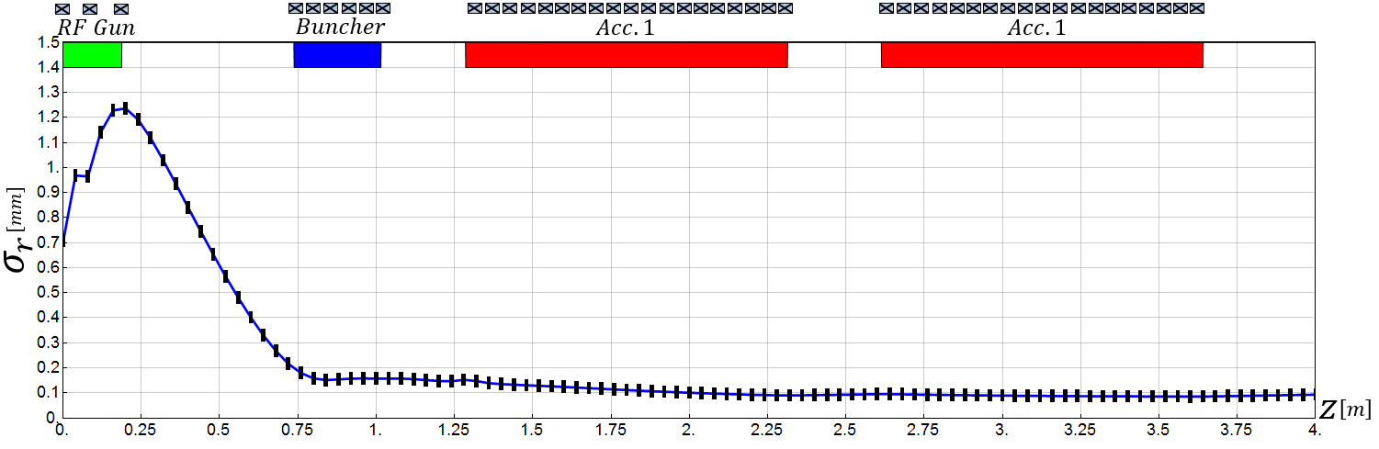
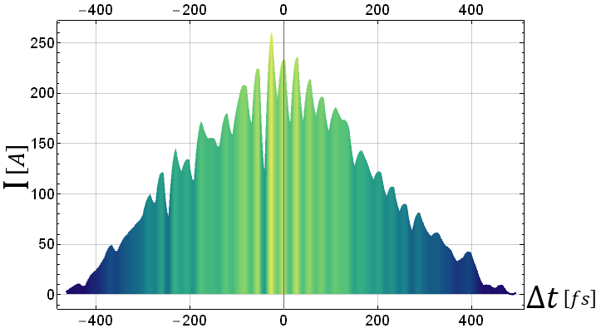
First Reference Design

Slide 5


The two new ideas for the reference design
More realistic and cost efficient
First Idea: 3 cavities of the same length
 | Frequency | Avg. Gradient | Length
Buncher (zero crossing) | 11.994 GHz | 30 MV/m | 90 cm
Acceleration X2 | 11.994 GHz | 80 MV/m | 90 cm
GUN
Buncher
Linac
Linac
Second Idea: a small cavity for bunching and 3 cavities for acc.
 | Frequency | Avg. Gradient | Length
Buncher (zero crossing) | 11.994 GHz | 30 MV/m | 30 cm
Acceleration X3 | 11.994 GHz | 55 MV/m | 90 cm
GUN
Buncher
Linac
Linac
Linac

Slide 6
Outline
X-Band Power System
GUN, Linac, Solenoid and simulations
Pulse compressor optimization
DH Waveguides

Slide 7
X-Band KLYSTRON
First Idea
MODE CONVERTER
DOUBLE-HEIGHT WAVEGUIDE
α=0,06 [dB/m]
Only one klystron is required
Two power dividers are required
A phase shifter is required
High accelerating voltage is required
MODE CONVERTER
PC
ASYMMETRIC Power Divider
SYMMETRIC Power Divider
Phase shifter
BUNCHER
LINAC
LINAC
30 MV/m
80 MV/m
80 MV/m

Slide 8
Small KLYSTRON
KLYSTRON
Second Idea
MODE CONVERTER
DOUBLE-HEIGHT WAVEGUIDE
Two Klystrons are required
Only one symmetric power divider is required
The shifter is not required
Accelerating Voltage lower compared to the previous case
MODE CONVERTER
PC
SYMMETRIC
Power Divider
Seems more suitable for our purposes
BUNCHER
LINAC
LINAC
LINAC
30 MV/m
53 MV/m
53 MV/m
53 MV/m

Slide 9
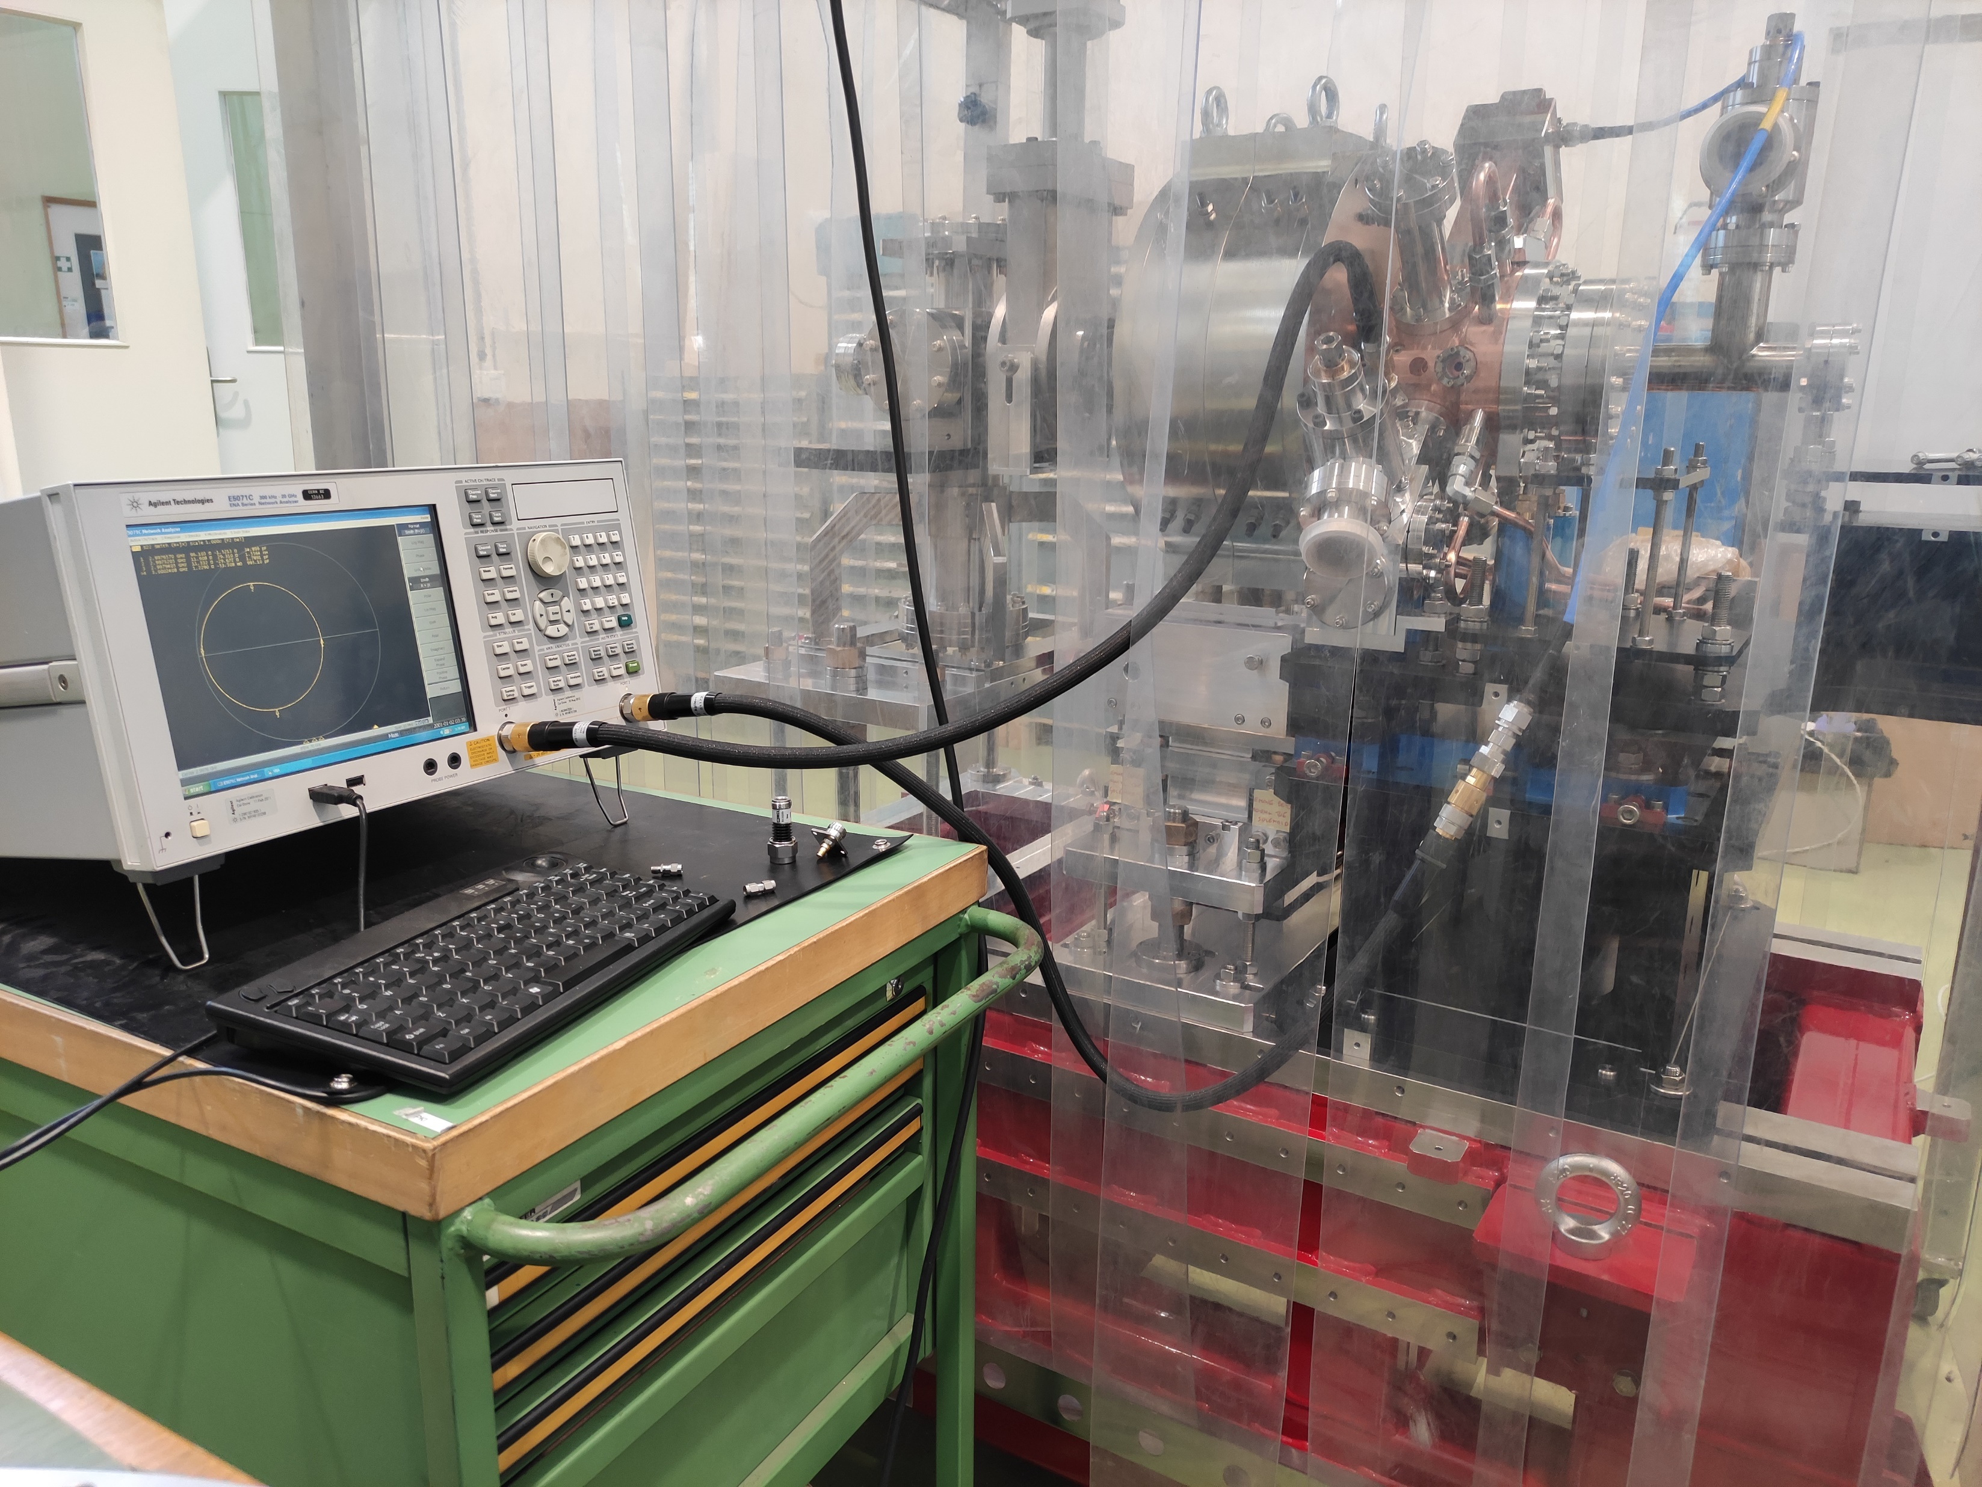
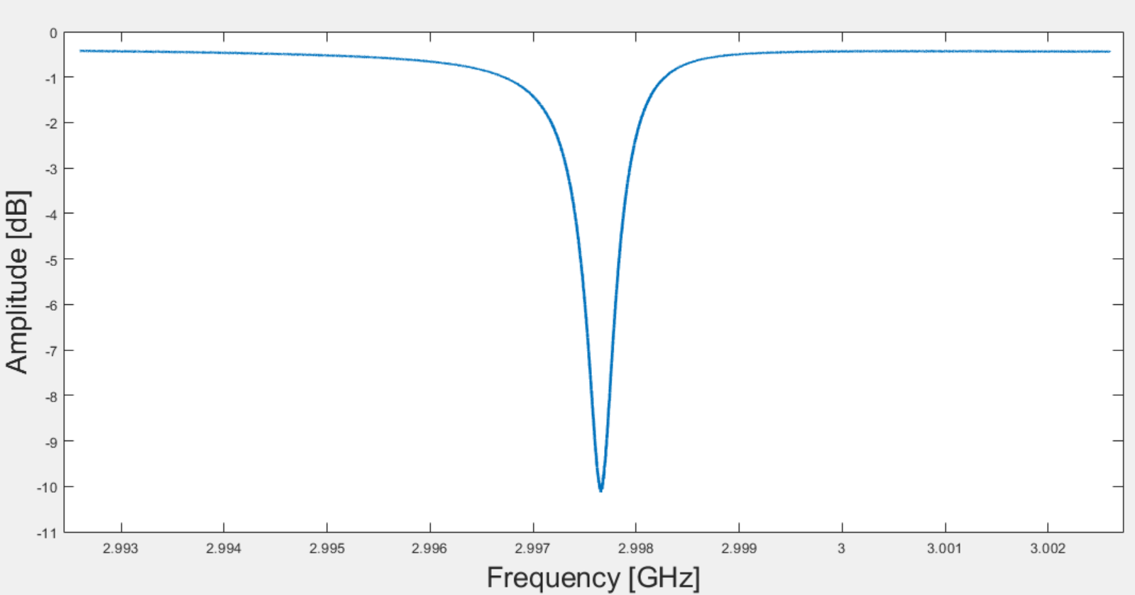
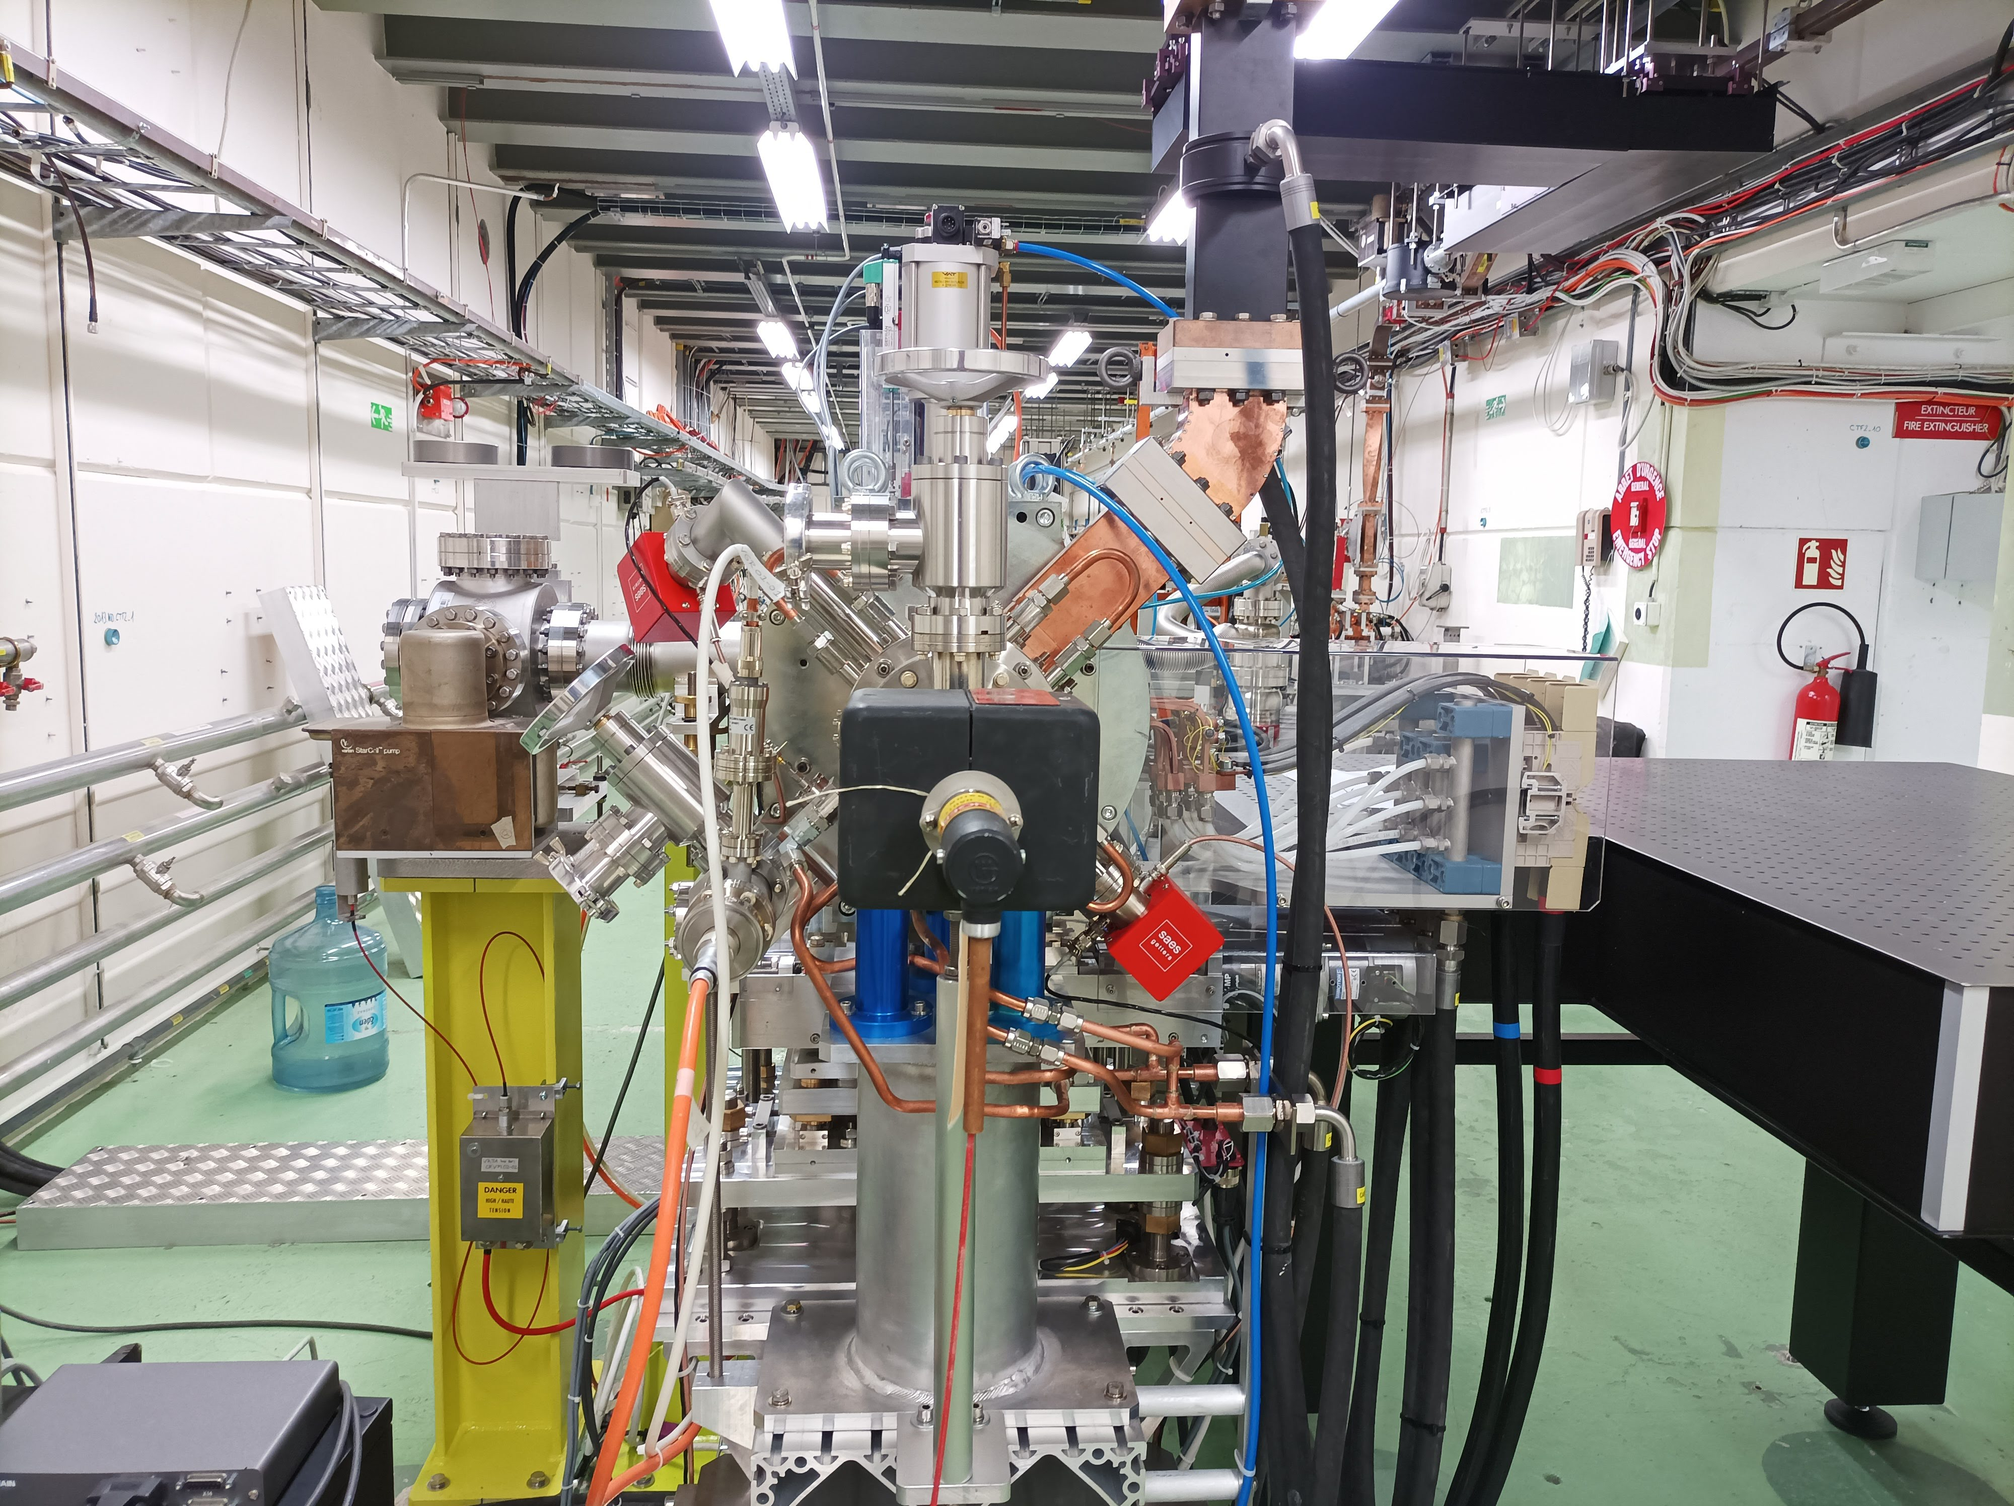
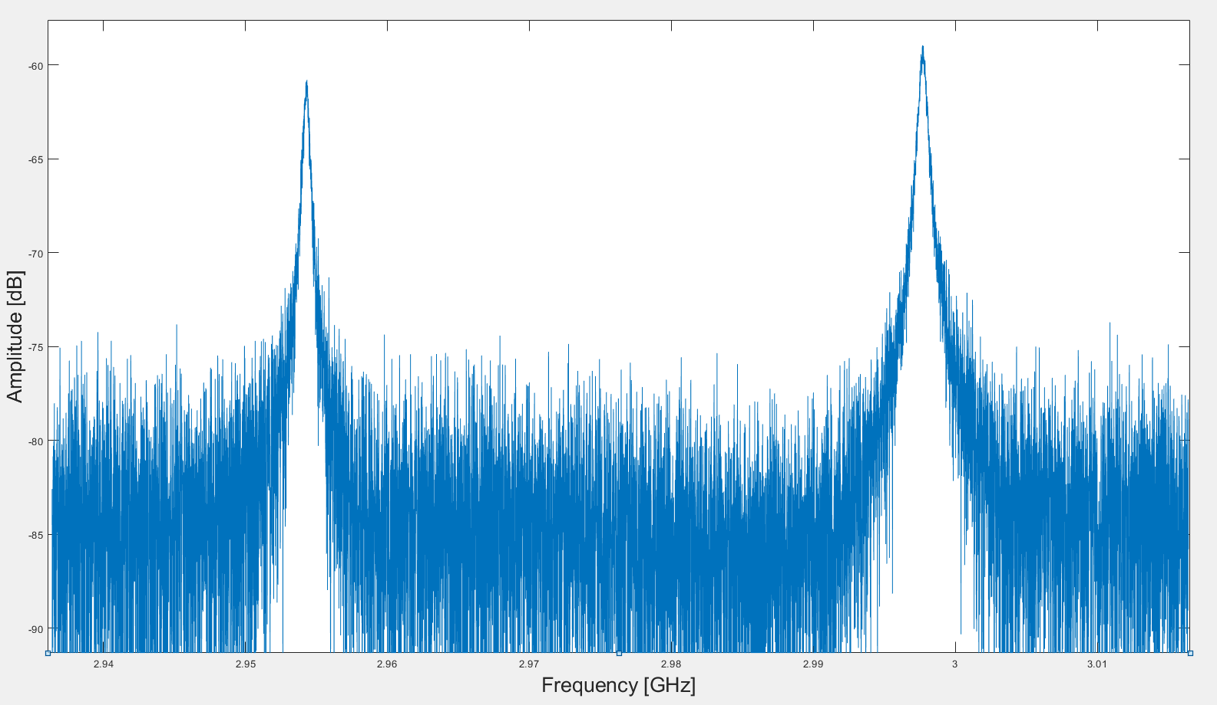
S-Band GUN
Low-Level RF Measurements
2.997656 [GHz]
-10.13 [dB]
Measurements has been performed under nitrogen at ambient temp.
Beta=1.90
Q=4834
Already
installed
at CTF2
Transmission
2.95433 [GHz] “0-mode”
-60 [dB]
2.99769 [GHz] “π-mode”
-58 [dB]

Slide 10
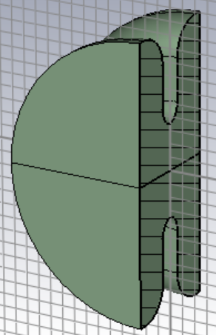
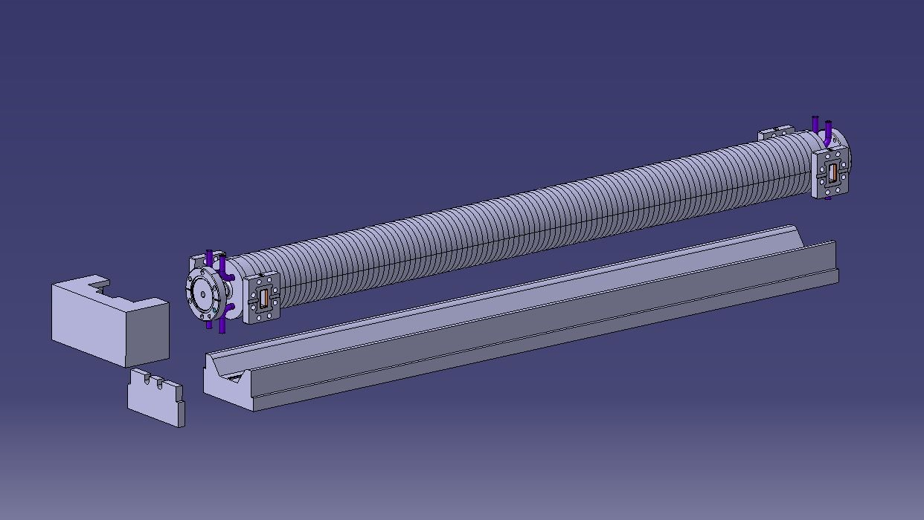
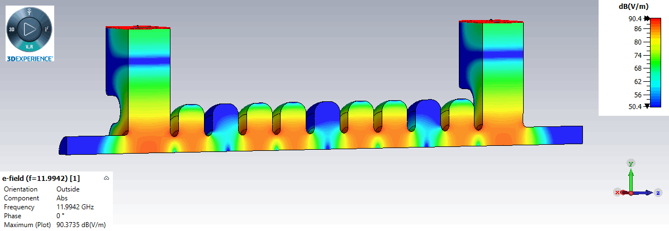
LINAC
Shunt Impedance [MΩ/m] | 100
Group Velocity vg/c [%] | 2.4
Q-Factor [A.U] | 7061
Attenuation [1/m] | 0.7
Travelling wave
Constant Impedance
Designed by INFN Frascati
Mechanical draw designed at CERN

Slide 11
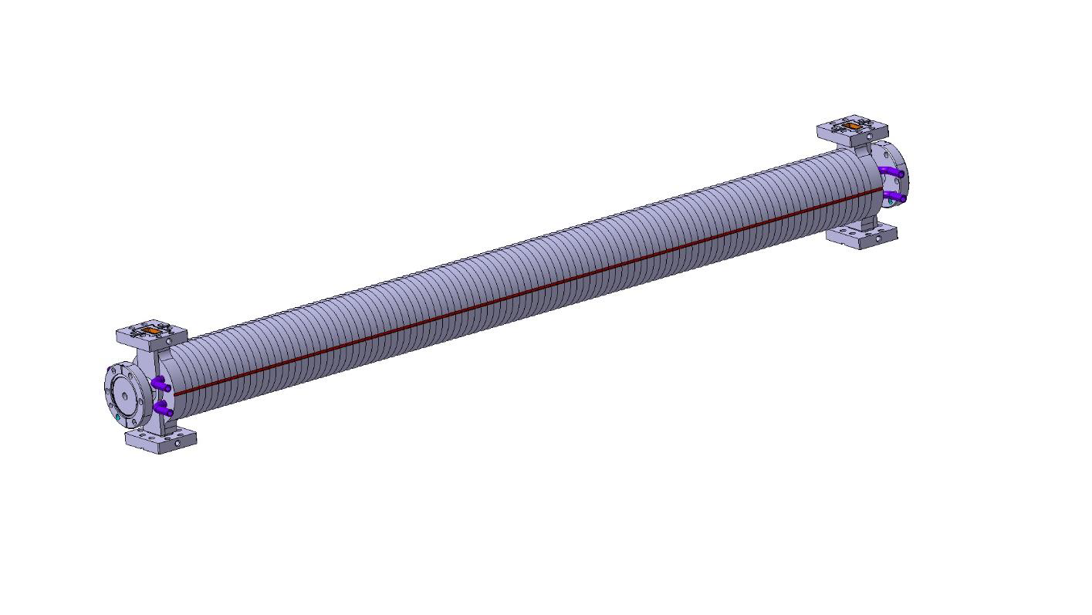
X-Band Mechanical Design
CLIC style tolerances
Vacuum brazing design
Structure to be inserted in a solenoid of 150 mm diameter bore radius

Slide 12
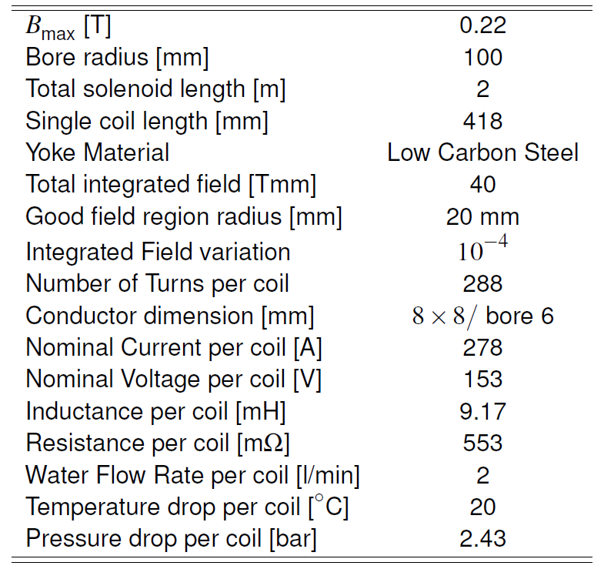
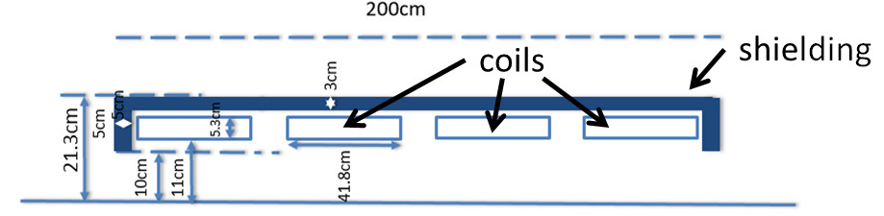
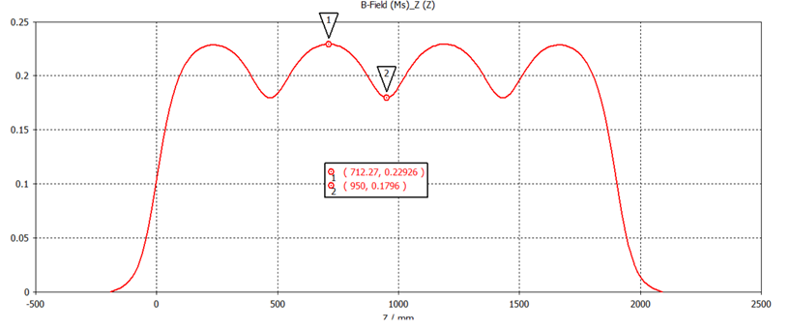
Solenoid
*
*
Simulation done by CST Microwave Studio (Magnetostatic solver)
2200 [Gauss]
*M. Ferrario, D. Alesini, et al., "Preliminary assessments and evaluations of the optimum e-gun and injector solution for the CompactLight design“, XLS-Report-2019-001 27 June 2019.

Slide 13
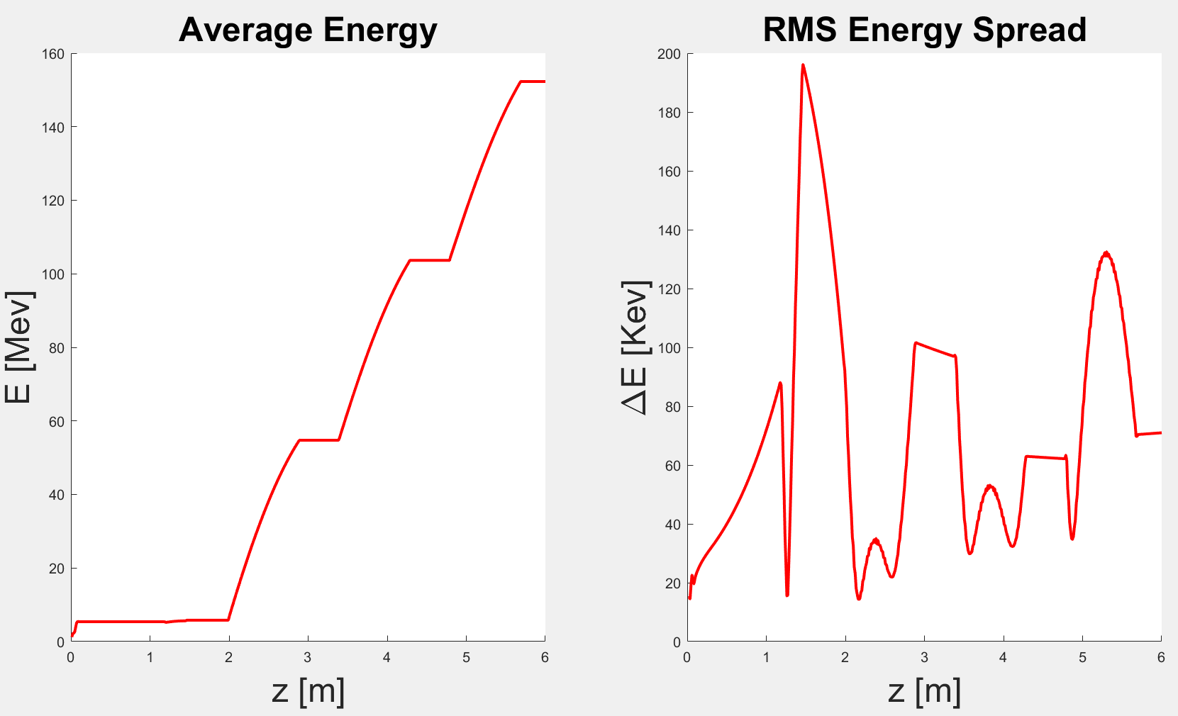
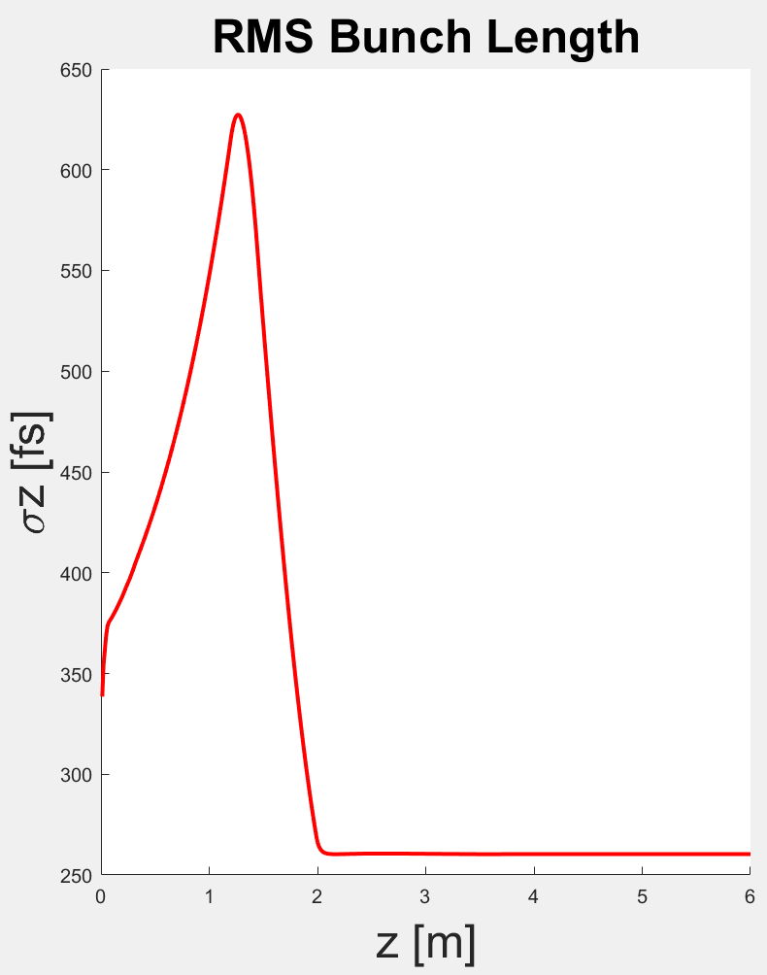
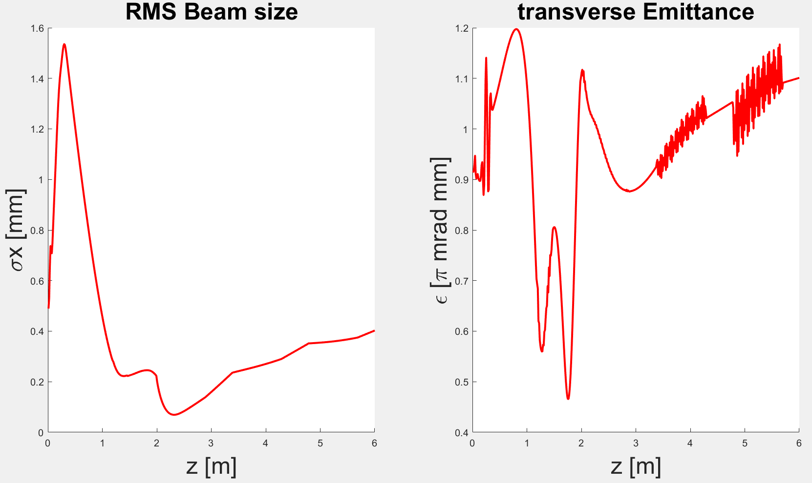
Astra
Simulations
𝑬_{𝒌}[M𝒆𝑽] | 𝝈_{𝒓}[𝒎𝒎] | 𝝈_{𝒕}[𝒇𝒔] | 𝜺_{𝒙}[m𝒎] | 𝝈_{𝑬}%
152 | 0.4 | 260 | 1.1 | <𝟎.1
Work in Progress!

Slide 14
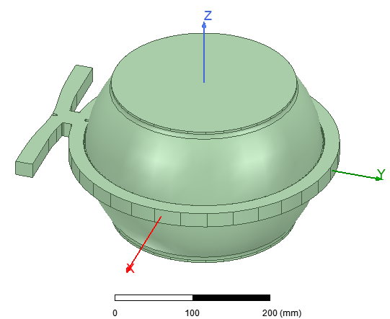
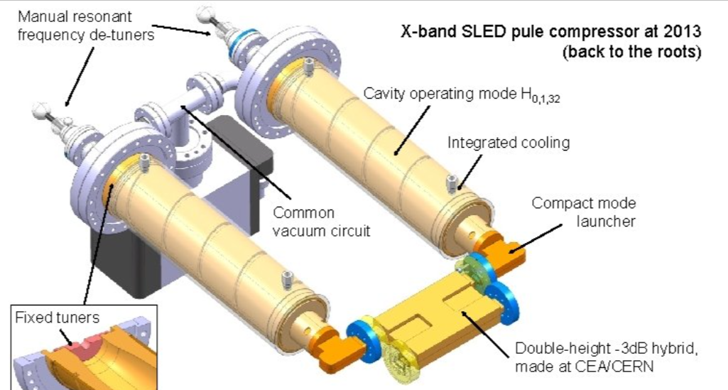
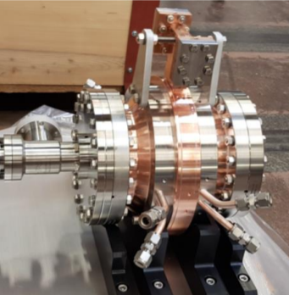
X-Band Power System Optimization
All of them have been optimized for a particular LINAC
XBOC – Barrel Open cavity
At PSI
XBOC – Barrel Open cavity for CLIC (work in progress)
“Classical” SLED here at CERN- Xbox2
Q=170000
Beta=5.8
Q=150000
Beta=7.5
Q=234000
Beta=7.4
1-Can we use them for our system?
2-Between these three, which one suits better for our system?

Slide 15
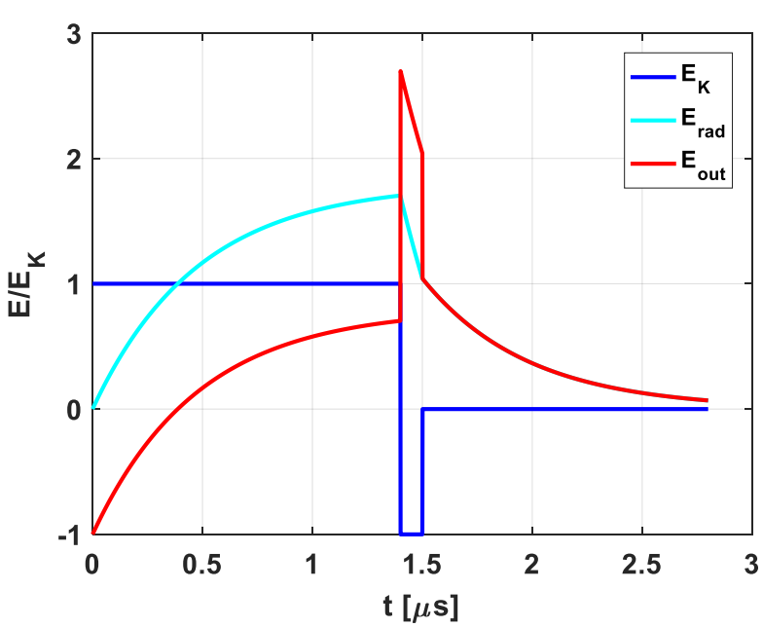
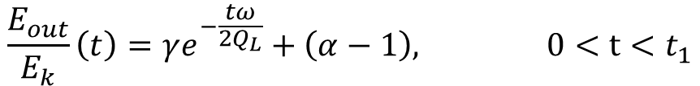
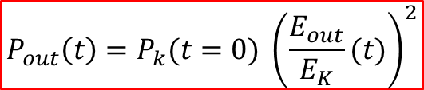


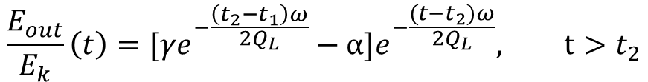
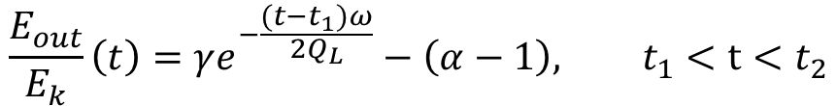
Pulse Compressor: the SLED theory
Example compressed pulse of 100 [ns] with a Qe of 200000.
$$E_{out}=E_{e}+E_{k}$$
$$P_{out}\left(t\right)=P_{k}(t=0) {\left(\frac{E_{out}}{E_{K}}(t)\right)}^{2}$$
$$γ=α(2−e^{−\frac{t_{1}ω}{2Q_{L}}})$$
$$\frac{E_{out}}{E_{k}}\left(t\right)=γe^{−\frac{tω}{2Q_{L}}}+\left(α−1\right), 0<t<t_{1}$$
$$\frac{E_{out}}{E_{k}}\left(t\right)=γe^{−\frac{(t−t_{1})ω}{2Q_{L}}}−\left(α−1\right), t_{1}<t<t_{2}$$
$$\frac{E_{out}}{E_{k}}\left(t\right)=[γe^{−\frac{\left(t_{2}−t_{1}\right)ω}{2Q_{L}}}−α]e^{−\frac{(t−t_{2})ω}{2Q_{L}}}, t>t_{2}$$
For the optimization Q₀ and β of the storage cavities and r, Q, vg, τ_{a} of the LINAC are the fundamentals parameters to analyze
Z. Farkas, et al. , SLED: A method of doubling SLAC’s energy, Proc. Of 9th Int. Conf. On High Energy Accelerators, 1974, p. 576

Slide 16

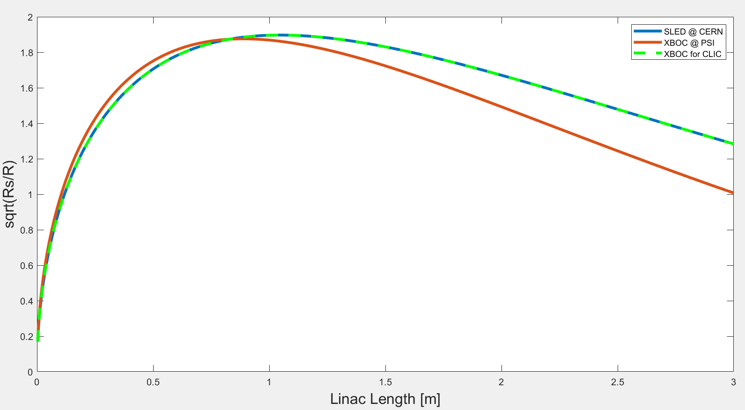
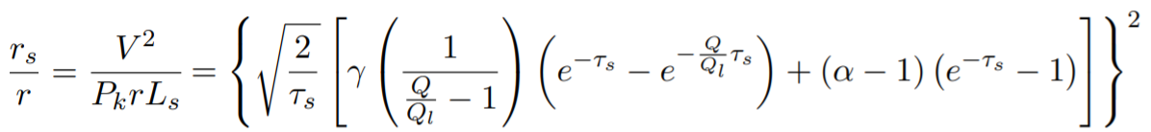
Pulse Compression Optimization
Q₀, β
r, Q, vg, τ_{s}
It can be proof that, for a TW costant impedance strcuture with Pulse compression*:
+
Effective Shunt Effective
To optimize**:
For each value of the filling time of the accelerating Structure there is a value of β of the storage cavities wich maximizes Rs*
L=0,9 m
τ_{s} =125 ns
*J. Le Duff, High-field electron linacs, CERN 95-06, (1995)
**M. Diomede, High-gradient structures and RF systems for high-brightness electron linacs

Slide 17
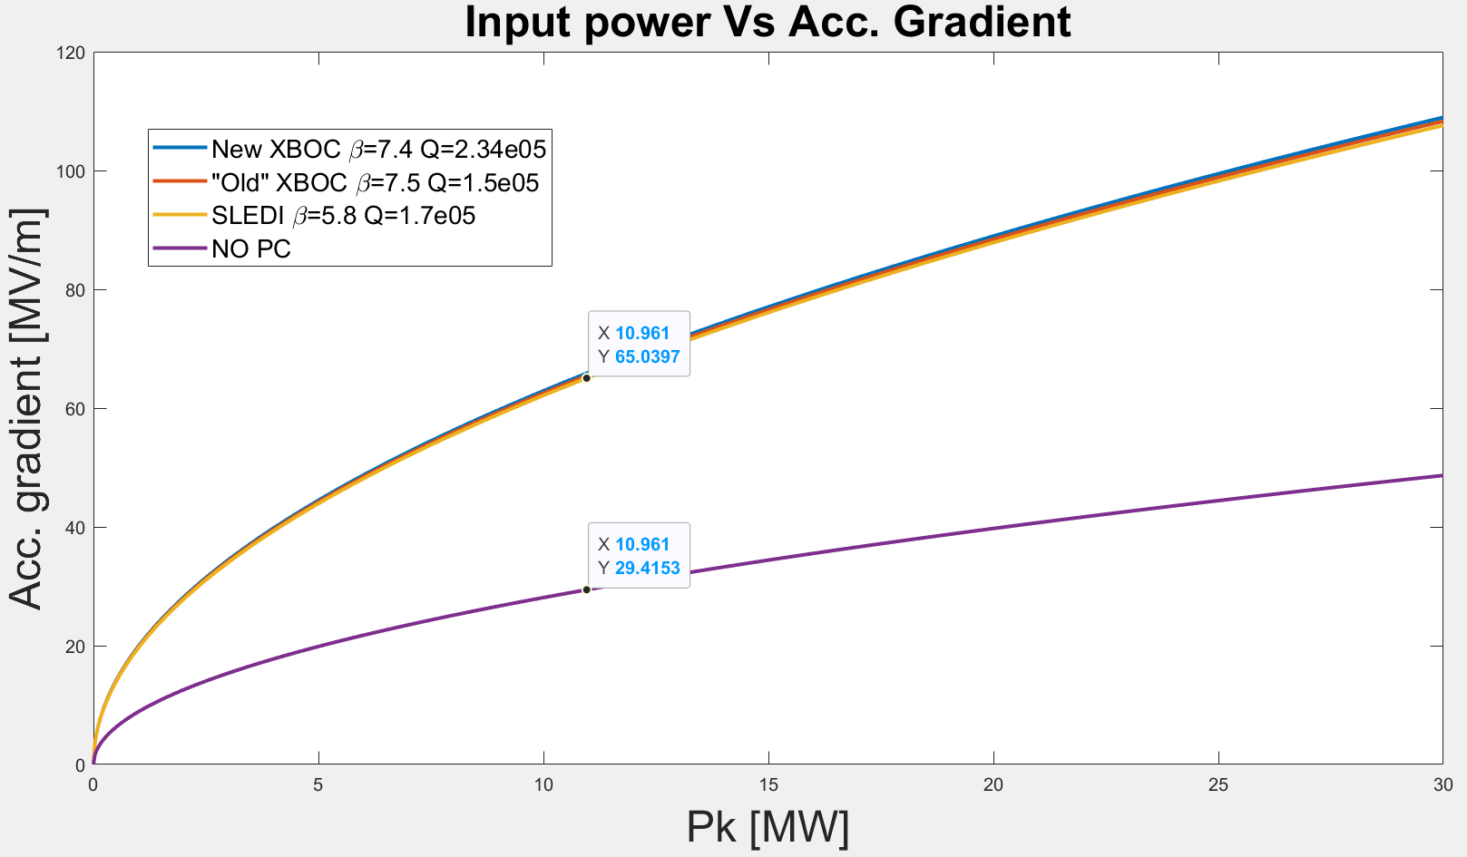
Pulse Compression Optimization
 | New XBOX | Old XBOX | SLEDI
Filling time [ns] (0,9 [m]) | 125 | 125 | 125
Imput power @65 MV/m [MW] | 10,7 | 10,8 | 10,9
*Effective shunt Impedance [MΩ/m] | 359 | 359 | 346
*Multiplication factor | 2,24 | 2,22 | 2,20
*Power Multiplication Factor | 5,01 | 4,93 | 4,84
*Compression Efficiency | 0,42 | 0,41 | 0,40
1-Can we use them for our system?:
yes, definitely
2-Between these three, which one suits better for our system?:
All 3 seem to be working fine
*Chao A., Tigner M., Handbook of accelerator Physics and Engineering

Slide 18
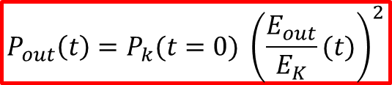
Some Numbers…
Small KLYSTRON
KLYSTRON
10 MW flat pulse,
1.5 [us]
40 MW flat pulse, 1.5 [us]
$$P_{out}\left(t\right)=P_{k}(t=0) {\left(\frac{E_{out}}{E_{K}}(t)\right)}^{2}$$
MODE CONVERTER
α=0,06 [dB/m]
α=0,06 [dB/m]
30 [m]=-1.8 [dB]
34% power loss
30 [m]=-1.8 [dB]
34% power loss
MODE CONVERTER
Q=170000
Beta=5.8
Input
26 MW flat pulse
7.3
4.2
PC
6.6 MW flat pulse
Output
190 MW peak
SLED Pulse
125 [ns]
SYMMETRIC
Power Divider
Output: 3X 58 MW peak
SLED pulse
BUNCHER
LINAC
LINAC
LINAC
30 MV/m
55 MV/m
55 MV/m
55 MV/m

Slide 19
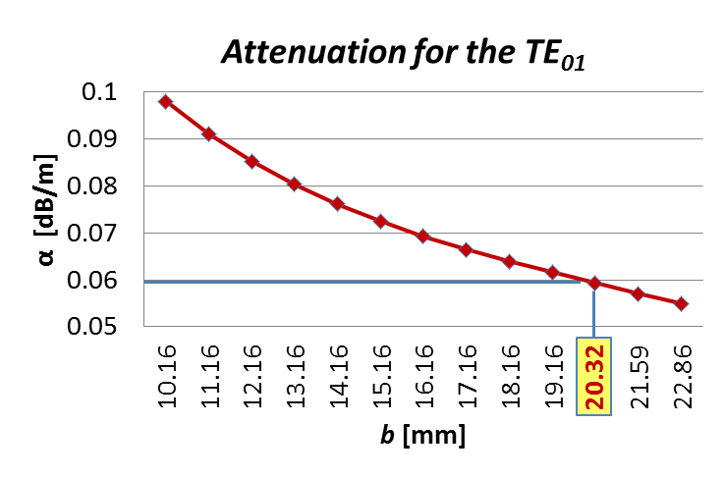
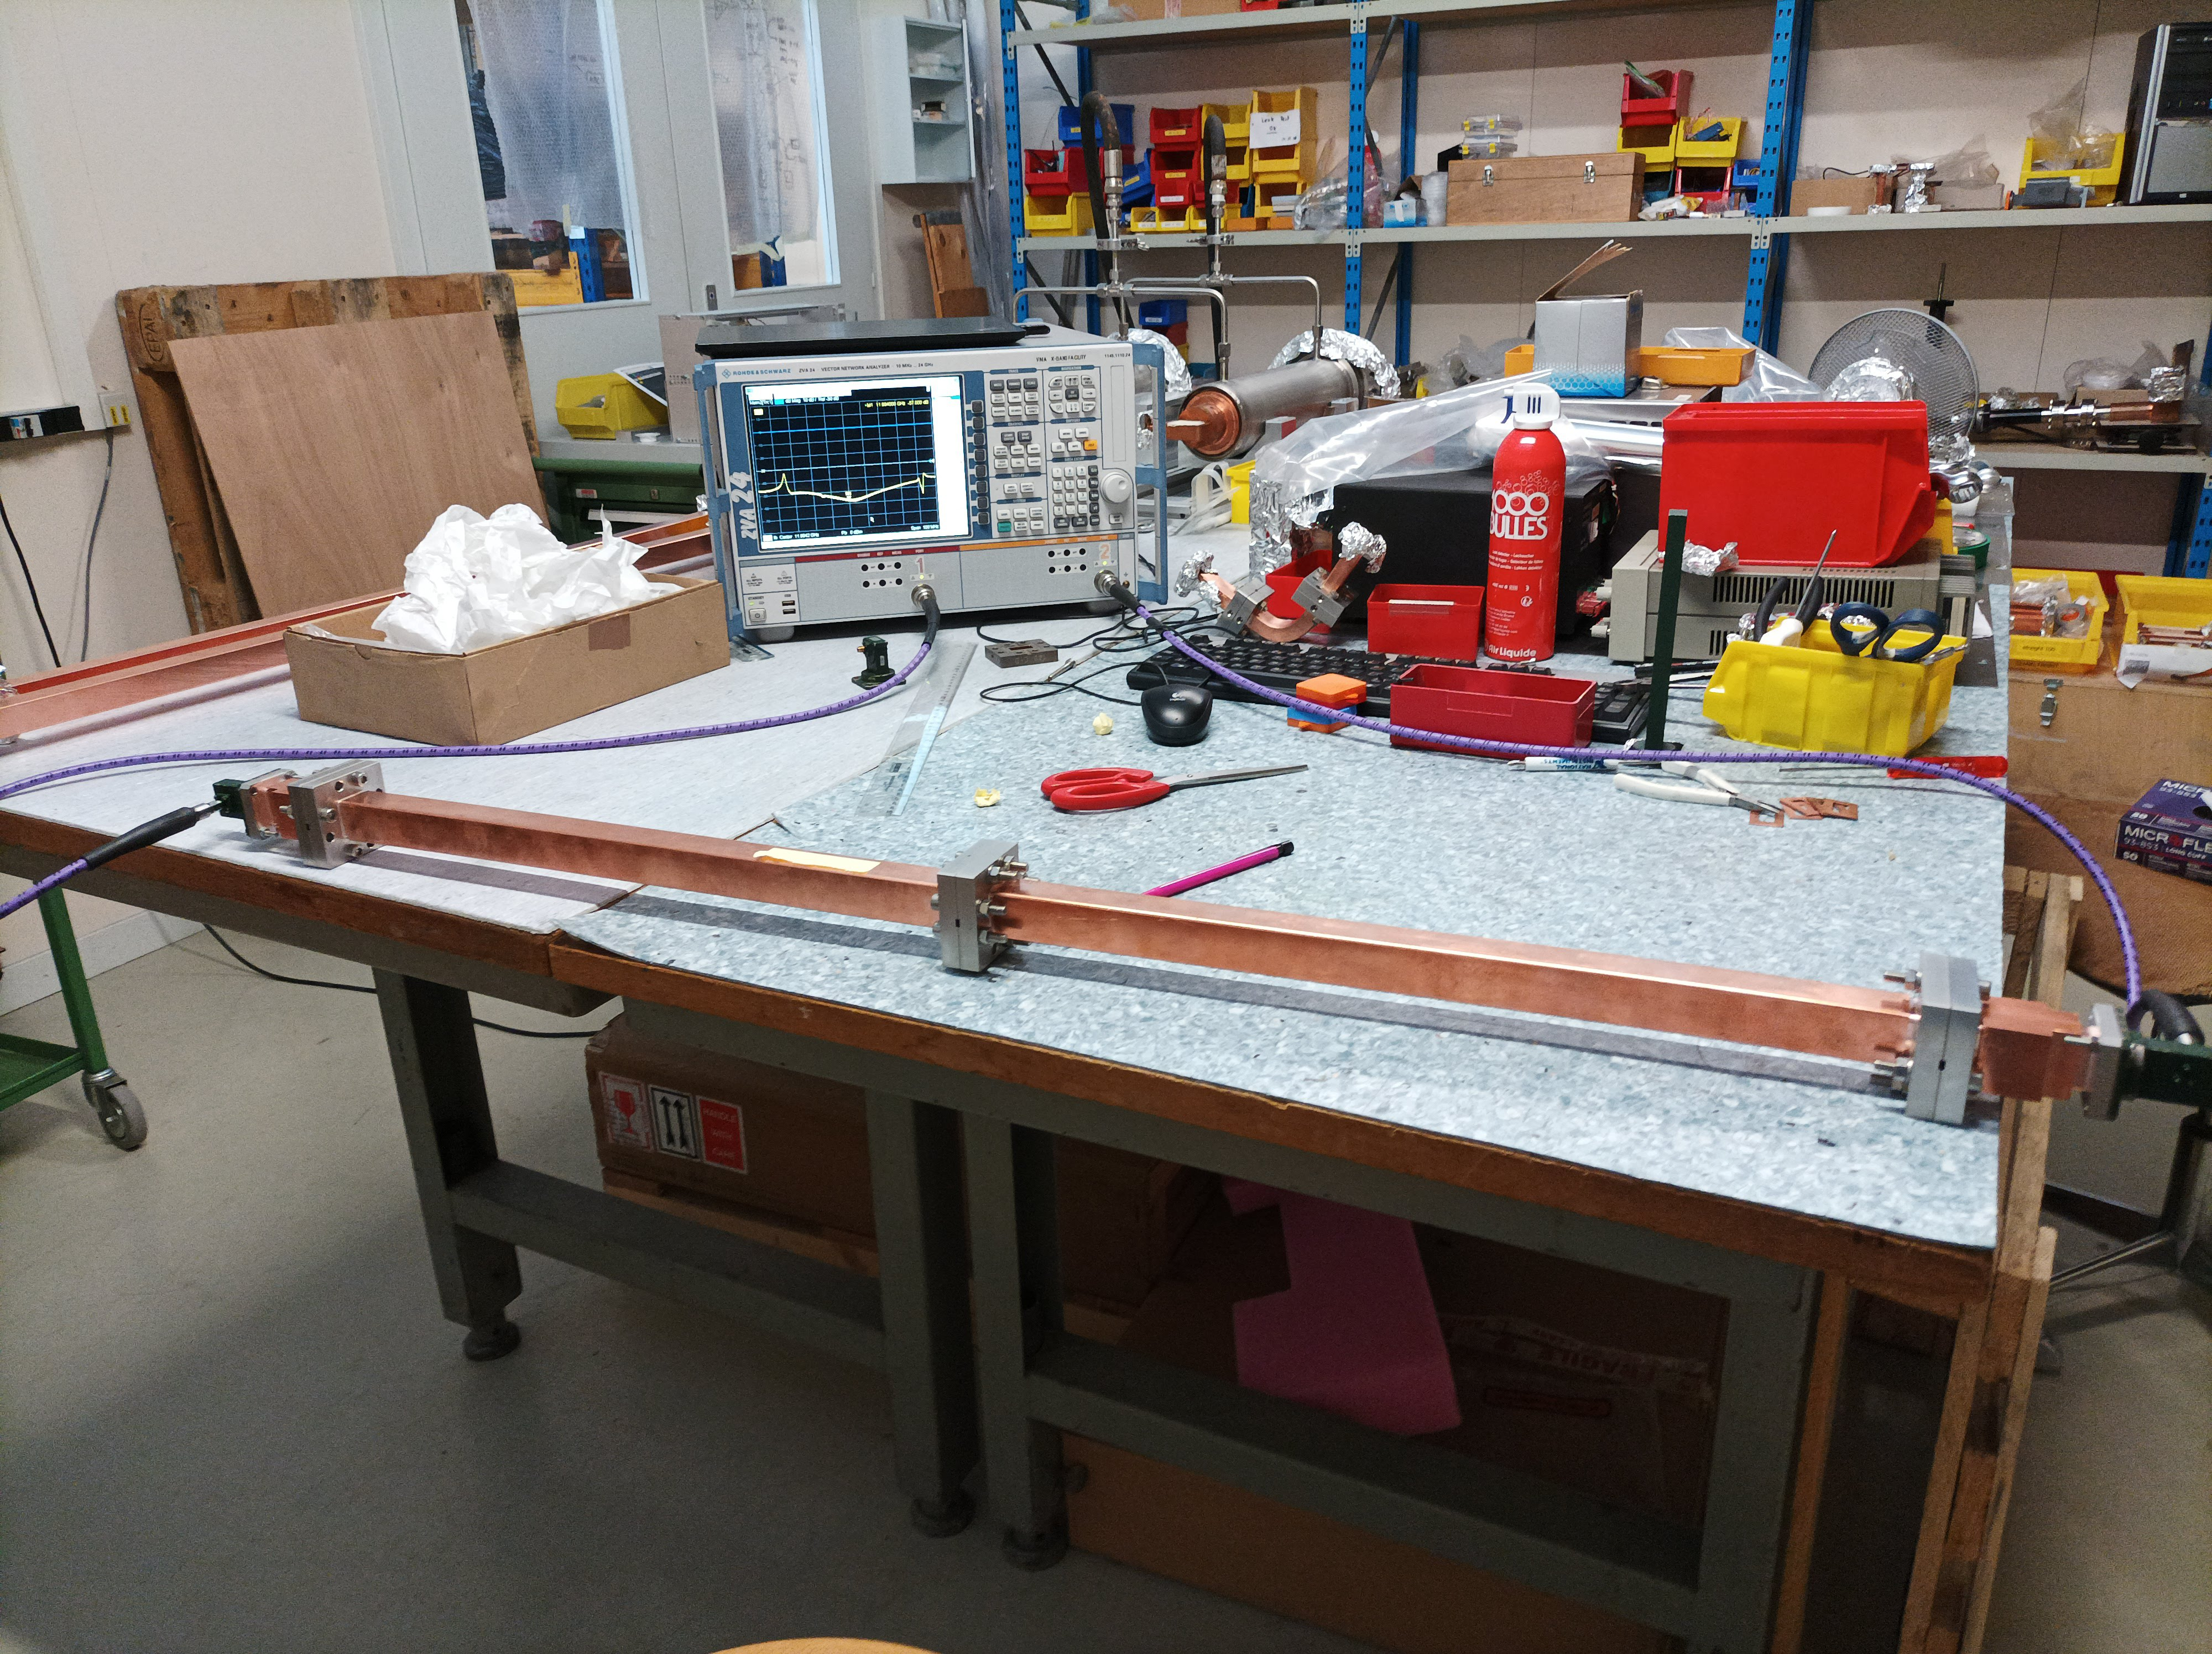
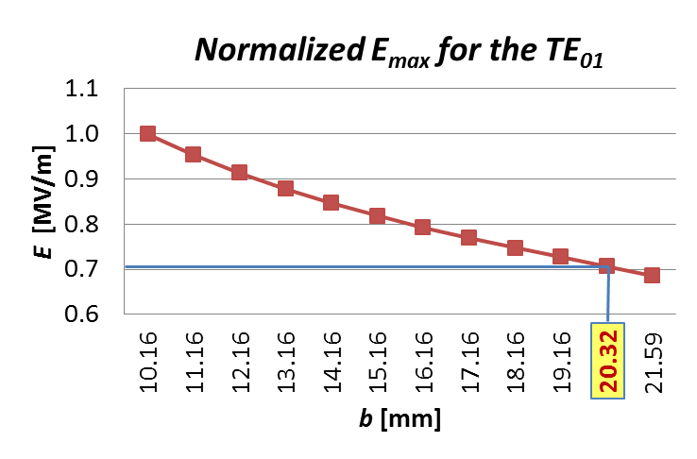
Double-Height Waveguide System
a = 22.86 mm
b = 20.32 mm
With a double-height waveguide, the attenuation is reduced by 40% and electric and magnetic fields are reduced by 30%.
Double height waveguide is preferred

Slide 20
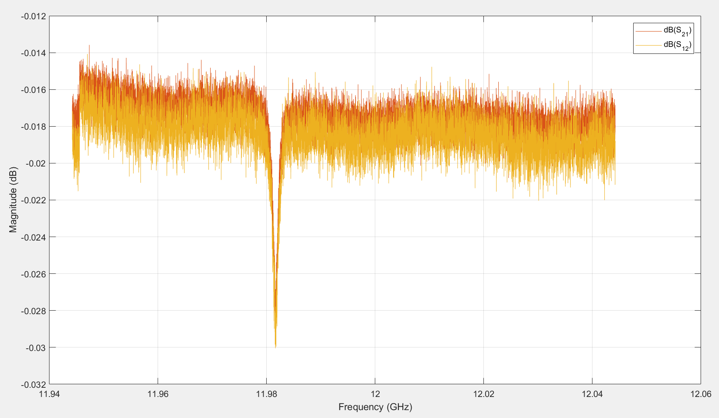
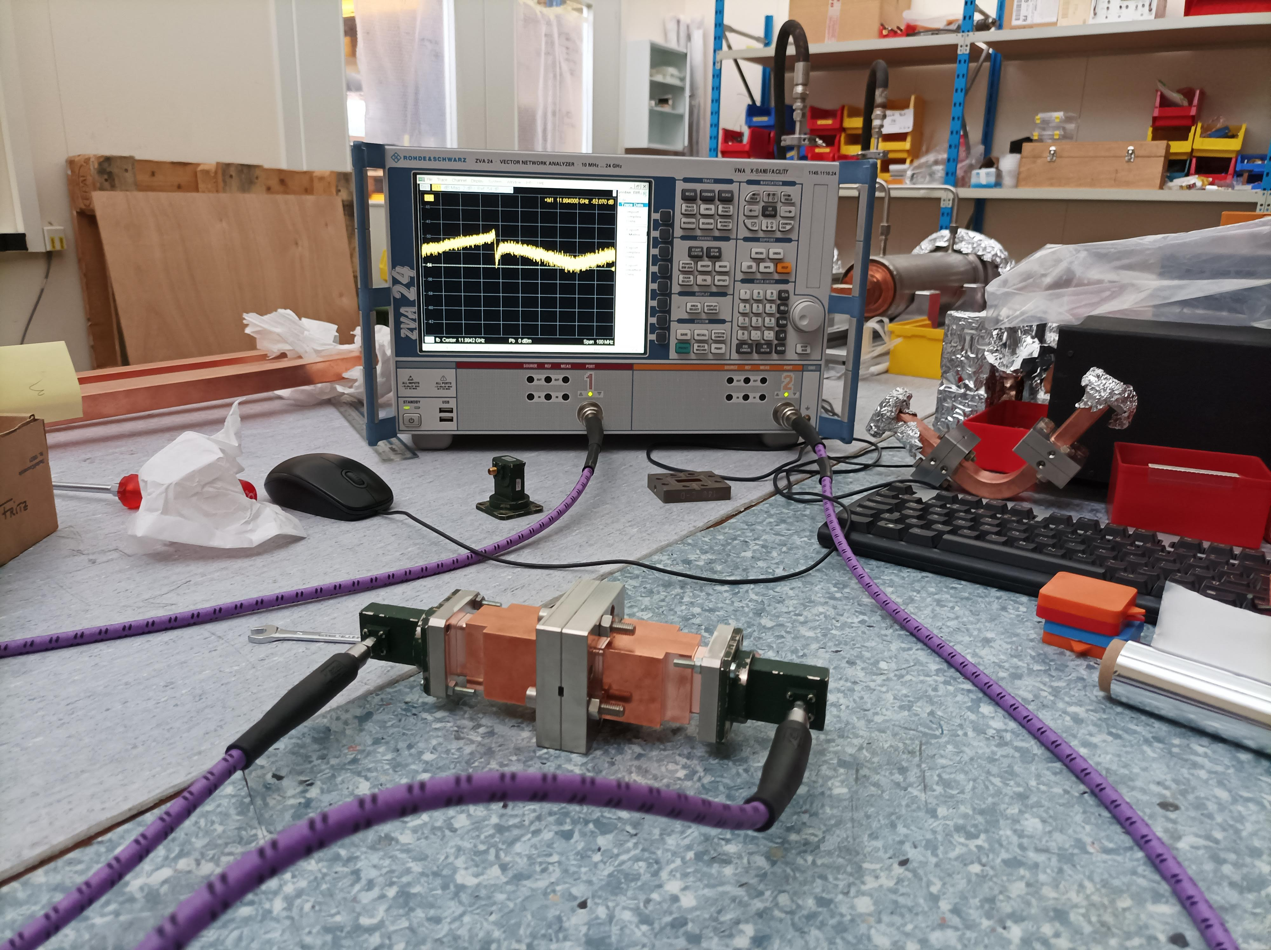
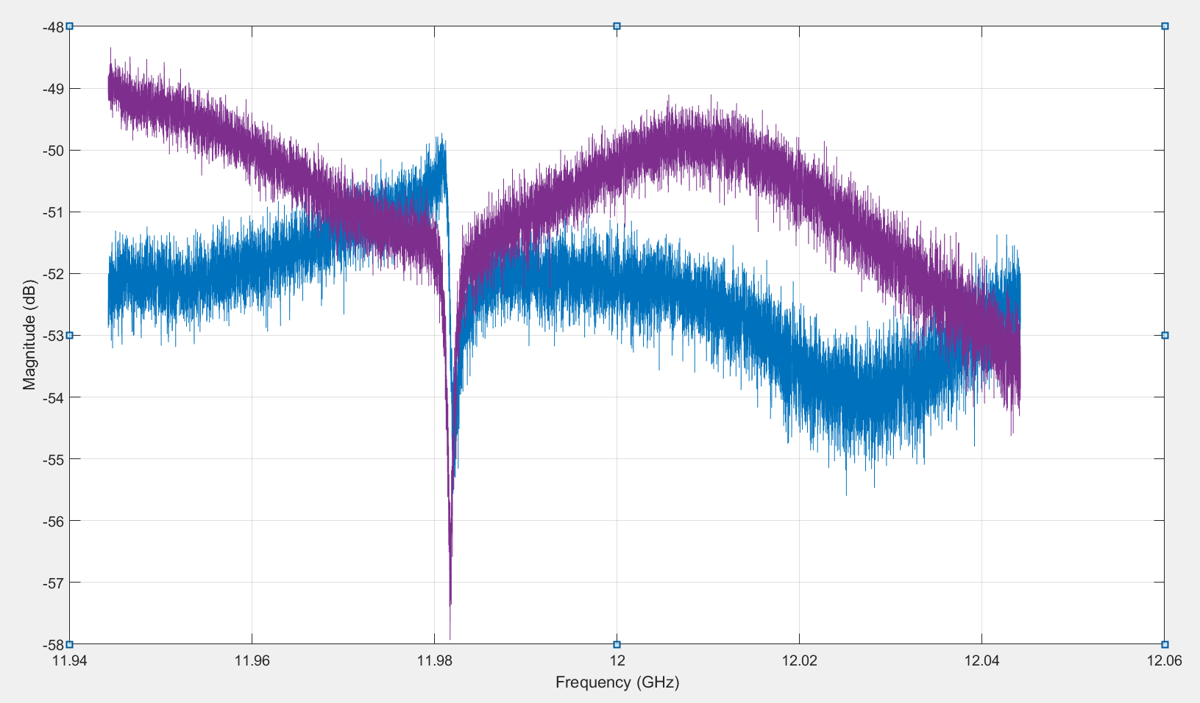
Double-Height Waveguide System
Transitions (wr90 to DH)
S-Parameters @11,9942 GHz
S11 < -50 dB
S21≈-0.018 dB
S12 ≈ -0.018 dB
S22 < -50 dB
Calibration:
Center Freq=11,9942GHz,
SPAN=100MHz
#points=16001, IF filter=1KHz

Slide 21
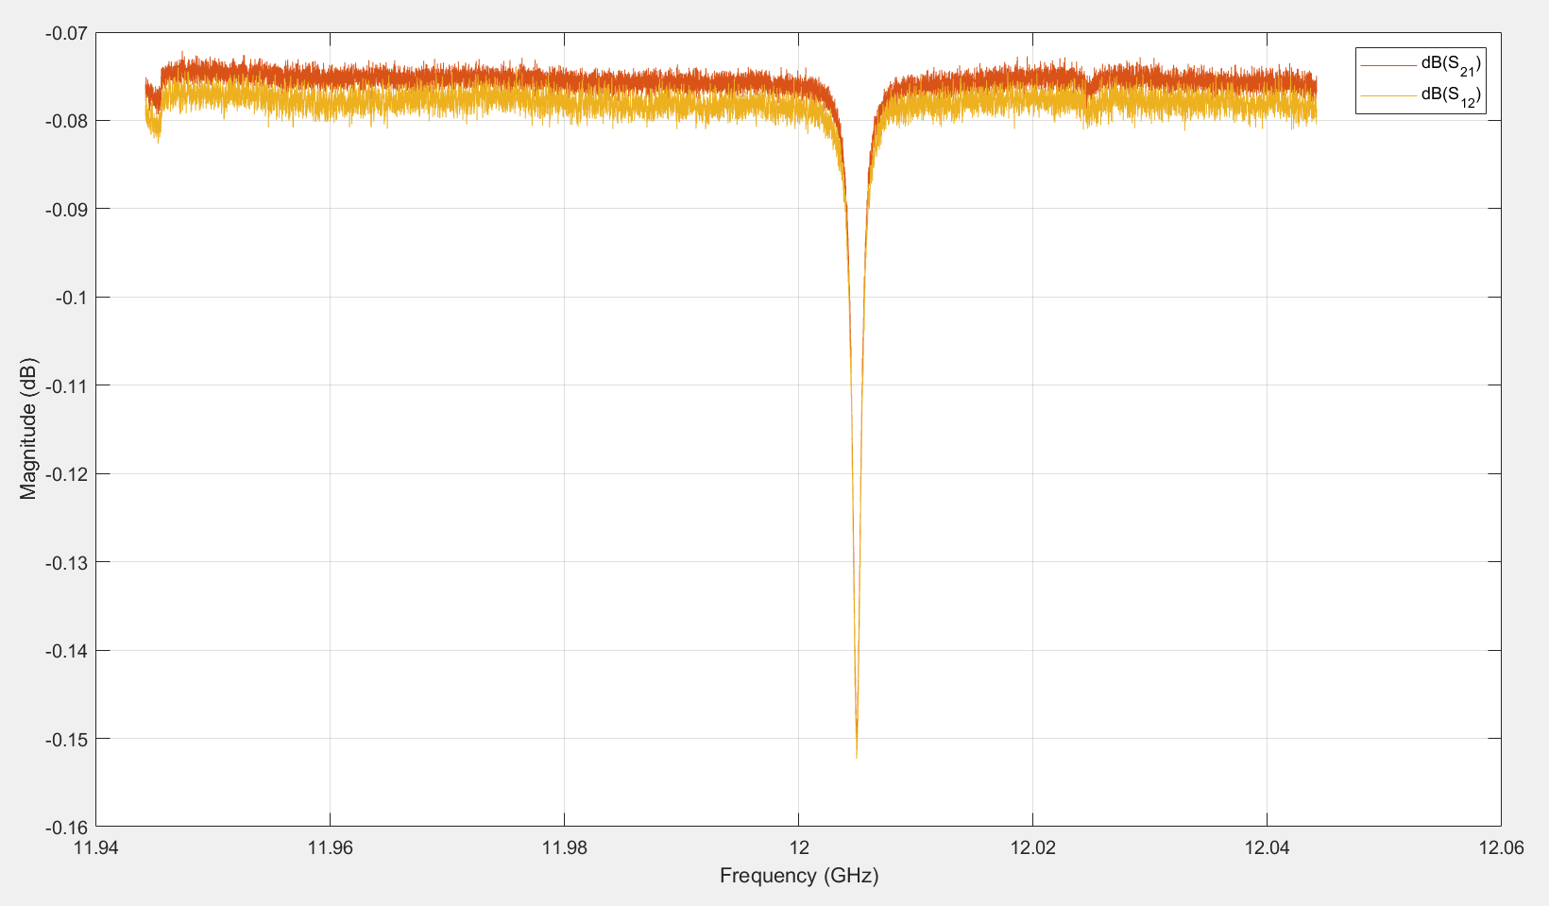
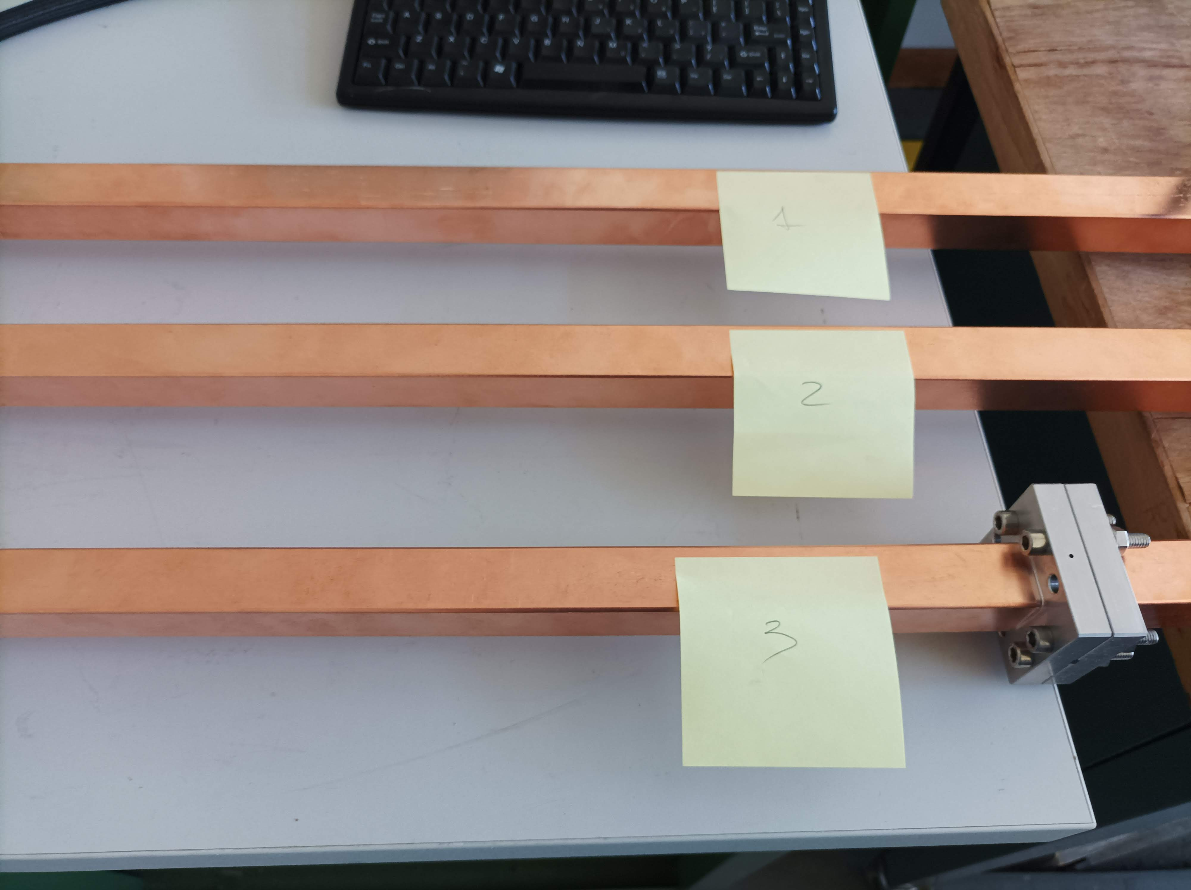
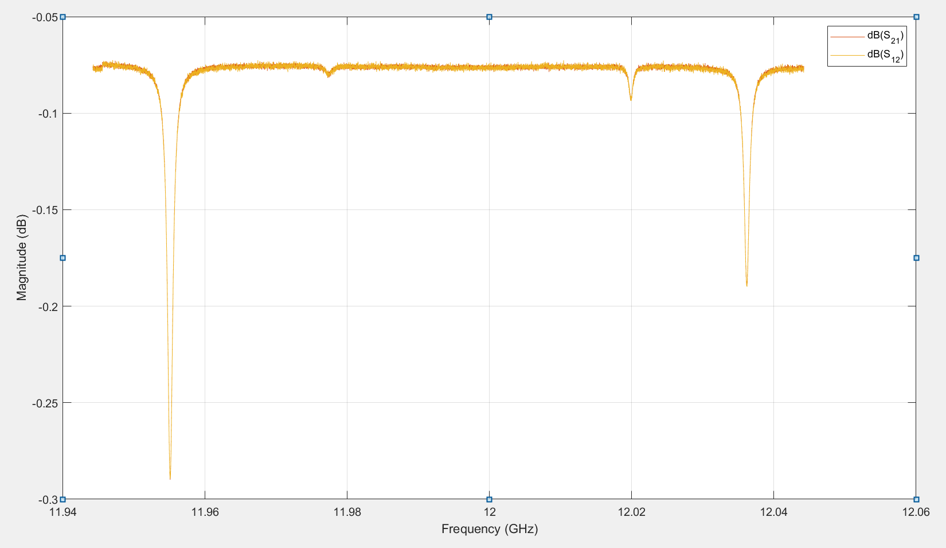
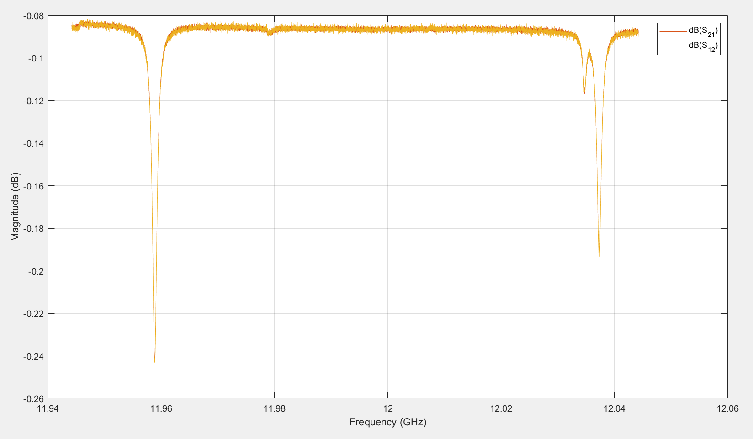
Double-Height Waveguide System
#1
1-meter WG 0.06 dB/m losses expected
#1 & #2 are 1 meter WG
#3 is 0.5 + 0.5 meter
S-Parameters
@11,9942 GHz
S11 ≈ -47 dB
S21≈-0.075 dB
S12 ≈ -0.078 dB
S22 < -60 dB
Losses:
0.06 dB/m
as expected
#2
#3 the combination of two half meter WG
S-Parameters
@11,9942 GHz
S11 ≈ -41 dB
S21≈-0.076 dB
S12 ≈ -0.076 dB
S22 ≈ -47 dB
Losses:
0.07 dB/m
A bit higher due to the flanges probably
Losses:
0.06 dB/m
as expected

Slide 22
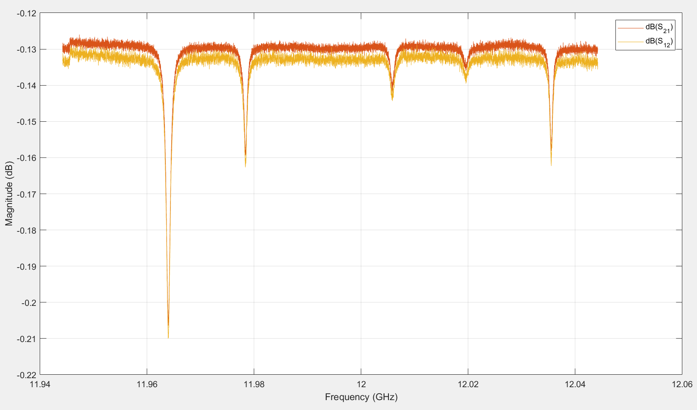
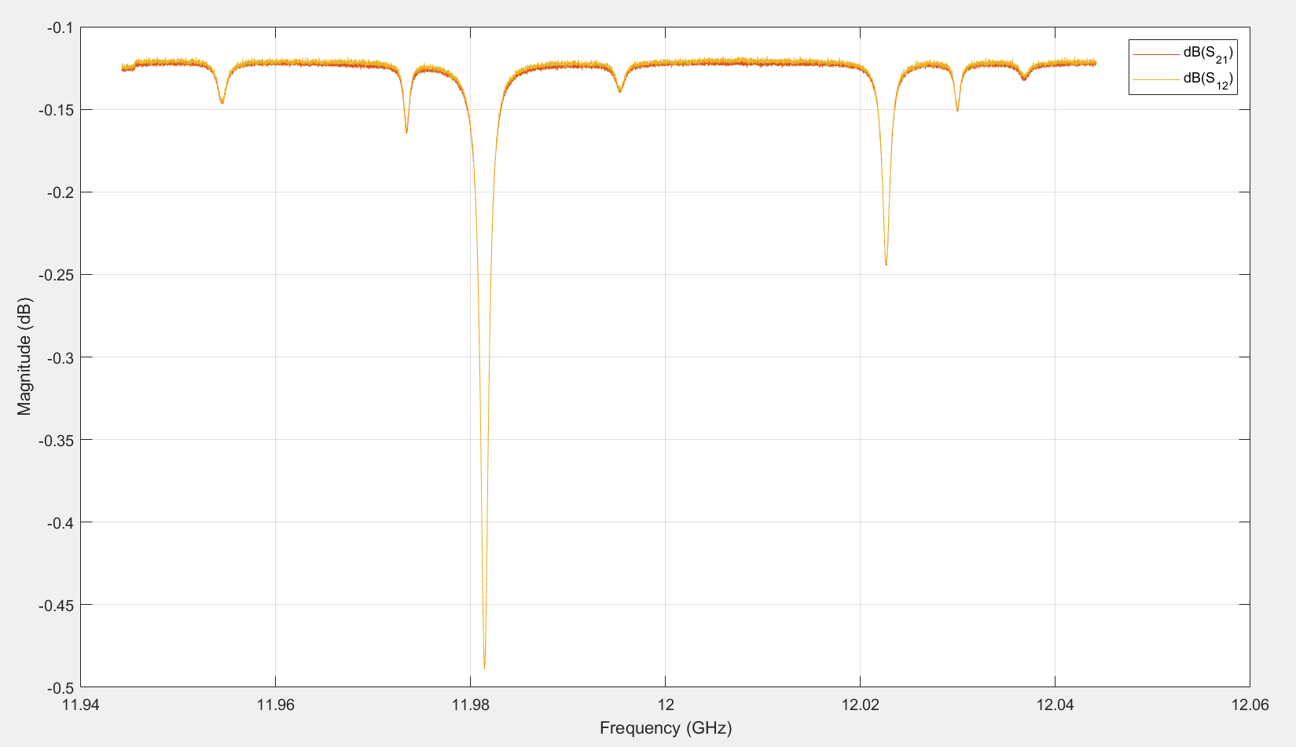
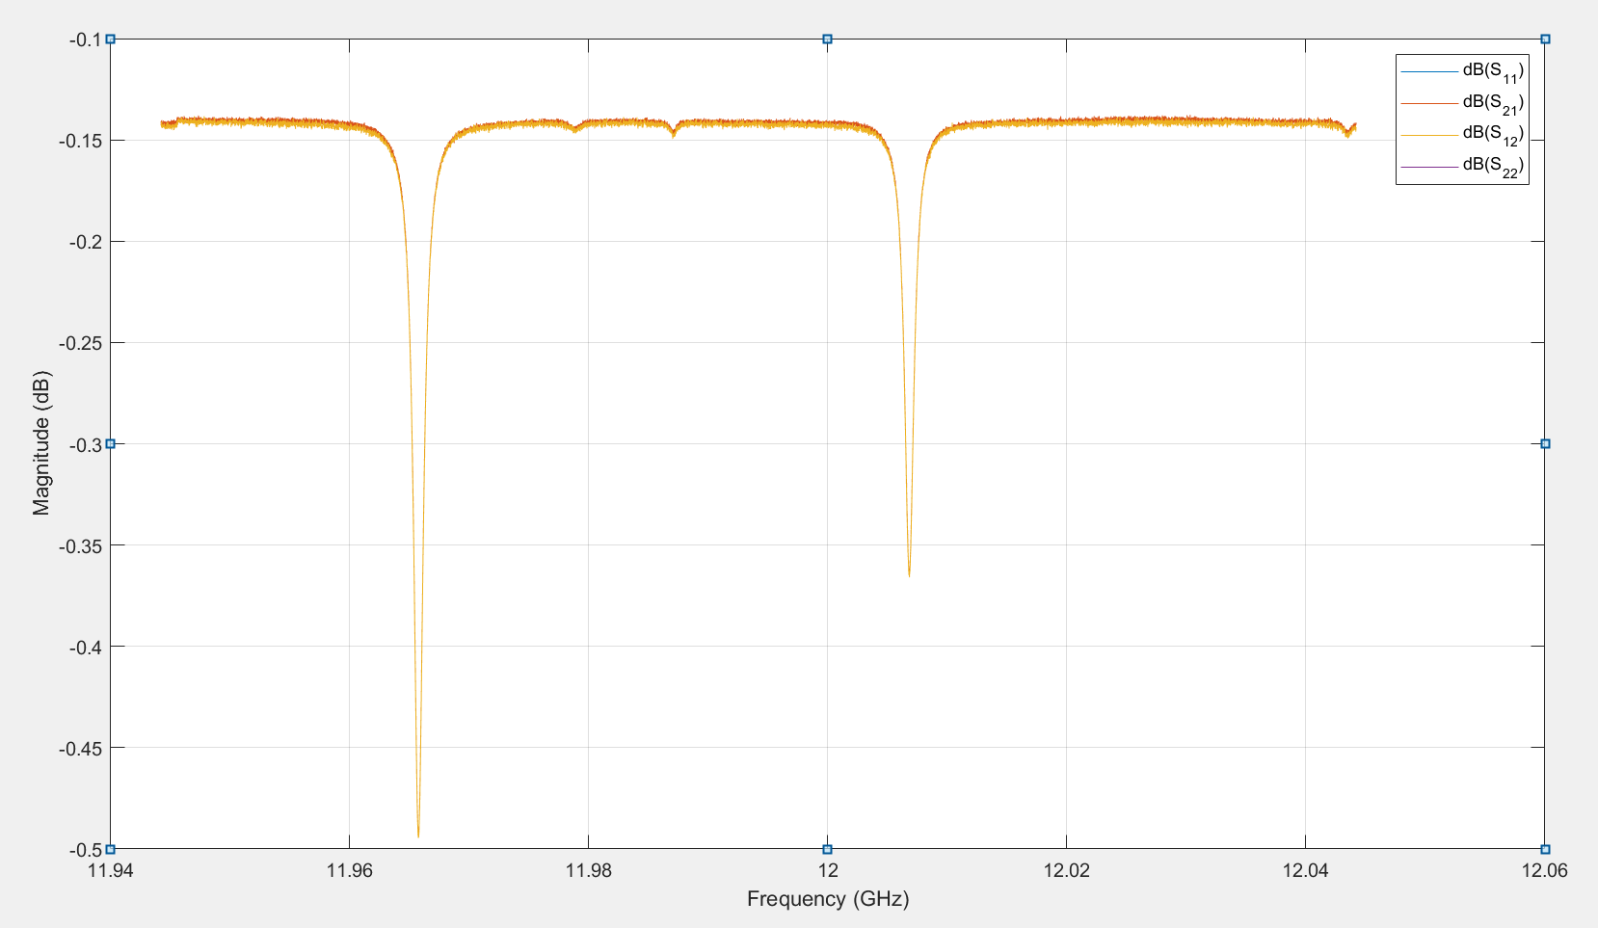
Double-Height Waveguide System
2 meter WG expected 0.12 dB/m losses
#1 + #2
Losses:
0.12 dB/m
as expected
#2+ #3
#1 + #3
S-Parameters
@11,9942 GHz
S11 ≈ -48 dB
S21≈-0.142 dB
S12 ≈ -0.142 dB
S22 ≈ -49 dB
Losses:
0.11 dB/m
Lower than expected
Losses:
0.13 dB/m
Bit higher again

Slide 23





