Slide 1
Doped Glass Small RPC study

Slide 2
Analysis Method
Clustering (for each hit pad find hits up to 2 cm away and add them to the cluster)
Alignment pass :
  fix one chamber
  offset the others by the difference of average x&y of clusters belonging to “Events”
  (Event=synchronized set of frames with hits in at least 3 chambers)
Tracking (see next page)

Slide 3
Tracking & Efficiency
For each pair of clusters in 2 chambers (but the one analyzed)
  Validate if a cluster<2 cm from prediction in a 3rd chamber
  Work out new track parameters with 3 chambers
  When 5 chambers: check last cross-check chamber and work out new parameters if possible
  Check if cluster is present < 2cm from prediction in studied chamber

Slide 4
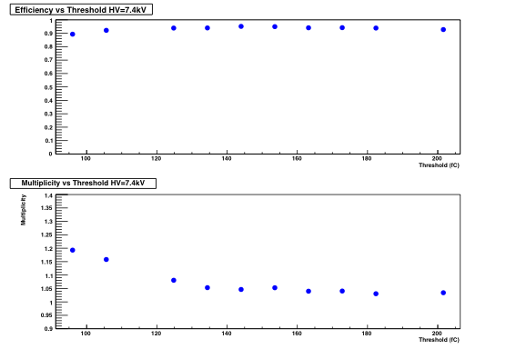
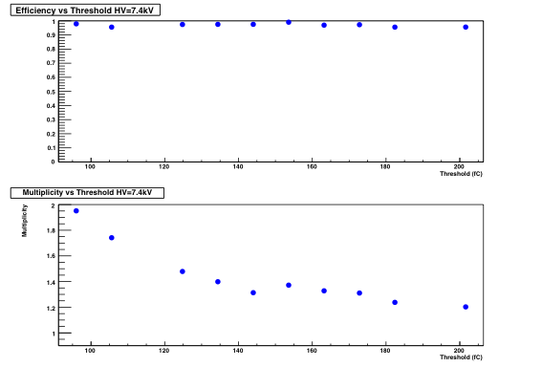
Thick Doped Glass PCB D
Triggered event only
Efficiency vs threshold
100 fC
140 fC
200 fC
Multiplicity vs threshold

Slide 5
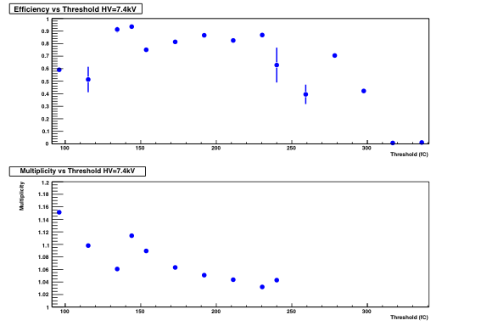
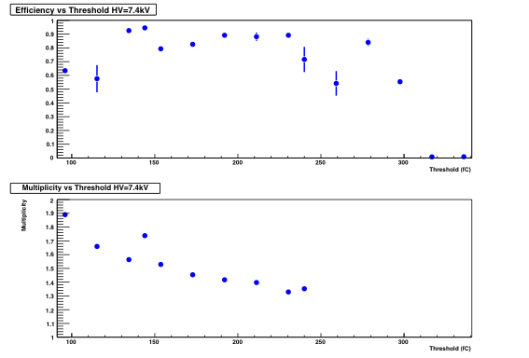
Graphite Float Glass PCB A
Triggered event only
Efficiency vs threshold
Multiplicity vs threshold

Slide 6
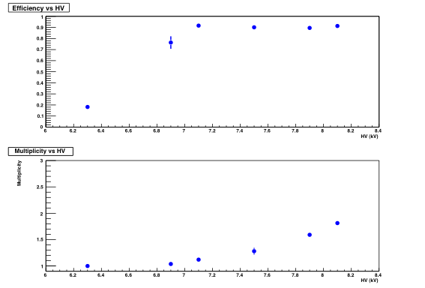
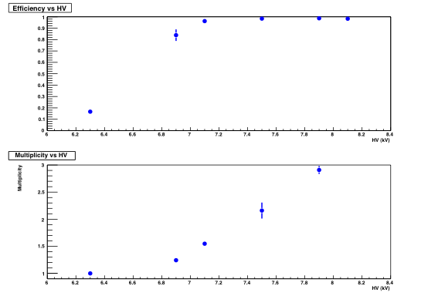
Thick Doped Glass Chamber
Triggered event only
Efficiency vs HV
Multiplicity vs HV

Slide 7
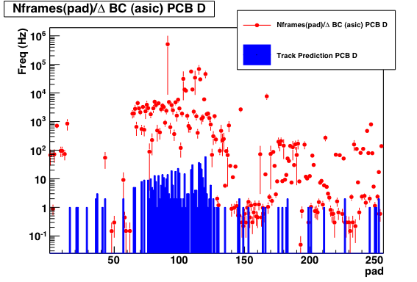
Rate calculation
Rate/pad : rate from #frames/time in pads with predictions.

Slide 8
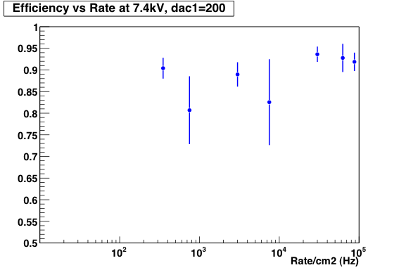
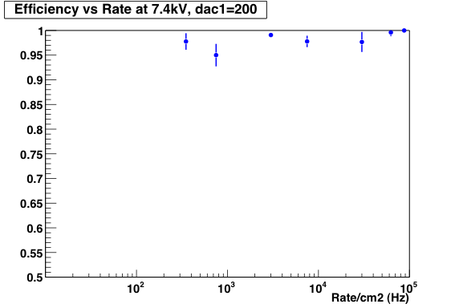
Thick Doped Glass Chamber
Triggered event only
Int_t run[]={1148,1189,1144,1142,1192,1194};
100
1000
10000

Slide 9
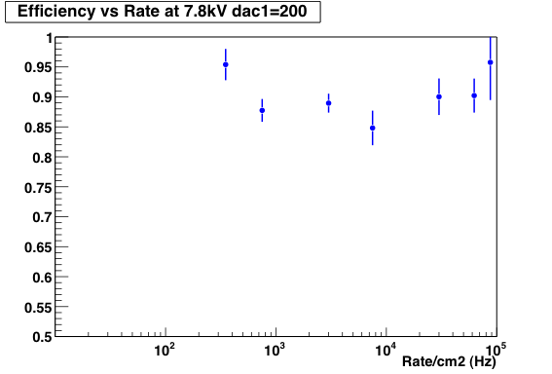
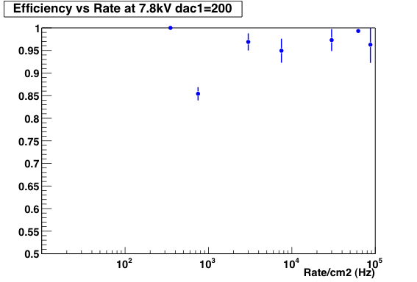
Thick Doped Glass Chamber
Triggered event only
Int_t run[]={1145,1147,1196,1195,1191,1190};

Slide 10
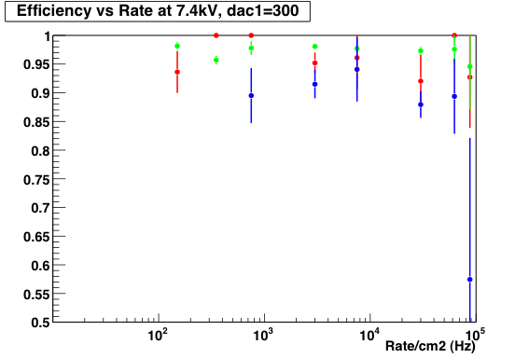
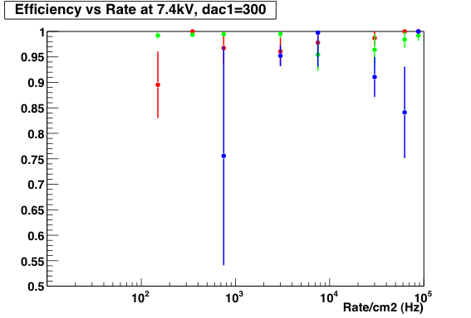
Float Glass - Graphite
Triggered event only

Slide 11
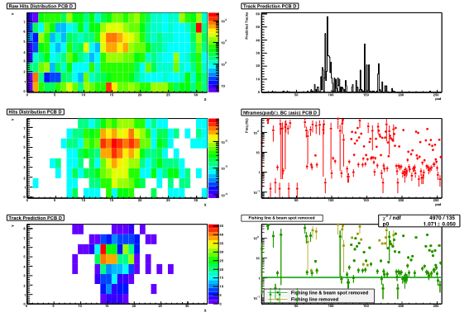
Noise Calculation
Track predictions
RAW Hits
#frames/time
synchronized
Track predictions
#frames/time no beam/no fishing line

Slide 12
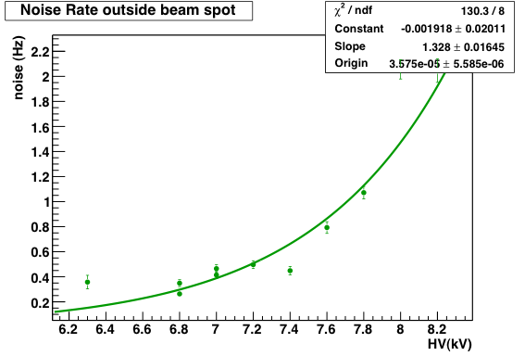
Noise Doped Glass
Int_t runs[]={1110,1112,1115,1117,1118,1119,1120,1121,1122,1123,1124};

