Slide 1
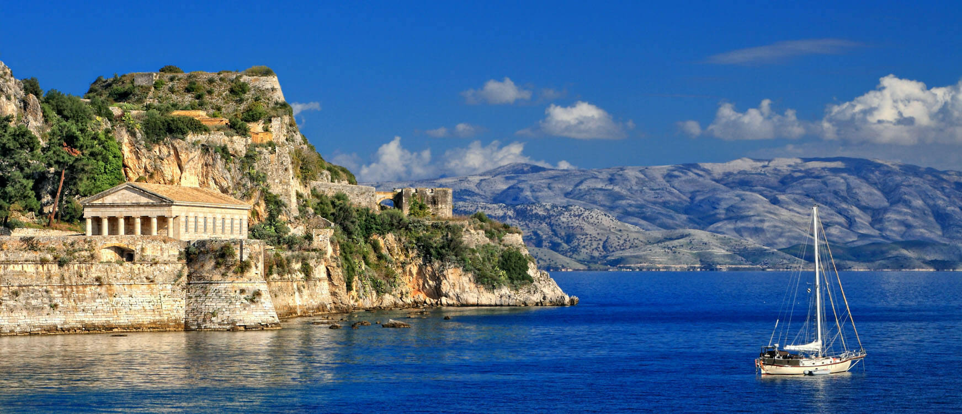

Axion Dark Matter Search
2022 Corfu Workshop on the Standard Model and Beyond
02/09/2022 Corfu, Greece
SungWoo YOUN
Center for Axion and Precision Physics Research (CAPP)
Institute for Basic Science (IBS)

Slide 2
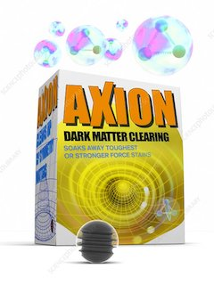
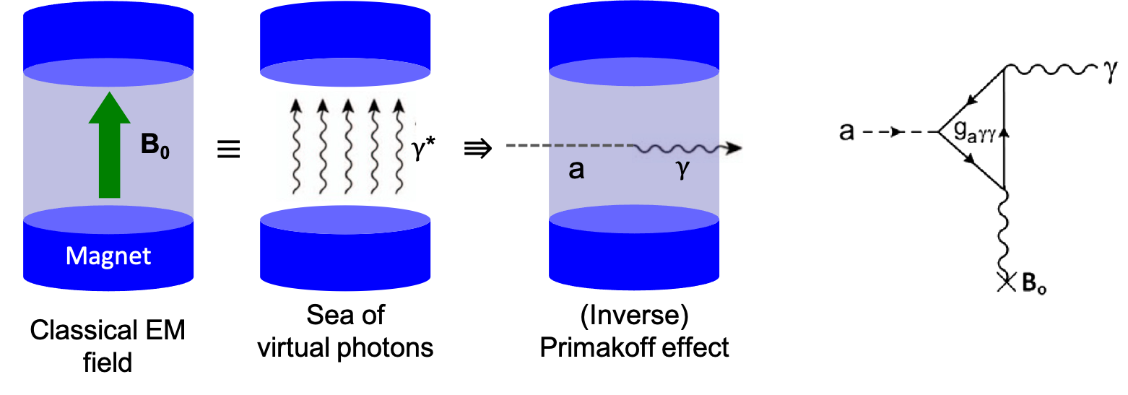
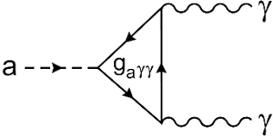
Outline
Background
  Dark matter and axion (ALP)
  Detection schemes
Experimental efforts
  Axion-photon coupling
  Haloscope
  Helioscope
  Light shinning through walls
Prospects
Summary

Slide 3
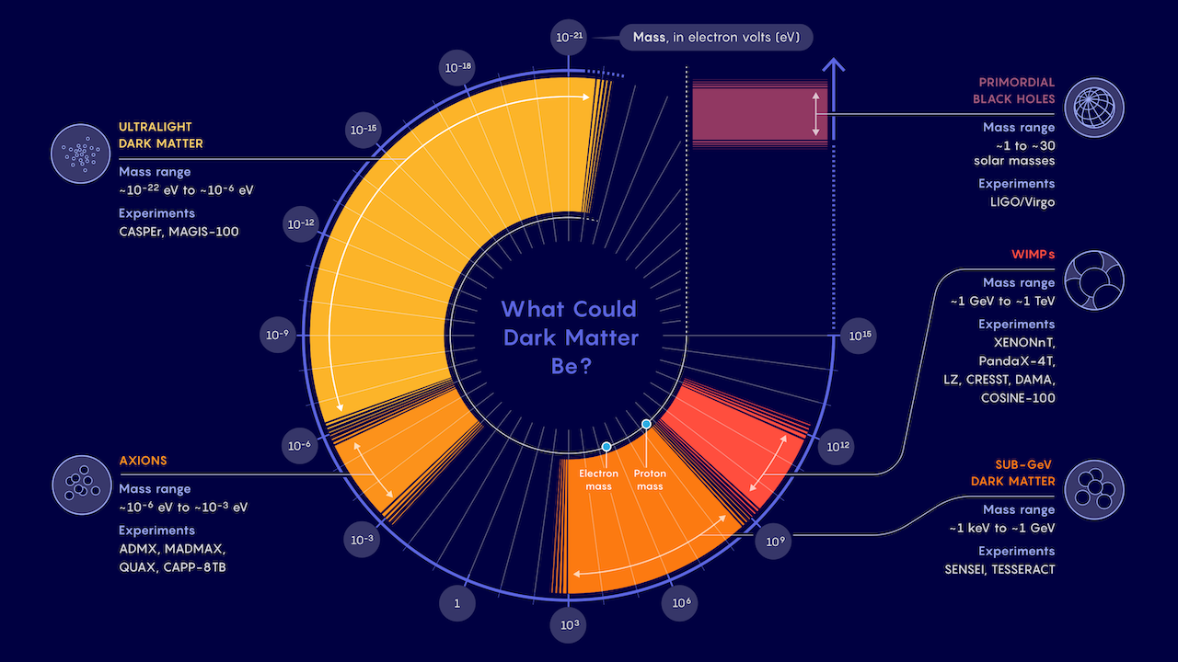
Dark matter business expanding
WIMPs may be down, but not out
Samuel Velasco/Quanta Magazine

Slide 4
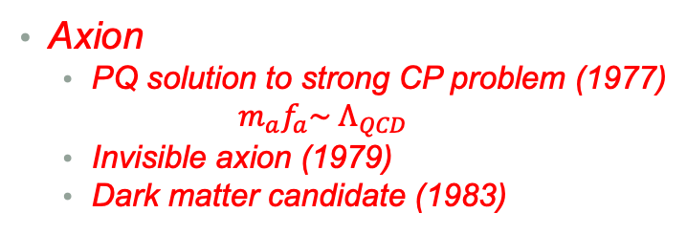
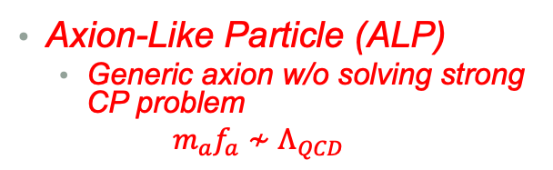
WISP zoo
Pseudo-scalar
WISP
Axion
  PQ solution to strong CP problem (1977)
  $$m_{a}f_{a}\sim Λ_{QCD}$$
  Invisible axion (1979)
  Dark matter candidate (1983)
Mili-chaged particle
.
.
.
J^{p} = 0–
J^{p} = 0⁺
Axion-Like Particle (ALP)
  Generic axion w/o solving strong CP problem
  $$m_{a}f_{a}≁Λ_{QCD}$$
ALP
Chameleon
Axion
Scalar
  Chameleon (2003)
    Dark energy candidate
J = 1
Hidden photon
Vector
  Hidden photon
    Gauge field in hidden sector
Others
  Mili-charged particle, …

Slide 5
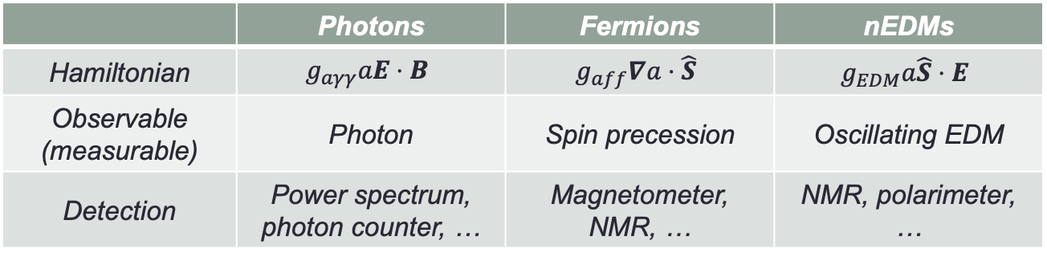
Couplings and models
Axion coupling to SM
Axion models
 | Photons | Fermions | nEDMs
Hamiltonian | $$g_{aγγ}aE⋅B$$ | $$g_{aff}∇a⋅\hat{S}$$ | $$g_{EDM}a\hat{S}⋅E$$
Observable (measurable) | Photon | Spin precession | Oscillating EDM
Detection | Power spectrum, photon counter, … | Magnetometer, NMR, … | NMR, polarimeter, …
U(1)_{PQ} x SU(3)_{c}²
From R. Ziegler
Origin of QCD anomaly:
SM fermions BSM fermions
Spontaneous PQ breaking:
2Higgs 2Higgs+singlet Higgs+singlet
PQWW DFSZ KSVZ
Peccei, Quinn, Wilczek, Weinberg (1978)
Dine-Fischler-Srednicki-Zhitnitsky (1980)
Kim-Shifman-Vainshtein-Zakharov (1980)

Slide 6
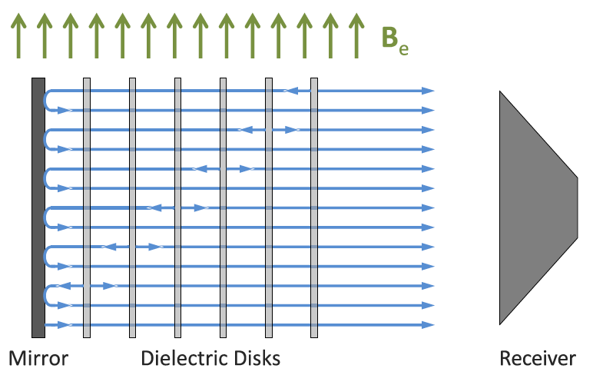
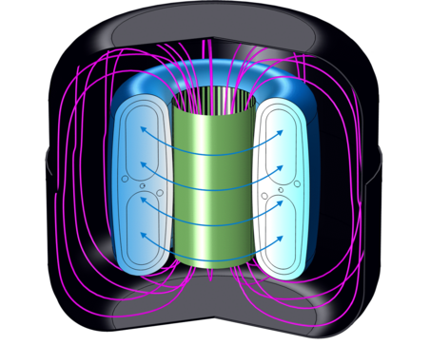
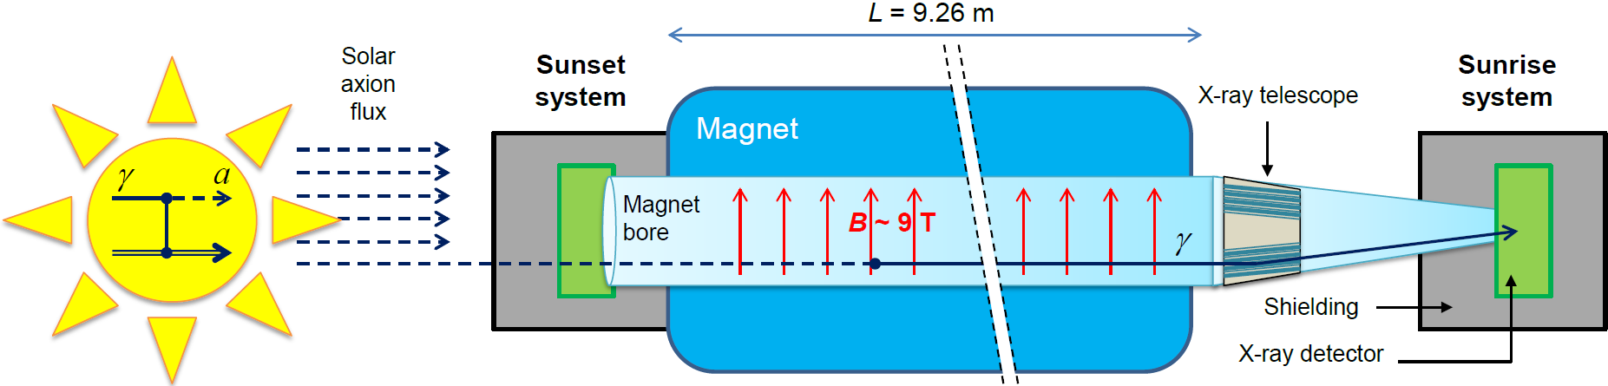
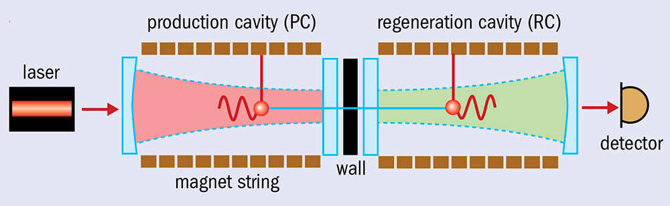


Search strategies
Detection principle
  Sikivie effect (1983)
Detection methods
  Haloscope
    Dark matter halo
    ADMX, CAPP, MADMAX, DM radio, …
  Helioscope
    Solar axions
    CAST, IAXO
  Light shining through walls
    Lab production
    OSQAR, ALPS (II)
$$γ$$
$γ$*

Slide 7
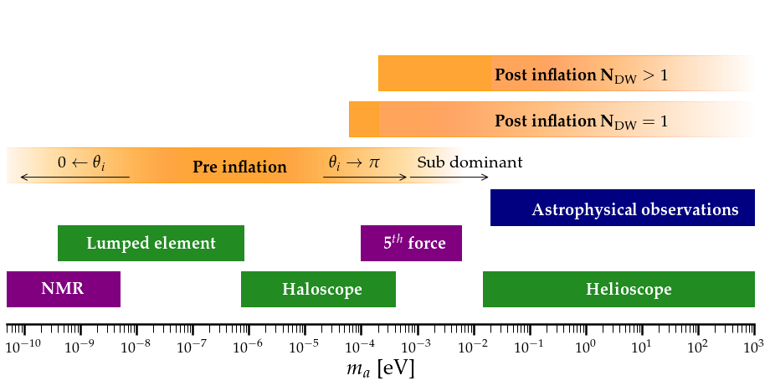



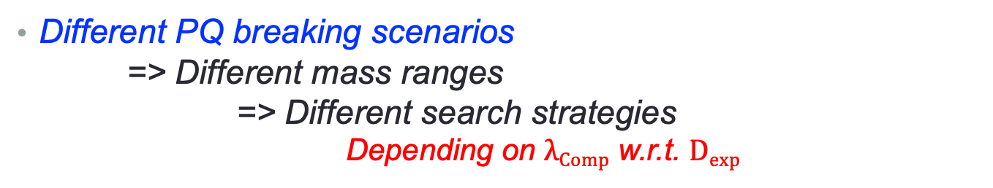
Where are dark matter axions?
Different PQ breaking scenarios
=> Different mass ranges
=> Different search strategies
Depending on $λComp$ w.r.t. $Dexp$
Theoretical scenarios
Photon coupling
Fermion/gluon coupling
Quasistatic regime
$$λComp≫Dexp$$
Cavity regime
$$λComp \sim Dexp$$
Radiation regime
$$λComp≪Dexp$$

Slide 8
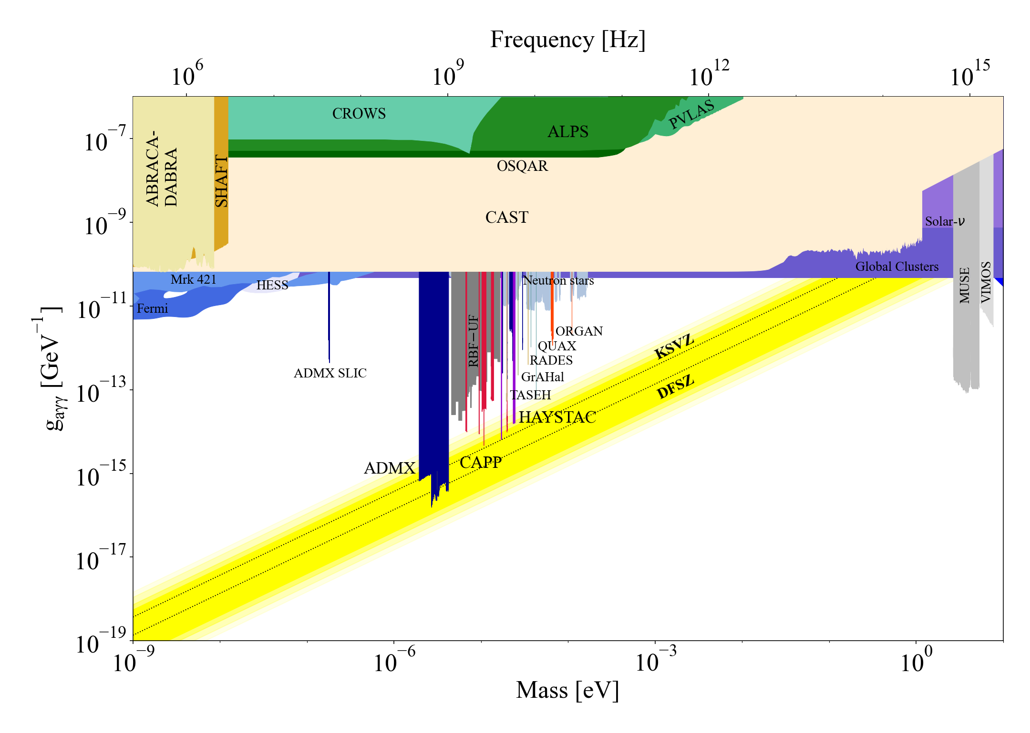
Axion searches – present
Most parameter space is unexplored

Slide 9
Outline
Background
  Dark matter and axion (ALP)
  Detection schemes
Experimental efforts
  Axion-photon coupling
  Haloscope
  Helioscope
  Light shinning through walls
Prospects
Summary

Slide 10
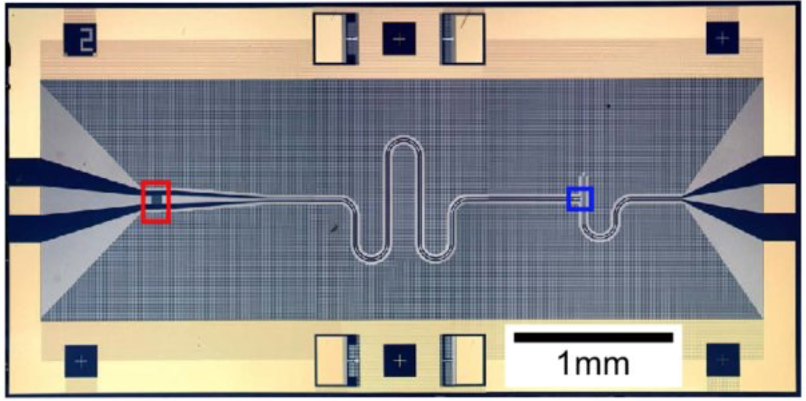
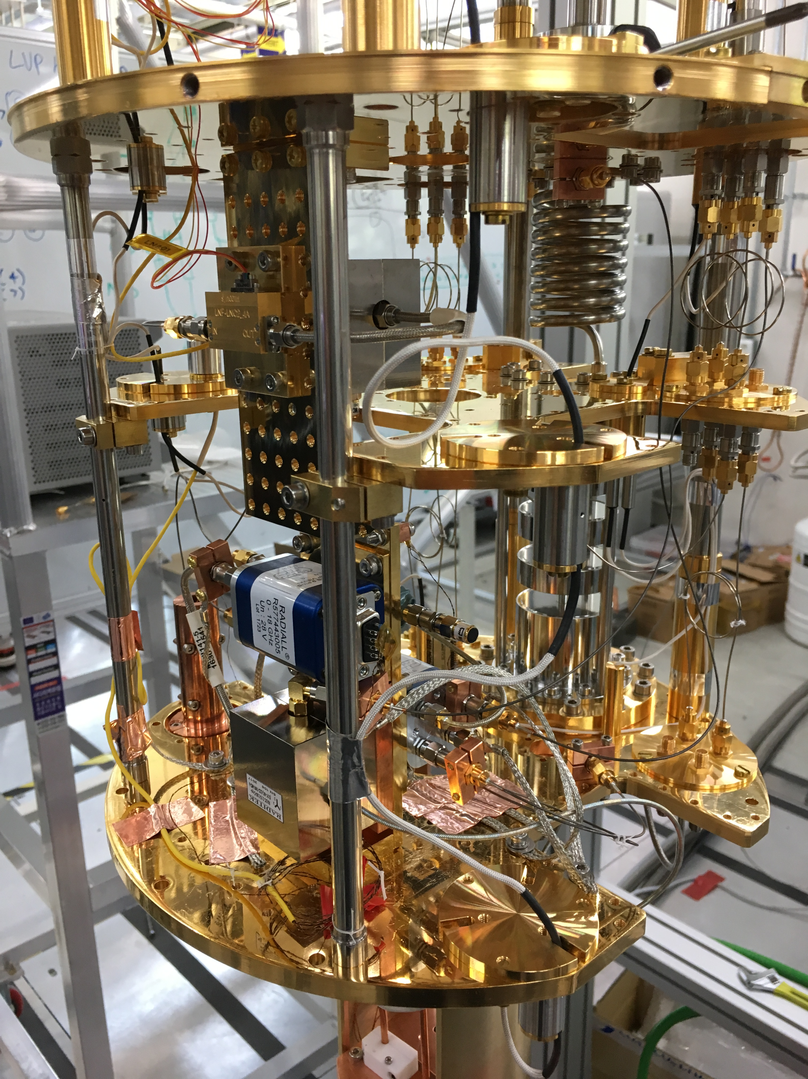
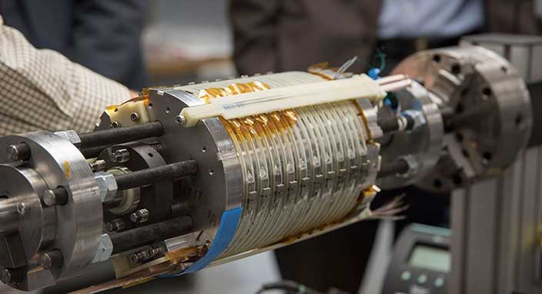
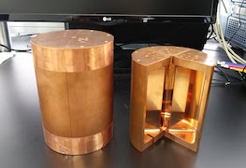



Cavity haloscope – in a nutshell
Most sensitive for microwave photons
Quantum noise limited amplifier T
Cryogenics T
P ~ 10^{–23} W
Signal amplification w/ minimal noise added
Lowering thermal noise
$$a$$
$$γ$$
Tunable High-Q resonator
V, Q, C, Δf
High field Magnet B
$γ$*
Small-scale experiments!
Boosting a→γγ conversion rate
Resonant frequency tuning

Slide 11
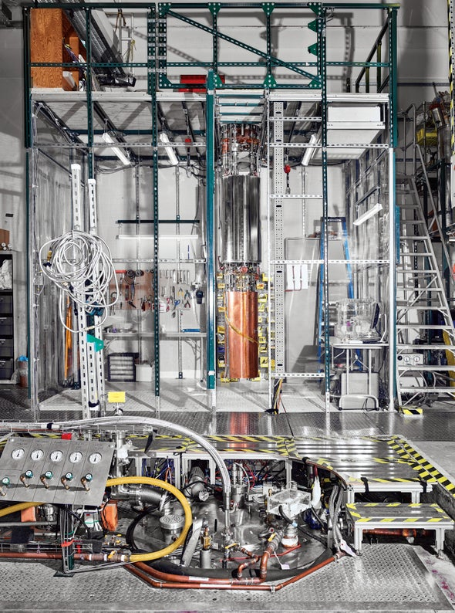
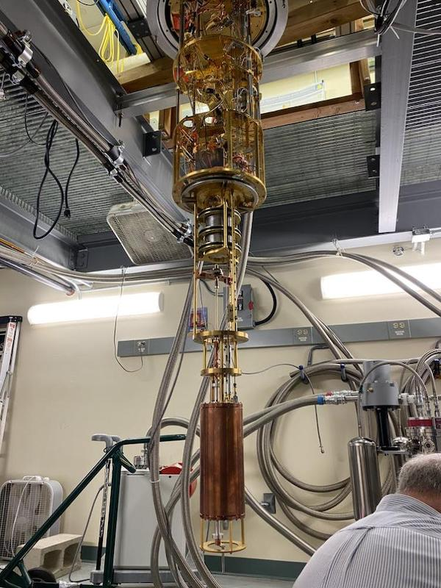
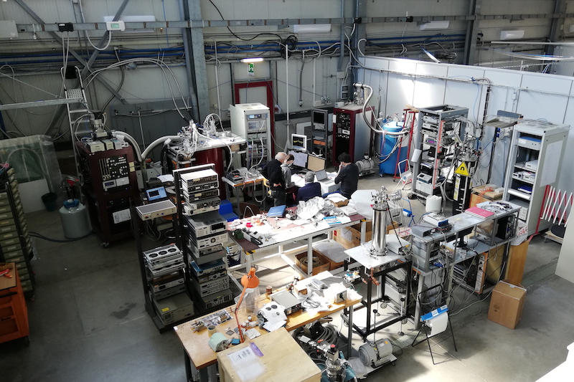
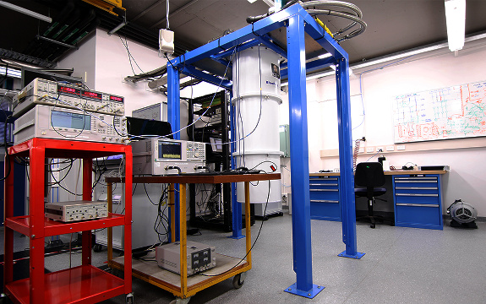
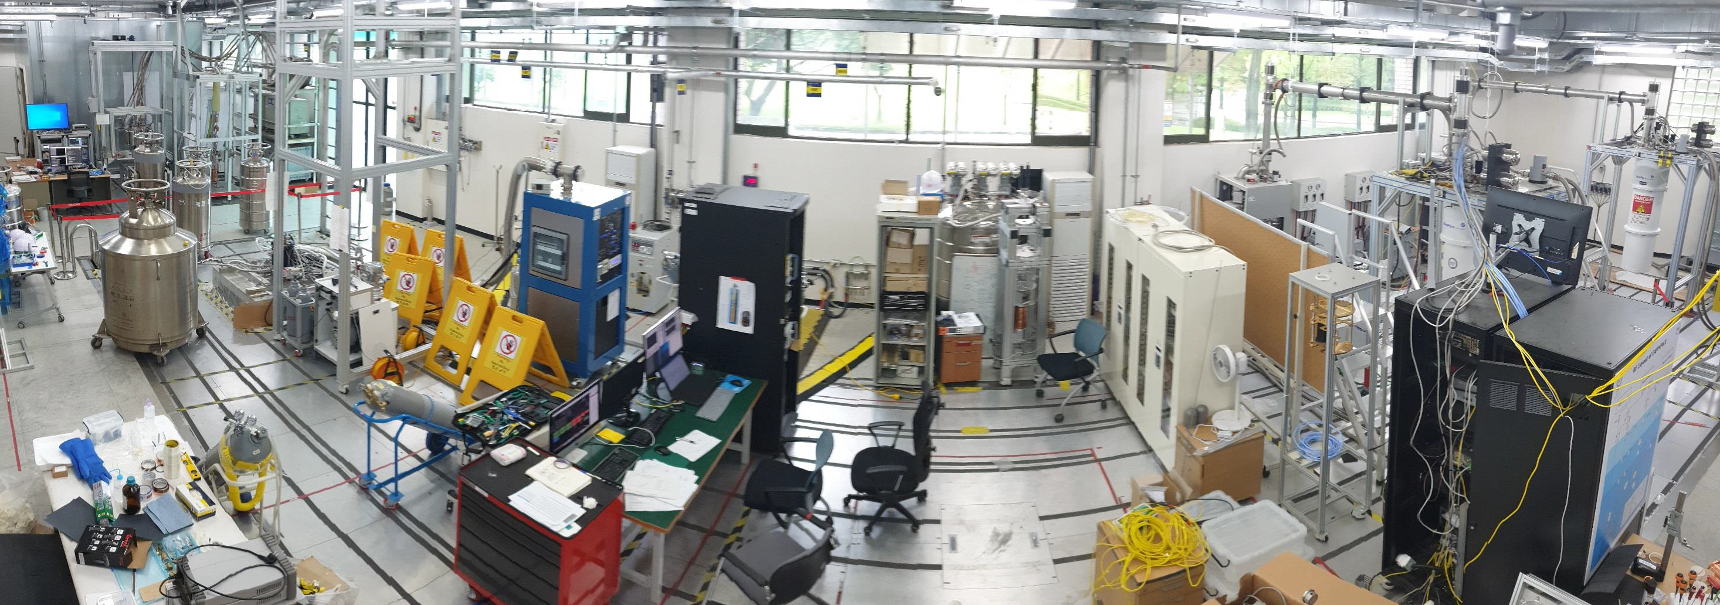

Cavity haloscopes
Cavity regime
$$λComp \sim Dexp$$
ADMX
HAYSTAC
QUAX
ORGAN
CAPP

Slide 12
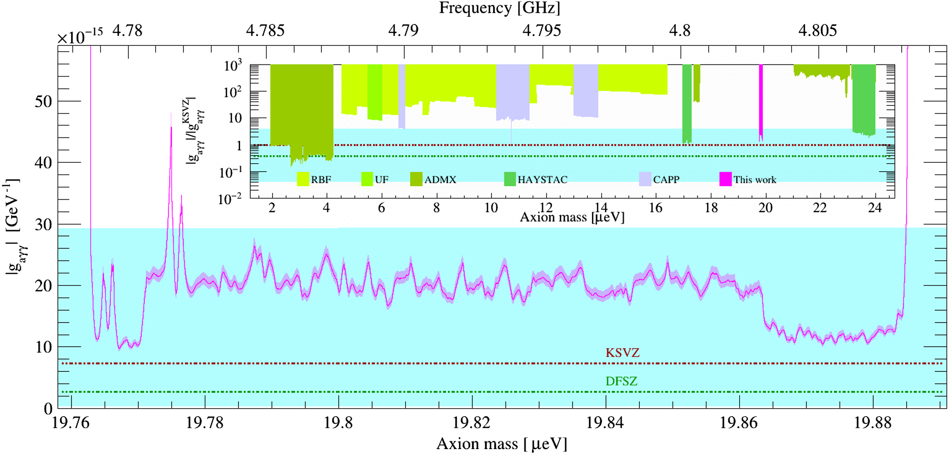
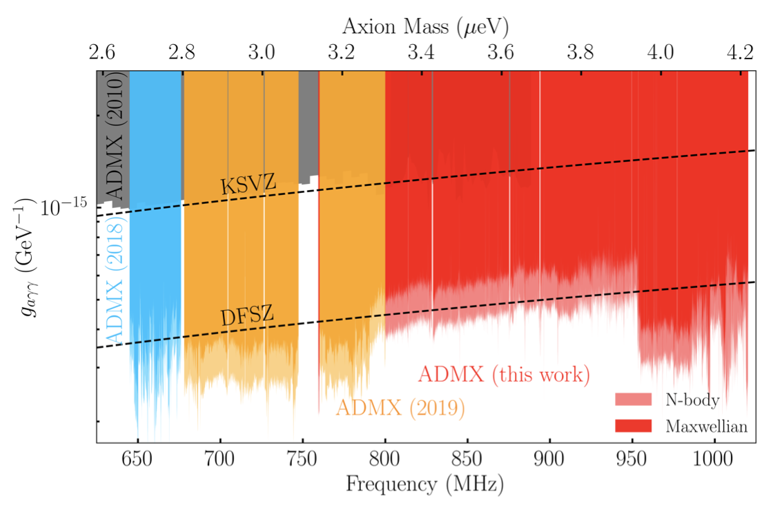
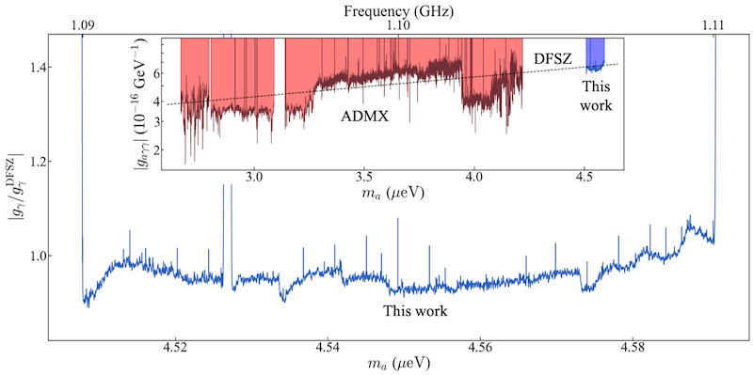
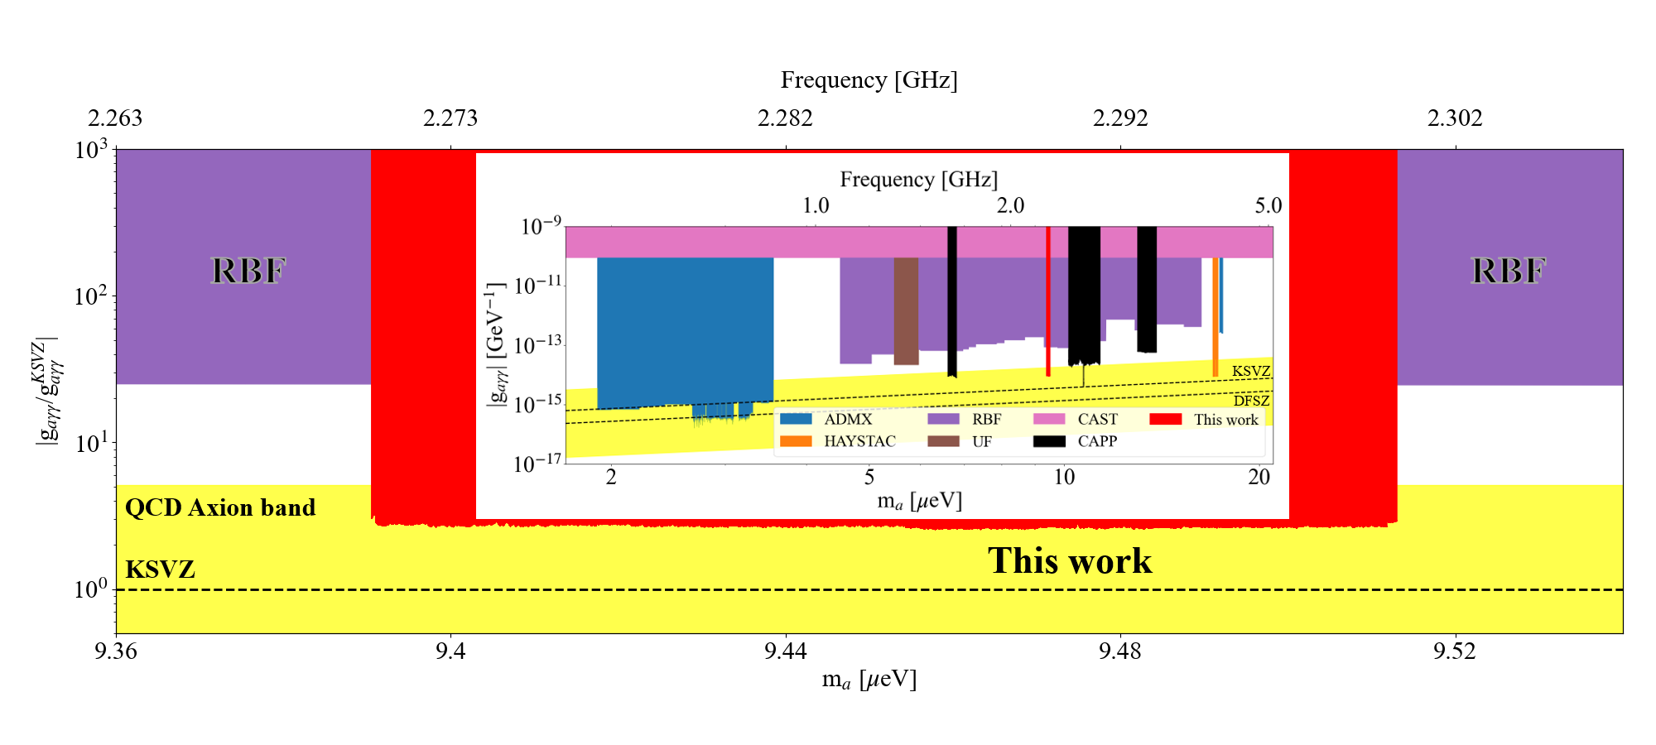
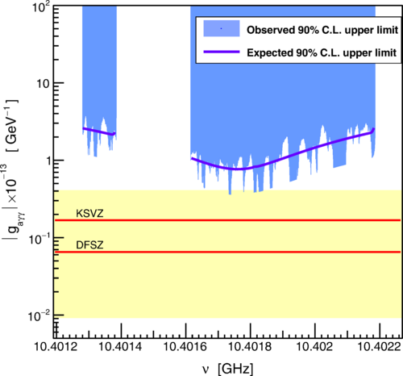
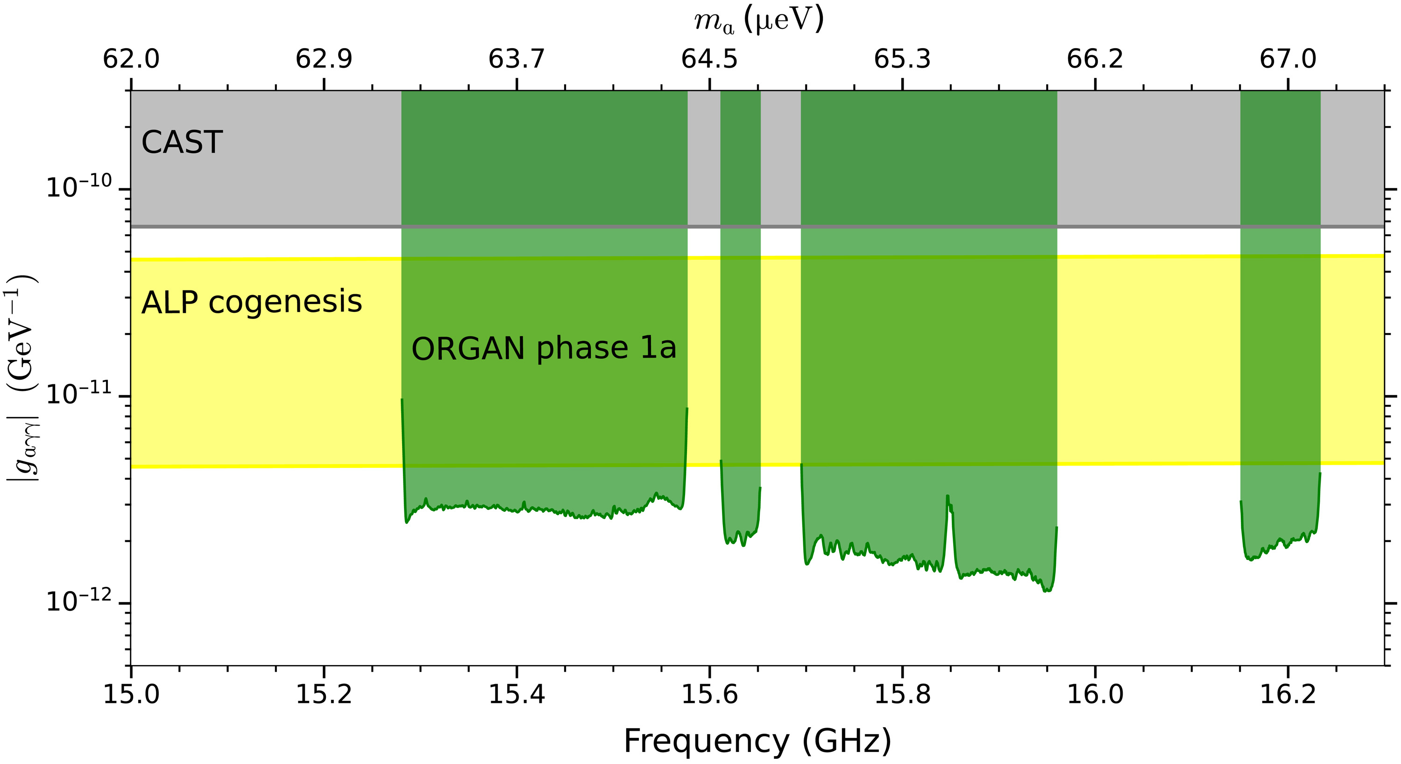
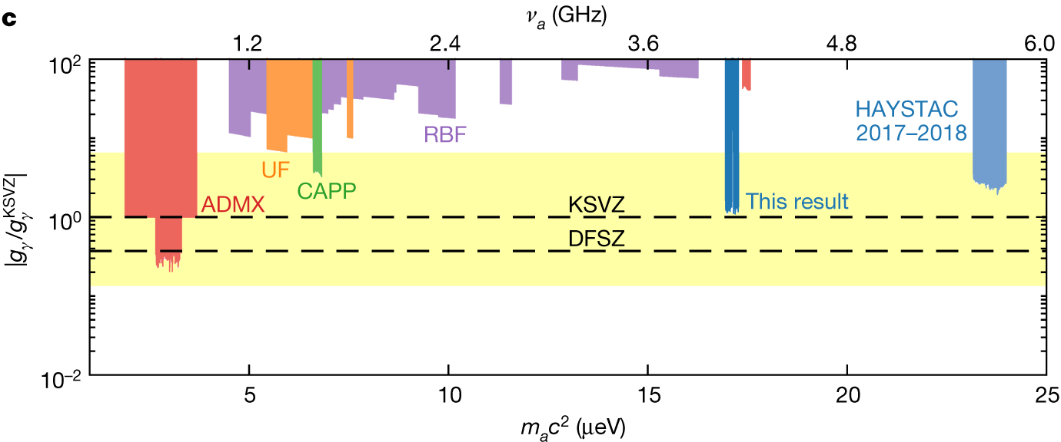
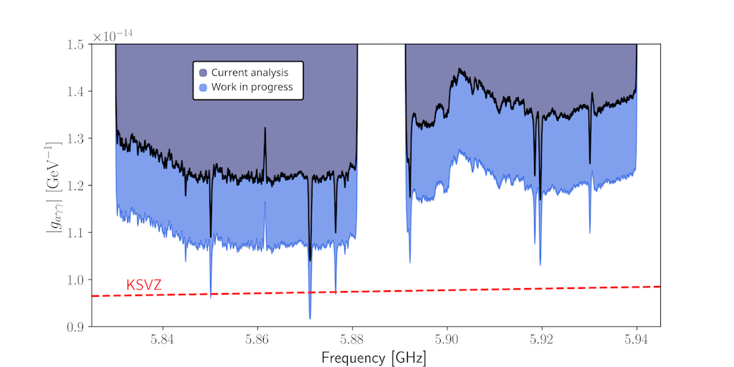
Search highlights
Cavity regime
$$λComp \sim Dexp$$
ADMX
HAYSTAC
QUAX
PRL 127 261803 (2021)
PRL 128 241805 (2022)
18T, JPC, 0.9 K
Preliminary
12T, JPA, 200 mK
JPA run
ORGAN
SC run
CAPP
arXiv:2207.13597
8T, JPA, Q=350K, 200 mK
Sci. Adv. 8 abq3765 (2022)
ALP genesis + SMASH
8.1T, JPA
Quantum squeezing
Nature 590 238 (2021)
PRD 103 102004 (2021)
8T, Pizza, 300 mK, 100MHz

Slide 13
Cavity haloscopes
Cavity regime
$$λComp \sim Dexp$$
ADMX
HAYSTAC
QUAX
ORGAN
CAPP

Slide 14
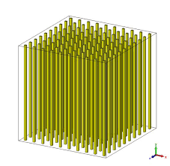
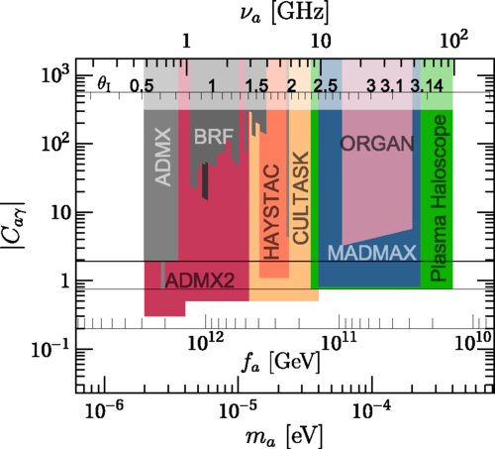
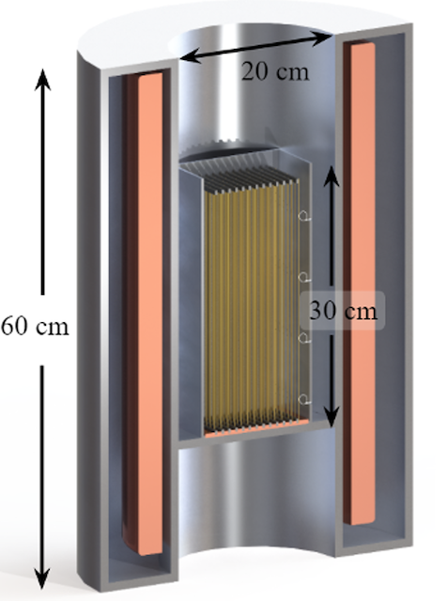
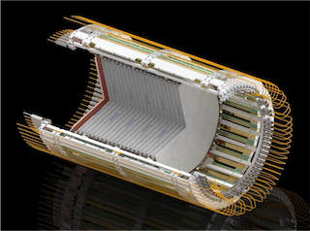
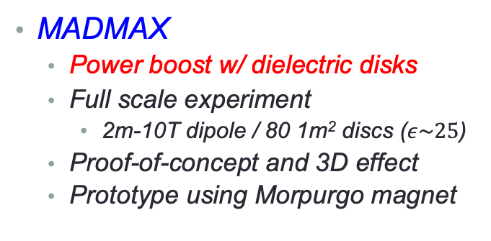

High frequency haloscopes
Radiation regime
$$λComp≪Dexp$$
Periodic array
  Search frequency independent of detector size
  Suitable for post-inflation scenario (10–100 GHz)
MADMAX
  Power boost w/ dielectric disks
  Full scale experiment
    2m-10T dipole / 80 1m² discs ($ε\sim 25$)
  Proof-of-concept and 3D effect
  Prototype using Morpurgo magnet
ALPHA
  Resonance w/ plasma frequency (metamaterial)
  Demonstration of frequency tuning
  Physics data in 2026
Prototype (2024)
20 discs
30 cm diameter

Slide 15
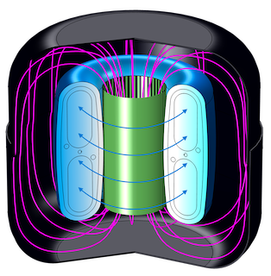
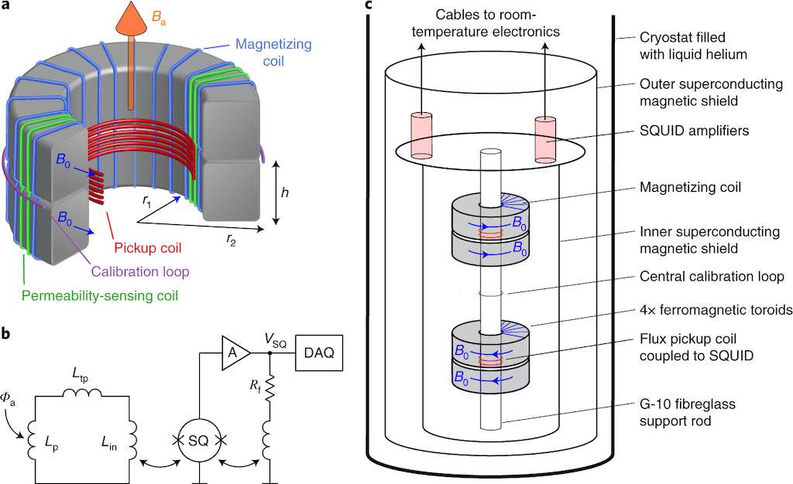
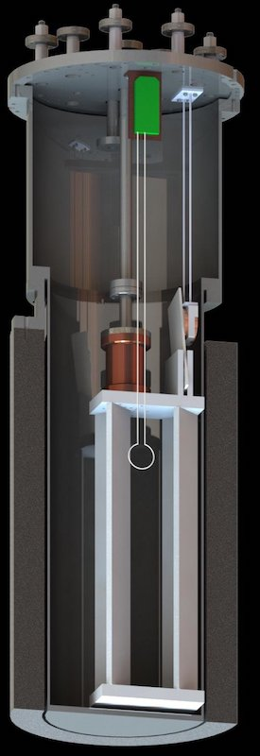
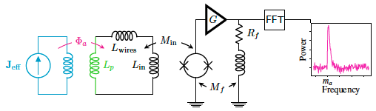
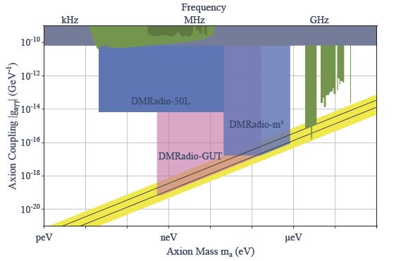
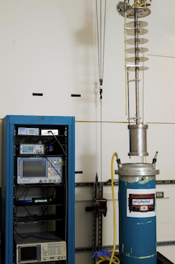
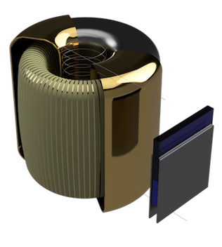
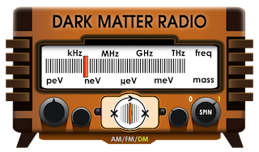


Lumped element haloscopes
Quasistatic regime
$$λComp≫Dexp$$
ABRACADABRA-10cm
Broadband low mass search (< 1 ueV)
  Sensitive to pre-inflation axions
PRL 12 081801 (2021)
SHAFT
Nature Phys. 17, 79 (2021)
$$J_{e}=g_{aγ}\sqrt{2ρ_{a}}\cos\left(m_{a}t\right)B_{0}$$
ADMX SLIC
DM Radio
PRL124, 241101 (2020)

Slide 16
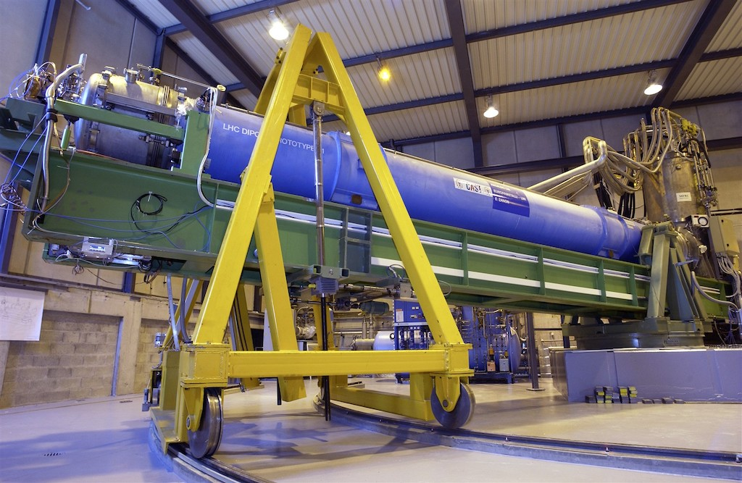
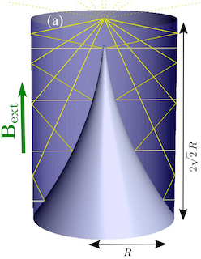
Other experiments
Running
  CAST dipole (9T)
    CAST-CAPP: phase-matched cavities, ~20 ueV
    RADES: microwave fiber, ~34 ueV
New
  Grenoble Axion Haloscope
    14T/52mm magnet, ~26 ueV
  Taiwan Axion Search Experiment with Haloscope
    4.7 GHz, 11 x g_{arr}^{KSVZ}
  Superconducting axion search
    SC cavity, 14T, 8.4 GHz (under construction)
Proposed
  Broadband Reflector Experiment for Axion Detection
    Parabolic reflector, THz region
  Canfranc Axion Detection Experiment
    90 GHz (W-band), Kinetic Induction Detectors

Slide 17
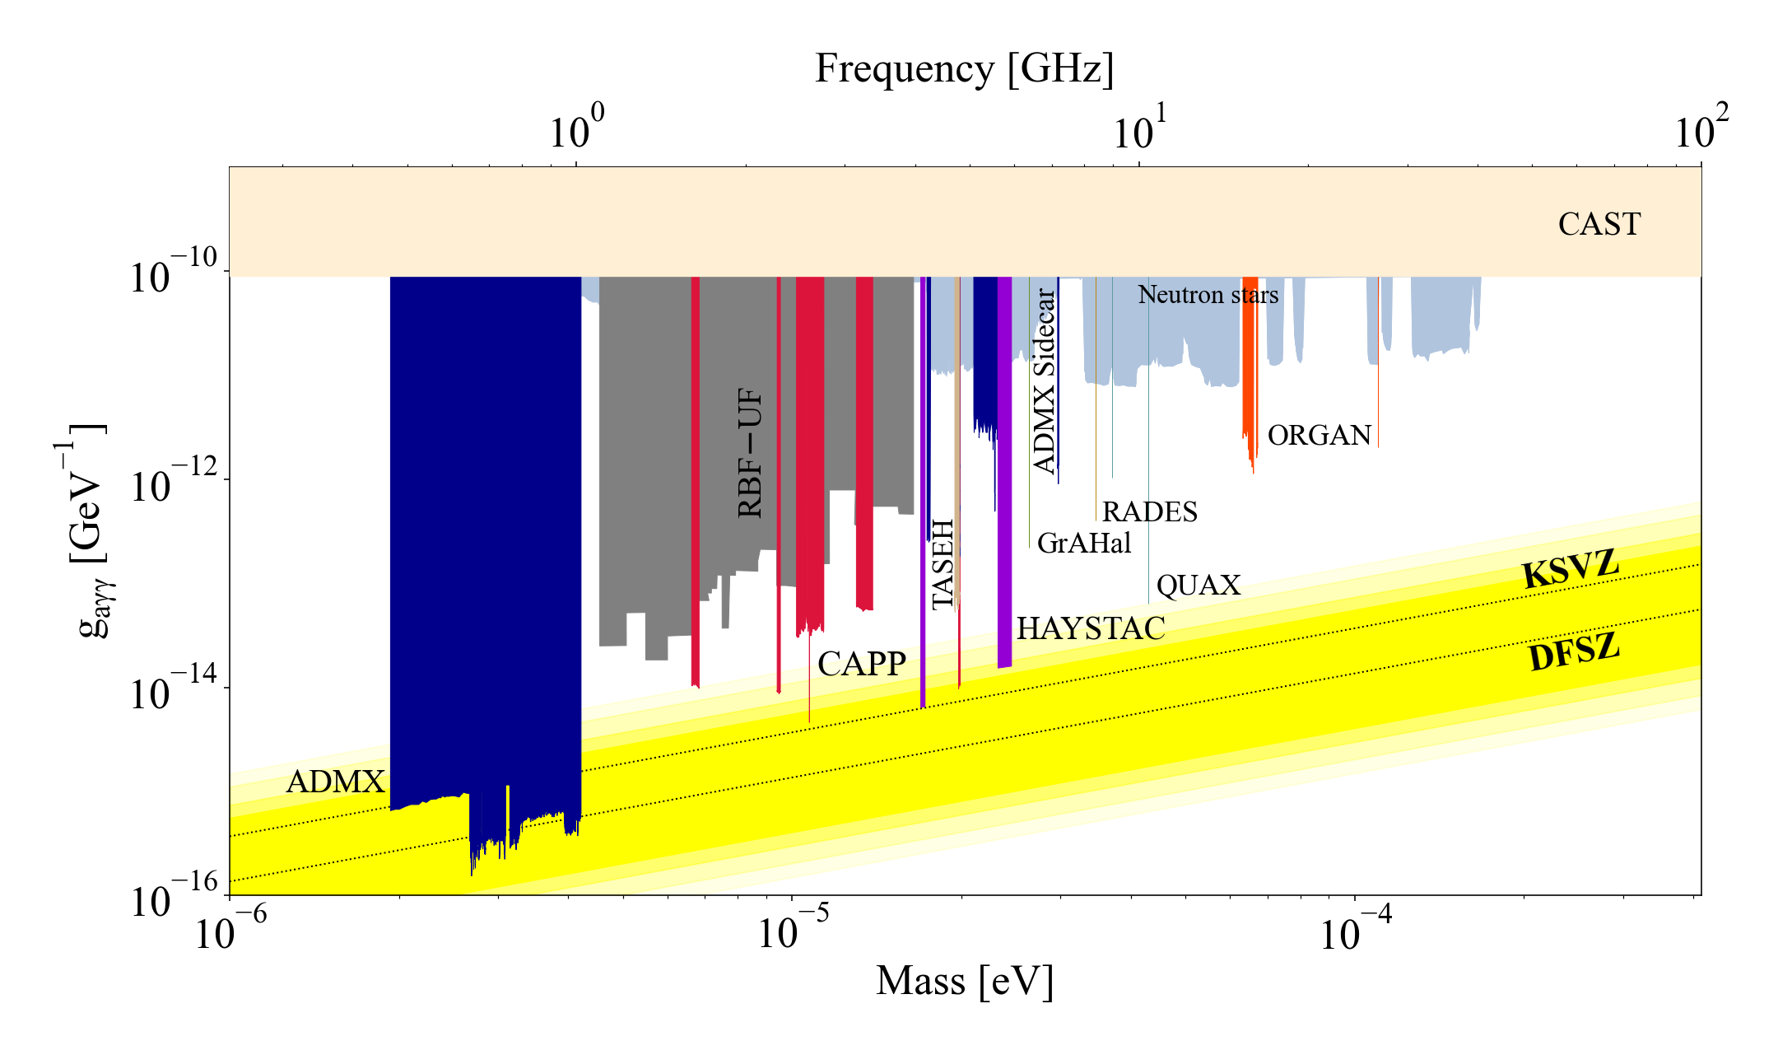
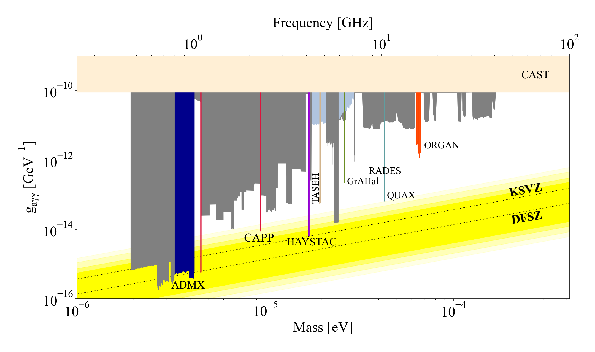
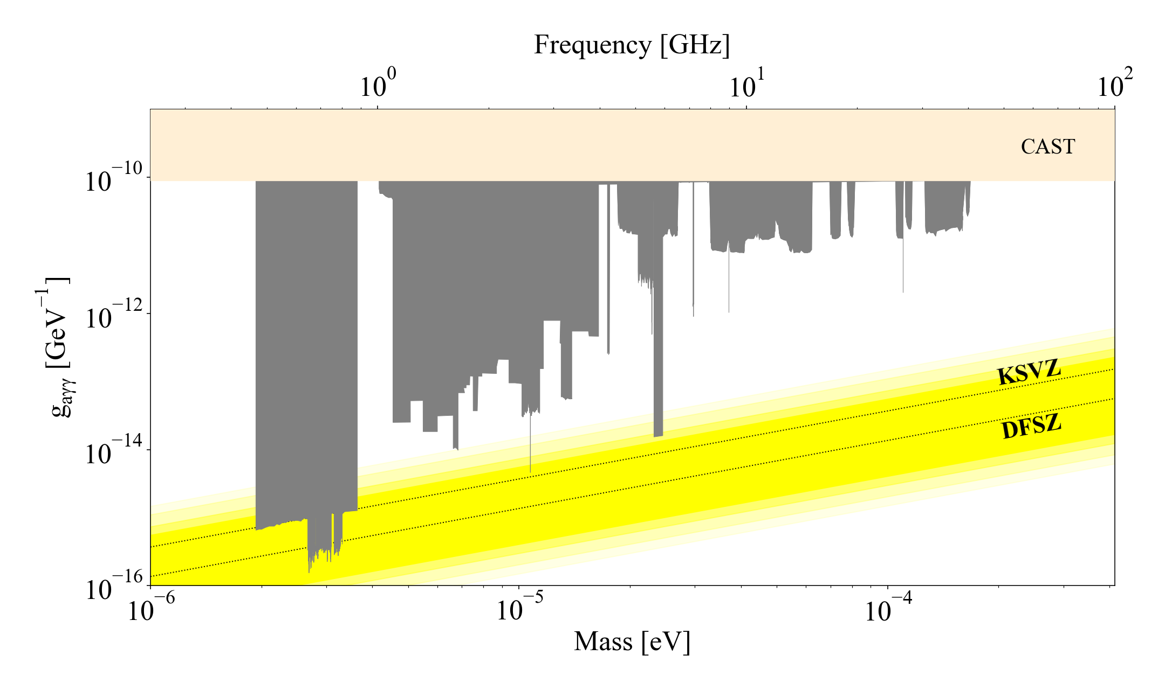
Haloscope searches
Update (2021–2022)
PAST (~2020)
Present (~2022)

Slide 18








Magnet
CAPP (12T/320mm)
CAPP (18T/70mm)
Grenoble (43T/34mm)
ADMX (8T/600mm)
YBCO pancakes
CERN (1.6T)
UIC (9.4T/800mm)
DESY (10T, dipole)

Slide 19









Cavity
arXiv: 2203.14923
PRD 99 101101 (2019)
9 GHz
PRL 125 221302 (2020)
arXiv: 2205.08885
NIM 985 164641 (2021)
10.9 GHz
5.4 GHz
Q₀ > 10⁷

Slide 20





Microwave photon detector
Power detection
(w/ amplifiers)
vs. photon counting
(w/ single photon detectors)
HEMT
Transistor-based
(T_{N} ~ K)
f = 10 GHz
SPD will be
the game changer
at high freq. & low temp.
JPA
Quantum limited
(T_{SQL} ~ 50 mK x f [GHz])
Nature 590 238 (2021)
IEEE TASC 2850019 (2018)
PRL 126 141302 (2021)
Quantum squeezing (T_{N} < T_{SQL} )
Photon counting (T_{N} << T_{SQL})

Slide 21




Helioscope
Solar axion telescope
  History
    BNL => SUMICO => CAST => IAXO
International AXion Observatory
  8 dipoles (5.4 T, 20 m, 600 mm)
  Goal: $g_{aγ} \sim {10}^{−12} GeV^{−1}$
  Diverse physics over wide range
    QCD axions
    ALP miracle (DM & inflation)
    Astrophysical hints
Baby-IAXO under construction (DESY)
  First step towards full IAXO
  4 T / 10 m => 10 x MFOM_{CAST}
Black-body photon (keV) to axion
in
dense stellar plasma
Reconversion into X-ray
in
laboratory magnetic fields
$$P_{aγγ}\sim \left(\frac{g_{aγγ}B_{0}}{q}\right)\sin\left(\frac{qL}{2}\right), q≡ \frac{m_{a}^{2}}{2E_{a}}$$

Slide 22



Light shining through a wall
Axion-production/photon-regeneration at the lab
  Model independent search
    No need of cosmo./astrophys. source
    cf. halo(helio)scope search needs density (flux)
  History
    BFRT => OSQAR => ALPS => ALPS II
Any Light Particle Search II
  2 x 12 Hera dipoles (8.8 m & 5.3 T)
  Dual high-finesse optical cavities
  Alignment sensing: PDH/DWS
  Photon detector: HET/TES
  Goal: $g_{aγγ} \sim {10}^{−11} GeV^{−1}$ below 0.1 eV
    Improvement by 3 orders of magnitude

Slide 23
Outline
Background
  Dark matter and axion (ALP)
  Detection schemes
Experimental efforts
  Axion-photon coupling
  Haloscope
  Helioscope
  Light shinning through walls
Prospects
Summary

Slide 24

Axion searches – present
Axion searches – future
Most parameter space will be explored within the next few decades!
Most parameter space is unexplored

Slide 25
Summary
Axions could address fundamental questions
  Strong CP problem and dark matter mystery
Theoretically well motivated but experimentally challenging
  Weak coupling and unknown mass
Tremendous search efforts
  Different technologies targeting at different mass ranges
Axion community is getting larger
  New results, new groups and new ideas
Next a few decades must be critical/exciting
  Covering a substantial portion of the parameter space
  Uncovering the nature of dark matter

Slide 27



Detector of halo axions
Most sensitive approach in $μ$eV regime
  Microwave photons resonantly converted from axions
Conversion signal power (a→γγ)
Signal-to-noise ratio (SNR)
Scanning rate (F.O.M.):
- theoretical parameters
- experimental parameters
Cavity Q factor
Axion Q factor
Coupling constant
Effective volume
Axion number density
Magnetic field
Integration time
Axion bandwidth (~10⁻⁶ f)
System noise temperature

Slide 28



Fermion coupling
QUAX-ae
  Ferromagnetic haloscope
    Axion-electron spin
  Photon-magnon system
    Series of YIG spheres
    TM₁₁₀ of a cylindrical cavity
  Upgraded with JPA
  Best limit near m_{a} ~ 43 $μ$eV
GNOME
  Topological defect dark matter
    Axion-nucleon spin
  Global network of optical magnetometers
    Correlated signal
Nature Phys. 17 1396 (2021)
PRL 124 171801 (2020)

Slide 29




Fermion/EDM coupling
Cosmic Axion Spin Precession Experiment
  CASPEr-wind(gradient)
    Axion-nuclear spin (axion wind)
  CASPEr-electric
    Axion-nEDM (electric field)
    Probe for $aG\tilde{G}$ (QCD axion?)
  Nuclear magnetic resonance
    $ω_{L}\left(∝B_{0}\right)=m_{a}$
    Highly sensitive to m_{a} < 10^{–8} eV

Slide 30




CPV and EDM
CPV in QCD
  $θ_{eff}≡θ_{QCD}−\frac{a}{f_{a}}=0$
  QCD axion => EDM = 0
Storage ring proton beam
  Direct probe for pEDM
  Sensitivity improvement
    pEDM ~${10}^{−29} e⋅cm$
Additional CPV in nature
  $θ_{eff}≡θ_{QCD}−\frac{a}{f_{a}}+ …≠0$
  EDM $≠$ 0 => non-QCD axion field?
ARIADNE
  Nucleon-nucleon interactions
    5th force mediator
  No cosmological assumptions
Decisive exclusion
  Negative results from the two independent experiments
  0.1 meV < m_{a} < 10 meV
vs.

Slide 31



Hidden photon
Vector field
  Gauge boson in hidden sector + dark matter
  Kinetic mixing with SM gauge fields
LSW-type w/ no magnets PLB 659 509 (2008)
Cavity searches
  ADMX PRL 105 171801 (2010)
  UWA PRD 82 052003 (2010)
  CROW PRD 88 075014 (2013)
  SC cavities and …
  New ideas
  PRD 103 055004 (2021)

Slide 32






Chameleon
Scalar field
  Dark energy candidate PRD 69 044026 (2004)
Effective potential dependent on ambient matter / EM field
  $$V_{eff}\left(φ,\vec{r}\right)=Λ^{4}e^{\frac{Λ^{n}}{φ^{n}}}+e^{\frac{β_{m}}{M_{Pl}}φ}ρ_{m}(\vec{r})+e^{\frac{β_{γ}}{M_{Pl}}φ}ρ_{γ}(\vec{r})$$
Searches
  Afterglow effect
    GammeV, CHASE, ADMX, …
  Solar chameleon
    Similar to solar axion search
    CAST ($φ−γ$) and KWISP ($φ−m$)
    $P_{φ→γ,m}∝β_{γ,m}^{2}B^{2}L^{2}$
Matter coupling
Photon coupling
Phys. Dark Univ. 26 100367 (2019)

