Slide 1


ORBIT Simulations of ISIS in the presence of the MICE Target
Adam Dobbs, CM29, 15th February 2011

Slide 2
Outline
Motivation
Introduction to ORBIT
ISIS
Simulation Description
Beam Loss Distributions
Affect of Depth, Delay, Material
Conclusion

Slide 3
Motivation
Already taken ISIS to higher losses than ever seen before...
... and we may need to go higher still
Important to understand where the losses we induce are deposited around the Ring e.g. which areas are likely to be activated, where to build collimators
Are there any changes we can make to maximise MICE particle rate whilst minimising beam loss?

Slide 4
ORBIT
Objective Ring Beam Injection and Tracking
Developed at SNS in the 90’s
Particle tracking for rings
Compiled C++ modules run by the SuperCode driver shell
Space charge
Tool of choice for ISIS

Slide 5
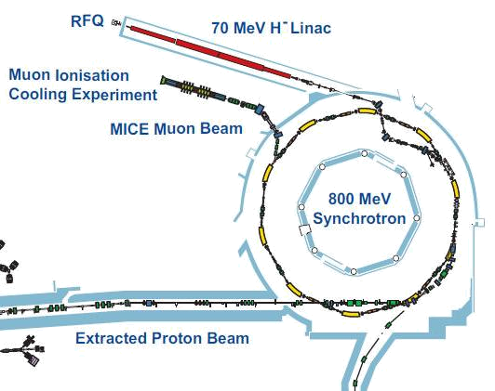
ISIS
Orbit longitudinal coordinate system 0m point on exit face of D0
S9
S8
S7
S0
MICE Target
S6
S1
S5
S2
Collimators
S4
S3
26m radius
163m circumference
Notes:
Ring is of 26m radius, 163m circumference
10 super periods, SP0 - SP9, each 16.3m in length
1 dipole per SP, dipole defines the start of the SP (hence D0 is at the start of SP0, not the end)
The Orbit longitudinal coordinate system sets 0m at a point known as Datum D, which sits on the exit face of D0.
MICE target is just after the start of SP7
Injection from the linac iis into SP0
The Collimators are in SP1
Extraction occurs in SP1

Slide 6
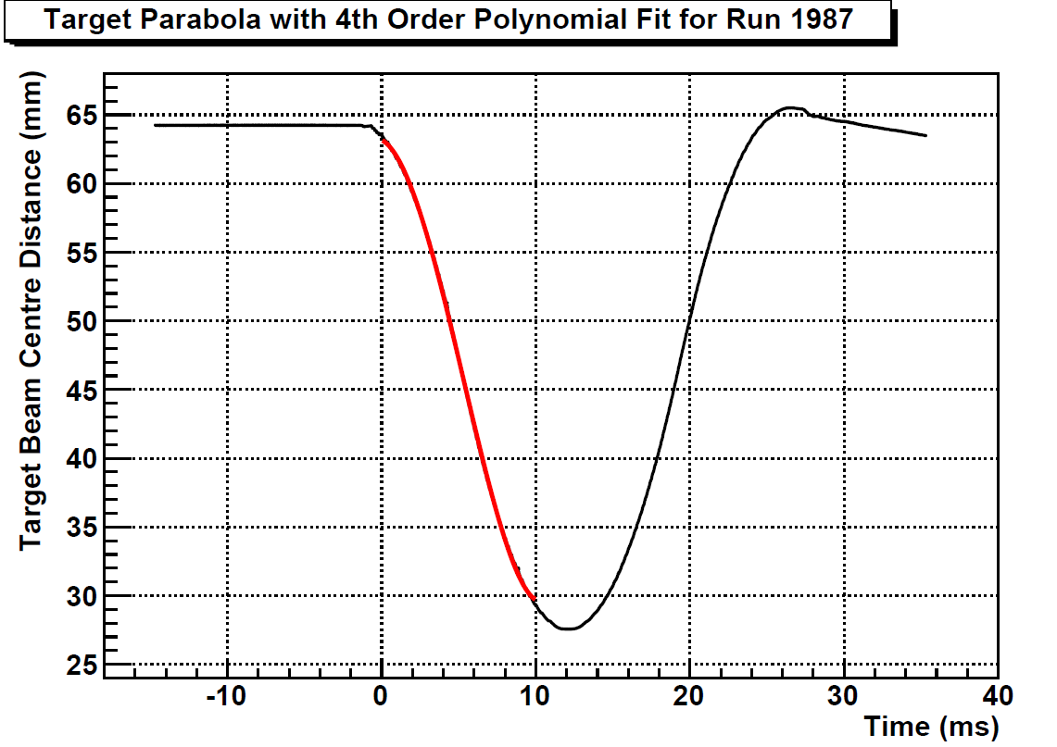
Simulation Description
MICE target modelled using 10 rectangular collimator elements
Iron used instead of Titanium
No Space Charge – too CPU intensive
~ 34,000 macro particles
Performed in two parts:
  Injection, 0 – 5000 turns, 0 – 5ms, fast ORBIT (minutes)
  Continuation, 5000 – 12000 turns, 5 – 10ms, slow ORBIT (day or two)
Target now
Modelling the target:
Modelling the dip (fit shown in red):
Dynamic

Slide 7
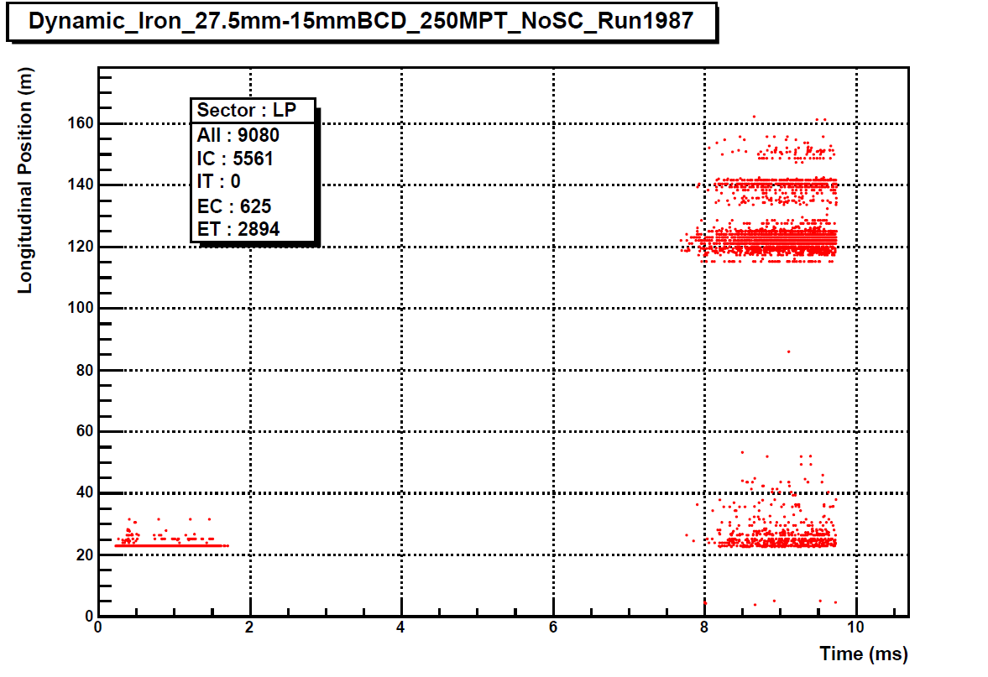
Beam Loss Distribution (Graph)
I = Injection
E = Extraction
C = Collimators
T = MICE Target
IT
ET
IC
EC

Slide 8
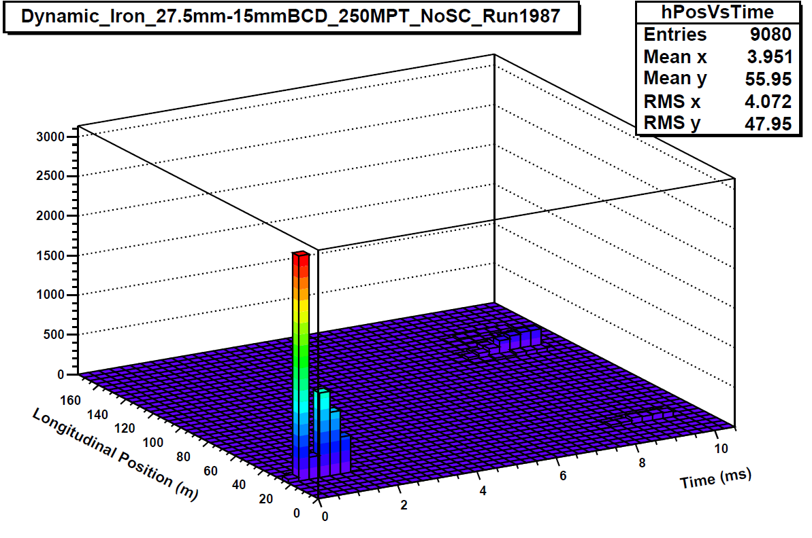
Beam Loss Distribution (TH2D)
Injection (IC)
Target losses near Target (ET)
Target losses at Collimators (EC)

Slide 9
Depth Study
Run | Nominal BL (mV.ms) | BCD (mm) | All | EC | ET | EC / ET
1985 | 2750 | 26.5 | 10732 | 862 | 4309 | 5.00
1987 | 2130 | 27.5 | 9080 | 625 | 2894 | 4.63
1988 | 1400 | 28.7 | 7623 | 365 | 1697 | 4.65
1989 | 1060 | 29.95 | 6573 | 158 | 854 | 5.41
1991 | 590 | 31.9 | 5694 | 29 | 104 | 3.59
Short Delay = 13.1ms
BCD offset = -15mm
Material = Iron
IC losses = 5561 particles
Little to no variation with target depth of where losses are deposited

Slide 10
Delay Study
Run | Nominal BL (mV.ms) | Short delay (ms) | All | EC | ET | EC / ET
2888 | 1400 | 13.5 | 16144 | 1771 | 8812 | 4.98
2890 | 600 | 14.3 | 11266 | 936 | 4769 | 5.10
2893 | 1500 | 12.7 | 20181 | 2386 | 12234 | 5.13
BCD = 30.5mm
BCD offset = - 20mm
Material = Iron
IC losses = 5561 particles
Little to no variation with short delay of where losses are deposited

Slide 11
Materials Study
Run | Nominal BL (mV.ms) | Material | All | EC | ET | EC / ET
1987 | 2130 | Carbon | 8881 | 2053 | 1267 | 0.62
1987 | 2130 | Iron | 9080 | 625 | 2894 | 4.63
1987 | 2130 | Tungsten | 9105 | 156 | 3388 | 21.72
BCD = 30.5mm
BCD offset = -15mm
Short Delay = 13.1ms
Material = Iron
IC losses = 5561 particles
Heavier Z materials dump preferentially at the MICE target not the Collimators
Check particle rate in MICE for each material with G4BeamLine

Slide 12
Conclusions
MICE target losses appear in the vicinity of the target and at the collimators (with some overspill)
Depth and delay observed to have little effect as to where the losses are deposited
NB: know from experience that losses do begin to propagate around the ring for highest BCDs
Higher atomic number materials cause a large shift of losses to the target vicinity, with only a slight increase in overall losses
To do: simulate effect of Z on MICE particle rate, errors, understand loss mechanism (multiple coulomb scattering, dE/dx, ...)

