Slide 1
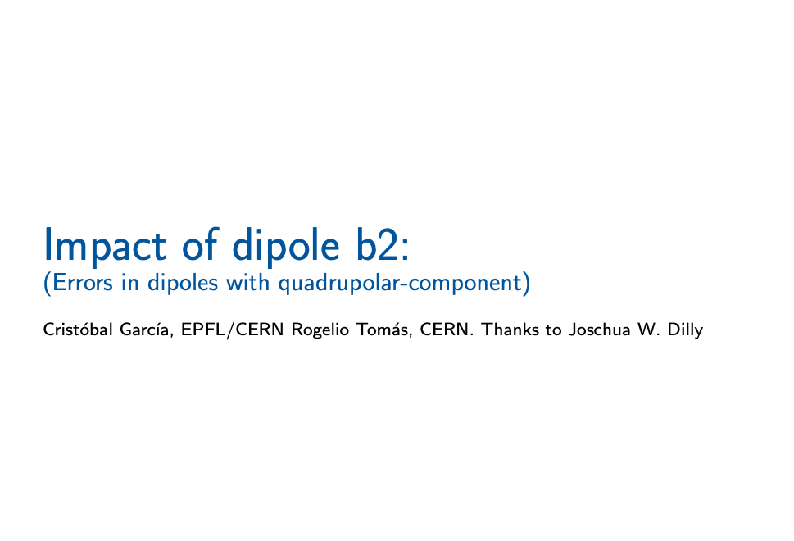

Slide 2
LAYOUT
IP 1
ARC 8
ARC 1
Intermediate Straight Section 4
sign in the dipole error [-]
sign in the dipole error [+]
Intermediate Straight Section 1
ARC 7
sign in the dipole error [+]
sign in the dipole error [-]
ARC 2
fccee_z.seq
Mar 17 2022
IP 4
IP 2
sign in the dipole error [-]
sign in the dipole error [+]
ARC 6
ARC 3
sign in the dipole error [+]
sign in the dipole error [-]
Intermediate Straight Section 3
Intermediate Straight Section 2
ARC 5
ARC 4
IP 3

Slide 3
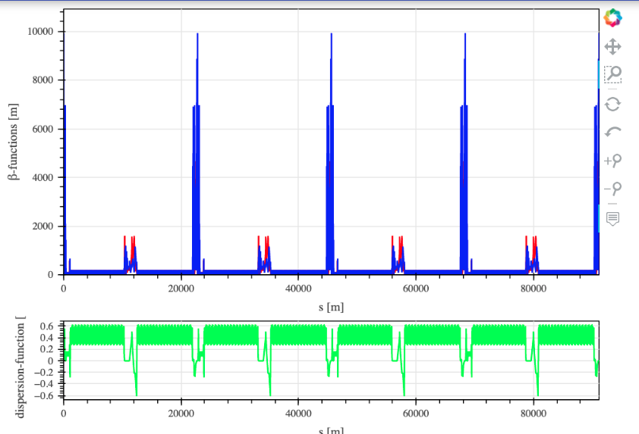
IP 2
IP 3
IP 4
IP 1
ISS 1
ISS 2
ISS 3
ISS 4
ARC 1
ARC 2
ARC 3
ARC 4
ARC 5
ARC 6
ARC 7
ARC 8
https://acc-models.web.cern.ch/acc-models/fcc/fccee/V22/z/

Slide 4
Summary for the dipoles in the ARCs
ARC | FROM | TO | # Dipoles | # FODOs | Structure (#5FODO)
1 | BGA.1: at = 1153.16 | B1.176: at = 10275.75 | 350 | 87 | 17x 5FODO 2x FODO
2 | BI4.1: at = 12478.01 | BL4.1: at = 21897.87 | 360 | 90 | 1x FODO 17x 5FODO 4x FODO
3 | BGA.2: at = 23946.69 | B1.533: at = 33069.28 | 350 | 87 | 17x 5FODO 2x FODO
4 | BI4.2: at = 35271.54 | BL4.2: at = 44691.40 | 360 | 90 | 1x FODO 17x 5FODO 4x FODO
5 | BGA.3: at = 46740.22 | B1.890: at = 55862.81 | 350 | 87 | 17x 5FODO 2x FODO
6 | BI4.3: at = 58065.07 | BL4.3: at = 67484.93 | 360 | 90 | 1x FODO 17x 5FODO 4x FODO
7 | BGA.4: at = 69533.75 | B1.1247: at = 78656.34 | 350 | 87 | 17x 5FODO 2x FODO
8 | BI4.4: at = 80858.60 | BL4.4: BL4, at = 90278.46 | 360 | 90 | 1x FODO 17x 5FODO 4x FODO
The FCC-ring with 8 straight sections has a periodic structure with 5FODO
5FODO
QF4.6 B1.11 B1.12 QD3.6 B1.13 B1S.9 | QF4.7 B1S.10 B1.14 QD3.7 B1.15 B1L.3 SF4.2 | QF4.8 B1S.11 B1S.12 SD4.1 QD3.8 B1.16 B1.17 | QF4.9 B1.18 B1S.13 QD3.9 B1S.14 B1.19 | QF4.10 B1.20 B1L.4 SD4.2 QD3.10 B1S.15 B1S.16 SF5.1 | QF4.11 B1.21 B1.22 QD3.11 B1.23 B1S.17
Same position of Dipoles and Quads

Slide 5
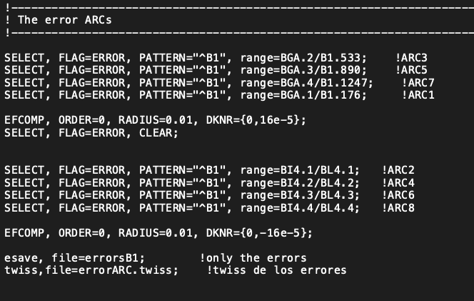
Assignment of errors per ARCs
Assigned field errors to 1400 elements:
ARCs 1,3,5,7
Assigned field errors to 1440 elements:
ARCs 2,4,6,8
 | Ideal | Error
Q1 | 214.2600 | 214.2492
Q2 | 214.3800 | 214.3876

Slide 6
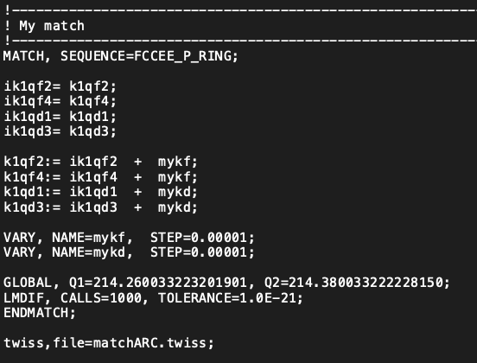
Define the matching for the tunes
 | Ideal | Matching (all the ring)
Q1 | 214.2600 | 214.2600
Q2 | 214.3800 | 214.3800

Slide 7
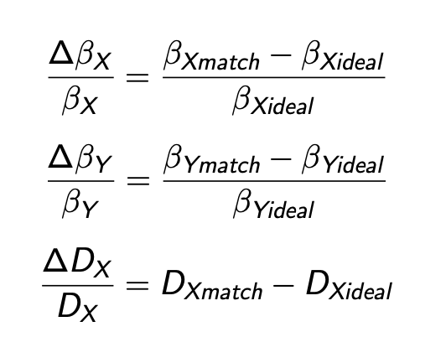
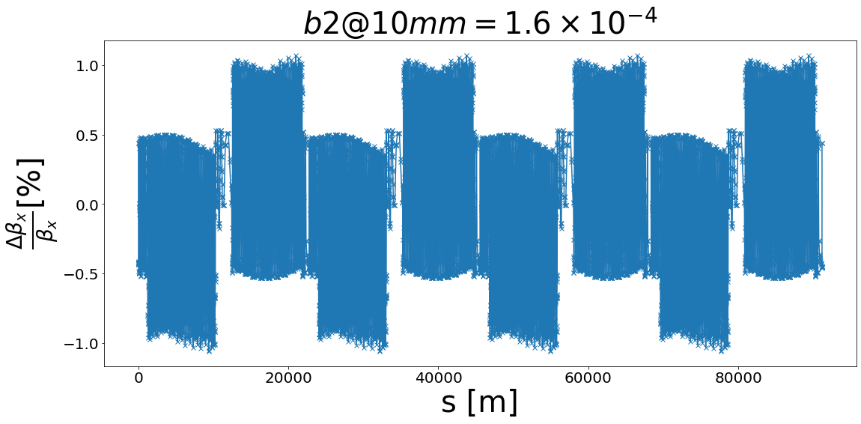
BETX-Beating (matching)

Slide 8
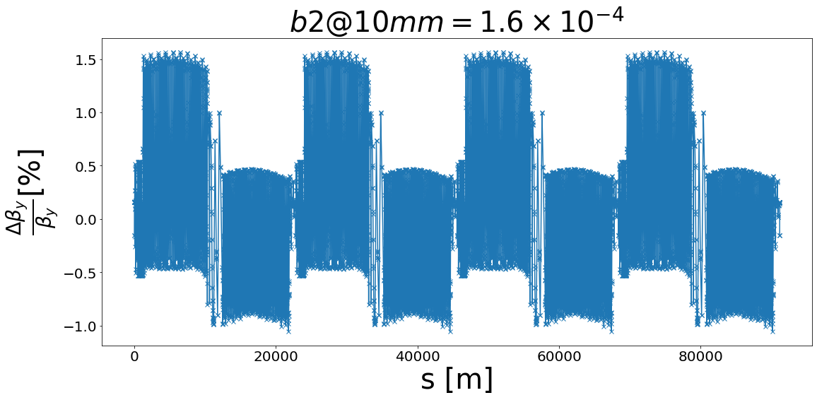
BETY-Beating (matching)

Slide 9
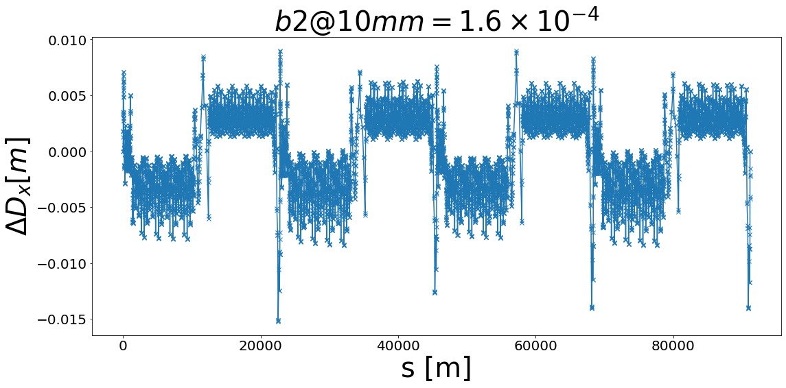
Dx-Beating (matching)

Slide 10
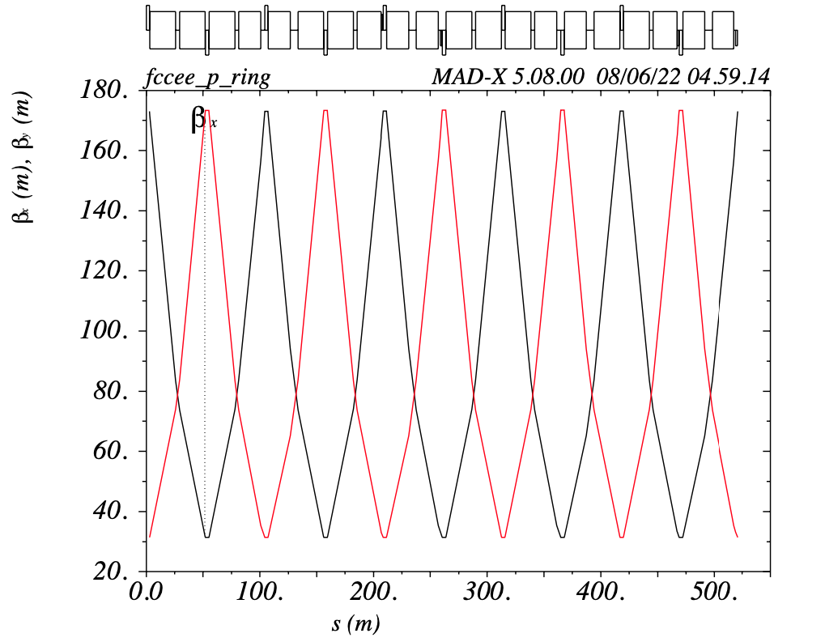
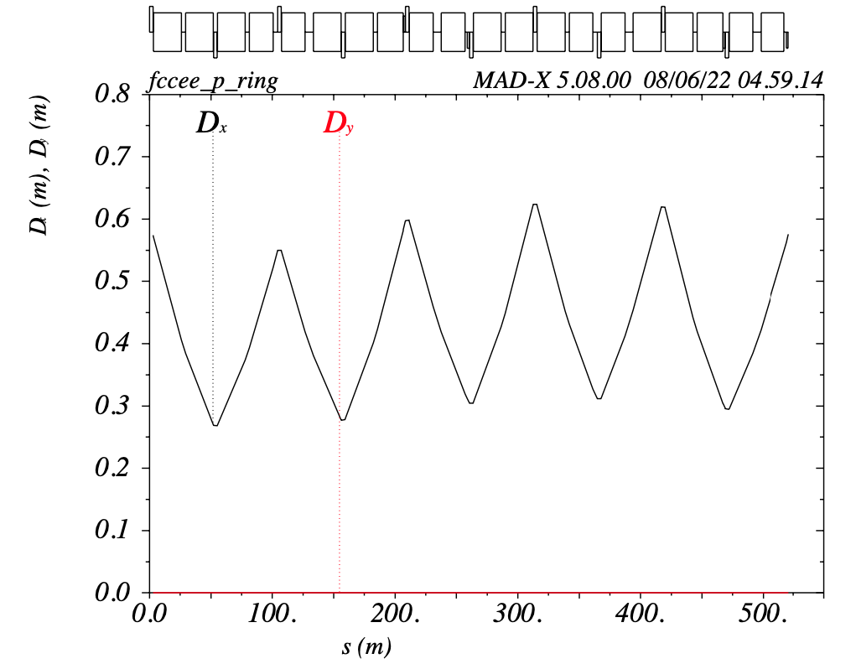
5FODO: QF4.6-QF4.11

Slide 11
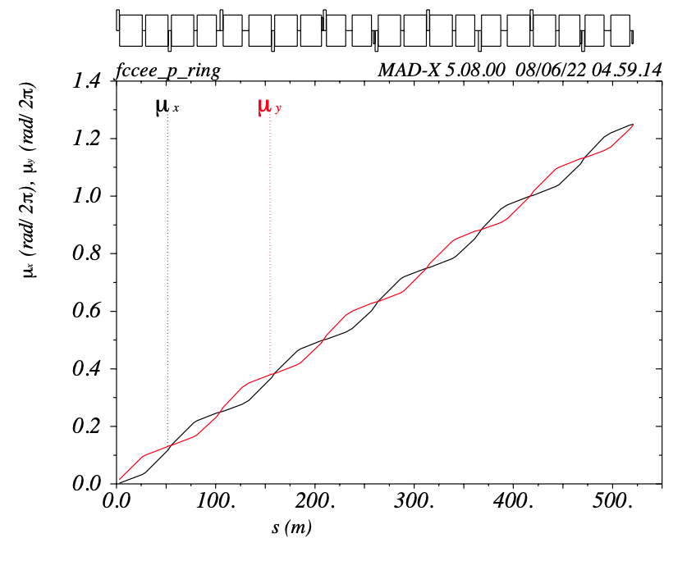
5FODO: QF4.6–QF4.11
How do the phase advance change with the b2 error in the dipoles?
 | Ideal | Error | Matching
𝝍_5FODO1 | 1.250000 | 1.254693 | 1.250000
𝝍_5FODO2 | 1.250000 | 1.245295 | 1.250000

Slide 12
Future work
To see the impact on phase advance between sext.
To see the impact for the 5FODO beta-betaing, etc.

