Slide 1
Trigger Systems and Filtering Muon Events
Mentee: Andrew Fonseca (University of Delaware)
Mentor: Darin Acosta (Rice University)

Slide 2
Abstract
Abstract: With the collection of and storage of data recorded by a set of detectors, also known as “data acquisition”, there needs to be a “trigger”. The job of the trigger would be to set conditions by which the sequence to digitize data from the analog sensors and record memory is initiated. With the detector, there would be a lot of events been recording, leading to a lot of recorded memory/disk space (100 TB per second!). Due to the limitation of storing this data, it is best to filter out unimportant events and keep uncommon and interesting events to save on storage (99.998% of the events are thrown out). With these interesting events, we can then deduce information about these special events, like its momentum. Before actual data is collected though, Monte Carlo simulations are used in training boosted decision trees to better determine effect methods to increase efficiency, decrease rate, and maintain a good resolution.

Slide 3
Overview
1. Introduction
2. Monte Carlo Simulation/Generated Data
3. Training of BDTs
4. Efficiency, Rate, and Resolution
7. Conclusion

Slide 4
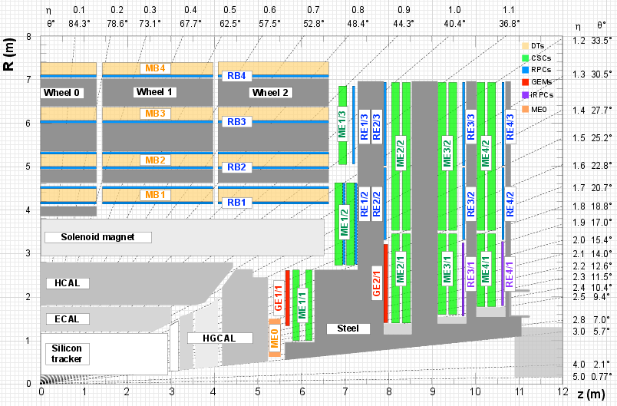
Introduction
There are “tracks” that particles would go along, and the data is collected once a particle would hit the detector along it.
There are three important aspects to the training that would need to be considered, and those are efficiency, rate, and resolution, and each relate into one another.

Slide 5
Work to do
Goal: Filter out uninteresting or common muon events out of the events recorded from the detector or Monte Carlo simulation.
We can filter out these common muon events through training of the BDT (Boosted Decision Trees) from Monte Carlo simulation.
The result of these simulations and trainings can be shared, compared, and contrasted through efficiency plots, rate plots, and resolution plots.

Slide 6
Method
Filtering out Events
  Boosted Decision Trees (BDT)
Training of BDT:
  Efficiency - How well are you filtering out uninteresting events
  Rate - How much data are you letting through
  Resolution - The quality of the events you are letting through
Efficiency, Resolution, and Rate Plots
Conclusion

