Slide 1

Networking & Resumes
Julie Hogan
6/23/22

Slide 2

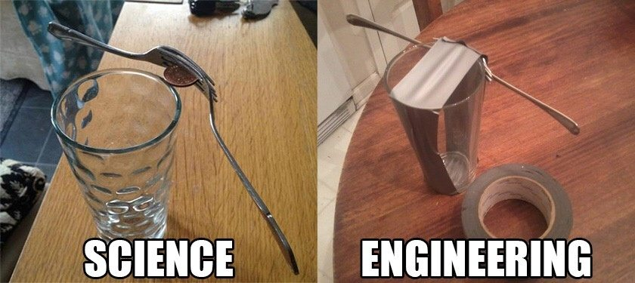
Physics & Engineering
J. Hogan, PHY/ENR 260
2

Slide 3
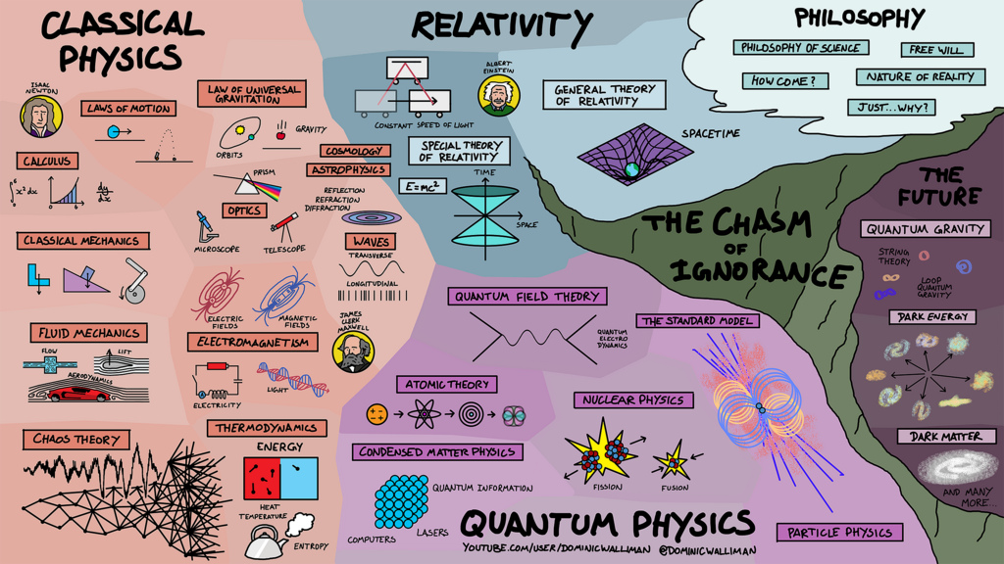
Physics
J. Hogan, PHY/ENR 260
3

Slide 4
Engineering
Engineering
Mechanical
Electrical
Chemical
Biomedical
Civil
Aerospace
J. Hogan, PHY/ENR 260
4

Slide 5
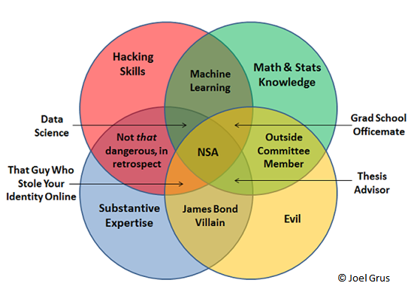
Connections: field → title
J. Hogan, PHY/ENR 260
5

Slide 6
Physics: fields → titles
Concentrations:
  Nuclear/Particle physics
  Astronomy/astrophysics
  Solid state/materials physics (like the Nano lab)
  Atomic & molecular optics (like the laser lab)
  Condensed matter physics
  Biological/medical physics
  Etc!
Experimental vs Theoretical
Academia, Government, Industry
J. Hogan, PHY/ENR 260
6

Slide 7
Physics: field → title
Undergrad
Grad student
Post-doctoral researcher
Faculty member
Academia:
  Many options for transitions out after any level on this track
Government (ex: Fermilab):
  Job description will include the type/category of science
Post-doctoral researcher
Associate Scientist
Scientist 1
Scientist 2
Scientist 3
J. Hogan, PHY/ENR 260
7

Slide 8
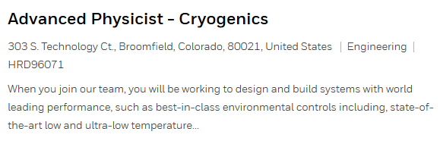

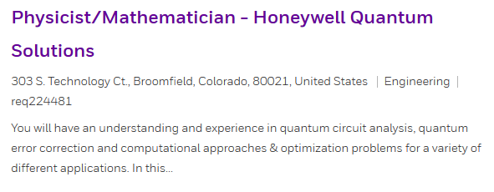
Physics: field → title
Industry: searches for “physics” will often return post-PhD job options
  Ex: Honeywell career site, search “physicist”
  Notice these jobs are posted in the “engineering” category on their search site!
Master’s, not PhD!
J. Hogan, PHY/ENR 260
8

Slide 9
Engineering: field → title
Engineering jobs are also usually not coded to the name of your degree!
Sales Engineer
Applications Engineer
Design/Process Engineer
Works directly with customers to understand their project
Creates initial specifications in order to offer a price quote to customers
Lots of variety – the details and “doing” are passed on to others
Design products
Analysis-heavy: simulation of solids, fluids, electronics, etc, to support product design
Create specific design details for elements of a product
Create the manufacturing specifications and procedures
Quality Engineer
Research & Development Engineer
Manufacturing Engineer
Maintain equipment required for manufacturing products
Design new equipment (or improve existing) for new projects
Perform statistical analysis for correctness and consistency of manufacturing
Improve processes or implement controls to ensure consistent quality
Develop new ideas for products or technologies
Implement new technological advances into existing products
J. Hogan, PHY/ENR 260
9

Slide 10
Engineering: field → title
Engineering progression
  Basic idea – every company will differ
Management vs Engineering tracks
Technician (no college degree)
Advanced / 2
Sr Advanced / 3
Senior / 4
Junior (no-label) / 1
J. Hogan, PHY/ENR 260
10

Slide 11
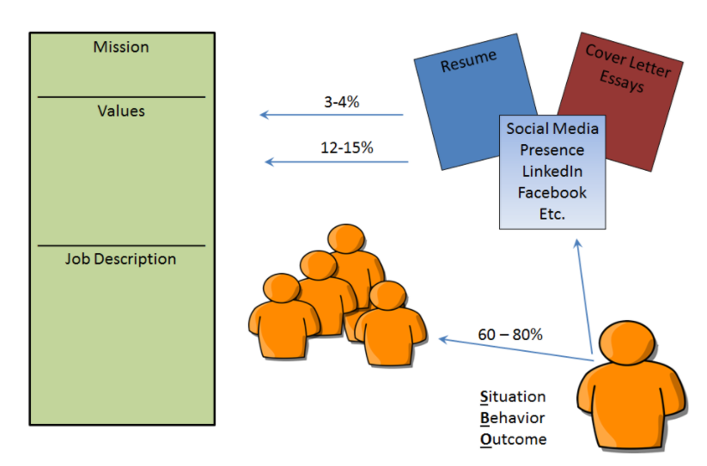
Behavior-based philosophy
History is the best predictor of future success
Employers create job descriptions from their mission & values
They want to know how your experiences align with their needs
J. Hogan, PHY/ENR 260
11

Slide 12
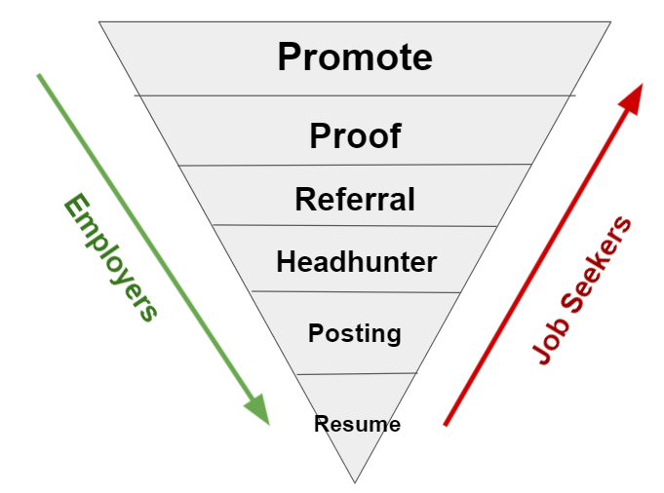
How jobs are filled
Companies don’t want to post jobs!!
  Costs $$!
  Costs time!
Referral bonuses
“It’s not about what you know, it’s about who you know”
J. Hogan, PHY/ENR 260
12

Slide 13
How jobs are filled
Companies don’t want to post jobs!!
  Costs $$!
  Costs time!
Referral bonuses
“It’s not about what you know, it’s about who knows you”
J. Hogan, PHY/ENR 260
13

Slide 14
Building your network
Internal
Talk to people about your job hopes!
School, hobbies, volunteering, parents
Online
LinkedIn
Social media
Events
Job fairs
Campus events
Contact info on job postings or company webpages
Community events
Conferences
How many people do you know?
Who has the biggest “internal” network?
J. Hogan, PHY/ENR 260
14

Slide 15
Building your network
Research
Inquire
Connect
Maintain
https://www.onetonline.org/
  Compendium of info and statistics on many many job titles
https://www.candidcareer.com
  Videos of people describing different jobs
  Also videos on career development strategies!
https://www.linkedin.com
  Let’s go search some alumni!
J. Hogan, PHY/ENR 260
15

Slide 16
Building your network
Research
Inquire
Connect
Maintain
Assessor versus Ally strategy
“Can you get me a job at your company?”
  Casts this connection as an assessor
  They are more defensive, given role of judging you
“Can you tell me a little about your job/company?”
  Casts this connection as an ally – no immediate “ask”
  Gets them talking about themselves
J. Hogan, PHY/ENR 260
16

Slide 17
Informational Interviews
Research
Inquire
Connect
Maintain
Informational interviews
  Have a conversation with someone in a job/field that interests you!
Know your objective: have tailored questions for this person
Keep it professional: not coffee with a friend, networking!
Keep on target: respect their time with questions that fit in ~30 minutes (unless they volunteer more time)
J. Hogan, PHY/ENR 260
17

Slide 18
Informational Interviews
Research
Inquire
Connect
Maintain
Example questions:
  Would you tell me your story? How did you get here professionally?
  How does your job relate to your training in school?
  What do you do on a typical day?
  Can you describe some of your projects and the tools/techniques?
  What do you like best/least about your job/company/field?
  What has been the hardest thing to learn in your position?
  What advice would give someone in my position? Any pitfalls to watch out for?
J. Hogan, PHY/ENR 260
18

Slide 19
Informational Interviews
Research
Inquire
Connect
Maintain
May I stay in touch with you periodically?
Would you recommend anyone else I could meet to hear their story?
After your connection: THANK THEM!
  Email is fine
  Follow through on following up
J. Hogan, PHY/ENR 260
19

Slide 20
Resumes
Your resume communicates your “brand” to the world
Contact information
Skills
Education
Job experience
Other experience
Goal is FAST information transfer
  Pass the computerized keyword search!
  Make sure a 30-second glance shows someone the highlights
J. Hogan, PHY/ENR 260
20

Slide 21
Resumes
Your resume communicates your “brand” to the world
On Indico:
  General Example 1 → January – April birthday breakout
  General Example 2 → May – August birthday breakout
  General Example 3 → September – December birthday breakout
  Science-specific example → Jan-April + Sept-Dec
  My old resume! → May-Aug
What common formatting features do you see in the examples?
J. Hogan, PHY/ENR 260
21

Slide 22




Name & contact
Your resume communicates your “brand” to the world
Contact information
  NAME! Biggest thing they see
  EMAIL!
  LinkedIn, etc
  Phone
  Location (not full address)
J. Hogan, PHY/ENR 260
22

Slide 23
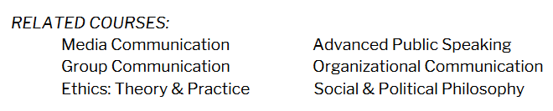

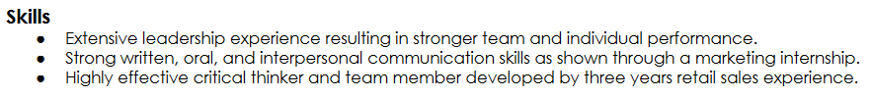
Courses / Skills
Your resume communicates your “brand” to the world
Contact information
Skills
  From courses?
  From hobbies?
  From jobs?
CAREFUL!!
J. Hogan, PHY/ENR 260
23
Notes:
DIRECT SKILLS
Specific, name-dropping

Slide 24
Beware of jargon!
Hi (Bethel Prof) –
Just wanted to give you some feedback – we did get several applications from Bethel students, so wherever you announced/posted had some impact. Thanks for that!
It might be good to also let them know they have resources at Bethel to help them with resumes … I can certainly relate what it’s like to be someone who has to read over a stack of resumes in a short amount of time and pick only one or two to recommend… But certainly let them know that a list of courses at Bethel isn’t really sufficient – they have to point out what skills or knowledge they have that applies to the posting.
(3M manager)
J. Hogan, PHY/ENR 260
24

Slide 25
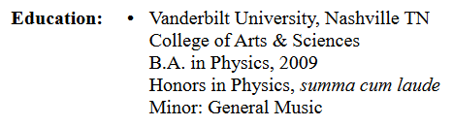
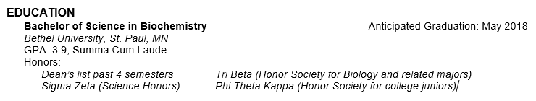

Education
Your resume communicates your “brand” to the world
Contact information
Skills
Education
  University & location
  Anticipated graduation
  GPA (unless it’s poor…), perhaps honors
J. Hogan, PHY/ENR 260
25

Slide 26
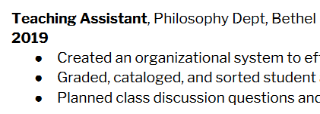
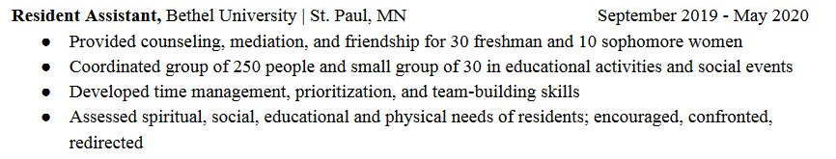
Job experience
Your resume communicates your “brand” to the world
Contact information
Skills
Education
Job experience
  Where, when
  Bullets for responsibilities
  ACTION WORDS
  BE SPECIFIC
J. Hogan, PHY/ENR 260
26

Slide 27
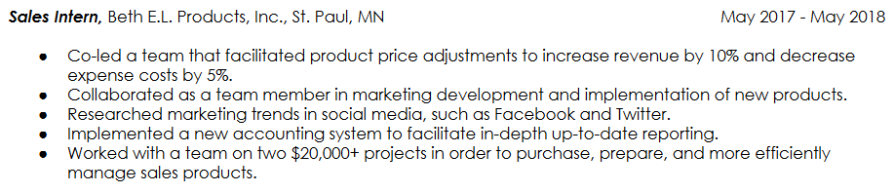
Job experience
Your resume communicates your “brand” to the world
Contact information
Skills
Education
Job experience
  Where, when
  Bullets for responsibilities
  ACTION WORDS
  BE SPECIFIC
J. Hogan, PHY/ENR 260
27

Slide 28
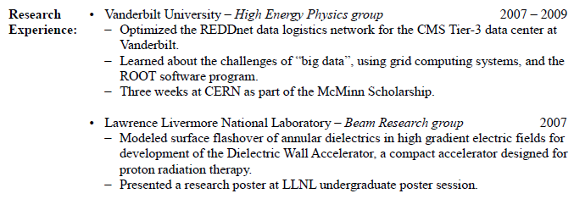
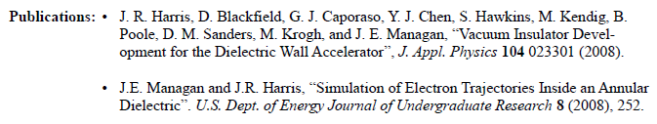
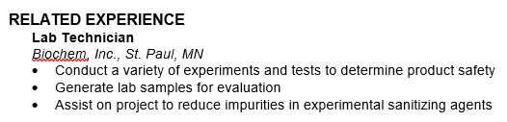
Other experience
Your resume communicates your “brand” to the world
Contact information
Skills
Education
Job experience
Other experience
  ENGINEERING!!
  PHYSICS!!
  Volunteering, etc
J. Hogan, PHY/ENR 260
28

Slide 29



Other experience
Your resume communicates your “brand” to the world
Contact information
Skills
Education
Job experience
Other experience
  ENGINEERING!!
  PHYSICS!!
  Volunteering, etc
J. Hogan, PHY/ENR 260
29

Slide 30
Brainstorm
How will you add this summer’s experience to your resume?
Skills you’re building?
Techniques you’re learning?
Bullet point descriptors?
J. Hogan, PHY/ENR 260
30

