Slide 1
Muon Detectors at Colliders
Kevin Black
University of Wisconsin-Madison

Slide 2
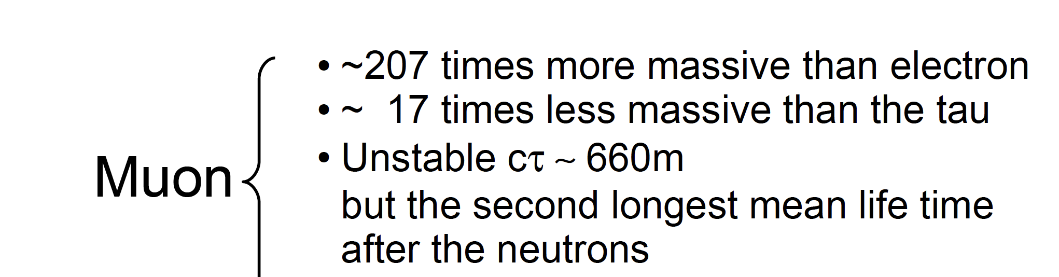
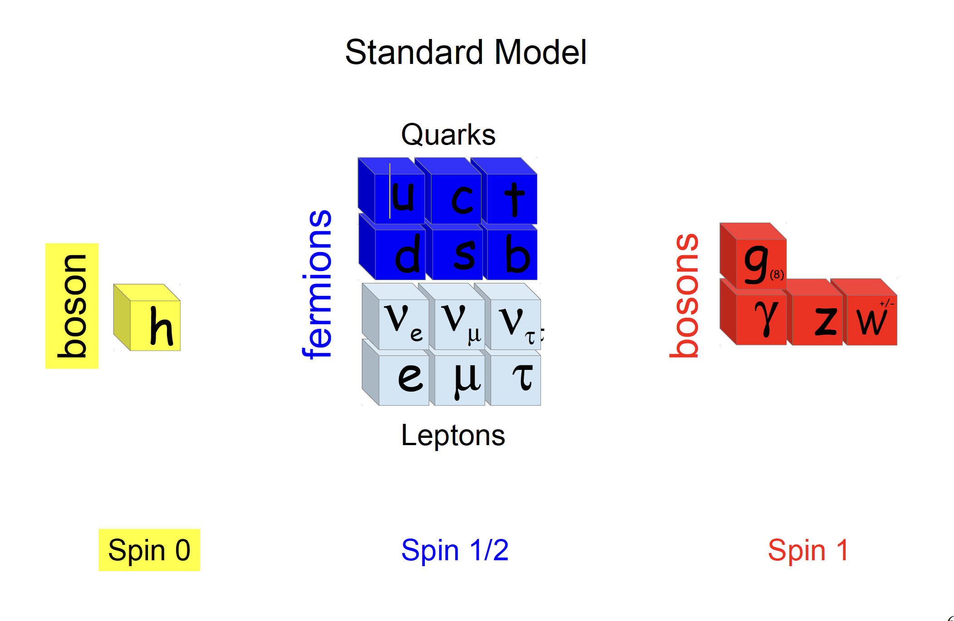
The Muon

Slide 3
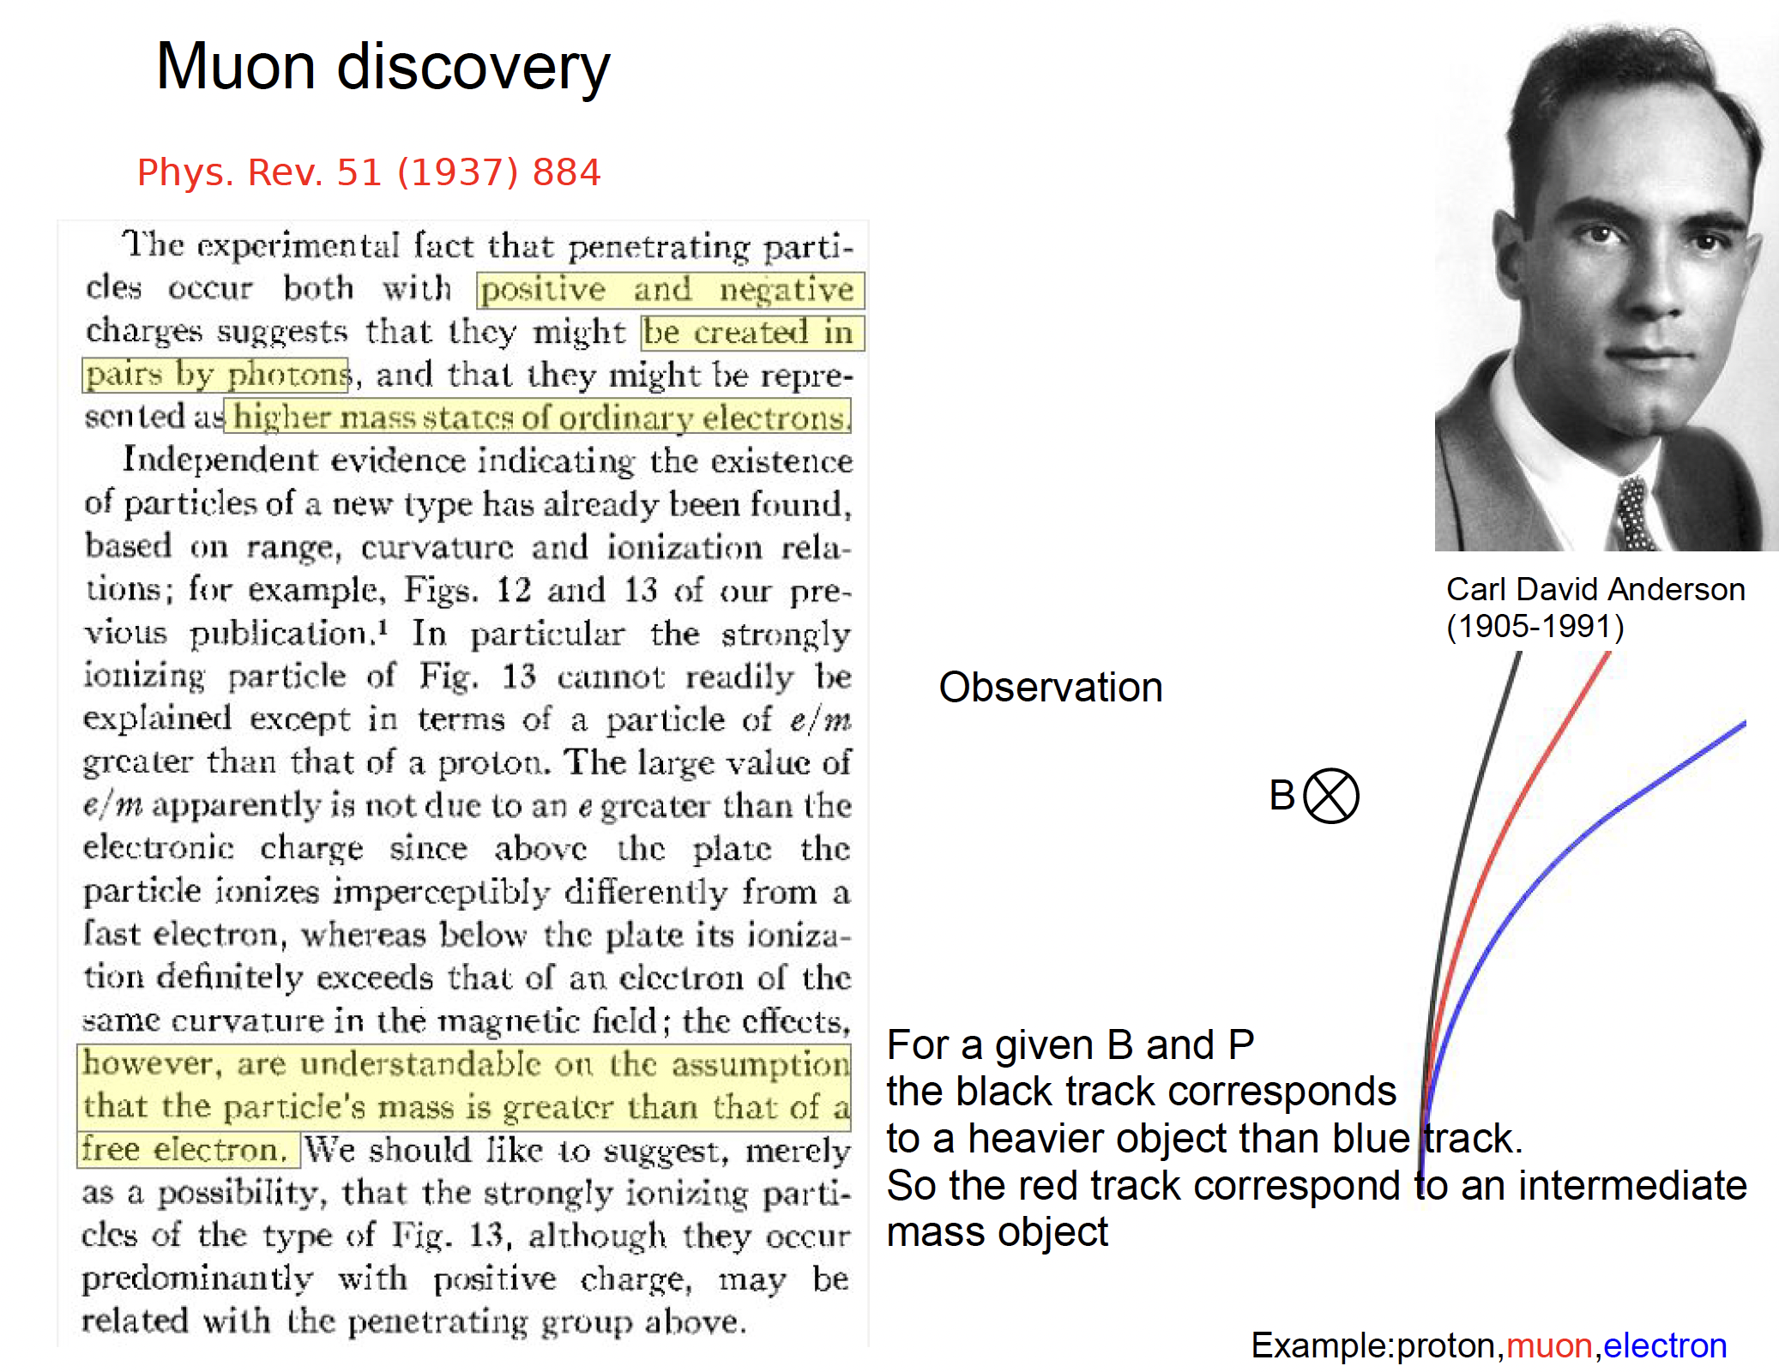

Slide 4
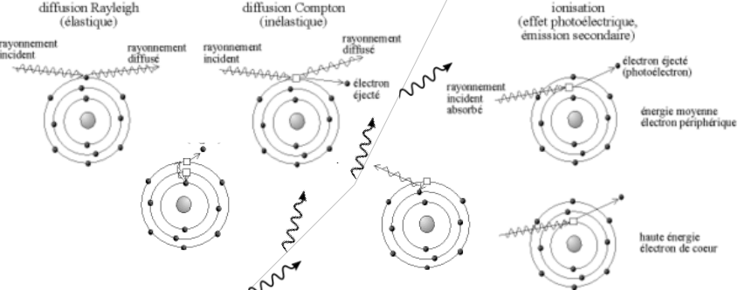
How do muons interact
In reality, many different processes contribute

Slide 5
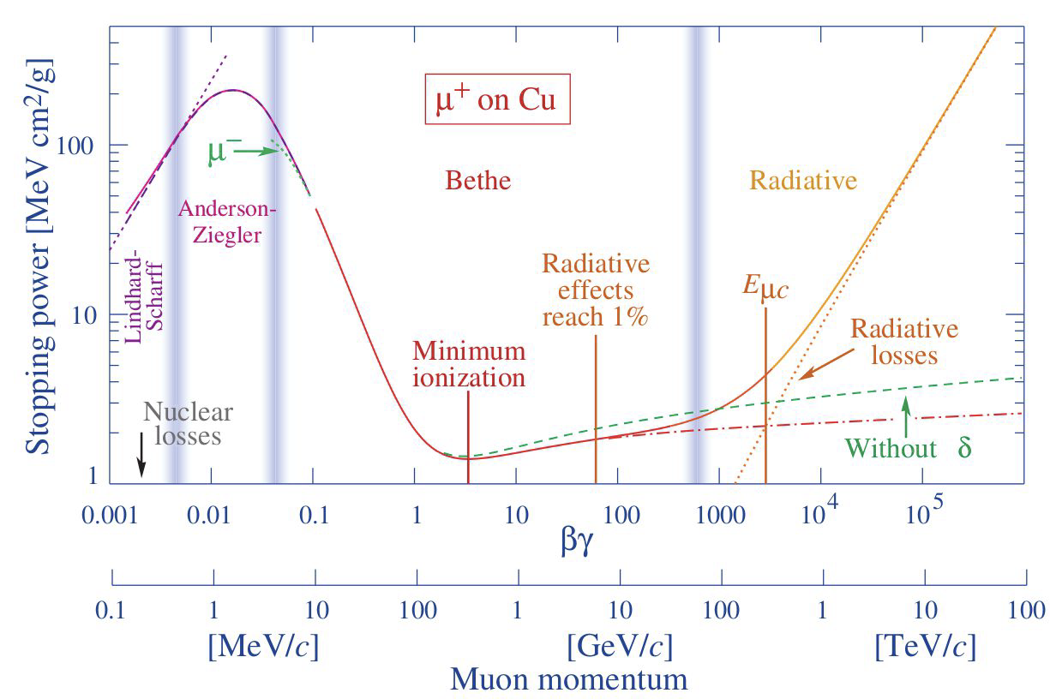
Muon interaction with material

Slide 6
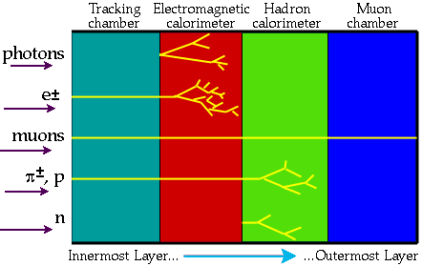
Introduction
How to select the interest muon tracks
  Muon spectrometer
    Magnets
    Trackers
How to optimize the parameters of muon spectrometer
  Efficiency
  Radiation hardness
  Long term stability
  Costs

Slide 7
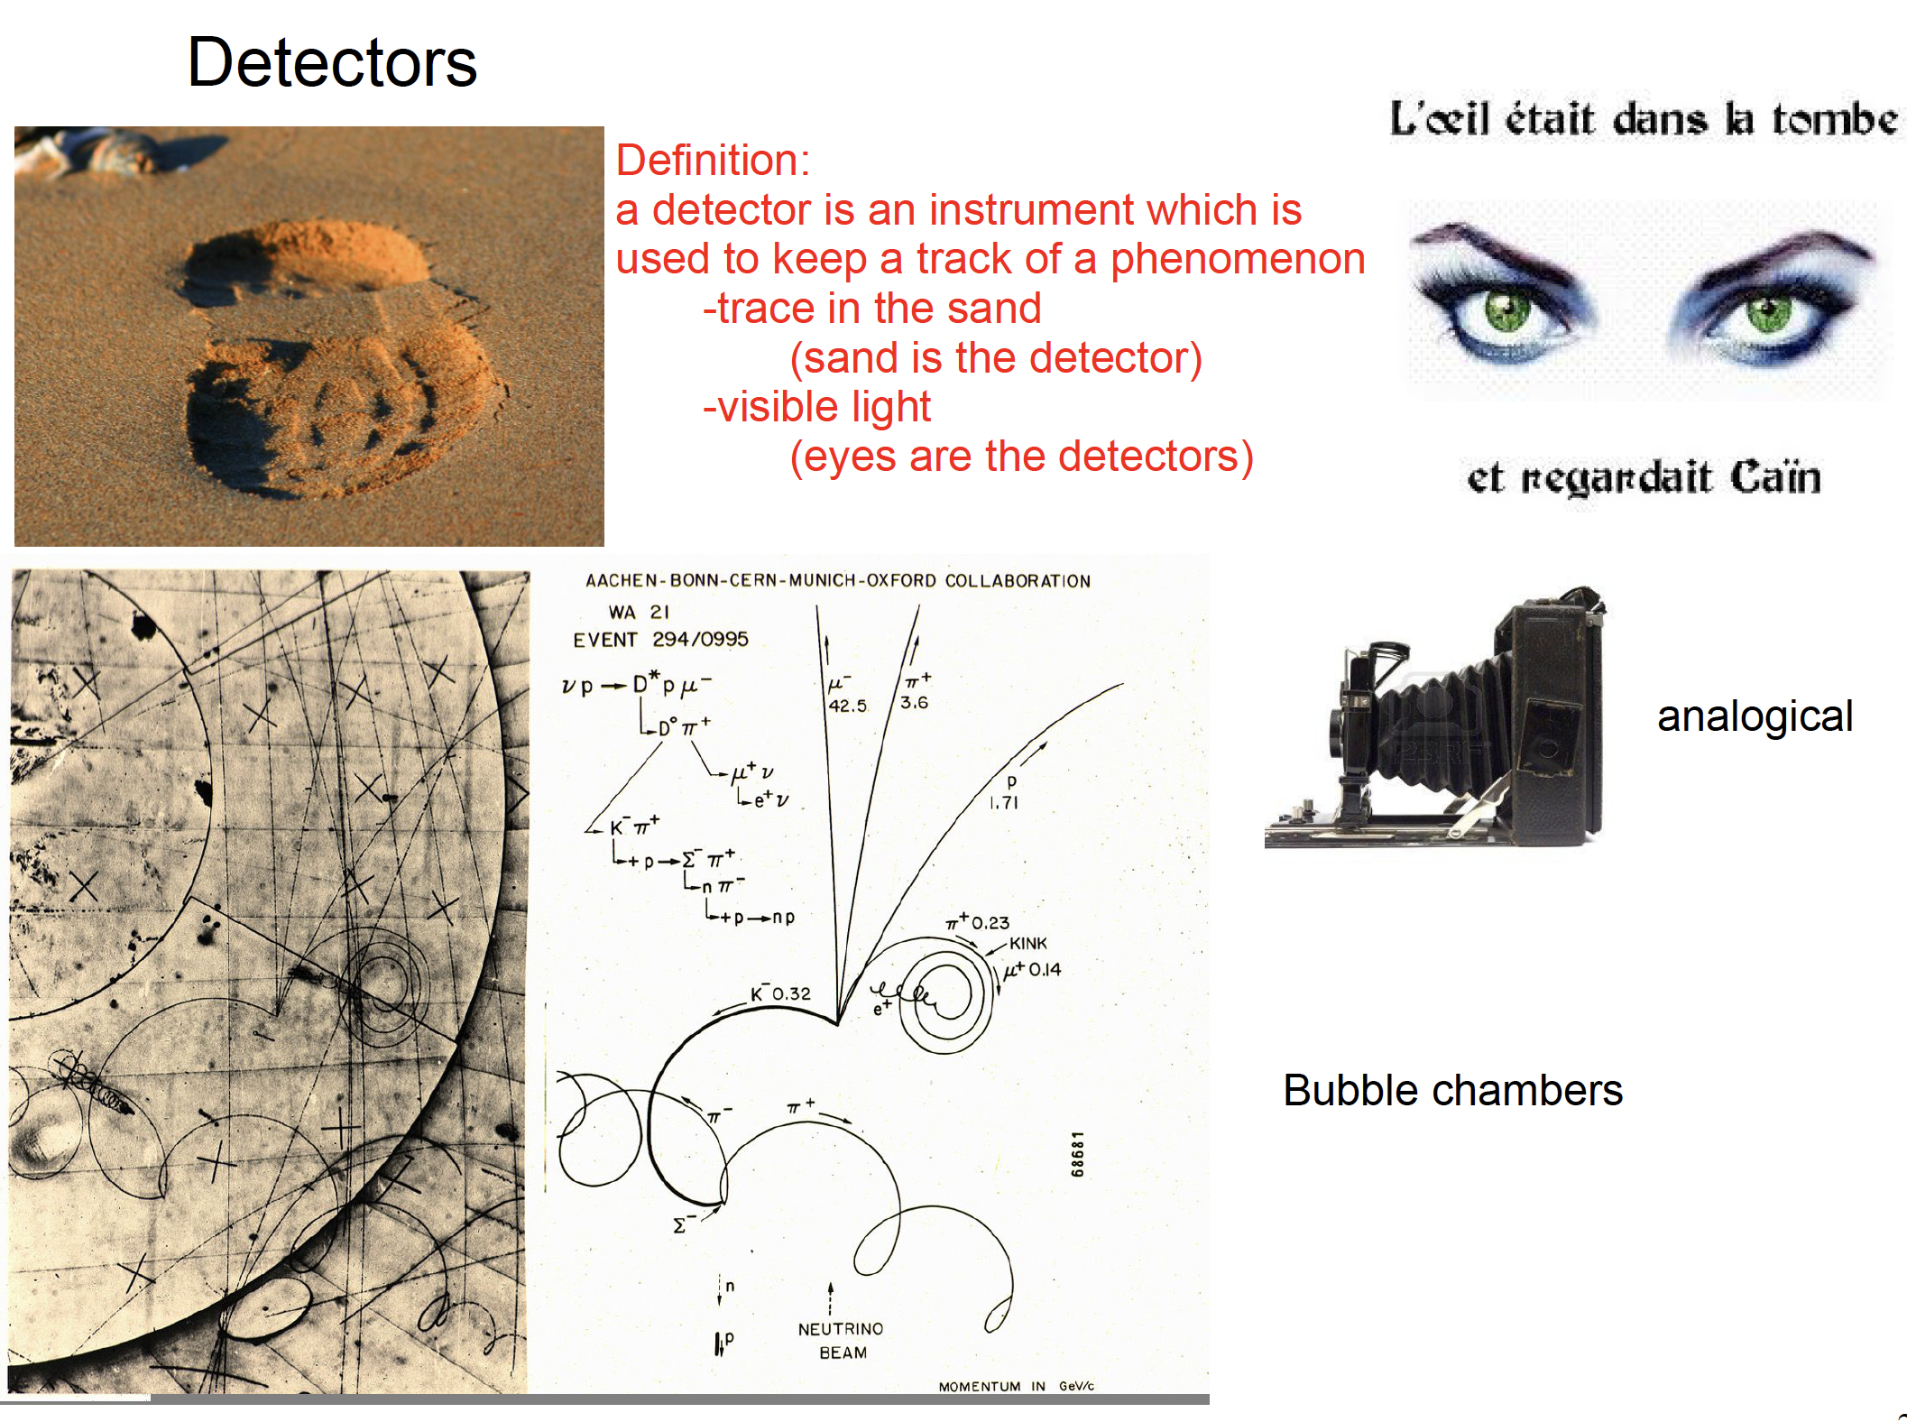

Slide 8
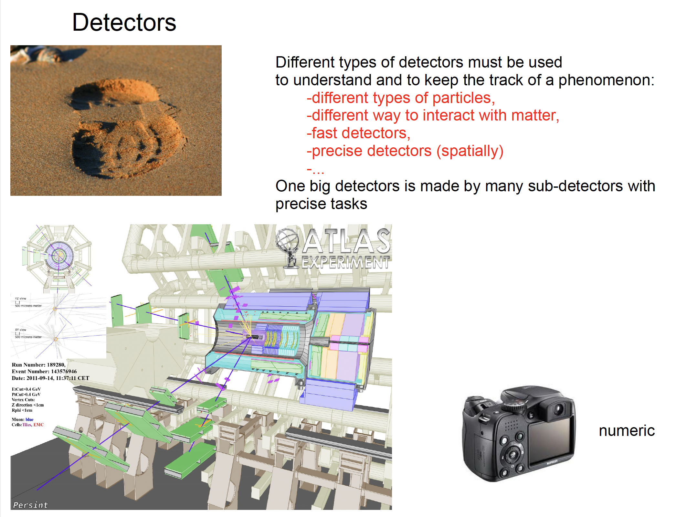

Slide 9
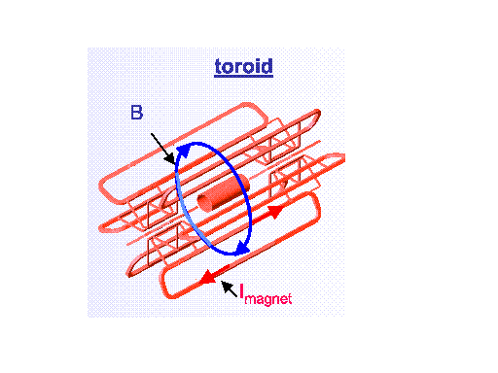
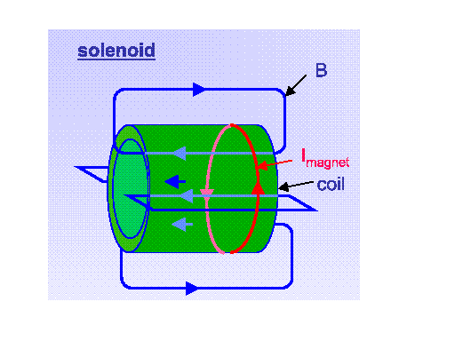
Difference of 2 type magnetic fields
*Large Homogenous field inside coil
*Weak opposite field in return yoke
*Size limited
*Large size area with high magnetic field
*Non-uniform field
*Field always perpendicular to momentum

Slide 10
How to measure Pt?
Measure the transverse component to B field
Position resolution σ(x) for each
Pt resolution depends on B, L and σ(x) (not R)!

Slide 11
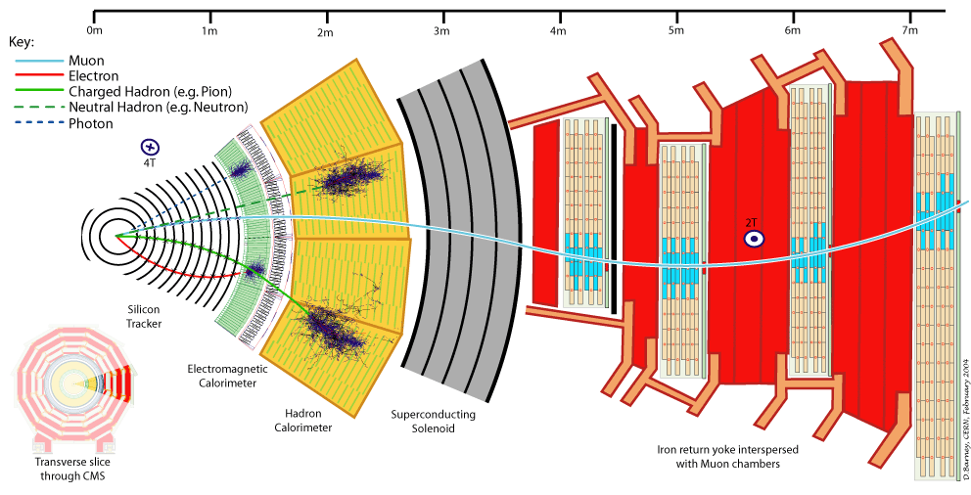
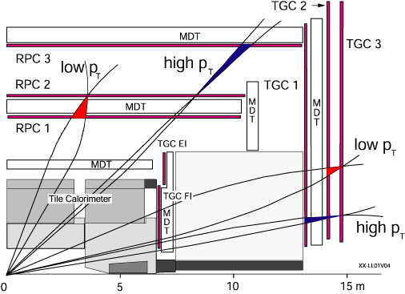
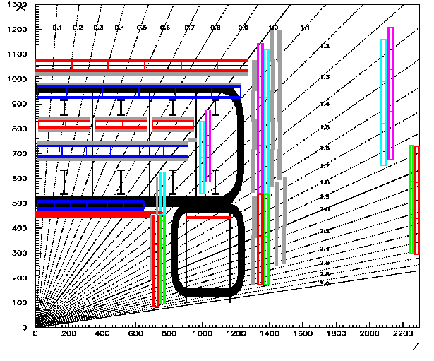
6m
←ATLAS：Troidal magnetic field
（y-z view)
3m
CMS: Solenoidal magnetic Field →
(r-φview)

Slide 12
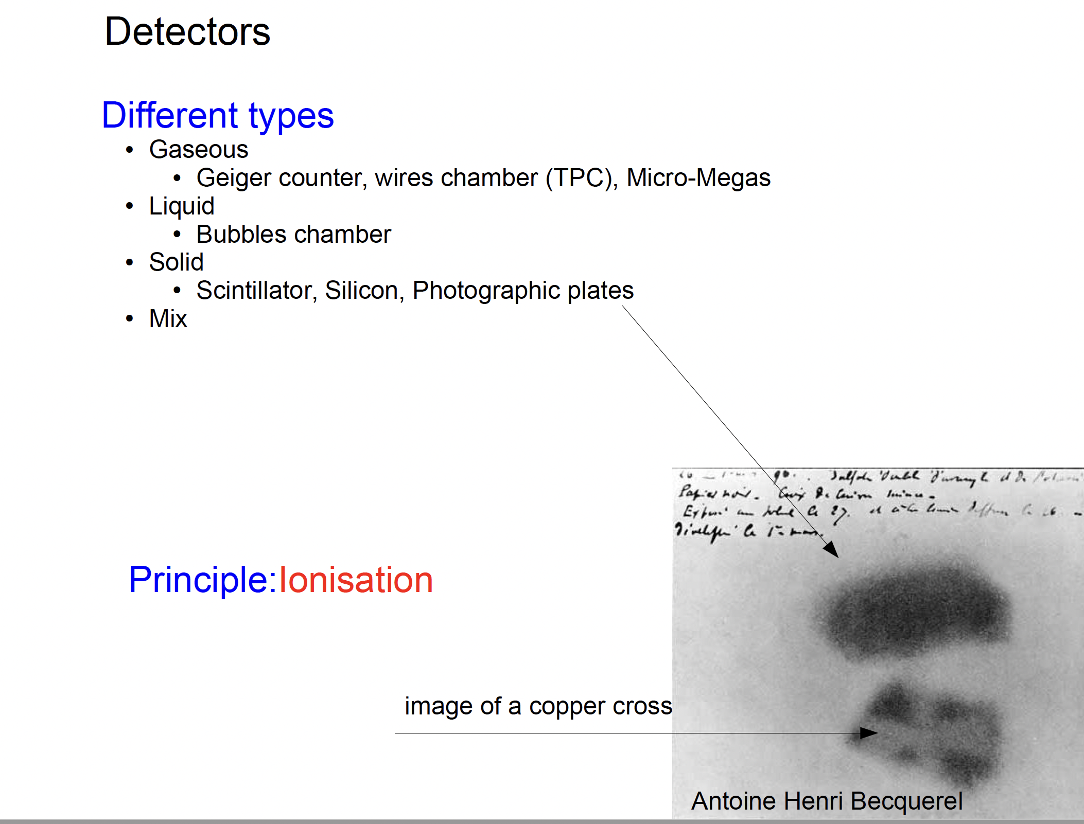

Slide 13
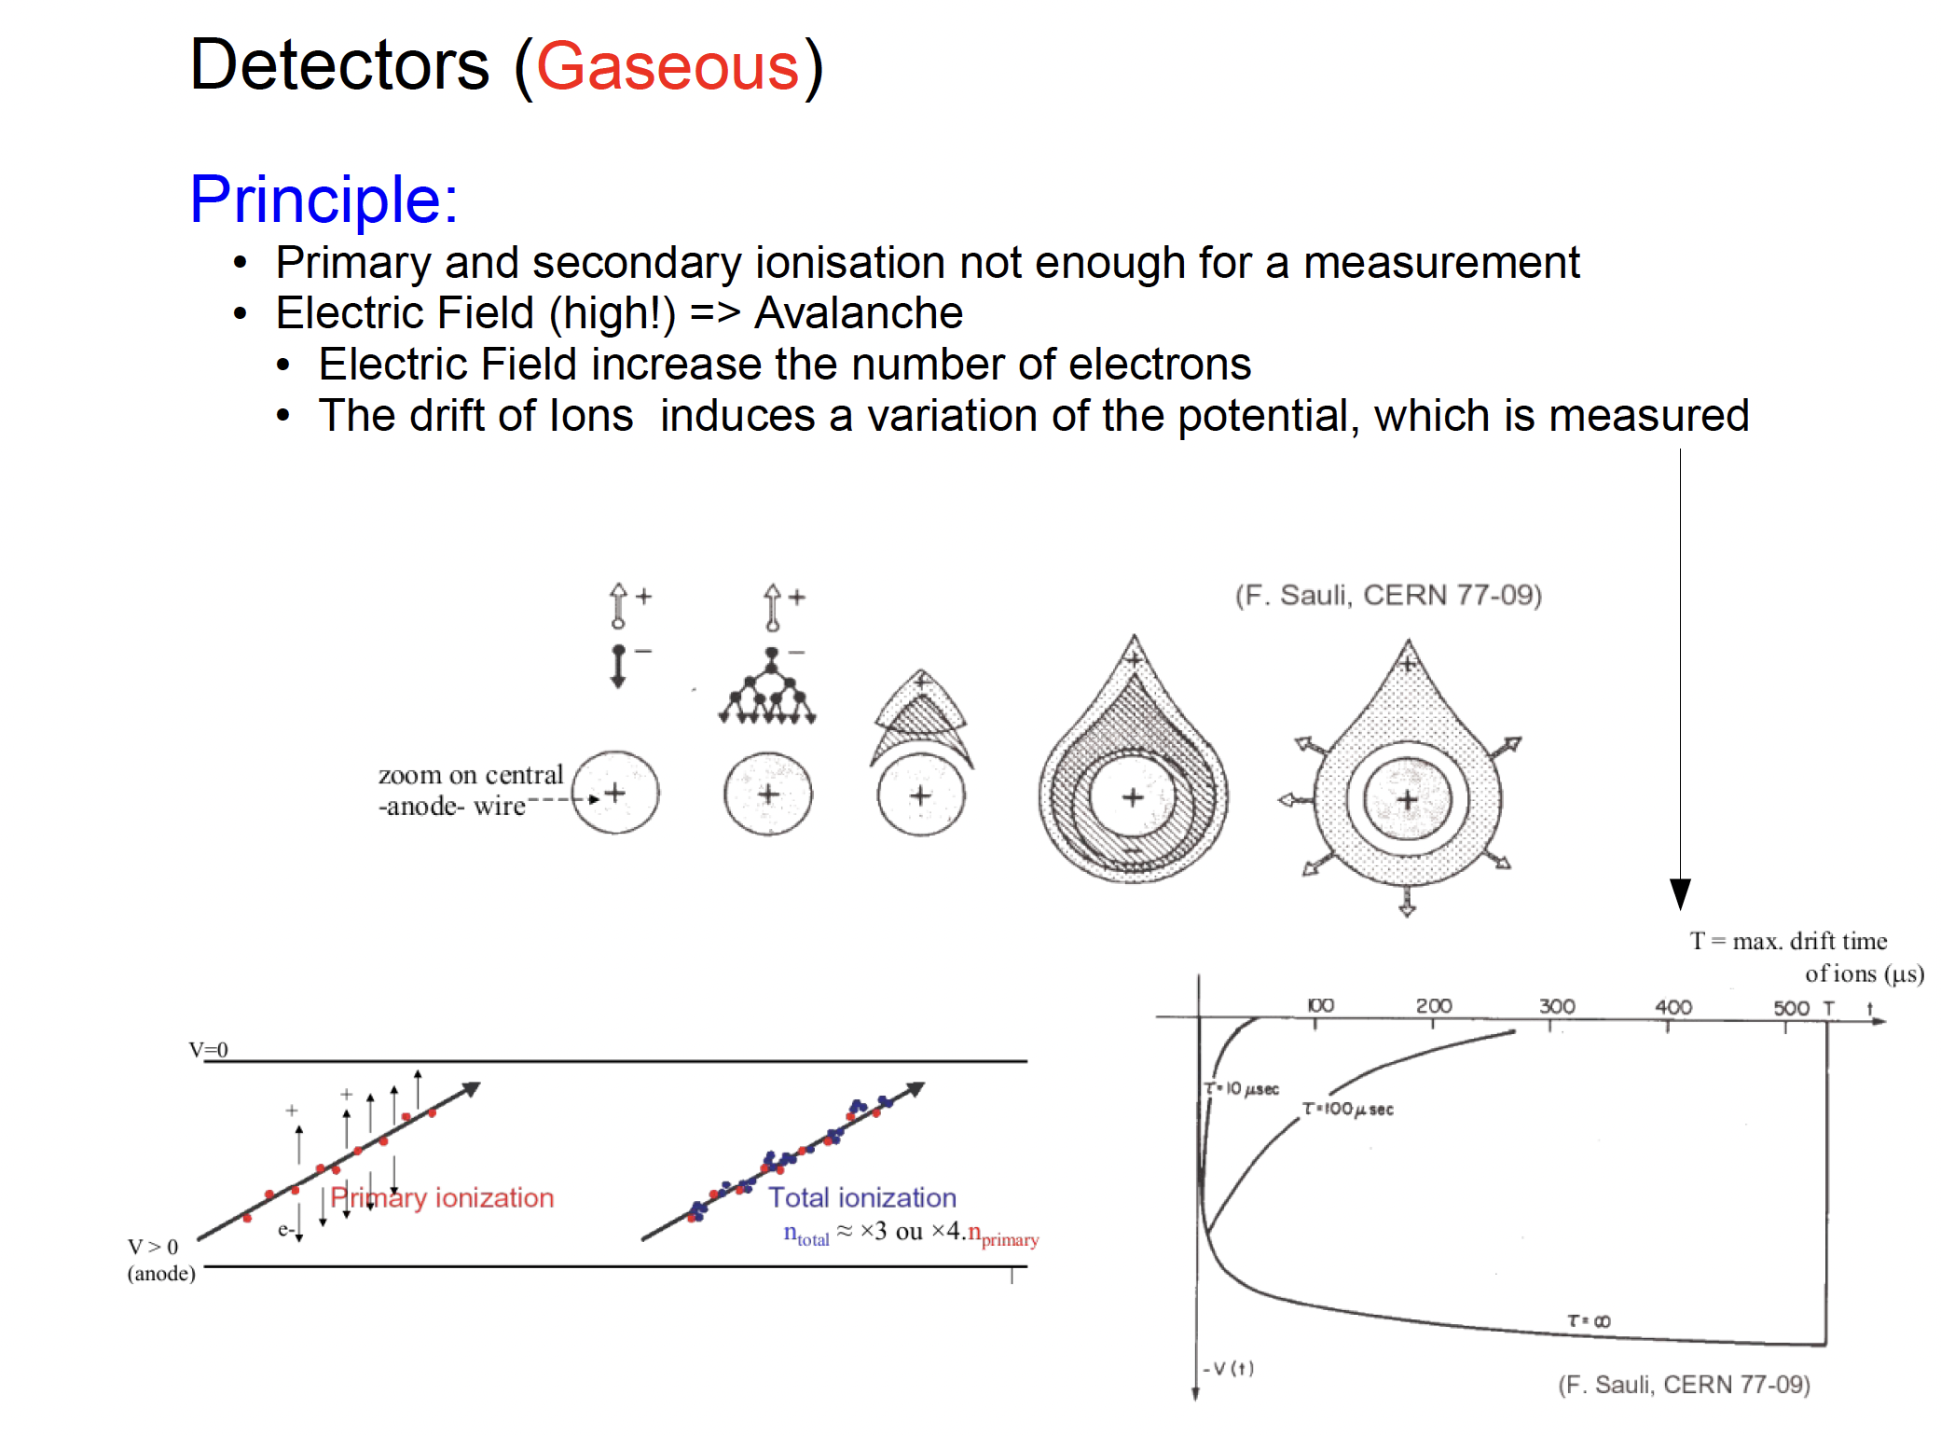

Slide 14
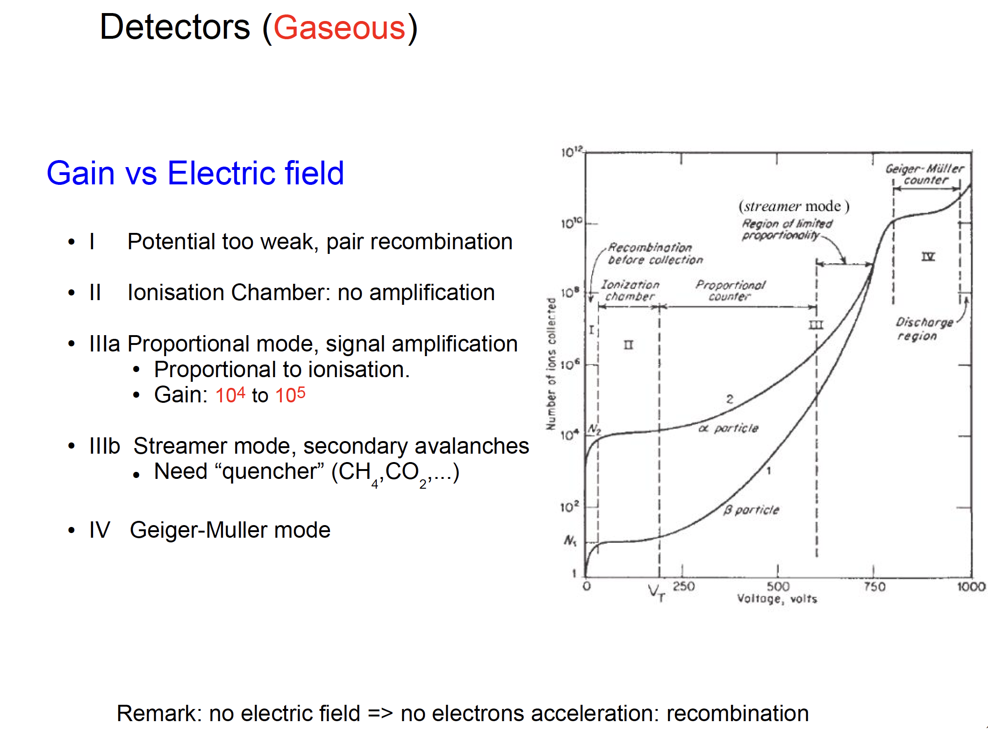

Slide 15
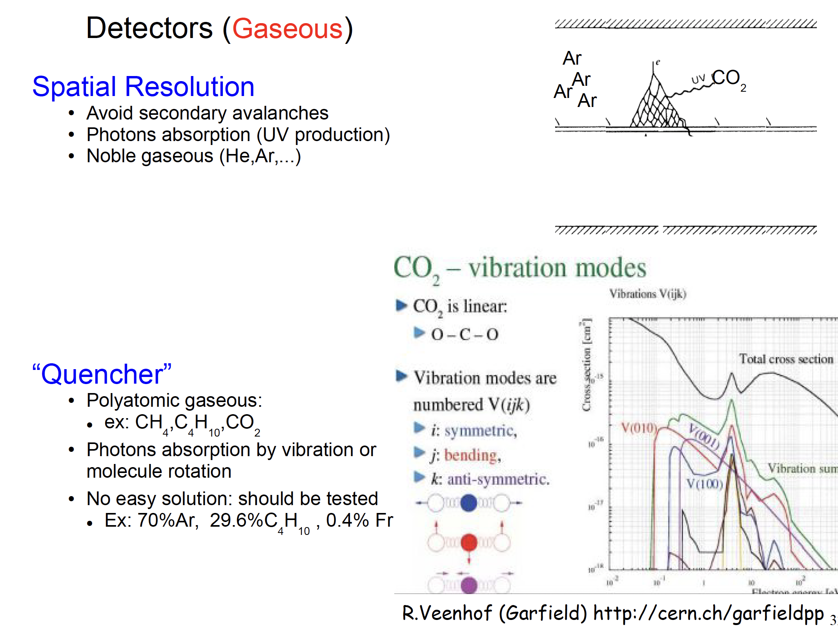

Slide 16
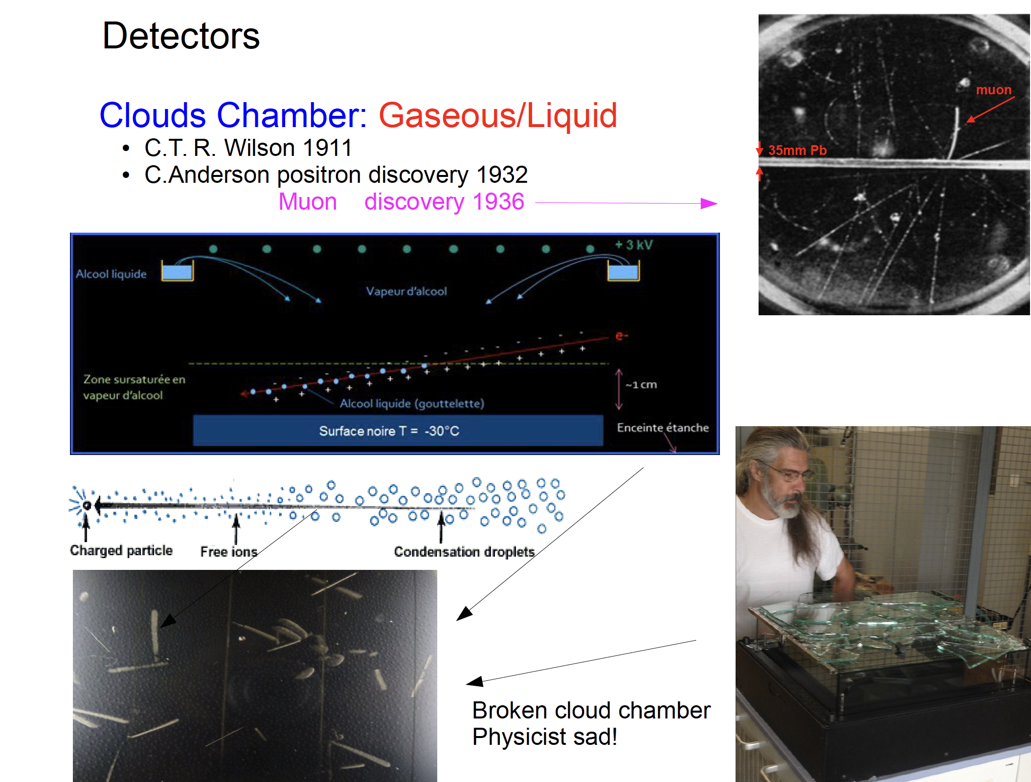

Slide 17
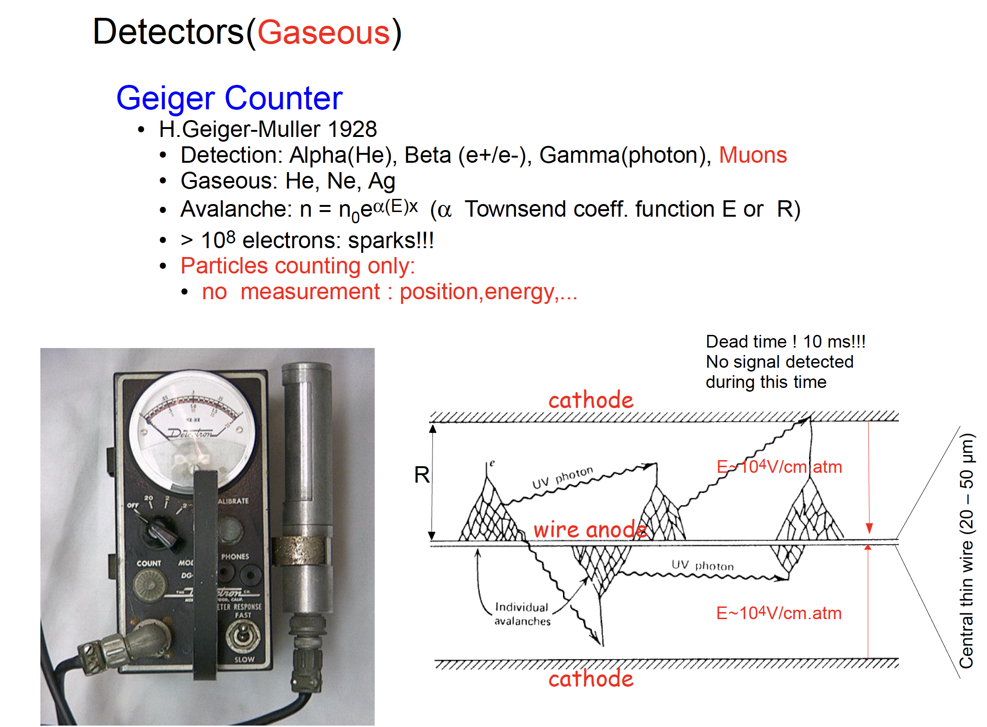

Slide 18
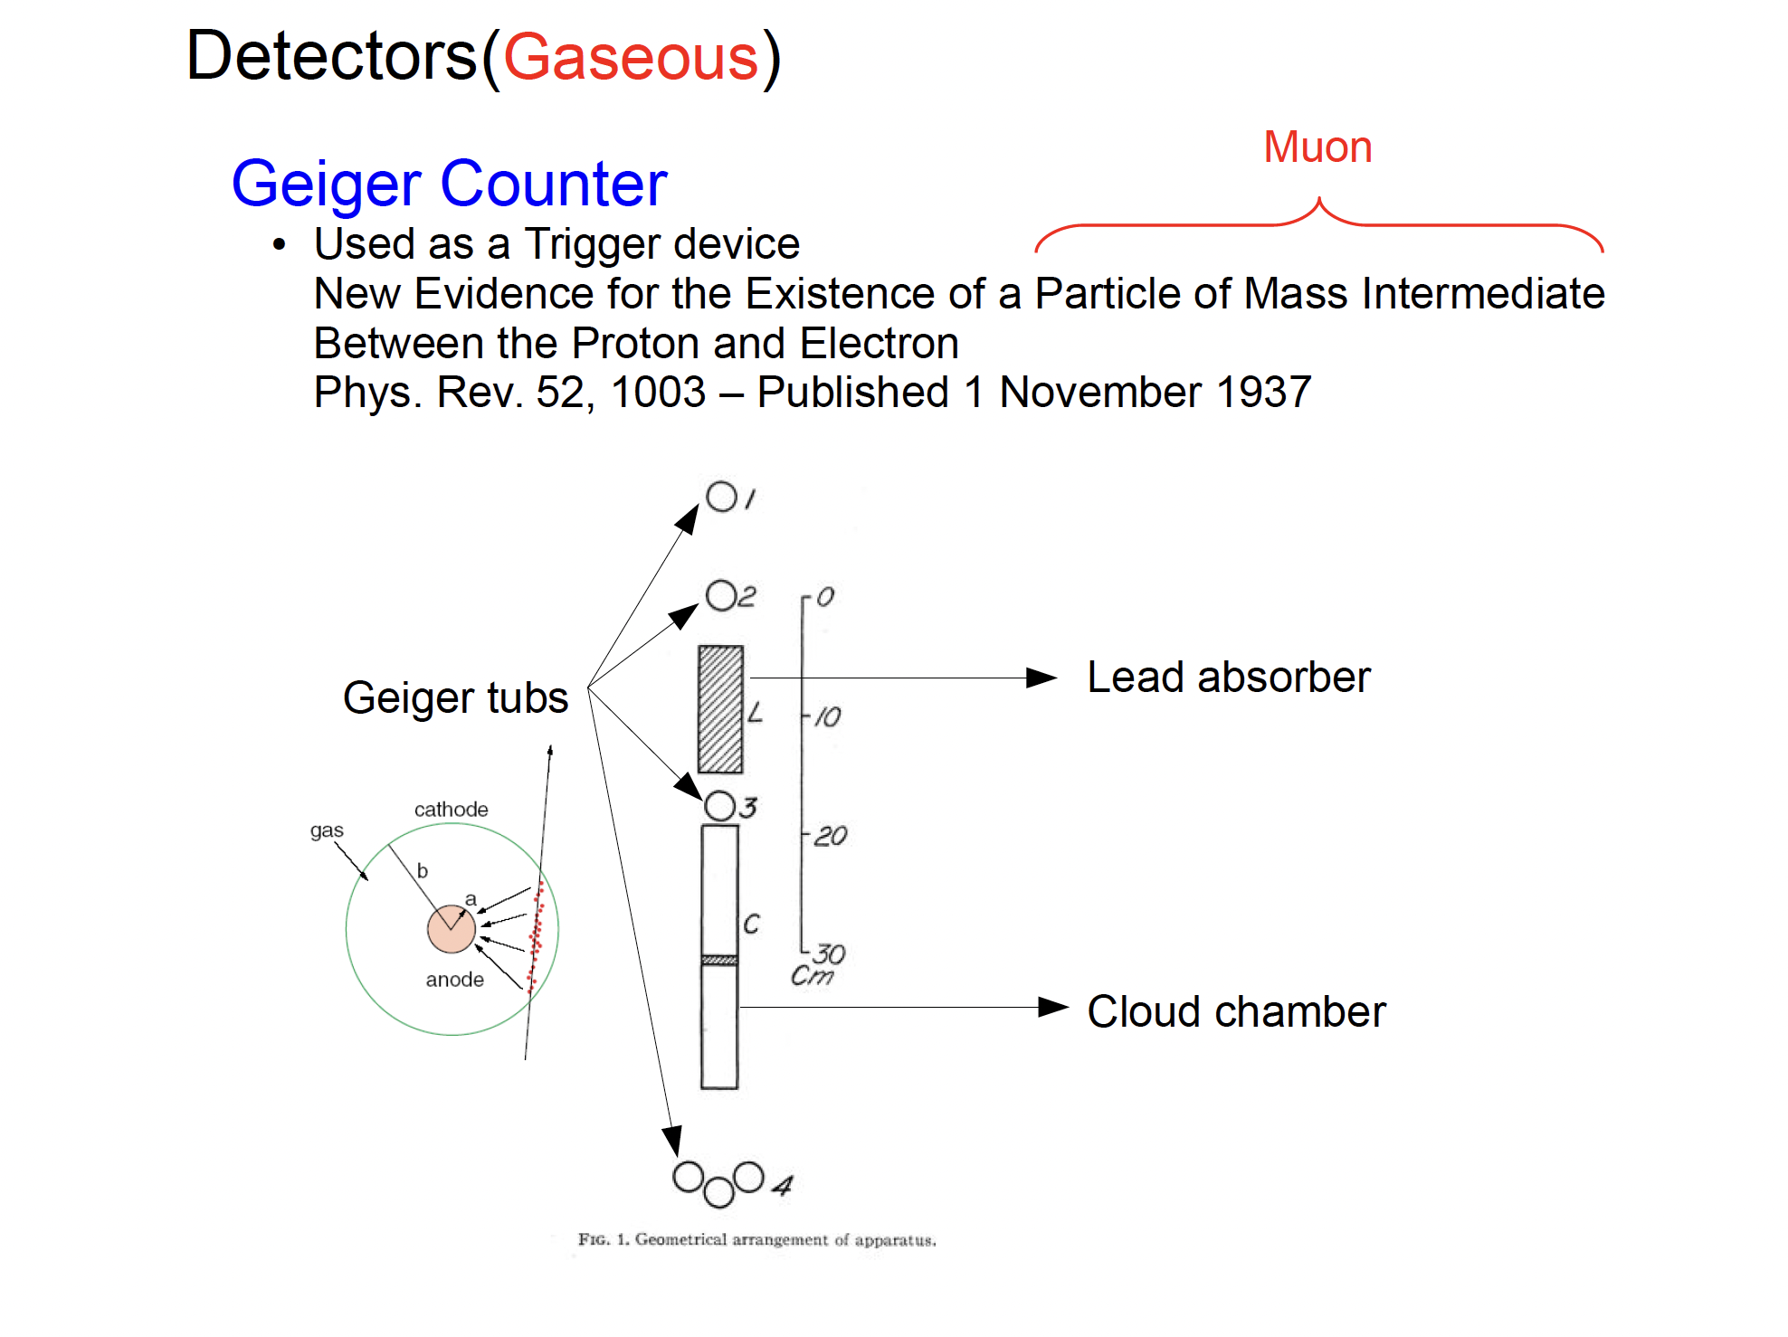

Slide 19
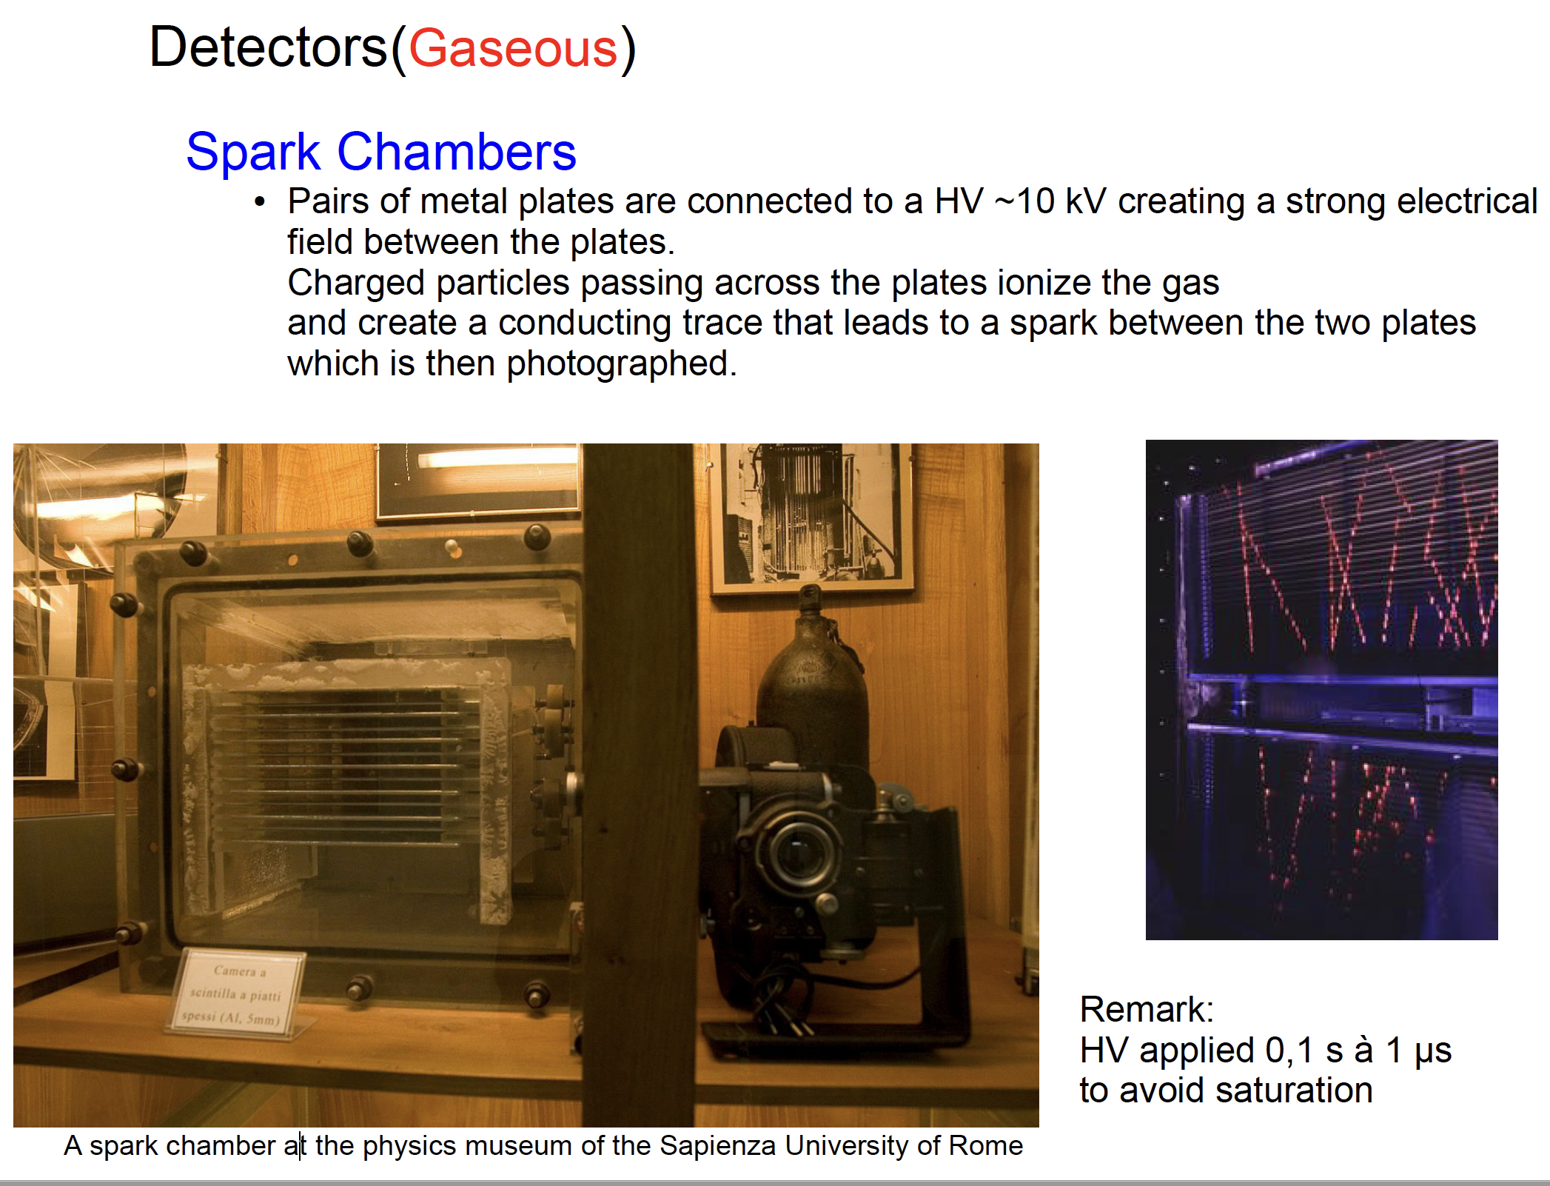

Slide 20
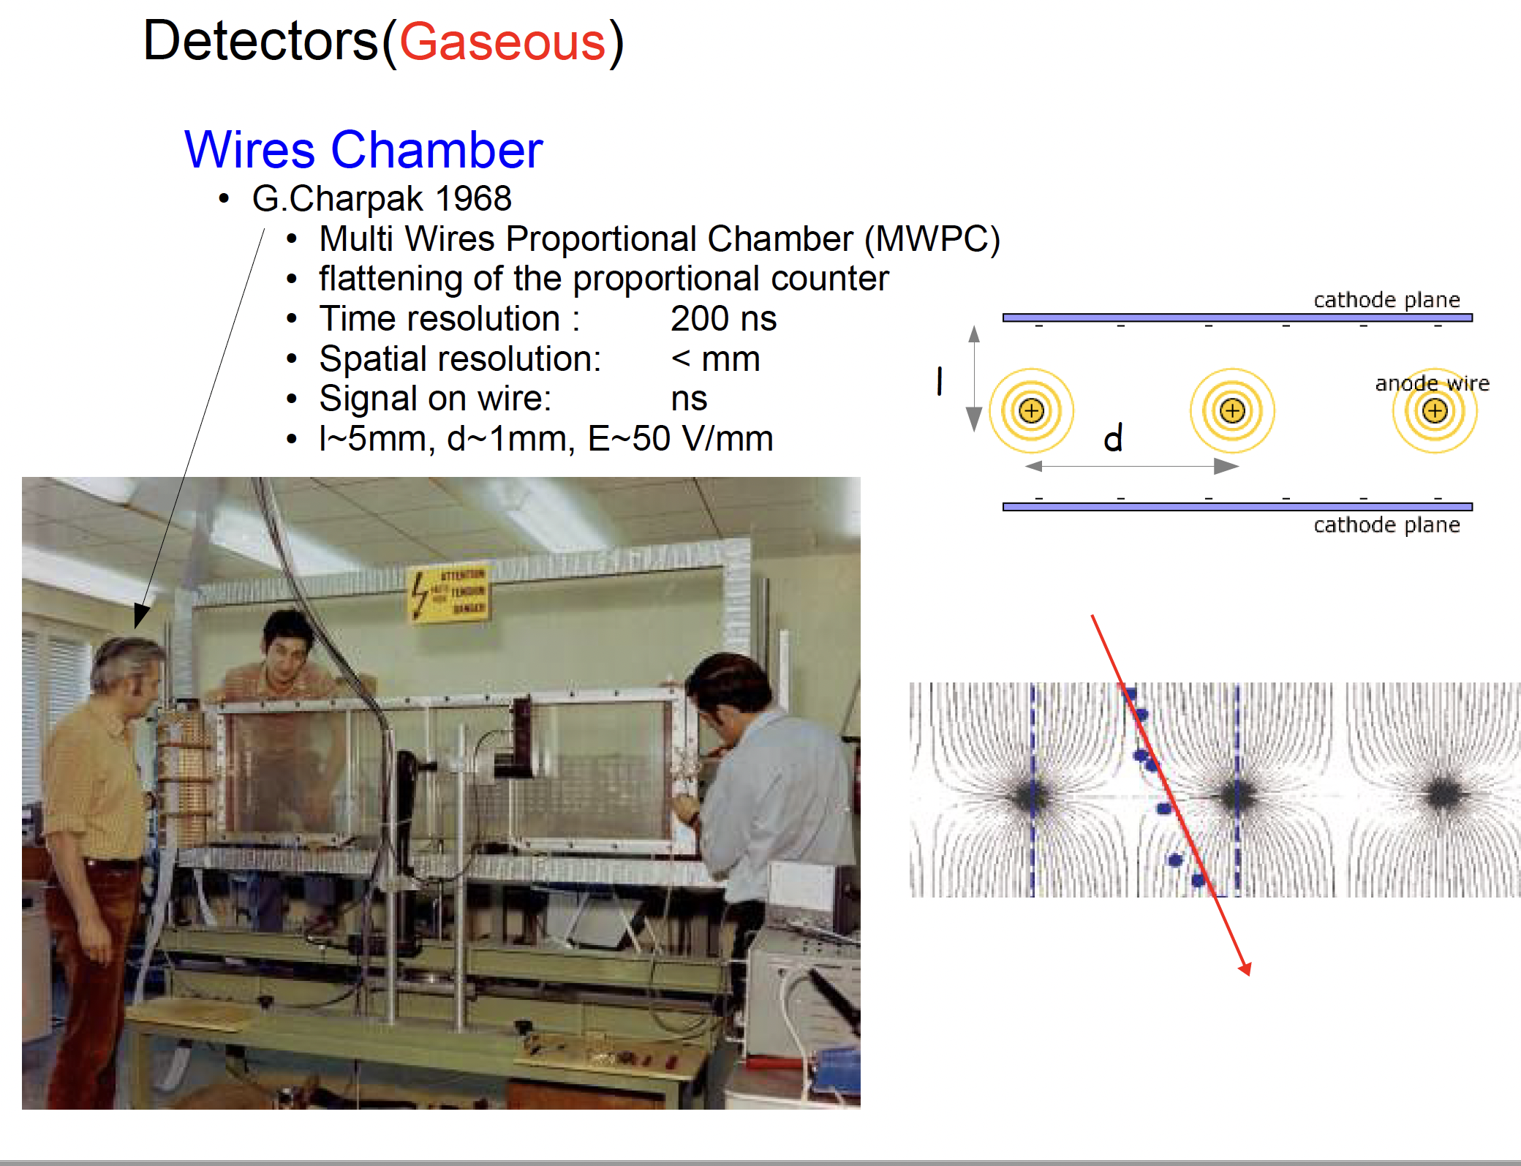

Slide 21
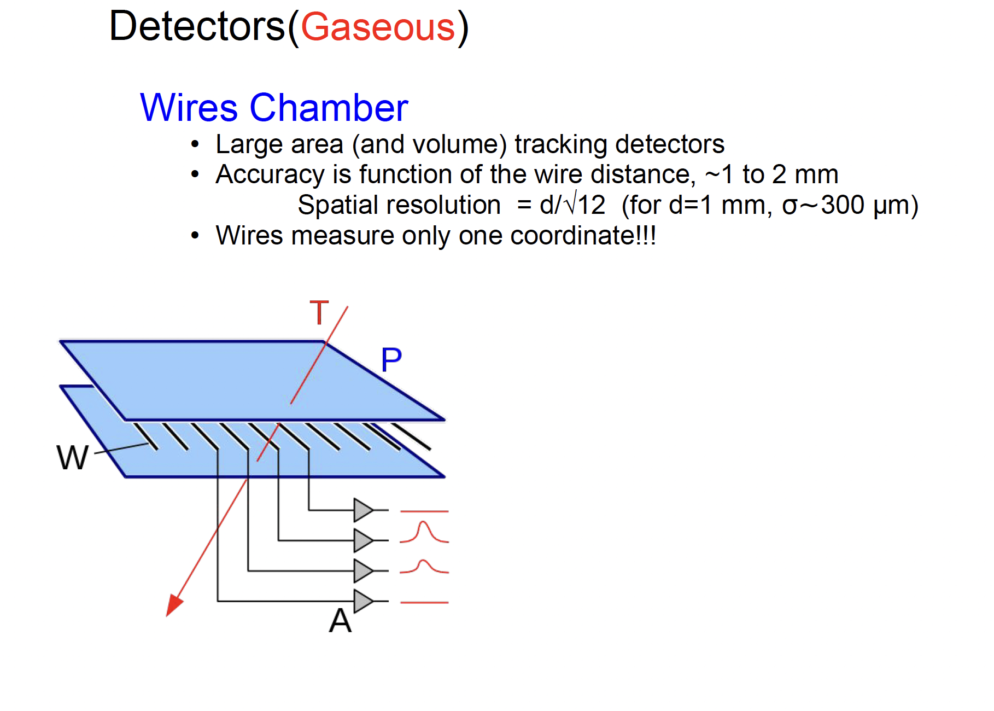

Slide 22
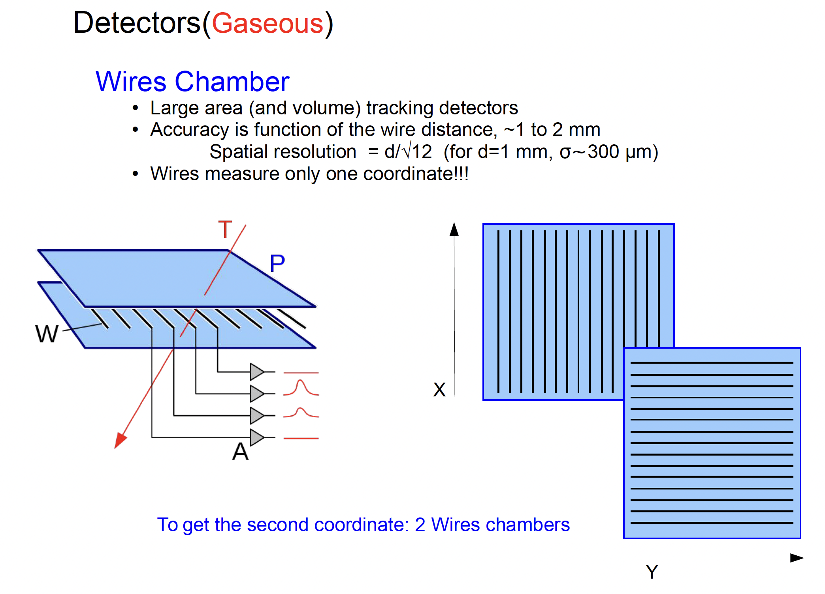

Slide 23
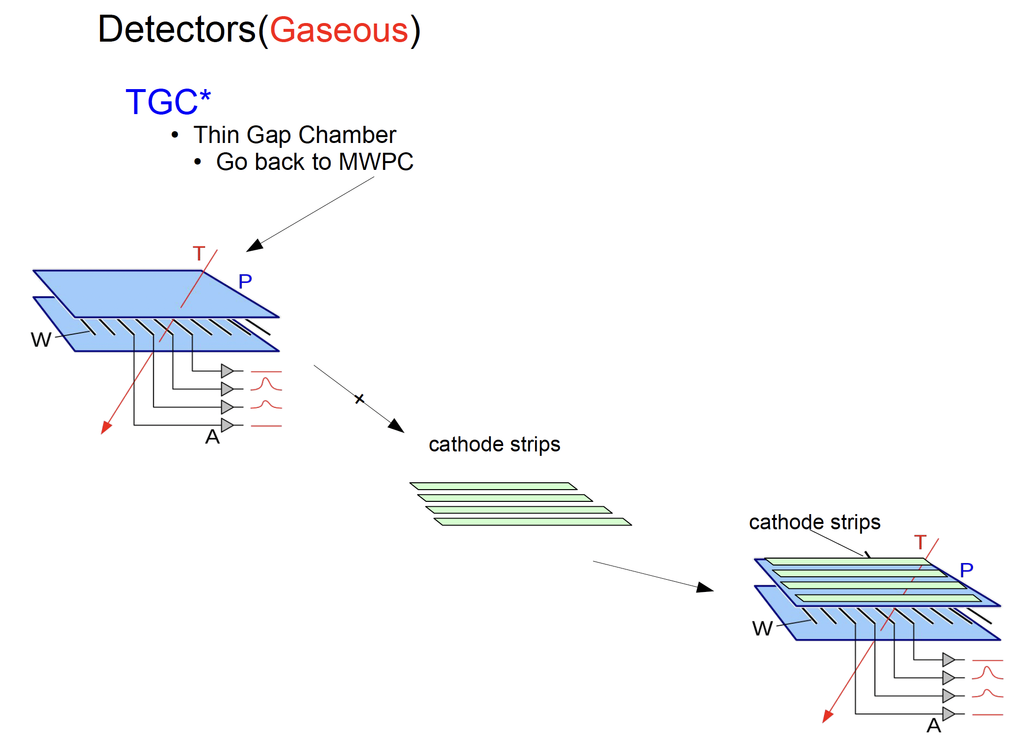

Slide 24
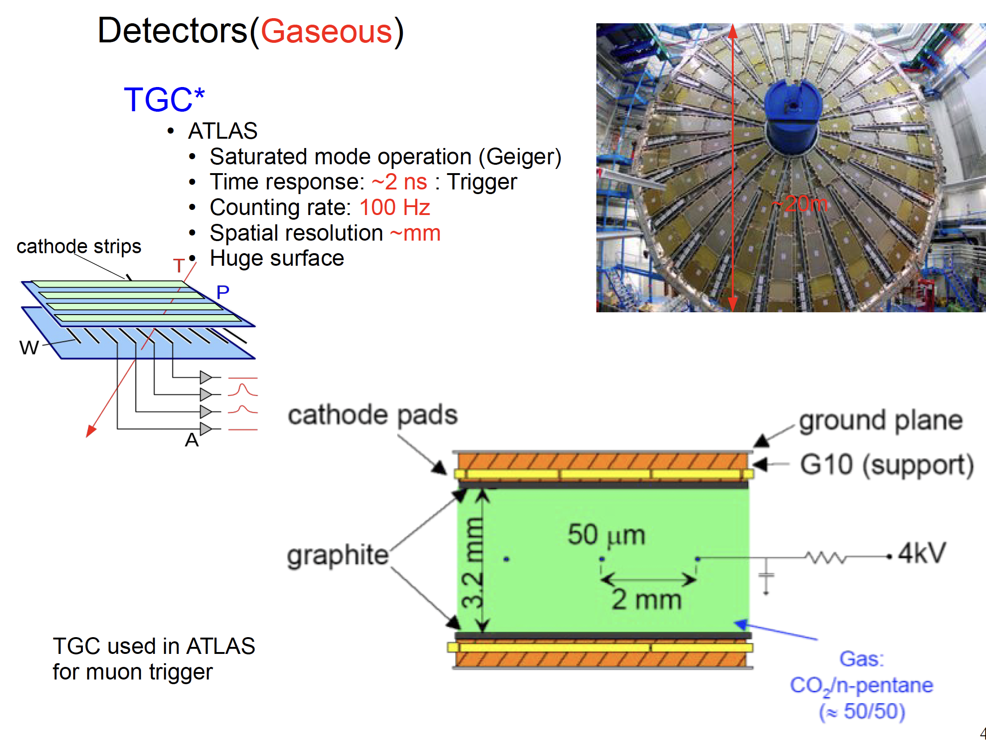

Slide 25
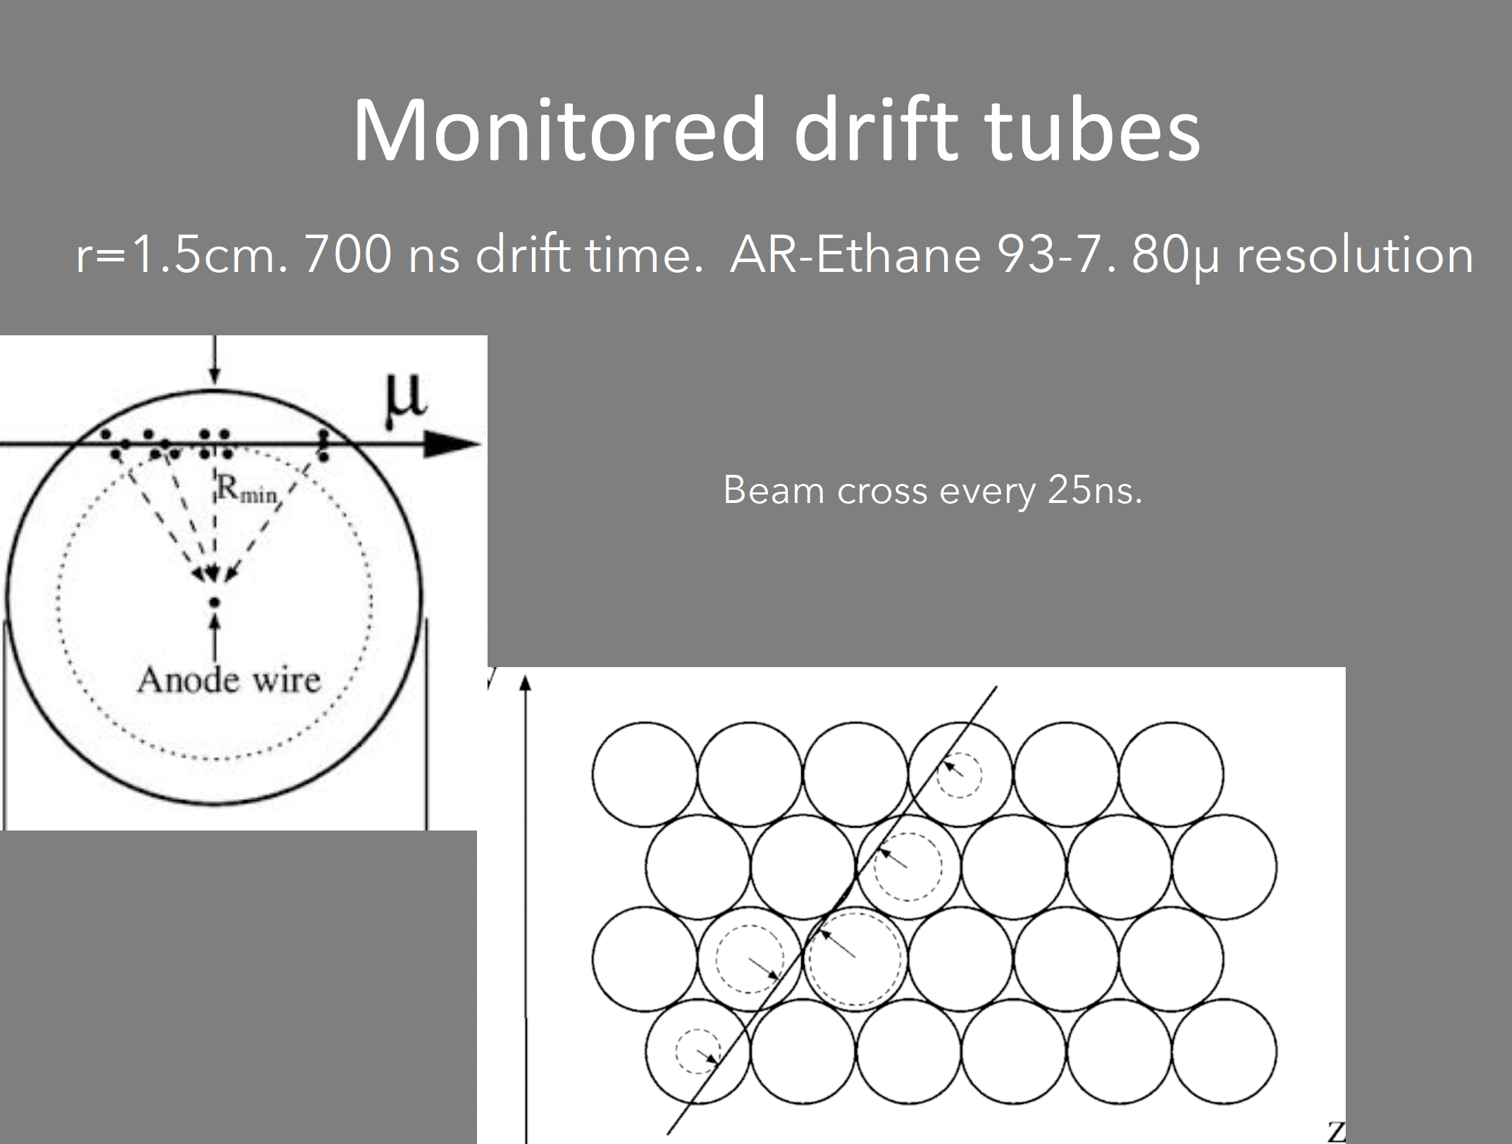

Slide 26
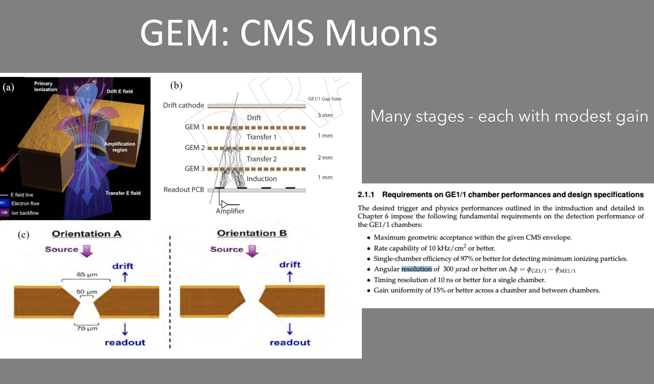

Slide 27
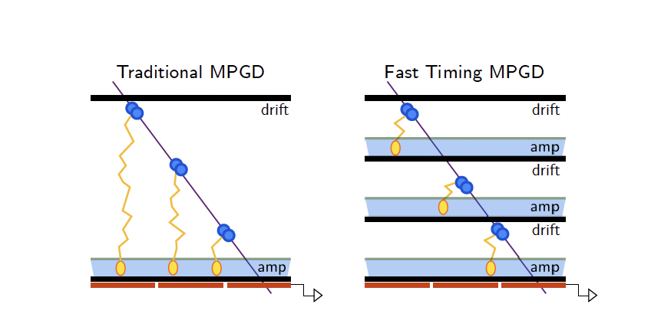
Future Directions
Micropattern detectors have improved spatial resolution
Future directions include
  Improving timing resolution ~10s of picoseconds
  Improved radiation hardness
  Integrated readout/trigger (improve bandwidth constrains)

