Slide 1

Interviewing skills
Julie Hogan
7/28/22

Slide 2

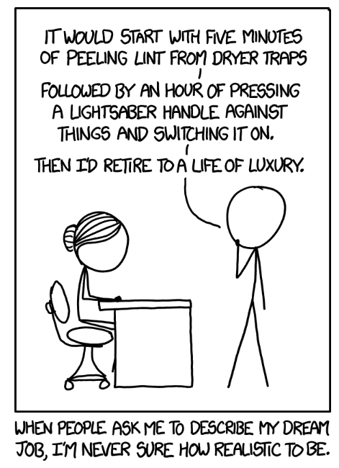
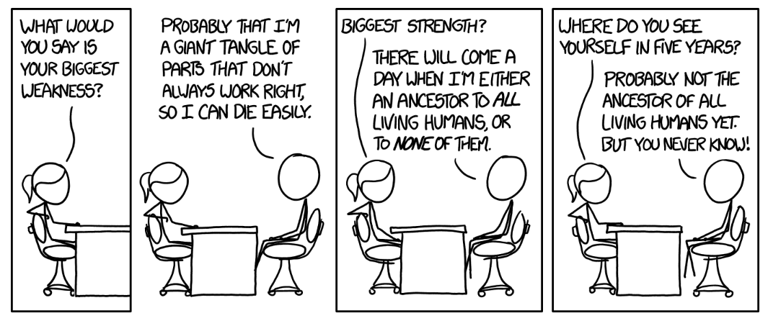
Outline
Types of Interviews
What to do before the interview
Behavior-based interviewing
Practice!!
Resources
J. Hogan, PHY/ENR 260
2

Slide 3
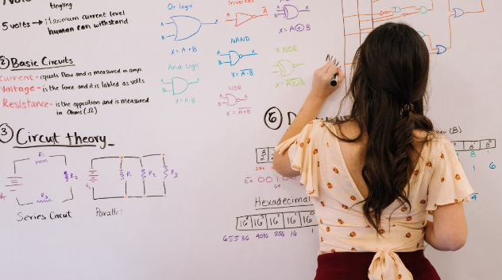
Types of interview
Early stages:
  Screening
  Phone interviews
You passed! What’s next:
  Zoom interviews
  In-person interviews
Structures:
  Rounds of interviews
  “Whiteboard” interviews
  Campus visits
J. Hogan, PHY/ENR 260
3

Slide 4
What to do
When does your interview begin?
J. Hogan, PHY/ENR 260
4

Slide 5
What to do
When does your interview begin?
Interviews
Social Media
Application
Parking lot
“Formal” interviews
Talking to their students or employees
Coffee breaks
Emails
J. Hogan, PHY/ENR 260
5

Slide 6
Prepare
Study a company (university, research group’s…) mission, vision, and/or values
  Websites!
  Links/text in job descriptions
  In HEP: search for their funding award online and read the summary!
Study the job posting
Prepare questions for them
P.R.A.C.T.I.C.E!
J. Hogan, PHY/ENR 260
6

Slide 7

Prepare
Plan:
  Clothes
  Route
  Timing
Do:
  Arrive early
  Turn off notifications
  Smile!
Don’t:
  Overload scent
  Chew gum or eat
  Bring extra people
J. Hogan, PHY/ENR 260
7

Slide 8
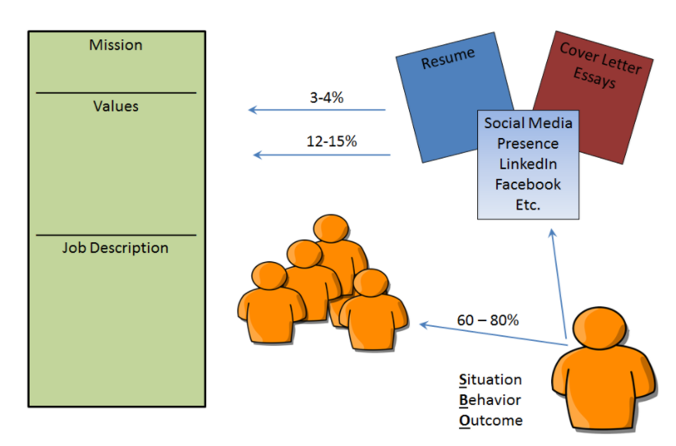
Behavior-based interviewing
History is the best predictor of future success
Employers write jobs based on their mission & values
How do your experiences help you fit their needs?
J. Hogan, PHY/ENR 260
8

Slide 9
Behavior-based interviewing
Situation
Task
Action
Response
Situation
Task
Action
Response
Describe an episode or situation that relates to the area they want to explore
Your responsibilities and assignments for that situation
How did you react to or handle that situation? What did you say and what did you do?
What was the consequence? How did the situation resolve?
J. Hogan, PHY/ENR 260
9

Slide 10
Behavior-based interviewing
Situation
Task
Action
Response
Think about their mission/values
Shine your qualifications and experience in practical ways
Share knowledge/education background
Focus on professional or educational experience
Try to see why they are asking…
J. Hogan, PHY/ENR 260
10

Slide 11
Behavior-based interviewing
Situation
Task
Action
Response
Need: Someone who can develop relationships with clients
Q: Tell me about a specific time you’ve built and nurtured a professional relationship?
Need: Ability to handle stressful people
Q: Tell me about your worst customer / client / coworker / boss
Need: Team player
Q: Tell me about how you get along with fellow students?
J. Hogan, PHY/ENR 260
11

Slide 12

Sample
J. Hogan, PHY/ENR 260
12

Slide 13
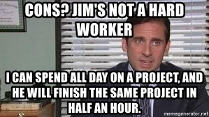
Sample
What did he do well?
What was weaker?
J. Hogan, PHY/ENR 260
13

Slide 14
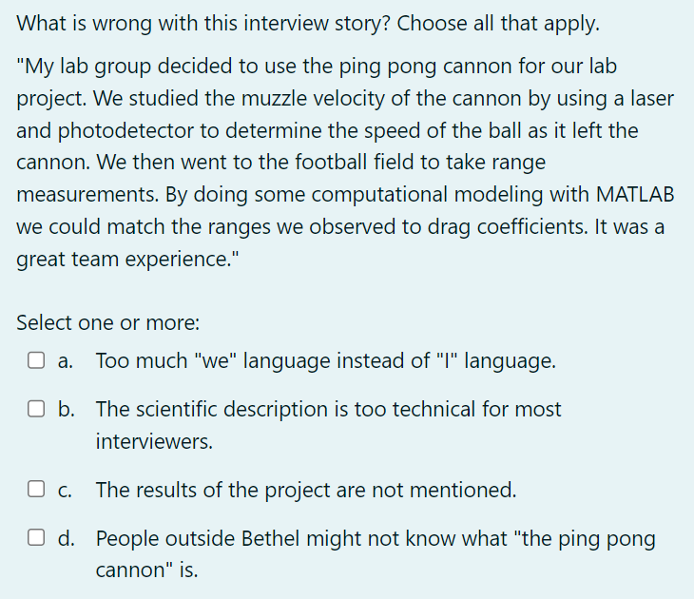
Sample
J. Hogan, PHY/ENR 260
14

Slide 15
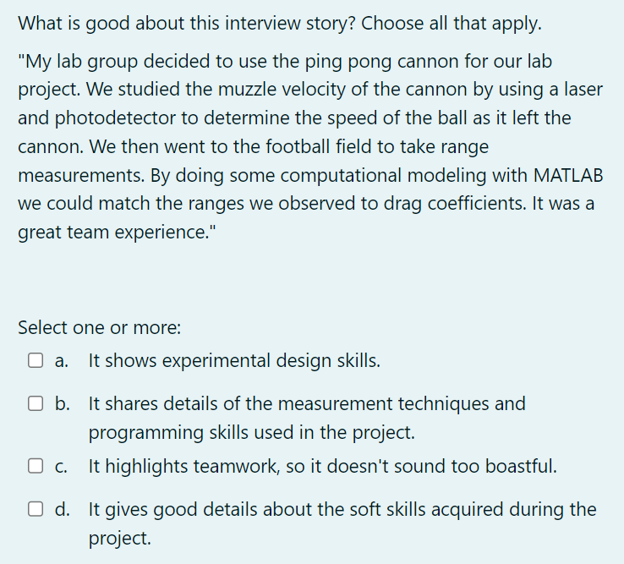
Sample
J. Hogan, PHY/ENR 260
15

Slide 16
Practice!
On Indico: example questions
Breakout room assignment: rotate through these roles
Employer
Applicant
Listener
Ask one of the questions to the applicant
Tell a STAR method story!
Provide constructive feedback
J. Hogan, PHY/ENR 260
16

Slide 17
Other common Q styles
Contrary information
  Strengths/weaknesses
  Good/bad customers, group members, bosses
  Good/bad encounters, experiences
On-the-spot coding
  Practice quick code flow diagramming in classes/research
  “Think out loud”
  Edge cases? Tests to pass?
  Quick pseudocode → actual language
No interview at all! “Personal statement”
  See extra slides on Indico
J. Hogan, PHY/ENR 260
17

Slide 18
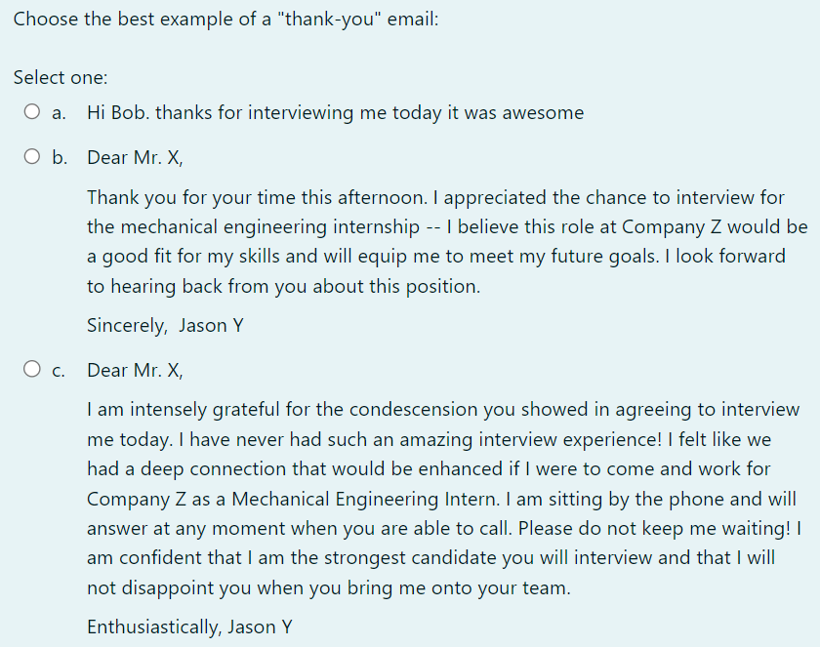
Following up
“How should I follow up with you about this position?”
Thank-you email (phone call, card)
J. Hogan, PHY/ENR 260
18

