Slide 1
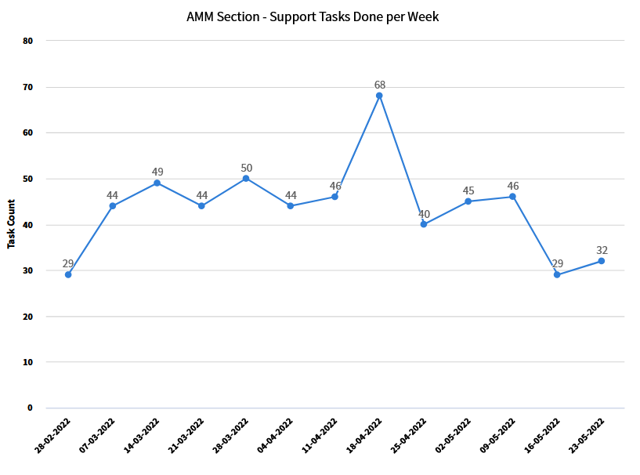
Tasks done per week (including TRACK-it 3rd line)

Slide 2
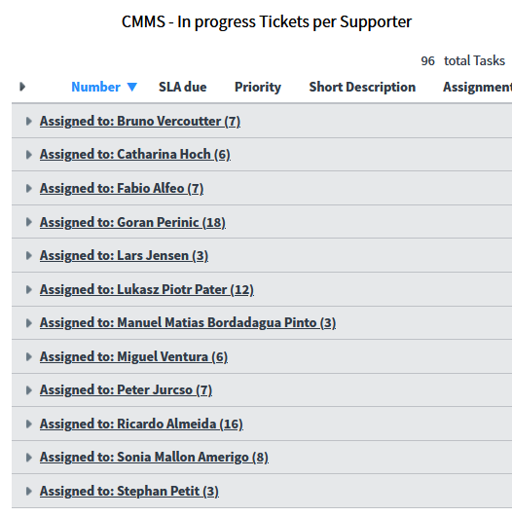
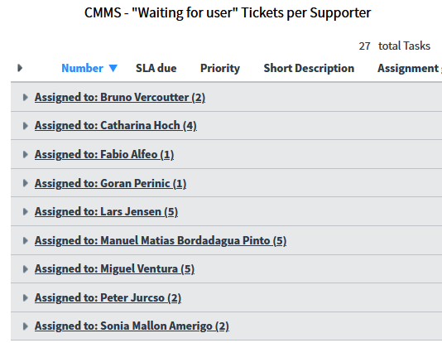
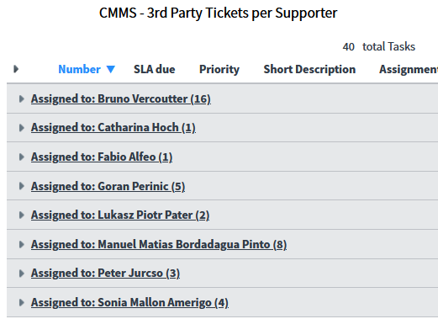
Active request tickets per supporter (total =162)
Waiting for user (27)
In progress = 96
Waiting for 3rd party (40)

Slide 3
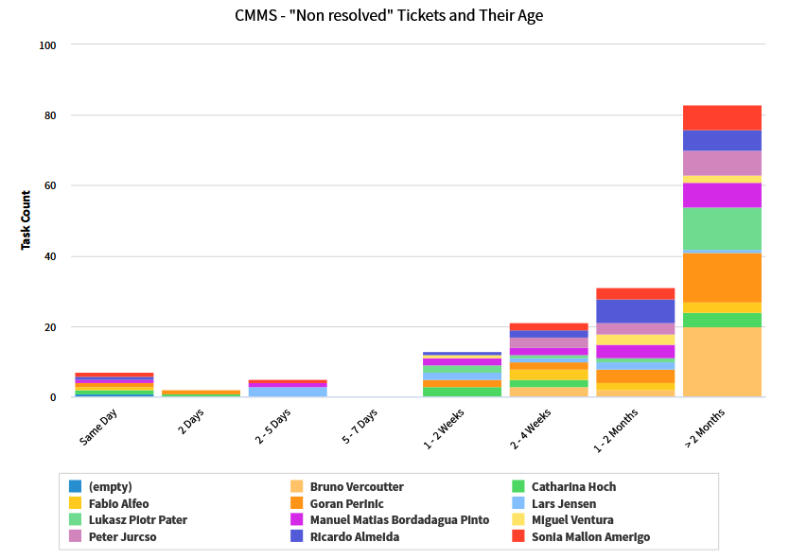
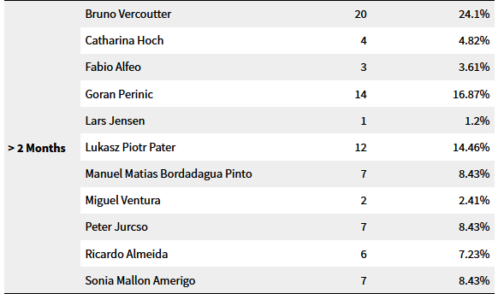
Age of active tickets Cnt =162

