Slide 1
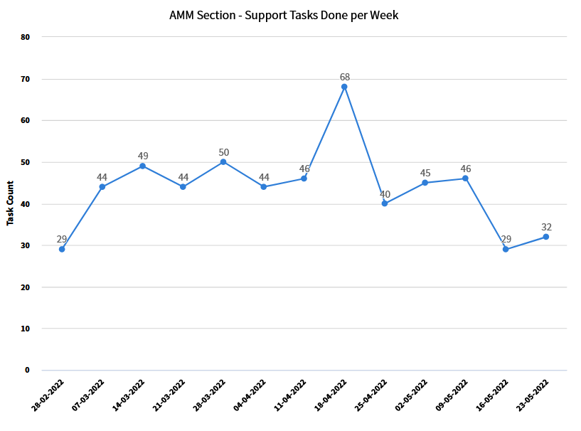
Tasks done per week (including TRACK-it 3rd line)

Slide 2
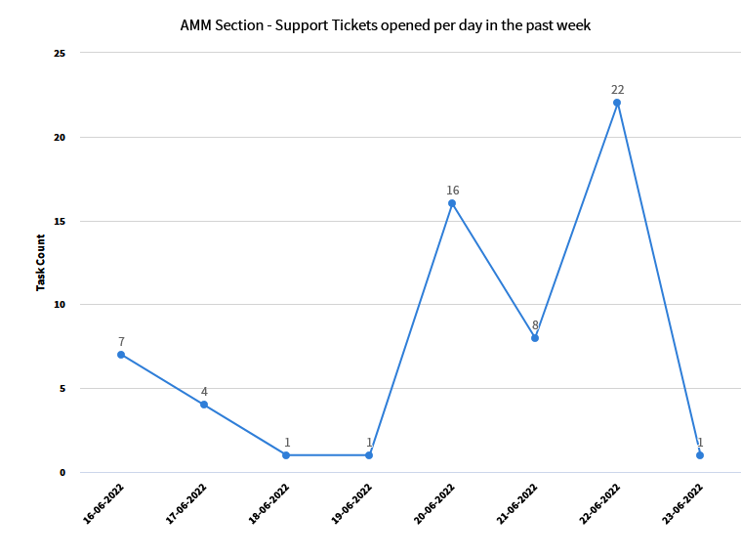
Tickets opened this week (upgrade to 11.7)
Issues with:
Checklist
Equipment generator
TREC
SOAP/REST API
Auto-complete for WO
More complete testing following upgrade?

Slide 3
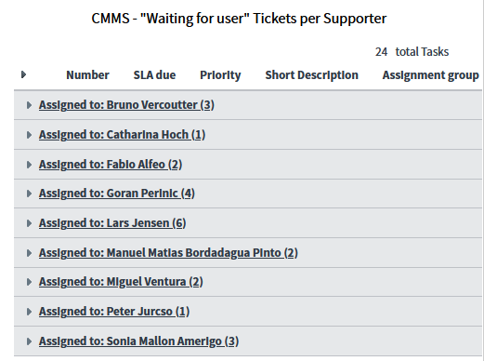
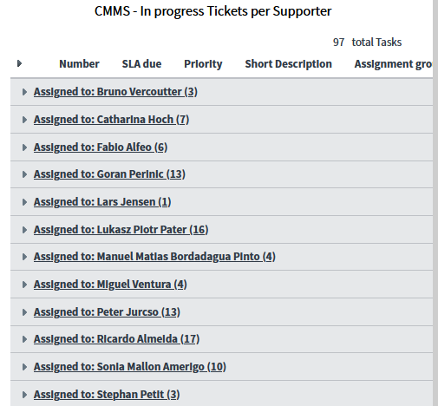
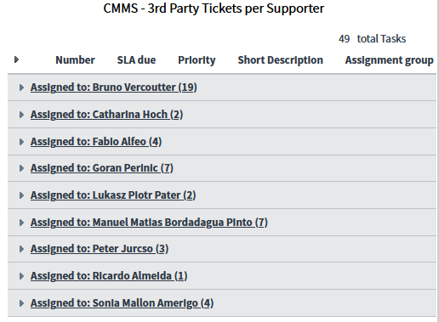
Active request tickets per supporter (total =175)
Waiting for user (24)
In progress = 97
Waiting for 3rd party (49)

Slide 4
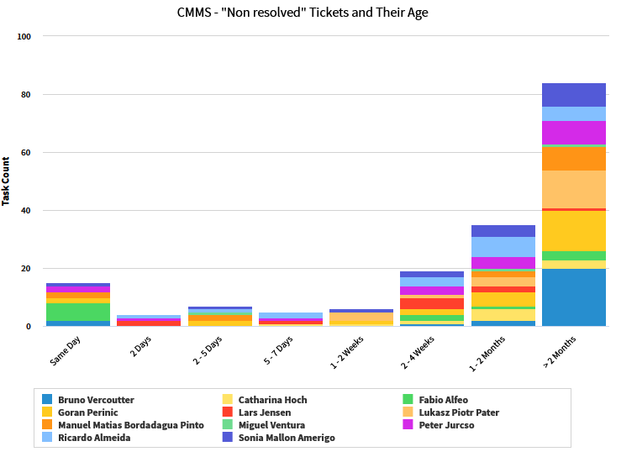
Age of non-resolved tickets Cnt =175

