Slide 1


RateMon Tools @ CMS HLT
Kevin Javier Zvonarek
Mentors: John Lawrence, Dr. Mateusz Zarucki, and Dr. Kevin Lannon
University of Michigan CERN Program, 27 June 2022
1

Slide 2
Overview
LHC
Collisions every 25 ns
Events: 40 MHz
L1
Decision Time: 4𝜇s
Events: 100 kHz
HLT
Decision Time: ~350 ms
Events: 1 kHz
2

Slide 3
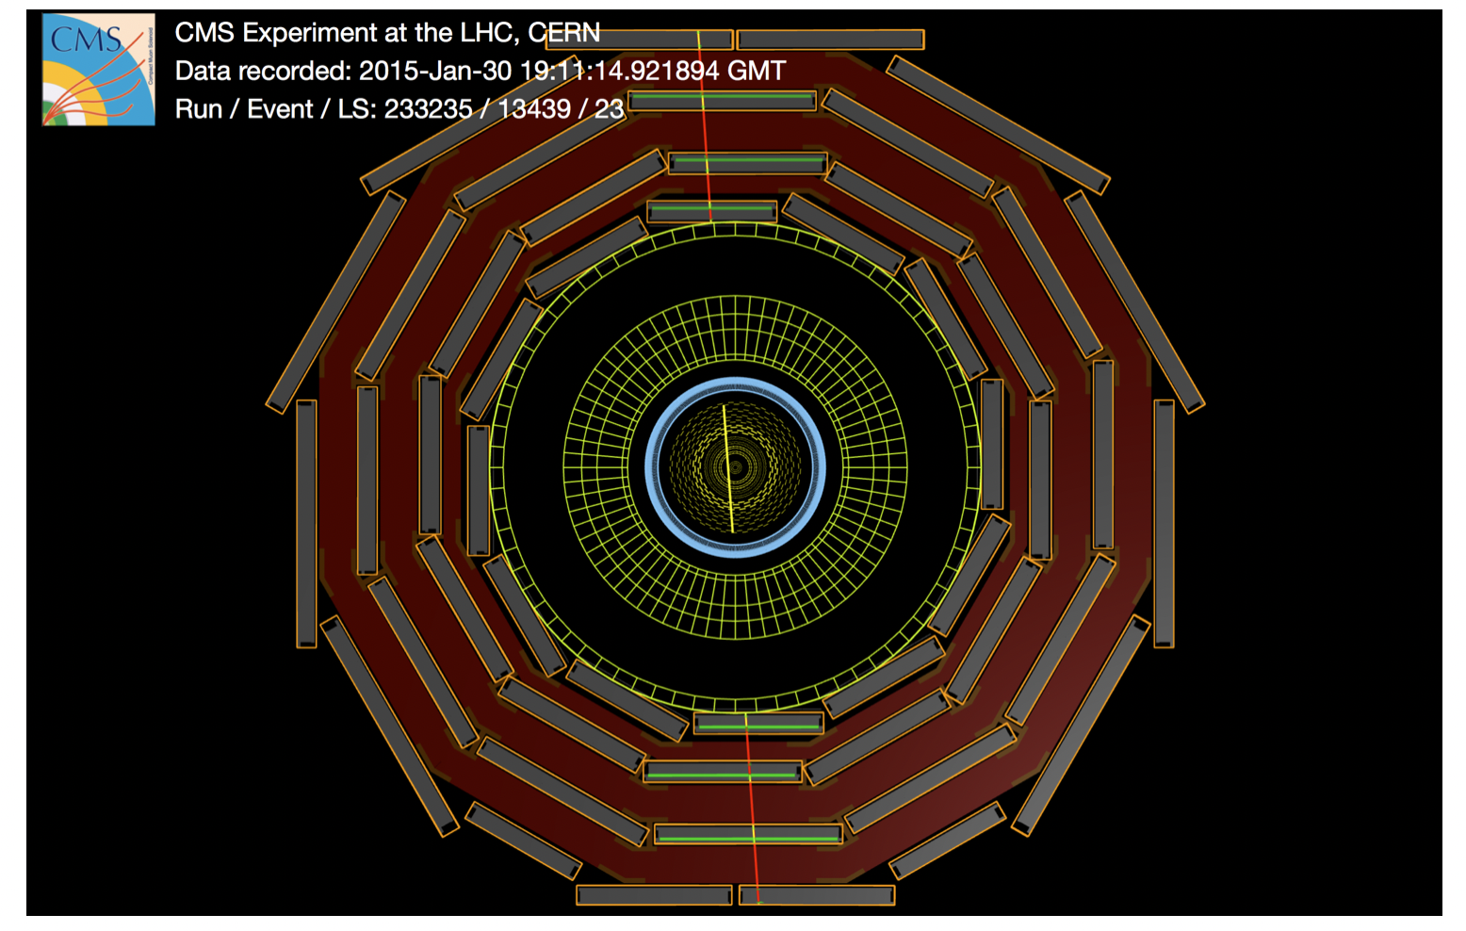
Reference Rates
Wrote scripts and updated existing software to access these rates when needed.
Diagnosing problems in hardware and confirming upgrades are performing as expected.
3
https://cms.cern/news/cms-never-idle

Slide 4
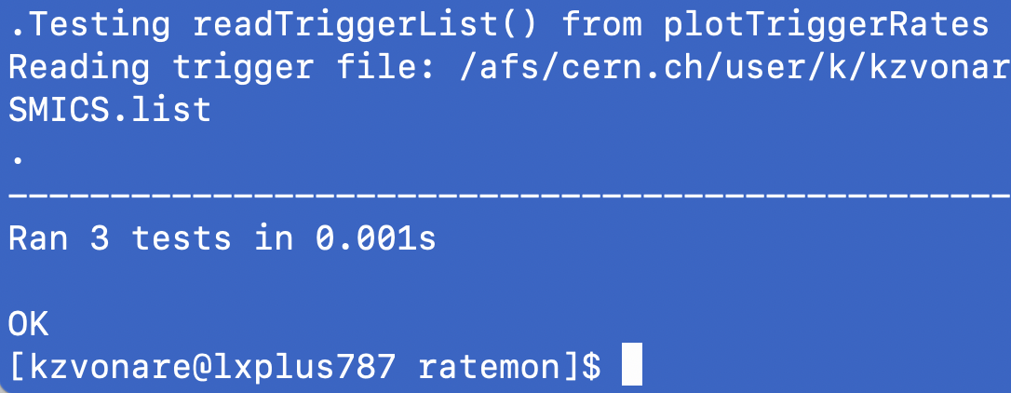
Unit Tests
Interrogate individual functions to exercise code functionality.
CI/CD: Contributions are tested and released automatically with less risk of human error.
4
https://gr.pinterest.com/pin/840273242960349141/?mt=login

Slide 5
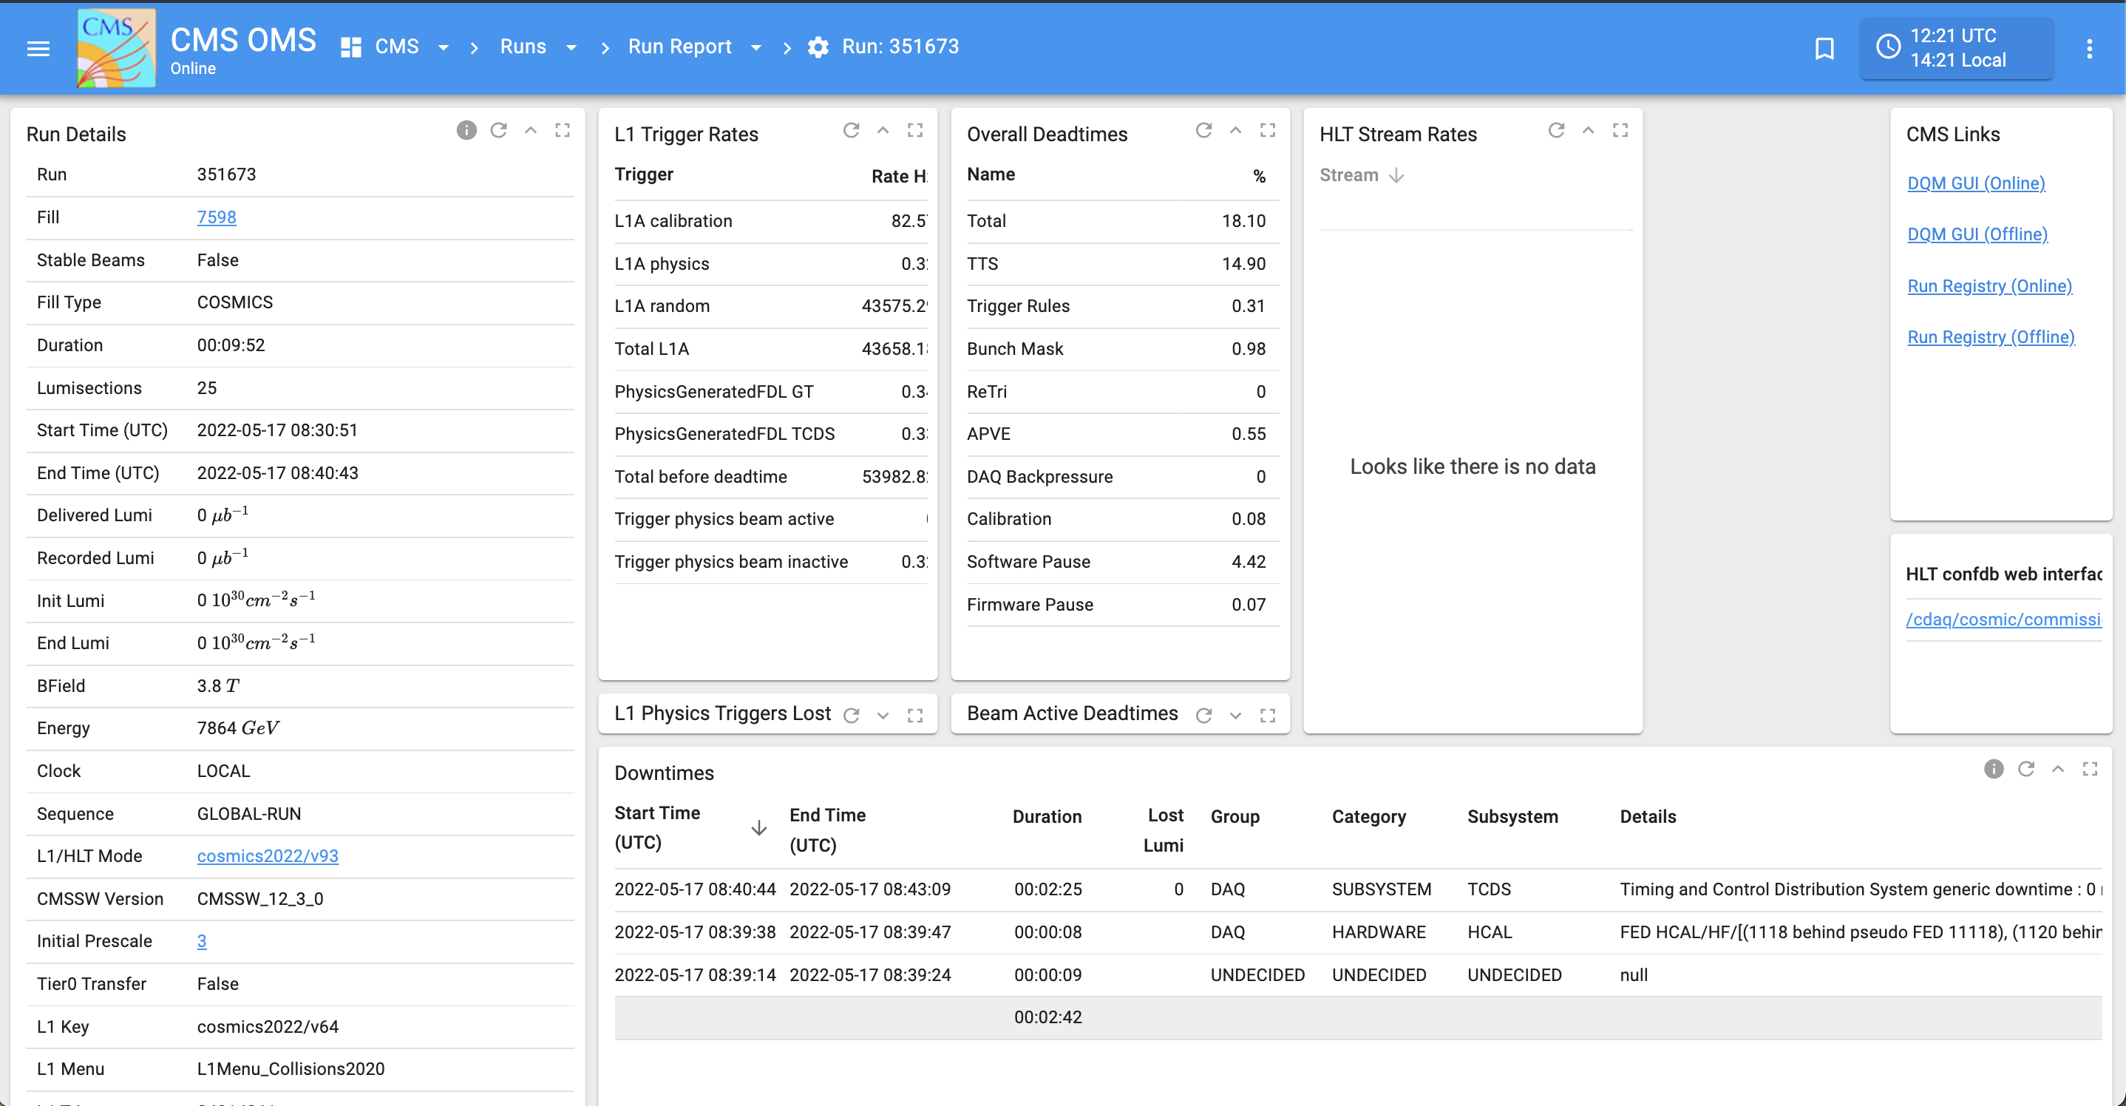
RateMon Tools
Automated, real-time rate monitoring with alerts.
Statistical analysis of trigger behavior, offline trigger analysis.
5
https://imgur.com/a/FGFO8

