Slide 1
The Beam Switching Project
Sebastian Rothe
21 JUNE 2022
https://indico.cern.ch/event/1168692/

Slide 2
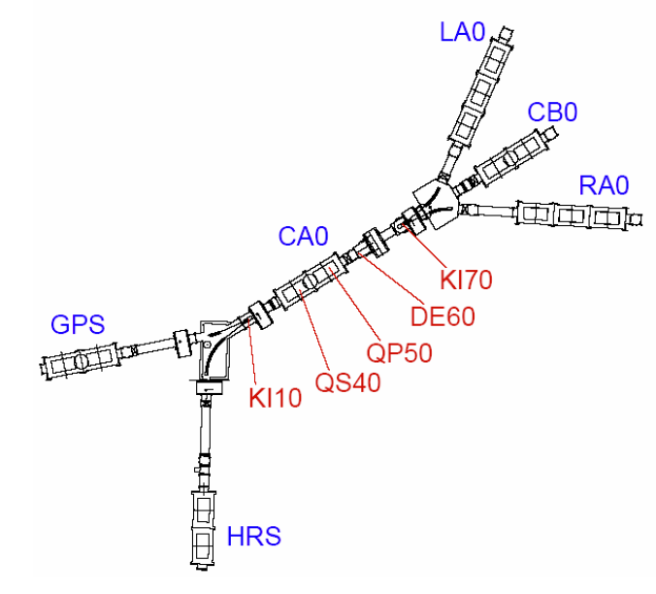
Alternating mode
Both FE deliver beam to multiple beamlines
More details see presentation in EPIC Workshop 2020
Constraints:
Beam parameters are different for HRS, GPS
Concept 1: (software solution) 16 Channels
Change settings each 1.2 s according to supercycle
Possible if powersupplies, controls are fast enough
-> can be safety issue if setpoints are not matched
-> cheaper
Concept 2: (hardware solution) 32 Channels
Double the set of HT supplies.
Tune CA0 individually for HRS,GPS
Use HT relays to alternate between the two settings
-> very robust
-> more expensive
-> programmatically simpler
Day 1 application: HIE ISOLDE tune while users still on other FE
90th ISOLDE Collaboration Committee meeting | S.Rothe
01 FEB 2021

Slide 3
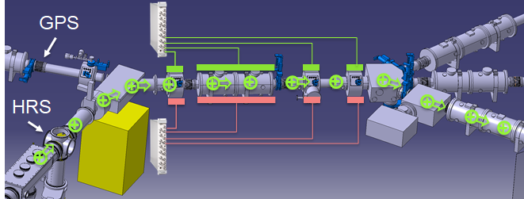
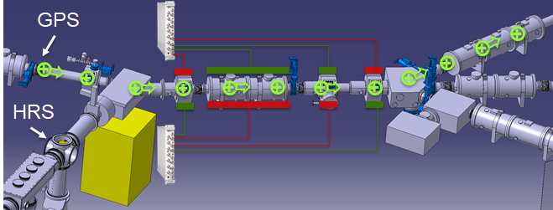

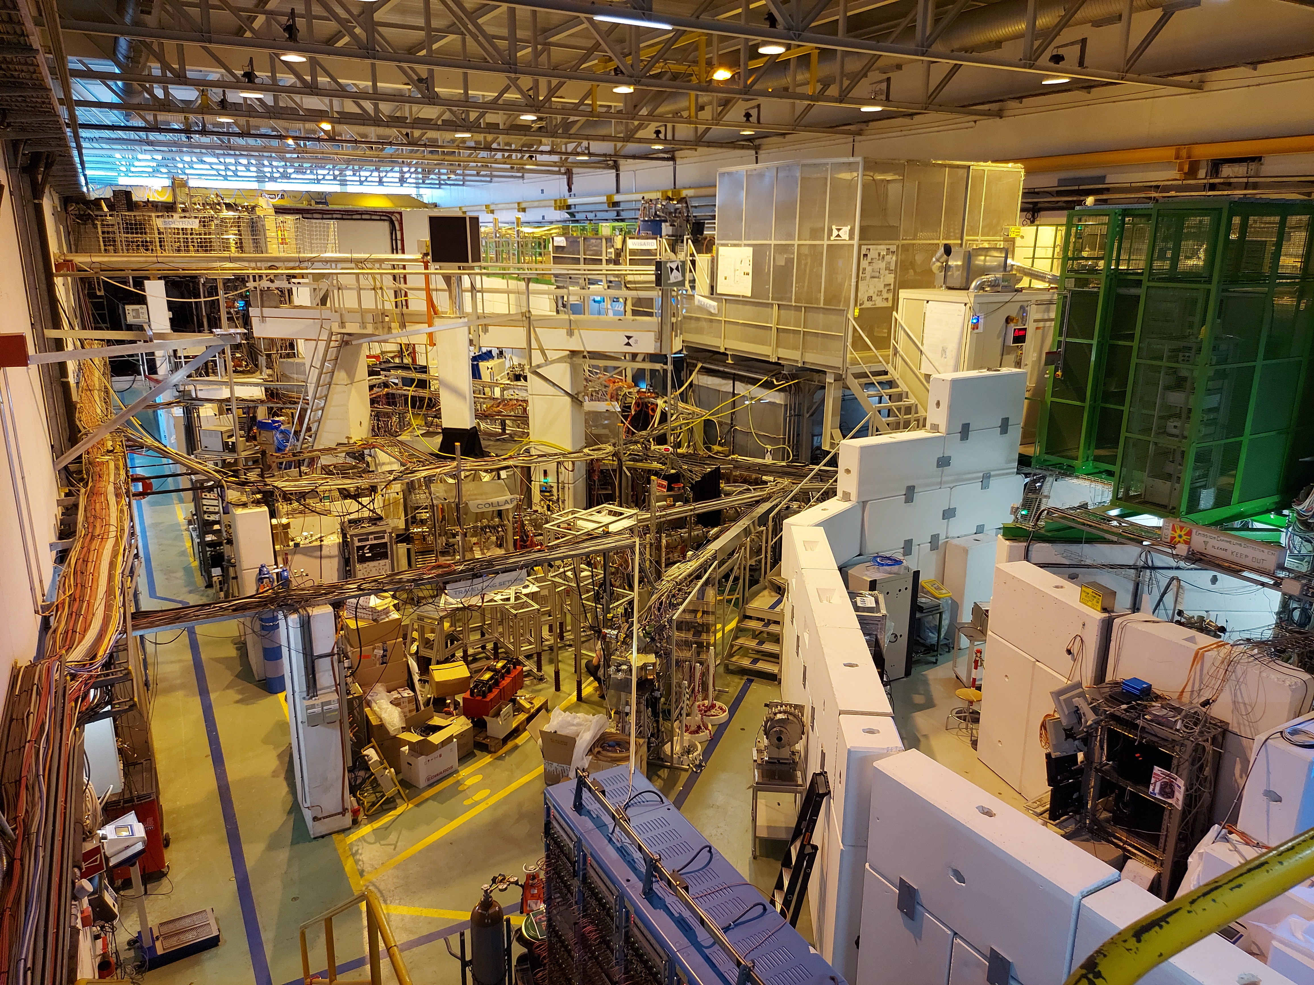
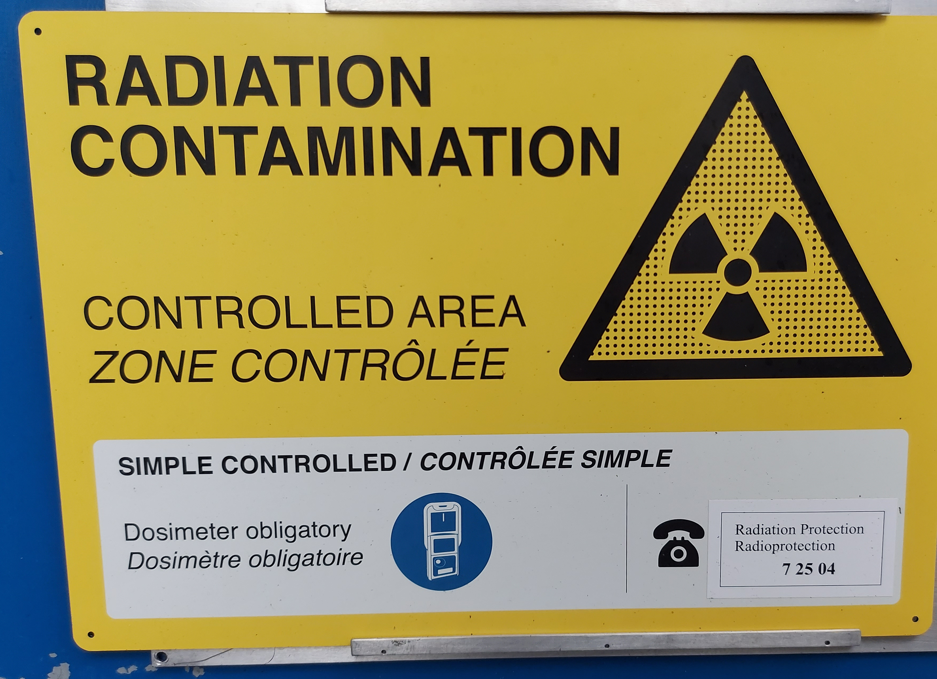
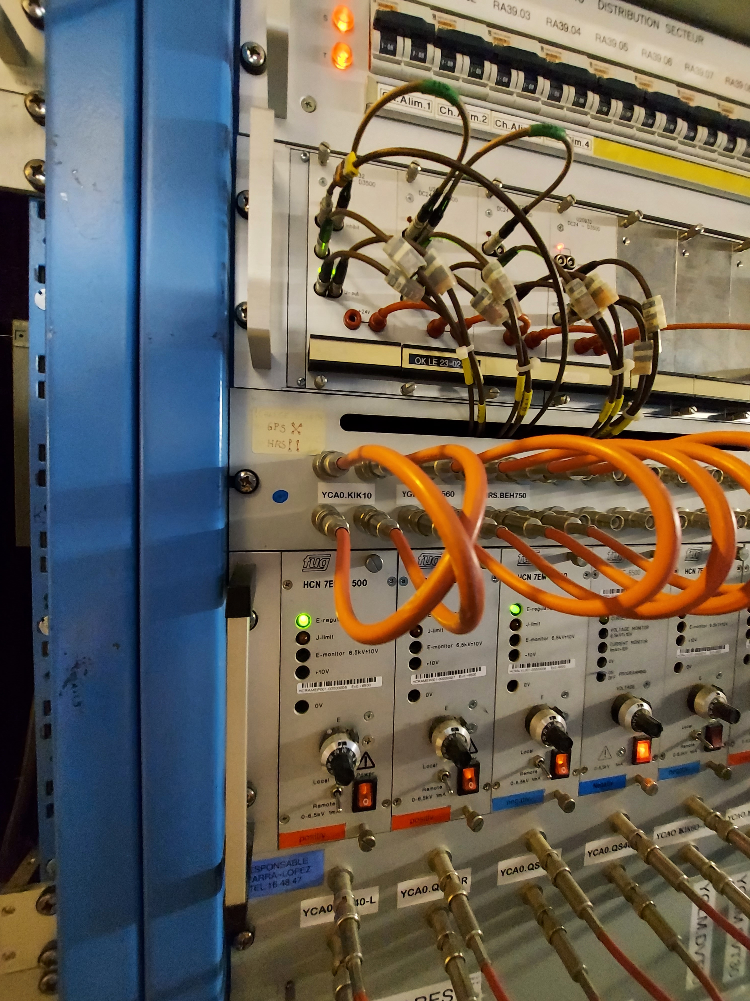
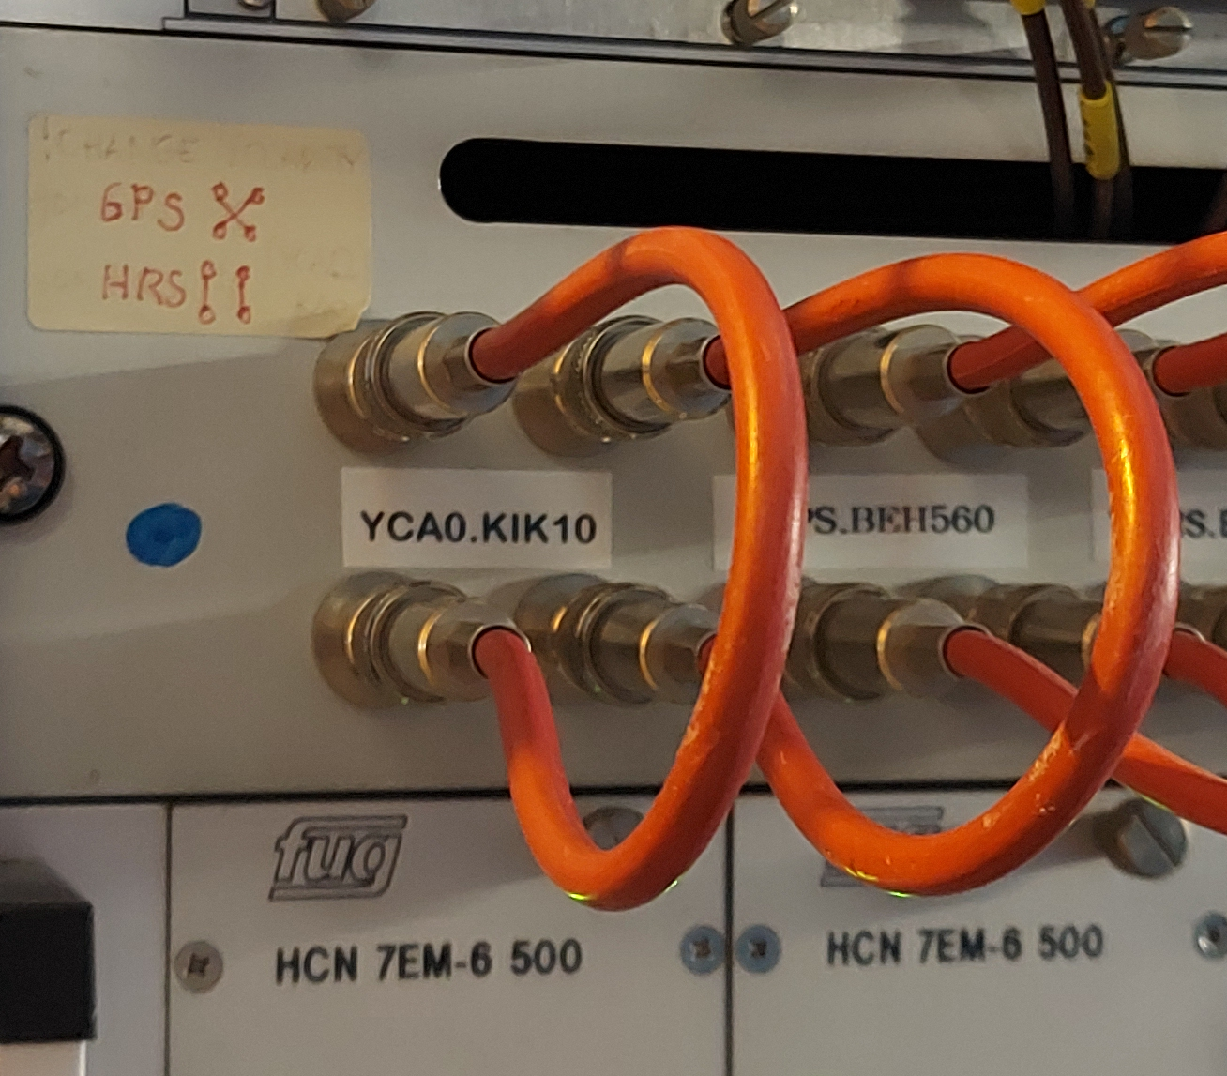
2. Beam Switching Project: Proposal (2/3)
PSU
PSU
Fig 12. ISOLDE CA0 Beam Line, polarity option 1. CATIA ST0377154_01
Load Voltage Data
Fig 13. ISOLDE CA0 Beam Line, polarity option 2. CATIA ST0377154_01
match tune and beam energy
change deflectors polarity
Trained person entering at ISOLDE
Swap High Voltage cables
Load voltage set data
>> 1.2s !
Yago Nel VILA GRACIA
Fig 14. Cycle to change from Front Ends at ISOLDE

Slide 4
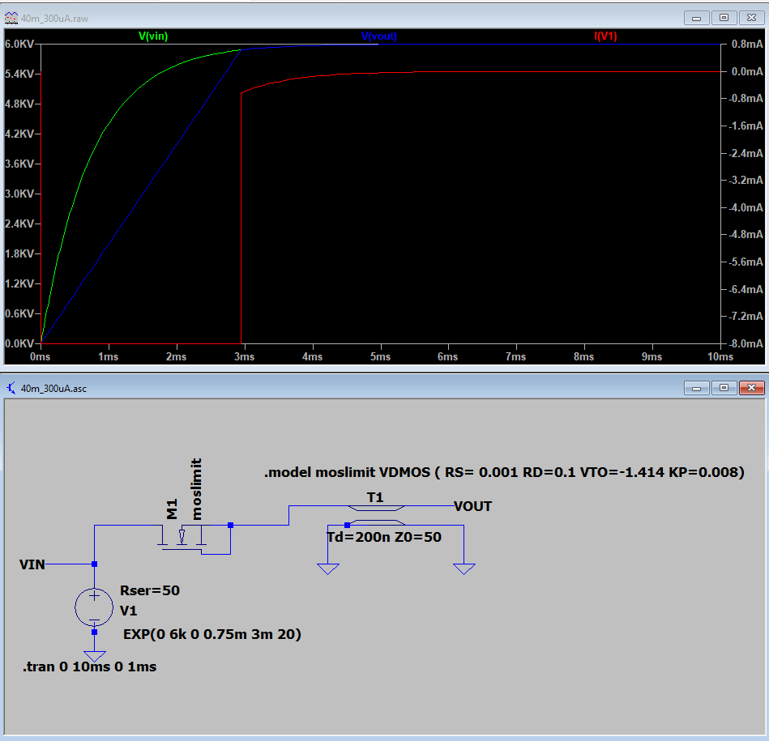
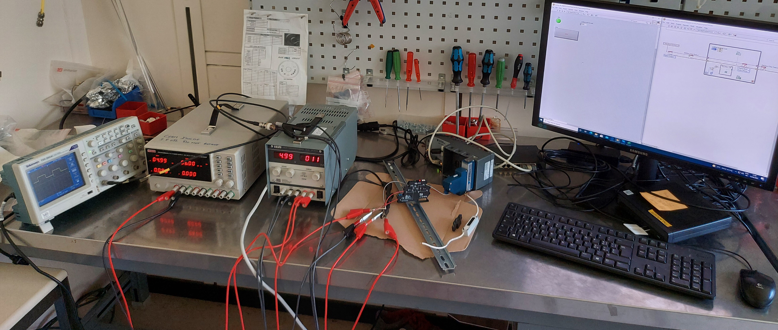
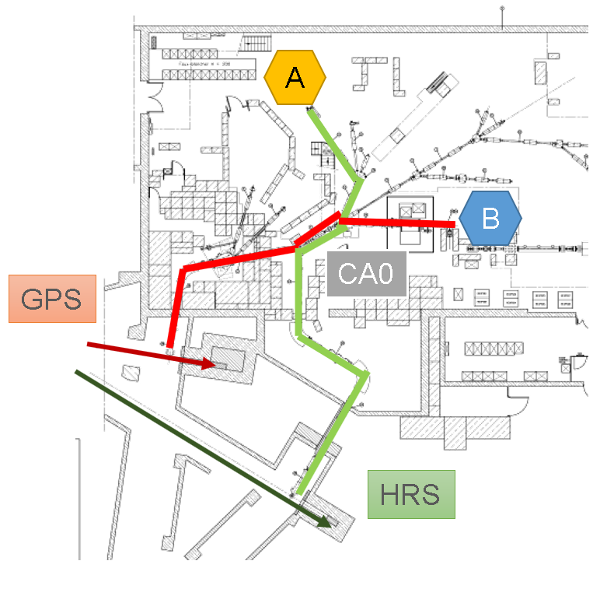
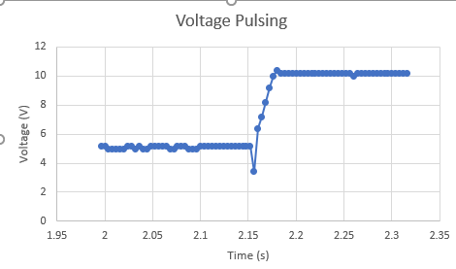
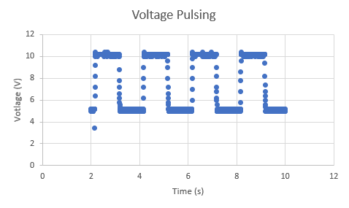
ISOLDE beamlines: Alternating operation
More details see presentation in EPIC Workshop 2020
Alternating mode
[TG06] M. Lindroos and T. Nilsson, “HIE-ISOLDE: the technical options,” CERN-2006-003, (2006). (Chapter 7 by T. Giles)
Requires proof of concept + prototype
  (funded via ISOLDE collaboration)
Final design can be installed during a winter shutdown
Initial prototype setup (simulation, first measurement)
Functional specification drafted
Project board to be appointed
90th ISOLDE Collaboration Committee meeting | S.Rothe
01 FEB 2021

Slide 5

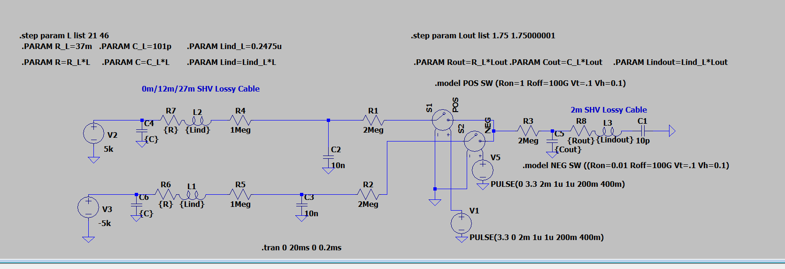
2. Beam Switching Project: Feasibility Study
Requirements:
  10-100 ms range charge/discharge 12kV
  Low inrush current in PSUs
  Location of hardware within ISOLDE
Simulations:
  Electronic Simulator (LTSpice)
  Characteristics of components
    Switch: Relay Type C
  Electronic circuit
Components:
  Match required components with market
  Purchase
Functional Specifications.
EDMS: 2589396
Fig 18. Electronic circuit proposed for the prototype. Simulation in LTSpice.
Yago Nel VILA GRACIA

Slide 6
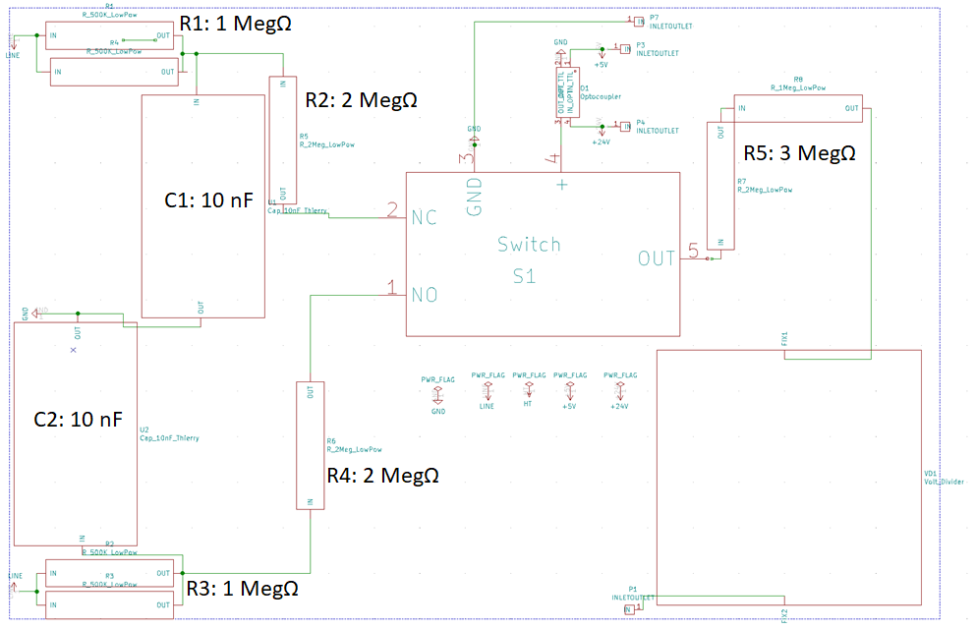
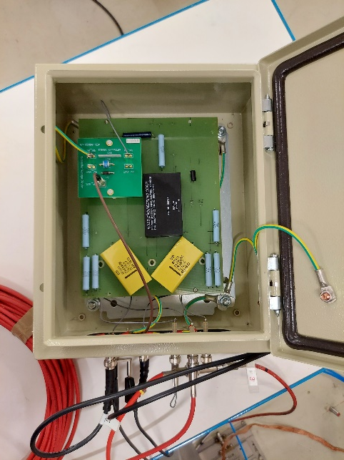
2. Beam Switching Project: Feasibility Study
Design:
  Compact circuit (Eagle + KiCAD)
  High Voltage Spacing
Assembly:
  Compact and robust box
Component | Quantity per switch unit
Relay Type C, 10kV | 1
HV Resistor: 1 MΩ | 2
HV Resistor: 2 MΩ | 4
HV Film Capacitor: 10 nF | 2
PCB | 1
Fig 19. Electronic circuit design proposed for the prototype.
Collaboration with SY-ABT-BTE.
Special thanks to Thierry Gharsa
Yago Nel VILA GRACIA
Fig 20. Beam Switch Box finalized.

Slide 7
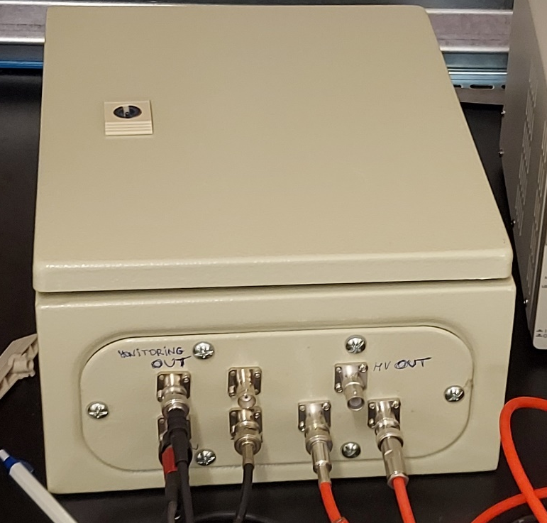
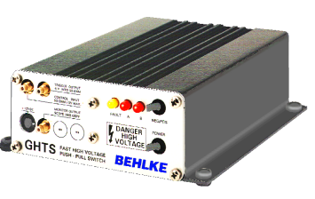
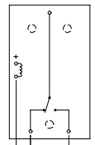
2. Beam Switching Project: Offline 2 tests
Switch Box (Relay)
Behlke GHTS 60A (Solid State)
Electromechanical Relay
Solid State
Simple
Economical
Slow (5-10ms)
Limited life (10 M cycles)
Fast (100us)
Long life
Commercial device
High price
power dissipation
Year: ~ 30 M secs
Yago Nel VILA GRACIA

Slide 8
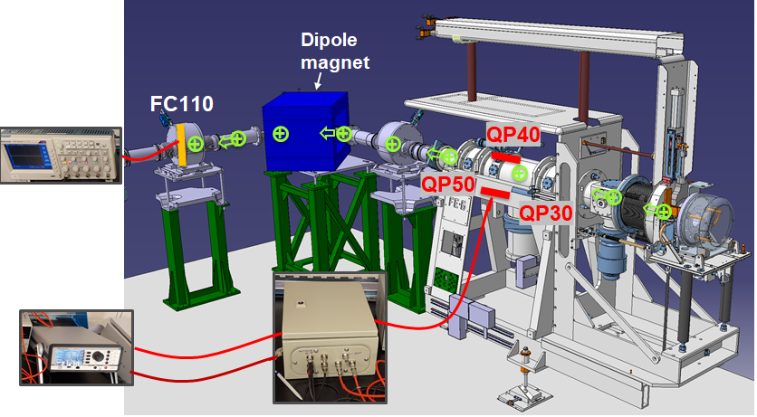
2. Beam Switching Project: Offline 2 tests
Key variables:
  Cable length PSU / Switch Box
  Cable length Switch Box / Quadrupole (QP)
  Sensitivity beam to QP Voltage
Key readings:
  Intensity reading in Faraday Cup (FC110)
  Beam shape
( )
Fig 21. Setup in Offline 2 Facility to test the Switch technology. CATIA: ST0818019
Yago Nel VILA GRACIA

Slide 9
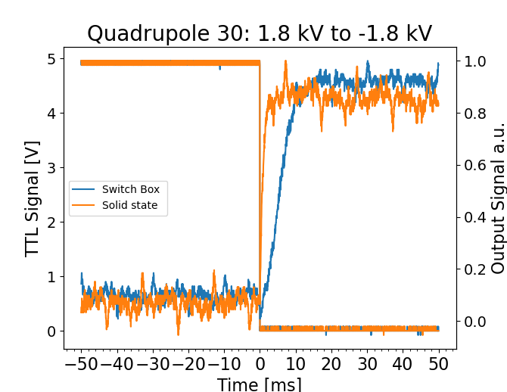
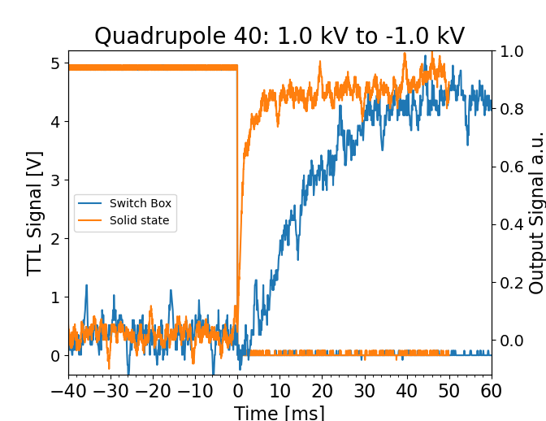
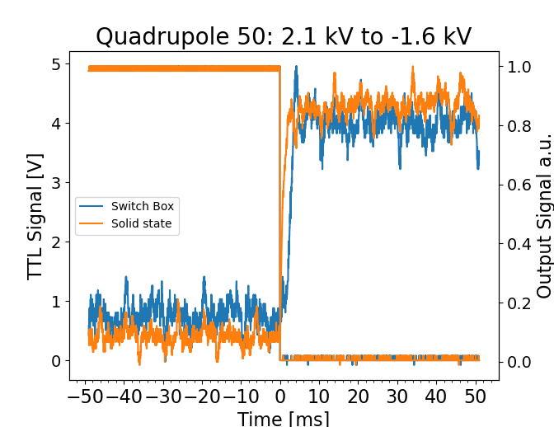
2. Beam Switching Project: Offline 2 tests
Yago Nel VILA GRACIA
Comparison of switching technologies: Offline 2 tests
  Fast response acquired for both switches (range 10-100ms)
  Solid state ~ 5 times faster than Switch box
  Sensitivity beam to Quadrupoles confirmed
 | Time (ms) to transmit 95% of beam
Quadrupole | Switch Box | Solid State
QP30 | 10.12 | 1.88
QP40 | 30.8 | 5.56
QP50 | 3.16 | 1.84
Table 4. Beam switching results for Switch box and solid state
TTL
Beam Signal

Slide 10
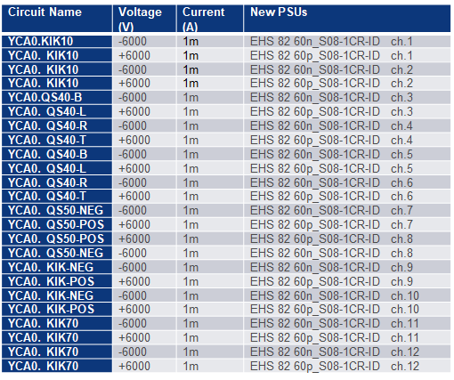
3. Conclusions
Switch box design and test phase successful
Both technologies fulfill initial requirements
Solid state switch has a better performance
12 Switches | Cost of Ownership Switch Box (kCHF) | Cost of Ownership Solid State (kCHF)
Parts cost | ~ 1.0 | ~ 3.0
Assembly work | ~ x | 0
Maintenance/ 4yrs | ~ 0.5 | ~ 0.1
Table 6. ISOLDE devices that would require a switch and a second pair of PSUs.
EMDS: 2636481. ISOLDE – REEX-ISOLDE Power Converter Consolidation
Table 5. Initial cost estimate for both technologies.
Yago Nel VILA GRACIA

Slide 11
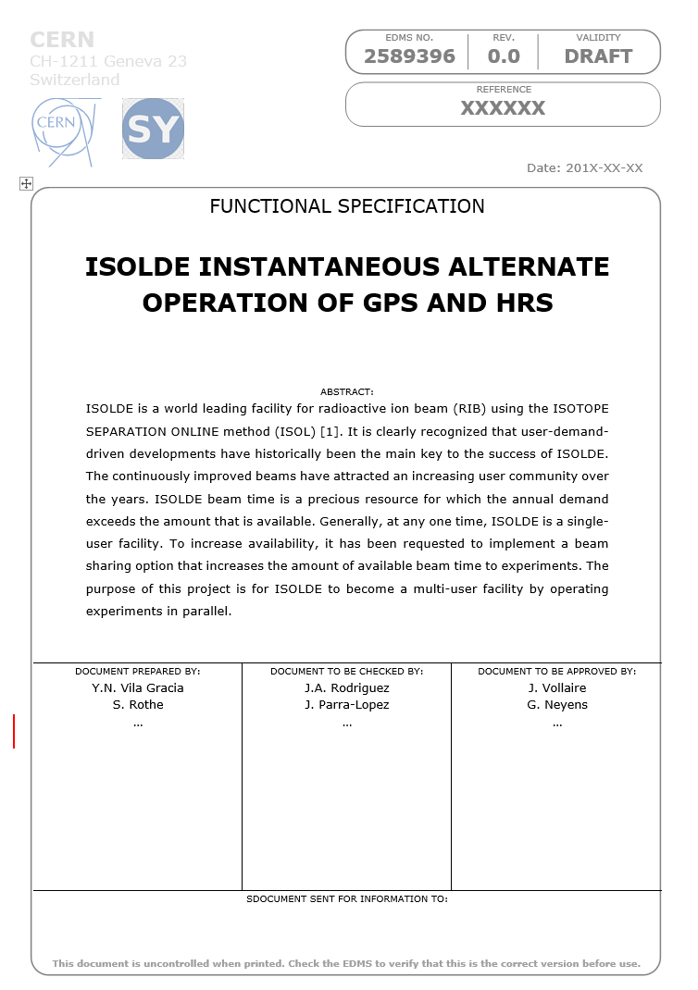
Next steps
Project board meeting
  Decide on switching technology
  Decide # channels for demonstrator
Finalize functional specification
Purchase (BEHLKE delay ~0.5y)

