Slide 1
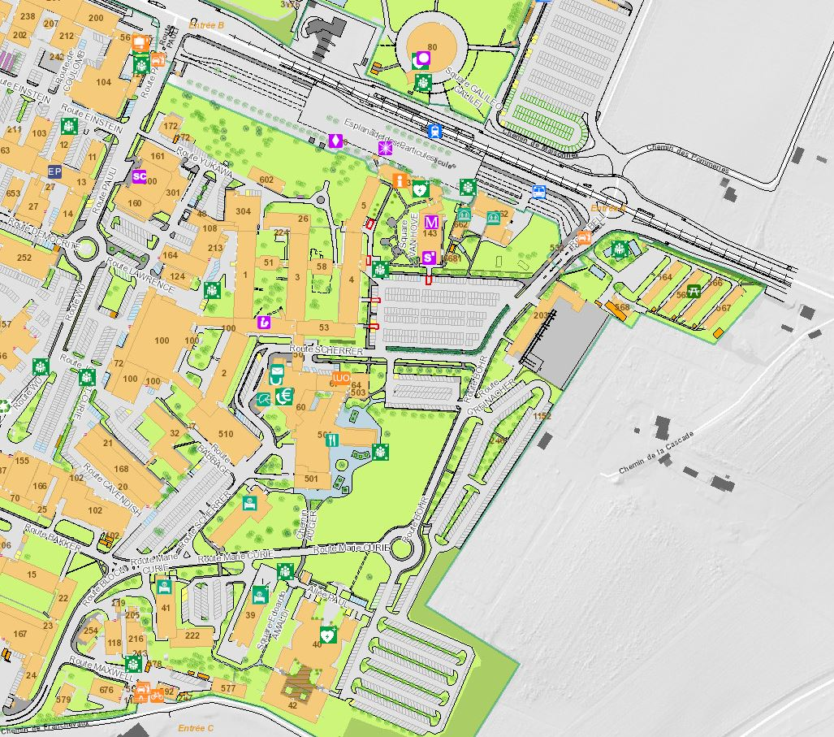
Entrance B (B.55):
open 24:00 hrs
304-1-001 & 304-1-007
Tram station 18
Main Reception (B.33):
Print your access card during working hours, otherwise Entrance B
2/1-034
1/1-025
4/S-030
52/1-001 Secretariat Neutrino
Council Chamber
Registration Desk
Main Auditorium
40/S2-B01 Salle Bohr & 40/S2-A01 Salle Anderson
222/R-003 & 222/R-001

