Slide 1

Space and Terrestrial Considerations for Access to High Energy U.S. Proton Accelerators for the Electronics Community
Kenneth A. LaBel, NASA-retired
  SSAI, Inc., work performed for NASA-GSFC
  kenneth.a.label@nasa.gov

Slide 2
Acronym List
Coronavirus disease (COVID)
Displacement Damage Dose (DDD)
Department of Defense (DoD)
Device Under Test (DUT)
Hampton University Proton Therapy Institute (HUPTI)
Integrated Circuits (ICs)
University Cyclotron Facility (IUCF)
linear energy transfer (LET)
monitor counts/units (MC/MU)
Massachusetts General Hospital (MGH) Francis H. Burr Proton Beam Therapy Center
National Aeronautics and Space Administration (NASA)
ProVision CARES Proton Therapy Center (ProVision)
Scripps Proton Therapy Center (SCRIPPS)
Synchronous Dynamic Random Access Memory (SDRAM)
Single Event Effects (SEE)
Science Systems and Applications, Inc. (SSAI, Inc.)
Total ionizing dose (TID)
Tri-University Meson Facility (TRIUMF) Proton Irradiation Facility
University of Alabama at Birmingham (UAB)
University of Alabama-Birmingham (UAB)

Slide 3
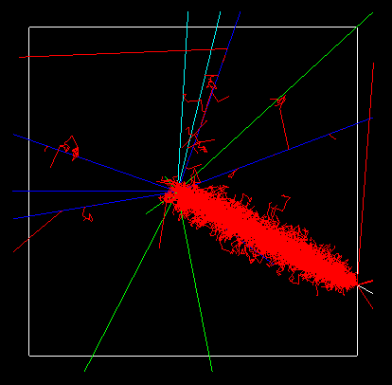
Problem Statement
Problem Statement (Space/Military Electronics)
  Particle accelerators are used to evaluate Single Event Effects (SEE) risk and qualify electronics for usage in the space/military radiation environment
    Protons
      Simulate solar events and protons trapped in planetary magnetic fields
      Are used as a surrogate for neutrons for avionics and weapons environment
  When Indiana University Cyclotron Facility (IUCF) closed in 2014, the prime U.S. facility for doing these tests was lost (~2000 hrs/year)
    Thus began, the “Great Proton Search” – reaching out to the growing network of proton therapy (medical) sites for parasitic access
Figure is of a simulated 100 MeV proton reaction in a 5 um Si block
Reactions have a range of types
of secondaries and energy depositions
Energy deposition by protons (displacement, spallation, etc…) have impacts on electronic functionality
(after Weller, Trans. Nucl. Sci., 2004)
P+

Slide 4
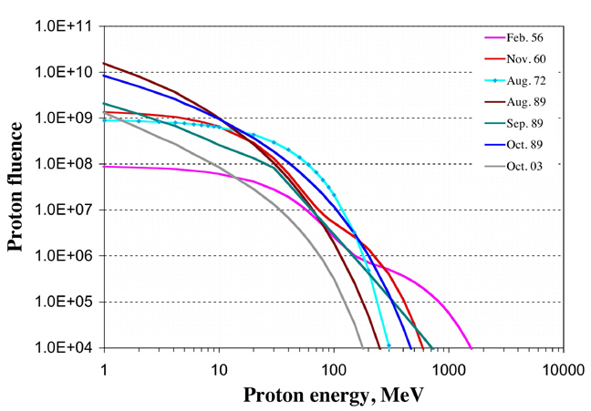
Why >200 MeV Protons for Electronics?
Used to simulate the space proton hazard
(solar events, trapped protons in Earth’s magnetic field)
Surrogate uses for protons
Prime Proton SEE Mechanism
Neutron SEE
Due to similar mechanisms, used to bound terrestrial, avionics, and other neutron SEE sensitivities
https://www.mdpi.com/2076-3417/10/9/3234
Representative solar events and their proton spectra
Courtesy Straume, NASA
Reaction of protons interacting with semiconductor materials causes secondary recoil ions – Indirect Ionization
Secondaries have various Linear Energy Transfers (LETs) and penetration ranges
Courtesy Ladbury/NASA
200 MeV is fairly accessible and a reasonable bounding energy for SEE sensitivity
Heavy Ion SEE
Used as screen for lower LET sensitivities, down-select testing, fault tolerance validation, etc

Slide 5
Proton Physics for SEE
Total nuclear production cross section
  # ions out/#protons in
These secondary particles have a distribution of linear energy transfer (LET) as well as usually being of short range.
  These are particle kinematic effects to consider when establishing a proton fluence:
    Number of interactions that occur that have secondary ion spallations,
    Distribution of the secondary ions, and
    Risk coverage versus mission environment, sample size, geometry, etc…
  Is 10¹² protons/cm² a realistic choice? Approximates the 10⁷ ions/cm² often used for heavy ion test runs.
  Be wary of total dose or displacement damage at higher fluence levels:
  - consider more samples of the DUT at lower fluence levels.
Energy(MeV) | Sigma (cm^-2)
50 | 4.76E-06
100 | 3.89E-06
200 | 3.46E-06
500 | 5.37E-06

Slide 6
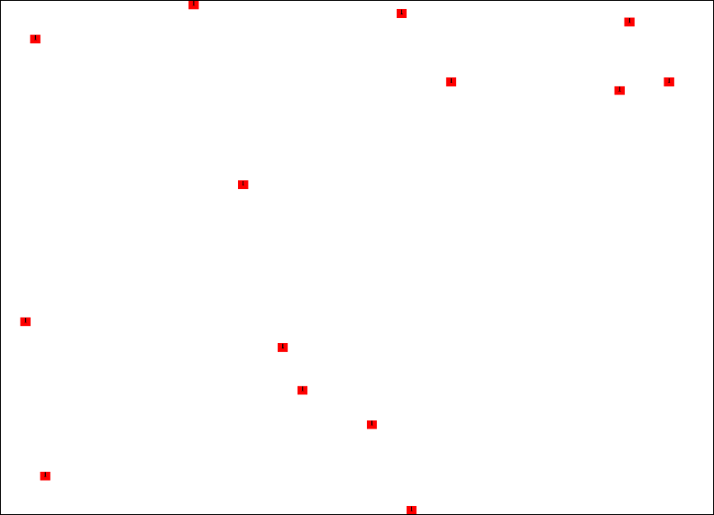
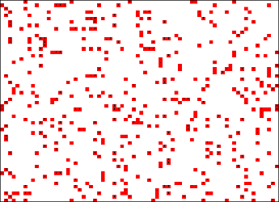
Heavy Ions vs. Protons for SEE Testing
Bottom Line: Proton facilities are usually more readily available, but insufficient to qualify hardware for deep space environments
Coverage from1E11 200 MeV protons/cm²
SEE Proton testing relies on proton nuclear interactions and spallation effects to generate secondary heavy ions. This secondary environment presents the following limitations:
Reduced feature coverage
  Infrared micrograph of a portion of a 512 Megabit (Mb) synchronous dynamic random access memory (SDRAM) ~60x70 µm²
  Shows both memory cells and control logic (10 yr. old tech.);
    Red spots are simulated ion hits
Maximum theoretical LET of 14 MeV-cm²/mg (for 200 MeV protons)
  8 MeV-cm²/mg more realistic
  Most programs/organizations want a higher LET such as 37, 60, or 75 MeV-cm²/mg
Limited penetration (range)
  Insufficient to cause some destructive effects that would occur in space
Caveats include dose during testing and material activation
∀ Z, Angle, Energy
Single Z, Angle, Energy
Coverage from1E7 heavy ions/cm²
After Ladbury, TNS-2017-TN35833

Slide 7
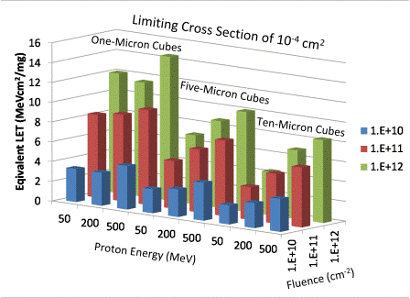
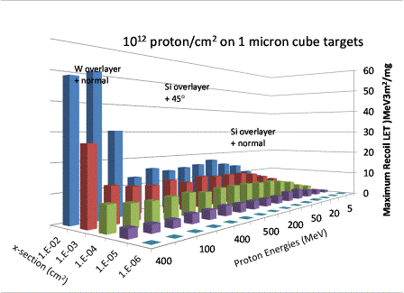
Visual Protons for SEE
(courtesy R. L. Ladbury and J.-M. Lauenstein, NASA/GSFC)
Silicon’s not the only culprit
In creating problems
How good are protons at
simulating heavy ions?

Slide 8
Proton Energies for SEE Testing - nominal break points
Low
Medium
High
After Straume, NASA

Slide 9
Proton Energy Regimes – Electronics Testing
For SEE testing (indirect ionization)
  Most common rate prediction method utilizes the Bendel 2-parameter fit to the test data.
  This method uses data points usually in both the high and medium energy regimes (curve fitting).
    High energy provides the “worst case” device sensitivity (go/no-go).
For SEE testing (direct ionization)
  Testing is performed in the low energy regime (<10 MeV).
Total ionizing dose (TID) or Displacement Damage Dose (DDD) on electronics
  May use both medium and high energy protons.
    Medium energy is the “go-to” energy regime for testing optics/sensors/etc…
  Low energy may not have sufficient penetration for a packaged device, but is used for testing of devices such as solar cells.

Slide 10
Basic Proton SEE Requirements from Medical Accelerators
Energy range:
  125 MeV to > 200 MeV (some machines 70-250 MeV)
Proton flux rates (f):
  1e7 to 1e9 p/cm²/sec
Test fluences (F):
  1e9 to 1e11 or 1e12 p/cm²
Irradiation area:
  Small (single chip ~ 1cm²) to board/assembly > 15cm x 15cm
Beam uniformity:
  >80%
Beam structure:
  Cyclotron preferred (random particle delivery over time)
    Pulsed beam structure acceptable for many (but not all) applications
  Fixed spot or scatter (random particle delivery over area)
    Scanning beams MAY be acceptable (needs consideration)

Slide 11
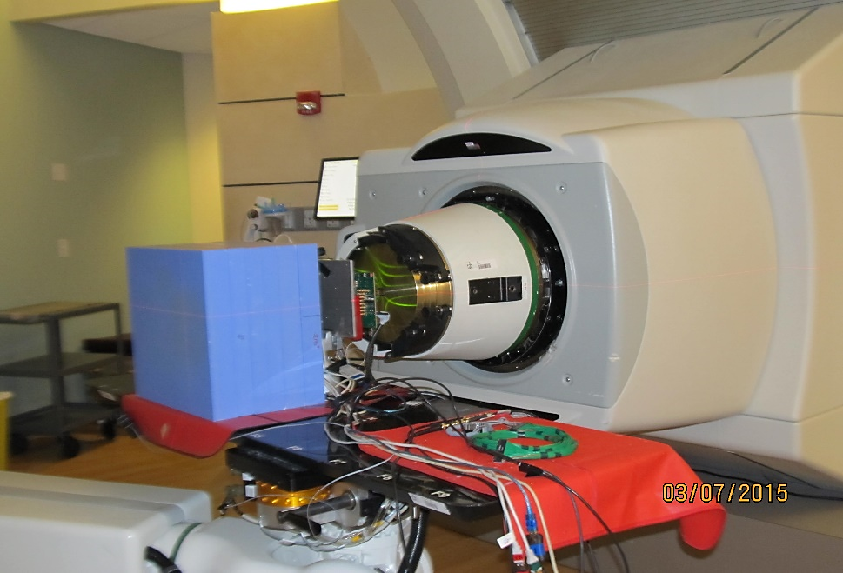
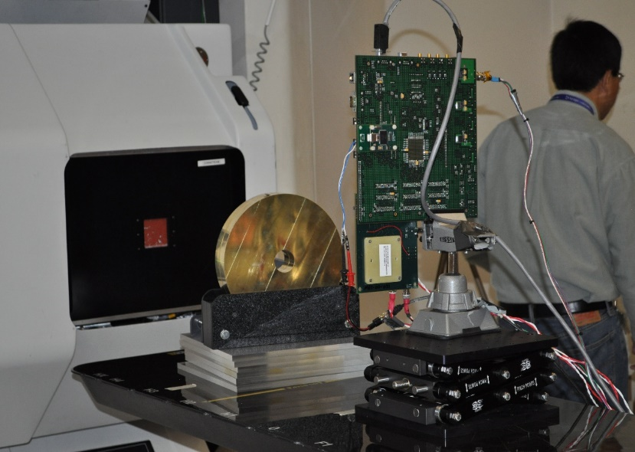
Pretty Pictures from Medical Facility Testing (1)
Northwestern Medicine Chicago Proton Center.
Big blue block is the beam stop.
Not all facilities thought one was necessary.
SCRIPPS Proton Center (now California Protons)
Beam comes out here
Brass collimator
supplied by SCRIPPS
Clamp
(NASA equipment)
Robotic patient sled
supplied by SCRIPPS
Device Under Test
Table jack (NASA equipment)

Slide 12
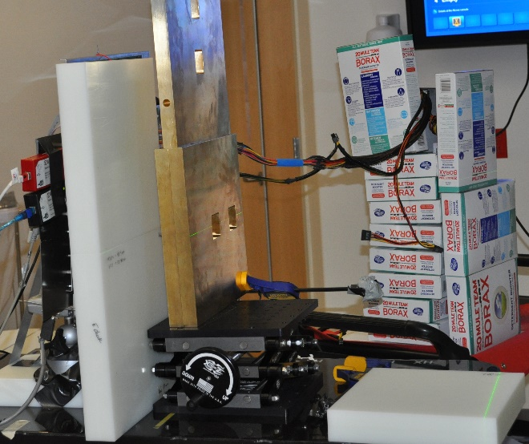
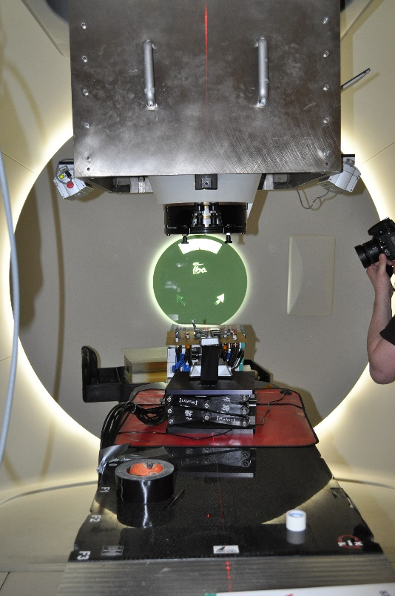
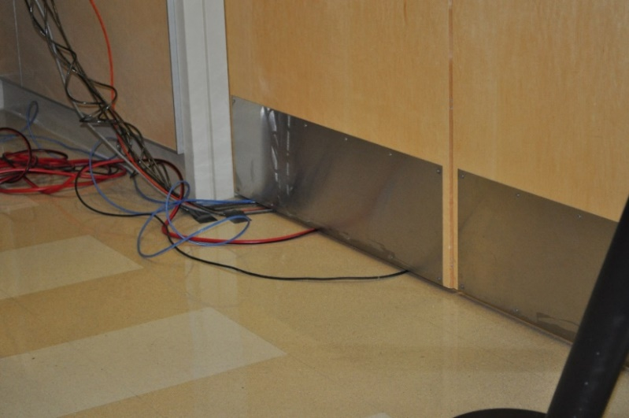
Pretty Pictures from Medical Facility Testing (2)
Device under test (target) on
an electronics board.
Brass (square) collimator and
Poly sheets used to protect
other devices on the board
from stray neutrons
SCRIPPS
Hampton University
Proton Therapy Institute (HUPTI)
Neutron protection
For
ancillary
test equipment
In the target room
Gantry was rotated for
vertical beam line.
The floor was the beam stop.
Typically, cables are run from target area to user/control area for monitoring and control of test electronics.

Slide 13
Electronics and Proton Effects
Sample Customer Base for Protons – beyond medical treatments and research
Space/military products
  Evaluate proton SEE risk
    Device level tests
    System level tests
    Technology/architecture research
  VALIDATION of radiation tolerance approaches
Space/military researchers
  Uses protons to develop test methods or knowledge of tolerance of new technologies or electronic designs
  Other space research with protons – human protection and material studies
  Instrument calibrations
Nuclear data research
Isotope production
  Higher intensity needed than proton therapy machines
Surrogate for neutrons
  Commercial – terrestrial
    Provides higher performance, but have proton/neutron sensitivities (terrestrial)
  Automotive
    Largest commercial growth area in the electronics market
    Have safety critical aspects (self-driving and driver assist)
    Systems validation is growing area
  Aviation/Aeronautics
    Increased use of sensitive electronics in new airplanes, drones, etc…
    System manufacturers use protons for validation
  Medical equipment
    High reliability requirement
To be presented by Kenneth A. LaBel to RADNEXT virtual webinar June 22, 2022

Slide 14
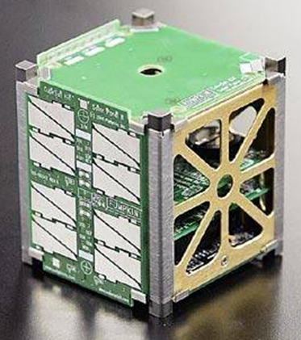
Sample Proton SEE Test Scenarios
Baseline: traditional IC test
Board-level test: testing of large amounts of individual ICs on a single test board
  2 sub-scenarios: one part at a time or multiple parts at a time
Board-level test: functional purpose board (e.g., space computer) – system response test
Board-level test: SEE mitigation validation
Assembly or stacked board test
IC
IC
IC
IC
IC
IC
IC
IC
IC
IC
IC
IC
IC
IC
IC
IC
IC
IC
IC
IC
IC
IC
Image courtesy of Vanderbilt University

Slide 15
Factors that are Increasing Proton Demand
(Space)
Expanding communities of interest (see Customer Base – see previous slide)
Increases in commercial space segment (new companies and more launches)
Increases in the Small Sat space segment (increasing constellations and launches) including universities
Limited time availability at heavy ion sites
Protons used as pre-selection tools and for risk reduction
Ability to test large devices/boards/systems
Ability to penetrate complex packaging and materials (testability)

Slide 16
Protons >200 MeV: U.S. Demand since 2013

Slide 17
Factors that Affect Proton Capacity (Therapy Sites)
Business model
  Ownership/management changes at proton therapy sites (volatility)
    Often changes accessibility with little warning
  Fiscal issues: on-going challenges with medical insurance acceptance of proton therapy
    Several have undergone Chapter 11 and/or undergone significant reorganization and removed access (e.g., ProVision, SCRIPPS – aka California Protons)
  Beam costs – medical sites are used to medical cost models and while electronics research is “simpler”, sites are uncertain how to handle/cost
Non-interference with patients
  Access only during non-patient treatment or regular maintenance hours
  Staffing limitations may not allow for “extra” hours to be used
Perceived Risk
  Concern over potential liability and/or damage to expensive medical equipment – few sites have dedicated research rooms.
Maintenance
  Older machines require refurbishment/repair (reliability risk)
Increased medical therapy research (FLASH therapy)
Trend: new sites are more likely to be a single treatment room (rather than multiple) and will have very limited potential for electronics test access

Slide 18
Possible Business Models for “Selling” Protons
(Medical Treatment Sites)
Available hours
  Weekends
    One day or both days
    2 weekends a month, 3 out of 4 weekends a month
    8, 12, or 16 hours each day
  Evenings
    After patient treatment
    4-8 hours (electronics tester personnel are used to “the graves”)
  Interleaving during the patient treatment hours
    Lowest priority patient model
    Assumes “Isolation” from patient area (dedicated research room)
    ~15 minutes of beam per hour (in 2-3 minute blocks)
      15-20 minutes of beam per hour is a sweet spot for users
    Minimizes additional staffing
  Model changes if no patients are being treated with a machine
Pricing
  Ranges from ~$1000 to >$2000 hr (depends on parent organization)
  Contracts, purchase orders, cash, check, charge – NO medical insurance needed

Slide 19
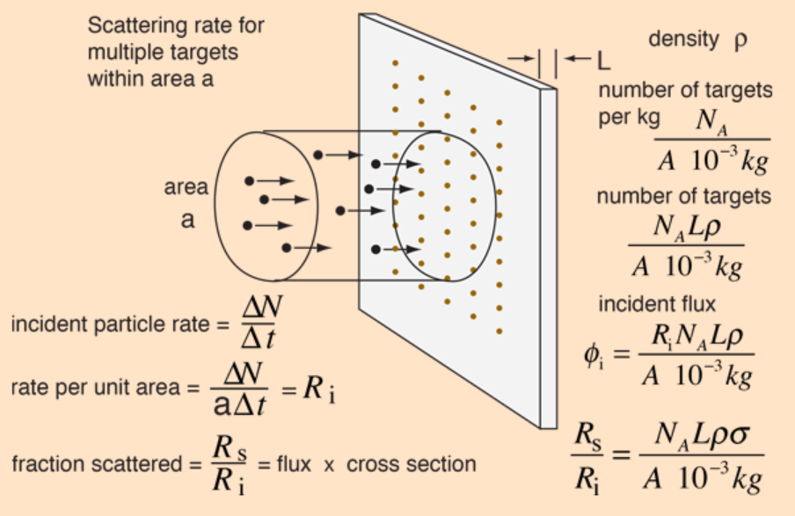
Background: Proton Beam Delivery
There are two types of accelerators being used for proton cancer therapy:
  Cyclotrons (relatively continuous beam), and,
  Synchrotrons/Synchrocyclotrons (pulsed beam, aka beam spills).
In addition, there are three types of beam delivery methods used.
  Scatter,
  Wobble/uniform scan, and,
  Pencil beam scan.
Newest treatment method is “FLASH” therapy (high dose rate - reduces tumor irradiation from minutes to seconds)
  Still in research/trial phase in the U.S.
IUCF was a cyclotron and utilized a scatter beam delivery system.
  This is preferred, but not 100% necessary.
This is a figure depicting ion beam particle interaction with a target at a cyclotron
Courtesy of Rod Nave
http://hyperphysics.phyastr.gsu.edu/hbase/nuclear/imgnuc/crosec.gif

Slide 20
Translating the terms: medical vs electronics
Patient (target)
Electronics (typical)
Measurement
  Dose (tissue/water), monitor counts/units (MC/MU)
Beam penetration
  Use Bragg peak to STOP beam in patient
Exposure stop
  Cumulative dose, MC/MUs
Target size
  Tumor
Beam delivery
  Pencil beam, wobble, uniform scan or fixed point/scatter
Beam timing structure
  Timing can be important
Patient exposure
  A few minutes
Beam movement
  Gantry or fixed/scan
Measurement
  Dose (material – Si, SiO2, GaAs, …) and particle rates (Fluence -protons/cm2, and flux - protons/cm2/sec)
Beam penetration
  Beam goes THROUGH target
    Suggest having a beam stop behind target
Exposure stop
  Cumulative dose or Fluence or
  Number of recorded events or degradation or
  “Unusual” event or failure
Target size
  Single chip (1cmx1cm) to full assembly (20cm x 20cm or larger)
Beam delivery
  Prefer fixed point/scatter
Beam timing structure
  When particle arrives versus electronics operation CAN be important (but not always)
Target exposure
  Seconds to minutes to ??? Depending on STOP criteria – usually under 2 minutes
  Often MANY exposures (test runs) per target (10’s to 100’s)
Beam movement
  Fixed
To be presented by Kenneth A. LaBel to RADNEXT virtual webinar June 22, 2022

Slide 21
Protons >200 MeV: U.S. capacity since 2013
Best case shown
Possibly as low as
2036 hours
ProVision Closure
Feb 2022

Slide 22
Protons >200 MeV: U.S. facilities currently providing access
Prime locations selling time
James M. Slater MD Proton Treatment & Research Center
Mayo Clinic Proton Beam Facility - Phoenix
Mayo Clinic Proton Beam facility - Rochester
Massachusetts General Hospital (MGH) Francis H. Burr Proton Beam Therapy Center
MGH has been struggling with recovery from unexpected maintenance
Unclear on actual availability, but best case for 2022 is ~300 hours (<50% of max pre-COVID and maintenance)
Northwestern Medicine Chicago Proton Center
Provision CARES Proton Therapy Center
Due to new management (Covenant Health), facility was closed as of 1 Feb 2022.
This was the U.S. site with most access for electronics testing (1500 hours/year+ - only “dedicated” research proton accelerator for SEE, etc)
Intending to sell
Johns Hopkins University Proton Therapy Center
Proton International at University of Alabama-Birmingham (UAB)
Canada
Tri-University Meson Facility (TRIUMF) Proton Irradiation Facility
No guaranteed access facility exists domestically.
The mix of who is providing access changes on a regular basis (tracked quarterly).

Slide 23
Protons >200 MeV:
U.S. capacity vs demand since 2013
ProVision Closure
Feb 2022
Min gap of 1556 hours
Possibly >2300 hours

Slide 24
Possible Options
With the current emphasis on the even worse accessibility issues related to heavy ions, finding solutions (and funding) won’t be simple
Proton therapy center success is not guaranteed
  Continuing issues with insurance acceptance
  Patient loads are uneven (utilization rates)
  FLASH therapy versus traditional irradiation
  Carbon ion therapy considerations (more efficient irradiation with even less peripheral damage)
Possibilities…
  ProVision gets resurrected
  Private industry finds funding (public/private) for a new facility
  Another proton therapy site undergoes bankruptcy, …

Slide 25
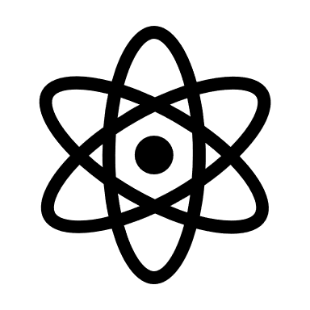
Summary and Comments
What’s Needed Now - Better demand study
  Current demand is based on general trends of usage and inputs from facilities
  Actual user inputs are required for more appropriate demand signal (and which segments it is critical to) – survey
Private industry has expressed interest in “solving” the problem possibly in a public-private venture
  Reuse potential for older or financially challenged sites?
    Medically installed machines have lots that we “don’t need” in a building
Right now, there are ~38 proton therapy sites active in the U.S and more planned
  May be able to get some additional access, but given the historical volatility, uncertainty exists for stable access (with a few exceptions)

