Slide 1
Infrastructure/Integration/Schedule constraints
A. Rossi with contributions from M. Modena , P. Fessia, J. Oliveira, G. Aparicio Cantalapiedra, S.Maridor, Y. Thurel, M. Martino, G. Girardot.
WP2/WP13 HL-LHC Satellite Meeting, Uppsala 2022 - Long-Range Beam-Beam Wire

Slide 2
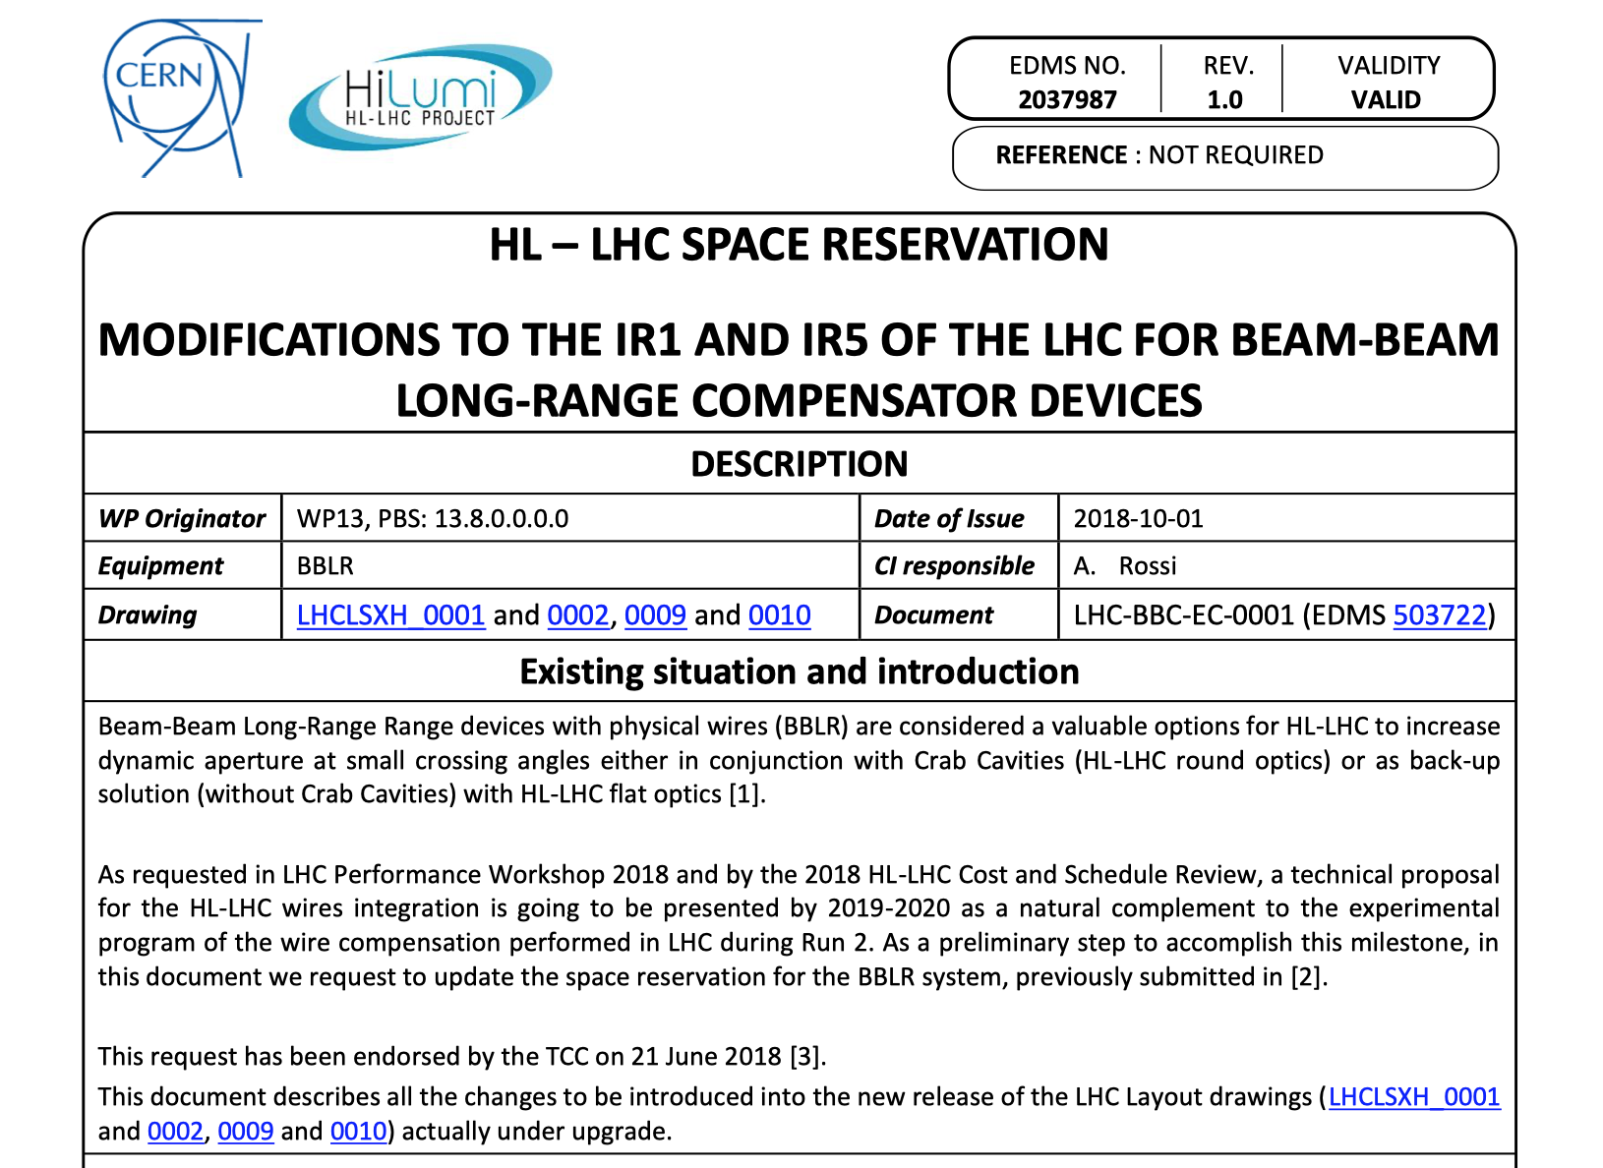
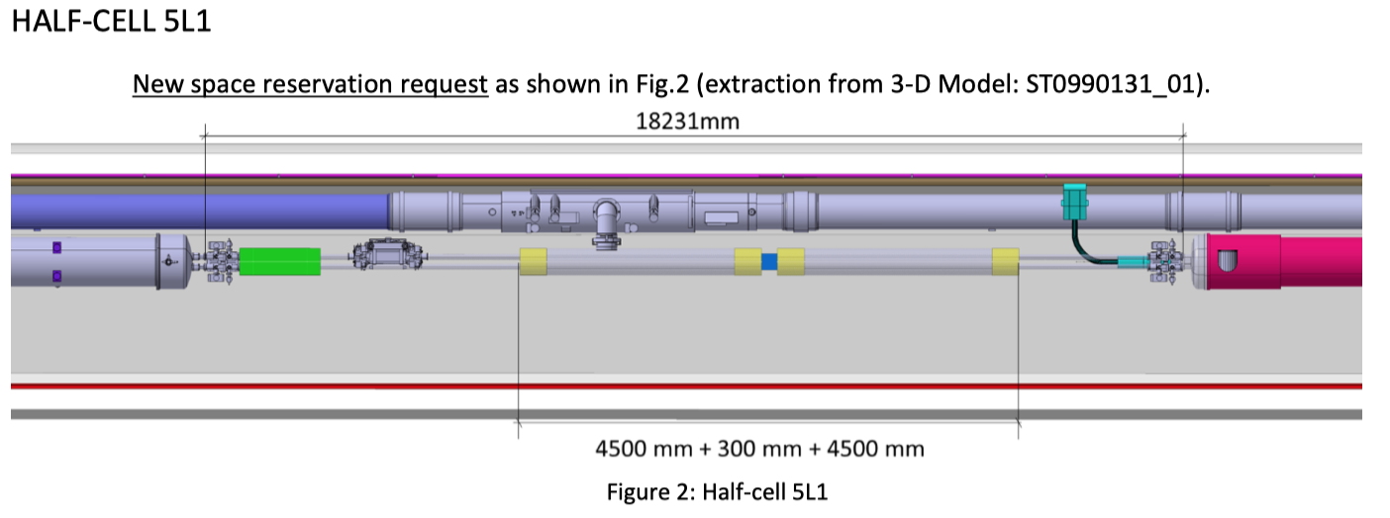
HL-LHC space reservation
A space reservation of
4.5 m on both beams was made on either sides of IP1/5 = 1 unit per beam per location, in cell 5 (between Q4 and Q5)
Space for racks

Slide 3
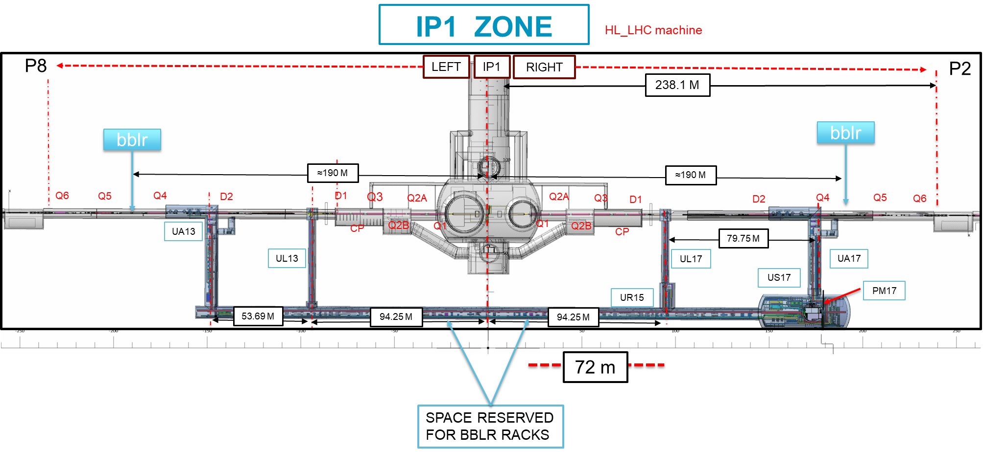
HL-LHC space reservation
(similar for IP5)

Slide 4
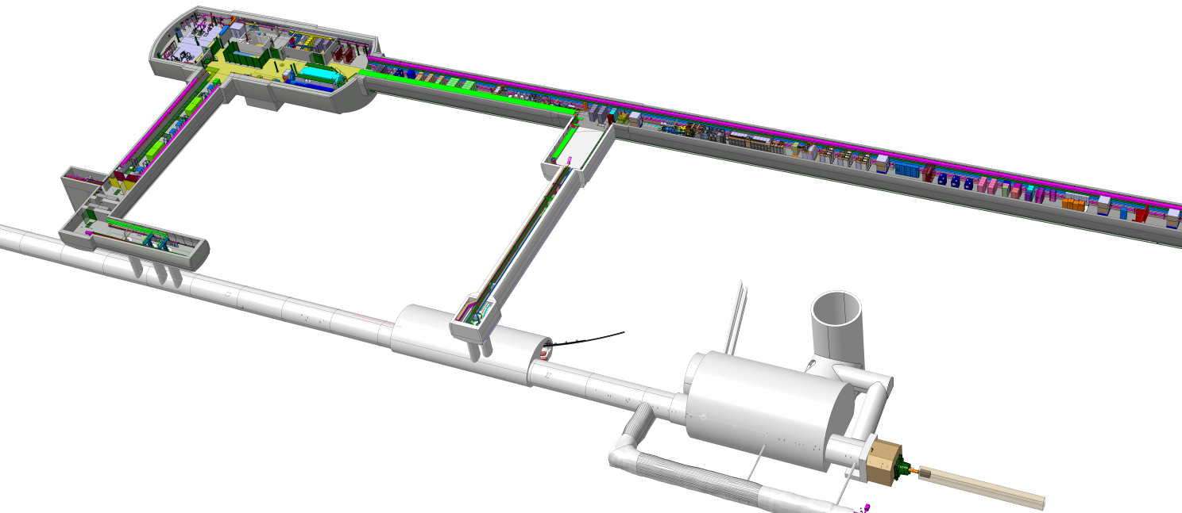
HL-LHC galleries - “UR Option”
PC in the new technical gallery UR and cables routed through :
UR → UA → cores → LHC → BBLR
UR
no-radiation
area
core
LHC

Slide 5
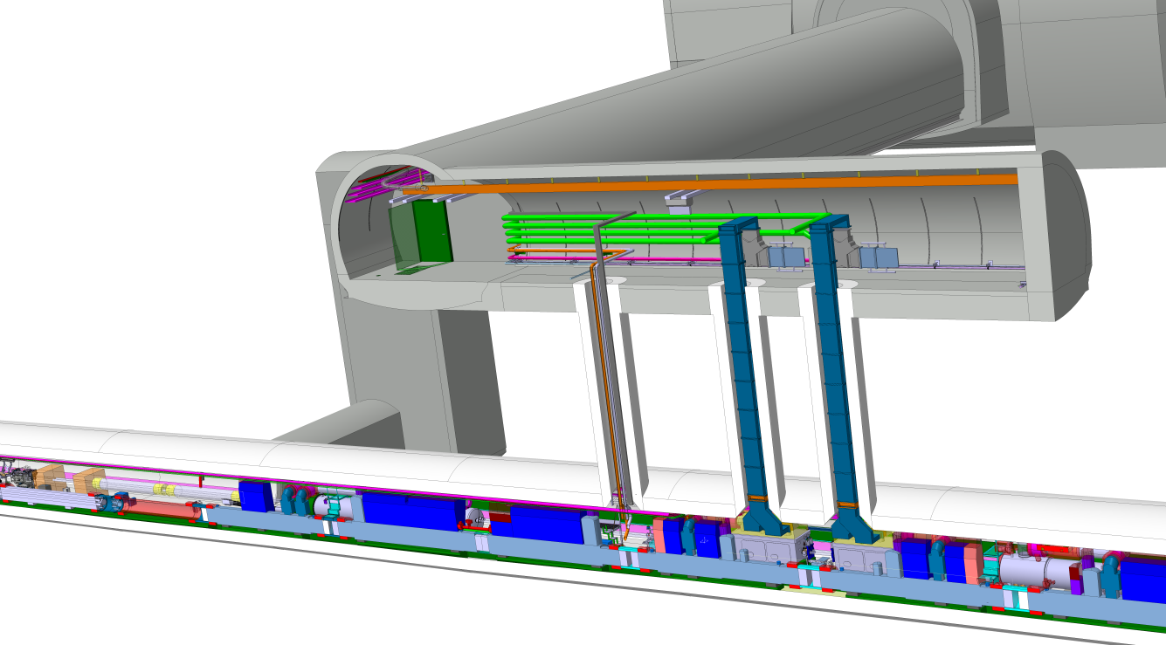
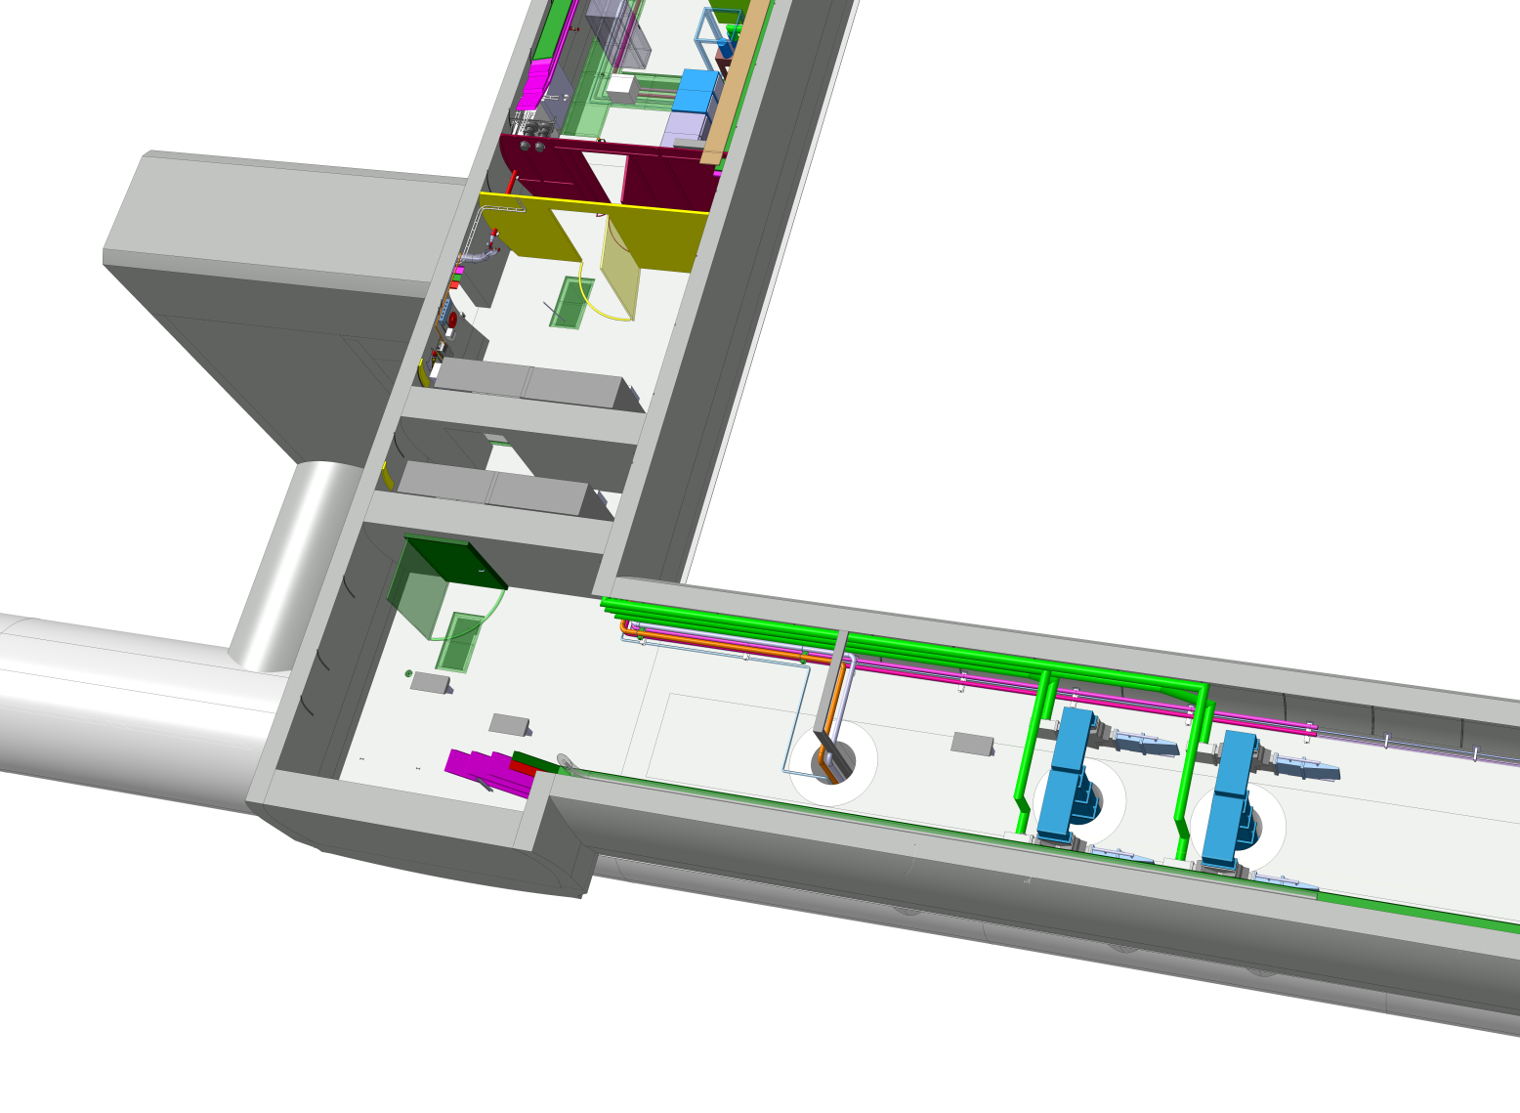
HL-LHC galleries - “UR Option”
PC in the new technical gallery UR and cables routed through :
UR → UA → cores → LHC → BBLR
BBLRC
core
Pro-1 : Finding/building converters of 150A x 60-70V* rating is feasible with commercial units.
Pro-2 : Space for racks already reserved.
Con-1: It is not possible to use any existing core: devoted to RF flexwell (fragile) cables, and not to share
signal cables with power cables.
Con-2: Heat losses to be managed around the core location.
Split Air Conditioner may be required - study to be done.

Slide 6
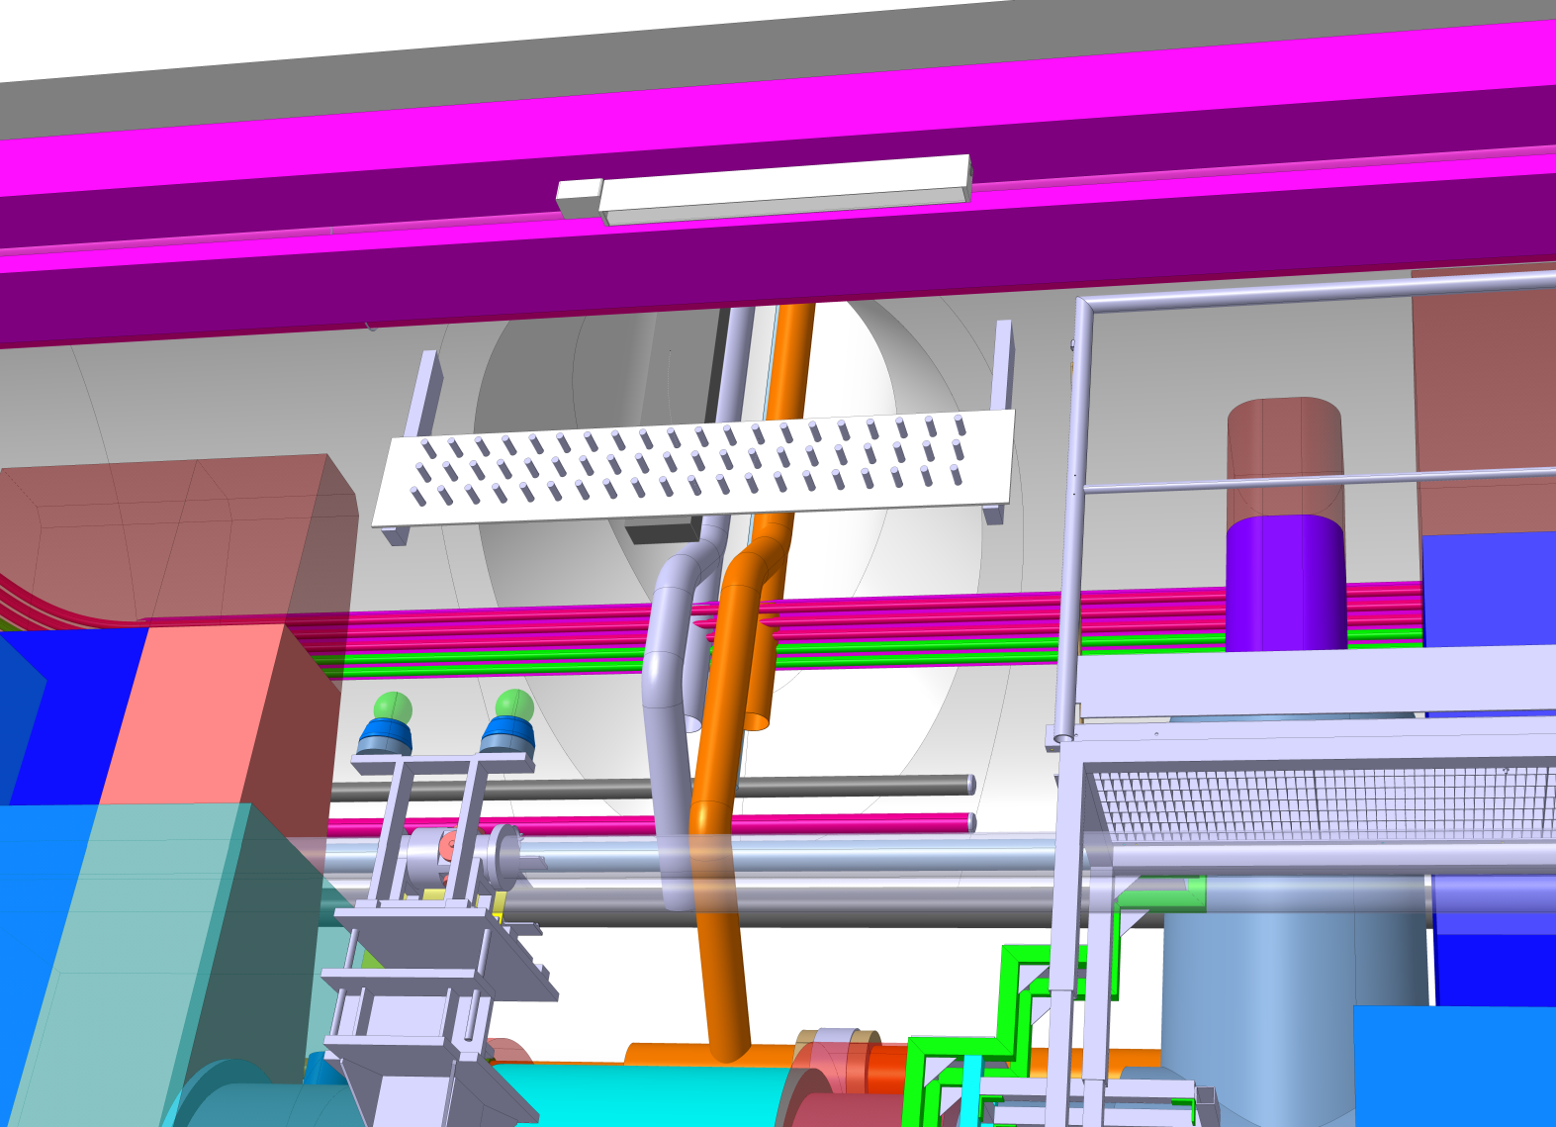
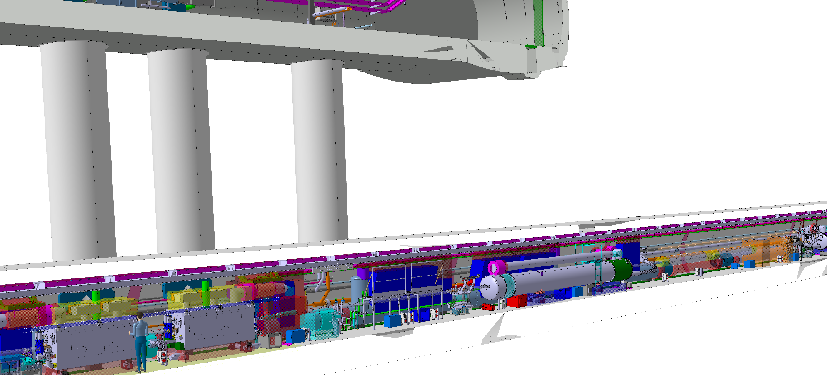
HL-LHC galleries - “UR Option”

Slide 7
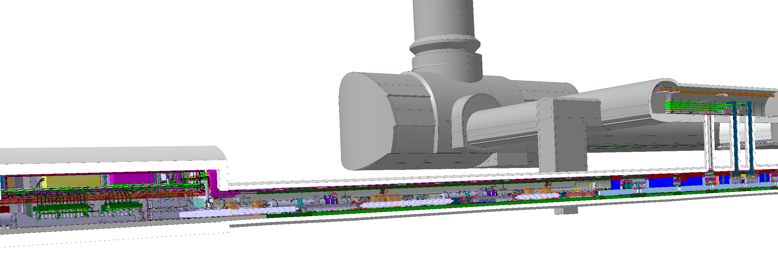
HL-LHC galleries - “RR Option”
Con-1 : This would require new radiation tolerant
design converters. Effort (design) for only few
units (#8).
Con-2 : Need to find place in RR(1/5), not studied here.
Pro-1 : No need to install DC power cables from
tunnel up to UR.
PC in the LHC RR alcoves and cables routed through :
RR → BBLR
RR (radioactive areas)
BBLRC

Slide 8
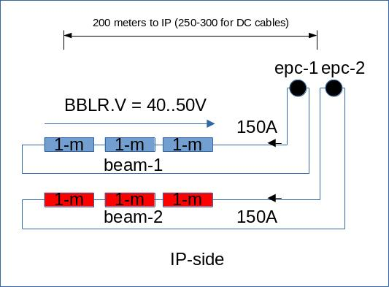
Powering: series recommended
Y. Thurel
~12V/m
@150A, 14Vx3+10V
(voltage drop for cabling)
52V
Bertarelli et. al,
Special Joint HiLumi WP2/WP5 Meeting
22.02.2022

Slide 9
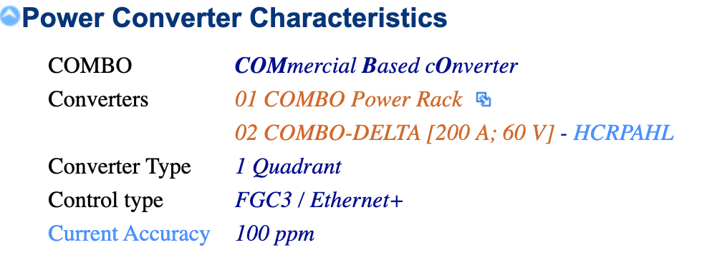
Powering: series recommended
Y. Thurel
@150A, 14Vx3+10V
(voltage drop for cabling)~60V
Ballpark figures:
1 rack with 2 converters of 12 kWatts each ≃ 60 kCHF => 240 kCHF
  (1 rack with 1 converters of 18 kWatts each ≃ 50 kCHF => 400 kCHF)
Cabling expected ≃ 500 kCHF (to be confirmed)

Slide 10
Schedule constraints
Cabling should be ideally implemented in the same campaign as for the rest of HL-LHC (LS3)
  If the power cable have to go in the same core as the RF cables, we should install them before (hybrid solution with bas-bars?) so to minimise impact on RF cables. Thermal studies to be done.
  If HL-LHC chooses to add another core (review in Nov. 2022), time may be more relaxed, but it would be less expensive/more efficient to do it at LS3.

