Slide 1



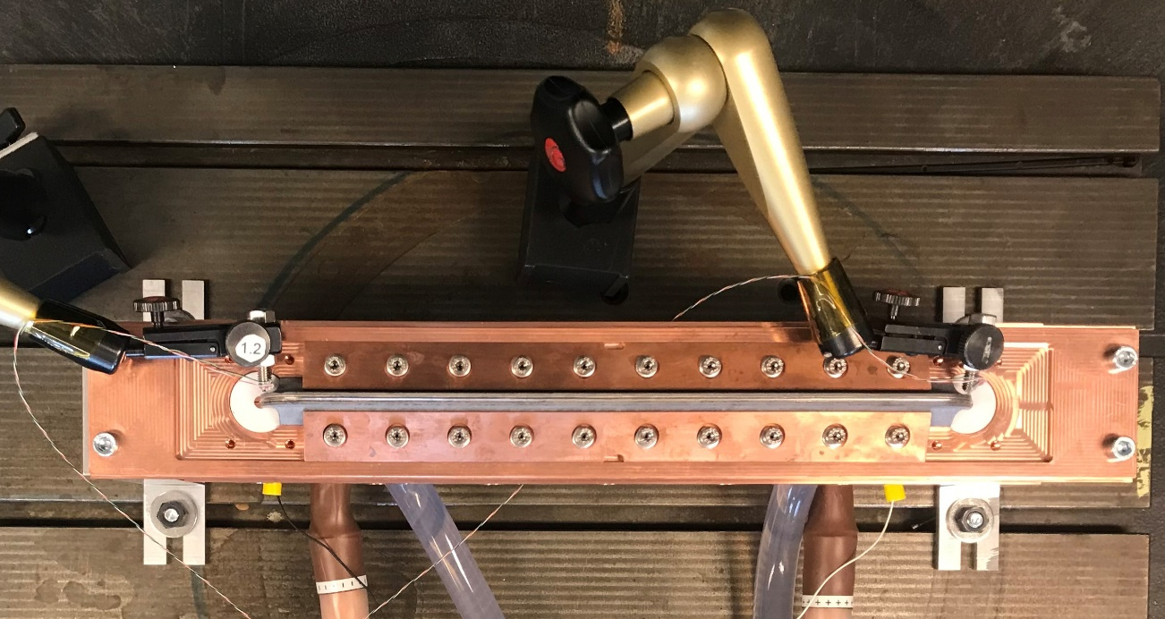
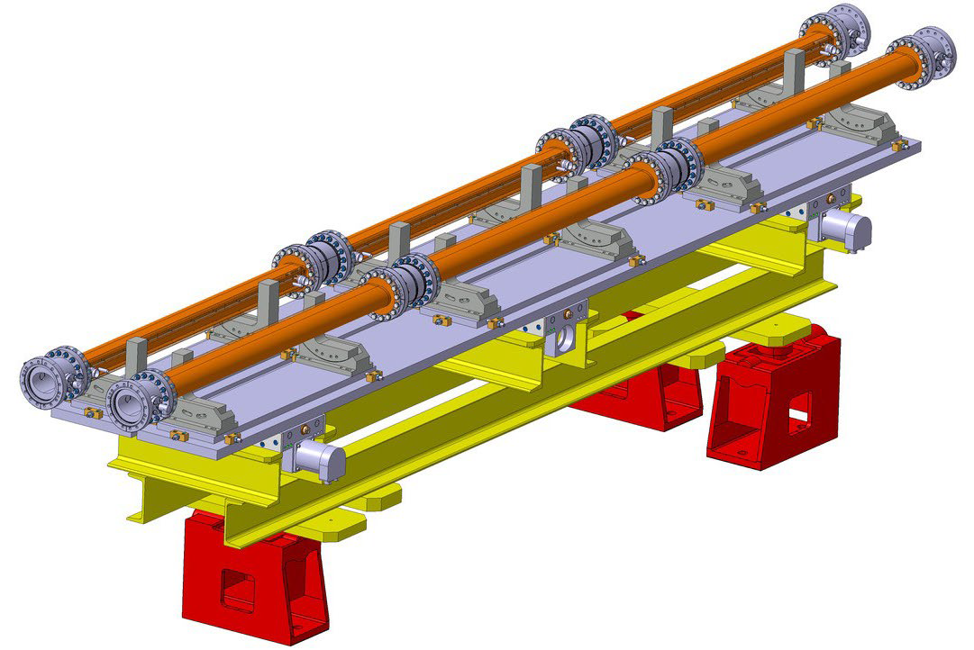
TRIUMF’s contribution to the BBLR Compensation Project
WP2/WP13 HL-LHC Satellite Meeting, Uppsala 2022
Long-Range Beam-Beam Wire
Oliver Kester
Director, Accelerator Division
TRIUMF

Slide 2
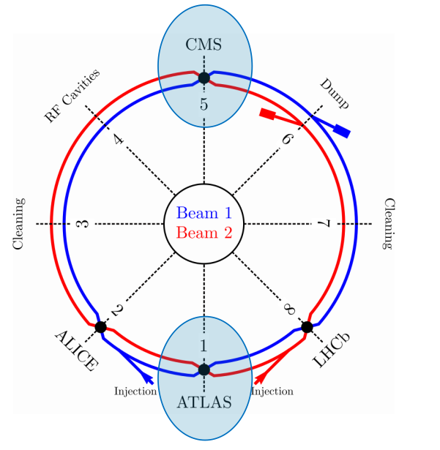
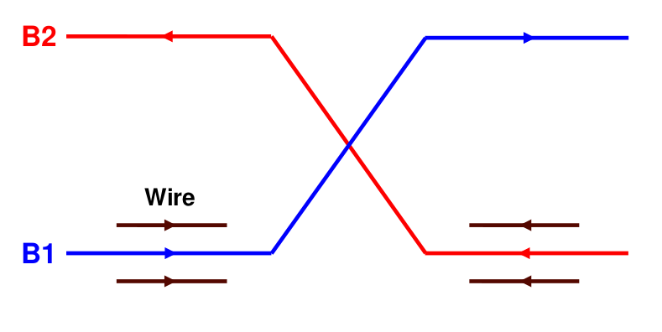
TRIUMF Beam Physics collaboration with CERN
D. Kaltchev and Ph.D. student Philippe Belanger
Wire compensators in collimators both beams
TRIUMF is actively supporting the BBCW project at CERN:
Supporting simulations and the software side of wire operation:
  Implementation of wires in MAD-X, the optics design tool
  used at CERN
  Implementation of wires in CPyMAD, the tracking tool used at CERN
  Alignment of the wires using tune measurements
  Feed-forward system to compensate tune shift introduced by the wire
Machine Development (MD) Studies started at the end of August
→ Supporting the beam test with the embedded wires in the
collimators in Run 3
Data analysis to quantify the effect of the wires on the luminosity production, effective cross section and beam lifetime.
→ Has been discussed by Philippe Belanger.
Notes:
2

Slide 3
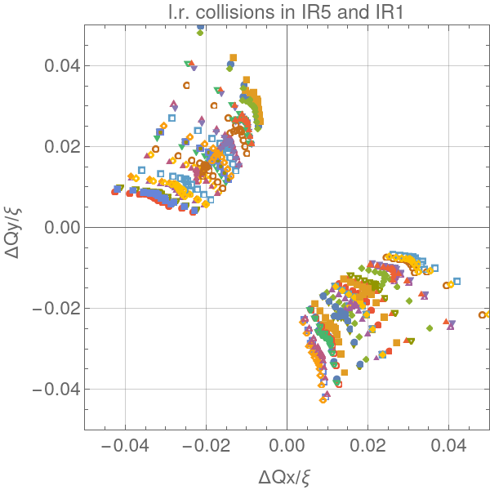
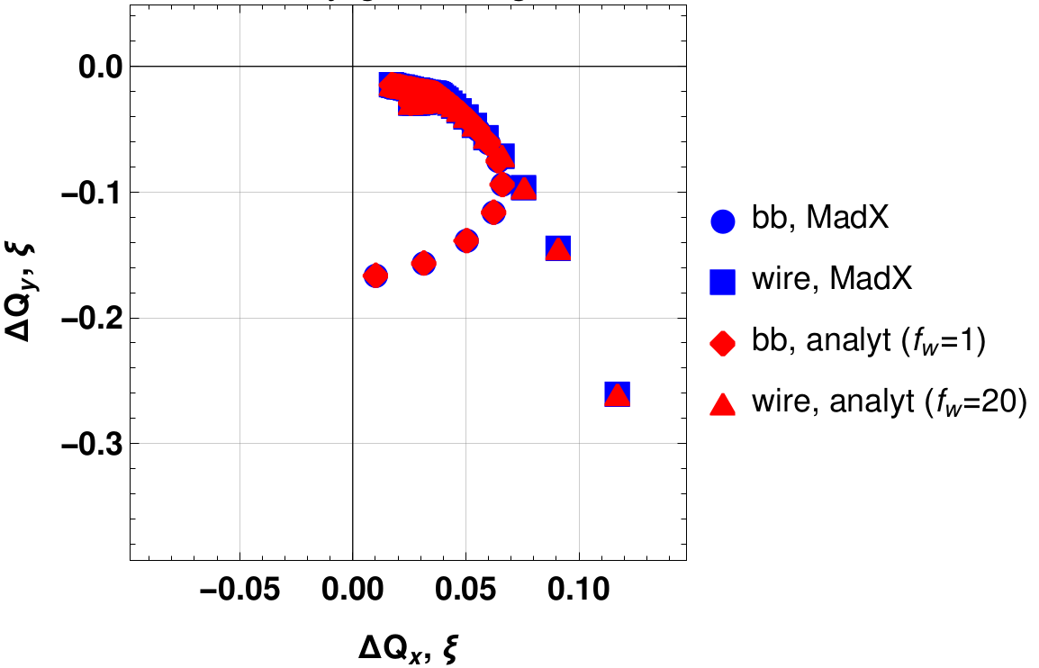
TRIUMF Beam Physics collaboration with CERN
- theoretical description
  Analytic calculation of tune shift and resonance driving terms from BB effects with/without wires
  Generalized expression to compute the resulting footprint
      Formulae using two-dimensional Bessel functions
      Agrees well with equations used in the past
      Can explain both head-on and long-range interactions in
      a unified way.
  Comparison of the resulting footprint with
  MAD-X yields very good agreement.
  Development of Python packages for the
  computation, helping to collaborate and
  add complexity in the future.
Notes:
3

Slide 4
Preparation for the planned wire review in early 2023
Preparing the tools for comprehensive simulation to prepare material for the review
  Analytic calculation of tune shift and resonance driving terms from BB effects with/without wires
  Further benchmarking with MAD-X simulation
Supporting LHC machine development with simulation and data analysis. Data analysis to quantify the effect of the wires on the luminosity production, effective cross section and beam lifetime.
Summarize the wire benefit under different operation scenarios
  Reduction of crossing angle and impact on losses → positive impact on lifetime

Slide 5
Outlook to future involvement of TRIUMF beam physics in HL-LHC
Preparing the tools for comprehensive simulation to prepare material for the review.
  Analytic calculation will allow for faster systematic parameter scans.
  Benchmarking with other codes need to be completed.
Supporting LHC machine development with simulation and data analysis.
  Data analysis to quantify the effect of the wires on the luminosity production, effective cross section and beam lifetime.
  Run octupole studies, also called "wire-as-octupole".
  Demonstrate that the wires allow a reduction of the diffusion of beam particles from the core into the halo!
Need to update and extend the Addendum 1 to the CERN-TRIUMF MoU on beam physics!

Slide 6
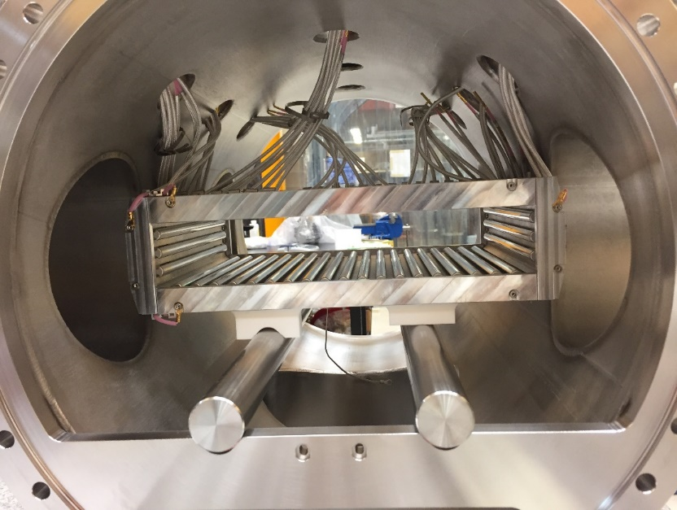
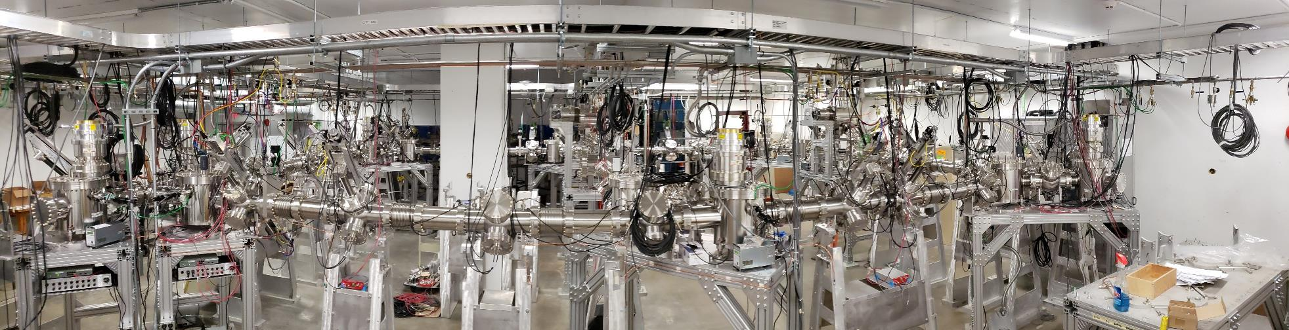
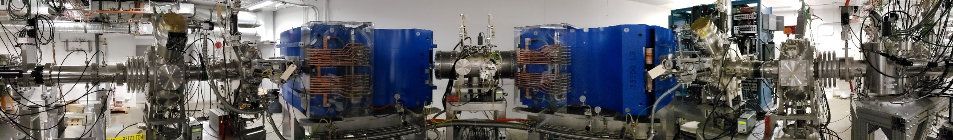
Accelerator Engineering Physics Group at TRIUMF
HRS multipole
Beam optics design (in collaboration with beam dynamics group)
Electrostatic (RIB transport) and magnetic (HRS) elements design
  OPERA® electro-magnetic field calculations
Hardware design, engineering and installation (including alignment) of electrostatic and magnetic beamlines
UHV cleaning and assembly procedure
ARIEL RIB transport system: 200+ m of electrostatic beamlines
High Resolution Separator
TRIUMF & ATLAS Canada seminar - September 21st , 2021

Slide 7
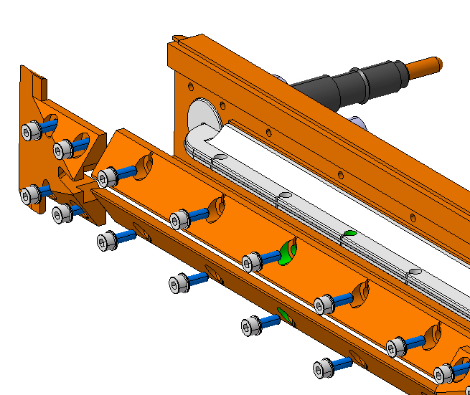
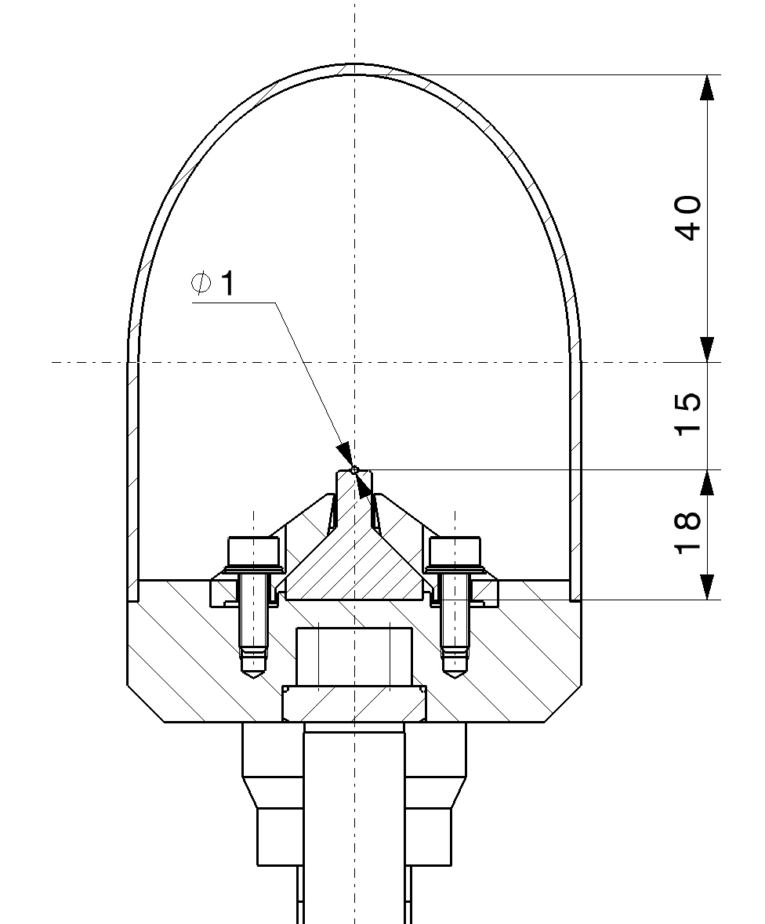
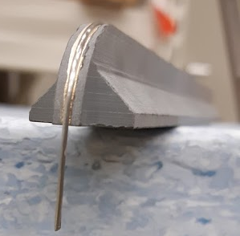
Plans for a full-scale prototype at TRIUMF
Proposal to produce a test system
addressing some engineering
aspects
  Thermo-mechanical characterization
  of AlN to ascertain its properties as a
  function of temperature.
  Current feedthrough and operational parameter.
Vacuum chamber addressing pumping, UHV cleaning, baking, access to the wire etc.)
Want to explore a simple, low-cost, modular design, allowing a certain scalability to the complete module

Slide 8
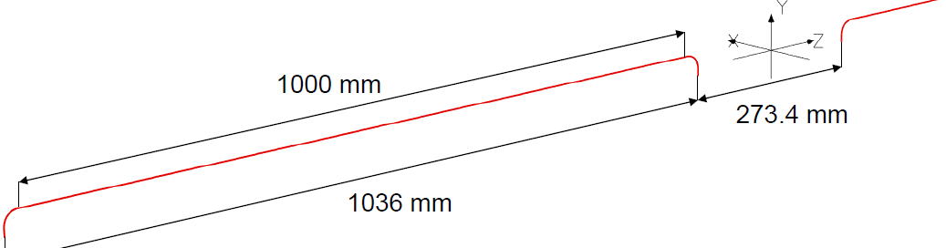
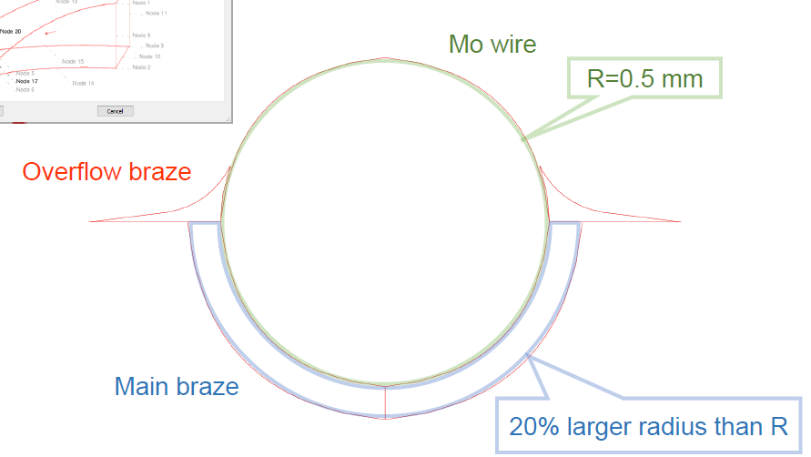
Modelling the magnetic field of the real wire
Baseline configuration with two simple wires (no brazing) modelled first
No material added (assuming
all material are non-magnetic)
Further modelling
based on the
radiographic
image of the brazed
wire.
Used OPERA 20-node brick to
re-create the profile of the brazed
wire in different sections.
See Marco Marchetto’s talk

Slide 9
Further work on prototype wire
Magnetic field mapping (at TRIUMF) of the prototype to be compared with OPERA simulations for different
wire+brazing geometries (OPERA benchmarking)
Work with CERN on possible alternative wire system geometries and vacuum chambers
Explore/developed Canadian knowledge in production methods (brazing, ceramic machining, etc.)

Slide 10
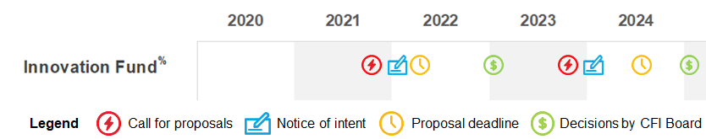
Project proposal to CFI typical timeline
The next call from the Canada Foundation for Innovation (CFI) Innovation Fund (IF) competition is expected in fall 2023.
The typical timeline could be:
Letter of intent (LOI) deadline in early 2024, the full proposal submission deadline in the spring or summer of 2024, and a decision by the CFI Board in early 2025.
The TRIUMF internal project is already defined (P530).
For the LOI the stakeholders – the involved Canadian Universities – need to be informed and fully included in the planning. A project description has to be provided to the lead university. We will again ask Alain Bellerive from Carlton University to be the PI of the wire project.
2022 2023 2024 2025

Slide 11
Plan for CFI project preparation and submission
Stakeholders are scientists from ATLAS Canada, which represent the universities that need to provide part of their contingent for CFI proposals.
Important for a success in the next round is the completion of the wire review, demonstration of the benefit of wires with simulations, then benchmarked by measurements with the prototype wires.
→ can we demonstrate that the diffusion of particles from the beam
core to the halo can be reduced?
Clear scope definition and project budget and get the CERN agreement on the installation of the systems in LHC!
This can be counted to be the required 60% of the whole project that must be provided by external (to Canada) partners.
Discussion about the overall budget (~$10M) including the power supplies

Slide 12
Why do I believe in the wires?
Right approach to simulate another beam and compensate the effect of interaction!
Reduced diffusion of particles from the core to the halo
→ reduced losses more particles be available for collisions
→ reduced activation
→ better and longer use of the particles of one filling (efficiency in terms of energy
costs for accelerator operation).
Allows for a reduced crossing angle even without crab cavities → reduced irradiation of equipment and lower background for experiments
Simple systems with high impact.

Slide 13




Thank you
Merci
www.triumf.ca
Follow us @TRIUMFLab

