Slide 1
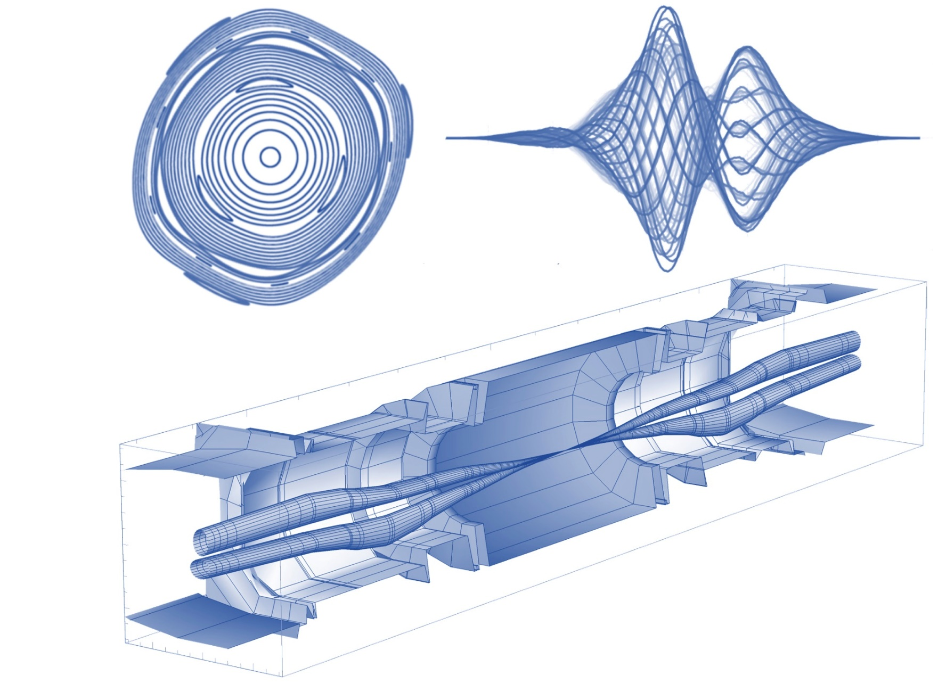
BBLRC
(Beam-Beam Long Range Compensator)
Preliminary Impedance Study
Leonardo Sito (impedance analysis)
and Lorenzo Giacomel (transverse stability analysis)
Replaced by B. Salvant
Special thanks to Alessandro Bertarelli, Federico Carra, Luca Gentini, Sebastien Joly, Nicolas Mounet, Guido Sterbini, Carlo Zannini.
BBLRC

Slide 2
Introduction to the BBLRC
Positioning and Mechanical Description
The need for an Impedance Study
Simulated model
Longitudinal Impedance Study:
  Matching the wire termination
  Dissipated Power
  Impact of the dielectric support
Transverse Impedance Study
Conclusions
Outline

Slide 3
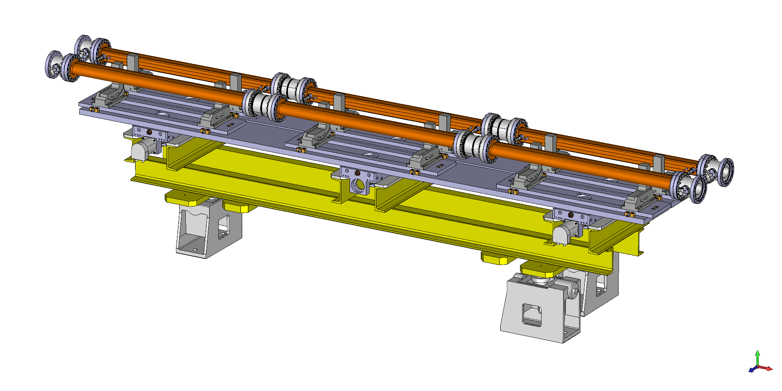
Introduction:
What is the electromagnetic impact of the BBLRC?
High Luminosity LHC significant impact of the Beam-Beam Long Range (BBLR) interactions.
To compensate for the BBLR effects: wire carrying a DC currents that can be moved with respect to the beam.
One proposed device is the DC wire Beam Beam Long Range Compensator (BBLRC).
BBLRC Unit

Slide 4
Introduction to the BBLRC
Positioning and Mechanical Description
The need for an Impedance Study
Simulated model
Longitudinal Impedance Study:
  Matching the wire termination
  Dissipated Power
  Impact of the dielectric support
Transverse Impedance Study
Conclusions
Outline

Slide 5
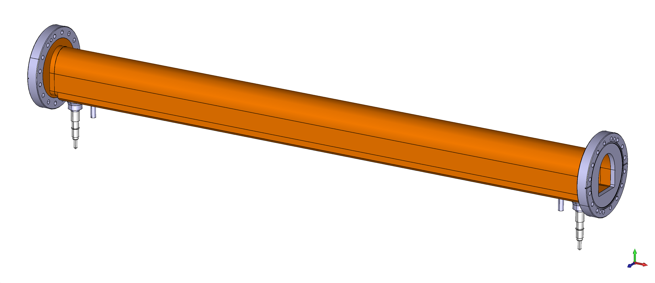
Mechanical Description and Positioning
Note: The design is being updated.
The taperings are going to be extended. The AlN support is going to be lower.
Notes:
This is one module (of the six present in a unit) of the BBLRC.
The module is 1.2m long and is composed of an outer shell made of Copper connected to Stainless Steel flanges.

Slide 6
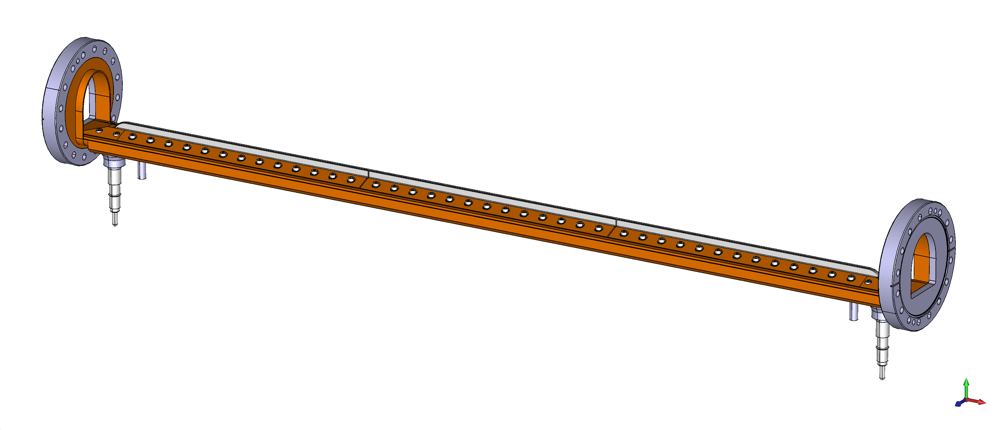

Positioning and Mechanical Description
$1mm$ Diameter
$1m$ Long
$150A/m$ DC current
Molybdenum wire
Aluminum Nitride support divided in three sections:
Support mechanically the wire.
Enables better heat dissipation.
Note: The design is being updated.
The taperings are going to be extended. The AlN support is going to be lower.
Notes:
Inside:
Molybdenum wire 1m long (1m refers to the active length, the length of the straight portion, not considering the bendings).
It is 1mm in diameter and has to carry a DC current of 150 A/m.
It is sustained by an Aluminum Nitride support, specifically chosen for being an electrical insulator with a good thermal conductibility to get rid of the heating of the wire (we are talking about 2.1 kW). Specifically, there is a cooling channel underneath the support.
The support Is fixed into place with a Copper structure fastened with Stainless Steel bolts.

Slide 7
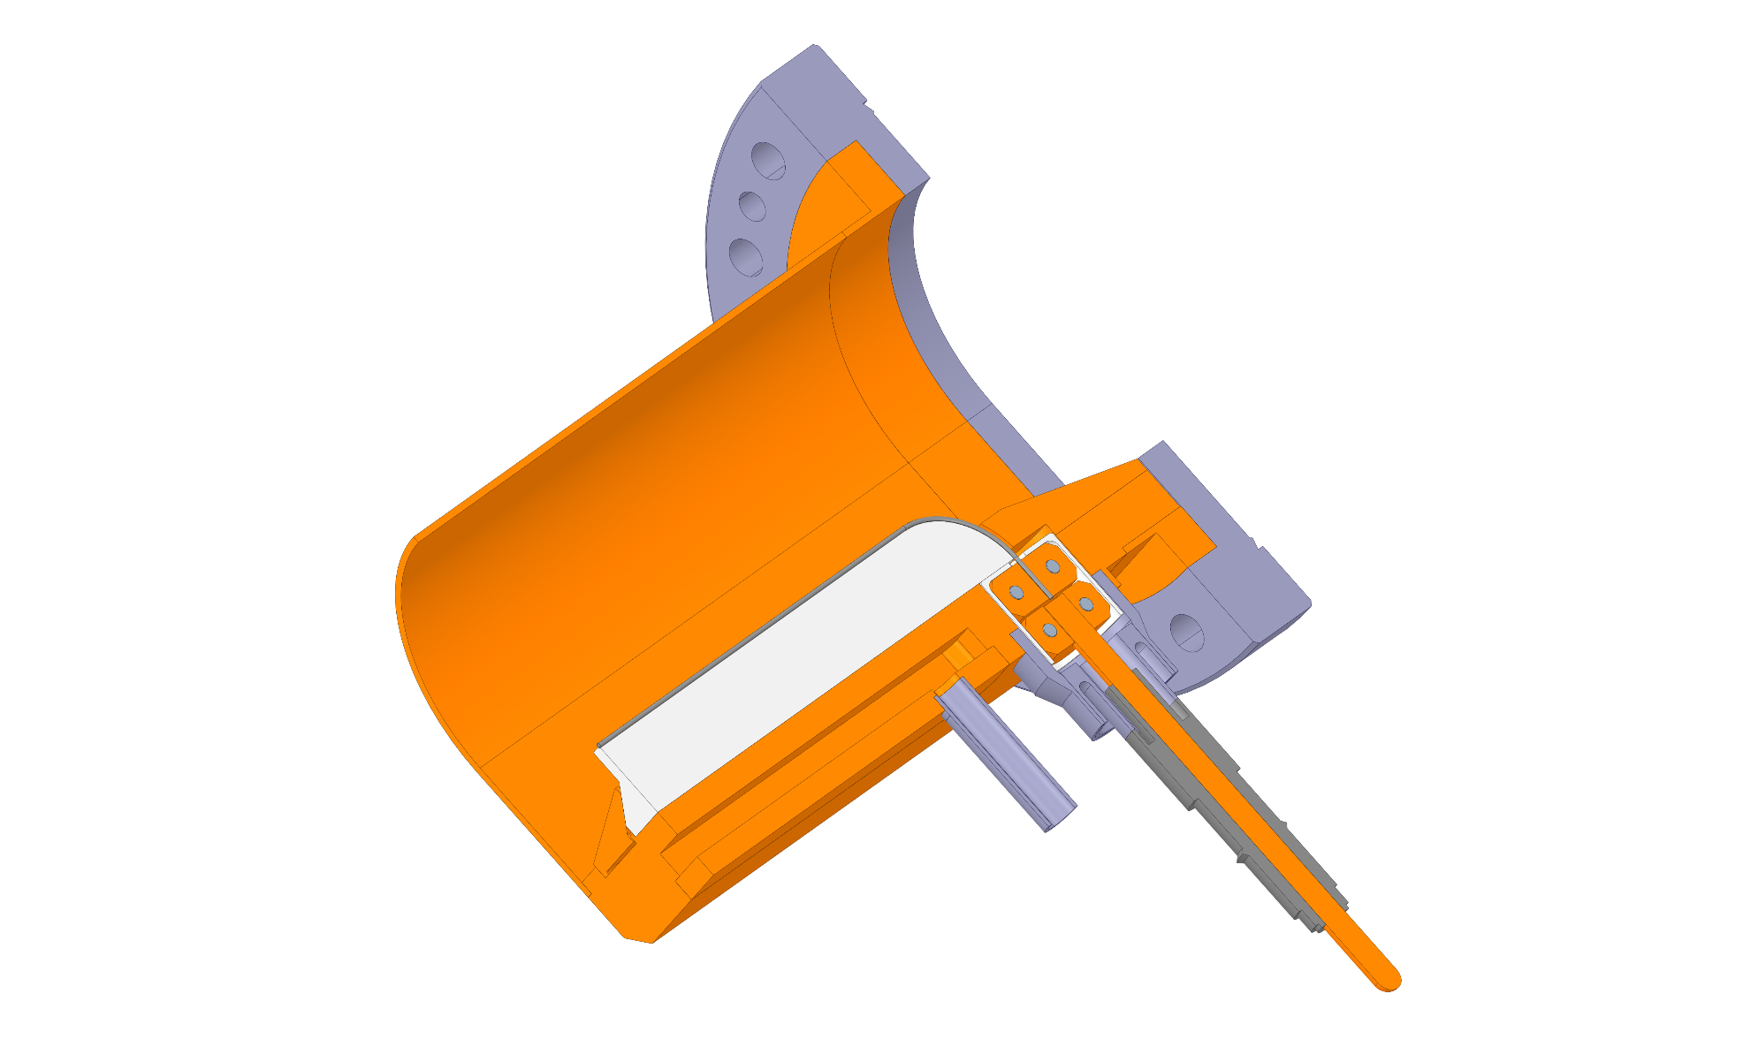
Positioning and Mechanical Description
Molybdenum Wire ø: 1mm
Aluminum Nitride Support
Feedthrough
Cooling Channel
Notes:
In this cross section it is possible to see:
Show cooling channel.
Show commercial Feedthrough and clamping mechanism for the driving of the wire.

Slide 8
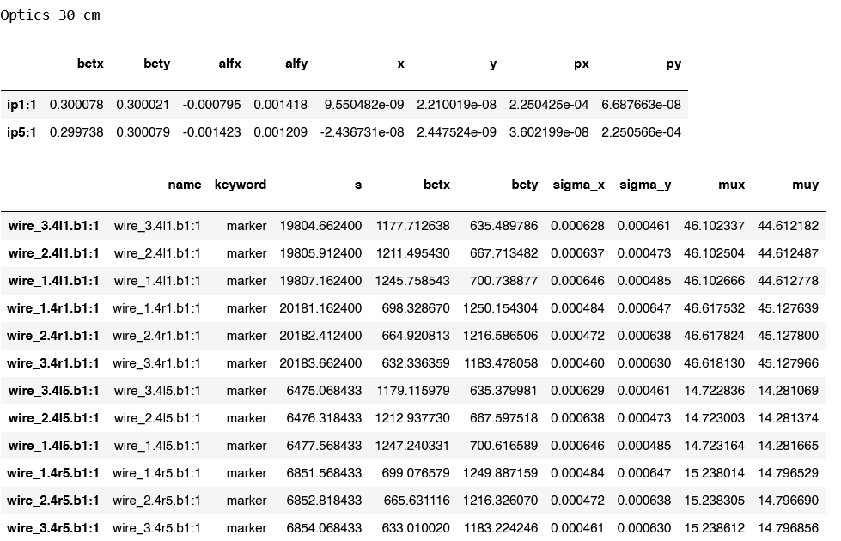
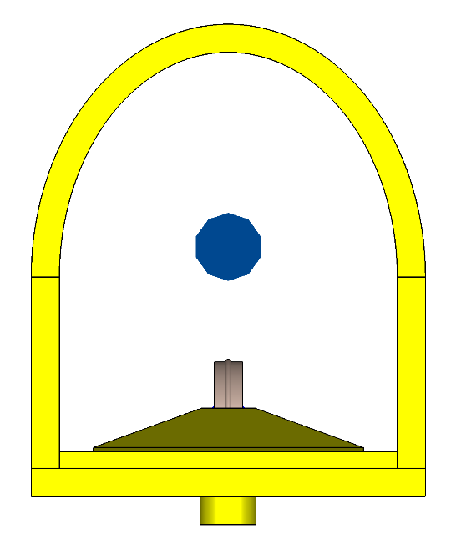

Positioning and Mechanical Description
Positioning:
4L1B1, 4L5B1
4R1B2, 4R5B2
Two optics: 30cm and 20cm.
Courtesy of Guido Sterbini:
Span of movement (of the beam’s position in respect to the wire): roughly estimated to be: [4.73 mm to 15.6 mm]
$$15mm$$

Slide 9
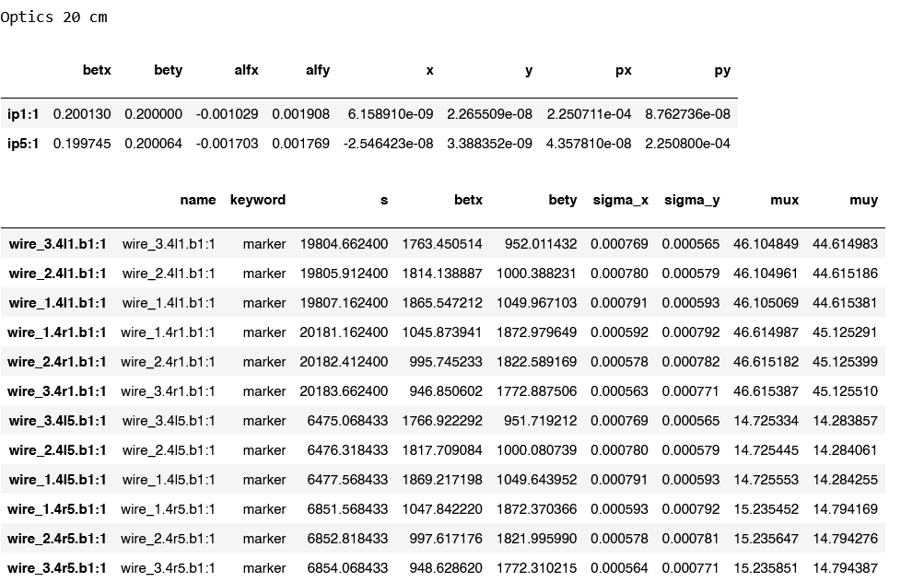
Positioning and Mechanical Description
Positioning:
4L1B1, 4L5B1
4R1B2, 4R5B2
Two optics: 20cm and 30cm.
Courtesy of Guido Sterbini:
Span of movement (of the beam’s position in respect to the wire): roughly estimated to be: [4.73 mm to 15.6 mm]
$$15mm$$

Slide 10
Introduction to the BBLRC
Positioning and Mechanical Description
The need for an Impedance Study
Simulated model
Longitudinal Impedance Study:
  Matching the wire termination
  Dissipated Power
  Impact of the dielectric support
Transverse Impedance Study
Conclusions
Outline

Slide 11

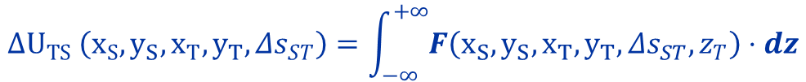






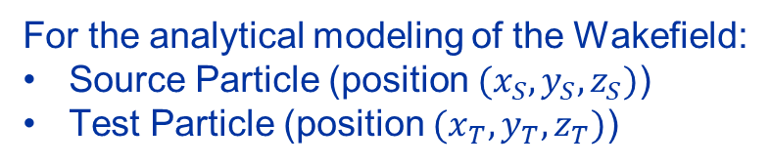

The need for an Impedance Study
$$y$$
For the analytical modeling of the Wakefield:
Source Particle (position $(x_{S},y_{S},z_{S})$)
Test Particle (position $(x_{T},y_{T},z_{T})$)
$$x$$
$$Δs_{ST}$$
$$q_{T}$$
$$O$$
$$z$$
$$q_{s}$$
$$z$$
Energy loss/gained by a test charge behind a source charge:
$$ΔU_{TS} \left(x_{S}, y_{S},x_{T},y_{T},Δs_{ST}\right)=\int_{−∞}^{+∞}{F\left(x_{S}, y_{S},x_{T},y_{T},Δs_{ST},z_{T}\right)⋅dz}$$
Longitudinal Wake Function:
$$w_{z} \left(x_{S}, y_{S},x_{T},y_{T},Δs_{ST}\right)=\frac{ΔU_{TS} \left(x_{S}, y_{S},x_{T},y_{T},Δs_{ST}\right)}{q_{S}q_{T}}=\frac{1}{q_{S}q_{T}}\int_{−∞}^{+∞}{F_{z}\left(x_{S}, y_{S},x_{T},y_{T},Δs_{ST},z_{T}\right)dz}$$

Slide 12

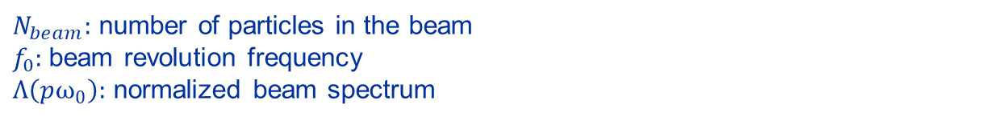
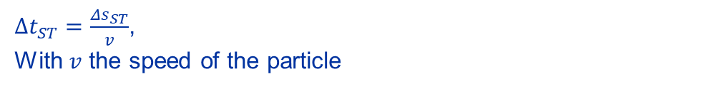
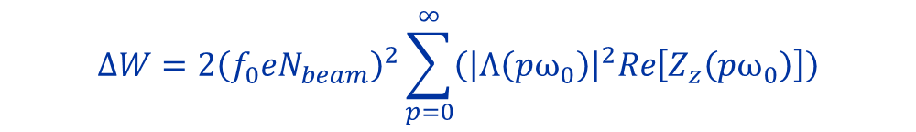
The need for an Impedance Study
The Longitudinal Wake Impedance is the Fourier Transform of the longitudinal Wake Function.
$$Z_{z}(ω) =\int_{−∞}^{+∞}{w_{z}\left(Δt_{ST}\right)e^{−jωΔt_{ST}}d(Δt_{ST})}$$
$Δt_{ST}=\frac{Δs_{ST}}{v}$,
With $v$ the speed of the particle
Advantages:
Easier to consider resonant modes of the structure.
Convenient analytical expression of the dissipated power.
Modeling of instabilities due to impedance.
$$ΔW=2{\left(f_{0}eN_{beam}\right)}^{2}\sum_{p=0}^{∞}{\left({\left|Λ\left(pω_{0}\right)\right|}^{2}Re\left[Z_{z}\left(pω_{0}\right)\right]\right)}$$
$N_{beam}:$ number of particles in the beam
$f_{0}:$beam revolution frequency
$Λ\left(pω_{0}\right):$ normalized beam spectrum

Slide 13
Introduction to the BBLRC
Positioning and Mechanical Description
The need for an Impedance Study
Simulated model
Longitudinal Impedance Study:
  Matching the wire termination
  Dissipated Power
  Impact of the dielectric support
Transverse Impedance Study
Conclusions
Outline

Slide 14
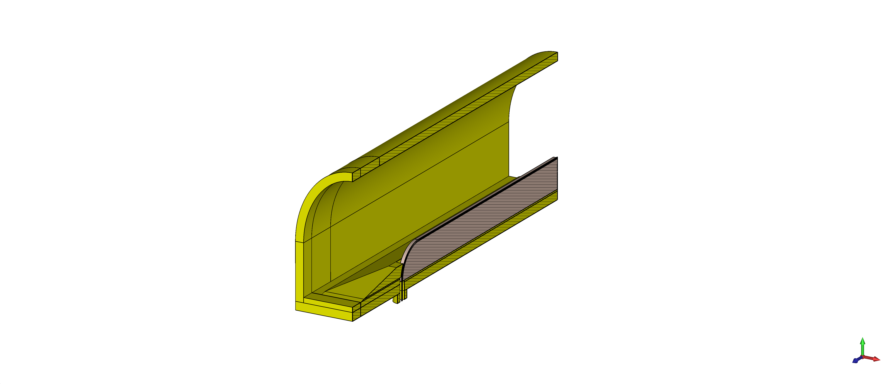
The BBLRC – single module: simplified
Simplified Model:
Model main features:
No small bendings.
No division of the AlN blocks.
No Stainless-Steel flanges.
No Stainless-Steel bolts..
No Cooling channel.
Thicker Shell.
Coaxial Structure.

Slide 15
The BBLRC – single module: simplified
Simplified Model:
Model main features:
No small bendings.
No division of the AlN blocks.
No Stainless-Steel flanges.
No Stainless-Steel bolts..
No Cooling channel.
Thicker Shell.
Coaxial Structure.

Slide 16
Introduction to the BBLRC
Positioning and Mechanical Description
The need for an Impedance Study
Simulated model
Longitudinal Impedance Study:
  Matching the wire termination
  Dissipated Power
  Impact of the dielectric support
Transverse Impedance Study
Conclusions
Outline

Slide 17

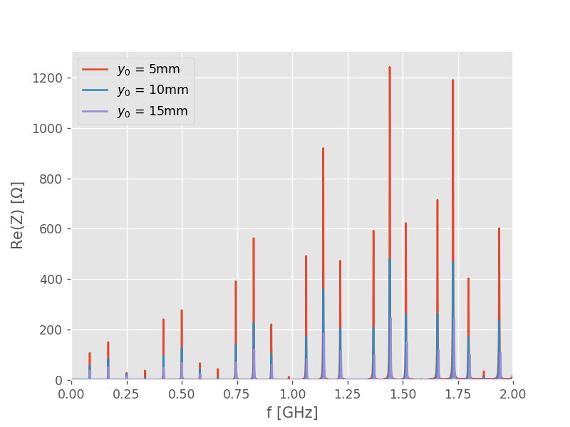
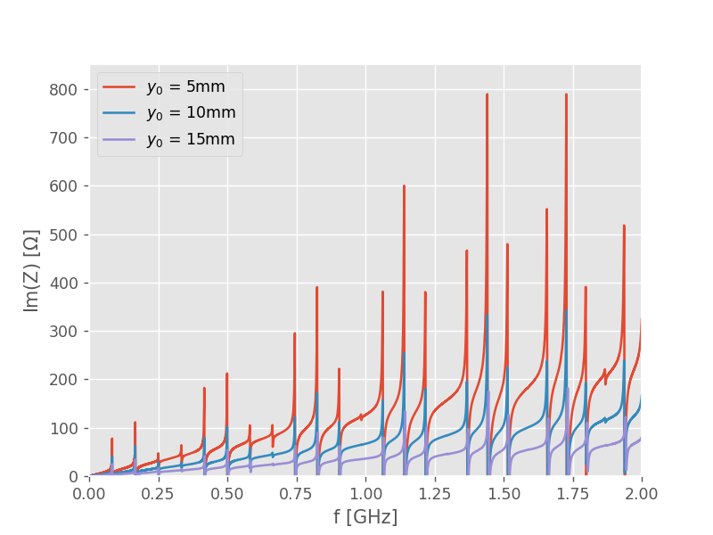

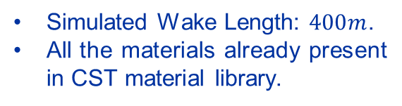





Longitudinal Beam Coupling Impedance
Three configurations of the beam in respect to the wire considered.
$$15mm$$
$$y_{0}$$
$$10mm$$
$$y_{0}$$
$$5mm$$
$$y_{0}$$
Simulated Wake Length: $400m$.
All the materials already present in CST material library.

Slide 18
Introduction to the BBLRC
Positioning and Mechanical Description
The need for an Impedance Study
Simulated model
Longitudinal Impedance Study:
  Matching the wire termination
  Dissipated Power
  Impact of the dielectric support
Transverse Impedance Study
Conclusions
Outline

Slide 19
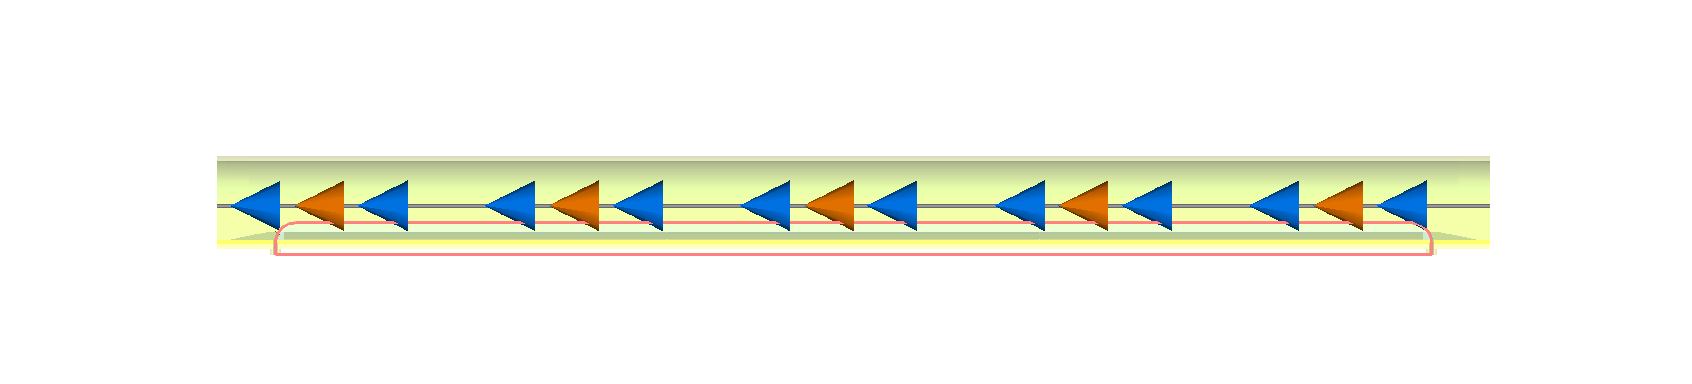
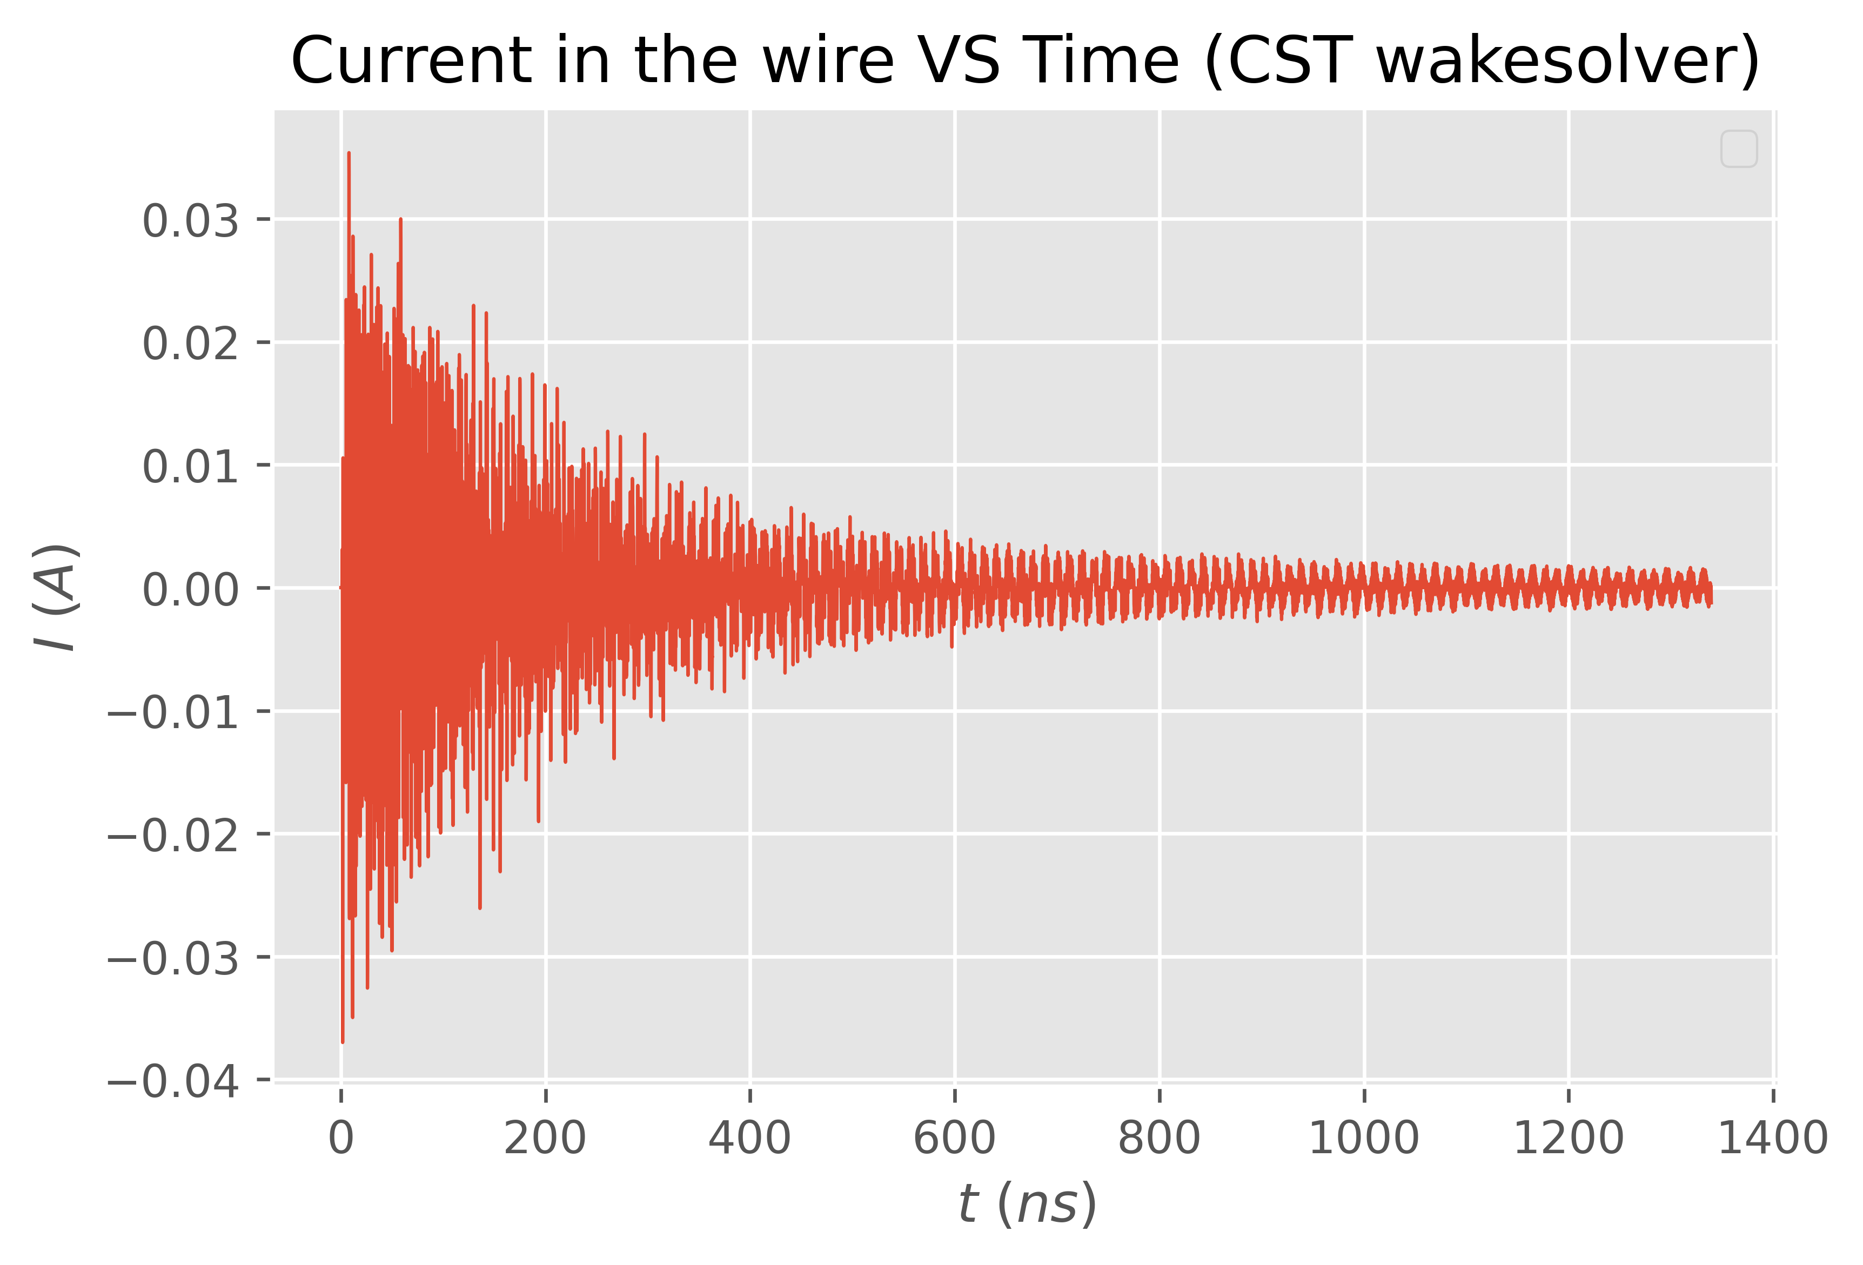
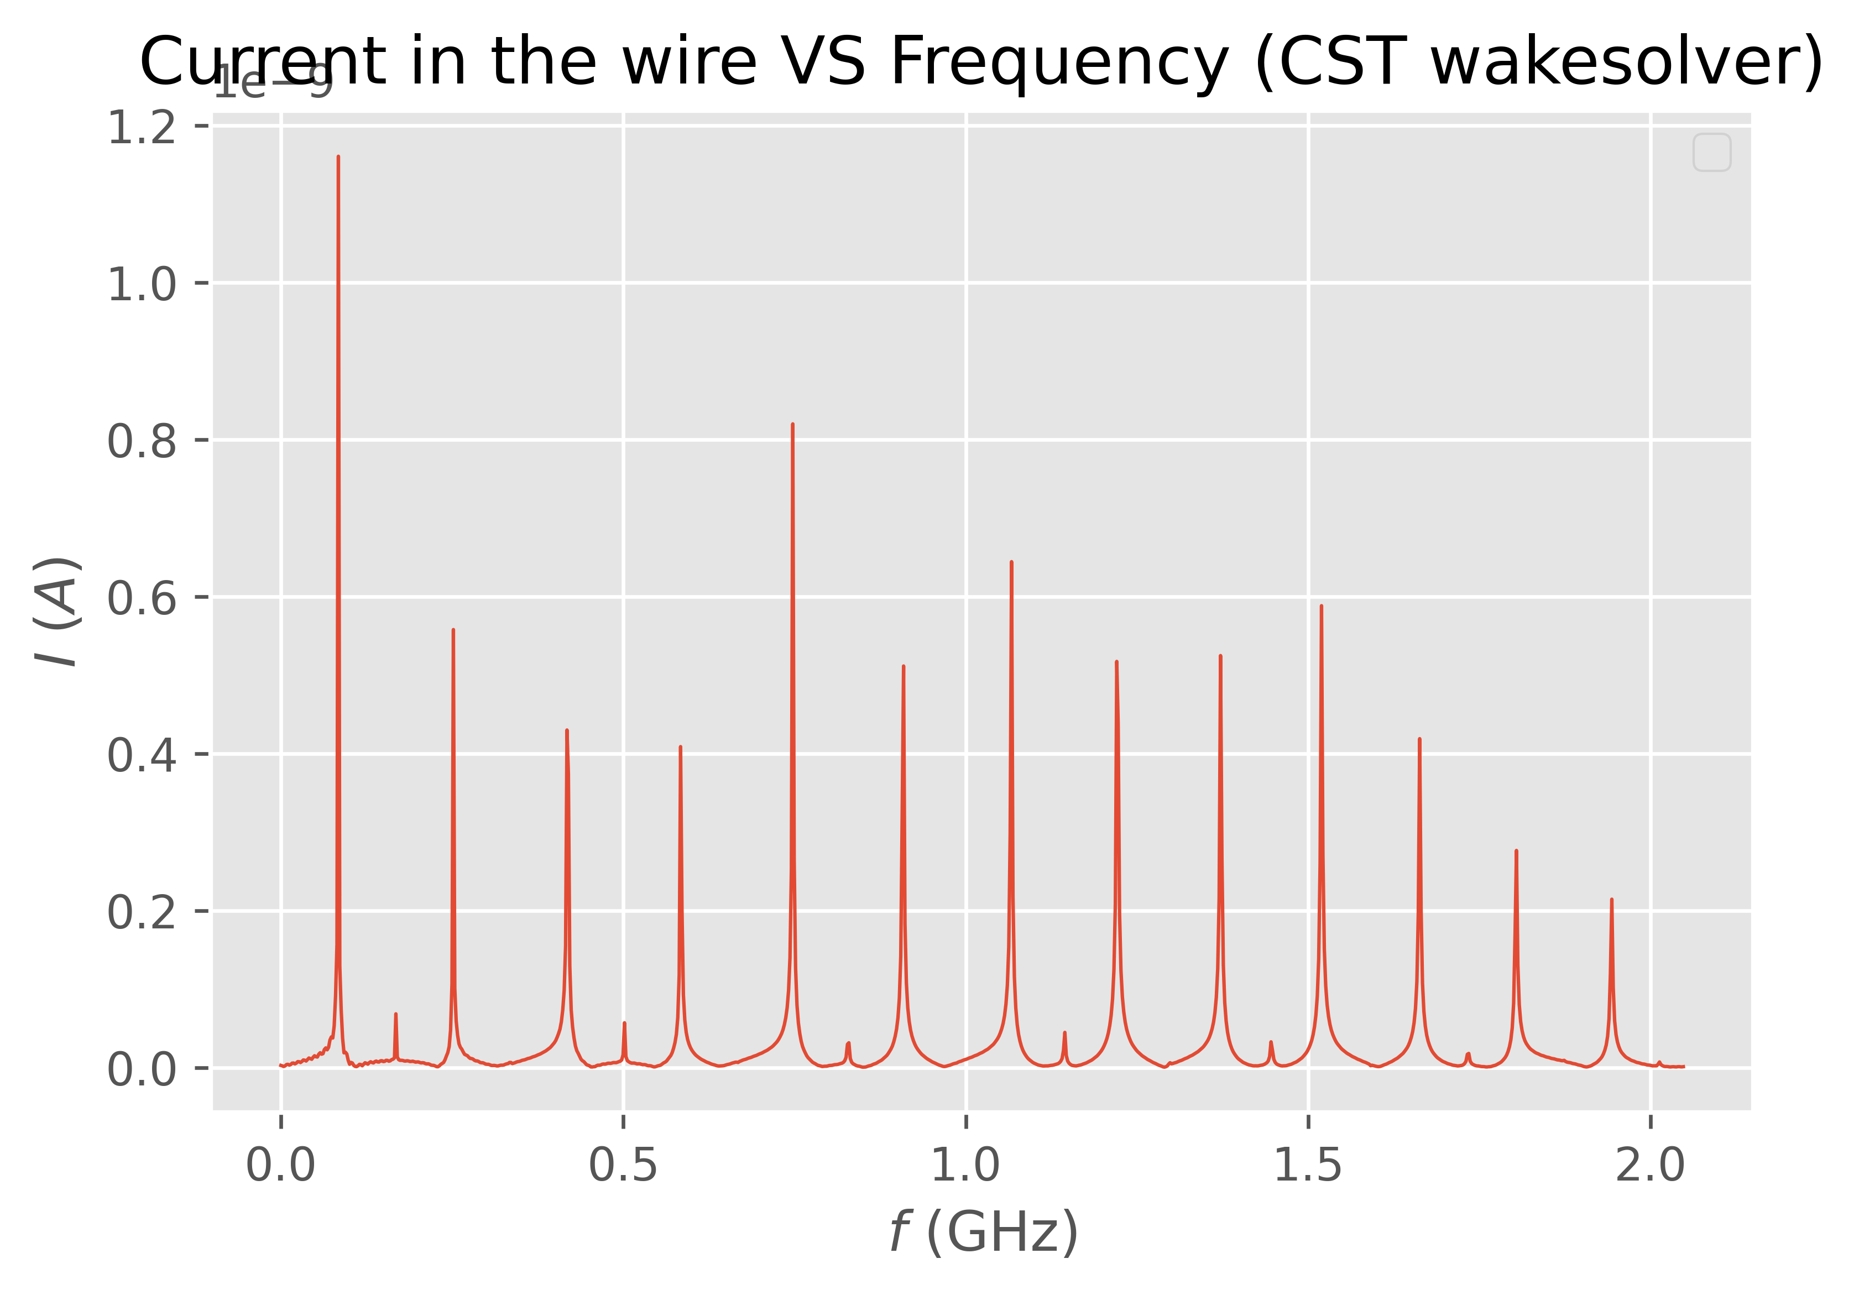
Longitudinal Beam Coupling Impedance
Termination of the wire is important for impedance
Beam Position Monitors such as Striplines are designed with perfect matching to optimize signal extraction.
No attention to the termination of the wire for RF.
To go more in depth: Currents in the wire.
Beam
Current’s path

Slide 20

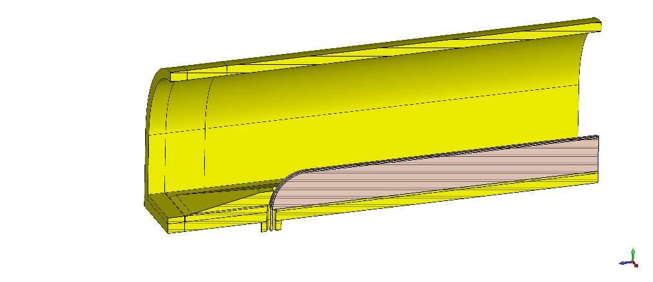
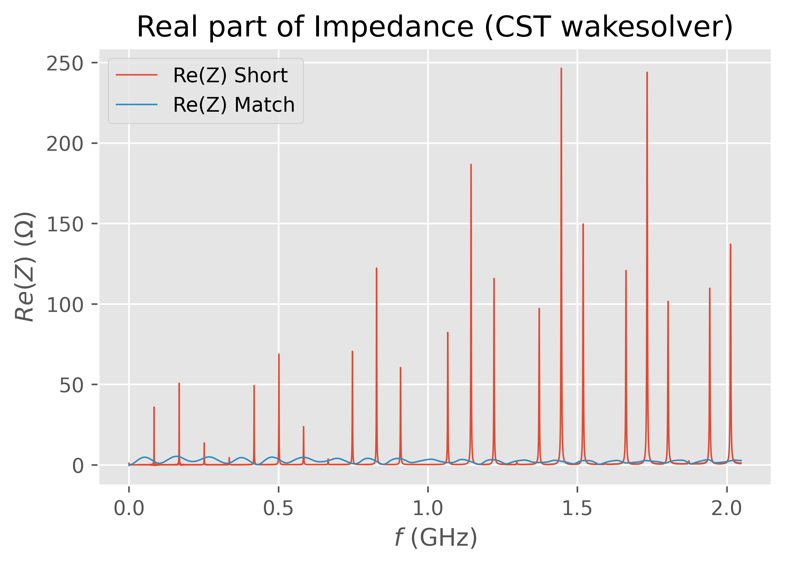
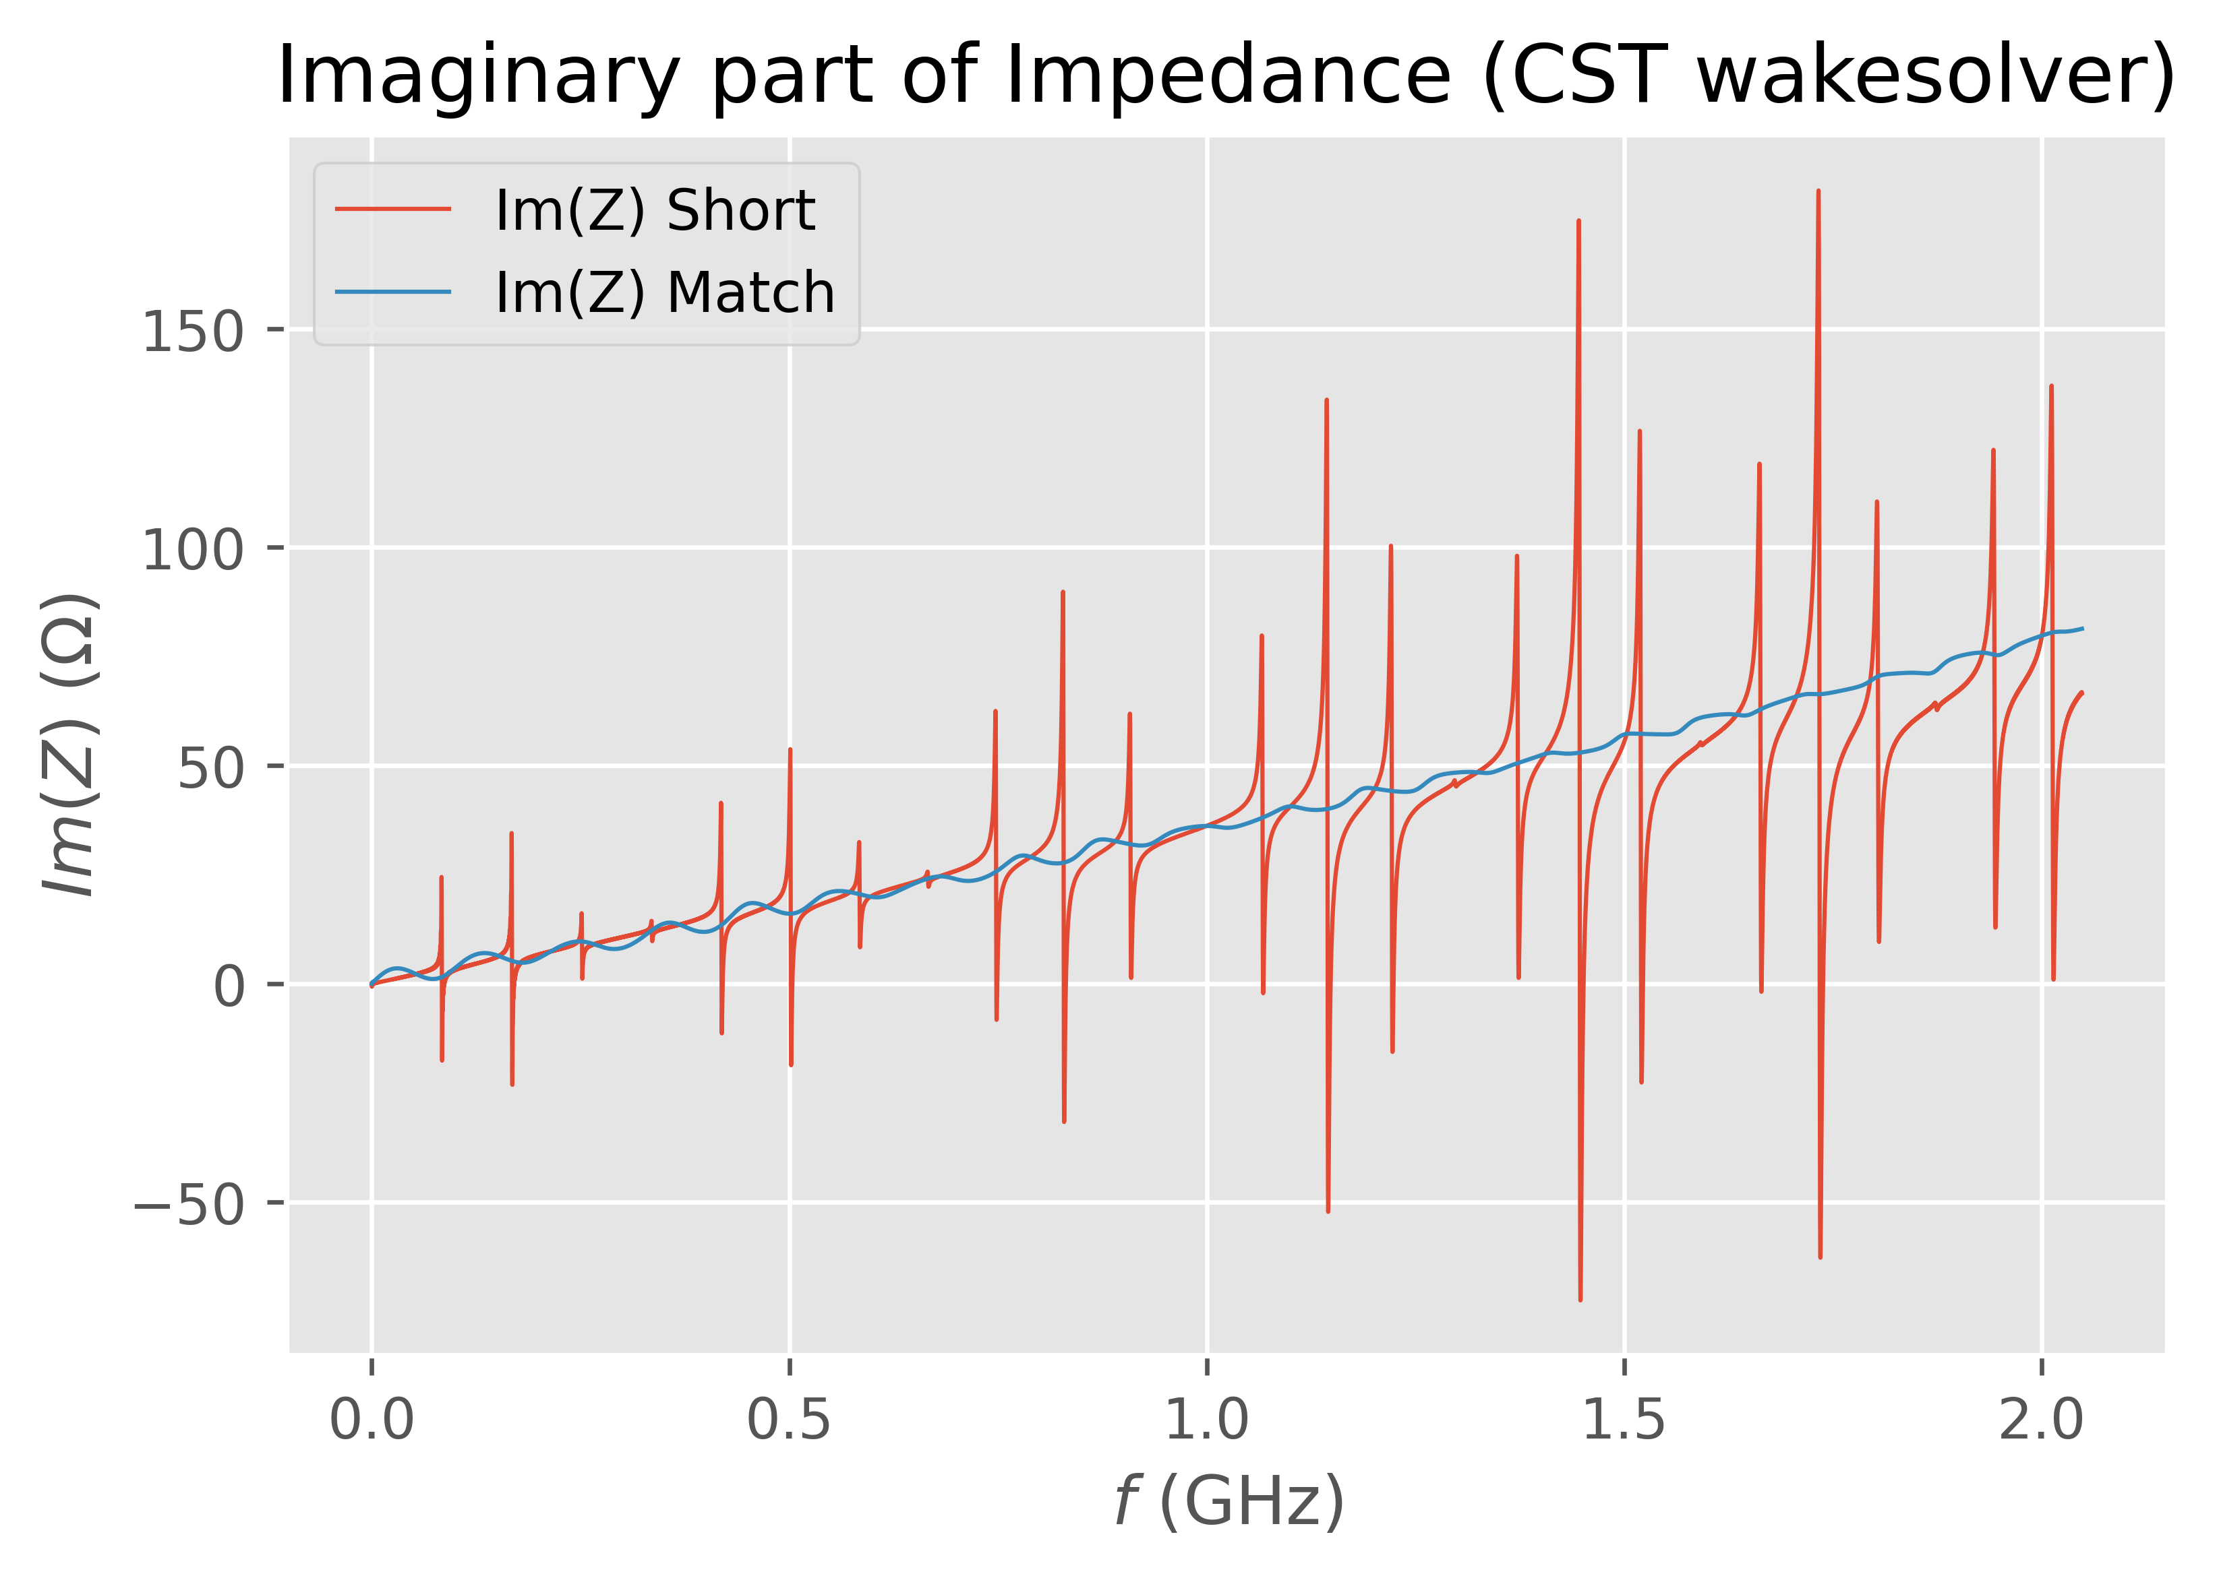
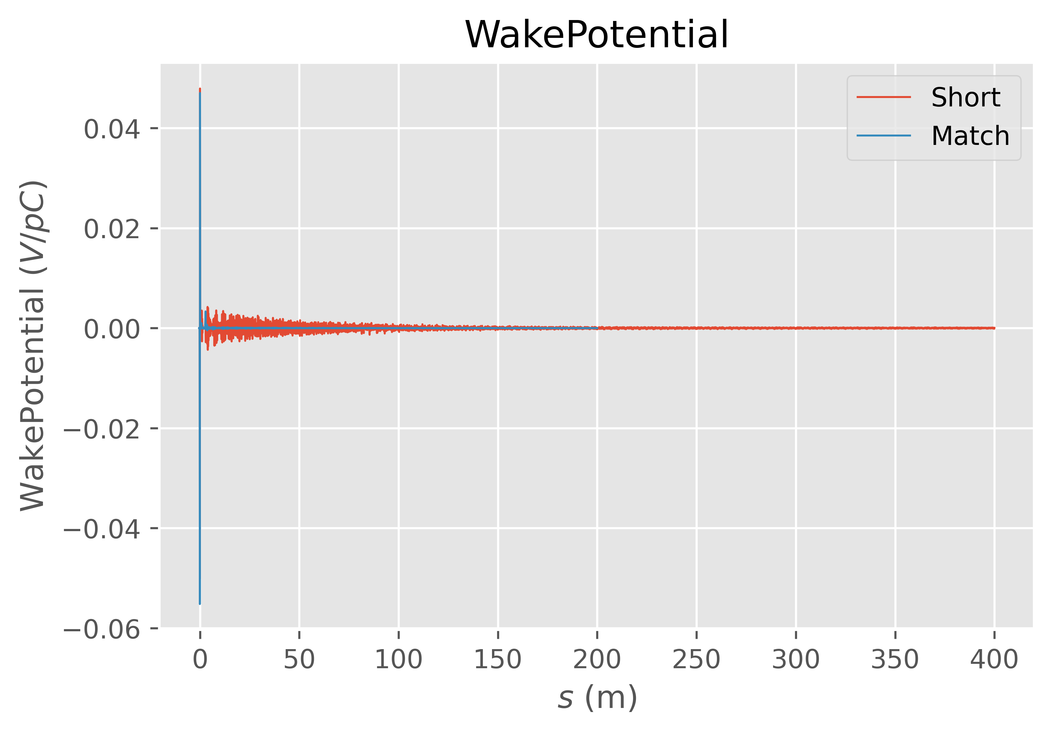


Longitudinal Beam Coupling Impedance
From an Impedance point of view the situation changes drastically if the Coaxial termination is closed on a load.
$$15mm$$
$$y_{0}$$

Slide 21
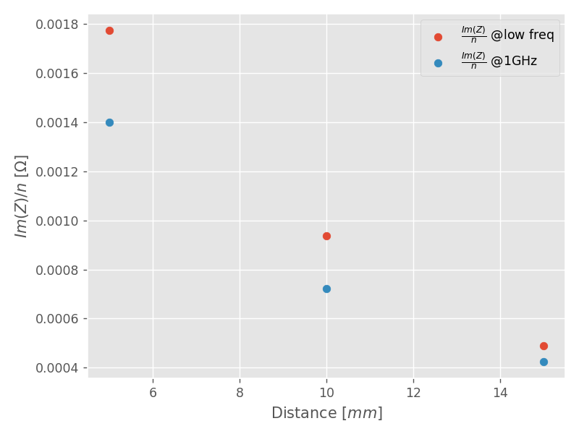
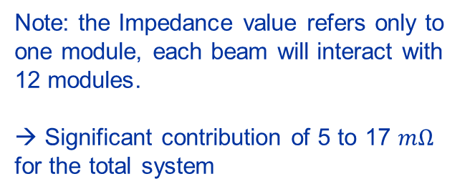
Effective Longitudinal Impedance
Impact of the beam position on the Longitudinal Effective Impedance: $\frac{Im (Z)}{n}$, $n= \frac{f}{f_{rev}}$
LHC Effective Impedance ~$90 mΩ$
Note: the Impedance value refers only to one module, each beam will interact with 12 modules.
→ Significant contribution of 5 to 17 $mΩ$ for the total system

Slide 22
Introduction to the BBLRC
Positioning and Mechanical Description
The need for an Impedance Study
Simulated model
Longitudinal Impedance Study:
  Matching the wire termination
  Dissipated Power
  Impact of the dielectric support
Transverse Impedance Study
Conclusions
Outline

Slide 23
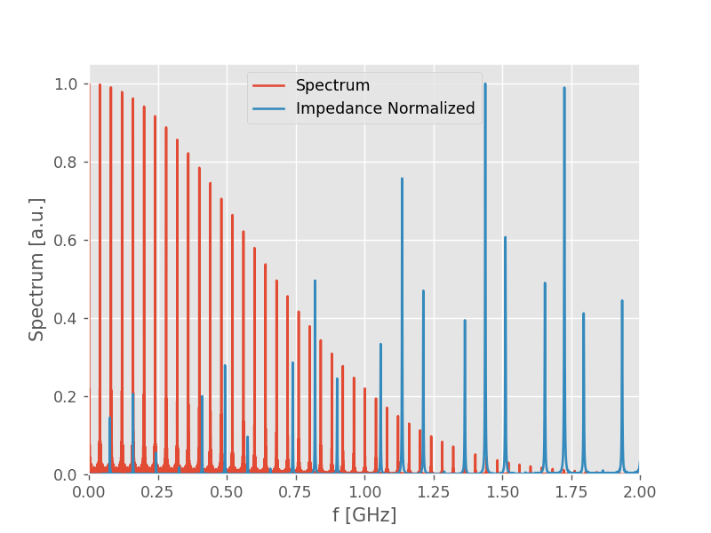
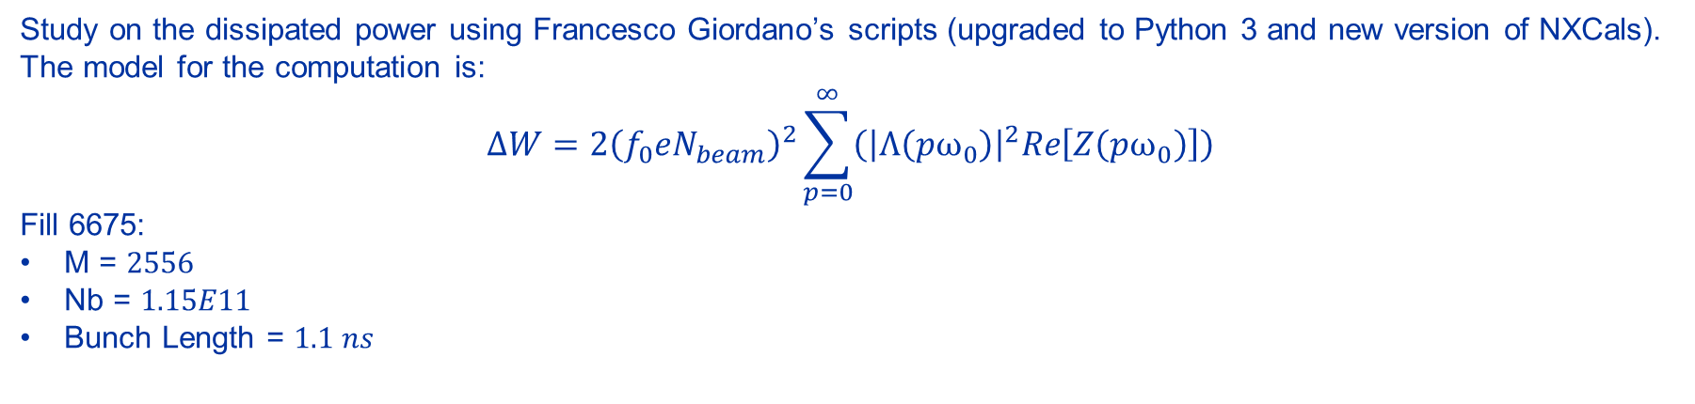
Dissipated Power
Study on the dissipated power using Francesco Giordano’s scripts (upgraded to Python 3 and new version of NXCals).
The model for the computation is:
$$ΔW=2{\left(f_{0}eN_{beam}\right)}^{2}\sum_{p=0}^{∞}{\left({\left|Λ\left(pω_{0}\right)\right|}^{2}Re\left[Z\left(pω_{0}\right)\right]\right)}$$
Fill 6675:
M = $2556$
Nb = $1.15E11$
Bunch Length = $1.1 ns$
But as it is:
Too much dependency on the Fill Spectrum.
The peak frequency can be not precise.
How to deal with this:
Randomly Shift the peaks.

Slide 24


Dissipated Power
$$15mm$$
$$y_{0}$$
Shifting rigidly the Impedance peaks we have a worst-case scenario:
FILL 6675 | Dissipated Power [W]
Matched termination | 30.16 W
Not Matched, No statistical analysis | 2.58 W
Not Matched, Random Shift, Max | 31.40 W
Not Matched, Random Shift Mean | 7.87 W
Changing the design to avoid reflections of the signal could be beneficial.
HL-LHC → need to multiply these numbers by a factor (2.3/1.15)²=4 (at the beginning of the fill)

Slide 25
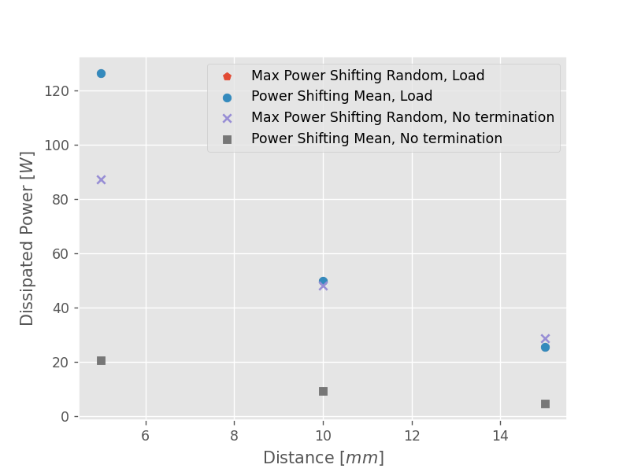
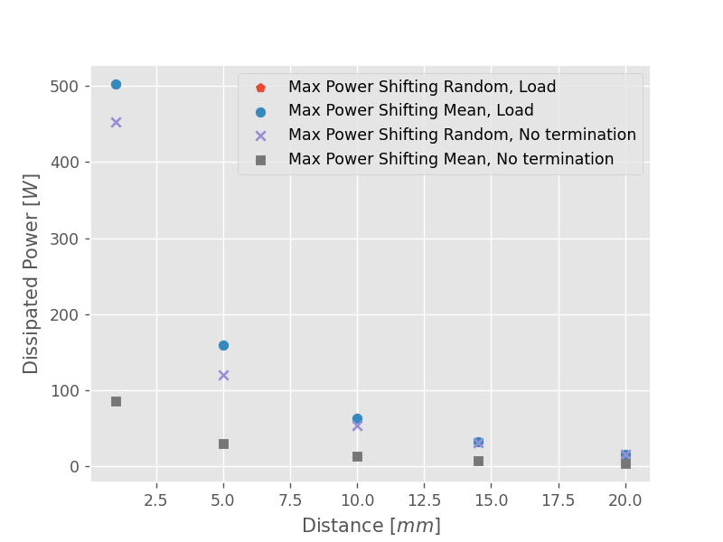
Dissipated Power
The dissipated power is growing when going closer to the wire.

Slide 26
Introduction to the BBLRC
Positioning and Mechanical Description
The need for an Impedance Study
Simulated model
Longitudinal Impedance Study:
  Matching the wire termination
  Dissipated Power
  Impact of the dielectric support
Transverse Impedance Study
Conclusions
Outline

Slide 27
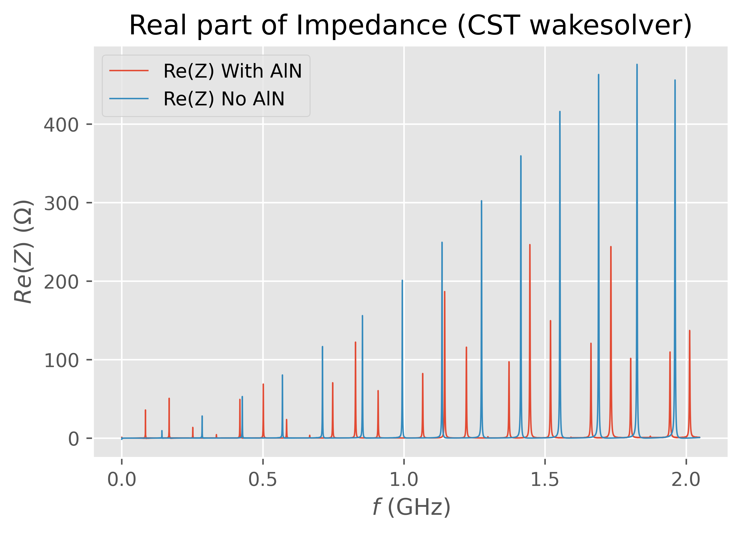
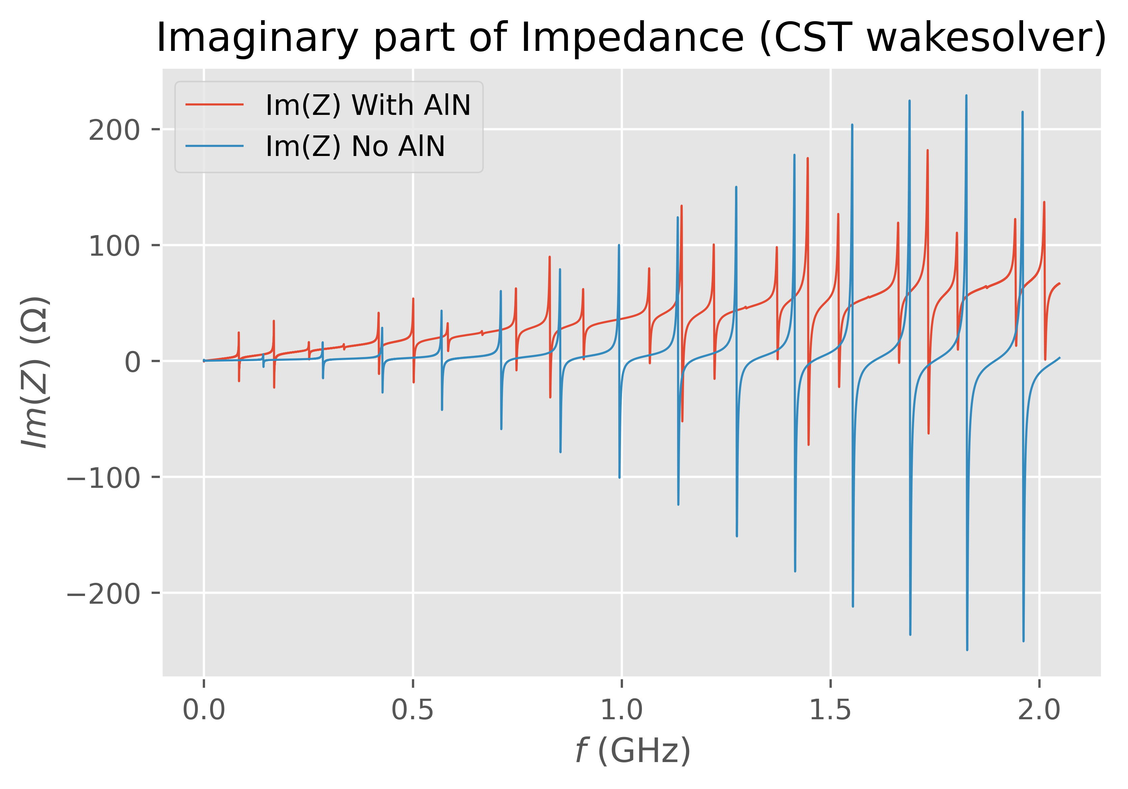
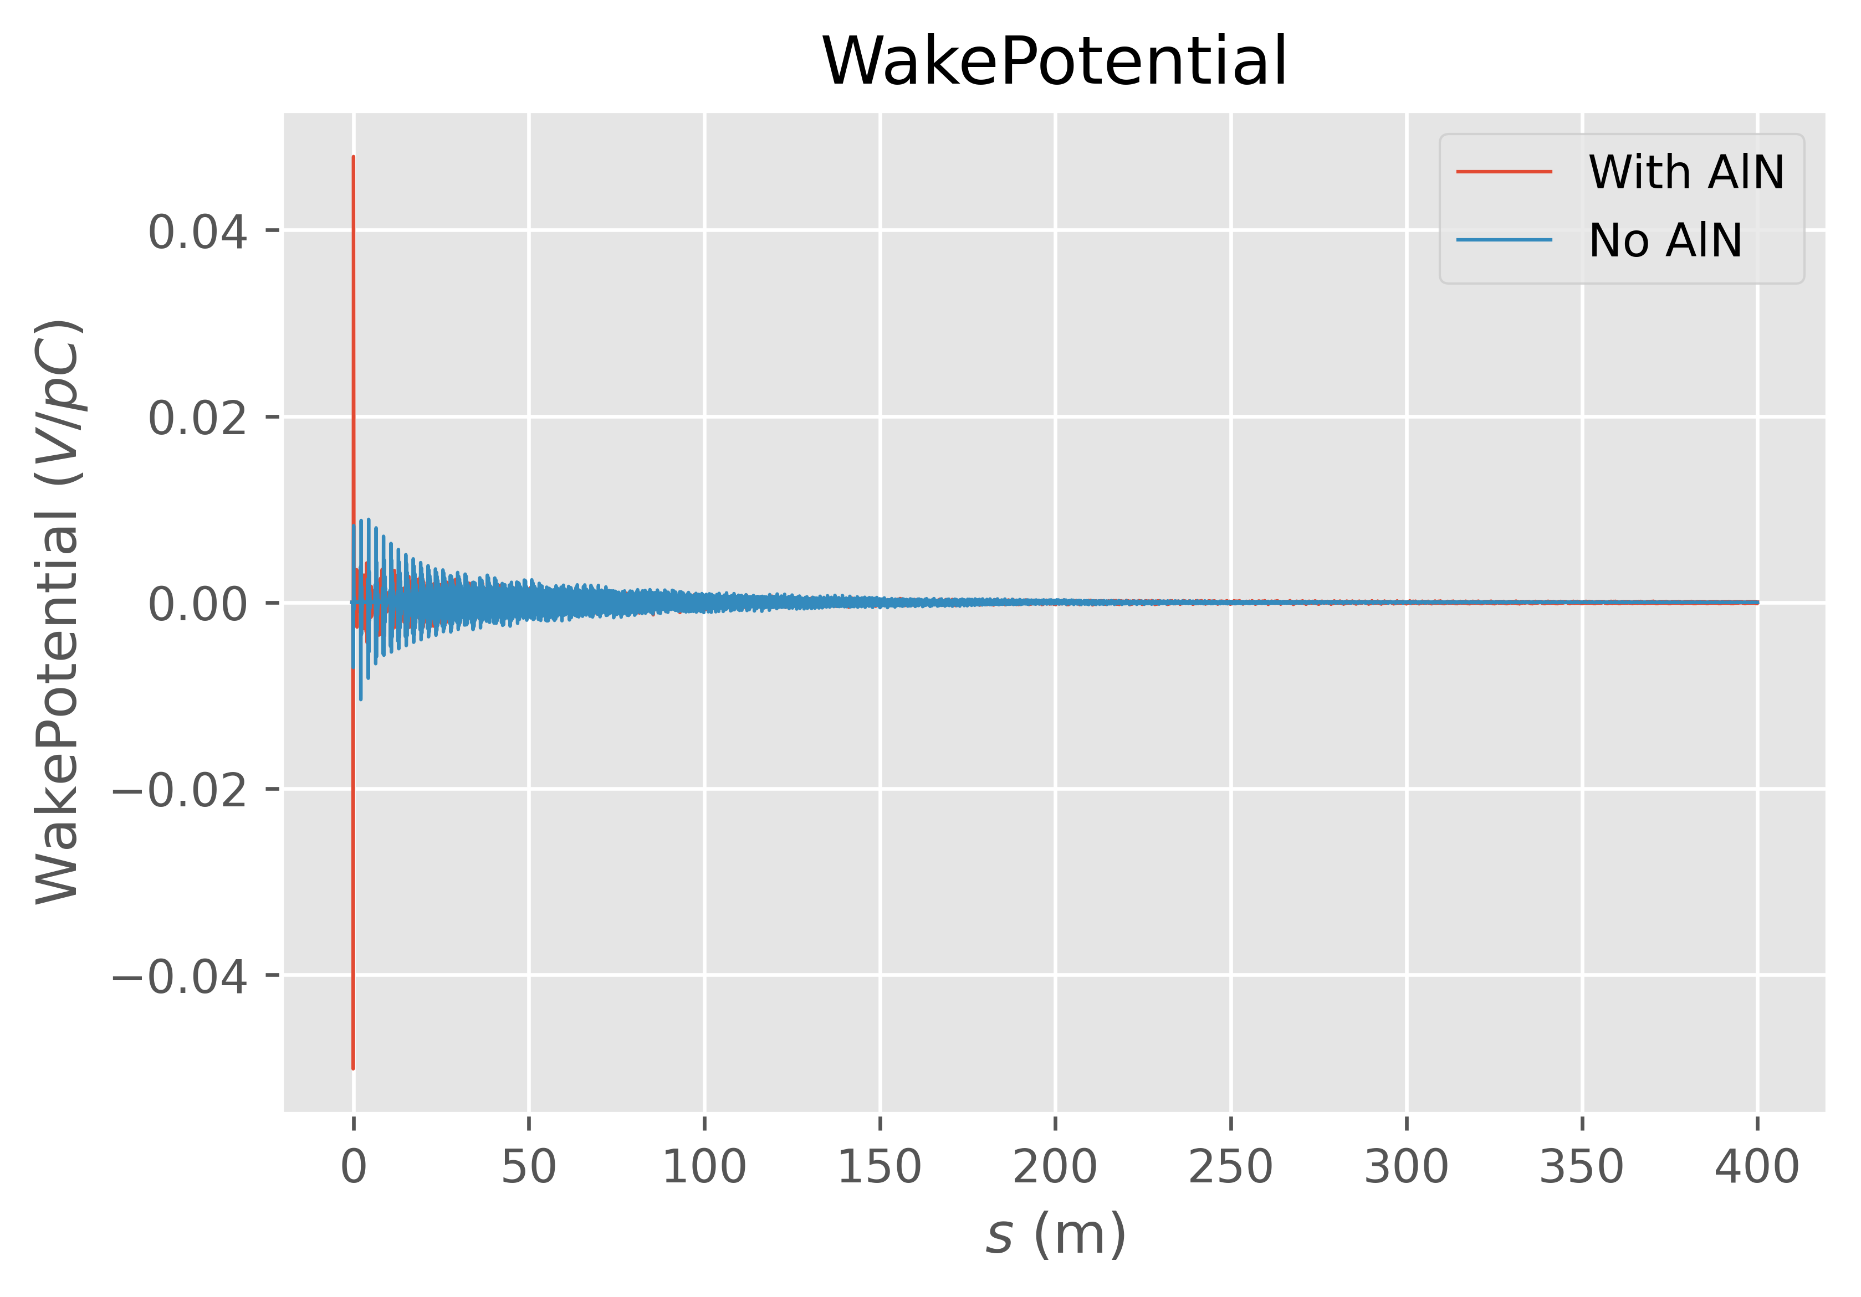
Impact of the AlN support
To study the impact of the AlN support on the device a simulation with and without AlN was performed.
$$15mm$$
$$y_{0}$$
Impact of the dielectric:

Slide 28
Impact of the AlN support
To study the impact of the AlN support on the device a simulation with and without AlN was performed.
$$15mm$$
$$y_{0}$$
Impact of the dielectric:
Peaks are shifting to lower frequencies.
Slope of the imaginary part is increasing.
Future work: what would happen coating a portion of the dielectric support?

Slide 29
Introduction to the BBLRC
Positioning and Mechanical Description
The need for an Impedance Study
Simulated model
Longitudinal Impedance Study:
  Matching the wire termination
  Dissipated Power
  Impact of the dielectric support
Transverse Impedance Study
Conclusions
Outline

Slide 30


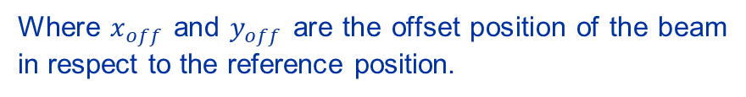








Transverse Dipolar Impedance
$$Z_{x}^{dip}= \frac{−(Z_{x}(x_{off})−Z_{x}(x_{off}=0))}{x_{off}}$$
Transverse Dipolar Impedances from wake field solver:
Where $x_{off}$ and $y_{off}$ are the offset position of the beam in respect to the reference position.
$$Z_{y}^{dip}= \frac{−(Z_{y}(y_{off})−Z_{y}(y_{off}=0))}{y_{off}}$$
Beam
Integration path
$$40mm$$
$$x_{off}$$
$$x_{off}$$
$$x_{off}$$
$$15mm$$
$$10mm$$
$$5mm$$
$$30mm$$

Slide 31
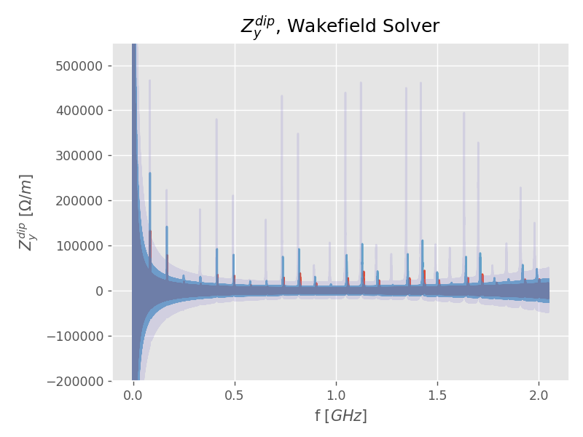
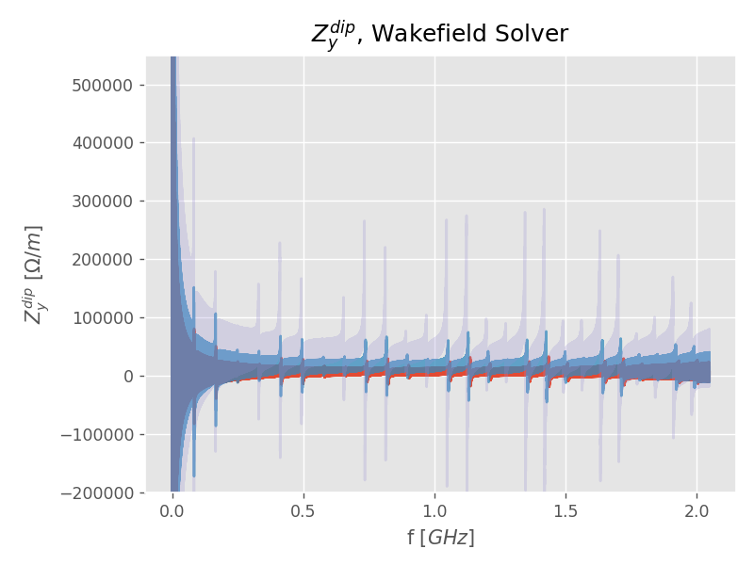
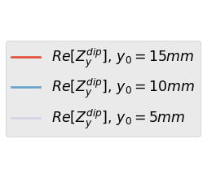
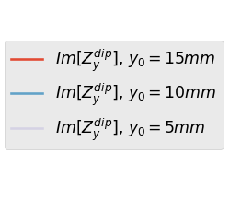
Transverse Dipolar Impedance on y
ONGOING

Slide 32
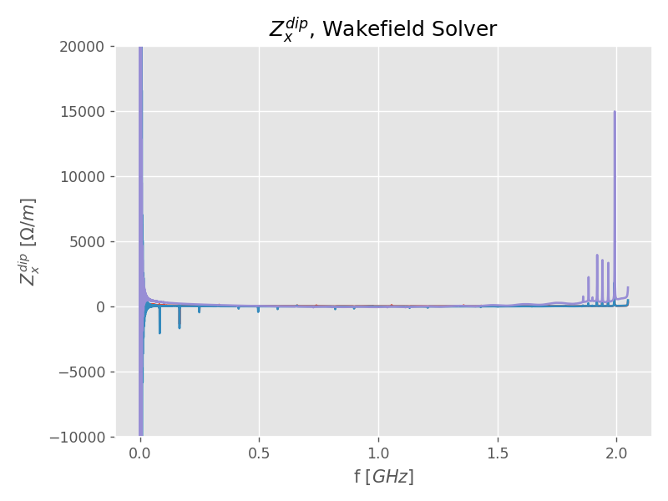
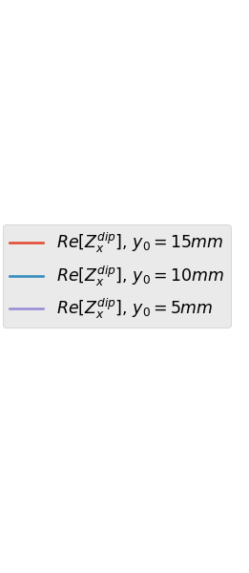
Transverse Dipolar Impedance on x
ONGOING
Issue with numerical dispersion:
Tried with cos-square filtering (0.2)
Tried to numerically remove the dispersion.

Slide 33
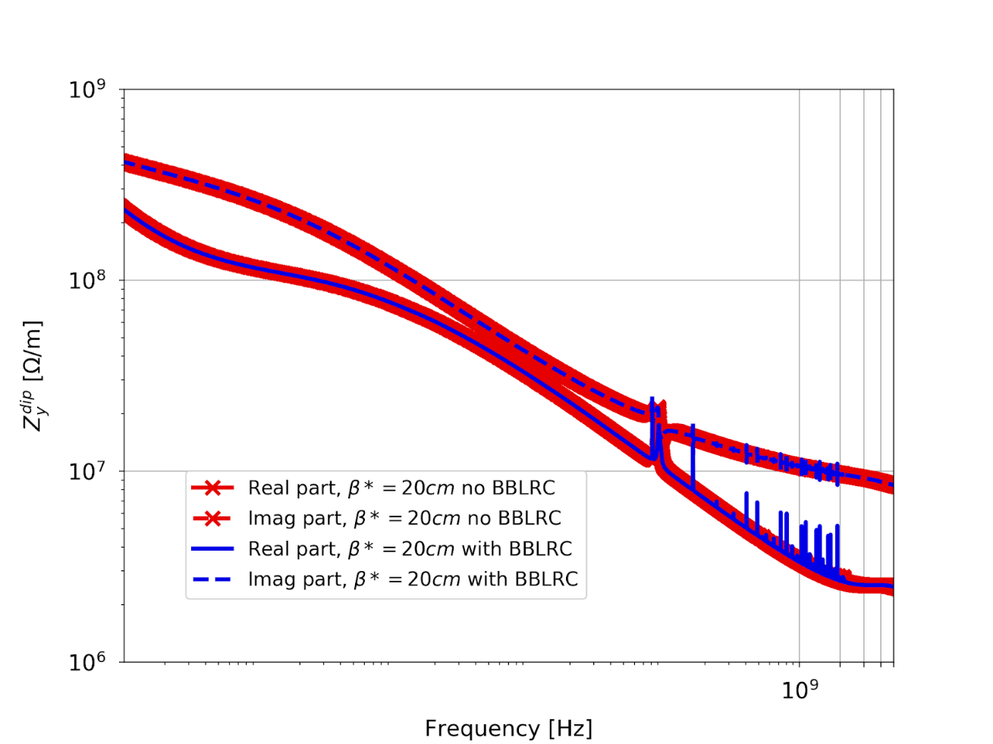
The impedance of the BBLRC
ONGOING
Wire at 15mm distance from the beam, at the end of levelling .
The BBLRC contributes mostly to the vertical dipolar impedance through a number of high-order modes

Slide 34
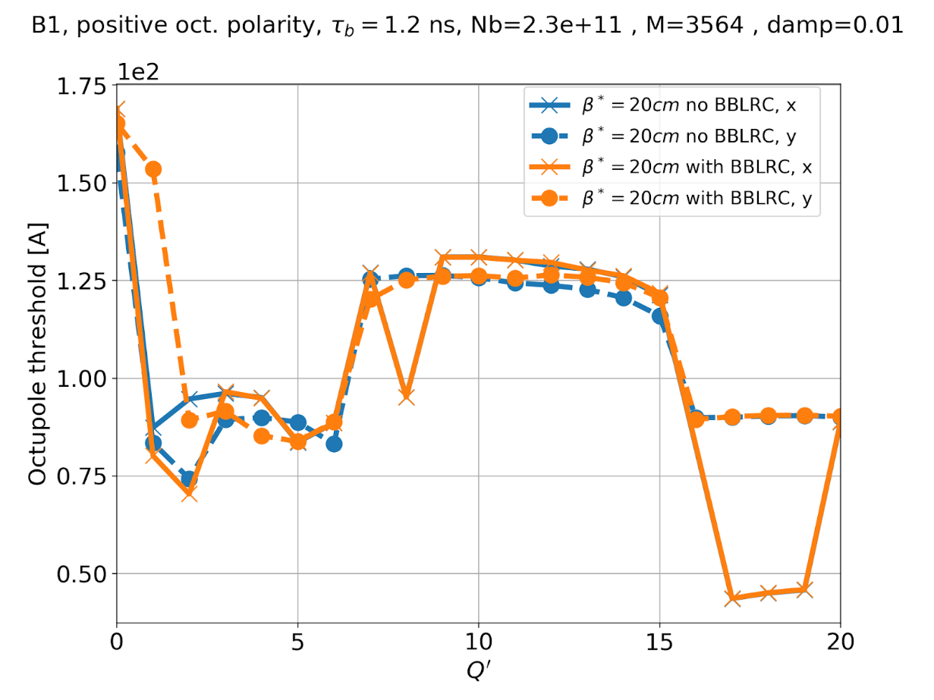
Impact of the BBLRC on transverse beam stability
ONGOING
We compute the octupole threshold with BBLRC to check the impact of the HOMs on beam stability
The increase of the stability threshold is well below 10A for Q’>10.
To be checked with 5 mm distance to the beam.

Slide 35
Introduction to the BBLRC
Positioning and Mechanical Description
The need for an Impedance Study
Simulated model
Longitudinal Impedance Study:
  Matching the wire termination
  Dissipated Power
  Impact of the dielectric support
Transverse Impedance Study:
Conclusions
Outline

Slide 36
Conclusion:
A preliminary study on the BBLRC is being made.
From the study some aspects have been underlined:
  Longitudinal and Transverse impedances for three configurations.
  The impact of terminating the wire with a matched load.
  The impact of the AlN support.
Impedance contributions are significant but no showstopper was identified
A shielding (e.g. foil, grid) between the wire and the beam would strongly reduce impedance
The transitions need to be modelled and could also have a large contribution (bellows and tapers)
Further studies:
Design to match the wire termination and avoid reflections.
Possibility of coating a part of the AlN support.
Measurements on the device and the prototype.
Dissipated Power distribution.
Study on the new design.
Full longitudinal and transverse stability study

Slide 37
Thank you for your attention
BBLRC (Beam-Beam Long Range Compensator)
Preliminary Impedance Study

