Slide 1

BBCW Collimation Scenarios for Run 4
B. Lindström, R. Bruce, S. Redaelli on behalf of
the collimation team
23rd September 2022 – 12th HL-LHC Collaboration Meeting

Slide 2
Introduction
What settings are acceptable for the wire?
Wires to be installed in shadow of IR1/IR5 TCTs
→ TCT settings define minimum wire setting
For larger effect on the beam, desirable to bring wire closer to beam
→ Need to see what we can do about the TCT settings
WP2 requested to relax the collimator settings due to impedance concerns
Assumption: wires are movable stand-alone objects not incorporated into the TCTs. In Run III they are embedded in the TCTs.

Slide 3
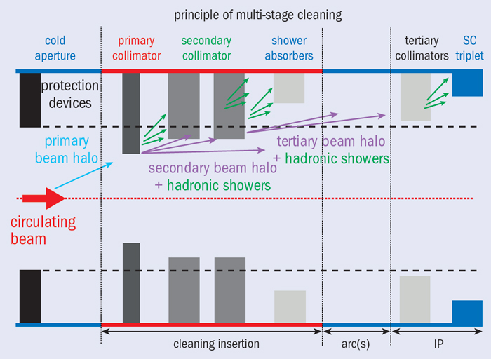
LHC collimation hierarchy
TCT upper limit determined by aperture
lower limit determined by retraction to secondaries, as well as other constraints (e.g. asynch dump) such that TCTs are not exposed to dangerously high losses
BBLR

Slide 4
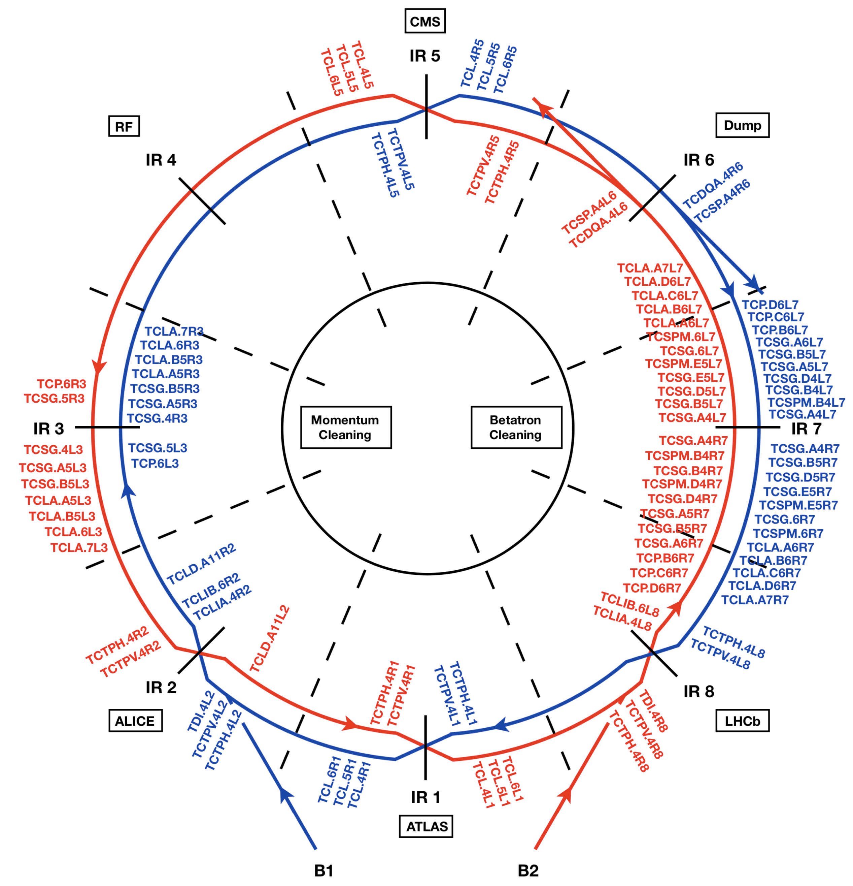
LHC collimation layout

Slide 5
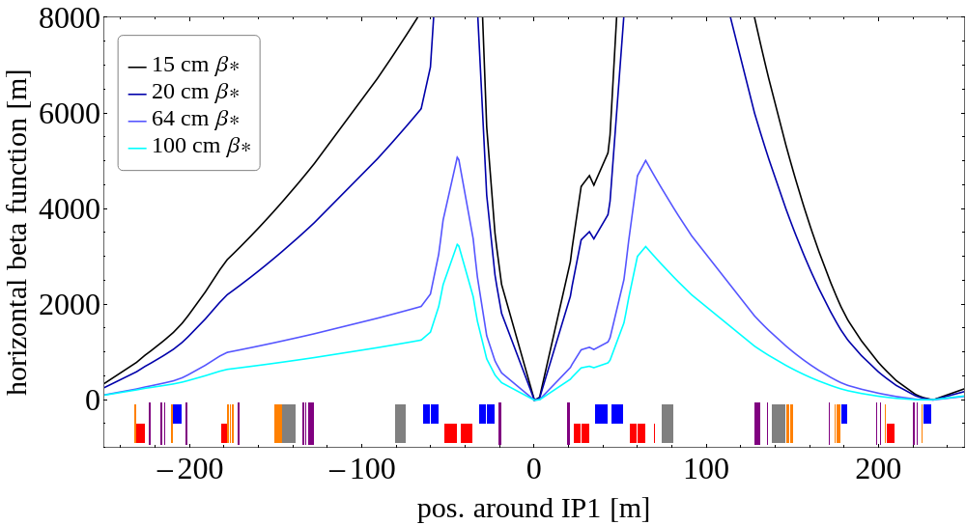
Beta functions
During the squeeze, beta functions change in IP1/IP5
Strategy for TCTs and TCLs is to fix the gap in mm
Consequently the effective setting in σ changes
optics: /afs/cern.ch/eng/lhc/optics/HLLHCV1.5/scenarios/run4
TCL4
BBLR
TCT4
BBLR
TCL6
TCT6
TCL5

Slide 6
Collimator Settings $\left(ε_{n}=2.5μm⋅rad\right)$
 | TDR Baseline (tight settings) | Relaxed Settings
 | 15 cm β* | 15 cm β* | 20 cm β* | 100 cm β*
TCP IR7 | 6.7 | 8.5 | 8.5 | 8.5
TCS IR7 | 9.1 | 10.1 | 10.1 | 10.1
TCLA IR7 | 12.7 | 14.0 | 13.7 | 13.7
TCLD IR7 | 16.6 | n/a** | n/a** | n/a**
TCP IR3 | 17.7 | 17.7 | 17.7 | 17.7
TCS IR3 | 21.3 | 21.3 | 21.3 | 21.3
TCLA IR3 | 23.7 | 23.7 | 23.7 | 23.7
TCS IR6 | 10.1 | 11.1 | 11.1 | 11.1
TCDQ IR6 | 10.1 | 11.1 | 11.1 | 11.1
TCL IR1/5 | 14.2 | 14.2* | 16.4* | 38 – 44*
TCT IR1/5 | 10.4 | 11.4* | 13.2* | 23 – 35*
Prot. Aperture IR1/5 | 11.8 | 12.8 | 14.6 | >24.4
TCT IR2 | 43.8 | 43.8 | 43.8 | 43.8
TCT IR8 | 17.7 | 17.7 | 17.7 | 17.7
TDIS | park | park | park | park
TCLD IR2 | park | park | park | park
* gap in mm is set to final (15 cm) value and kept constant throughout squeeze
** likely n/a for runIV, status for runV to be confirmed

Slide 7
Wire position
Wire position depends on the beta functions, and the endpoint TCT setting
Endpoint TCT setting depends on collimator settings (tight / relaxed) and final β* (20 cm here)
Retraction from the TCTs is not defined yet,
example for roman pots, three sigmas+300µm but would have to be studied
TCT endpoint setting [σ] | BBLR IR1L pos [mm] | BBLR IR1R pos [mm] | BBLR IR5L pos [mm] | BBLR IR5R pos [mm]
12.0 tight | 8.9 | 7.0 | 6.3 | 9.4
13.2 relaxed | 9.7 | 7.6 | 6.9 | 10.3

Slide 8
Potential options for moving wire closer (1/6)
Keep TCTs at constant sigma settings from FT (tight or relaxed settings)
  Wire is closer at beginning of collisions
  Wire moves out during levelling
  TCTs are more exposed with the higher beam current at FT, in particular for asynchronous dump failures (phase advance conditions to be verified)
  Note that copper diamond TCTs have been removed from baseline. They would have been more robust against beam losses.

Slide 9
Potential options for moving wire closer (1/6)
Keep TCTs at constant sigma settings from FT (tight or relaxed settings)
  Wire is closer at beginning of collisions
  Wire moves out during levelling
  TCTs are more exposed with the higher beam current at FT, in particular for asynchronous dump failures (phase advance conditions to be verified)
  Note that copper diamond TCTs have been removed from baseline. They would have been more robust against beam losses.
d, retraction from TCT, to be defined
relaxed, 13.2σ
β* [cm] | BBLR IR1L pos [mm] | BBLR IR1R pos [mm] | BBLR IR5L pos [mm] | BBLR IR5R pos [mm]
20 | 9.8 + d | 7.6 + d | 7.0 + d | 10.3 + d
64 | 6.4 + d | 3.8 + d | 3.5 + d | 6.9 + d
100 | 5.4 + d | 3.0 + d | 2.7 + d | 5.7 + d
tight, 12.0σ
β* [cm] | BBLR IR1L pos [mm] | BBLR IR1R pos [mm] | BBLR IR5L pos [mm] | BBLR IR5R pos [mm]
20 | 8.9 + d | 7.0 + d | 6.3 + d | 9.4 + d
64 | 5.8 + d | 3.5 + d | 3.2 + d | 6.3 + d
100 | 4.9 + d | 2.7 + d | 2.5 + d | 5.1 + d

Slide 10
Potential options for moving wire closer (2/6)
Use tighter TCT settings
  Wire is closer throughout levelling
  TCTs are more exposed
  More leakage to experiments
  Note that copper diamond TCTs have been removed from baseline. They would have been more robust against beam losses.

Slide 11
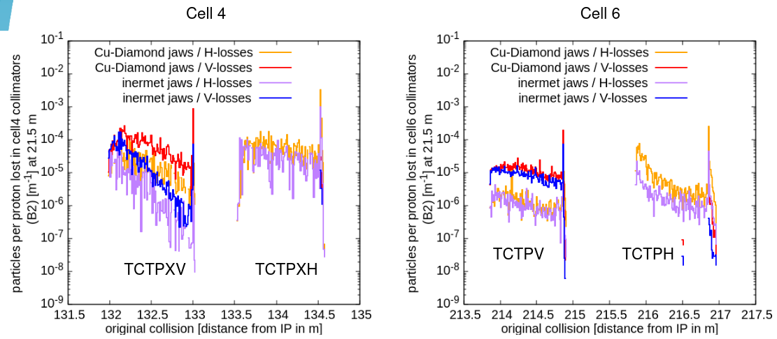
Potential options for moving wire closer (2/6)
Use tighter TCT settings
  Wire is closer throughout levelling
  TCTs are more exposed
  More leakage to experiments
  Note that copper diamond TCTs have been removed from baseline. They would have been more robust against beam losses.
  Most leakage to experiments from TCTs in cell 4, one could possibly adjust the relative settings of the TCTs to mitigate the leakage
M. Sabaté-Gilarte, 114th LBS, https://indico.cern.ch/event/1195003/

Slide 12
Potential options for moving wire closer (3/6)
Use tight collimator settings throughout cycle
  Wire is closer from beginning of collisions (n.b. wires positions are fixed at the mm settings corresponding to their end-point sigma setting)
  Bunch instabilities might occur from impedance
  Recent MD results* indicate that a lower octupole current is needed than initially foreseen, still to be understood, but would give more margin and allow for tighter settings
  If limited in intensity by electron clouds, we can tighten the collimator settings
* L. Giacomel, Impedance measurements, LHC-MDs,
12th HL-LHC Collaboration Meeting, https://indico.cern.ch/event/1161569/contributions/4921657/

Slide 13
Potential options for moving wire closer (4/6)
Bring in collimators (including TCP) during collisions as bunch intensity drops
  Wire is brought closer as intensity drops
  Impedance remains good when there is a large beam intensity
  Moving the TCPs in with full intensity beams is tricky and has not been done operationally. Will provoke loss spikes, in particular without the electron lens
  Note that electron lens has been removed from baseline

Slide 14
Potential options for moving wire closer (5/6)
Keep TCPs at tight settings from FT and then bring in TCS/TCT during levelling
  No TCP movement
  Wire is brought closer as intensity drops
  Impedance remains good when there is a large beam intensity
  Large retraction of TCS to TCP – worsened cleaning. Unlikely to work unless positive surprises on beam life time.

Slide 15
Potential options for moving wire closer (6/6)
Put wire closer to beam than TCTs
  Wire is closer from beginning of collisions
  Wire exposed to secondary halo
  Horizontal wires exposed to asynchronous dump failures
  Cleaning performance could be negatively affected

Slide 16
Potential studies
Instability simulations / MDs / follow-up on previous MD results
→ to better understand impedance limitations
(see talk by B. Salvant, this meeting)
MD on tightening the whole IR7 hierarchy during levelling
→ to understand feasibility of moving, in particular the TCPs, inwards with high-intensity beams
Study wire exposed to secondary halo/asynch dump (SixTrack/FLUKA)
→ to understand if one could allow a hierarchy breakage (wire vs TCT) and what retraction margin to use
Study cleaning performance with tight TCP and relaxed TCS/TCT (simulations and MD)
→ to quantify worsening of cleaning
Further studies will require discussion on available manpower

Slide 17
Potential methods to move wires further in
Keep TCTs at constant sigma settings from FT (tight or relaxed settings)
  Wire is closer at beginning of collisions
  Wire moves out during levelling
  TCTs are more exposed with the higher beam current at FT, in particular for asynchronous dump failures (phase advance conditions to be verified)
Use tighter TCT settings
  Wire is closer throughout levelling
  TCTs are more exposed
  More leakage to experiments
Use tight collimator settings throughout cycle
  Wire is closer from beginning of collisions
  Bunch instabilities might occur from impedance
Bring in collimators (including TCP) during collisions as bunch intensity drops
  Wire is brought closer as intensity drops
  Impedance remains good when there is a large beam intensity
  Moving the TCPs in with full intensity beams is tricky and has not been done operationally. Will provoke loss spikes, in particular without the electron lens
Keep TCPs at tight settings from FT and then bring in TCS/TCT during levelling
  No TCP movement
  Wire is brought closer as intensity drops
  Impedance remains good when there is a large beam intensity
  Large retraction of TCS to TCP – worsened cleaning. Unlikely to work unless positive surprises on beam life time.
Put wire closer to beam than TCTs
  Wire is closer from beginning of collisions
  Wire exposed to secondary halo
  Horizontal wires exposed to asynchronous dump failures
  Cleaning performance could be negatively affected

Slide 18
Extra slides

Slide 19
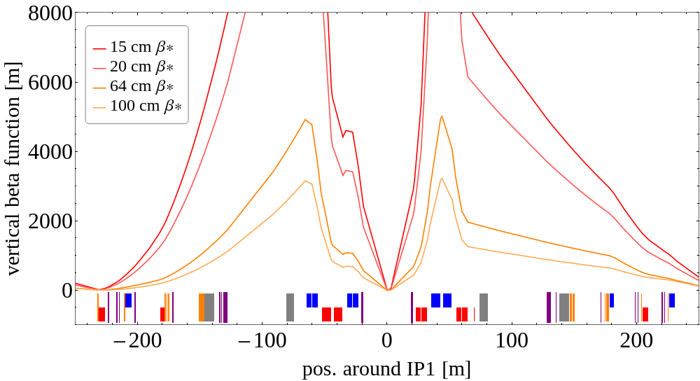
Beta functions
During the squeeze, beta functions change in IP1/IP5
Strategy for TCTs and TCLs is to fix the gap in mm
  consistent with previous scenarios
Consequently the effective setting in σ changes
optics: /afs/cern.ch/eng/lhc/optics/HLLHCV1.5/scenarios/run4
TCL4
TCT4
TCL6
TCT6
TCL5

