Slide 1


Wire compensator in IR1:
radiation levels and impact on the machine
Marta Sabaté-Gilarte, Francesco Cerutti
With input from A. Bertarelli and L. Gentini
WP10 Energy deposition & R2E
WP2/WP13 HL-LHC Satellite Meeting Uppsala September 23rd 2022

Slide 2
Overview
HL-LHC: IR1 – right side.
Optics v1.5 Nov.19.
Horizontal crossing with a half crossing angle of 250 μrad towards the external side of the ring.
β* = 15 cm
Collision at IP1 considering 7 TeV per proton beam.
Inclusion of the wire compensator model in the tunnel file:
  Dose levels and energy deposition.

Slide 3
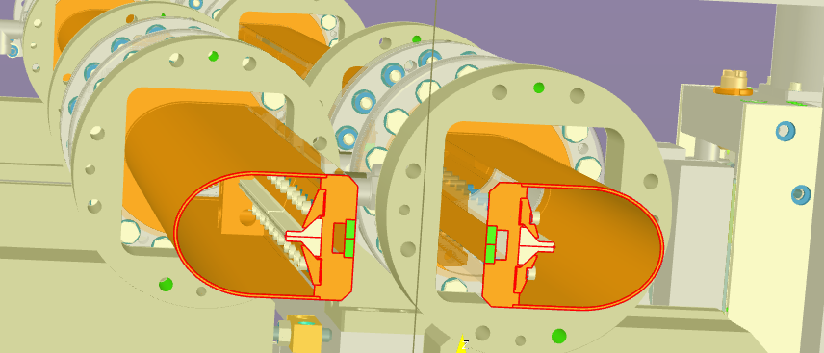
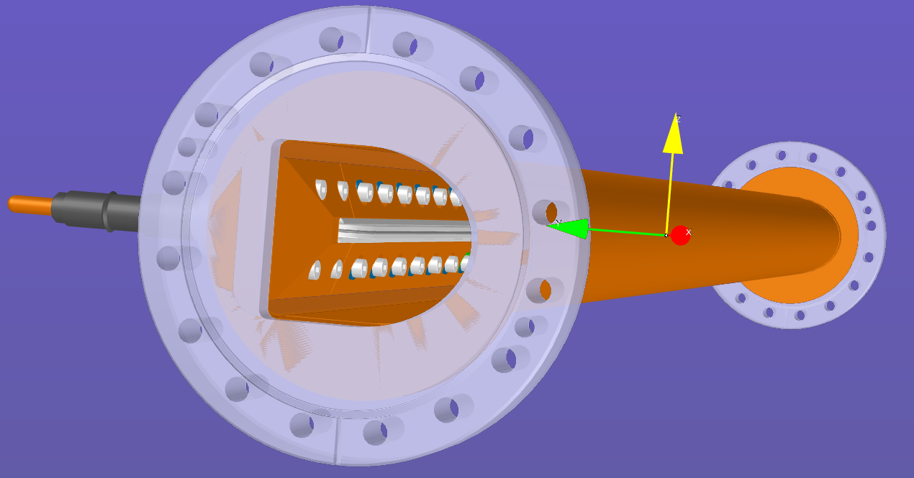
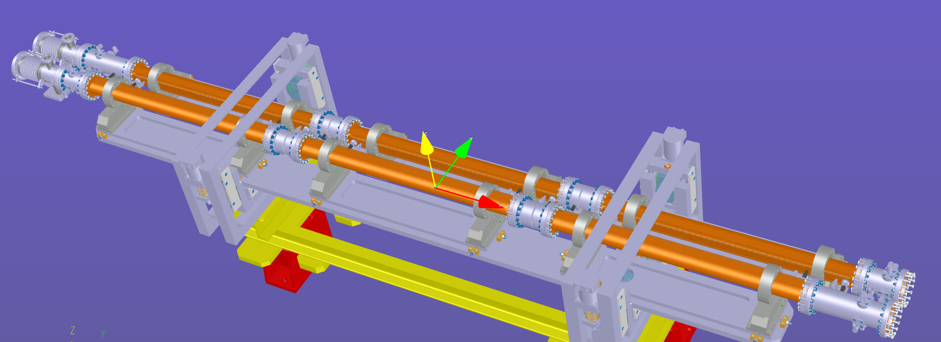
Geometry model
ST1536002_01
ST1536463_01
Incoming beam
Outgoing beam
ST1536002_01
March 2022

Slide 4
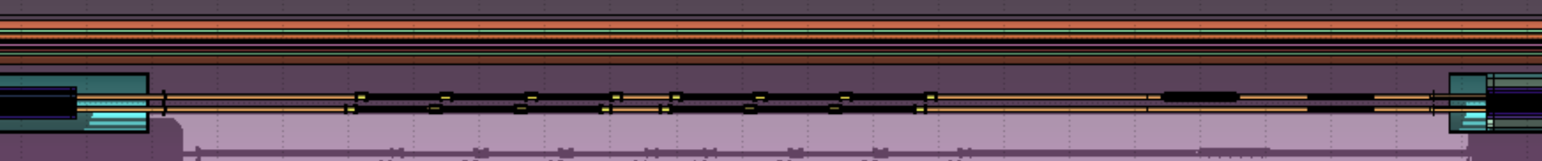
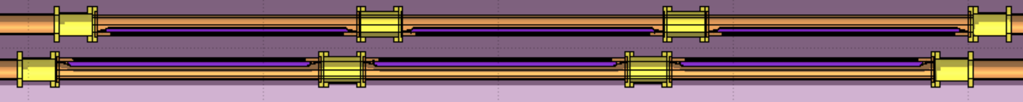
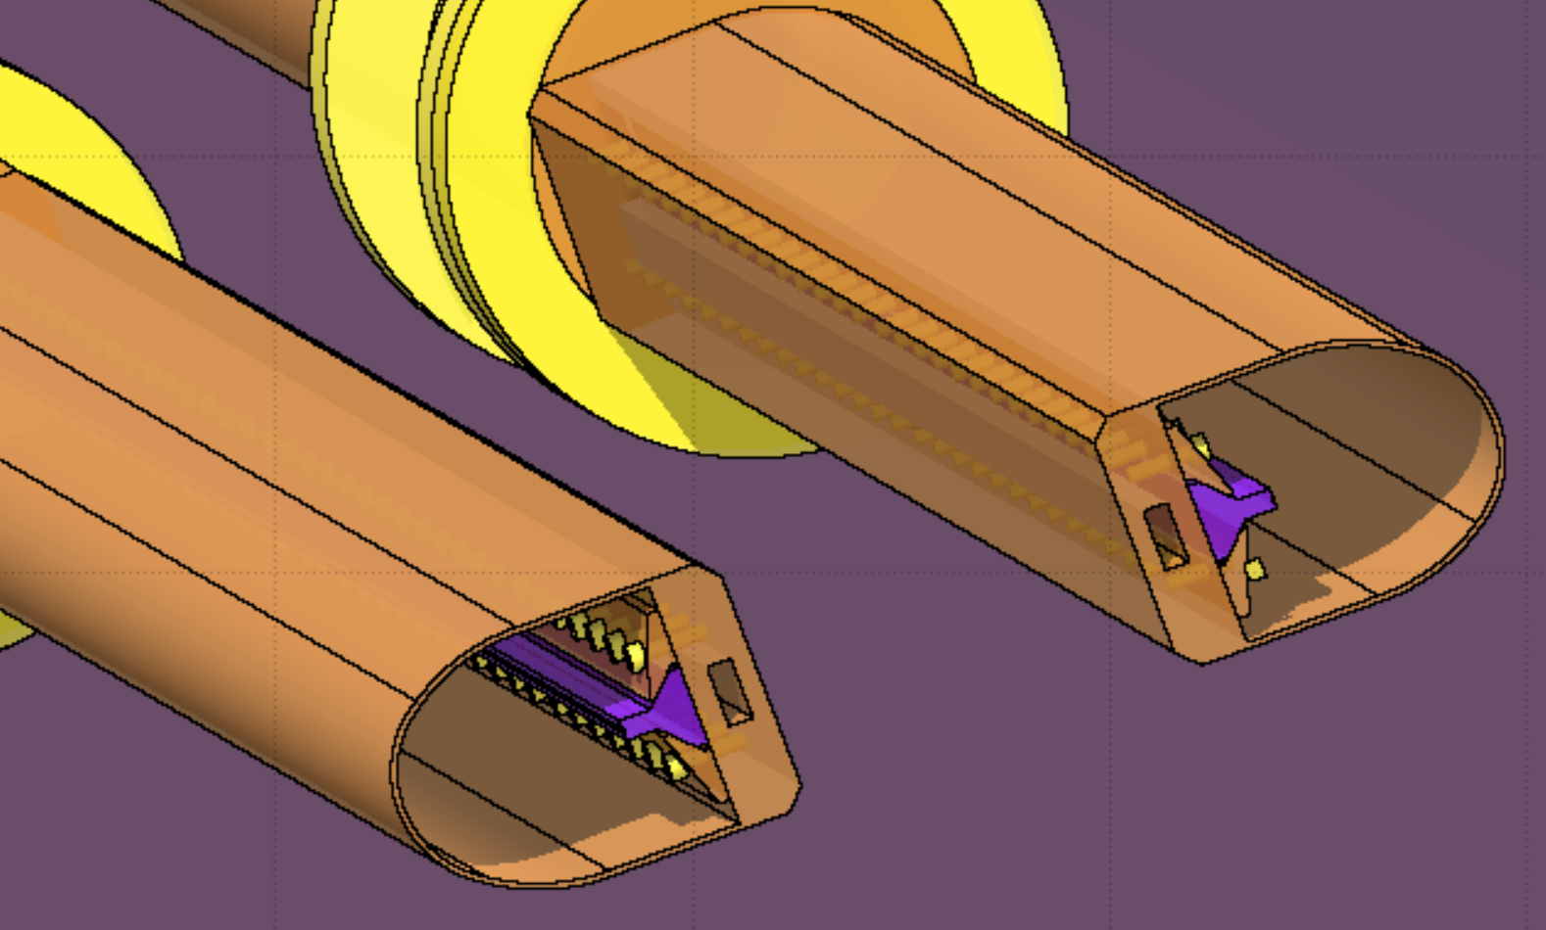
Geometry model: implementation in FLUKA
Q4 ← wire compensator → TCL5 TCLM5 Q5
186 m from IP1 195 m from IP1
2 modules of 3 compensators in each beam line.
Distance from the wire to the center of the vacuum chamber: 15 mm
Outgoing beam
Incoming beam

Slide 5
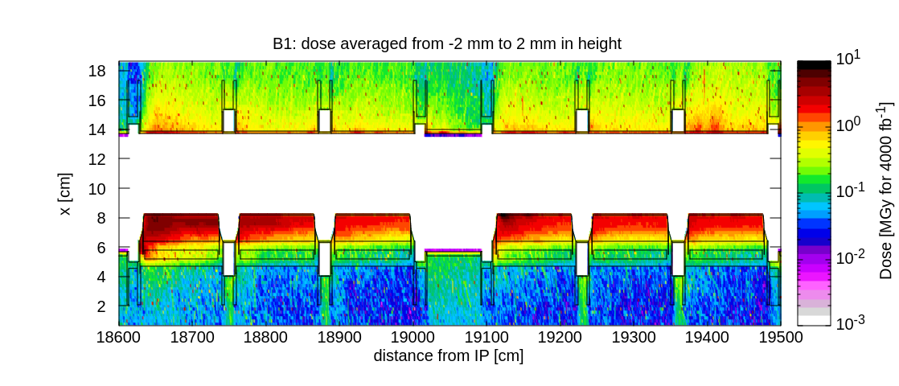
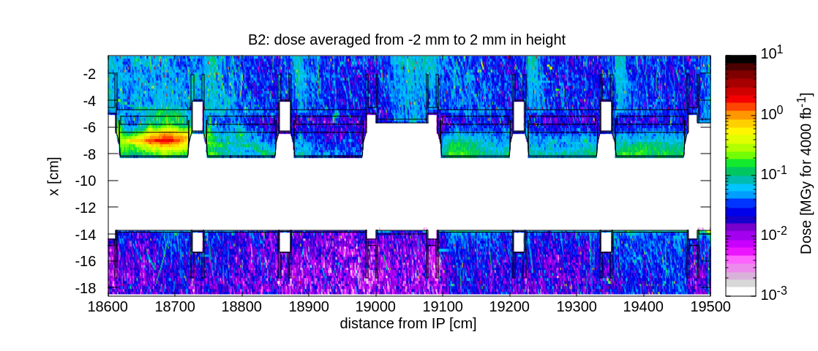
Dose levels in the wire compensator
Outgoing beam
Incoming beam

Slide 6
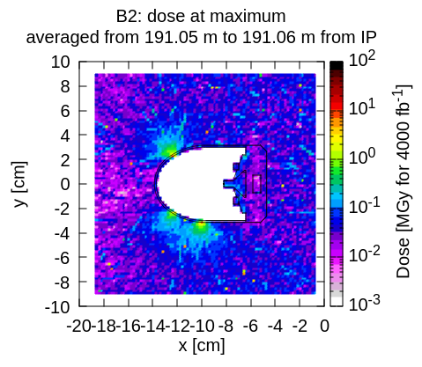
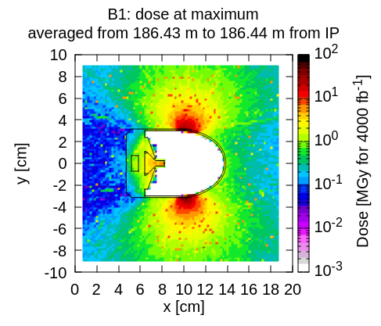
Dose levels in wire compensator at peak

Slide 7
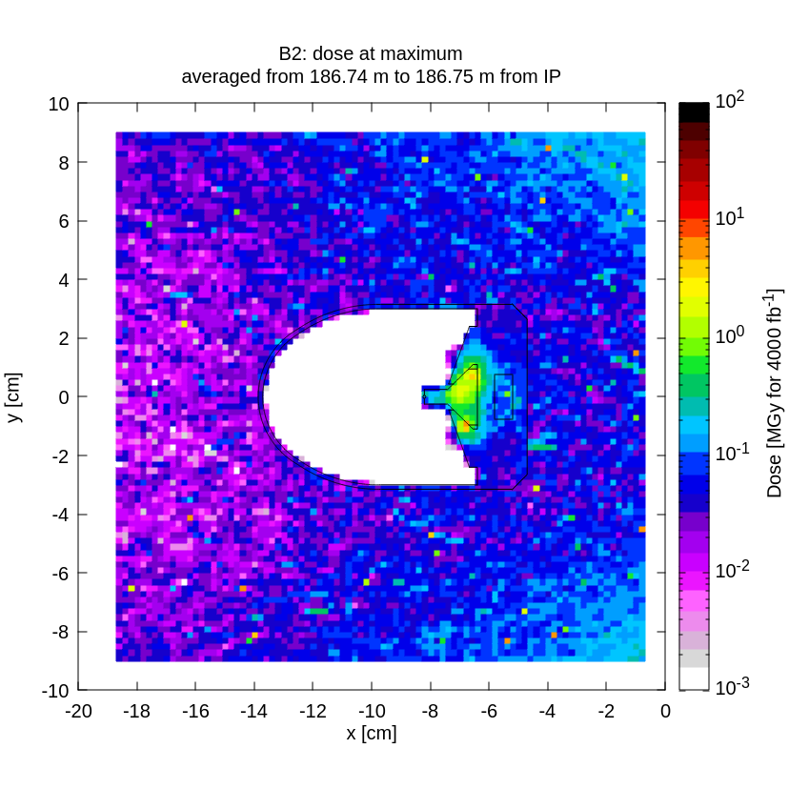
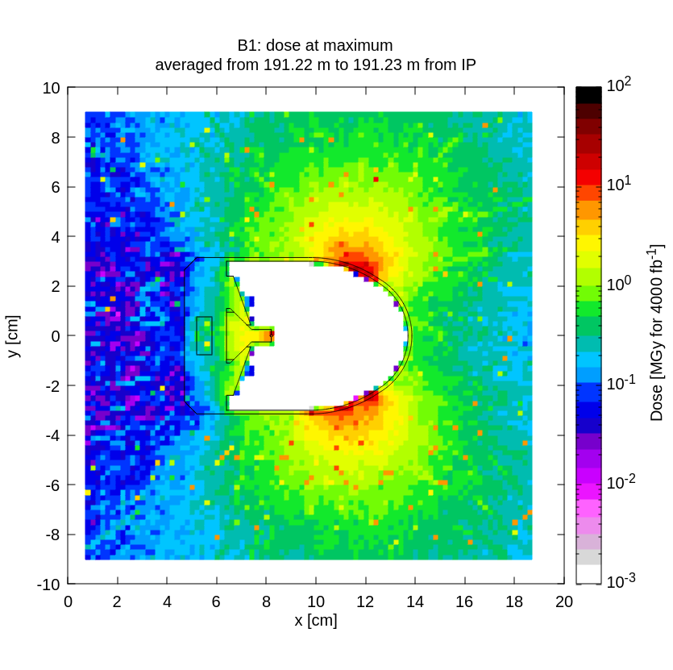
Dose levels in wire compensator at peak in the wire

Slide 8
Energy deposition in the wire compensator
B1.1 B1.2 B1.3 B1.4 B1.5 B1.6
IP
B2.1 B2.2 B2.3 B2.4 B2.5 B2.6
Total power in the Mo wire (W) for 7.5 Lo | .1 | .2 | .3 | .4 | .5 | .6
B1 | 0.6 x 10⁻³ | 0.4 x 10⁻³ | 0.3 x 10⁻³ | 1.2 x 10⁻³ | 0.4 x 10⁻³ | 0.4 x 10⁻³
B2 | 24 x 10⁻⁴ | 14 x 10⁻⁶ | 6 x 10⁻⁶ | 23 x 10⁻⁶ | 15 x 10⁻⁶ | 24 x 10⁻⁶
Total power in the full compensator (W) for 7.5 Lo | .1 | .2 | .3 | .4 | .5 | .6
B1 | 0.4 | 0.2 | 0.2 | 0.3 | 0.2 | 0.3
B2 | 0.04 | 0.02 | 0.01 | 0.02 | 0.02 | 0.02

Slide 9
Thank you for your attention

