Slide 1
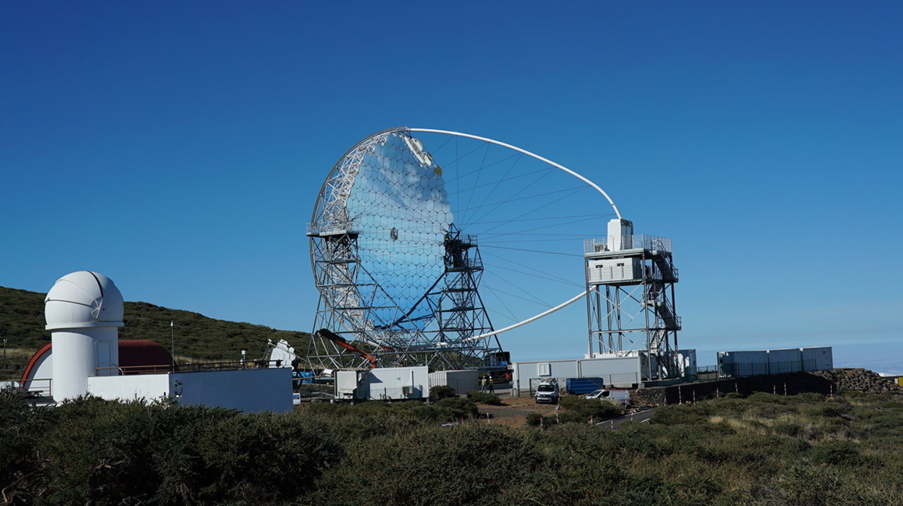
Cherenkov Telescope Array Observatory CTAO
Update on the participation of Switzerland in CTAO ERIC
Kevin Reymond – SERI
Swiss CTA Days / 13 December 2022

Slide 2
1. Relationship between CTAO (ERIC) and Switzerland
2015/2019: CTAO in the « Swiss Roadmap for Research Infrastructures » (Funding projection 8 MCHF)
2020: Possible scale of contribution confirmed by the Parliament (8 MCHF over 4 years)
2021:
Setting-up of the Swiss CTAO Collaboration (CTAO-CH)
Identification of the in-kind contributions of Switzerland to the construction of CTAO ERIC (ACADA; DPPS; off-site date center; etc.)
Establishment of various support measures by SERI to enable the delivery of the in-kind contributions.
2022:
CH requested accession to CTAO ERIC as Founding Observer

Slide 3
2. Next steps
CTAO ERIC to be established in 2023. The Founding Observer status of Switzerland shall be valid until end of 2026.
The participation of Switzerland in CTAO ERIC has been examined by SNSF in the frame of the process towards the Swiss Roadmap for research infrastructures 2023
Outcome is positive -> transition to full membership shall be proposed within the upcoming ERI dispatch 25-28
Breaking news: On Monday 12th December, Swiss Parliament approved a legal change that facilitates accession of Switzerland to research infrastructures based on the ERIC legal framework.
Notes:
ERI Dispatch: Public consultation during 2023
ERI Dispatch: submitted to Parliament feb 2024
Support measures would be extended, should CH become
FLARE: la poursuite de FLARE fait l’objet du message 25-28
EU COM has examined the Statutes of CTAO ERIC and has not raised any questions.
Federal Council can approve accession to ERICs – not Parliament anymore – as long as Parliament has approved the funding.

